Slide 1
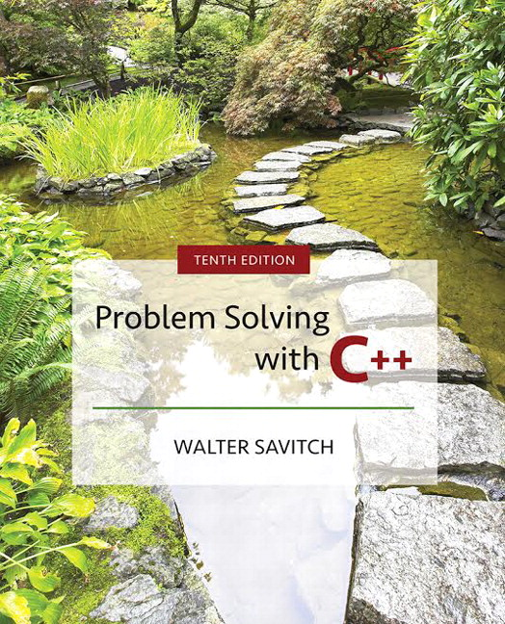

Slide 2
Chapter 1
Introduction to Computers and
C++ Programming

Slide 3
Overview
1.1 Computer Systems
1.2 Programming and Problem Solving
1.3 Introduction to C++
1.4 Testing and Debugging

Slide 4
1.1
Computer Systems

Slide 5
Computer Systems
A computer program is…
  A set of instructions for a computer to follow
Computer software is …
  The collection of programs used by a computer
    Includes:
        Editors
        Translators
        System Managers

Slide 6
Hardware
Three main classes of computers
  PCs (Personal Computer)
    Relatively small used by one person at a time
  Workstation
    Larger and more powerful than a PC
  Mainframe
    Still larger
    Requires support staff
    Shared by multiple users

Slide 7
Networks
A number of computers connected to
share resources
  Share printers and other devices
  Share information

Slide 8
Computer Organization
  Five main components
    Input devices
      Allows communication to the computer
    Output devices
      Allows communication to the user
    Processor (CPU)
    Main memory
      Memory locations containing the running program
    Secondary memory
      Permanent record of data often on a disk
Display 1.1

Slide 9
Computer Memory
Main Memory
  Long list of memory locations
    Each contains zeros and ones
    Can change during program execution
  Binary Digit or Bit
    A digit that can only be zero or one
  Byte
    Each memory location has eight bits
  Address
    Number that identifies a memory location

Slide 10
Larger Data Items
Some data is too large for a single byte
  Most integers and real numbers are too large
  Address refers to the first byte
  Next few consecutive bytes can store the
  additional
  bits for larger data
Display 1.2

Slide 11
Data or Code?
‘A’ may look like 01000001
65 may look like 01000001
An instruction may look like 01000001
How does the computer know the meaning
of 01000001?
  Interpretation depends on the current instruction
Programmers rarely need to be concerned with
this problem.
  Reason as if memory locations contain letters and
  numbers rather than zeroes and ones

Slide 12
Secondary Memory
Main memory stores instructions and
data while a program is running.
Secondary memory
  Stores instructions and data between sessions
  A file stores data or instructions in
  secondary memory

Slide 13
Secondary Memory Media
A computer might have any of these
types of secondary memory
  Hard disk
    Fast
    Fixed in the computer and not normally removed
  Floppy disk
    Slow
    Easily shared with other computers
  Compact disk
    Slower than hard disks
    Easily shared with other computers
    Can be read only or re-writable

Slide 14
Memory Access
Random Access
  Usually called RAM
    Computer can directly access any memory location
Sequential Access
  Data is generally found by searching through
  other items first
    More common in secondary memory

Slide 15
The Processor
Typically called the CPU
  Central Processing Unit
  Follows program instructions
  Typical capabilities of CPU include:
  add
  subtract
  multiply
  divide
  move data from location to location

Slide 16
Computer Software
The operating system
  Allows us to communicate with the computer
  Is a program
  Allocates the computer’s resources
  Responds to user requests to run other programs
Common operating systems include…
  UNIX Linux DOS
  Windows Macintosh VMS

Slide 17
Computer Input
Computer input consists of
  A program
  Some data
Display 1.3

Slide 18
High-level Languages
Common programming languages include …
C C++ Java Pascal Visual Basic FORTRAN Perl
PHP Lisp Scheme Ada C# Python
These high – level languages
  Resemble human languages
  Are designed to be easy to read and write
  Use more complicated instructions than
  the CPU can follow
  Must be translated to zeros and ones for the CPU
  to execute a program

Slide 19
Low-level Languages
An assembly language command such as
ADD X Y Z
might mean add the values found at x and y
in memory, and store the result in location z.
Assembly language must be translated to
machine language (zeros and ones)
0110 1001 1010 1011
The CPU can follow machine language

Slide 20
Compilers
Translate high-level language to
machine language
  Source code
    The original program in a high level language
  Object code
    The translated version in machine language
Display 1.4

Slide 21
Linkers
Some programs we use are already compiled
  Their object code is available for us to use
  For example: Input and output routines
A Linker combines
  The object code for the programs we write
  and
  The object code for the pre-compiled routines
  into
  The machine language program the CPU can run
Display 1.5

Slide 22
History Note
First programmable computer
  Designed by Charles Babbage
  Began work in 1822
  Not completed in Babbage’s life time
First programmer
  Ada Augusta, Countess of Lovelace
    Colleague of Babbage

Slide 23
Section 1.1 Conclusion
Can you…
  List the five main components of a computer?
  List the data for a program that adds two numbers?
  Describe the work of a compiler?
  Define source code? Define object code?
  Describe the purpose of the operating system?

Slide 24
1.2
Programming and Problem-Solving

Slide 25
Algorithms
Algorithm
  A sequence of precise instructions that
  leads to a solution
Program
  An algorithm expressed in a language the
  computer can understand
Display 1.6

Slide 26
Program Design
Programming is a creative process
  No complete set of rules for creating a program
Program Design Process
  Problem Solving Phase
    Result is an algorithm that solves the problem
  Implementation Phase
    Result is the algorithm translated into a programming
    language

Slide 27
Problem Solving Phase
Be certain the task is completely specified
  What is the input?
  What information is in the output?
  How is the output organized?
Develop the algorithm before implementation
  Experience shows this saves time in getting your program to run.
  Test the algorithm for correctness

Slide 28
Implementation Phase
Translate the algorithm into a programming
language
  Easier as you gain experience with the language
Compile the source code
  Locates errors in using the programming language
Run the program on sample data
  Verify correctness of results
Results may require modification of
the algorithm and program
Display 1.7

Slide 29
Object Oriented Programming
Abbreviated OOP
Used for many modern programs
Program is viewed as interacting objects
  Each object contains algorithms to describe
  its behavior
  Program design phase involves designing
  objects and their algorithms

Slide 30
OOP Characteristics
Encapsulation
  Information hiding
  Objects contain their own data and algorithms
Inheritance
  Writing reusable code
  Objects can inherit characteristics from other objects
Polymorphism
  A single name can have multiple meanings depending
  on its context

Slide 31
Software Life Cycle
Analysis and specification of the task
(problem definition)
Design of the software
(object and algorithm design)
Implementation (coding)
Maintenance and evolution of the system
Obsolescence

Slide 32
Section 1.2 Conclusion
Can you…
  Describe the first step to take when creating
  a program?
  List the two main phases of the program
  design process?
  Explain the importance of the problem-solving phase?
  List the steps in the software life cycle?

Slide 33
1.3
Introduction to C++

Slide 34
Introduction to C++
Where did C++ come from?
  Derived from the C language
  C was derived from the B language
  B was derived from the BCPL language
Why the ‘++’?
  ++ is an operator in C++ and results in a cute pun

Slide 35
C++ History
C developed by Dennis Ritchie at AT&T
Bell Labs in the 1970s.
  Used to maintain UNIX systems
  Many commercial applications written in c
C++ developed by Bjarne Stroustrup at AT&T
Bell Labs in the 1980s.
  Overcame several shortcomings of C
  Incorporated object oriented programming
  C remains a subset of C++

Slide 36
A Sample C++ Program
A simple C++ program begins this way
#include <iostream>
using namespace std;
int main()
{
And ends this way
return 0;
}
Display 1.8

Slide 37
Explanation of code (1/5)
Variable declaration line
int numberOfPods, peasPerPod, totalPeas;
  Identifies names of three variables to name numbers
  int means that the variables represent integers

Slide 38
Explanation of code (2/5)
Program statement
cout << “Press return after entering a number.\n”;
  cout (see-out) used for output to the monitor
  “<<“ inserts “Press…a number.\n” in the data
  bound for the monitor
  Think of cout as a name for the monitor
    “<<“ points to where the data is to end up
  ‘\n’ causes a new line to be started on the monitor

Slide 39
Explanation of code (3/5)
Program statement
cin >> numberOfPods;
  cin (see-in) used for input from the keyboard
  “>>” extracts data from the keyboard
  Think of cin as a name for the keyboard
    “>>” points from the keyboard to a variable where the data
    is stored

Slide 40
Explanation of code (4/5)
Program statement
totalPeas = numberOfPods * peasPerPod;
  Performs a computation
  ‘*’ is used for multiplication
  ‘=‘ causes totalPeas to get a new value based on
  the calculation shown on the right of the equal sign

Slide 41
Explanation of code (5/5)
Program statement
cout << numberOfPods;
  Sends the value of variable numberOfPods to the monitor

Slide 42
Program Layout (1/3)
Compiler accepts almost any pattern of line
breaks and indentation
Programmers format programs so they
are easy to read
  Place opening brace ‘{‘ and closing brace ‘}’
  on a line by themselves
  Indent statements
  Use only one statement per line

Slide 43
Program Layout (2/3)
Variables are declared before they are used
  Typically variables are declared at the beginning of
  the program
  Statements (not always lines) end with a semi-colon
Include Directives
#include <iostream>
  Tells compiler where to find information about items
  used in the program
  iostream is a library containing definitions of cin and cout

Slide 44
Program Layout (3/3)
using namespace std;
  Tells the compiler to use names in iostream in
  a “standard” way
To begin the main function of the program
int main()
{
To end the main function
return 0;
}
  Main function ends with a return statement

Slide 45
Running a C++ Program
C++ source code is written with a text
editor
The compiler on your system converts
source code to object code.
The linker combines all the object code
into an executable program.

Slide 46
C++11
C++11 (formerly known as C++0x) is the most recent version of the standard of the C++ programming language.
  Approved on August 12, 2011 by the International Organization for Standardization.
C++11 language features are not supported by older compilers
Check the documentation with your compiler to determine if special steps are needed to compile C++11 programs
  e.g. with g++, use extra flags of –std=c++11

Slide 47
Run a Program
Obtain code in Display 1.10
Compile the code
Fix any errors the compiler indicates and
re-compile the code
Run the program
Now you know how to run a program on
your system
Display 1.10

Slide 48
Section 1.3 Conclusion
Can you…
  Describe the output of this line?
  cout << “C++ is easy to understand.”;
  Explain what this line does?
  cin >> peasPerPod;
  Explain this? #include <iostream>

Slide 49
1.4
Testing and Debugging

Slide 50
Testing and Debugging
Bug
  A mistake in a program
Debugging
  Eliminating mistakes in programs
  Term used when a moth caused a failed relay
  on the Harvard Mark 1 computer. Grace Hopper
  and other programmers taped the moth in logbook
  stating:
  “First actual case of a bug being found.”

Slide 51
Program Errors
Syntax errors
  Violation of the grammar rules of the language
  Discovered by the compiler
    Error messages may not always show correct location of
    errors
Run-time errors
  Error conditions detected by the computer at run-time
Logic errors
  Errors in the program’s algorithm
  Most difficult to diagnose
  Computer does not recognize an error

Slide 52
Section 1-4 Conclusion
Can you…
  Describe the three kinds of program errors?
  Tell what kind of errors the compiler catches?
  What kind of error is produced if you forget a
  punctuation symbol such as a semi-colon?
  Tell what type of error is produced when a program
  runs but produces incorrect results?

Slide 53
Chapter 1 -- End

Slide 54
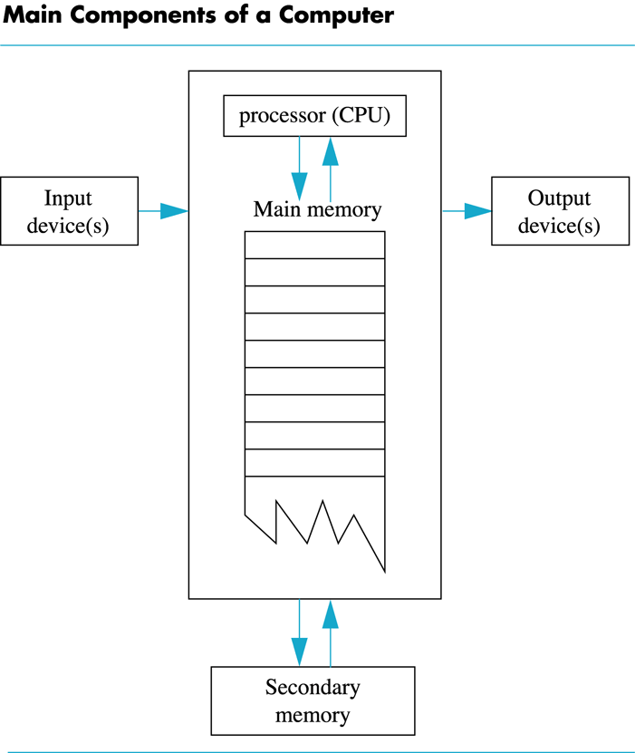
Display 1.1
Back
Next

Slide 55
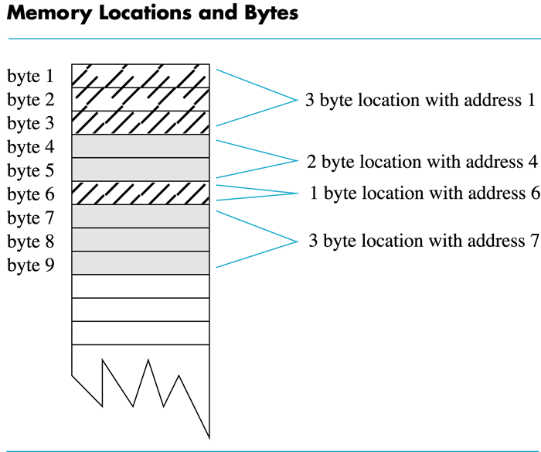
Display 1.2
Back
Next

Slide 56
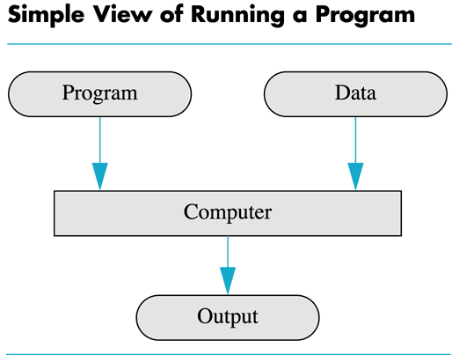
Display 1.3
Back
Next

Slide 57
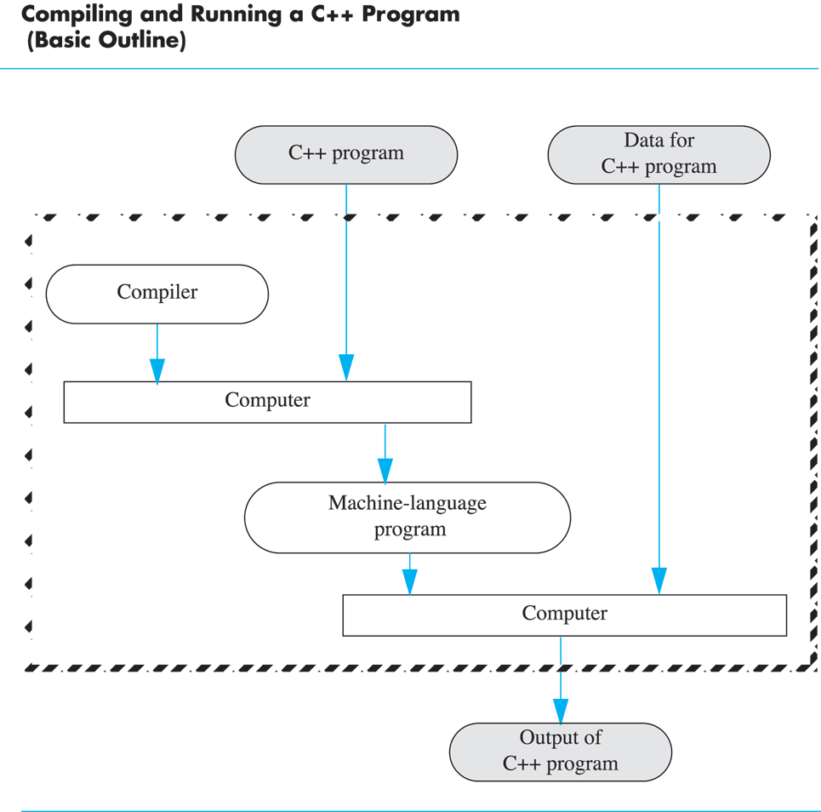
Display 1.4
Back
Next

Slide 58
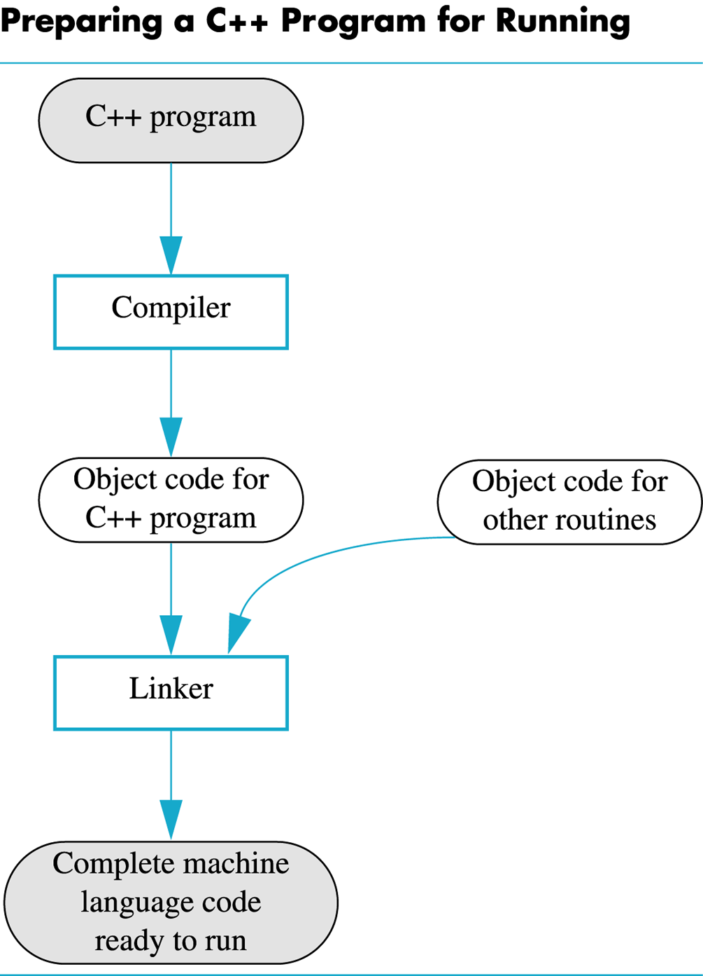
Display 1.5
Back
Next

Slide 59
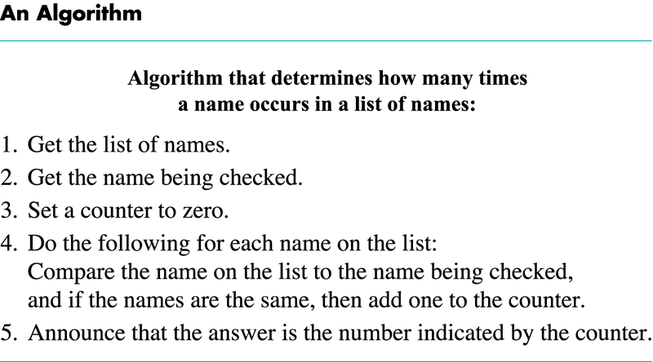
Display 1.6
Back
Next

Slide 60
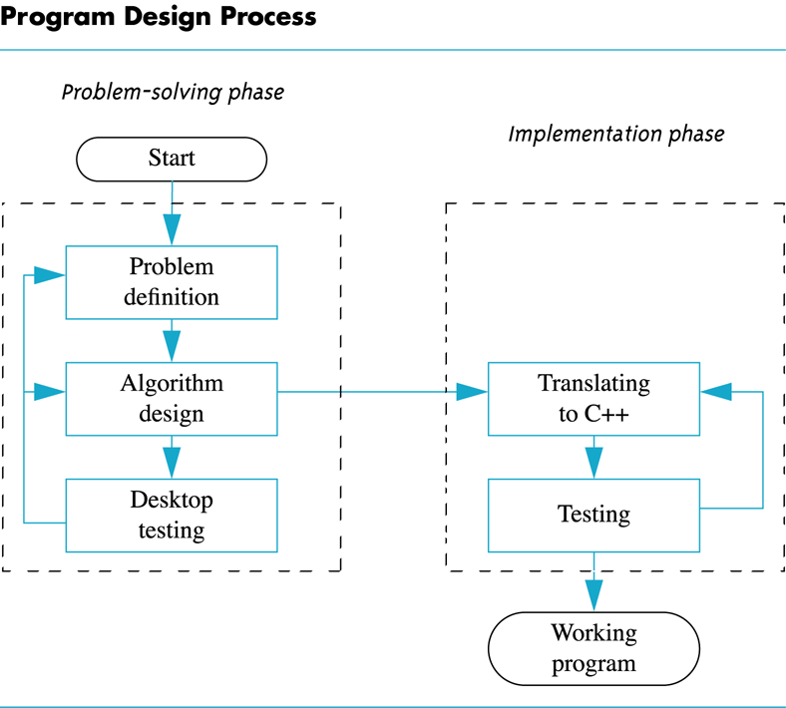
Display 1.7
Back
Next

Slide 61
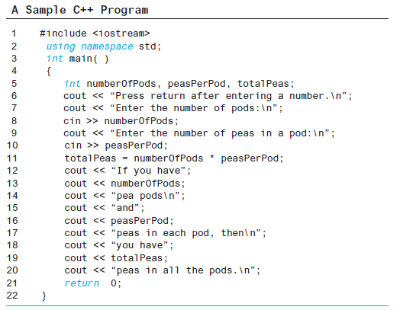
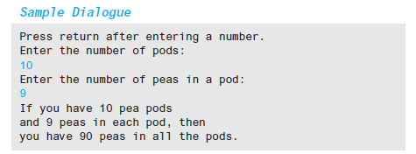
Display 1.8
Back
Next

Slide 62
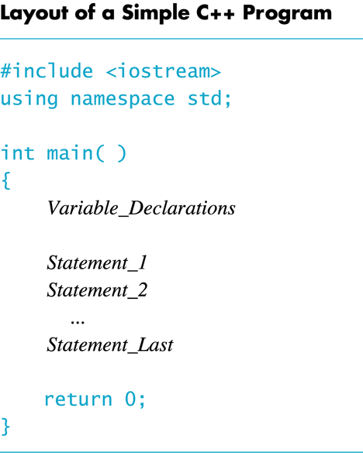
Display 1.9
Back
Next

Slide 63
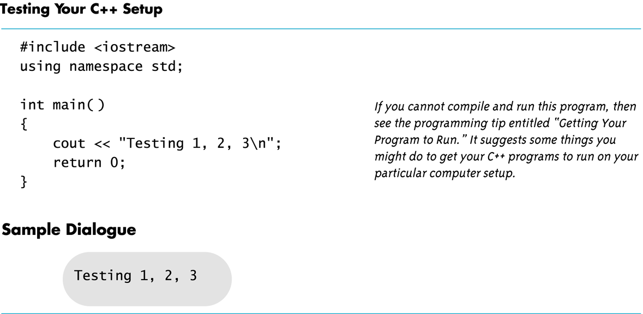
Display 1.10
Back
Next

