Slide 1
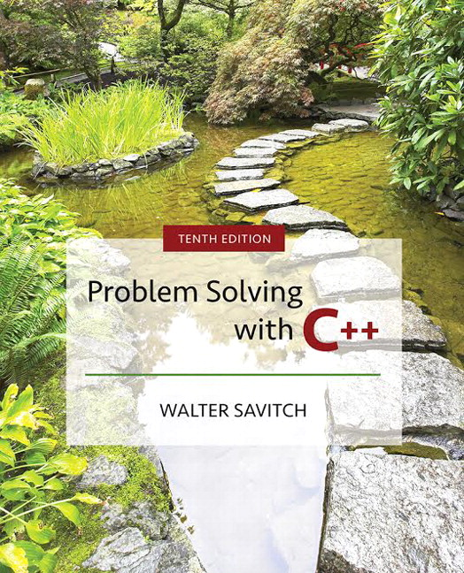

Slide 2
Chapter 2
C++ Basics

Slide 3
Overview
2.1 Variables and Assignments
2.2 Input and Output
2.3 Data Types and Expressions
2.4 Simple Flow of Control
2.5 Program Style
Slide 2- <number>

Slide 4
2.1
Variables and Assignments

Slide 5
Variables and Assignments
Variables are like small blackboards
  We can write a number on them
  We can change the number
  We can erase the number
C++ variables are names for memory locations
  We can write a value in them
  We can change the value stored there
  We cannot erase the memory location
    Some value is always there
Display 2.1
Slide 2- <number>

Slide 6
Identifiers
Variables names are called identifiers
Choosing variable names
  Use meaningful names that represent data to
  be stored
  First character must be
    a letter
    the underscore character
  Remaining characters must be
    letters
    numbers
    underscore character
Slide 2- <number>

Slide 7
Keywords
Keywords (also called reserved words)
  Are used by the C++ language
  Must be used as they are defined in
  the programming language
  Cannot be used as identifiers
Slide 2- <number>

Slide 8
Declaring Variables (Part 1)
Before use, variables must be declared
  Tells the compiler the type of data to store
  Examples: int numberOfBars;
  double one_weight, totalWeight;
  int is an abbreviation for integer.
    could store 3, 102, 3211, -456, etc.
    number_of_bars is of type integer
  double represents numbers with a fractional
  component
    could store 1.34, 4.0, -345.6, etc.
    one_weight and totalWeight are both of type double

Slide 9
Declaring Variables (Part 2)
Immediately prior to use
int main()
{
…
int sum;
sum = score1 + score 2;
…
return 0;
  }
Two locations for variable declarations
  At the beginning
  int main()
  {
  int sum;
  …
  sum = score1 + score2;
  …
  return 0;
  }
Slide 2- <number>

Slide 10
Declaring Variables (Part 3)
Declaration syntax:
  Type_name Variable_1 , Variable_2, . . . ;
Declaration Examples:
  double average, m_score, totalScore;
  double moonDistance;
  int age, numStudents;
  int carsWaiting;
Slide 2- <number>

Slide 11
Assignment Statements
An assignment statement changes the value of a variable
  totalWeight = oneWeight + numberOfBars;
    totalWeight is set to the sum oneWeight + numberOfBars
  Assignment statements end with a semi-colon
  The single variable to be changed is always on the left
  of the assignment operator ‘=‘
  On the right of the assignment operator can be
    Constants -- age = 21;
    Variables -- myCost = yourCost;
    Expressions -- circumference = diameter * 3.14159;
Slide 2- <number>

Slide 12
Assignment Statements and Algebra
The ‘=‘ operator in C++ is not an equal sign
  The following statement cannot be true in algebra
    numberOfBars = numberOfBars + 3;
  In C++ it means the new value of numberOfBars
  is the previous value of numberOfBars plus 3
Slide 2- <number>

Slide 13
Initializing Variables
Declaring a variable does not give it a value
  Giving a variable its first value is initializing the variable
Variables are initialized in assignment statements
double mpg; // declare the variable
mpg = 26.3; // initialize the variable
Declaration and initialization can be combined
using two methods
  Method 1
  double mpg = 26.3, area = 0.0 , volume;
  Method 2
  double mpg(26.3), area(0.0), volume;
Slide 2- <number>

Slide 14
Section 2.1 Conclusion
Can you
  Declare and initialize two integers variables to zero?
  The variables are named feet and inches.
  Declare and initialize two variables, one int and one double?
  Both should be initialized to the appropriate form of 5.
  Give good variable names for identifiers to store
    the speed of an automobile?
    an hourly pay rate?
    the highest score on an exam?
Slide 2- <number>

Slide 15
2.2
Input and Output

Slide 16
Input and Output
A data stream is a sequence of data
  Typically in the form of characters or numbers
An input stream is data for the program to use
  Typically originates
    at the keyboard
    at a file
An output stream is the program’s output
  Destination is typically
    the monitor
    a file
Slide 2- <number>

Slide 17
Output using cout
cout is an output stream sending data to the monitor
The insertion operator "<<" inserts data into cout
Example:
cout << numberOfBars << " candy bars\n";
  This line sends two items to the monitor
    The value of numberOfBars
    The quoted string of characters " candy bars\n"
      Notice the space before the ‘c’ in candy
      The ‘\n’ causes a new line to be started following the ‘s’ in bars
    A new insertion operator is used for each item of output
Slide 2- <number>

Slide 18
Examples Using cout
This produces the same result as the previous sample
cout << numberOfBars;
cout << " candy bars\n";
Here arithmetic is performed in the cout statement
cout << "Total cost is $" << (price + tax);
Quoted strings are enclosed in double quotes ("Walter")
  Don’t use two single quotes (')
A blank space can also be inserted with
cout << " " ;
if there are no strings in which a space is desired as
in " candy bars\n"
Slide 2- <number>

Slide 19
Include Directives
Include Directives add library files to our programs
  To make the definitions of the cin and cout available to
  the program:
  #include <iostream>
Using Directives include a collection of defined names
  To make the names cin and cout available to our program:
  using namespace std;
Slide 2- <number>

Slide 20
Escape Sequences
Escape sequences tell the compiler to treat characters
in a special way
'\' is the escape character
  To create a newline in output use
  \n – cout << "\n";
  or the newer alternative
  cout << endl;
  Other escape sequences:
  \t -- a tab
  \\ -- a backslash character
  \" -- a quote character
Slide 2- <number>

Slide 21
Formatting Real Numbers
Real numbers (type double) produce a variety of outputs
double price = 78.5;
cout << "The price is $" << price << endl;
  The output could be any of these:
  The price is $78.5
  The price is $78.500000
  The price is $7.850000e01
  The most unlikely output is:
  The price is $78.50
Slide 2- <number>

Slide 22
Showing Decimal Places
cout includes tools to specify the output of type double
To specify fixed point notation
  setf(ios::fixed)
To specify that the decimal point will always be shown
  setf(ios::showpoint)
To specify that two decimal places will always be shown
  precision(2)
Example: cout.setf(ios::fixed);
cout.setf(ios::showpoint);
cout.precision(2);
cout << "The price is "
<< price << endl;
Slide 2- <number>

Slide 23
Input Using cin
cin is an input stream bringing data from the keyboard
The extraction operator (>>) removes data to be used
Example:
cout << "Enter the number of bars in a package\n";
cout << " and the weight in ounces of one bar.\n";
cin >> numberOfBars;
cin >> oneWeight;
This code prompts the user to enter data then
reads two data items from cin
  The first value read is stored in numberOfBars
  The second value read is stored in oneWeight
  Data is separated by spaces when entered
Slide 2- <number>

Slide 24
Reading Data From cin
Multiple data items are separated by spaces
Data is not read until the enter key is pressed
  Allows user to make corrections
Example:
cin >> v1 >> v2 >> v3;
  Requires three space separated values
  User might type
  34 45 12 <enter key>
Slide 2- <number>

Slide 25
Designing Input and Output
Prompt the user for input that is desired
  cout statements provide instructions
  cout << "Enter your age: ";
  cin >> age;
    Notice the absence of a new line before using cin
Echo the input by displaying what was read
  Gives the user a chance to verify data
  cout << age << " was entered." << endl;
Slide 2- <number>

Slide 26
Section 2.2 Conclusion
Can you
  write an input statement to place a
  value in the variable theNumber?
  Write the output statement to prompt for
  the value to store in theNumber?
  Write an output statement that produces a
  newline?
  Format output of rational numbers to show
  4 decimal places?
Slide 2- <number>

Slide 27
2.3
Data Types and Expressions

Slide 28
Data Types and Expressions
2 and 2.0 are not the same number
  A whole number such as 2 is of type int
  A real number such as 2.0 is of type double
Numbers of type int are stored as exact values
Numbers of type double may be stored as approximate
values due to limitations on number of significant
digits that can be represented
Slide 2- <number>

Slide 29
Writing Integer constants
Type int does not contain decimal points
    Examples: 34 45 1 89
Slide 2- <number>

Slide 30
Writing Double Constants
Type double can be written in two ways
  Simple form must include a decimal point
    Examples: 34.1 23.0034 1.0 89.9
  Floating Point Notation (Scientific Notation)
    Examples: 3.41e1 means 34.1
    3.67e17 means 367000000000000000.0
    5.89e-6 means 0.00000589
  Number left of e does not require a decimal point
  Exponent cannot contain a decimal point
Slide 2- <number>

Slide 31
Other Number Types
Various number types have different memory
requirements
  More precision requires more bytes of memory
  Very large numbers require more bytes of memory
  Very small numbers require more bytes of memory
Display 2.2
Slide 2- <number>

Slide 32
Integer types
long or long int (often 4 bytes)
  Equivalent forms to declare very large integers
  long bigTotal;
  long int bigTotal;
short or short int (often 2 bytes)
  Equivalent forms to declare smaller integers
  short smallTotal;
  short int smallTtotal;
Slide 2- <number>

Slide 33
Floating point types
long double (often 10 bytes)
  Declares floating point numbers with up to
  19 significant digits
  long double bigNumber;
float (often 4 bytes)
  Declares floating point numbers with up to
  7 significant digits
  float notSoBigNumber;
Slide 2- <number>

Slide 34
Type char
Computers process character data too
char
  Short for character
  Can be any single character from the keyboard
To declare a variable of type char:
char letter;
Slide 2- <number>

Slide 35
char constants
Character constants are enclosed in single quotes
char letter = 'a';
Strings of characters, even if only one character
is enclosed in double quotes
  "a" is a string of characters containing one character
  'a' is a value of type character
Slide 2- <number>

Slide 36
C++11 Types
The size of numeric data types can vary from one machine to another.
  For example, an int might be 32 bits or 64 bits
C++11 introduced new integer types that specify exactly the size and whether or not the data type is signed or unsigned
C++11 also has an “auto” type that deduces the type of the variable based on the expression on the right hand side of the assignment
  auto x = 2.4 * 10; // x becomes a double due to 2.4
Display 2.3
Slide 2- <number>

Slide 37
Reading Character Data
cin skips blanks and line breaks looking for data
The following reads two characters but skips
any space that might be between
char symbol1, symbol2;
cin >> symbol1 >> symbol2;
User normally separate data items by spaces
J D
Results are the same if the data is not separated
by spaces
JD
Display 2.4
Slide 2- <number>

Slide 38
Type string
string is a class, different from the primitive data types discussed so far
  Difference is discussed in Chapter 8
  Use double quotes around the text to store into the string variable
  Requires the following be added to the top of your program:
    #include <string>
To declare a variable of type string:
string name = "Apu Nahasapeemapetilon";
Display 2.5
Slide 2- <number>

Slide 39
Type Compatibilities
In general store values in variables of the
same type
  This is a type mismatch:
  int intVariable;
  intVariable = 2.99;
  If your compiler allows this, intVariable will
  most likely contain the value 2, not 2.99
Slide 2- <number>

Slide 40
int ←→ double (part 1)
Variables of type double should not be assigned
to variables of type int
int intVariable;
double doubleVariable;
doubleVariable = 2.00;
intVariable = doubleVariable;
  If allowed, intVariable contains 2, not 2.00
Slide 2- <number>

Slide 41
int ←→ double (part 2)
Integer values can normally be stored in
variables of type double
double doubleVariable;
doubleVariable = 2;
  doubleVariable will contain 2.0
Slide 2- <number>

Slide 42
char ← → int
The following actions are possible but generally not
recommended!
It is possible to store char values in integer
variables
int value = 'A';
value will contain an integer representing 'A'
It is possible to store int values in char
variables
char letter = 65;
Slide 2- <number>

Slide 43
bool ← → int
The following actions are possible but generally
not recommended!
Values of type bool can be assigned to int
variables
  True is stored as 1
  False is stored as 0
Values of type int can be assigned to bool
variables
  Any non-zero integer is stored as true
  Zero is stored as false
Slide 2- <number>

Slide 44
Arithmetic
Arithmetic is performed with operators
  + for addition
  - for subtraction
  * for multiplication
  / for division
Example: storing a product in the variable
totalWeight
totalWeight = oneWeight * numberOfBars;
Slide 2- <number>

Slide 45
Results of Operators
Arithmetic operators can be used with any
numeric type
An operand is a number or variable
used by the operator
Result of an operator depends on the types
of operands
  If both operands are int, the result is int
  If one or both operands are double, the result is double
Slide 2- <number>

Slide 46
Division of Doubles
Division with at least one operator of type double
produces the expected results.
double divisor, dividend, quotient;
divisor = 3;
dividend = 5;
quotient = dividend / divisor;
  quotient = 1.6666…
  Result is the same if either dividend or divisor is
  of type int
Slide 2- <number>

Slide 47
Division of Integers
Be careful with the division operator!
  int / int produces an integer result
  (true for variables or numeric constants)
  int dividend, divisor, quotient;
  dividend = 5;
  divisor = 3;
  quotient = dividend / divisor;
  The value of quotient is 1, not 1.666…
  Integer division does not round the result, the
  fractional part is discarded!
Slide 2- <number>

Slide 48
Integer Remainders
% operator gives the remainder from integer
division
int dividend, divisor, remainder;
dividend = 5;
divisor = 3;
remainder = dividend % divisor;
The value of remainder is 2
Display 2.6
Slide 2- <number>

Slide 49
Arithmetic Expressions
Use spacing to make expressions readable
  Which is easier to read?
  x+y*z or x + y * z
Precedence rules for operators are the same as
used in your algebra classes
Use parentheses to alter the order of operations
x + y * z ( y is multiplied by z first)
(x + y) * z ( x and y are added first)
Display 2.7
Slide 2- <number>

Slide 50
Operator Shorthand
Some expressions occur so often that C++
contains to shorthand operators for them
All arithmetic operators can be used this way
  += count = count + 2; becomes
  count += 2;
  *= bonus = bonus * 2; becomes
  bonus *= 2;
  /= time = time / rushFactor; becomes
  time /= rushFactor;
  %= remainder = remainder % (cnt1+ cnt2); becomes
  remainder %= (cnt1 + cnt2);
Slide 2- <number>

Slide 51
2.4
Simple Flow of Control

Slide 52
Simple Flow of Control
Flow of control
  The order in which statements are executed
Branch
  Lets program choose between two alternatives
Slide 2- <number>

Slide 53
Branch Example
To calculate hourly wages there are two choices
  Regular time ( up to 40 hours)
    grossPay = rate * hours;
  Overtime ( over 40 hours)
    grossPay = rate * 40 + 1.5 * rate * (hours - 40);
  The program must choose which of these
  expressions to use
Slide 2- <number>

Slide 54
Designing the Branch
Decide if (hours >40) is true
  If it is true, then use
  grossPay = rate * 40 + 1.5 * rate * (hours - 40);
  If it is not true, then use
  grossPay = rate * hours;
Slide 2- <number>

Slide 55
Implementing the Branch
if-else statement is used in C++ to perform a
branch
  if (hours > 40)
  grossPay = rate * 40 + 1.5 * rate * (hours - 40);
  else
  grossPay = rate * hours;
Display 2.8
Display 2.9
Slide 2- <number>

Slide 56
Boolean Expressions
Boolean expressions are expressions that are
either true or false
comparison operators such as '>' (greater than)
are used to compare variables and/or numbers
  (hours > 40) Including the parentheses, is the
  boolean expression from the wages example
  A few of the comparison operators that use two
  symbols (No spaces allowed between the symbols!)
    >= greater than or equal to
    != not equal or inequality
    = = equal or equivalent
Display 2.10
Slide 2- <number>

Slide 57
if-else Flow Control (1)
if (boolean expression)
true statement
else
false statement
When the boolean expression is true
  Only the true statement is executed
When the boolean expression is false
  Only the false statement is executed
Slide 2- <number>

Slide 58
if-else Flow Control (2)
if (boolean expression)
{
true statements
}
else
{
false statements
}
When the boolean expression is true
  Only the true statements enclosed in { } are executed
When the boolean expression is false
  Only the false statements enclosed in { } are executed
Slide 2- <number>

Slide 59
AND
Boolean expressions can be combined into
more complex expressions with
  && -- The AND operator
    True if both expressions are true
Syntax: (Comparison_1) && (Comparison_2)
Example: if ( (2 < x) && (x < 7) )
  True only if x is between 2 and 7
  Inside parentheses are optional but enhance meaning
Slide 2- <number>

Slide 60
OR
| | -- The OR operator (no space!)
  True if either or both expressions are true
Syntax: (Comparison_1) | | (Comparison_2)
Example: if ( ( x = = 1) | | ( x = = y) )
  True if x contains 1
  True if x contains the same value as y
  True if both comparisons are true
Slide 2- <number>

Slide 61
NOT
! -- negates any boolean expression
  !( x < y)
    True if x is NOT less than y
  !(x = = y)
    True if x is NOT equal to y
! Operator can make expressions difficult to
understand…use only when appropriate
Slide 2- <number>

Slide 62
Inequalities
Be careful translating inequalities to C++
if x < y < z translates as
if ( ( x < y ) && ( y < z ) )
NOT
if ( x < y < z )
Slide 2- <number>

Slide 63
Pitfall: Using = or ==
' = ' is the assignment operator
  Used to assign values to variables
  Example: x = 3;
'= = ' is the equality operator
  Used to compare values
  Example: if ( x == 3)
The compiler will accept this error:
if (x = 3)
but stores 3 in x instead of comparing x and 3
  Since the result is 3 (non-zero), the expression is true
Slide 2- <number>

Slide 64
Compound Statements
A compound statement is more than one
statement enclosed in { }
Branches of if-else statements often need to
execute more that one statement
Example: if (boolean expression)
{
true statements
}
else
{
false statements
}
Display 2.11
Slide 2- <number>

Slide 65
Branches Conclusion
Can you
  Write an if-else statement that outputs the word
  High if the value of the variable score is greater
  than 100 and Low if the value of score is at most
  100? The variables are of type int.
  Write an if-else statement that outputs the word
  Warning provided that either the value of the variable
  temperature is greater than or equal to 100, or the
  of the variable pressure is greater than or equal to
  200, or both. Otherwise, the if_else sttement outputs
  the word OK. The variables are of type int.
Slide 2- <number>

Slide 66
Simple Loops
When an action must be repeated, a loop is used
C++ includes several ways to create loops
We start with the while-loop
Example: while (countDown > 0)
{
cout << "Hello ";
countDown -= 1;
}
Output: Hello Hello Hello
when countDown starts at 3
Display 2.12
Slide 2- <number>

Slide 67
While Loop Operation
First, the boolean expression is evaluated
  If false, the program skips to the line following the
  while loop
  If true, the body of the loop is executed
    During execution, some item from the boolean expression
    is changed
  After executing the loop body, the boolean
  expression is checked again repeating the process
  until the expression becomes false
A while loop might not execute at all if the
boolean expression is false on the first check
Slide 2- <number>

Slide 68
while Loop Syntax
while (boolean expression is true)
{
statements to repeat
}
  Semi-colons are used only to end the statements
  within the loop
while (boolean expression is true)
statement to repeat
Display 2.13
Slide 2- <number>

Slide 69
do-while loop
A variation of the while loop.
A do-while loop is always executed at least once
  The body of the loop is first executed
  The boolean expression is checked after the body
  has been executed
Syntax: do
{
statements to repeat
} while (boolean_expression);
Display 2.14
Display 2.15
Slide 2- <number>

Slide 70
Increment/Decrement
Unary operators require only one operand
  + in front of a number such as +5
  - in front of a number such as -5
++ increment operator
  Adds 1 to the value of a variable
  x ++;
  is equivalent to x = x + 1;
-- decrement operator
  Subtracts 1 from the value of a variable
  x --;
  is equivalent to x = x – 1;
Slide 2- <number>

Slide 71
Sample Program
Bank charge card balance of $50
2% per month interest
How many months without payments before
your balance exceeds $100
After 1 month: $50 + 2% of $50 = $51
After 2 months: $51 + 2% of $51 = $52.02
After 3 months: $52.02 + 2% of $52.02 …
Display 2.16
Slide 2- <number>

Slide 72
Infinite Loops
Loops that never stop are infinite loops
The loop body should contain a line that will
eventually cause the boolean expression to
become false
Example: Print the odd numbers less than 12
x = 1;
while (x != 12)
{
cout << x << endl;
x = x + 2;
}
Better to use this comparison: while ( x < 12)
Slide 2- <number>

Slide 73
Section 2.4 Conclusion
Can you
  Show the output of this code if x is of type int?
  x = 10;
  while ( x > 0)
  {
  cout << x << endl;
  x = x – 3;
  }
  Show the output of the previous code using the
  comparison x < 0 instead of x > 0?
Slide 2- <number>

Slide 74
2.5
Program Style

Slide 75
Program Style
A program written with attention to style
  is easier to read
  easier to correct
  easier to change
Slide 2- <number>

Slide 76
Program Style - Indenting
Items considered a group should look like a
group
  Skip lines between logical groups of statements
  Indent statements within statements
  if (x = = 0)
  statement;
Braces {} create groups
  Indent within braces to make the group clear
  Braces placed on separate lines are easier to locate
Slide 2- <number>

Slide 77
Program Style - Comments
// is the symbol for a single line comment
  Comments are explanatory notes for the programmer
  All text on the line following // is ignored by the
  compiler
  Example: //calculate regular wages
  grossPay = rate * hours;
/* and */ enclose multiple line comments
  Example: /* This is a comment that spans
  multiple lines without a
  comment symbol on the middle line
  */
Slide 2- <number>

Slide 78
Program Style - Constants
Number constants have no mnemonic value
Number constants used throughout a program
are difficult to find and change when needed
Constants
  Allow us to name number constants so they have
  meaning
  Allow us to change all occurrences simply by
  changing the value of the constant
Slide 2- <number>

Slide 79
Constants
const is the keyword to declare a constant
Example:
const int WINDOW_COUNT = 10;
declares a constant named WINDOW_COUNT
  Its value cannot be changed by the program like a
  variable
  It is common to name constants with all capitals
Display 2.17
Slide 2- <number>

Slide 80
Section 2.5 Conclusion
Can you
  Create a named constant of type double?
  Determine if a program can modify the value of a
  constant?
  Describe the benefits of comments?
  Explain why indenting is important in a program?
  Explain why blank lines are important in a program?
Slide 2- <number>

Slide 81
Chapter 2 -- End
Slide 2- <number>

Slide 82
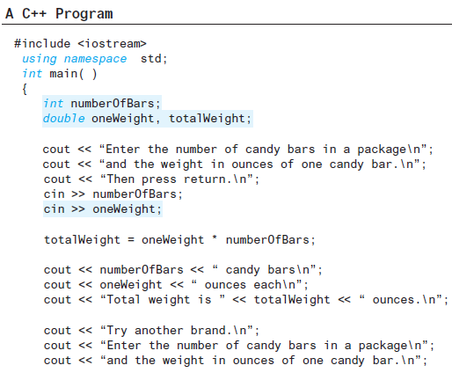
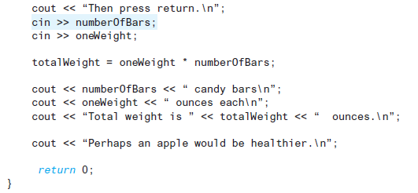
Display 2.1 (1/2)
Back
Next
Slide 2- <number>

Slide 83
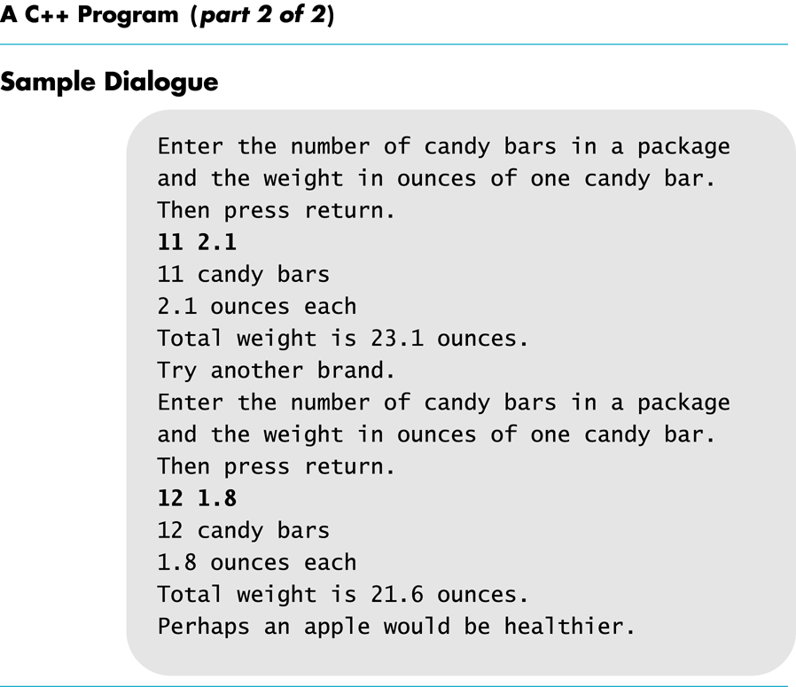
Display 2.1
(2 /2)
Back
Next
Slide 2- <number>

Slide 84
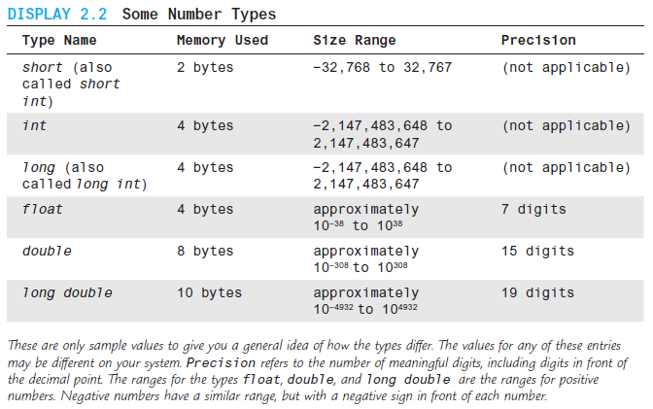
Display 2.2
Back
Next
Slide 2- <number>

Slide 85
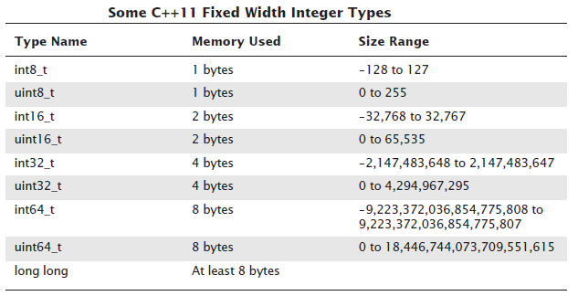
Display 2.3
Back
Next
Slide 2- <number>

Slide 86
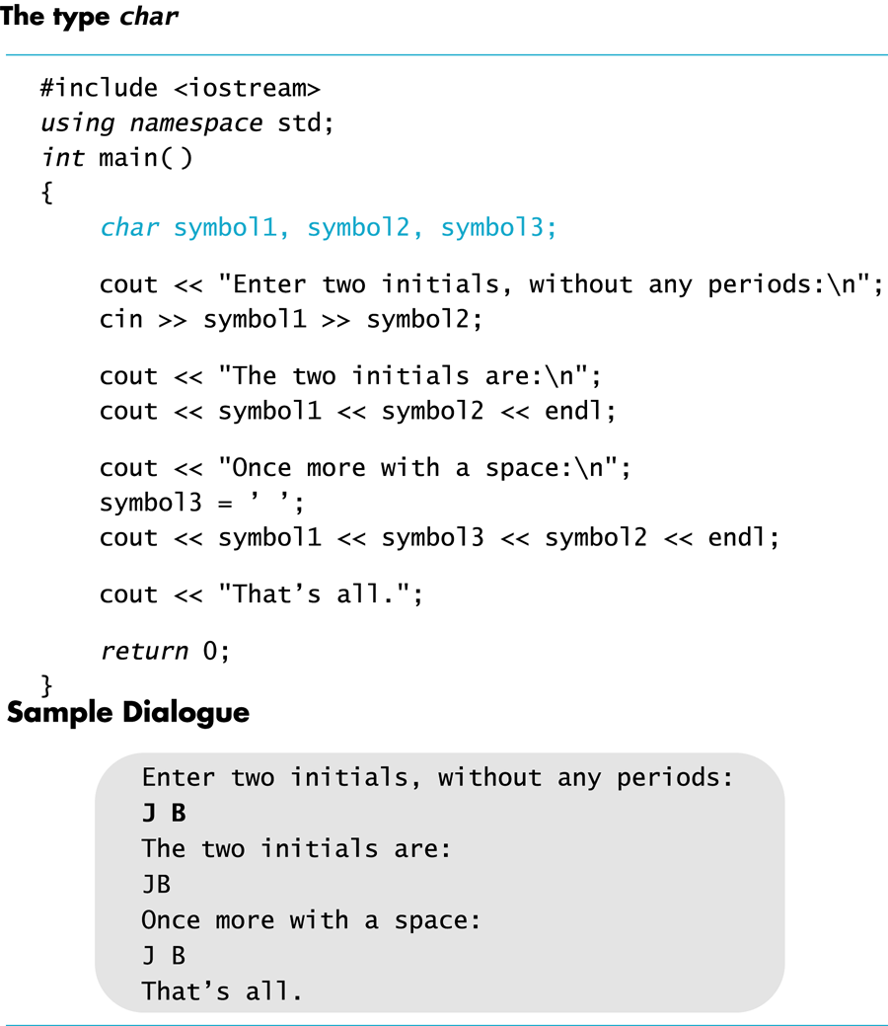
Display 2.4
Back
Next
Slide 2- <number>

Slide 87
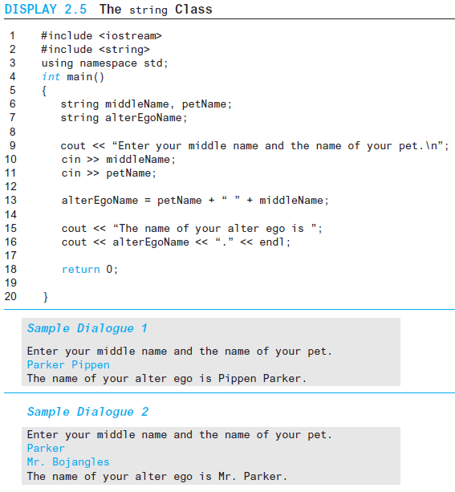
Display 2.5
Back
Next
Slide 2- <number>

Slide 88
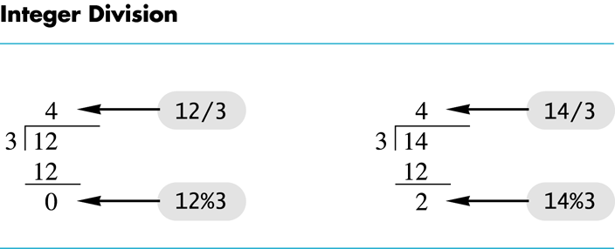
Display 2.6
Back
Next
Slide 2- <number>

Slide 89
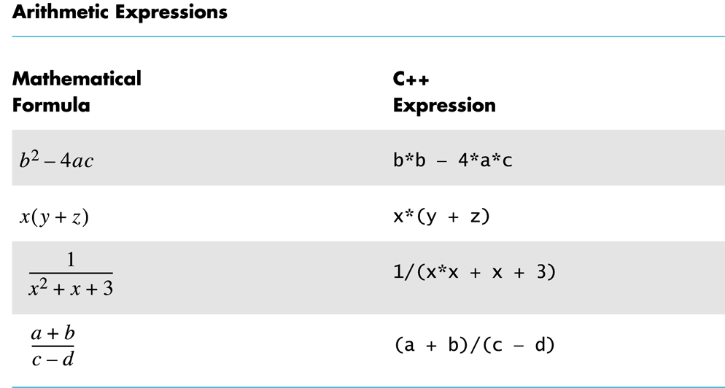
Display 2.7
Back
Next
Slide 2- <number>

Slide 90
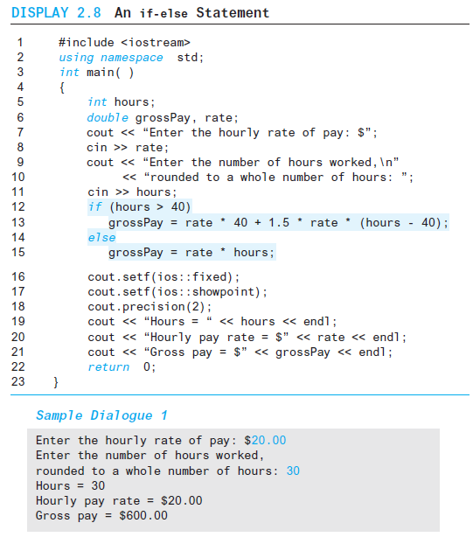
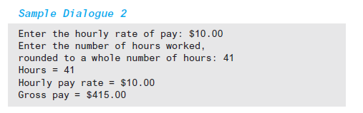
Display 2.8
Back
Next
Slide 2- <number>

Slide 91
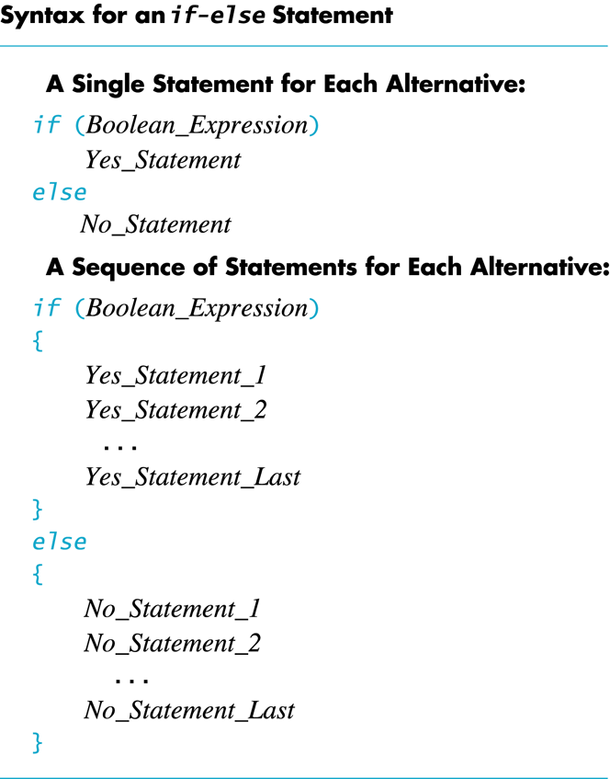
Display 2.9
Back
Next
Slide 2- <number>

Slide 92
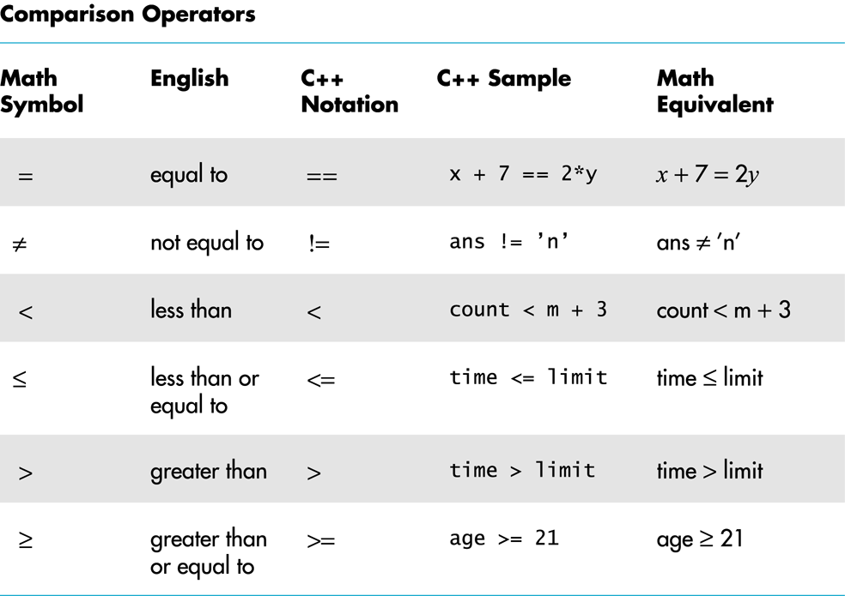
Display 2.10
Back
Next
Slide 2- <number>

Slide 93
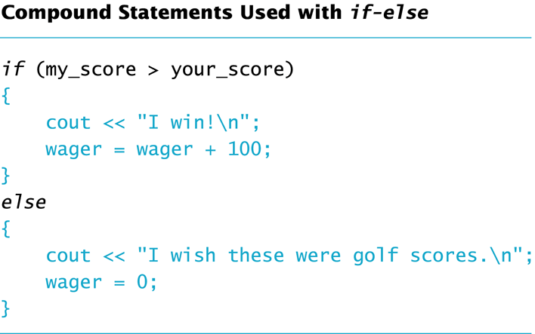
Display 2.11
Back
Next
Slide 2- <number>

Slide 94
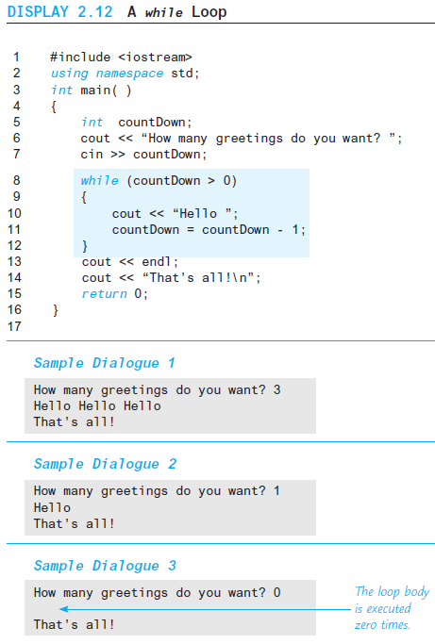
Display 2.12
Back
Next
Slide 2- <number>

Slide 95
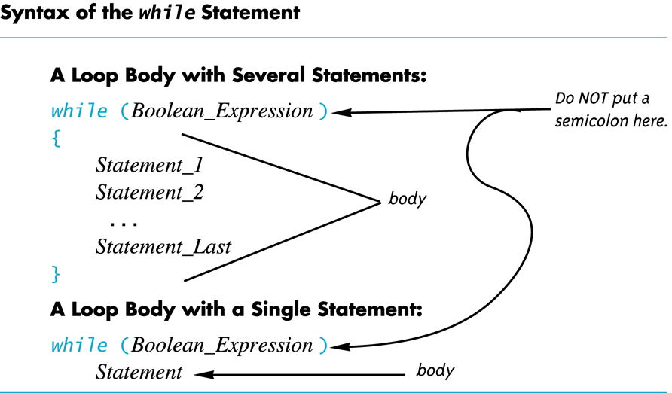
Display 2.13
Back
Next
Slide 2- <number>

Slide 96
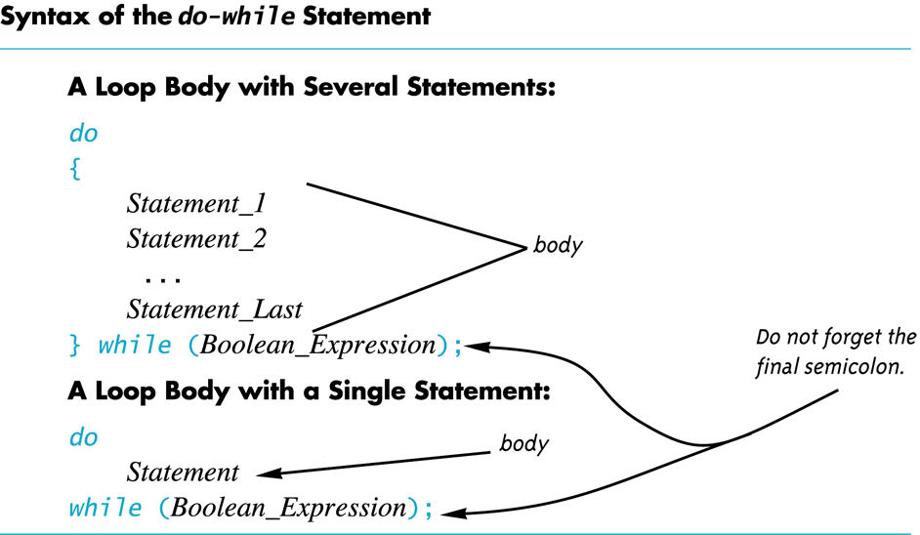
Display 2.14
Back
Next
Slide 2- <number>

Slide 97
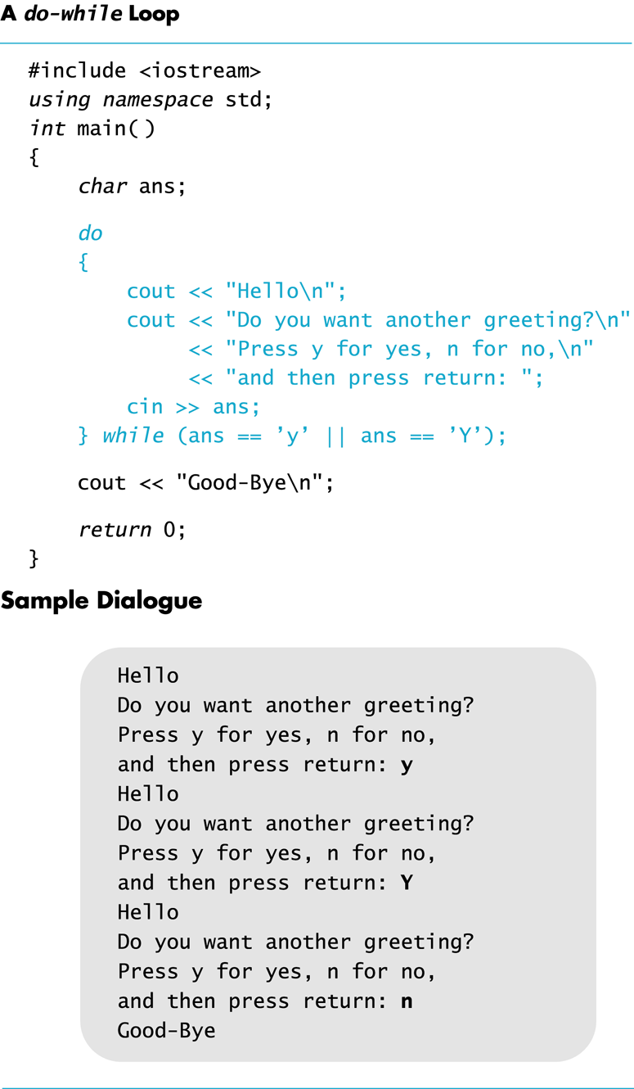
Display 2.15
Back
Next
Slide 2- <number>

Slide 98
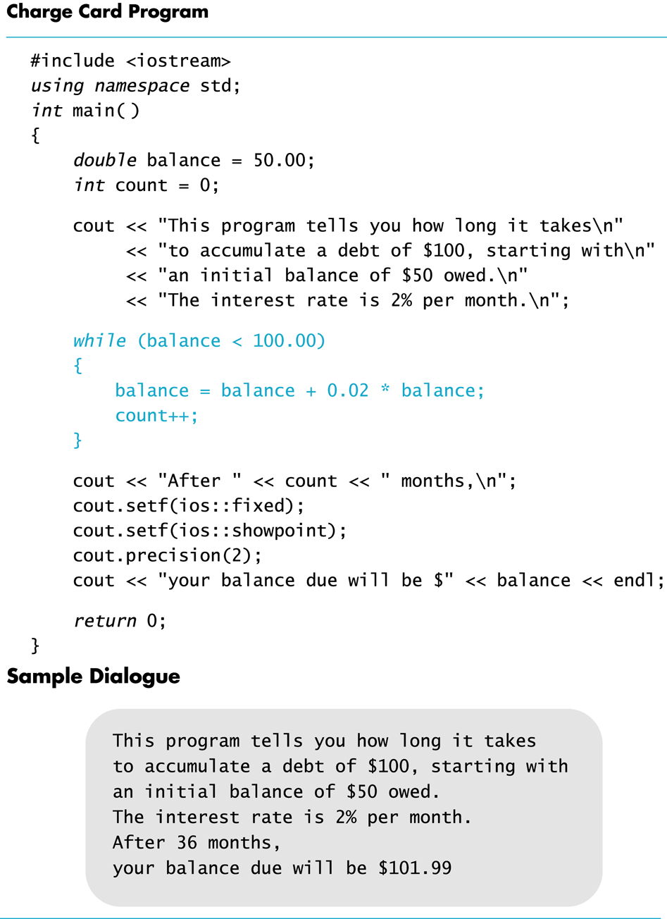
Display 2.16
Back
Next
Slide 2- <number>

Slide 99
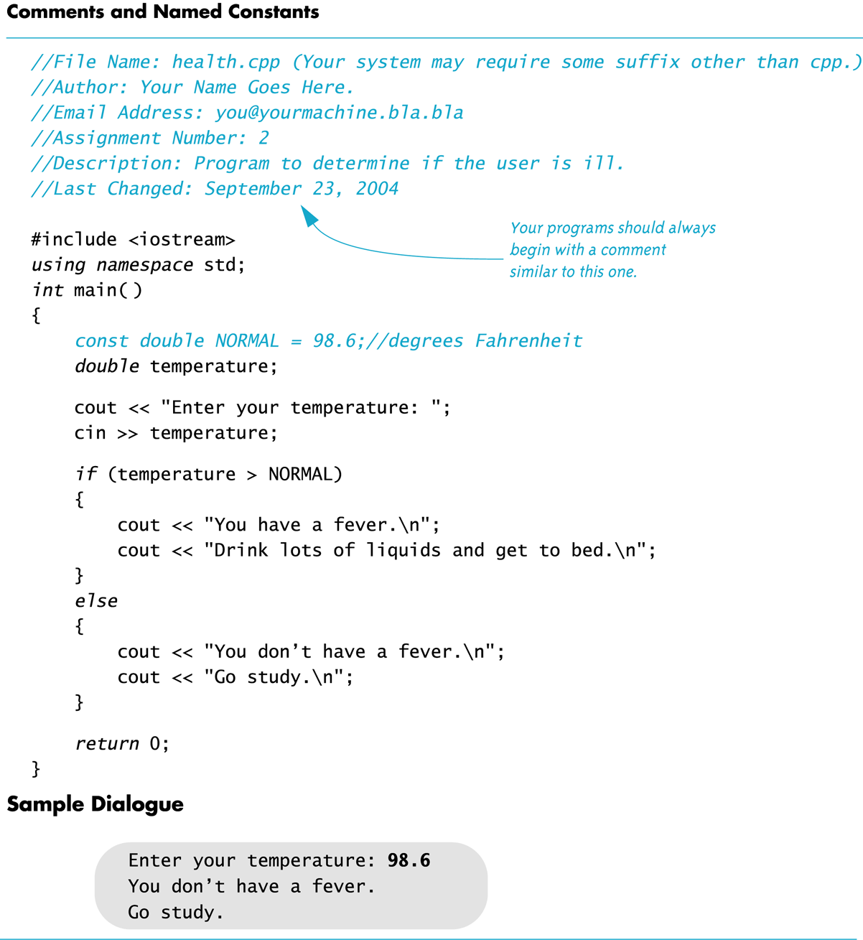
Display 2.17
Back
Next
Slide 2- <number>

