Slide 1
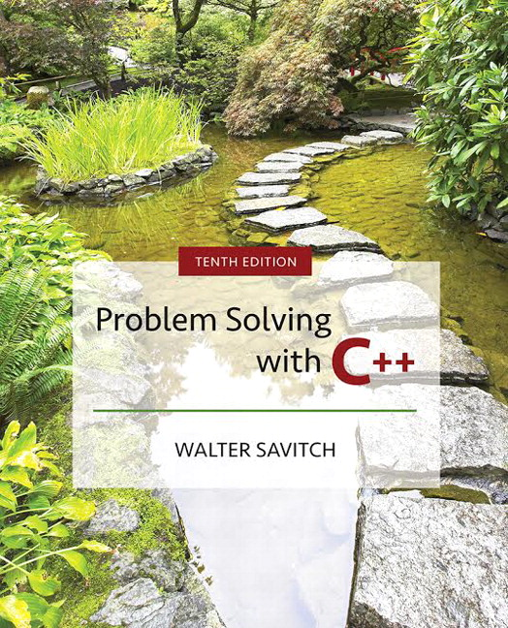

Slide 2
Chapter 3
More Flow of Control

Slide 3
Overview
3.1 Using Boolean Expressions
3.2 Multiway Branches
3.3 More about C++ Loop Statements
3.4 Designing Loops
Slide 3- <number>

Slide 4
Flow Of Control
Flow of control refers to the order in which
program statements are performed
  We have seen the following ways to specify flow of control
    if-else-statements
    while-statements
    do-while-statements
  New methods described in this chapter include
    switch-statements
    for-statements
Slide 3- <number>

Slide 5
3.1
Using Boolean Expressions

Slide 6
Using Boolean Expressions
A Boolean Expression is an expression that is
either true or false
  Boolean expressions are evaluated using
  relational operations such as
    = = , < , and >= which produce a boolean value
  and boolean operations such as
    &&, | |, and ! which also produce a boolean value
Type bool allows declaration of variables that
carry the value true or false
Slide 3- <number>

Slide 7
Evaluating Boolean Expressions
Boolean expressions are evaluated using values
from the Truth Tables in
  For example, if y is 8, the expression
  !( ( y < 3) | | ( y > 7) )
  is evaluated in the following sequence
Display 3.1
! ( false | | true )
! ( true )
false
Slide 3- <number>

Slide 8
Order of Precedence
If parenthesis are omitted from boolean
expressions, the default precedence of
operations is:
  Perform ! operations first
  Perform relational operations such as < next
  Perform && operations next
  Perform | | operations last
Slide 3- <number>

Slide 9
Precedence Rules
Items in expressions are grouped by precedence
rules for arithmetic and boolean operators
  Operators with higher precedence are performed first
  Binary operators with equal precedence are
  performed left to right
  Unary operators of equal precedence are
  performed right to left
Display 3.2
Slide 3- <number>

Slide 10
Precedence Rule Example
The expression
(x+1) > 2 | | (x + 1) < -3
is equivalent to
( (x + 1) > 2) | | ( ( x + 1) < -3)
  Because > and < have higher precedence than | |
and is also equivalent to
x + 1 > 2 | | x + 1 < - 3
Slide 3- <number>

Slide 11
Evaluating x + 1 > 2 | | x + 1 < - 3
Using the precedence rules of Display 3.2
  First apply the unary –
  Next apply the +'s
  Now apply the > and <
  Finally do the | |
Slide 3- <number>

Slide 12
Short-Circuit Evaluation
Some boolean expressions do not need to be
completely evaluated
  if x is negative, the value of the expression
  (x >= 0) && ( y > 1)
  can be determined by evaluating only (x >= 0)
C++ uses short-circuit evaluation
  If the value of the leftmost sub-expression
  determines the final value of the expression, the rest
  of the expression is not evaluated
Slide 3- <number>

Slide 13
Using Short-Circuit Evaluation
Short-circuit evaluation can be used to prevent
run time errors
  Consider this if-statement
  if ((kids != 0) && (pieces / kids >= 2) )
  cout << "Each child may have two pieces!";
  If the value of kids is zero, short-circuit evaluation
  prevents evaluation of (pieces / 0 >= 2)
    Division by zero causes a run-time error
Slide 3- <number>

Slide 14
Type bool and Type int
C++ can use integers as if they were Boolean
values
  Any non-zero number (typically 1) is true
  0 (zero) is false
Slide 3- <number>

Slide 15
Problems with !
The expression ( ! time > limit ), with limit = 60,
is evaluated as
(!time) > limit
If time is an int with value 36, what is !time?
  False! Or zero since it will be compared to an integer
  The expression is further evaluated as
  0 > limit
  false
Slide 3- <number>

Slide 16
Correcting the ! Problem
The intent of the previous expression was
most likely the expression
( ! ( time > limit) )
which evaluates as
( ! ( false) )
true
Slide 3- <number>

Slide 17
Avoiding !
Just as not in English can make things
not undifficult to read, the ! operator can
make C++ expressions difficult to understand
Before using the ! operator see if you can
express the same idea more clearly without
the ! operator
Slide 3- <number>

Slide 18
Enumeration Types (Optional)
An enumeration type is a type with values
defined by a list of constants of type int
Example:
  enum MonthLength{JAN_LENGTH = 31,
  FEB_LENGTH = 28,
  MAR_LENGTH = 31,
  …
  DEC_LENGTH = 31};
Slide 3- <number>

Slide 19
Default enum Values
If numeric values are not specified, identifiers
are assigned consecutive values starting with 0
  enum Direction { NORTH = 0, SOUTH = 1,
  EAST = 2, WEST = 3};
  is equivalent to
  enum Direction {NORTH, SOUTH, EAST, WEST};
Slide 3- <number>

Slide 20
Enumeration Values
Unless specified, the value assigned an
enumeration constant is 1 more than the previous
constant
enum MyEnum{ONE = 17, TWO, THREE,
FOUR = -3, FIVE};
results in these values
  ONE = 17, TWO = 18, THREE = 19,
  FOUR = -3, FIVE = -2
Slide 3- <number>

Slide 21

Strong Enums
C++11 introduced a new version of enumeration called strong enums or enum classes that avoids some problems of conventional enums
  May not want an enum to act like an int
  Enums are global so you can’t have the same enum value twice
Define a strong enum as follows:
Slide 3- <number>

Slide 22
Using Strong Enums
To use our strong enums:
Days d = Days::Tue;
Weather w = Weather::Sun;
The variables d and w are not integers so we can’t treat them as such.
Slide 3- <number>

Slide 23
Section 3.1 Conclusion
Can you
  Write a function definition for a function named
  in_order that takes three arguments of type int?
  The function returns true if the arguments are in
  ascending order; otherwise, it returns false.
  Determine the value of these Boolean expressions?
    Assume count = 0 and limit = 10
    (count == 0) && (limit < 20)
    !(count == 12)
    (limit < 0) && ((limit /count) > 7)
Slide 3- <number>

Slide 24
3.2
Multiway Branches

Slide 25
Multiway Branches
A branching mechanism selects one out of a
number of alternative actions
  The if-else-statement is a branching mechanism
Branching mechanisms can be a subpart of
another branching mechanism
  An if-else-statement can include another
  if-else-statement as a subpart
Slide 3- <number>

Slide 26
Nested Statements
A statement that is a subpart of another statement
is a nested statement
  When writing nested statements it is normal to
  indent each level of nesting
  Example:
  if (count < 10)
  if ( x < y)
  cout << x << " is less than " << y;
  else
  cout << y << " is less than " << x;
Display 3.3
indented
Slide 3- <number>

Slide 27
Nested if-else Statements
Use care in nesting if-else-statements
Example: To design an if-else statement to
warn a driver when fuel is low, but tells the
driver to bypass pit stops if the fuel is close
to full. Other wise there should be no output.
Pseudocode: if fuel gauge is below ¾ then:
if fuel gauge is below ¼ then:
issue a warning
otherwise (gauge > ¾) then:
output a statement saying don't stop
Slide 3- <number>

Slide 28
First Try Nested if's
Translating the previous pseudocode to C++
could yield (if we are not careful)
if (fuelGaugeReading < 0.75)
if (fuelGaugeReading < 0.25)
cout << "Fuel very low. Caution!\n";
else
cout << "Fuel over 3/4. Don't stop now!\n";
  This would compile and run, but does not produce the
  desired results
  The compiler pairs the "else" with the nearest previous "if"
Slide 3- <number>

Slide 29
Braces and Nested Statements
Braces in nested statements are like parenthesis
in arithmetic expressions
  Braces tell the compiler how to group things
Use braces around substatements
demonstrates the use of braces in nested if-else-statements
Display 3.4
Slide 3- <number>

Slide 30
Multi-way if-else-statements
An if-else-statement is a two-way branch
Three or four (or more) way branches can be
designed using nested if-else-statements
  Example: The number guessing game with the number stored in variable number, the guess in variable
  guess. How do we give hints?
Slide 3- <number>

Slide 31
Number Guessing
The following nested statements implement the
hints for our number guessing game
  if (guess> number)
  cout << "Too high.";
  else
  if (guess < number)
  cout << "Too low.");
  else
  if (guess == number)
  cout << "Correct!";
Slide 3- <number>

Slide 32
Indenting Nested if-else
Notice how the code on the previous slide crept
across the page leaving less and less space
  Use this alternative for indenting several nested
  if-else-statements:
  if (guess> number)
  cout << "Too high.";
  else if (guess < number)
  cout << "Too low.");
  else if (guess == number)
  cout << "Correct!";
Slide 3- <number>

Slide 33
The Final if-else-statement
When the conditions tested in an if-else-statement
are mutually exclusive, the final if-else can
sometimes be omitted.
  The previous example can be written as
  if (guess> number)
  cout << "Too high.";
  else if (guess < number)
  cout << "Too low.");
  else // (guess == number)
  cout << "Correct!";
Slide 3- <number>

Slide 34
Nested if-else Syntax
A Multiway if-else statement is written as
  if(Boolean_Expression_1)
  Statement_1
  else if ( Boolean_Expression_2)
  Statement_2
  …
  else if (Boolean_Expression_n)
  Statement _n
  else
  Statement_For_All_Other_Possibilities
Slide 3- <number>

Slide 35
Program Example: State Income Tax
Write a program for a state that computes tax
according to the rate schedule:
No tax on first $15,000 of income
5% tax on each dollar from $15,001
to $25,000
10% tax on each dollar over $25,000
Display 3.5 (1)
Display 3.5 (2)
Slide 3- <number>

Slide 36
Refining if-else-statements
Notice that the line
else if (( netIncome > 15000
&& netIncome < = 25000))
can be replaced with
else if (netIncome <= 25000)
  The computer will not get to this line unless it
  is already determined that netIncome > 15000
Slide 3- <number>

Slide 37
The switch-statement
The switch-statement is an alternative for
constructing multi-way branches
  The example in Display 3.6 determines output
  based on a letter grade
    Grades 'A', 'B', and 'C' each have a branch
    Grades 'D' and 'F' use the same branch
    If an invalid grade is entered, a default branch is used
Display 3.6 (1)
Display 3.6 (2)
Slide 3- <number>

Slide 38
switch-statement Syntax
switch (controlling expression)
{
case Constant_1:
statement_Sequence_1
break;
case Constant_2:
Statement_Sequence_2
break;
. . .
case Constant_n:
Statement_Sequence_n
break;
default:
Default_Statement_Sequence
}
Slide 3- <number>

Slide 39
The Controlling Statement
A switch statement's controlling statement
must return one of these types
  A bool value
  An enum constant
  An integer type
  A character
The value returned is compared to the
constant values after each "case"
  When a match is found, the code for that case is used
Slide 3- <number>

Slide 40
The break Statement
The break statement ends the switch-statement
  Omitting the break statement will cause the code
  for the next case to be executed!
  Omitting a break statement allows the use of
  multiple case labels for a section of code
    case 'A':
    case 'a':
    cout << "Excellent.";
    break;
    Runs the same code for either 'A' or 'a'
Slide 3- <number>

Slide 41
The default Statement
If no case label has a constant that matches the
controlling expression, the statements following
the default label are executed
  If there is no default label, nothing happens when the switch statement is executed
  It is a good idea to include a default section
Slide 3- <number>

Slide 42
Switch-statements and Menus
Nested if-else statements are more versatile than
a switch statement
Switch-statements can make some code more
clear
  A menu is a natural application for a switch-statement
Display 3.7 (1)
Display 3.7 (2)
Slide 3- <number>

Slide 43
Function Calls in Branches
Switch and if-else-statements allow the use of
multiple statements in a branch
  Multiple statements in a branch can make the
  switch or if-else-statement difficult to read
  Using function calls (as shown in Display 3.7)
  instead of multiple statements can make the
  switch or if-else-statement much easier to read
Slide 3- <number>

Slide 44
Blocks
Each branch of a switch or if-else statement is
a separate sub-task
  If the action of a branch is too simple to warrant a
  function call, use multiple statements between braces
  A block is a section of code enclosed by braces
  Variables declared within a block, are local to the
  block or have the block as their scope.
    Variable names declared in the block can be reused outside
    the block
Display 3.8 (1)
Display 3.8 (2)
Slide 3- <number>

Slide 45
Statement Blocks
A statement block is a block that is not a function
body or the body of the main part of a program
Statement blocks can be nested in other
statement blocks
  Nesting statement blocks can make code difficult to
  read
  It is generally better to create function calls than to
  nest statement blocks
Slide 3- <number>

Slide 46
Scope Rule for Nested Blocks
If a single identifier is declared as a variable in
each of two blocks, one within the other, then
these are two different variables with the same
name
  One of the variables exists only within the inner
  block and cannot be accessed outside the inner
  block
  The other variable exists only in the outer block and
  cannot be accessed in the inner block
Slide 3- <number>

Slide 47
Section 3.2 Conclusion
Can you
  Give the output of this code fragment?
  {
  int x = 1;
  cout << x << endl;
  {
  cout << x << endl;
  int x = 2;
  cout << x << endl;
  }
  cout << x << endl;
Slide 3- <number>

Slide 48
3.3
More About C++ Loop
Statements

Slide 49
More About
C++ Loop Statements
A loop is a program construction that repeats a
statement or sequence of statements a number
of times
  The body of the loop is the statement(s) repeated
  Each repetition of the loop is an iteration
Loop design questions:
  What should the loop body be?
  How many times should the body be iterated?
Slide 3- <number>

Slide 50
while and do-while
An important difference between while and
do-while loops:
  A while loop checks the Boolean expression at the
  beginning of the loop
    A while loop might never be executed!
  A do-while loop checks the Boolean expression at
  the end of the loop
    A do-while loop is always executed at least once
Review while and do-while syntax in
Display 3.9
Slide 3- <number>

Slide 51
The Increment Operator
We have used the increment operator in
statements such as
number++;
to increase the value of number by one
The increment operator can also be used in
expressions:
int number = 2;
int valueProduced = 2 * (number++);
  (number++) first returns the value of number (2) to
  be multiplied by 2, then increments number to three
Slide 3- <number>

Slide 52
number++ vs ++number
(number++) returns the current value of number,
then increments number
  An expression using (number++) will use
  the value of number BEFORE it is incremented
(++number) increments number first and returns
the new value of number
  An expression using (++number) will use
  the value of number AFTER it is incremented
Number has the same value after either version!
Slide 3- <number>

Slide 53
++ Comparisons
int number = 2;
int valueProduced = 2 * (number++);
cout << valueProduced << " " << number;
displays 4 3
int number = 2;
int valueProduced = 2* (++number);
cout << valueProduced << " " number;
displays 6 3
Display 3.10
Slide 3- <number>

Slide 54
The Decrement Operator
The decrement operator (--) decreases the value
of the variable by one
int number = 8;
int valueProduced = number--;
cout << valueProduced << " " << number;
displays 8 7
Replacing "number--" with "--number"
displays 7 7
Slide 3- <number>

Slide 55
The for-Statement
A for-Statement (for-loop) is another loop
mechanism in C++
  Designed for common tasks such as adding numbers in a given range
  Is sometimes more convenient to use than a while loop
  Does not do anything a while loop cannot do
Slide 3- <number>

Slide 56
for/while Loop Comparison
sum = 0;
n = 1;
while(n <= 10) // add the numbers 1 - 10
{
sum = sum + n;
n++;
}
sum = 0;
for (n = 1; n <= 10; n++) //add the numbers 1 - 10
sum = sum + n;
Slide 3- <number>

Slide 57
For Loop Dissection
The for loop uses the same components as the
while loop in a more compact form
  for (n = 1; n <= 10; n++)
Initialization Action
Update Action
Boolean Expression
Slide 3- <number>

Slide 58
for Loop Alternative
A for loop can also include a variable declaration
in the initialization action
  for (int n = 1; n < = 10; n++)
  This line means
    Create a variable, n, of type int and initialize it with 1
    Continue to iterate the body as long as n <= 10
    Increment n by one after each iteration
For-loop syntax and while loop comparison
are found in
Display 3.11
Slide 3- <number>

Slide 59
for-loop Details
Initialization and update actions of for-loops
often contain more complex expressions
  Here are some samples
  for (n = 1; n < = 10; n = n + 2)
  for(n = 0 ; n > -100 ; n = n -7)
  for(double x = pow(y,3.0); x > 2.0; x = sqrt(x) )
Slide 3- <number>

Slide 60
The for-loop Body
The body of a for-loop can be
  A single statement
  A compound statement enclosed in braces
    Example:
    for(int number = 1; number >= 0; number--)
    {
    // loop body statements
    }
shows the syntax for a for-loop
with a multi-statement body
Display 3.13
Slide 3- <number>

Slide 61
The Empty Statement
A semicolon creates a C++ statement
  Placing a semicolon after x++ creates the statement
  x++;
  Placing a semicolon after nothing creates an
  empty statement that compiles but does nothing
  cout << "Hello" << endl;
  ;
  cout << "Good Bye"<< endl;
Slide 3- <number>

Slide 62
Extra Semicolon
Placing a semicolon after the parentheses of a
for loop creates an empty statement as the
body of the loop
  Example: for(int count = 1; count <= 10; count++);
  cout << "Hello\n";
  prints one "Hello", but not as part of the loop!
    The empty statement is the body of the loop
    cout << "Hello\n"; is not part of the loop body!
Slide 3- <number>

Slide 63
Local Variable Standard
ANSI C++ standard requires that a variable
declared in the for-loop initialization section
be local to the block of the for-loop
Find out how your compiler treats these
variables!
If you want your code to be portable, do not
depend on all compilers to treat these variables
as local to the for-loop!
Slide 3- <number>

Slide 64
Which Loop To Use?
Choose the type of loop late in the design process
  First design the loop using pseudocode
  Translate the pseudocode into C++
  The translation generally makes the choice of an
  appropriate loop clear
  While-loops are used for all other loops when there
  might be occassions when the loop should not run
  Do-while loops are used for all other loops when
  the loop must always run at least once
Slide 3- <number>

Slide 65
Choosing a for-loop
for-loops are typically selected when doing
numeric calculations, especially when using
a variable changed by equal amounts each
time the loop iterates
Slide 3- <number>

Slide 66
Choosing a while-loop
A while-loop is typically used
  When a for-loop is not appropriate
  When there are circumstances for which the loop body should not be executed at all
Slide 3- <number>

Slide 67
Choosing a do-while Loop
A do-while-loop is typically used
  When a for-loop is not appropriate
  When the loop body must be executed at least once
Slide 3- <number>

Slide 68
The break-Statement
There are times to exit a loop before it ends
  If the loop checks for invalid input that would ruin a calculation, it is often best to end the loop
The break-statement can be used to exit a loop
before normal termination
  Be careful with nested loops! Using break only exits the loop in which the break-statement occurs
Display 3.14
Slide 3- <number>

Slide 69
Section 3.3 Conclusion
Can you
  Determine the output of the following?
  for(int count = 1; count < 5; count++)
  cout << (2 * count) << " " ;
  Determine which type of loop is likely to be best
  for
    Summing a series such as 1/2 + 1/3 + 1/4 + … + 1/10?
    Reading a list of exam scores for one student?
    Testing a function to see how it performs with different
    values of its arguments
Slide 3- <number>

Slide 70
3.4
Designing Loops

Slide 71
Designing Loops
Designing a loop involves designing
  The body of the loop
  The initializing statements
  The conditions for ending the loop
Slide 3- <number>

Slide 72
Sums and Products
A common task is reading a list of numbers
and computing the sum
  Pseudocode for this task might be:
  sum = 0;
  repeat the following this_many times
  cin >> next;
  sum = sum + next;
  end of loop
  This pseudocode can be implemented with a for-loop
  as shown on the next slide
Slide 3- <number>

Slide 73
for-loop for a sum
The pseudocode from the previous slide is
implemented as
int sum = 0;
for(int count=1; count <= this_many; count++)
{
cin >> next;
sum = sum + next;
}
  sum must be initialized prior to the loop body!
Slide 3- <number>

Slide 74
Repeat "this many times"
Pseudocode containing the line
repeat the following "this many times"
is often implemented with a for-loop
A for-loop is generally the choice when there is
a predetermined number of iterations
  Example:
  for(int count = 1; count <= this_many; count++)
  Loop_body
Slide 3- <number>

Slide 75
for-loop For a Product
Forming a product is very similar to the sum
example seen earlier
int product = 1;
for(int count=1; count <= this_many; count++)
{
cin >> next;
product = product * next;
}
  product must be initialized prior to the loop body
  Notice that product is initialized to 1, not 0!
Slide 3- <number>

Slide 76
Ending a Loop
The are four common methods to terminate
an input loop
  List headed by size
    When we can determine the size of the list beforehand
  Ask before iterating
    Ask if the user wants to continue before each iteration
  List ended with a sentinel value
    Using a particular value to signal the end of the list
  Running out of input
    Using the eof function to indicate the end of a file
Slide 3- <number>

Slide 77
List Headed By Size
The for-loops we have seen provide a natural
implementation of the list headed by size
method of ending a loop
  Example: int items;
  cout << "How many items in the list?";
  cin >> items;
  for(int count = 1; count <= items; count++)
  {
  int number;
  cout << "Enter number " << count;
  cin >> number;
  cout << endl;
  // statements to process the number
  }
Slide 3- <number>

Slide 78
Ask Before Iterating
A while loop is used here to implement the ask
before iterating method to end a loop
sum = 0;
cout << "Are there numbers in the list (Y/N)?";
char ans;
cin >> ans;
while (( ans = 'Y') || (ans = 'y'))
{
//statements to read and process the number
cout << "Are there more numbers(Y/N)? ";
cin >> ans;
}
Slide 3- <number>

Slide 79
List Ended With a Sentinel Value
A while loop is typically used to end a loop using
the list ended with a sentinel value method
cout << "Enter a list of nonnegative integers.\n"
<< "Place a negative integer after the list.\n";
sum = 0;
cin >> number;
while (number > 0)
{
//statements to process the number
cin >> number;
}
  Notice that the sentinel value is read, but not processed
Slide 3- <number>

Slide 80
Running Out of Input
The while loop is typically used to implement the
running out of input method of ending a loop
ifstream infile;
infile.open("data.dat");
while (! infile.eof( ) )
{
// read and process items from the file
// File I/O covered in Chapter 6
}
infile.close( );
Slide 3- <number>

Slide 81
General Methods To Control Loops
Three general methods to control any loop
  Count controlled loops
  Ask before iterating
  Exit on flag condition
Slide 3- <number>

Slide 82
Count Controlled Loops
Count controlled loops are loops that determine
the number of iterations before the loop begins
  The list headed by size is an example of a count controlled loop for input
Slide 3- <number>

Slide 83
Exit on Flag Condition
Loops can be ended when a particular flag
condition exists
  A variable that changes value to indicate that
  some event has taken place is a flag
  Examples of exit on a flag condition for input
    List ended with a sentinel value
    Running out of input
Slide 3- <number>

Slide 84
Exit on Flag Caution
Consider this loop to identify a student with a
grade of 90 or better
int n = 1;
grade = computeGrade(n);
while (grade < 90)
{
n++;
grade = computeGrade(n);
}
cout << "Student number " << n
<< " has a score of " << grade << endl;
Slide 3- <number>

Slide 85
The Problem
The loop on the previous slide might not stop at
the end of the list of students if no student has a
grade of 90 or higher
  It is a good idea to use a second flag to ensure that there are still students to consider
  The code on the following slide shows a better
  solution
Slide 3- <number>

Slide 86
The Exit On Flag Solution
This code solves the problem of having no student
grade at 90 or higher
int n=1;
grade = computeGrade(n);
while (( grade < 90) && ( n < numberOfStudents))
{
// same as before
}
if (grade > 90)
// same output as before
else
cout << "No student has a high score.";
Slide 3- <number>

Slide 87
Nested Loops
The body of a loop may contain any kind of
statement, including another loop
  When loops are nested, all iterations of the inner loop
  are executed for each iteration of the outer loop
  Give serious consideration to making the inner loop
  a function call to make it easier to read your program
Display 3.15 show two versions of a
program with nested loops
Display 3.15
Slide 3- <number>

Slide 88
Debugging Loops
Common errors involving loops include
  Off-by-one errors in which the loop executes
  one too many or one too few times
  Infinite loops usually result from a mistake
  in the Boolean expression that controls
  the loop
Slide 3- <number>

Slide 89
Fixing Off By One Errors
Check your comparison:
should it be < or <=?
Check that the initialization uses the
correct value
Does the loop handle the zero iterations
case?
Slide 3- <number>

Slide 90
Fixing Infinite Loops
Check the direction of inequalities:
< or > ?
Test for < or > rather than equality (==)
  Remember that doubles are really only
  approximations
Slide 3- <number>

Slide 91
More
Loop Debugging Tips
Be sure that the mistake is really in the loop
Trace the variable to observe how the variable
changes
  Tracing a variable is watching its value change during
  execution
    Many systems include utilities to help with this
  cout statements can be used to trace a value
Slide 3- <number>

Slide 92
Debugging Example
The following code is supposed to conclude
with the variable product containing the product
of the numbers 2 through 5
int next = 2, product = 1;
while (next < 5)
{
next++;
product = product * next;
}
Slide 3- <number>

Slide 93
Tracing Variables
Add temporary cout statements to trace variables
int next = 2, product = 1;
while (next < 5)
{
next++;
product = product * next;
cout << "next = " << next
<< "product = " << product
<< endl;
}
Slide 3- <number>

Slide 94
First Fix
The cout statements added to the loop show us
that the loop never multiplied by 2
  Solve the problem by moving the statement next++
  int next = 2, product = 1;
  while (next < 5)
  {
  product = product * next;
  next++;
  cout << "next = " << next
  << "product = " << product
  << endl;
  }
  There is still a problem!
Slide 3- <number>

Slide 95
Second Fix
Re-testing the loop shows us that now the loop
never multiplies by 5
  The fix is to use <= instead of < in our comparison
  int next = 2, product = 1;
  while (next <= 5)
  {
  product = product * next;
  next++;
  }
Slide 3- <number>

Slide 96
Loop Testing Guidelines
Every time a program is changed, it must be
retested
  Changing one part may require a change to another
Every loop should at least be tested using input
to cause:
  Zero iterations of the loop body
  One iteration of the loop body
  One less than the maximum number of iterations
  The maximum number of iteratons
Slide 3- <number>

Slide 97
Starting Over
Sometimes it is more efficient to throw out a
buggy program and start over
  The new program will be easier to read
  The new program is less likely to be as buggy
  You may develop a working program faster than if you repair the bad code
    The lessons learned in the buggy code will help you
    design a better program faster
Slide 3- <number>

Slide 98
Chapter 3.4 Conclusion
Can you
  Describe how to trace a variable?
  List possible solutions to an off-by-one error?
  Determine the number of fence posts needed for a 100 meter long fence?
Slide 3- <number>

Slide 99
Chapter 3 -- End
Slide 3- <number>

Slide 100
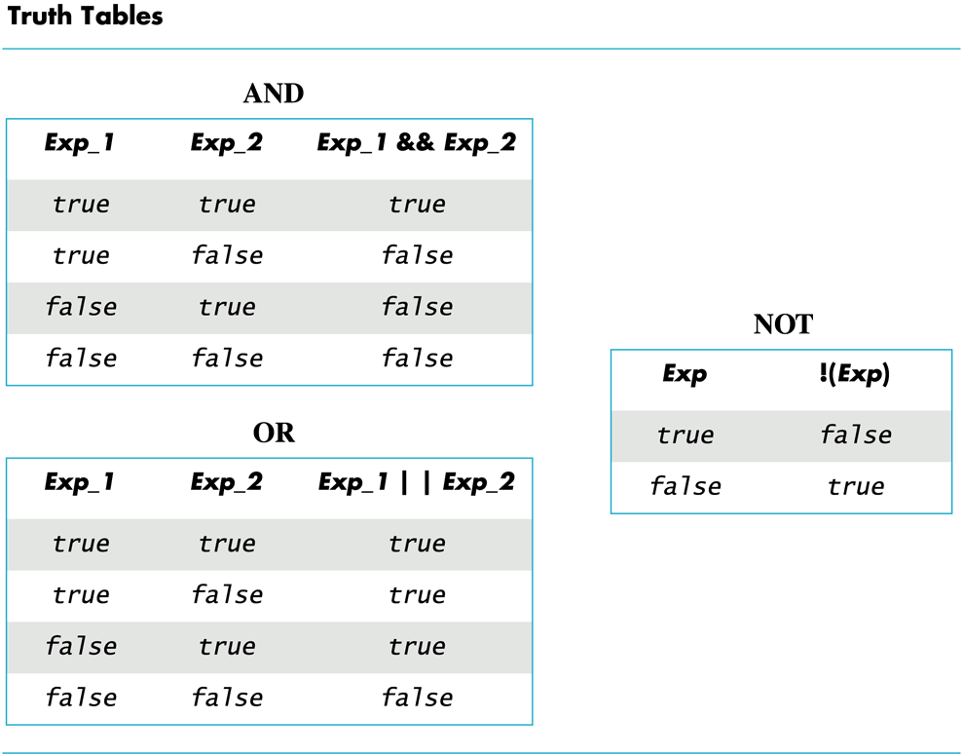
Display 3.1
Back
Next
Slide 3- <number>

Slide 101
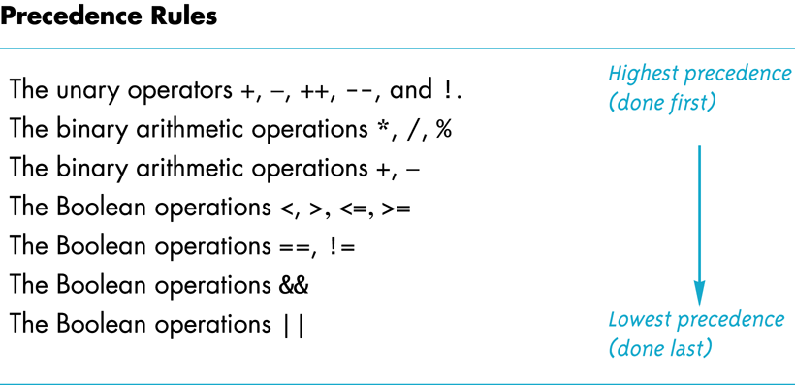
Display 3.2
Back
Next
Slide 3- <number>

Slide 102
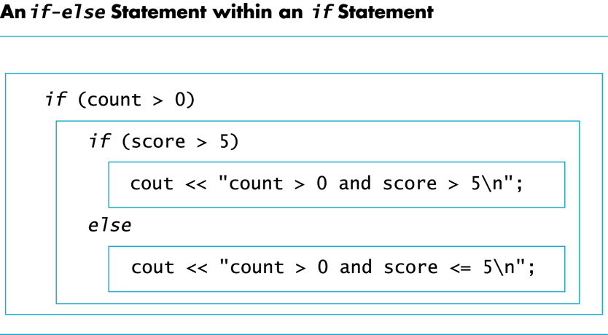
Display 3.3
Back
Next
Slide 3- <number>

Slide 103
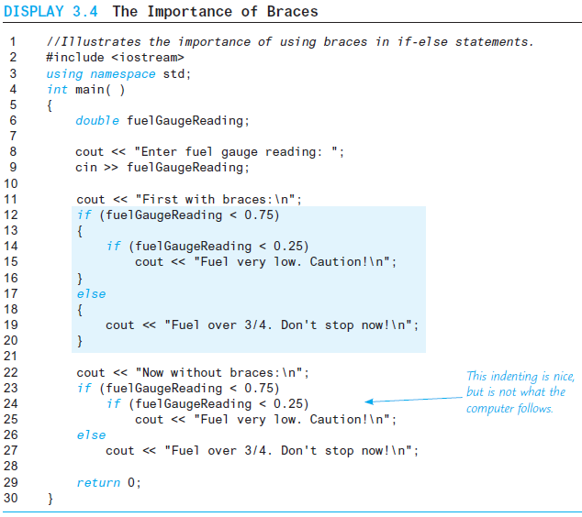
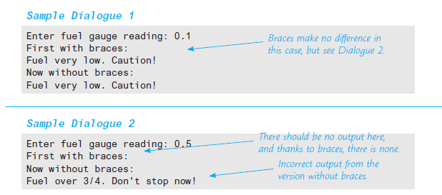
Display 3.4
Back
Next
Slide 3- <number>

Slide 104
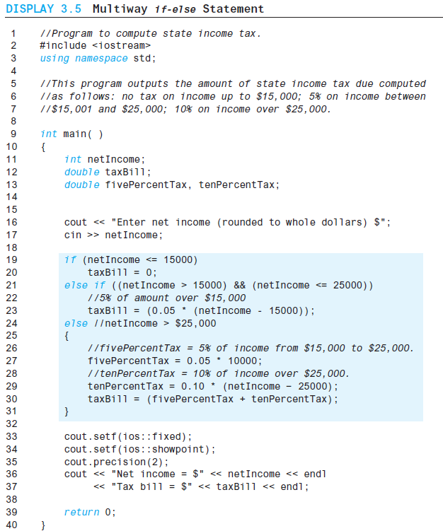
Display 3.5 (1/2)
Back
Next
Slide 3- <number>

Slide 105
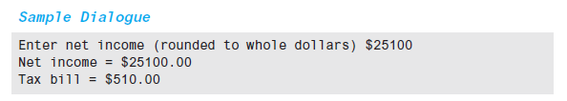
Display 3.5
(2/2)
Back
Next
Slide 3- <number>

Slide 106
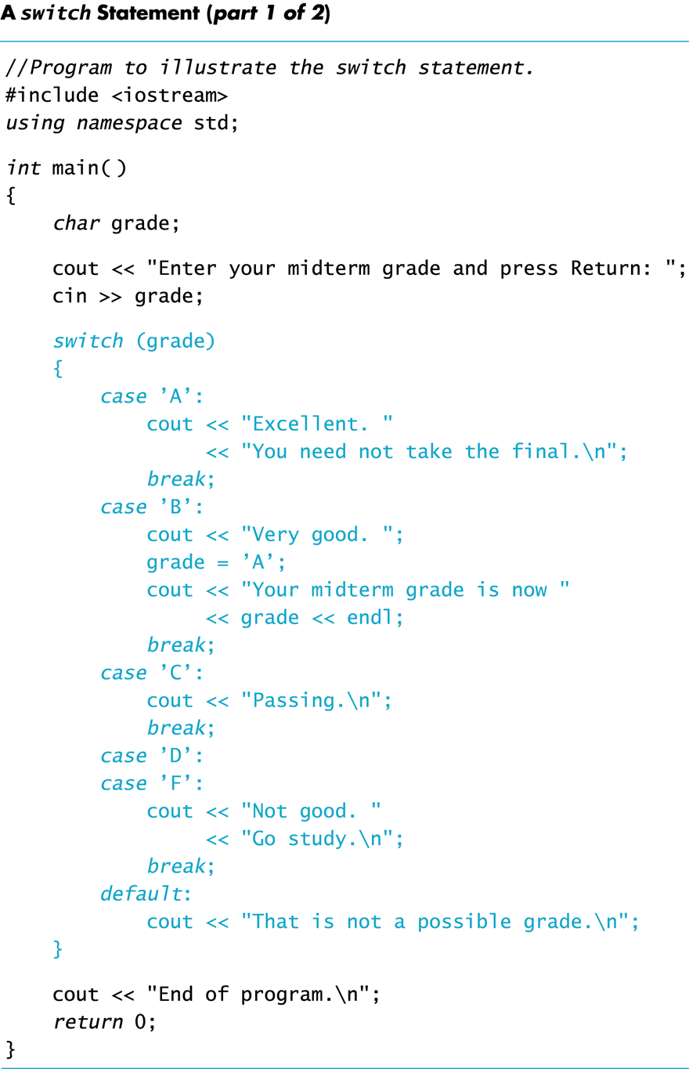
Display 3.6 (1/2)
Back
Next
Slide 3- <number>

Slide 107
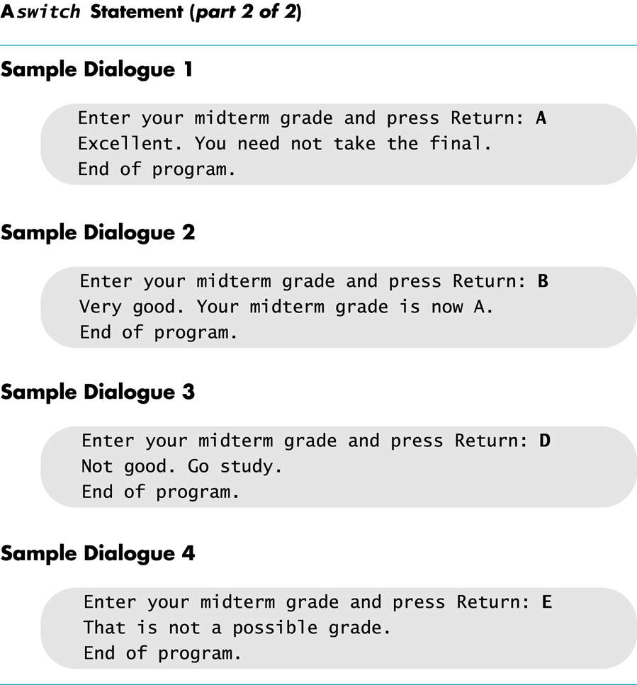
Display 3.6
(2/2)
Back
Next
Slide 3- <number>

Slide 108
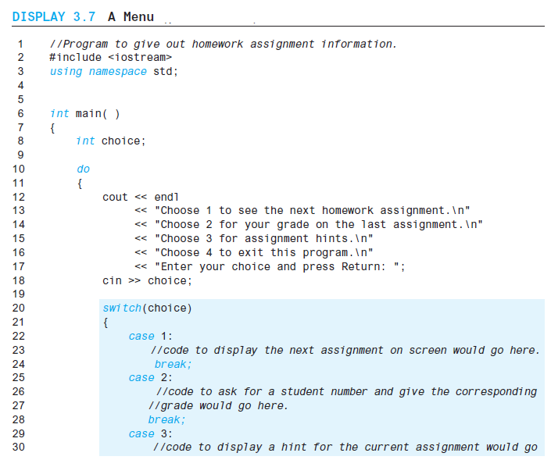
Display 3.7 (1/2)
Back
Next
Slide 3- <number>

Slide 109
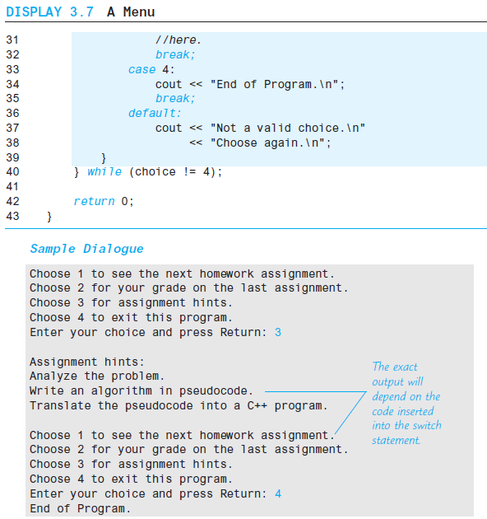
Display 3.7 (2/2)
Back
Next
Slide 3- <number>

Slide 110
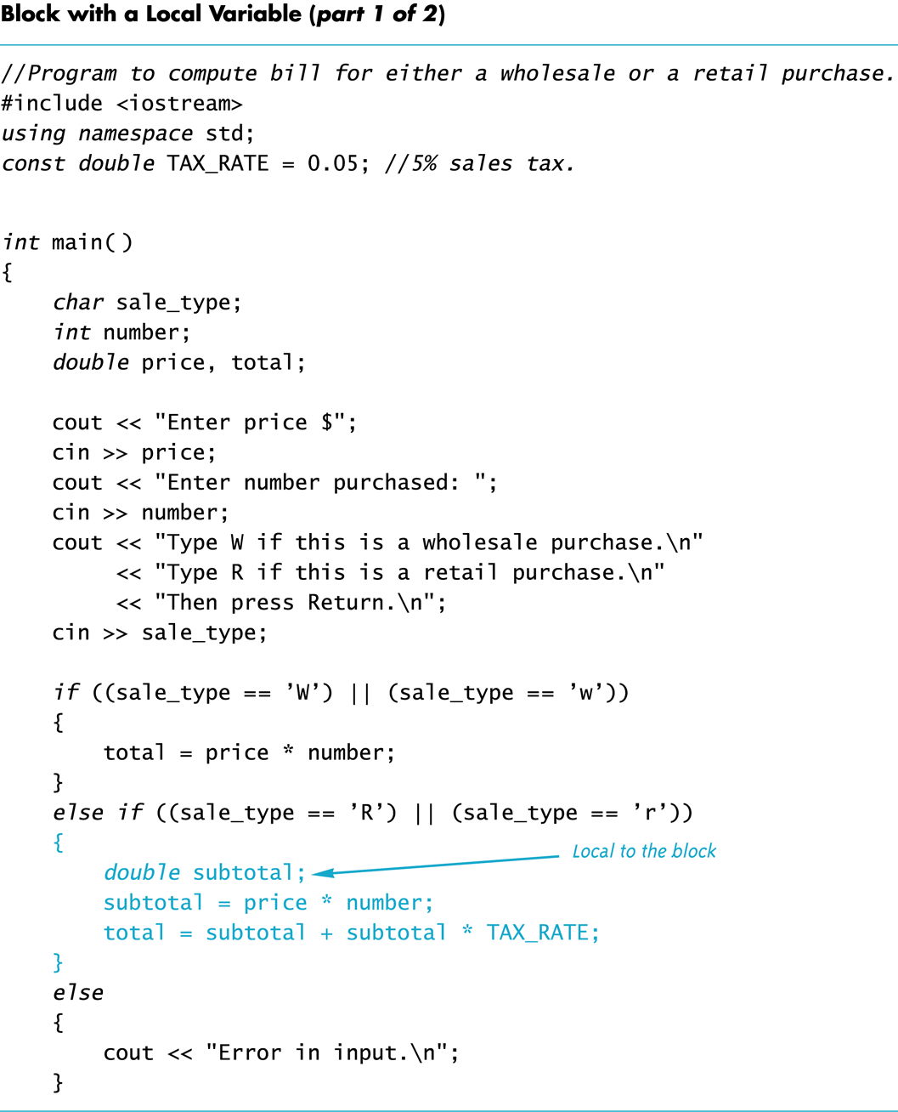
Display 3.8 (1/2)
Back
Next
Slide 3- <number>

Slide 111
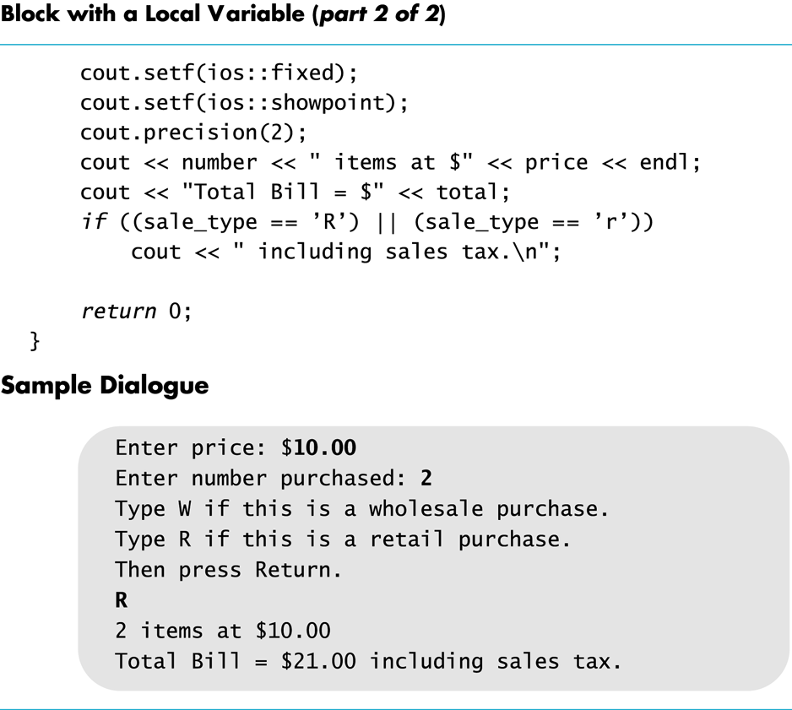
Display 3.8
(2/2)
Back
Next
Slide 3- <number>

Slide 112
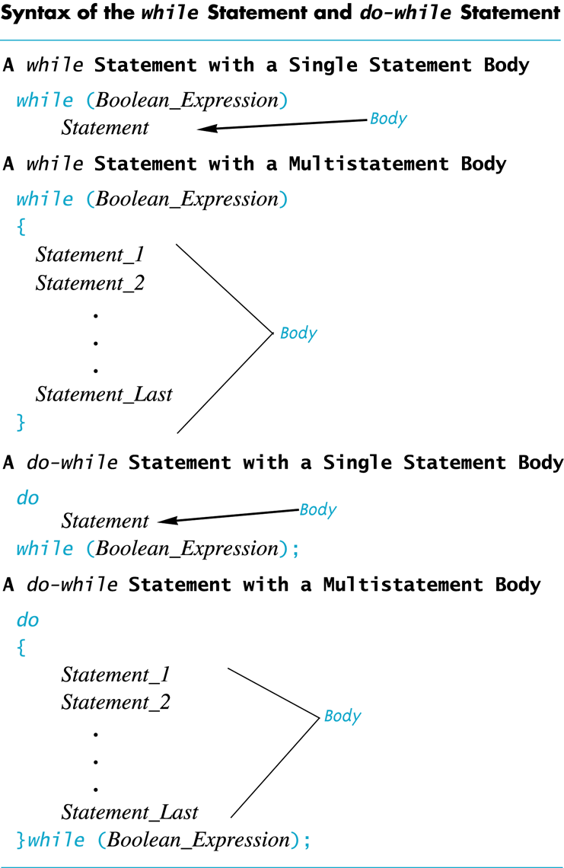
Display 3.9
Back
Next
Slide 3- <number>

Slide 113
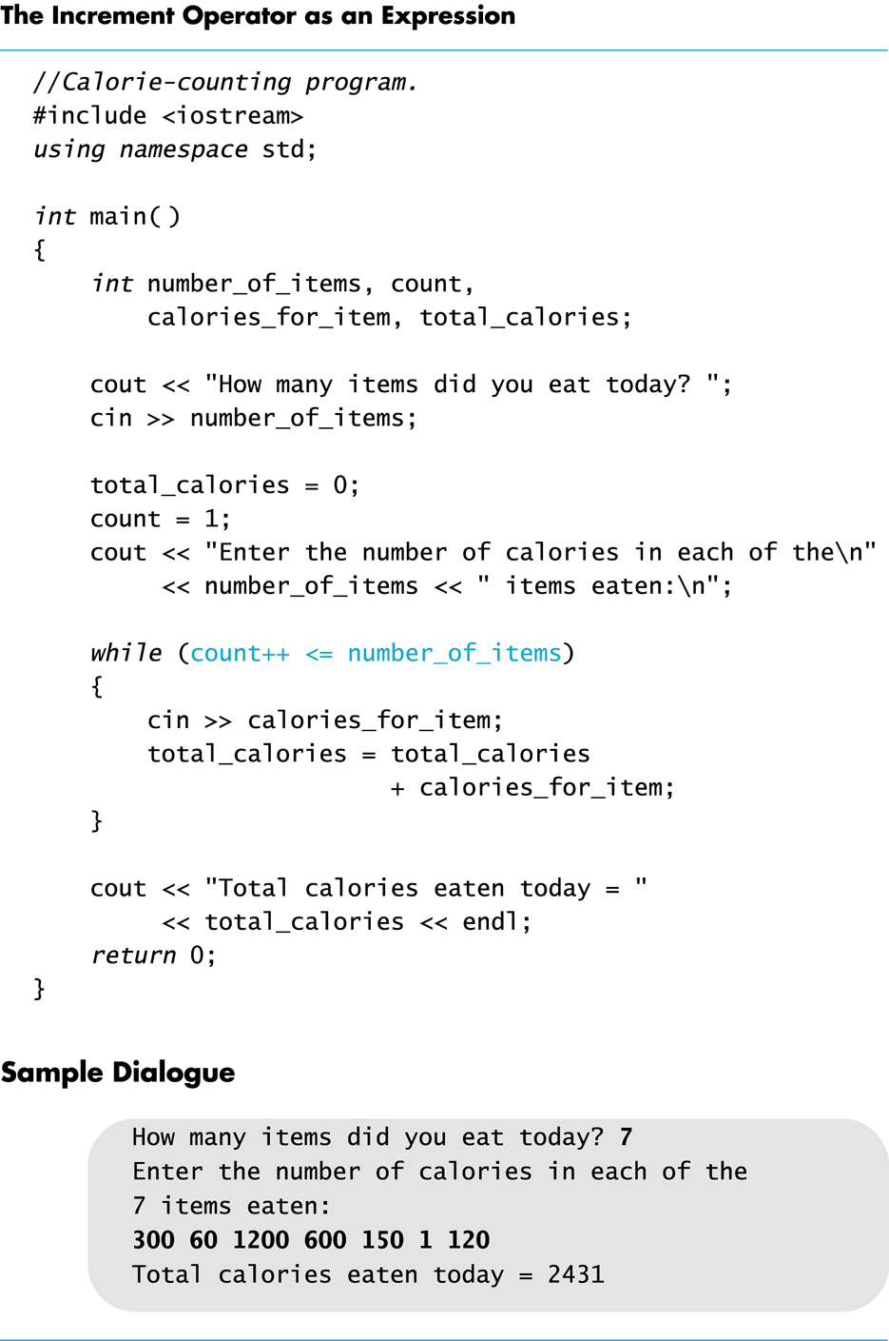
Display 3.10
Back
Next
Slide 3- <number>

Slide 114
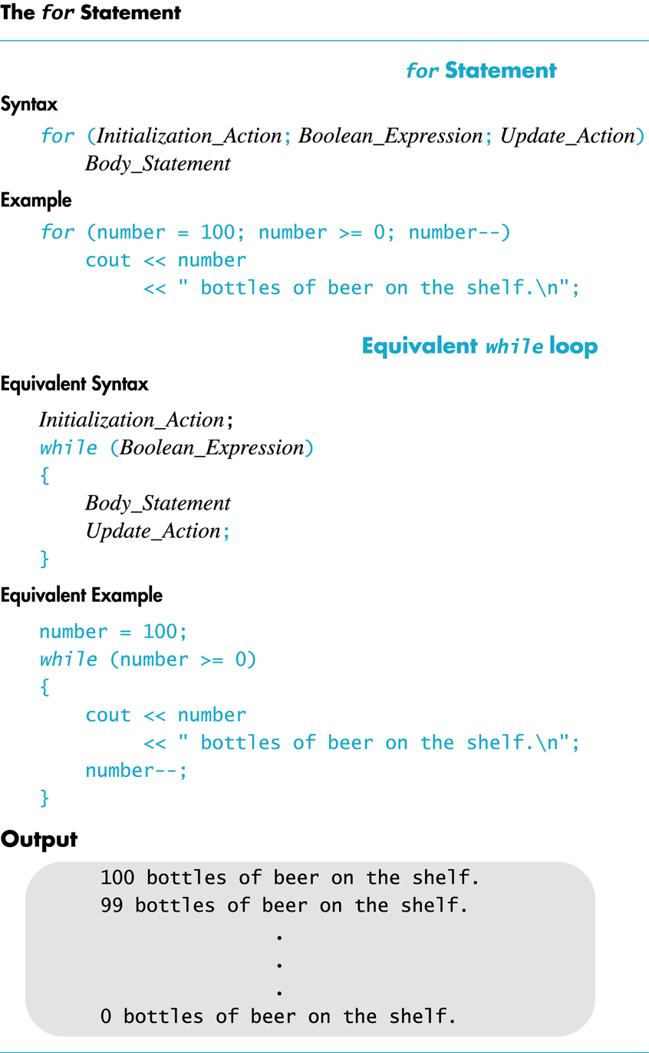
Display 3.11
Back
Next
Slide 3- <number>

Slide 115
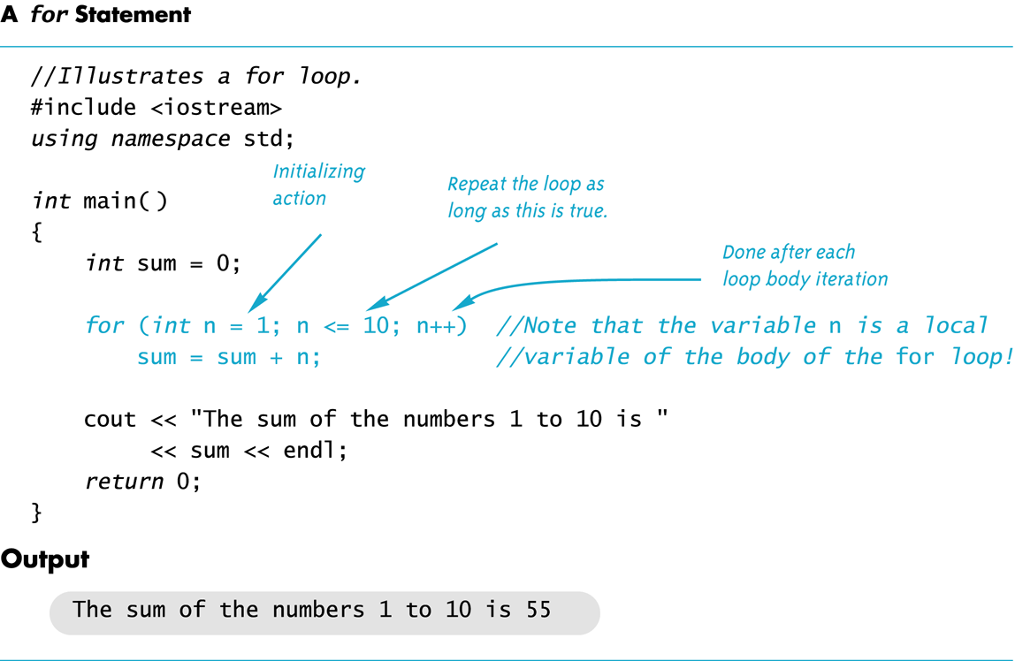
Display 3.12
Back
Next
Slide 3- <number>

Slide 116
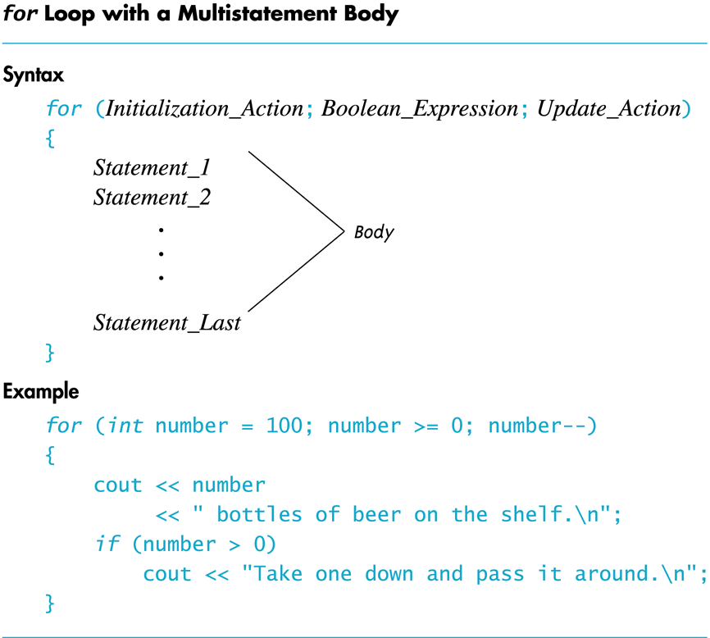
Display 3.13
Back
Next
Slide 3- <number>

Slide 117
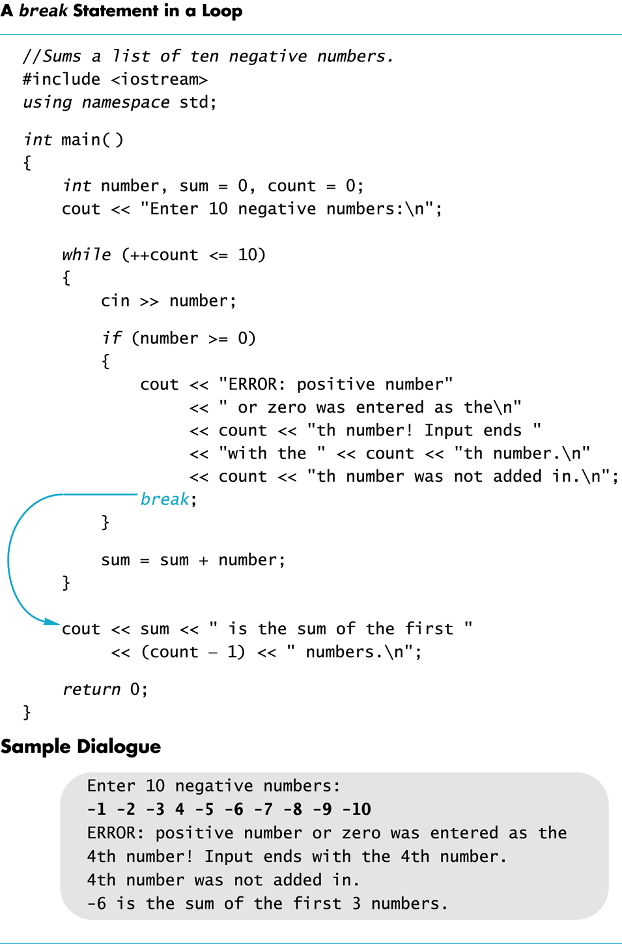
Display 3.14
Back
Next
Slide 3- <number>

Slide 118
Display 3.15
Back
Next
cout << "Enter the number of eggs in each nest.\n"
<< "Place a negative integer at the end of your list.\n";
subtotal = 0;
int next;
cin >> next;
while (next >=0)
{
subtotal = subtotal + next;
cin >> next;
}
cout << "Total egg count for conservationist "
<< " number " << count << " is "
<< subtotal << endl;
grandTotal = grandTotal + subtotal;
}
cout << endl << "Total egg count for all reports = "
<< grandTotal << endl;
return 0;
}
//DISPLAY 3.15 Explicitly Nested Loops
//Determines the total number of green-necked vulture eggs
//counted by all conservationists in the conservation district.
#include <iostream>
using namespace std;
int main()
{
cout << "This program tallies conservationist reports\n"
<< "on the green-necked vulture.\n"
<< "Each conservationist's report consists of\n"
<< "a list of numbers. Each number is the count of\n"
<< "the eggs observed in one "
<< "green-necked vulture nest.\n"
<< "This program then tallies "
<< "the total number of eggs.\n";
int numberOfReports;
cout << "How many conservationist reports are there? ";
cin >> numberOfReports;
int grandTotal = 0, subtotal, count;
for (count = 1; count <= numberOfReports; count++)
{
cout << endl << "Enter the report of "
<< "conservationist number " << count << endl;
Slide 3- <number>

