Slide 1
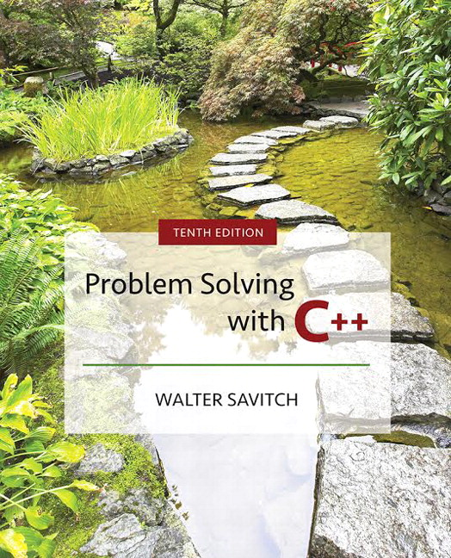

Slide 2
Chapter 5
Functions for All Subtasks

Slide 3
Overview
5.1 void Functions
5.2 Call-By-Reference Parameters
5.3 Using Procedural Abstraction
5.4 Testing and Debugging
5.5 General Debugging Techniques
Slide 5- <number>

Slide 4
5.1
void Functions

Slide 5
void-Functions
In top-down design, a subtask might produce
  No value (just input or output for example)
  One value
  More than one value
We have seen how to implement functions that
return one value
A void-function implements a subtask that
returns no value or more than one value
Slide 5- <number>

Slide 6
void-Function Definition
Two main differences between void-function
definitions and the definitions of functions
that return one value
  Keyword void replaces the type of the value returned
    void means that no value is returned by the function
  The return statement does not include and expression
Example:
void showResults(double f_degrees, double c_degrees)
{
using namespace std;
cout << f_degrees
<< “ degrees Fahrenheit is euivalent to “ << endl
<< c_degrees << “ degrees Celsius.” << endl;
return;
}
Display 5.1
Slide 5- <number>

Slide 7
Using a void-Function
void-function calls are executable statements
  They do not need to be part of another statement
  They end with a semi-colon
Example:
showResults(32.5, 0.3);
NOT: cout << showResults(32.5, 0.3);
Slide 5- <number>

Slide 8
void-Function Calls
Mechanism is nearly the same as the function
calls we have seen
  Argument values are substituted for the formal
  parameters
    It is fairly common to have no parameters in
    void-functions
      In this case there will be no arguments in the function call
  Statements in function body are executed
  Optional return statement ends the function
    Return statement does not include a value to return
    Return statement is implicit if it is not included
Slide 5- <number>

Slide 9
Example:
Converting Temperatures
The functions just developed can be used in a
program to convert Fahrenheit temperatures to
Celcius using the formula
C = (5/9) (F – 32)
  Do you see the integer division problem?
Display 5.2 (1)
Display 5.2 (2)
Slide 5- <number>

Slide 10
void-Functions
Why Use a Return?
Is a return-statement ever needed in a
void-function since no value is returned?
  Yes!
    What if a branch of an if-else statement requires
    that the function ends to avoid producing more
    output, or creating a mathematical error?
    void-function in Display 5.3, avoids division by zero
    with a return statement
Display 5.3
Slide 5- <number>

Slide 11
The Main Function
The main function in a program is used like a
void function…do you have to end the program
with a return-statement?
  Because the main function is defined to return a
  value of type int, the return is needed
  C++ standard says the return 0 can be omitted, but
  many compilers still require it
Slide 5- <number>

Slide 12
Section 5.1 Conclusion
Can you
  Describe the differences between void-functions and functions that return one value?
  Tell what happens if you forget the return-statementin a void-function?
  Distinguish between functions that are used as
  expressions and those used as statements?
Slide 5- <number>

Slide 13
5.2
Call-By-Reference Parameters

Slide 14
Call-by-Reference Parameters
Call-by-value is not adequate when we need
a sub-task to obtain input values
  Call-by-value means that the formal parameters
  receive the values of the arguments
  To obtain input values, we need to change the
  variables that are arguments to the function
    Recall that we have changed the values of
    formal parameters in a function body, but we have not
    changed the arguments found in the function call
Call-by-reference parameters allow us to change
the variable used in the function call
  Arguments for call-by-reference parameters must be
  variables, not numbers
Slide 5- <number>

Slide 15
Call-by-Reference Example
void getInput(double& fVariable)
{
using namespace std;
cout << “ Convert a Fahrenheit temperature”
<< “ to Celsius.\n”
<< “ Enter a temperature in Fahrenheit: “;
cin >> fVariable;
}
‘&’ symbol (ampersand) identifies fVariable as a
call-by-reference parameter
  Used in both declaration and definition!
Display 5.4
Slide 5- <number>

Slide 16
Call-By-Reference Details
Call-by-reference works almost as if the
argument variable is substituted for the formal
parameter, not the argument’s value
In reality, the memory location of the argument
variable is given to the formal parameter
  Whatever is done to a formal parameter in the
  function body, is actually done to the value at the
  memory location of the argument variable
Display 5.5 (1)
Display 5.5 (2)
Slide 5- <number>

Slide 17
Call Comparisons
Call By Reference vs Value
Call-by-value
  The function call:
  f(age);
  void f(int var_par);
Call-by-reference
  The function call:
  f(age);
  void f(int& ref_par);
Memory
Name | Location | Contents
age | 1001 | 34
initial | 1002 | A
hours | 1003 | 23.5
 | 1004
Slide 5- <number>

Slide 18
Example: swapValues
void swap(int& variable1, int& variable2)
{
int temp = variable1;
variable1 = variable2;
variable2 = temp;
}
If called with swap(firstNum, secondNum);
  firstNum is substituted for variable1 in the parameter list
  secondNum is substituted for variable2 in the parameter list
  temp is assigned the value of variable1 (firstNum) since the
  next line will loose the value in firstNum
  variable1 (firstNum) is assigned the value in variable2 (secondNum)
  variable2 (secondNum) is assigned the original value of
  variable1 (firstNum) which was stored in temp
Slide 5- <number>

Slide 19
Mixed Parameter Lists
Call-by-value and call-by-reference parameters
can be mixed in the same function
Example:
void goodStuff(int& par1, int par2, double& par3);
  par1 and par3 are call-by-reference formal parameters
    Changes in par1 and par3 change the argument variable
  par2 is a call-by-value formal parameter
    Changes in par2 do not change the argument variable
Slide 5- <number>

Slide 20
Choosing Parameter Types
How do you decide whether a call-by-reference
or call-by-value formal parameter is needed?
  Does the function need to change the value of the
  variable used as an argument?
  Yes? Use a call-by-reference formal parameter
  No? Use a call-by-value formal parameter
Display 5.6
Slide 5- <number>

Slide 21
Inadvertent Local Variables
If a function is to change the value of a variable
the corresponding formal parameter must be a
call-by-reference parameter with an ampersand
(&) attached
Forgetting the ampersand (&) creates a
call-by-value parameter
  The value of the variable will not be changed
  The formal parameter is a local variable that has no
  effect outside the function
  Hard error to find…it looks right!
Display 5.7
Slide 5- <number>

Slide 22
Section 5.2 Conclusion
Can you
  Write a void-function definition for a function called
  zeroBoth that has two reference parameters, both
  of which are variables of type int, and sets the values
  of both variables to 0.
  Write a function that returns a value and has a
  call-by-reference parameter?
  Write a function with both call-by-value and
  call-by-reference parameters
Slide 5- <number>

Slide 23
5.3
Using Procedural Abstraction

Slide 24
Using Procedural Abstraction
Functions should be designed so they can be used as black boxes
To use a function, the declaration and comment
should be sufficient
Programmer should not need to know the
details of the function to use it
Slide 5- <number>

Slide 25
Functions Calling Functions
A function body may contain a call to another
function
  The called function declaration must still appear
  before it is called
    Functions cannot be defined in the body of another function
  Example: void order(int& n1, int& n2)
  {
  if (n1 > n2)
  swapValues(n1, n2);
  }
    swapValues called if n1 and n2
    are not in ascending order
    After the call to order, n1 and
    n2 are in ascending order
Display 5.8 (1)
Display 5.8 (2)
Slide 5- <number>

Slide 26
Pre and Postconditions
Precondition
  States what is assumed to be true when the function
  is called
    Function should not be used unless the precondition holds
Postcondition
  Describes the effect of the function call
  Tells what will be true after the function is executed
  (when the precondition holds)
  If the function returns a value, that value is described
  Changes to call-by-reference parameters are described
Slide 5- <number>

Slide 27
swapValues revisited
Using preconditions and postconditions the
declaration of swapValues becomes:
void swapValues(int& n1, int& n2);
//Precondition: variable1 and variable 2 have
// been given values
// Postcondition: The values of variable1 and
// variable2 have been
// interchanged
Slide 5- <number>

Slide 28
Function celsius
Preconditions and postconditions make the
declaration for celsius:
double celsius(double farenheit);
//Precondition: fahrenheit is a temperature
// expressed in degrees Fahrenheit
//Postcondition: Returns the equivalent temperature
// expressed in degrees Celsius
Slide 5- <number>

Slide 29
Why use preconditions and postconditions?
Preconditions and postconditions
  should be the first step in designing a function
  specify what a function should do
    Always specify what a function should do before
    designing how the function will do it
  Minimize design errors
  Minimize time wasted writing code that doesn’t
  match the task at hand
Slide 5- <number>

Slide 30
Case Study
Supermarket Pricing
Problem definition
  Determine retail price of an item given suitable input
  5% markup if item should sell in a week
  10% markup if item expected to take more than a
  week
    5% for up to 7 days, changes to 10% at 8 days
  Input
    The wholesale price and the estimate of days until item sells
  Output
    The retail price of the item
Slide 5- <number>

Slide 31
Supermarket Pricing:
Problem Analysis
Three main subtasks
  Input the data
  Compute the retail price of the item
  Output the results
Each task can be implemented with a function
  Notice the use of call-by-value and
  call-by-reference parameters in the following function declarations
Slide 5- <number>

Slide 32
Supermarket Pricing:
Function getInput
void getInput(double& cost, int& turnover);
//Precondition: User is ready to enter values
// correctly.
//Postcondition: The value of cost has been set to
// the wholesale cost of one item.
// The value of turnover has been
// set to the expected number of
// days until the item is sold.
Slide 5- <number>

Slide 33
Supermarket Pricing:
Function price
double price(double cost, int turnover);
//Precondition: cost is the wholesale cost of one
// item. turnover is the expected
// number of days until the item is
// sold.
//Postcondition: returns the retail price of the item
Slide 5- <number>

Slide 34
Supermarket Pricing:
Function giveOutput
void giveOutput(double cost, int turnover, double price);
//Precondition: cost is the wholesale cost of one item;
// turnover is the expected time until sale
// of the item; price is the retail price of
// the item.
//Postcondition: The values of cost, turnover, and price
// been written to the screen.
Slide 5- <number>

Slide 35
Supermarket Pricing:
The main function
With the functions declared, we can write the
main function:
int main()
{
double wholesaleCost, retailPrice;
int shelftime;
getInput(wholesaleCost, shelftime);
retailPrice = price(wholesaleCost, shelftime);
giveOutput(wholesaleCost, shelftime, retailPrice);
return 0;
}
Slide 5- <number>

Slide 36
Supermarket Pricing:
Algorithm Design -- price
Implementations of getInput and giveOutput
are straightforward, so we concentrate on
the price function
pseudocode for the price function
  If turnover <= 7 days then
  return (cost + 5% of cost);
  else
  return (cost + 10% of cost);
Slide 5- <number>

Slide 37
Supermarket Pricing:
Constants for The price Function
The numeric values in the pseudocode will be
represented by constants
  Const double LOW_MARKUP = 0.05; // 5%
  Const double HIGH_MARKUP = 0.10; // 10%
  Const int THRESHOLD = 7; // At 8 days use
  //HIGH_MARKUP
Slide 5- <number>

Slide 38
Supermarket Pricing:
Coding The price Function
The body of the price function
  {
  if (turnover <= THRESHOLD)
  return ( cost + (LOW_MARKUP * cost) ) ;
  else
  return ( cost + ( HIGH_MARKUP * cost) ) ;
  }
See the complete program in
Display 5.9 (1)
Display 5.9 (2)
Display 5.9 (3)
Slide 5- <number>

Slide 39
Supermarket Pricing :
Program Testing
Testing strategies
  Use data that tests both the high and low markup cases
  Test boundary conditions, where the program is expected
  to change behavior or make a choice
    In function price, 7 days is a boundary condition
    Test for exactly 7 days as well as one day more and one day less
Slide 5- <number>

Slide 40
Section 5.3 Conclusion
Can you
  Define a function in the body of another function?
  Call one function from the body of another function?
  Give preconditions and postconditions for the
  predefined function sqrt?
Slide 5- <number>

Slide 41
5.4
Testing and Debugging

Slide 42
Testing and Debugging Functions
Each function should be tested as a separate unit
Testing individual functions facilitates finding
mistakes
Driver programs allow testing of individual
functions
Once a function is tested, it can be used in the
driver program to test other functions
Function getInput is tested in the driver program
of and
Display 5.10 (1)
Display 5.10 (2)
Slide 5- <number>

Slide 43
Stubs
When a function being tested calls other functions
that are not yet tested, use a stub
A stub is a simplified version of a function
  Stubs are usually provide values for testing rather
  than perform the intended calculation
  Stubs should be so simple that you have confidence
  they will perform correctly
  Function price is used as a stub to test the rest of
  the supermarket pricing program in
  and
Display 5.11 (1)
Display 5.11 (2)
Slide 5- <number>

Slide 44
Rule for Testing Functions
Fundamental Rule for Testing Functions
  Test every function in a program in which every other function in that program has already been fully tested and debugged.
Slide 5- <number>

Slide 45
Section 5.4 Conclusion
Can you
  Describe the fundamental rule for testing functions?
  Describe a driver program?
  Write a driver program to test a function?
  Describe and use a stub?
  Write a stub?
Slide 5- <number>

Slide 46
5.5
General Debugging Techniques

Slide 47
General Debugging Techniques
Stubs, drivers, test cases as described in the previous section
Keep an open mind
  Don’t assume the bug is in a particular location
Don’t randomly change code without understanding what you are doing until the program works
  This strategy may work for the first few small programs you write but is doomed to failure for any programs of moderate complexity
Show the program to someone else
Slide 5- <number>

Slide 48
General Debugging Techniques
Check for common errors, e.g.
  Local vs. Reference Parameter
  = instead of ==
Localize the error
  This temperature conversion program has a bug
  Narrow down bug using cout statements
Display 5.12
Display 5.13
Slide 1- <number>

Slide 49
General Debugging Techniques
Use a debugger
  Tool typically integrated with a development environment that allows you to stop and step through a program line-by-line while inspecting variables
The assert macro
  Can be used to test pre or post conditions
  #include <cassert>
  assert(boolean expression)
  If the boolean is false then the program will abort
Slide 5- <number>

Slide 50
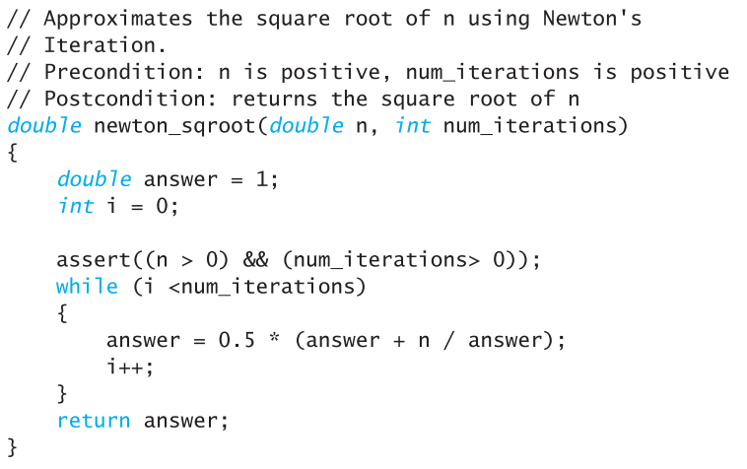
Assert Example
Denominator should not be zero in Newton’s Method
Slide 5- <number>

Slide 51
Section 5.5 Conclusion
Can you
  Recognize common errors?
  Use the assert macro?
  Debug a program using cout statements to localize the error?
  Debug a program using a debugger?
Slide 5- <number>

Slide 52
Chapter 5 -- End
Slide 5- <number>

Slide 53
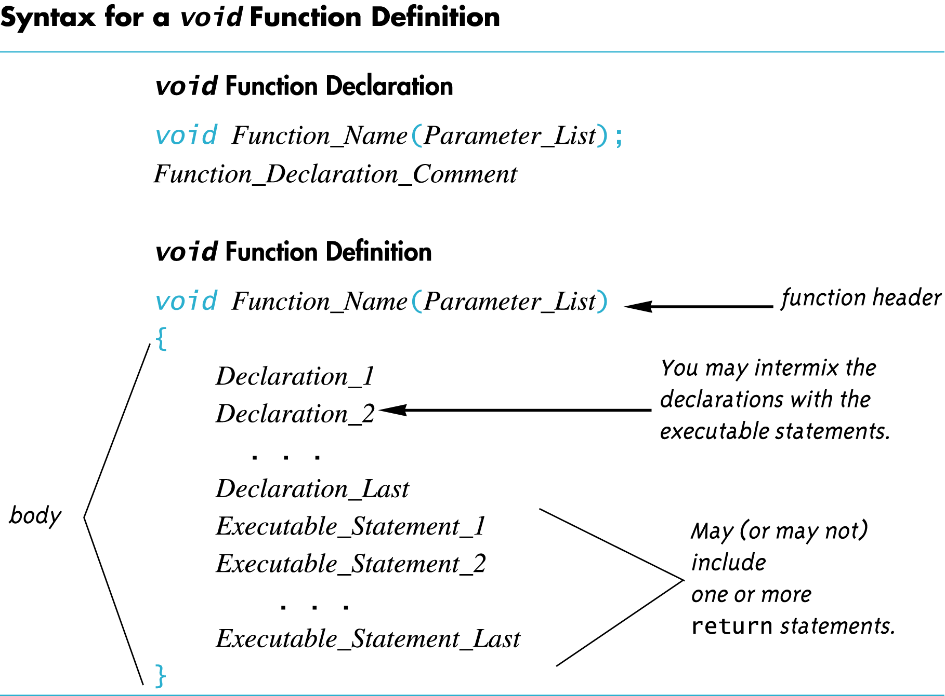
Display 5.1
Back
Next
Slide 5- <number>

Slide 54
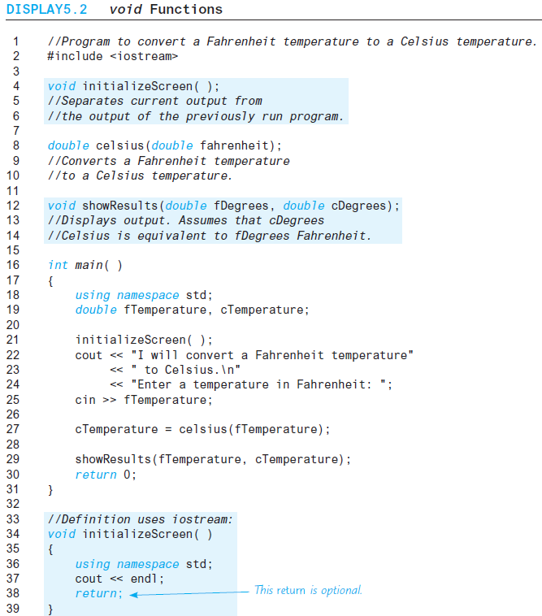
Display 5.2 (1/2)
Back
Next
Slide 5- <number>

Slide 55
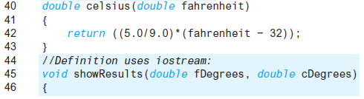
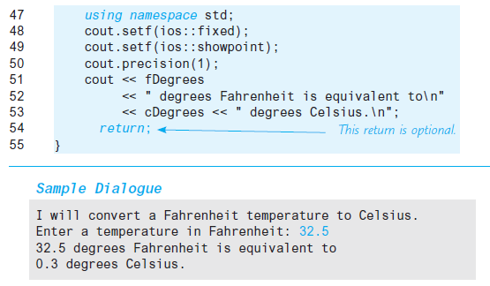
Display 5.2
(2/2)
Back
Next
Slide 5- <number>

Slide 56
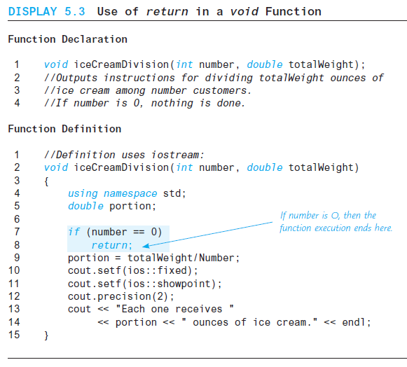
Display 5.3
Back
Next
Slide 5- <number>

Slide 57
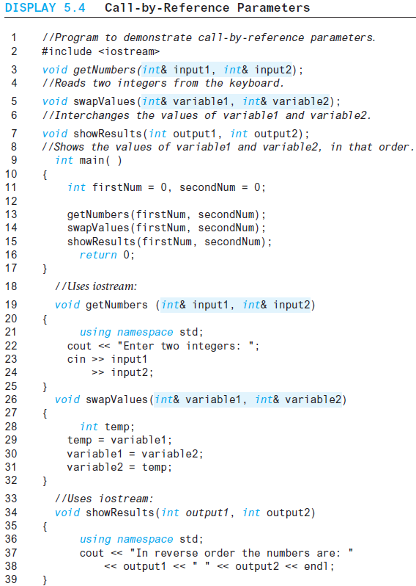

Display 5.4
Back
Next
Slide 5- <number>

Slide 58
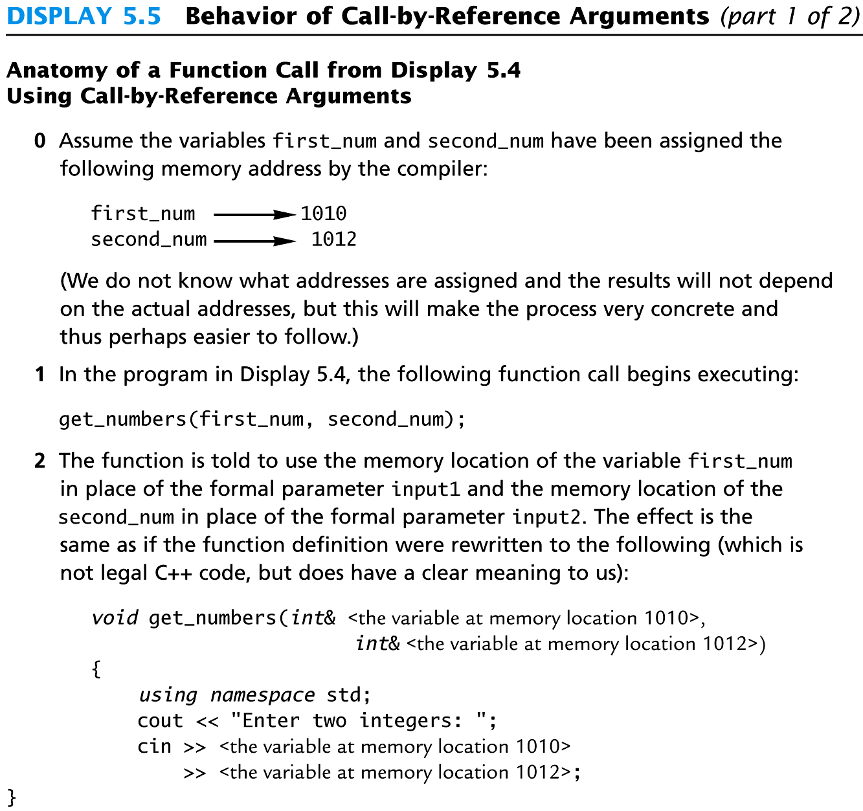
Display 5.5
(1/2)
Back
Next
Slide 5- <number>

Slide 59
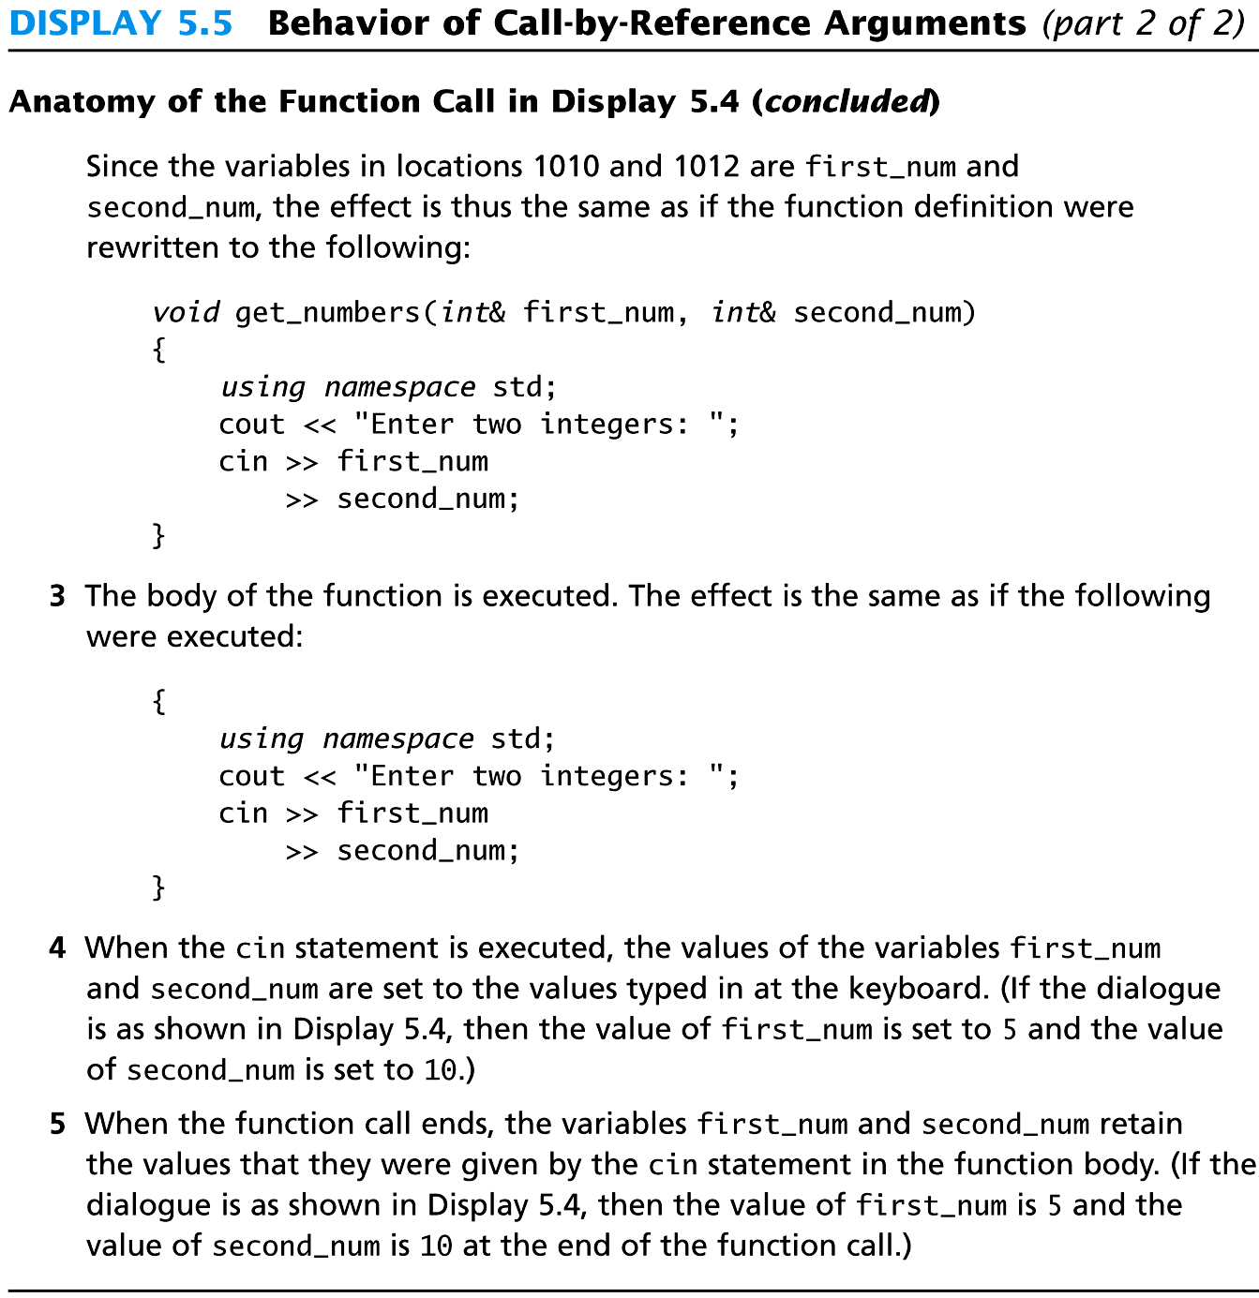
Display 5.5
(2/2)
Back
Next
Slide 5- <number>

Slide 60
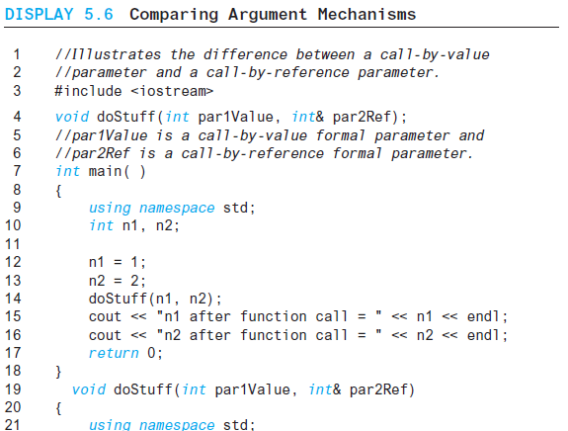
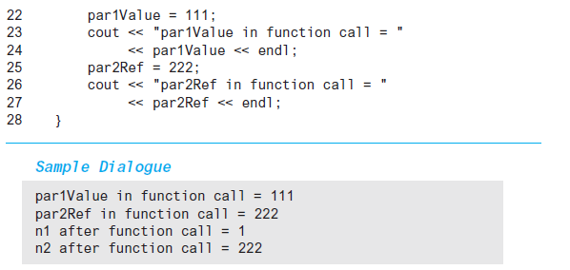
Display 5.6
Back
Next
Slide 5- <number>

Slide 61
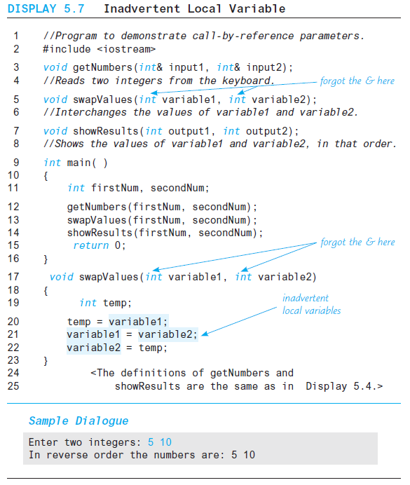
Display 5.7
Back
Next
Slide 5- <number>

Slide 62
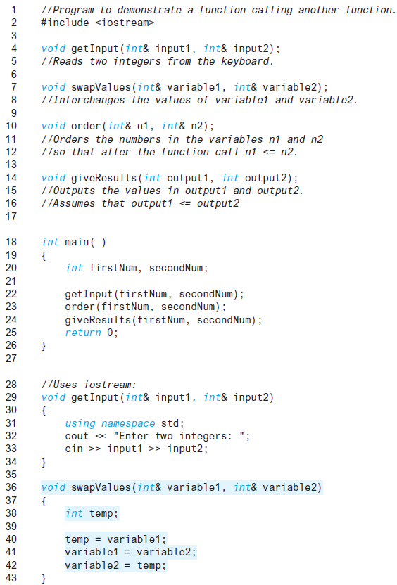
Display 5.8 (1/2)
Back
Next
Slide 5- <number>

Slide 63
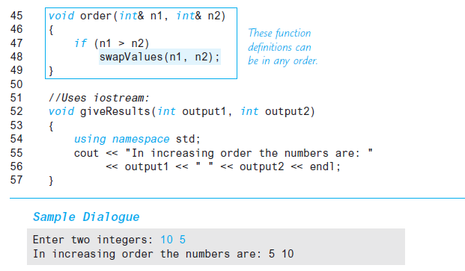
Display 5.8
(2/2)
Back
Next
Slide 5- <number>

Slide 64
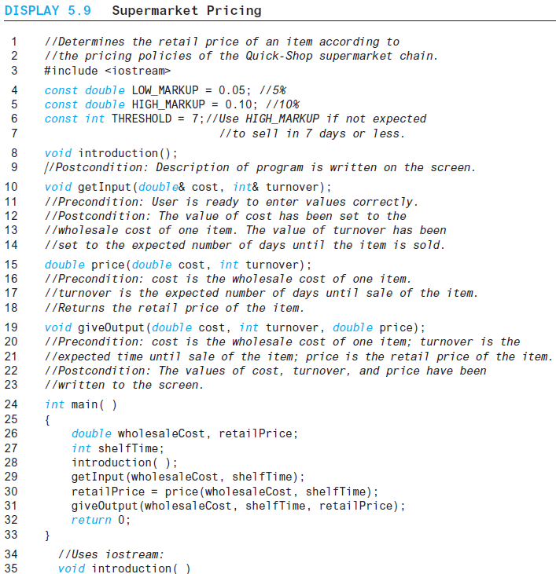
Display 5.9 (1/3)
Back
Next
Slide 5- <number>

Slide 65
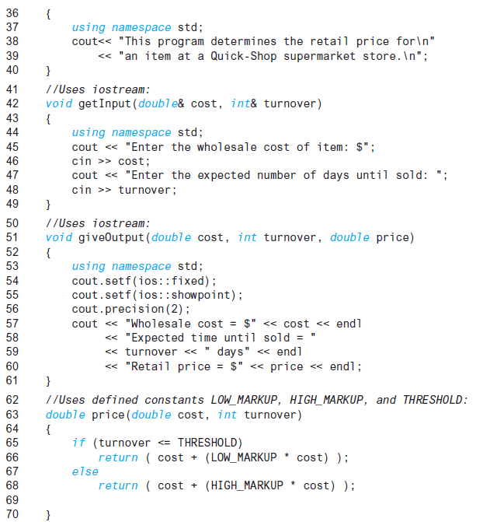
Display 5.9 (2/3)
Back
Next
Slide 5- <number>

Slide 66
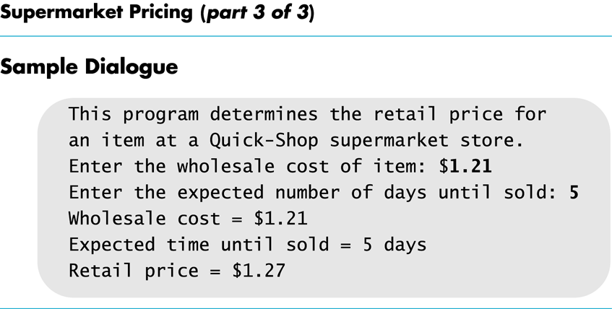
Display 5.9
(3/3)
Back
Next
Slide 5- <number>

Slide 67
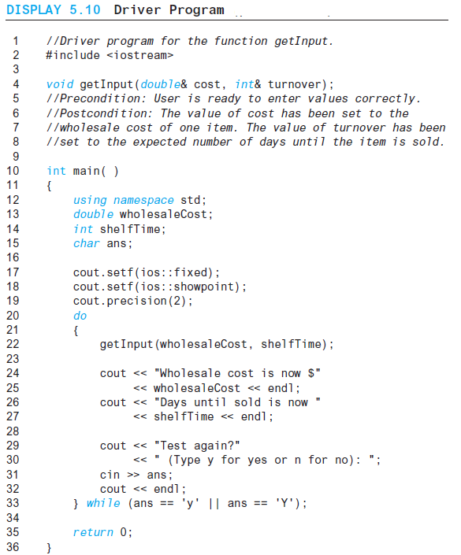
Display 5.10 (1/2)
Back
Next
Slide 5- <number>

Slide 68
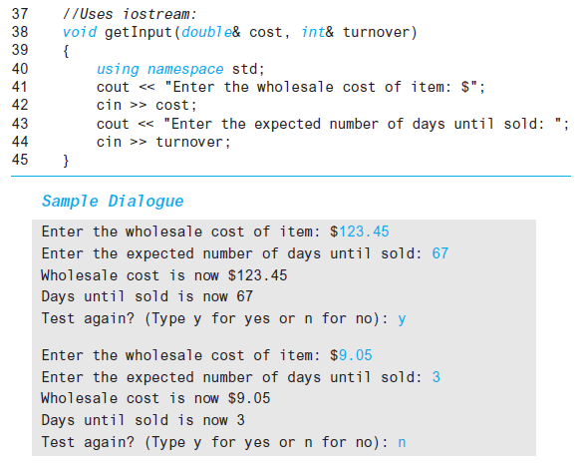
Display 5.10
(2/2)
Back
Next
Slide 5- <number>

Slide 69
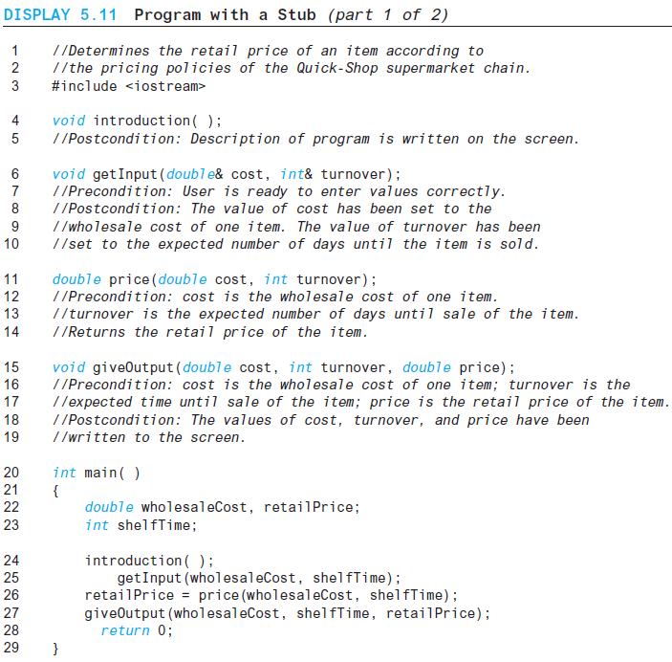
Display 5.11 (1/2)
Back
Next
Slide 5- <number>

Slide 70
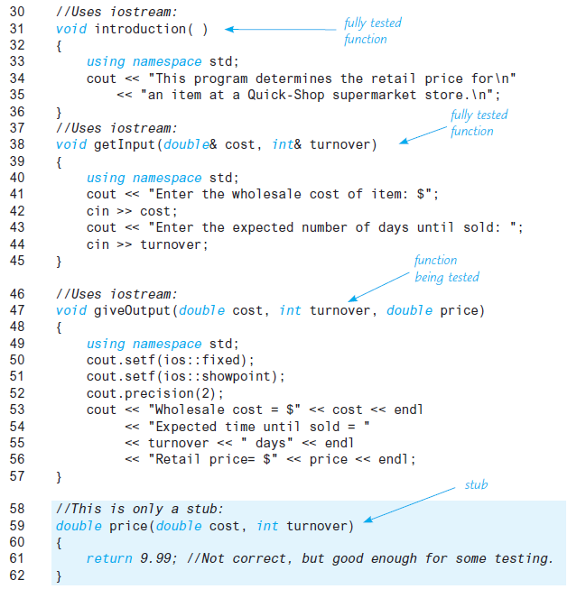
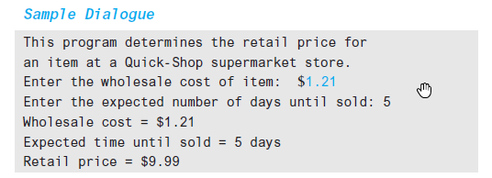
Display 5.11 (2/2)
Back
Next
Slide 5- <number>

Slide 71
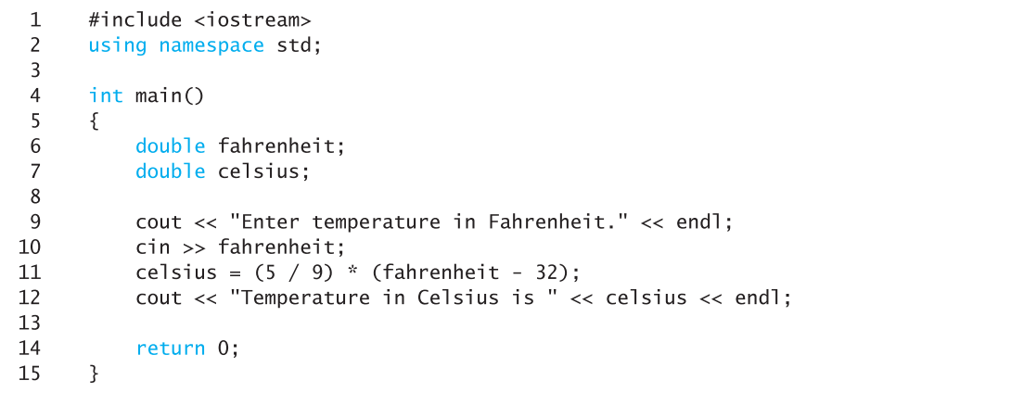
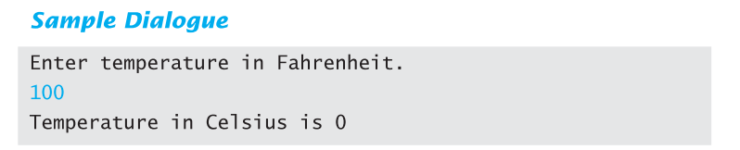
Display 5.12
Back
Next
Slide 5- <number>

Slide 72
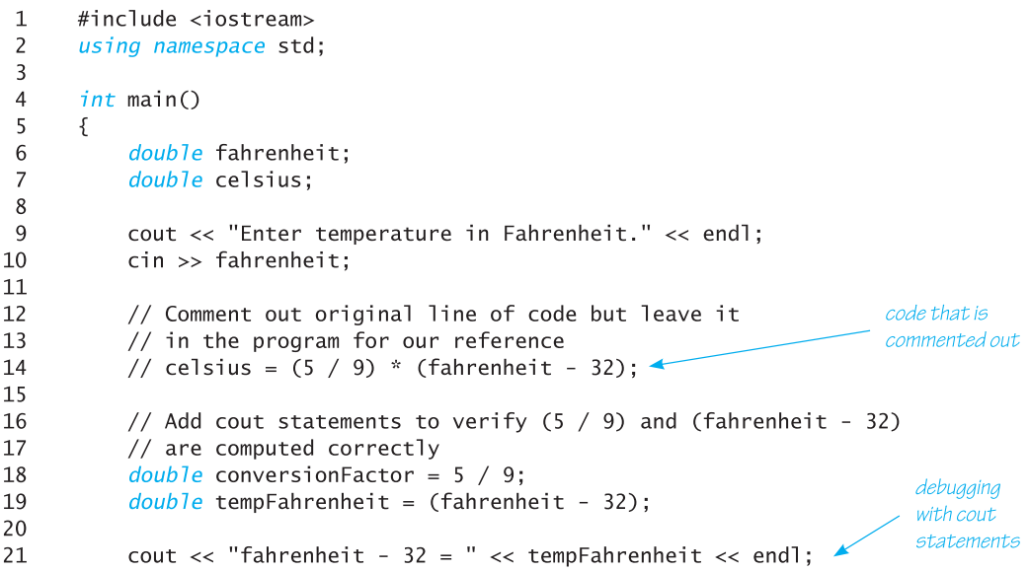
Display 5.13 (1 of 2)
Back
Next
Slide 5- <number>

Slide 73
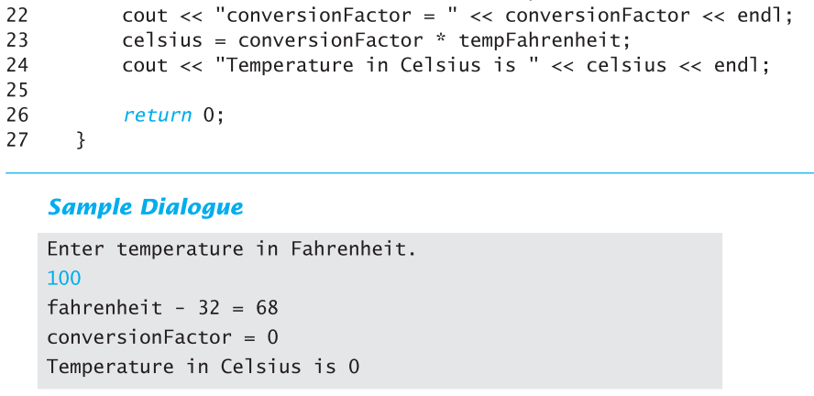
Display 5.13 (2 of 2)
Back
Next
Slide 5- <number>

