Slide 1
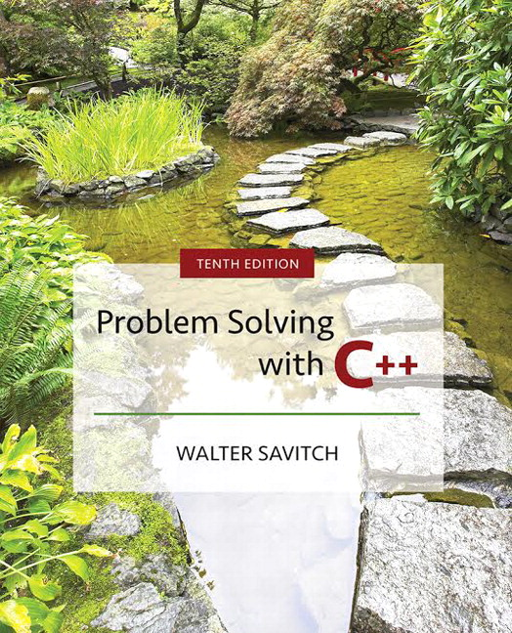

Slide 2
Chapter 6
I/O Streams as an Introduction to Objects and Classes

Slide 3
Overview
6.1 Streams and Basic File I/O
6.2 Tools for Stream I/O
6.3 Character I/O
Slide 6- <number>

Slide 4
6.1
Streams and Basic File I/O

Slide 5
I/O Streams
I/O refers to program input and output
  Input is delivered to your program via a stream object
  Input can be from
    The keyboard
    A file
  Output is delivered to the output device via a stream
  object
  Output can be to
    The screen
    A file
Slide 6- <number>

Slide 6
Objects
Objects are special variables that
  Have their own special-purpose functions
  Set C++ apart from earlier programming languages
Slide 6- <number>

Slide 7
Streams and Basic File I/O
Files for I/O are the same type of files used to
store programs
A stream is a flow of data.
  Input stream: Data flows into the program
    If input stream flows from keyboard, the program will
    accept data from the keyboard
    If input stream flows from a file, the program will accept
    data from the file
  Output stream: Data flows out of the program
    To the screen
    To a file
Slide 6- <number>

Slide 8
cin And cout Streams
cin
  Input stream connected to the keyboard
cout
  Output stream connected to the screen
cin and cout defined in the iostream library
  Use include directive: #include <iostream>
You can declare your own streams to use with
files.
Slide 6- <number>

Slide 9
Why Use Files?
Files allow you to store data permanently!
Data output to a file lasts after the program ends
An input file can be used over and over
  No typing of data again and again for testing
Create a data file or read an output file at your
convenience
Files allow you to deal with larger data sets
Slide 6- <number>

Slide 10
File I/O
Reading from a file
  Taking input from a file
  Done from beginning to the end (for now)
    No backing up to read something again (OK to start over)
    Just as done from the keyboard
Writing to a file
  Sending output to a file
  Done from beginning to end (for now)
    No backing up to write something again( OK to start over)
    Just as done to the screen
Slide 6- <number>

Slide 11
Stream Variables
Like other variables, a stream variable…
  Must be declared before it can be used
  Must be initialized before it contains valid data
    Initializing a stream means connecting it to a file
    The value of the stream variable can be thought of
    as the file it is connected to
  Can have its value changed
    Changing a stream value means disconnecting from one file and connecting to another
Slide 6- <number>

Slide 12
Streams and Assignment
A stream is a special kind of variable called
an object
  Objects can use special functions to complete tasks
Streams use special functions instead of the
assignment operator to change values
Slide 6- <number>

Slide 13
Declaring An
Input-file Stream Variable
Input-file streams are of type ifstream
Type ifstream is defined in the fstream library
  You must use the include and using directives
  #include <fstream>
  using namespace std;
Declare an input-file stream variable using
ifstream inStream;
Slide 6- <number>

Slide 14
Declaring An
Output-file Stream Variable
Ouput-file streams of are type ofstream
Type ofstream is defined in the fstream library
  You must use these include and using directives
  #include <fstream>
  using namespace std;
Declare an input-file stream variable using
ofstream outStream;
Slide 6- <number>

Slide 15
Connecting To A File
Once a stream variable is declared, connect it to
a file
  Connecting a stream to a file is opening the file
  Use the open function of the stream object
  inStream.open("infile.dat");
Double quotes
Period
File name on the disk
Slide 6- <number>

Slide 16
Using The Input Stream
Once connected to a file, the input-stream
variable can be used to produce input just as
you would use cin with the extraction operator
  Example:
  int oneNumber, anotherNumber;
  inStream >> oneNumber
  >> anotherNumber;
Slide 6- <number>

Slide 17
Using The Output Stream
An output-stream works similarly to the
input-stream
  ofstream outStream;
  outStream.open("outfile.dat");
  outStream << "one number = "
  << oneNumber
  << "another number = "
  << anotherNumber;
Slide 6- <number>

Slide 18
External File Names
An External File Name…
  Is the name for a file that the operating system uses
    infile.dat and outfile.dat used in the previous examples
  Is the "real", on-the-disk, name for a file
  Needs to match the naming conventions on
  your system
  Usually only used in the stream's open statement
  Once open, referred to using the
  name of the stream connected to it.
Slide 6- <number>

Slide 19
Closing a File
After using a file, it should be closed
  This disconnects the stream from the file
  Close files to reduce the chance of a file being
  corrupted if the program terminates abnormally
It is important to close an output file if your
program later needs to read input from the output file
The system will automatically close files if you
forget as long as your program ends normally
Display 6.1
Slide 6- <number>

Slide 20
Objects
An object is a variable that has functions and
data associated with it
  inStream and outStream each have a function named open associated with them
  inStream and outStream use different
  versions of a function named open
    One version of open is for input files
    A different version of open is for output files
Slide 6- <number>

Slide 21
Member Functions
A member function is a function associated with
an object
  The open function is a member function of
  inStream in the previous examples
  A different open function is a member function of outStream in the previous examples
Slide 6- <number>

Slide 22
Objects and
Member Function Names
Objects of different types have different member
functions
  Some of these member functions might have the same name
Different objects of the same type have the same
member functions
Slide 6- <number>

Slide 23
Classes
A type whose variables are objects, is a class
  ifstream is the type of the inStream variable (object)
  ifstream is a class
  The class of an object determines its
  member functions
  Example:
  ifstream inStream1, inStream2;
    inStream1.open and inStream2.open are the same
    function but might have different arguments
Slide 6- <number>

Slide 24
Class Member Functions
Member functions of an object are the member
functions of its class
The class determines the member functions of
the object
  The class ifstream has an open function
  Every variable (object) declared of type ifstream
  has that open function
Slide 6- <number>

Slide 25
Calling a Member Function
Calling a member function requires specifying
the object containing the function
The calling object is separated from the member
function by the dot operator
Example: inStream.open("infile.dat");
Calling object
Member function
Dot operator
Slide 6- <number>

Slide 26
Member Function
Calling Syntax
Syntax for calling a member function:
Calling_object.Member_Function_Name(Argument_list);
Slide 6- <number>

Slide 27
Errors On Opening Files
Opening a file could fail for several reasons
  Common reasons for open to fail include
    The file might not exist
    The name might be typed incorrectly
May be no error message if the call to open fails
  Program execution continues!
Slide 6- <number>

Slide 28
Catching Stream Errors
Member function fail, can be used to test the
success of a stream operation
  fail returns a boolean type (true or false)
  fail returns true if the stream operation failed
Slide 6- <number>

Slide 29
Halting Execution
When a stream open function fails, it is
generally best to stop the program
The function exit, halts a program
  exit returns its argument to the operating system
  exit causes program execution to stop
  exit is NOT a member function
Exit requires the include and using directives
#include <cstdlib>
using namespace std;
Slide 6- <number>

Slide 30
Using fail and exit
Immediately following the call to open, check
that the operation was successful:
inStream.open("stuff.dat");
if( inStream.fail( ) )
{
cout << "Input file opening failed.\n";
exit(1) ;
}
Display 6.2
Slide 6- <number>

Slide 31
Techniques for File I/O
When reading input from a file…
  Do not include prompts or echo the input
    The lines cout << "Enter the number: ";
    cin >> the_number;
    cout << "The number you entered is "
    << the_number;
    become just one line
    inFile >> the_number;
  The input file must contain exactly the data expected
Slide 6- <number>

Slide 32
Appending Data (optional)
Output examples so far create new files
  If the output file already contains data, that data
  is lost
To append new output to the end an existing file
  use the constant ios::app defined in the iostream
  library:
  outStream.open("important.txt", ios::app);
  If the file does not exist, a new file will be created
Display 6.3
Slide 6- <number>

Slide 33
File Names as Input (optional)
Program users can enter the name of a file to
use for input or for output
Program must use a variable that can hold
multiple characters
  A sequence of characters is called a string
  Declaring a variable to hold a string of characters:
  char fileName[16];
    fileName is the name of a variable
    Brackets enclose the maximum number of characters + 1
    The variable fileName contains up to 15 characters
Slide 6- <number>

Slide 34
Using A Character String
char fileName[16];
cout << "Enter the fileName ";
cin >> fileName;
ifstream inStream;
inStream.open(fileName);
if (inStream.fail( ) )
{
cout << "Input file opening failed.\n";
exit(1);
}
Display 6.4 (1)
Display 6.4 (2)
Slide 6- <number>

Slide 35
Section 6.1 Conclusion
Can you
  Write a program that uses a stream called fin which
  will be connected to an input file and a stream called
  fout which will be connected to an output file? How
  do you declare fin and fout? What include
  directive, if any, do you nee to place in your
  program file?
  Name at least three member functions of an
  iostream object and give examples of usage of
  each?
Slide 6- <number>

Slide 36
6.2
Tools for Streams I/O

Slide 37
Tools for Stream I/O
To control the format of the program's output
  We use commands that determine such details as:
    The spaces between items
    The number of digits after a decimal point
    The numeric style: scientific notation for fixed point
    Showing digits after a decimal point even if they are zeroes
    Showing plus signs in front of positive numbers
    Left or right justifying numbers in a given space
Slide 6- <number>

Slide 38
Formatting Output to Files
Format output to the screen with:
cout.setf(ios::fixed);
cout.setf(ios::showpoint);
cout.precision(2);
Format output to a file using the out-file stream
named outStream with:
outStream.setf(ios::fixed);
outStream.setf(ios::showpoint);
outStream.precision(2);
Slide 6- <number>

Slide 39
outStream.precision(2);
precision is a member function of output streams
  After outStream.precision(2);
  Output of numbers with decimal points…
    will show a total of 2 significant digits
    23. 2.2e7 2.2 6.9e-1 0.00069
    OR
    will show 2 digits after the decimal point
    23.56 2.26e7 2.21 0.69 0.69e-4
Calls to precision apply only to the stream
named in the call
Slide 6- <number>

Slide 40
setf(ios::fixed);
setf is a member function of output streams
  setf is an abbreviation for set flags
    A flag is an instruction to do one of two options
    ios::fixed is a flag
  After outStream.setf(ios::fixed);
  All further output of floating point numbers…
    Will be written in fixed-point notation, the way we
    normally expect to see numbers
Calls to setf apply only to the stream named in
the call
Slide 6- <number>

Slide 41
setf(ios::showpoint);
After outStream.setf(ios::showpoint);
Output of floating point numbers…
    Will show the decimal point even if all digits after the
    decimal point are zeroes
Display 6.5
Slide 6- <number>

Slide 42
Creating Space in Output
The width function specifies the number of
spaces for the next item
  Applies only to the next item of output
Example: To print the digit 7 in four spaces use
outStream.width(4);
outStream << 7 << endl;
  Three of the spaces will be blank
7
7
(ios::right)
(ios::left)
Slide 6- <number>

Slide 43
Not Enough Width?
What if the argument for width is too small?
  Such as specifying
  cout.width(3);
  when the value to print is 3456.45
The entire item is always output
  If too few spaces are specified, as many more
  spaces as needed are used
Slide 6- <number>

Slide 44
Unsetting Flags
Any flag that is set, may be unset
Use the unsetf function
  Example:
  cout.unsetf(ios::showpos);
  causes the program to stop printing plus signs on positive numbers
Slide 6- <number>

Slide 45
Manipulators
A manipulator is a function called in a
nontraditional way
  Manipulators in turn call member functions
  Manipulators may or may not have arguments
  Used after the insertion operator (<<) as if the
  manipulator function call is an output item
Slide 6- <number>

Slide 46
The setw Manipulator
setw does the same task as the member
function width
  setw calls the width function to set spaces for output
Example: cout << "Start" << setw(4) << 10
<< setw(4) << setw(6) << 30;
produces: Start 10 20 30
Two Spaces
Four Spaces
Slide 6- <number>

Slide 47
The setprecision Manipulator
setprecision does the same task as the member
function precision
Example: cout.setf(ios::fixed);
cout.setf(ios::showpoint);
cout << "$" << setprecision(2)
<< 10.3 << endl
<< "$" << 20.5 << endl;
produces: $10.30
$20.50
  setprecision setting stays in effect until changed
Slide 6- <number>

Slide 48
Manipulator Definitions
The manipulators setw and setprecision are
defined in the iomanip library
  To use these manipulators, add these lines
  #include <iomanip>
  using namespace std;
Slide 6- <number>

Slide 49
Stream Names as Arguments
Streams can be arguments to a function
  The function's formal parameter for the stream
  must be call-by-reference
Example: void makeNeat(ifstream& messyFile, ofstream& neatFile);
Slide 6- <number>

Slide 50
The End of The File
Input files used by a program may vary in length
  Programs may not be able to assume the number
  of items in the file
A way to know the end of the file is reached:
  The boolean expression (inStream >> next)
    Reads a value from inStream and stores it in next
    True if a value can be read and stored in next
    False if there is not a value to be read (the end of the file)
Slide 6- <number>

Slide 51
End of File Example
To calculate the average of the numbers in a file
  double next, sum = 0;
  int count = 0;
  while(inStream >> next)
  {
  sum = sum + next;
  count++;
  }
  double average = sum / count;
Slide 6- <number>

Slide 52
Stream Arguments and Namespaces
Using directives have been local to function
definitions in the examples so far
When parameter type names are in a namespace
  A using directive must be outside the function so
  C++ will understand the parameter type names such
  as ifstream
Easy solution is to place the using directive at the
beginning of the file
  Many experts do not approve as this does not allow
  using multiple namespaces with names in common
Slide 6- <number>

Slide 53
Program Example
The program in Display 6.6…
  Takes input from rawdata.dat
  Writes output to the screen and to neat.dat
    Formatting instructions are used to create a neater layout
    Numbers are written one per line in a field width of 12
    Each number is written with 5 digits after the decimal point
    Each number is written with a plus or minus sign
  Uses function make_neat that has formal parameters
  for the input-file stream and output-file stream
Display 6.6 (1)
Display 6.6 (2)
Display 6.6 (3)
Slide 6- <number>

Slide 54
Section 6.2 Conclusion
Can you
  Show the output produced when the following line
  is executed?
  cout << "*" << setw(3) << 12345 << "*" endl;
  Describe the effect of each of these flags?
  Ios::fixed ios::scientific ios::showpoint
  ios::right ios::right ios::showpos
Slide 6- <number>

Slide 55
6.3
Character I/O

Slide 56
Character I/O
All data is input and output as characters
  Output of the number 10 is two characters '1' and '0'
  Input of the number 10 is also done as '1' and '0'
  Interpretation of 10 as the number 10 or as characters
  depends on the program
  Conversion between characters and numbers is
  usually automatic
Slide 6- <number>

Slide 57
Low Level Character I/O
Low level C++ functions for character I/O
  Perform character input and output
  Do not perform automatic conversions
  Allow you to do input and output in anyway you
  can devise
Slide 6- <number>

Slide 58
Member Function get
Function get
  Member function of every input stream
  Reads one character from an input stream
  Stores the character read in a variable of type char, the single argument the function takes
  Does not use the extraction operator (>>)
  which performs some automatic work
  Does not skip blanks
Slide 6- <number>

Slide 59
Using get
These lines use get to read a character and store
it in the variable nextSymbol
char nextSymbol;
cin.get(nextSymbol);
  Any character will be read with these statements
    Blank spaces too!
    '\n' too! (The newline character)
Slide 6- <number>

Slide 60
get Syntax
inputStream.get(charVariable);
Examples: char nextSymbol;
cin.get(nextSymbol);
ifstream inStream;
inStream.open("infile.dat");
inStream.get(nextSymbol);
Slide 6- <number>

Slide 61
More About get
Given this code: char c1, c2, c3;
cin.get(c1);
cin.get(c2);
cin.get(c3);
and this input:
AB
CD
c1 = 'A' c2 = 'B' c3 = '\n'
  cin >> c1 >> c2 >> c3; would place 'C' in c3
  (the ">>" operator skips the newline character)
Slide 6- <number>

Slide 62
The End of The Line
To read and echo a line of input
  Look for '\n' at the end of the input line:
  cout<<"Enter a line of input and I will "
  << "echo it.\n";
  char symbol;
  do
  {
  cin.get(symbol);
  cout << symbol;
  } while (symbol != '\n');
  All characters, including '\n' will be output
Slide 6- <number>

Slide 63
'\n ' vs "\n "
'\n'
  A value of type char
  Can be stored in a variable of type char
"\n"
  A string containing only one character
  Cannot be stored in a variable of type char
In a cout-statement they produce the same result
Slide 6- <number>

Slide 64
Member Function put
Function put
  Member function of every output stream
  Requires one argument of type char
  Places its argument of type char in the output stream
  Does not do allow you to do more than previous output with the insertion operator and cout
Slide 6- <number>

Slide 65
put Syntax
outputStream.put(Char_expression);
Examples: cout.put(nextSymbol);
cout.put('a');
ofstream outStream;
outStream.open("outfile.dat");
outStream.put('Z');
Slide 6- <number>

Slide 66
Member Function putback
The putback member function places a character
in the input stream
  putback is a member function of every input stream
  Useful when input continues until a specific character
  is read, but you do not want to process the character
  Places its argument of type char in the input stream
  Character placed in the stream does not have to
  be a character read from the stream
Slide 6- <number>

Slide 67
putback Example
The following code reads up to the first blank in
the input stream fin, and writes the characters to
the file connected to the output stream fout
  fin.get(next);
  while (next != ' ')
  {
  fout.put(next);
  fin.get(next);
  }
  fin.putback(next);
  The blank space read to end the loop is put back into
  the input stream
Slide 6- <number>

Slide 68
Program Example
Checking Input
Incorrect input can produce worthless output
Use input functions that allow the user to
re-enter input until it is correct, such as
  Echoing the input and asking the user if it is correct
  If the input is not correct, allow the user to enter the data again
Slide 6- <number>

Slide 69
Checking Input: getInt
The getInt function seen in Display 6.7
obtains an integer value from the user
  getInt prompts the user, reads the input, and displays
  the input
  After displaying the input, getInt asks the user to
  confirm the number and reads the user's response
  using a variable of type character
  The process is repeated until the user indicates with
  a 'Y' or 'y' that the number entered is correct
Slide 6- <number>

Slide 70
Checking Input: newLine
The newLine function seen in Display 6.7 is
called by the getInt function
  newLine reads all the characters remaining in the
  input line but does nothing with them, essentially
  discarding them
  newLine is used to discard what follows the first
  character of the the user's response to get_line's
  "Is that correct? (yes/no)"
    The newline character is
    discarded as well
Display 6.7 (1)
Display 6.7 (2)
Slide 6- <number>

Slide 71
Inheritance and Output
ostream is the class of all output streams
  cout is of type ostream
ofstream is the class of output-file streams
  The ofstream class is a child class of ostream
  More about this in Chapter 10
  This function can be called with ostream or
  ofstream arguments
  void sayHello(ostream& anyOutStream)
  {
  anyOutStream << "Hello";
  }
Slide 6- <number>

Slide 72
Program Example:
Another newLine Function
The newLine function from Display 6.7 only
works with cin
This version works for any input stream
void newLine(istream& inStream)
{
char symbol;
do
{
inStream.get(symbol);
} while (symbol != '\n');
}
Slide 6- <number>

Slide 73
Program Example:
Calling newLine
The new version of newLine can be called with
cin as the argument
newLine(cin);
  If the original version of newLine is kept in the
  program, this call produces the same result
  newLine( );
newLine can also be called with an
input-file stream as an argument
newLine(fin);
Slide 6- <number>

Slide 74
Default Arguments
It is not necessary to have two versions of
the newLine function
  A default value can be specified in the parameter list
  The default value is selected if no argument is
  available for the parameter
The newLine header can be written as
newLine (istream & inStream = cin)
  If newLine is called without an argument, cin is used
Slide 6- <number>

Slide 75
Multiple Default Arguments
When some formal parameters have default
values and others do not
  All formal parameters with default values must be
  at the end of the parameter list
  Arguments are applied to the all formal parameters
  in order just as we have seen before
  The function call must provide at least as many
  arguments as there are parameters without default
  values
Slide 6- <number>

Slide 76
Default Argument Example
void defaultArgs(int arg1, int arg2 = -3)
{
cout << arg1 << ' ' << arg2 << endl;
}
defaultArgs can be called with one or
two parameters
  defaultArgs(5); //output is 5 -3
  defaultArgs(5, 6); //output is 5 6
Slide 6- <number>

Slide 77
Checking Input:
Check for Yes or No?
getInt continues to ask for a number until the
user responds 'Y' or 'y' using the do-while loop
do
{
// the loop body
} while ((ans !='Y') &&(ans != 'y') )
Why not use ((ans =='N') | | (ans == 'n') )?
  User must enter a correct response to continue
  a loop tested with ((ans =='N') | | (ans == 'n') )
    What if they mis-typed "Bo" instead of "No"?
  User must enter a correct response to end the loop tested with ((ans !='Y') &&(ans != 'y') )
Slide 6- <number>

Slide 78
Mixing cin >> and cin.get
Be sure to deal with the '\n' that ends each
input line if using cin >> and cin.get
  "cin >>" reads up to the '\n'
  The '\n' remains in the input stream
  Using cin.get next will read the '\n'
  The newLine function from Display 6.7 can
  be used to clear the '\n'
Slide 6- <number>

Slide 79
'\n' Example
The Dialogue:
Enter a number:
21
Now enter a letter:
A
The Code:
cout << "Enter a number:\n";
int number;
cin >> number;
cout << "Now enter a letter:\n";
char symbol;
cin.get(symbol);
The Result:
  number = 21
  symbol = '\n'
Slide 6- <number>

Slide 80
A Fix To Remove '\n'
cout << "Enter a number:\n";
int number;
cin >> number;
cout << "Now enter a letter:\n";
char symbol;
cin >>symbol;
Slide 6- <number>

Slide 81
Another '\n' Fix
cout << "Enter a number:\n";
int number;
cin >> number;
newLine( ); // From Display 6.7
cout << "Now enter a letter:\n";
char symbol;
cin.get(symbol);
Slide 6- <number>

Slide 82
Detecting the End of a File
Member function eof detects the end of a file
  Member function of every input-file stream
  eof stands for end of file
  eof returns a boolean value
    True when the end of the file has been reached
    False when there is more data to read
  Normally used to determine when we are NOT
  at the end of the file
    Example: if ( ! inStream.eof( ) )
Slide 6- <number>

Slide 83
Using eof
This loop reads each character, and writes it to
the screen
inStream.get(next);
while (! inStream.eof( ) )
{
cout << next;
inStream.get(next);
}
( ! inStream.eof( ) ) becomes false when the
program reads past the last character in the file
Slide 6- <number>

Slide 84
The End Of File Character
End of a file is indicated by a special character
inStream.eof( ) is still true after the last
character of data is read
inStream.eof( ) becomes false when the
special end of file character is read
Slide 6- <number>

Slide 85
How To Test End of File
We have seen two methods
  while ( inStream >> next)
  while ( ! inStream.eof( ) )
Which should be used?
  In general, use eof when input is treated as text and using a member function get to read input
  In general, use the extraction operator method when processing numeric data
Slide 6- <number>

Slide 86
Program Example:
Editing a Text File
The program of Display 6.8…
  Reads every character of file cad.dat and copies it to
  file cplusad.dat except that every 'C' is changed to
  "C++" in cplusad.dat
  Preserves line breaks in cad.dat
    get is used for input as the extraction operator would skip
    line breaks
    get is used to preserve spaces as well
  Uses eof to test for end of file
Display 6.8 (1)
Display 6.8 (2)
Slide 6- <number>

Slide 87
Character Functions
Several predefined functions exist to facilitate
working with characters
The cctype library is required
  #include <cctype>
  using namespace std;
Slide 6- <number>

Slide 88
The toupper Function
toupper returns the argument's upper case
character
  toupper('a') returns 'A'
  toupper('A') return 'A'
Slide 6- <number>

Slide 89
toupper Returns An int
Characters are actually stored as an integer
assigned to the character
toupper and tolower actually return the integer
representing the character
  cout << toupper('a'); //prints the integer for 'A'
  char c = toupper('a'); //places the integer for 'A' in c
  cout << c; //prints 'A'
  cout << static_cast<char>(toupper('a')); //works too
Slide 6- <number>

Slide 90
The isspace Function
isspace returns true if the argument is whitespace
  Whitespace is spaces, tabs, and newlines
  isspace(' ') returns true
  Example: if (isspace(next) )
  cout << '-';
  else
  cout << next;
  Prints a '-' if next contains a space, tab, or
  newline character
See more character functions in
Display 6.9 (1)
Display 6.9 (2)
Slide 6- <number>

Slide 91
Section 6.3 Conclusion
Can you
  Write code that will read a line of text and echo the line with all the uppercase letters deleted?
  Describe two methods to detect the end of an input file:
  Describe whitespace?
Slide 6- <number>

Slide 92
Chapter 6 -- End
Slide 6- <number>

Slide 93
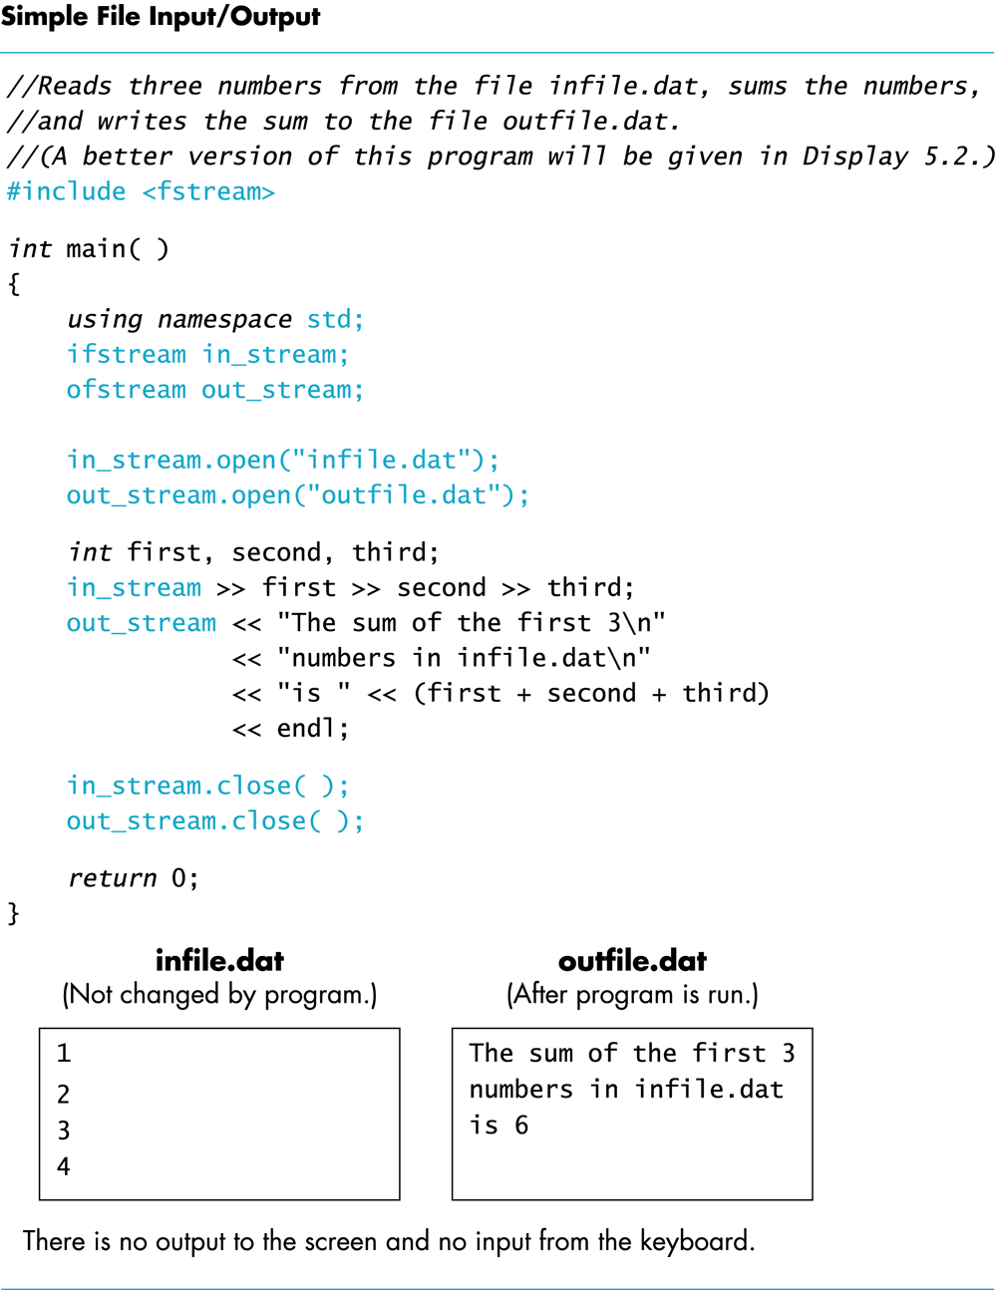
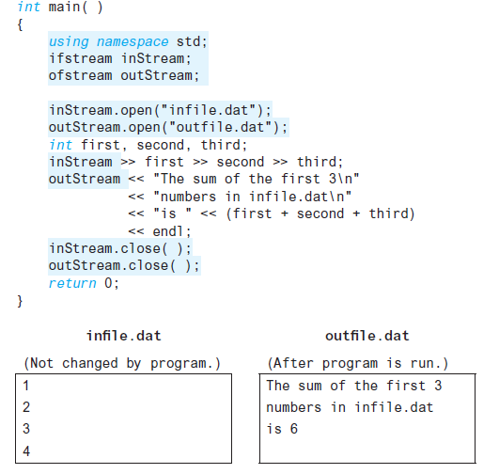
Display 6.1
Back
Next
Slide 6- <number>

Slide 94
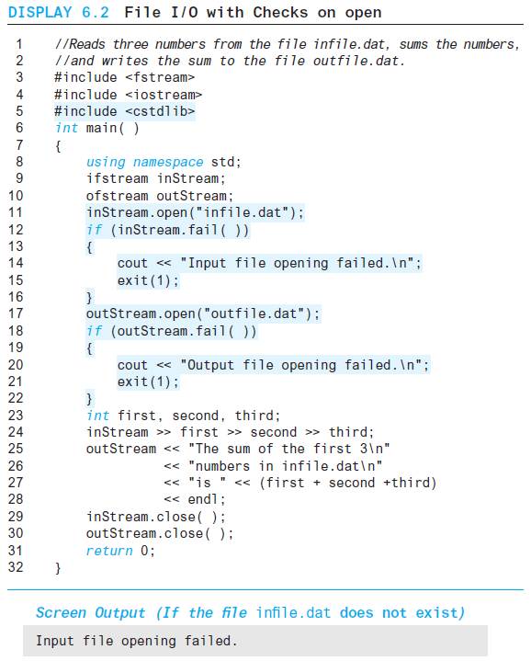
Display 6.2
Back
Next
Slide 6- <number>

Slide 95
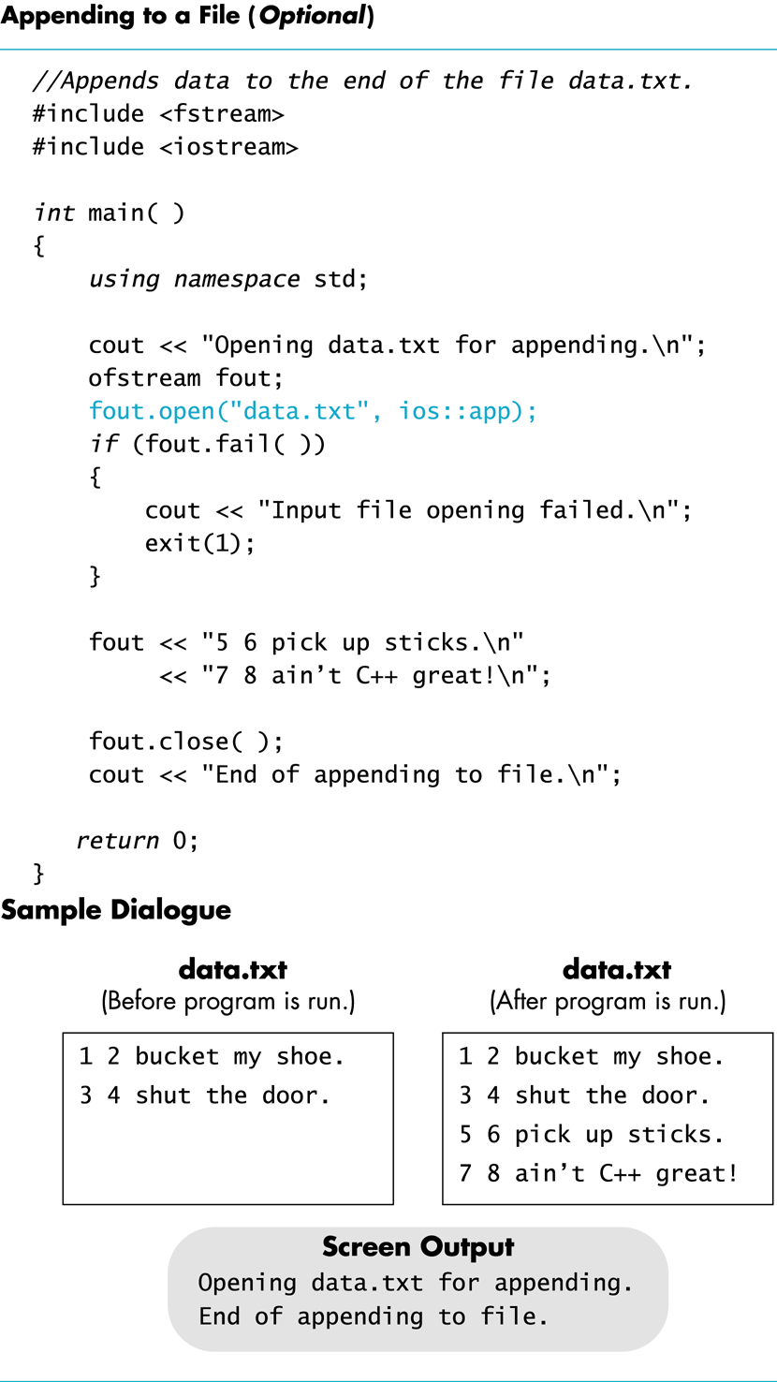
Display 6.3
Back
Next
Slide 6- <number>

Slide 96
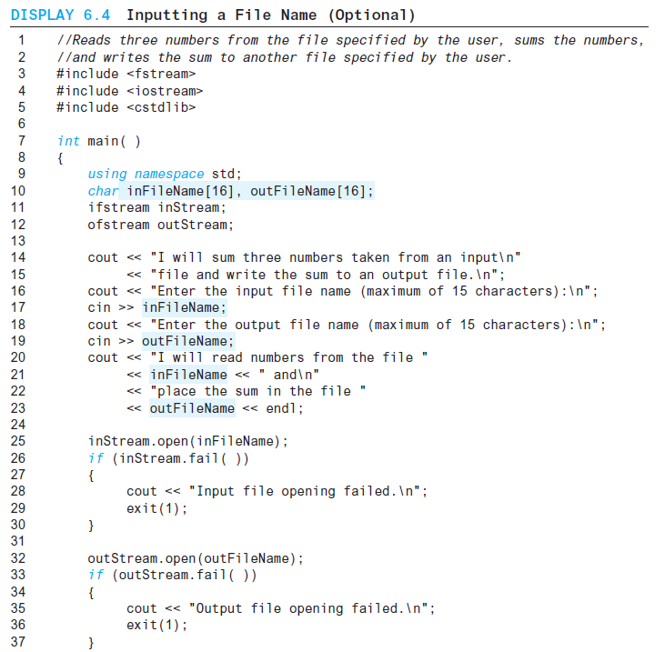
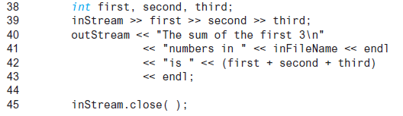
Display 6.4 (1/2)
Back
Next
Slide 6- <number>

Slide 97
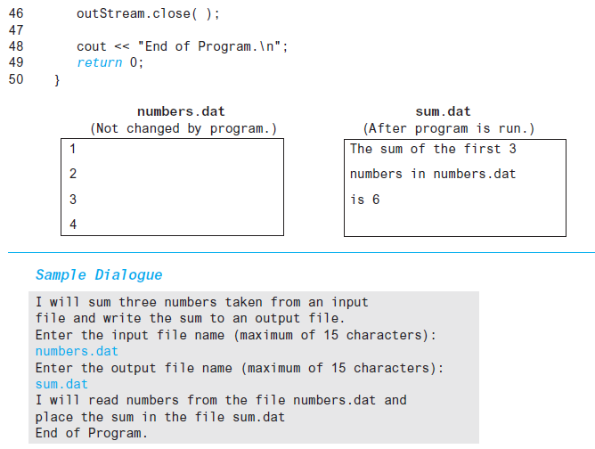
Display 6.4 (2/2)
Back
Next
Slide 6- <number>

Slide 98
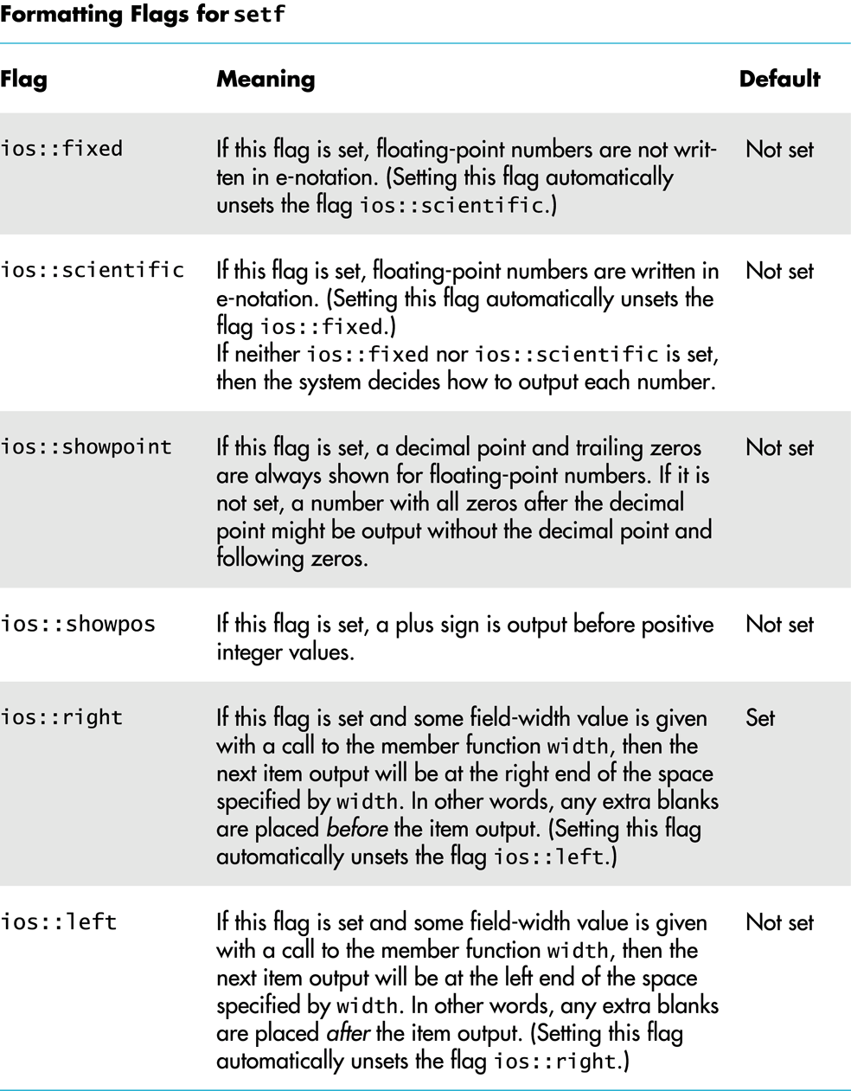
Display 6.5
Back
Next
Slide 6- <number>

Slide 99
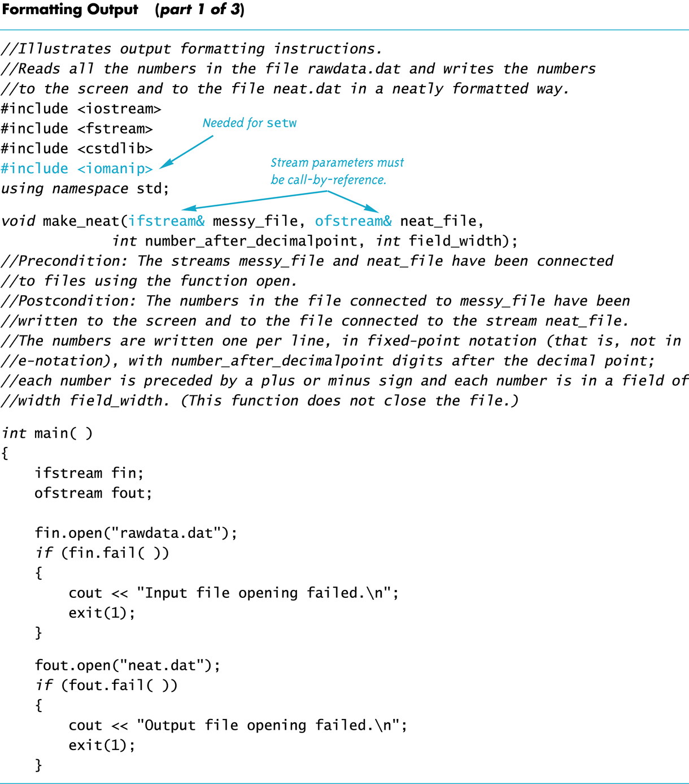
Display 6.6 (1/3)
Back
Next
Slide 6- <number>

Slide 100
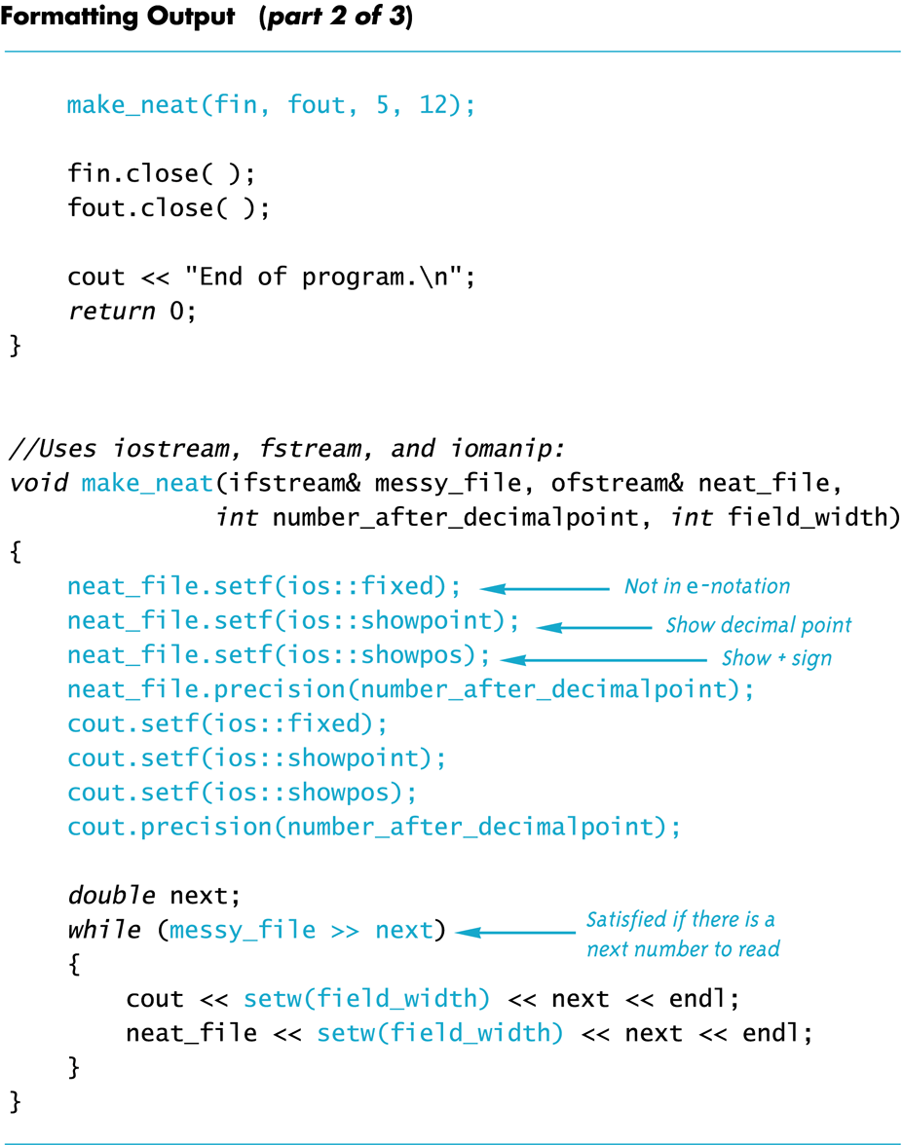
Display 6.6 (2/3)
Back
Next
Slide 6- <number>

Slide 101
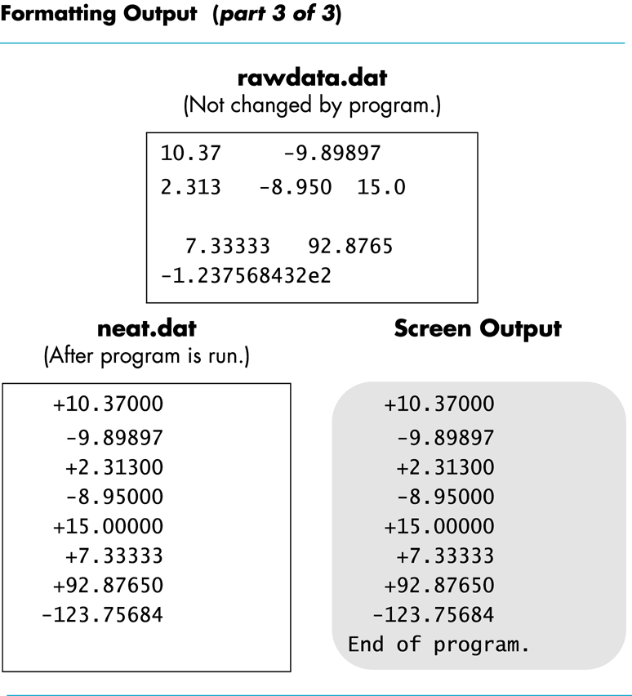
Display 6.6
(3/3)
Back
Next
Slide 6- <number>

Slide 102
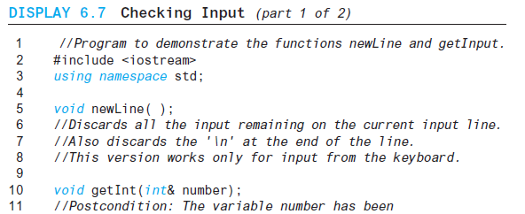
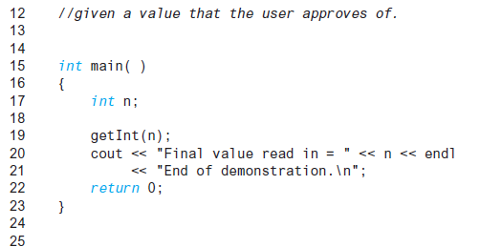
Display 6.7 (1/2)
Back
Next
Slide 6- <number>

Slide 103
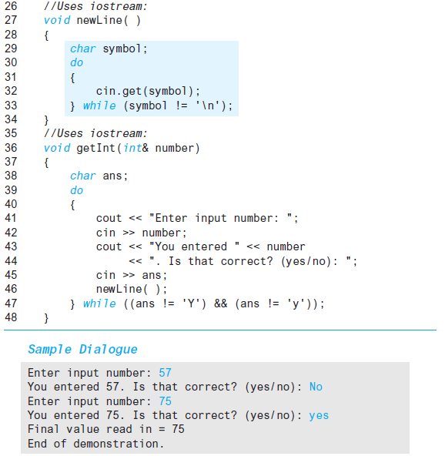
Display 6.7
(2/2)
Back
Next
Slide 6- <number>

Slide 104
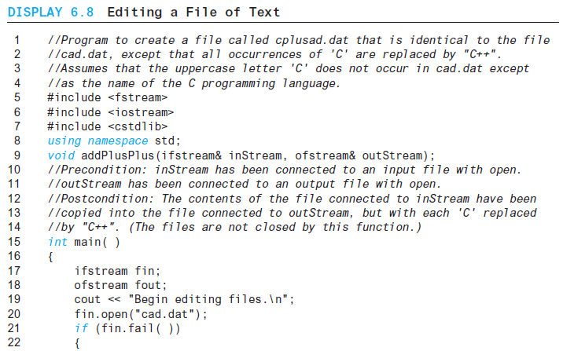
Display 6.8 (1/2)
Back
Next
Slide 6- <number>

Slide 105
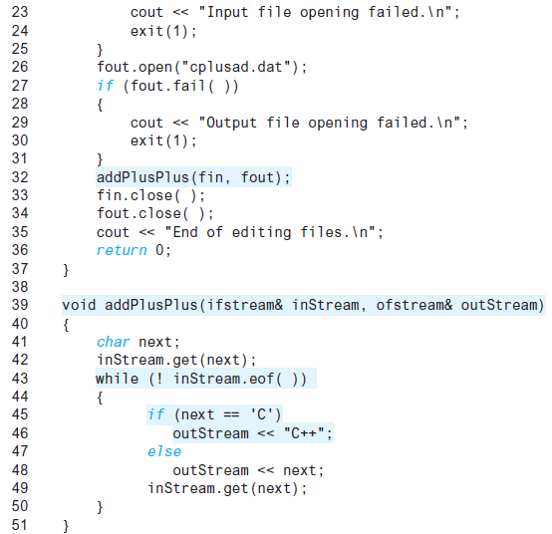
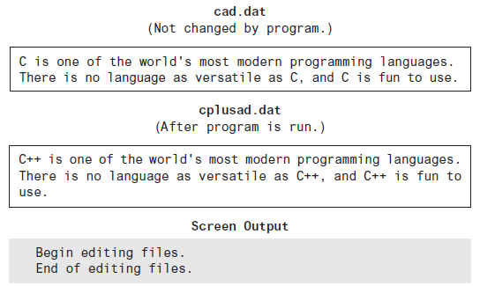
Display 6.8 (2/2)
Back
Next
Slide 6- <number>

Slide 106
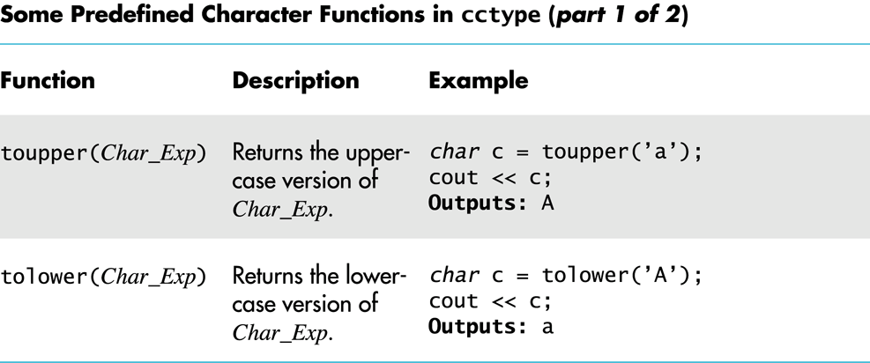
Display 6.9
(1/2)
Back
Next
Slide 6- <number>

Slide 107
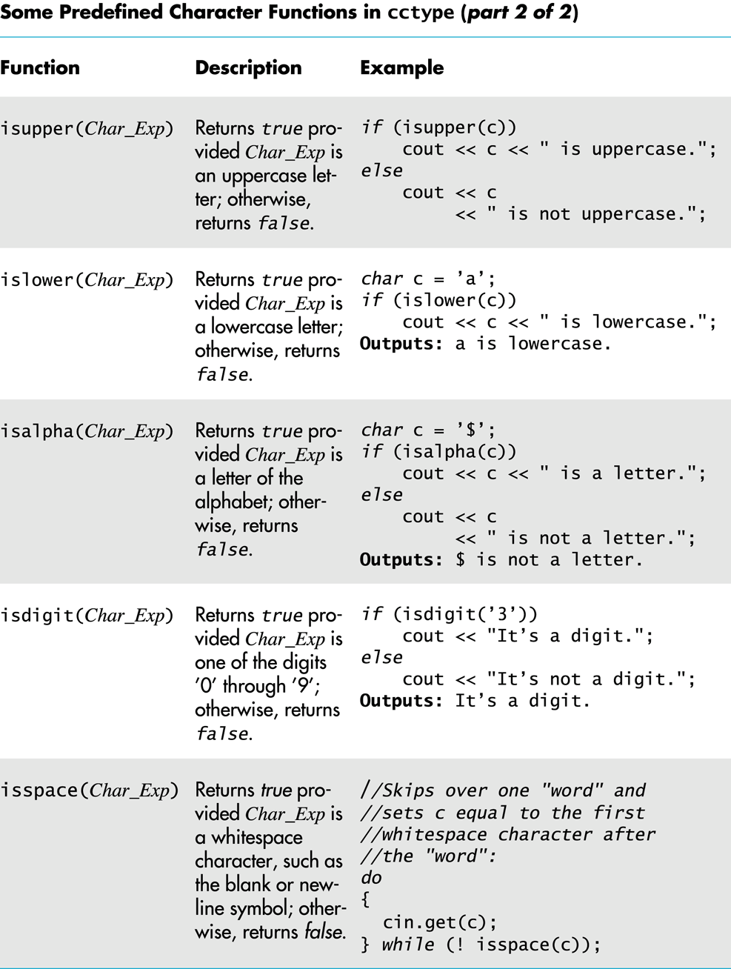
Display 6.9 (2/2)
Back
Next
Slide 6- <number>

