Slide 1
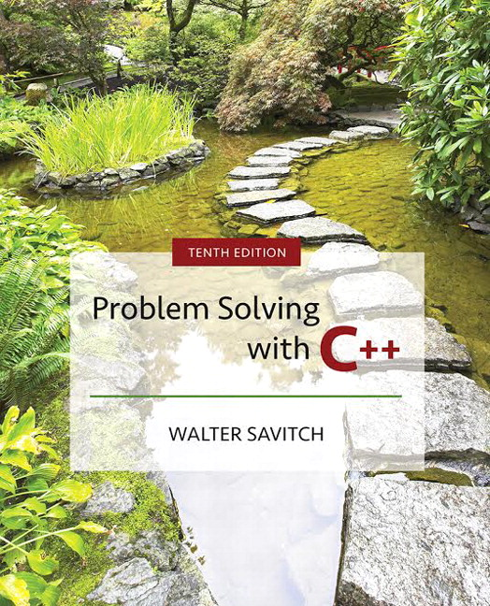

Slide 2
Chapter 7
Arrays

Slide 3
Overview
7.1 Introduction to Arrays
7.2 Arrays in Functions
7.3 Programming with Arrays
7.4 Multidimensional Arrays
Slide 7- <number>

Slide 4
7.1
Introduction to Arrays

Slide 5
Introduction to Arrays
An array is used to process a collection of data
of the same type
  Examples: A list of names
  A list of temperatures
Why do we need arrays?
  Imagine keeping track of 5 test scores, or 100, or 1000 in memory
    How would you name all the variables?
    How would you process each of the variables?
Slide 7- <number>

Slide 6
Declaring an Array
An array, named score, containing five variables
of type int can be declared as
int score[ 5 ];
This is like declaring 5 variables of type int:
score[0], score[1], … , score[4]
The value in brackets is called
  A subscript
  An index
Slide 7- <number>

Slide 7
The Array Variables
The variables making up the array are referred to
as
  Indexed variables
  Subscripted variables
  Elements of the array
The number of indexed variables in an array is
the declared size, or size, of the array
  The largest index is one less than the size
  The first index value is zero
Slide 7- <number>

Slide 8
Array Variable Types
An array can have indexed variables of any type
All indexed variables in an array are of the
same type
  This is the base type of the array
An indexed variable can be used anywhere an
ordinary variable of the base type is used
Slide 7- <number>

Slide 9
Using [ ] With Arrays
In an array declaration, [ ]'s enclose the size
of the array such as this array of 5 integers:
int score [5];
When referring to one of the indexed variables,
the [ ]'s enclose a number identifying one of
the indexed variables
  score[3] is one of the indexed variables
  The value in the [ ]'s can be any expression that evaluates to one of the integers 0 to (size -1)
Slide 7- <number>

Slide 10
Indexed Variable Assignment
To assign a value to an indexed variable, use
the assignment operator:
int n = 2;
score[n + 1] = 99;
  In this example, variable score[3] is assigned 99
Slide 7- <number>

Slide 11
Loops And Arrays
for-loops are commonly used to step through
arrays
  Example: for (i = 0; i < 5; i++)
  {
  cout << score[i] << " off by "
  << (max – score[i]) << endl;
  }
  could display the difference between each score and the maximum score stored in an array
First index is 0
Last index is (size – 1)
Display 7.1
Slide 7- <number>

Slide 12
Constants and Arrays
Use constants to declare the size of an array
  Using a constant allows your code to be easily
  altered for use on a smaller or larger set of data
    Example: const int NUMBER_OF_STUDENTS = 50;
    int score[NUMBER_OF_STUDENTS];
    …
    for ( i = 0; i < NUMBER_OF_STUDENTS; i++)
    cout << score[i] << " off by "
    << (max – score[i]) << endl;
    Only the value of the constant must be changed to make this code work for any number of students
Slide 7- <number>

Slide 13
Variables and Declarations
Some compilers do not allow the use of a variable
to declare the size of an array
Example: cout << "Enter number of students: ";
cin >> number;
int score[number];
This code is illegal on many compilers
Later we will see dynamic arrays which supports this idea
Slide 7- <number>

Slide 14
Array Declaration Syntax
To declare an array, use the syntax:
Type_Name Array_Name[Declared_Size];
  Type_Name can be any type
  Declared_Size can be a constant to make your
  program more versatile
Once declared, the array consists of the indexed
variables:
Array_Name[0] to Array_Name[Declared_Size -1]
Slide 7- <number>

Slide 15
Computer Memory
Computer memory consists of numbered
locations called bytes
  A byte's number is its address
A simple variable is stored in consecutive bytes
  The number of bytes depends on the variable's type
A variable's address is the address of its first byte
Slide 7- <number>

Slide 16
Arrays and Memory
Declaring the array int a[6]
  Reserves memory for six variables of type int
  The variables are stored one after another
  The address of a[0] is remembered
    The addresses of the other indexed variables is not
    remembered
  To determine the address of a[3]
    Start at a[0]
    Count past enough memory for three integers to find a[3]
Display 7.2
Slide 7- <number>

Slide 17
Array Index Out of Range
A common error is using a nonexistent index
  Index values for int a[6] are the values 0 through 5
  An index value not allowed by the array declaration is out of range
  Using an out of range index value doe not produce an error message!
Slide 7- <number>

Slide 18
Out of Range Problems
If an array is declared as: int a[6];
and an integer is declared as: int i = 7;
Executing the statement a[i] = 238; causes…
    The computer to calculate the address of the illegal a[7]
    (This address could be where some other variable is stored)
    The value 238 is stored at the address calculated for a[7]
    No warning is given!
Slide 7- <number>

Slide 19
Initializing Arrays
To initialize an array when it is declared
  The values for the indexed variables are enclosed in braces and separated by commas
Example: int children[3] = { 2, 12, 1 };
Is equivalent to:
int children[3];
children[0] = 2;
children[1] = 12;
children[2] = 1;
Slide 7- <number>

Slide 20
Default Values
If too few values are listed in an initialization
statement
  The listed values are used to initialize the first of the indexed variables
  The remaining indexed variables are initialized to a zero of the base type
  Example: int a[10] = {5, 5};
  initializes a[0] and a[1] to 5 and
  a[2] through a[9] to 0
Slide 7- <number>

Slide 21
Un-initialized Arrays
If no values are listed in the array declaration,
some compilers will initialize each variable to a
zero of the base type
  DO NOT DEPEND ON THIS!
Slide 7- <number>

Slide 22
Range-Based For Loops
C++11 includes a new type of for loop, the range-based for loop, that simplifies iteration over every element in an array. The syntax is shown below:
for (datatype varname : array)
{
// varname is successively set to each
// element in the array
}
Slide 7- <number>

Slide 23
Range-Based For Loop Example
The following code outputs 2 4 6 8
int arr[ ] = {2, 4, 6, 8};
for (int x : arr)
cout << x;
cout << endl;
Slide 7- <number>

Slide 24
Section 7.1 Conclusion
Can you
  Describe the difference between a[4] and int a[5]?
  Show the output of
  char symbol[3] = {'a', 'b', 'c'};
  for (int index = 0; index < 3; index++)
  cout << symbol[index];
Slide 7- <number>

Slide 25
7.2
Arrays in Functions

Slide 26
Arrays in Functions
Indexed variables can be arguments to functions
  Example: If a program contains these declarations:
  int i, n, a[10];
  void myFunction(int n);
  Variables a[0] through a[9] are of type int, making these calls legal:
  myFunction( a[ 0 ] );
  myFunction( a[ 3 ] );
  myFunction( a[ i ] );
Display 7.3
Slide 7- <number>

Slide 27
Arrays as Function Arguments
A formal parameter can be for an entire array
  Such a parameter is called an array parameter
    It is not a call-by-value parameter
    It is not a call-by-reference parameter
    Array parameters behave much like call-by-reference parameters
Slide 7- <number>

Slide 28
Array Parameter Declaration
An array parameter is indicated using empty
brackets in the parameter list such as
void fillUp(int a[ ], int size);
Slide 7- <number>

Slide 29
Function Calls With Arrays
If function fillUp is declared in this way:
void fillUp(int a[ ], int size);
and array score is declared this way:
int score[5], numberOfScores;
fillUp is called in this way:
fillUp(score, numberOfScores);
Display 7.4
Slide 7- <number>

Slide 30
Function Call Details
A formal parameter is identified as an array
parameter by the [ ]'s with no index expression
void fillUp(int a[ ], int size);
An array argument does not use the [ ]'s
fillUp(score, numberOfScores);
Slide 7- <number>

Slide 31
Array Formal Parameters
An array formal parameter is a placeholder for
the argument
  When an array is an argument in a function call, an action performed on the array parameter is performed on the array argument
  The values of the indexed variables can be changed by the function
Slide 7- <number>

Slide 32
Array Argument Details
What does the computer know about an array?
  The base type
  The address of the first indexed variable
  The number of indexed variables
What does a function know about an array
argument?
  The base type
  The address of the first indexed variable
Slide 7- <number>

Slide 33
Array Parameter Considerations
Because a function does not know the size of
an array argument…
  The programmer should include a formal parameter that specifies the size of the array
  The function can process arrays of various sizes
    Function fillUp from Display 7.4 can be used to fill
    an array of any size:
    fillUp(score, 5);
    fillUp(time, 10);
Slide 7- <number>

Slide 34
const Modifier
Array parameters allow a function to change the
values stored in the array argument
If a function should not change the values of the
array argument, use the modifier const
An array parameter modified with const is a
constant array parameter
  Example:
  void showTheWorld(const int a[ ], int size);
Slide 7- <number>

Slide 35
Using const With Arrays
If const is used to modify an array parameter:
  const is used in both the function declaration and definition to modify the array parameter
  The compiler will issue an error if you write code that changes the values stored in the array parameter
Slide 7- <number>

Slide 36
Function Calls and const
If a function with a constant array parameter
calls another function using the const array
parameter as an argument…
  The called function must use a constant
  array parameter as a placeholder for the array
  The compiler will issue an error if a function is
  called that does not have a const array parameter to accept the array argument
Slide 7- <number>

Slide 37
const Parameters Example
double computeAverage(int a[ ], int size);
void showDifference(const int a[ ], int size)
{
double average = computeAverage(a, size);
…
}
computeAverage has no constant array parameter
This code generates an error message because
computeAverage could change the array parameter
Slide 7- <number>

Slide 38
Returning An Array
Recall that functions can return a value of
type int, double, char, …, or a class type
Functions cannot return arrays
We learn later how to return a pointer to an array
Slide 7- <number>

Slide 39
Case Study:
Production Graph
Problem Definition:
  We are writing a program for the Apex Plastic
  Spoon Company
  The program will display a bar graph showing the production of each of four plants for a week
  Each plant has separate records for each department
  Input is entered plant by plant
  Output shows one asterisk for each 1000 units, and production is rounded to the nearest 1,000 units
Slide 7- <number>

Slide 40
Analysis of The Problem
Use an array named production to hold total
production of each plant
  Production for plant n is stored in production[n-1]
Program must scale production to nearest
1,000 units to display asterisks in the bar
Slide 7- <number>

Slide 41
Production Graph Sub-Tasks
Analysis leads to the following sub-tasks
  inputData: Read input for each plant
  Set production [plantNumber -1]
  to the total production for plant
  number n
  scale: For each plant, change production[plantNumber]
  to the correct number of asterisks
  graph: Output the bar graph
Slide 7- <number>

Slide 42
More Analysis Details
The entire array will be an argument for the
functions we write to perform the subtasks
  We will also include a formal parameter for the size
  The size of the array is equal to the number of plants
  We will use a constant for the number of plants
The function declarations and main function
for the production graph program are found in
Display 7.5
Slide 7- <number>

Slide 43
Algorithm Design: inputData
We must read all departments' data for each
plant and add them to produce a plant's total
  Algorithm for inputData:
  for plantNumber is 1, 2, …, lastPlantNumber
  do the following
  Read all the data for plant number plantNumber
  Sum the numbers
  Set production[plantNumber – 1] to the total
Slide 7- <number>

Slide 44
Coding inputData
The algorithm can be translated to C++ as:
void inputData(int a [ ], int lastPlantNumber)
{
using namespace std;
for (int plantNumber = 1;
plantNumber <= lastPlantNumber;
plantNumber++)
{
cout << endl;
<< "Enter production for plant"
<< plantNumber << endl;
getTotal( a[plantNumber -1] );
}
}
Slide 7- <number>

Slide 45
Testing inputData
Each function should be tested in a program in
which it is the only untested function
Because inputData calls getTotal, getTotal
is tested first
Once tested, getTotal can be used to test
inputData
Display 7.6 (1)
Display 7.6 (2)
Display 7.6 (3)
Slide 7- <number>

Slide 46
Test Data for inputData
Remember that inputData should be tested
  With a plant that contains no production figures
  With a plant having only one production figure
  With a plant having more than one figure
  With zero and non-zero production figures
Slide 7- <number>

Slide 47
Algorithm for scale
scale changes the value of the indexed variable
to show the whole number of asterisks to print
  Scale is called using
  scale (production, NUMBER_OF_PLANTS);
  and its algorithm is
  for (int index = 0; index < size; index++)
  Divide the value of a[index] by 1,000 and round the result to the nearest integer
Slide 7- <number>

Slide 48
Coding scale
The code for scale, below, uses a function named
round that must be defined as well
  void scale(int a[ ], int size)
  {
  for (int index = 0; index < size; index++)
  a[index] = round (a[index] / 1000.0);
  }
Why not 1000?
Slide 7- <number>

Slide 49
Function floor
Function round, called by scale, uses the floor
function from the cmath library
  The floor function returns the first whole number less than its argument:
  floor (3.4) returns 3
  floor (3.9) returns 3
  Adding 0.5 to the argument for floor is how round performs its task
  floor (3.4 + 0.5) returns 3
  floor (3.9 + 0.5) returns 4
Slide 7- <number>

Slide 50
Testing scale
To test scale
  First test round
  Scale should be tested with arguments that
    Are 0
    Round up
    Round down
Display 7.7 (1)
Display 7.7 (2)
Slide 7- <number>

Slide 51
Function graph
The design of graph is quite straightforward
and not included here
The complete program to produce the bar
graph is found in
Display 7.8 (1)
Display 7.8 (2)
Display 7.8 (3)
Slide 7- <number>

Slide 52
Section 7.2 Conclusion
Can you
  Write a function definition for a function called
  oneMore, which has a formal parameter for an array of integers and increases the value of each array element by one. Are other formal parameters needed?
Slide 7- <number>

Slide 53
7.3
Programming with Arrays

Slide 54
Programming With Arrays
The size needed for an array is changeable
  Often varies from one run of a program to another
  Is often not known when the program is written
A common solution to the size problem
  Declare the array size to be the largest that could be needed
  Decide how to deal with partially filled arrays
Slide 7- <number>

Slide 55
Partially Filled Arrays
When using arrays that are partially filled
  Functions dealing with the array may not need to know the declared size of the array, only how many elements are stored in the array
  A parameter, number_used, may be sufficient to ensure that referenced index values are legal
  A function such as fillArray in Display 7.9 needs to know the declared size of the array
Display 7.9 (1)
Display 7.9 (2)
Display 7.9 (3)
Slide 7- <number>

Slide 56
Constants as Arguments
When function fillArray (Display 7.9) is called,
MAX_NUMBER_SCORES is used as an
argument
  Can't MAX_NUMBER_SCORES be used directly without making it an argument?
    Using MAX_NUMBER_SCORES as an argument makes it clear that fillArray requires the array's declared size
    This makes fillArray easier to be used in other programs
Slide 7- <number>

Slide 57
Searching Arrays
A sequential search is one way to search
an array for a given value
  Look at each element from first to last to see if the target value is equal to any of the array elements
  The index of the target value can be returned to indicate where the value was found in the array
  A value of -1 can be returned if the value was not found
Slide 7- <number>

Slide 58
The search Function
The search function of Display 7.10…
  Uses a while loop to compare array elements to the target value
  Sets a variable of type bool to true if the target
  value is found, ending the loop
  Checks the boolean variable when the loop ends to see if the target value was found
  Returns the index of the target value if found,
  otherwise returns -1
Display 7.10 (1)
Display 7.10 (2)
Slide 7- <number>

Slide 59
Program Example:
Sorting an Array
Sorting a list of values is very common task
  Create an alphabetical listing
  Create a list of values in ascending order
  Create a list of values in descending order
Many sorting algorithms exist
  Some are very efficient
  Some are easier to understand
Slide 7- <number>

Slide 60
Program Example:
The Selection Sort Algorithm
When the sort is complete, the elements of the
array are ordered such that
a[0] < a[1] < … < a [ number_used -1]
  This leads to an outline of an algorithm:
  for (int index = 0; index < number_used; index++)
  place the indexth smallest element in a[index]
Slide 7- <number>

Slide 61
Program Example:
Sort Algorithm Development
One array is sufficient to do our sorting
  Search for the smallest value in the array
  Place this value in a[0], and place the value that was in a[0] in the location where the smallest was found
  Starting at a[1], find the smallest remaining value swap it with the value currently in a[1]
  Starting at a[2], continue the process until the array is sorted
Display 7.11
Display 7.12 (1-2)
Slide 7- <number>

Slide 62

Program Example:
Bubble Sort
There are many sorting algorithms, another simple one is Bubble Sort
Idea is to bubble the largest value toward the end of the array by swapping consecutive elements
Initial array:
  3, 10, 9, 2, 5
Compare 3 and 10; no swap since 10 is greater than 3
Slide 7- <number>

Slide 63
Program Example:
Bubble Sort
  3, 10, 9, 2, 5
Compare 10 and 9; swap since 10 is larger than 9
  3, 9, 10, 2, 5
Compare 10 and 2; swap since 10 is larger than 2
  3, 9, 2, 10, 5
Compare 10 and 5; swap since 10 is larger than 5
Slide 7- <number>

Slide 64
Program Example:
Bubble Sort
  3, 9, 2, 5, 10
We have now “bubbled” the largest value, 10, to the right of the array
The algorithm now repeats the process but stops at the position to the left of 10
  3, 9, 2, 5, 10
Implementation requires nested loops
Bubble largest value between index 0-3 here
Display 7.13
Slide 7- <number>

Slide 65
Section 7.3 Conclusion
Can you
  Write a program that will read up to 10 letters into an array and write the letters back to the screen in the reverse order?
  abcd should be output as dcba
  Use a period as a sentinel value to mark the end of input
Slide 7- <number>

Slide 66
7.4
Multidimensional Arrays

Slide 67
Multi-Dimensional Arrays
C++ allows arrays with multiple index values
  char page [30] [100];
  declares an array of characters named page
    page has two index values:
    The first ranges from 0 to 29
    The second ranges from 0 to 99
  Each index in enclosed in its own brackets
  Page can be visualized as an array of
  30 rows and 100 columns
Slide 7- <number>

Slide 68
Index Values of page
The indexed variables for array page are
page[0][0], page[0][1], …, page[0][99]
page[1][0], page[1][1], …, page[1][99]
…
page[29][0], page[29][1], … , page[29][99]
page is actually an array of size 30
  page's base type is an array of 100 characters
Slide 7- <number>

Slide 69
Multidimensional Array Parameters
Recall that the size of an array is not needed
when declaring a formal parameter:
void displayLine(const char a[ ], int size);
The base type of a multi-dimensional array must
be completely specified in the parameter
declaration
  void displayPage(const char page[ ] [100],
  int sizeDimension1);
Slide 7- <number>

Slide 70
Program Example:
Grading Program
Grade records for a class can be stored in a
two-dimensional array
  For a class with 4 students and 3 quizzes the array could be declared as
  int grade[4][3];
    The first array index refers to the number of a student
    The second array index refers to a quiz number
Since student and quiz numbers start with one,
we subtract one to obtain the correct index
Slide 7- <number>

Slide 71
Grading Program: average scores
The grading program uses one-dimensional
arrays to store…
  Each student's average score
  Each quiz's average score
The functions that calculate these averages
use global constants for the size of the arrays
  This was done because the functions seem to be
  particular to this program
Display 7.14 (1-3)
Display 7.15
Display 7.16
Slide 7- <number>

Slide 72
Section 7.5 Conclusion
Can you
  Write code that will fill the array a(declared below) with numbers typed at the keyboard? The numbers will be input fiver per line, on four lines.
  int a[4][5];
Slide 7- <number>

Slide 73
Chapter 7 - End
Slide 7- <number>

Slide 74
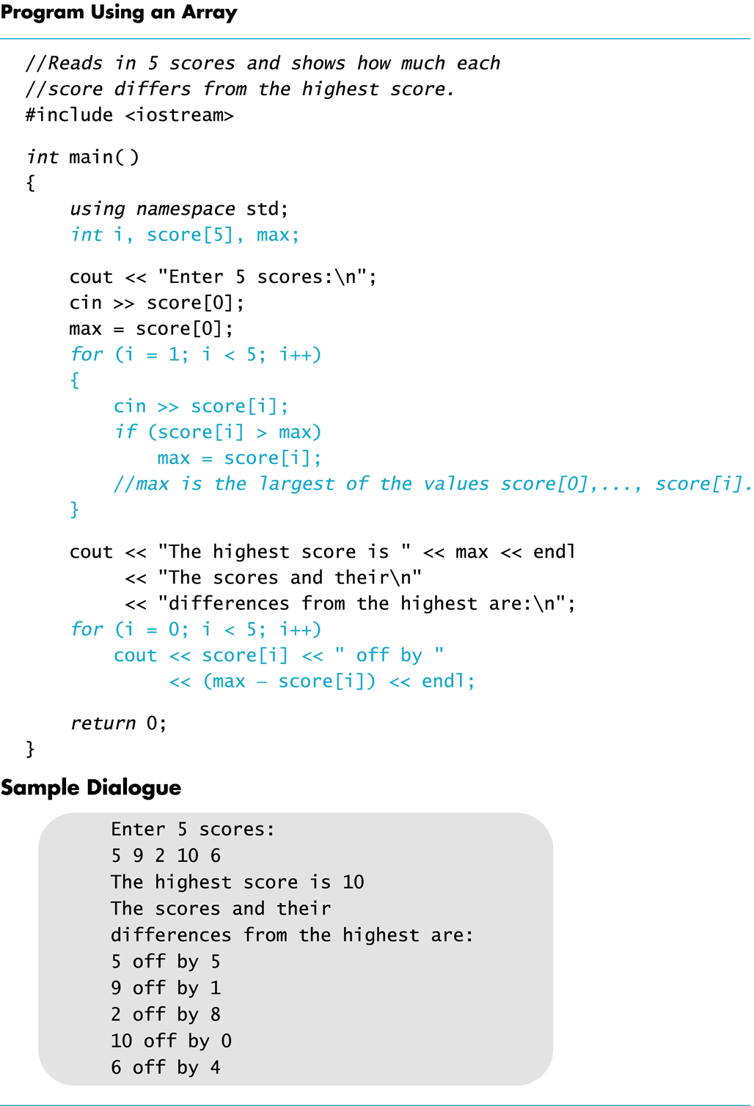
Display 7.1
Back
Next
Slide 7- <number>

Slide 75
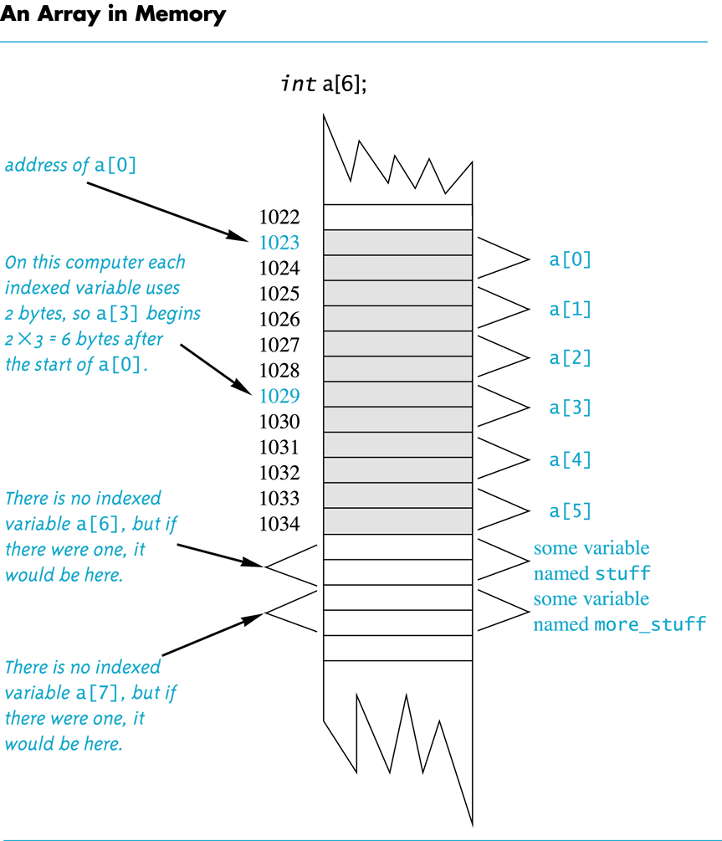
Display 7.2
Back
Next
Slide 7- <number>

Slide 76
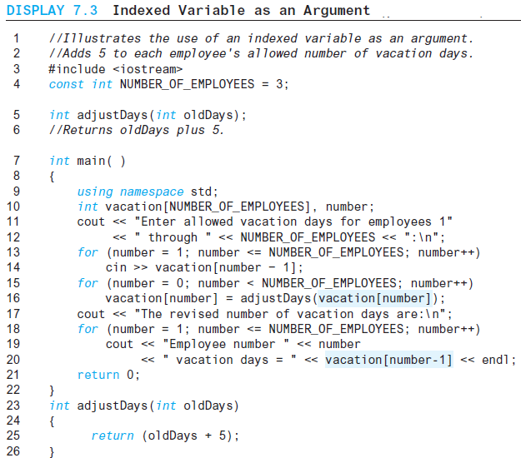
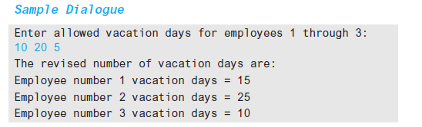
Display 7.3
Back
Next
Slide 7- <number>

Slide 77
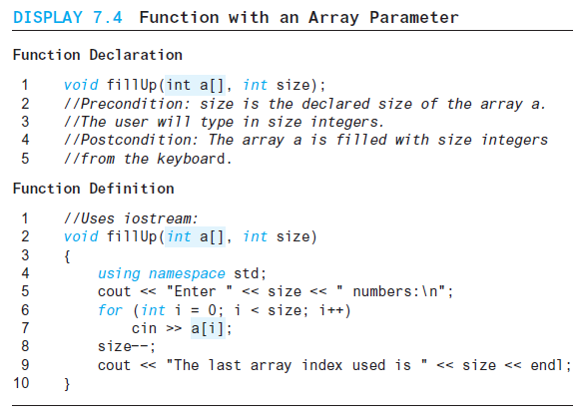
Display 7.4
Back
Next
Slide 7- <number>

Slide 78
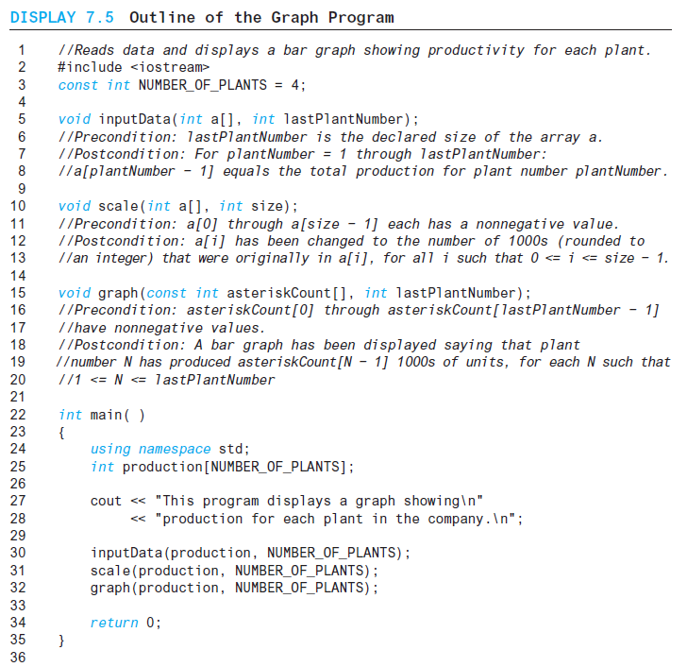
Display 7.5
Back
Next
Slide 7- <number>

Slide 79
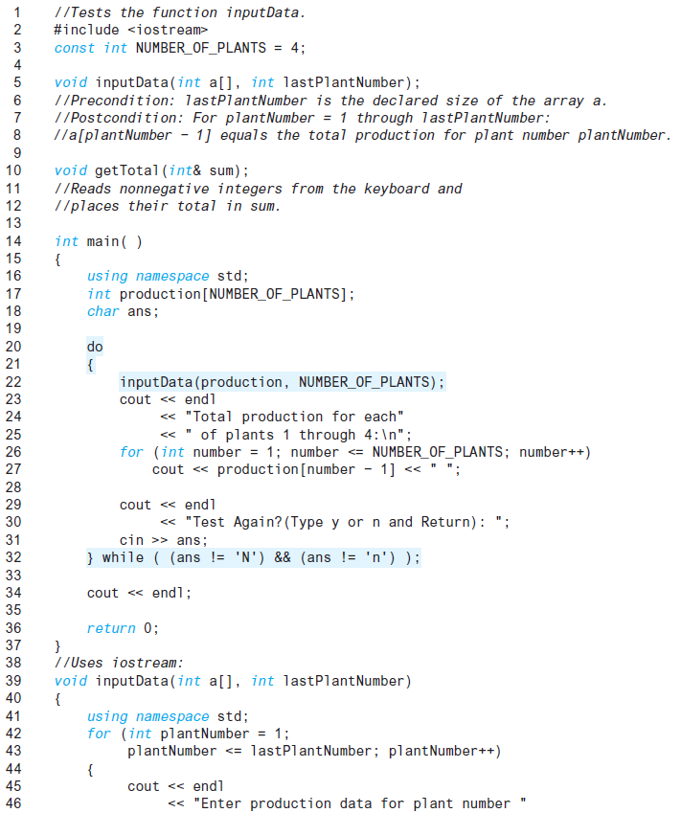
Display 7.6 (1/3)
Back
Next
Slide 7- <number>

Slide 80
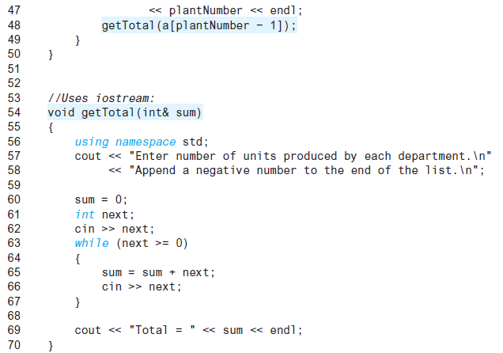
Display 7.6 (2/3)
Back
Next
Slide 7- <number>

Slide 81
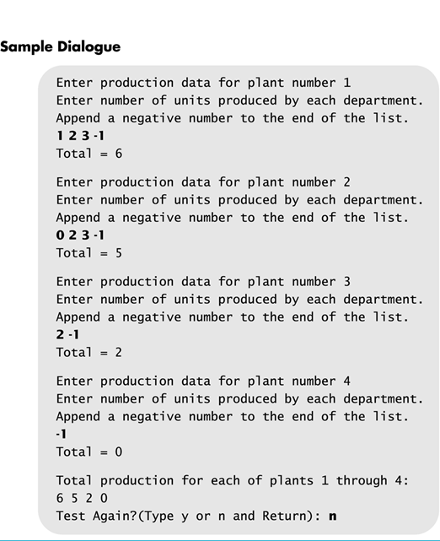
Display 7.6 (3/3)
Back
Next
Slide 7- <number>

Slide 82
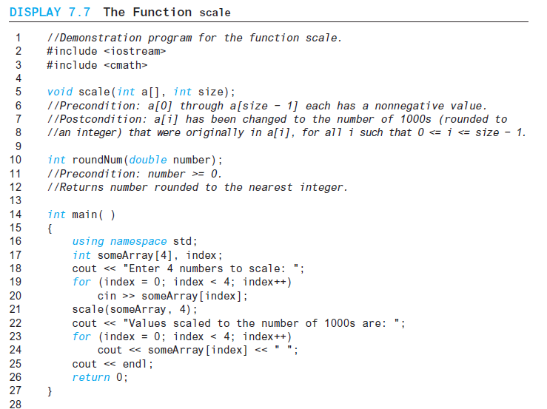
Display 7.7 (1/2)
Back
Next
Slide 7- <number>

Slide 83
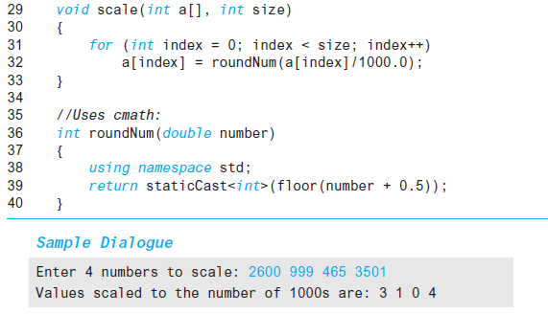
Display 7.7
(2/2)
Back
Next
Slide 7- <number>

Slide 84
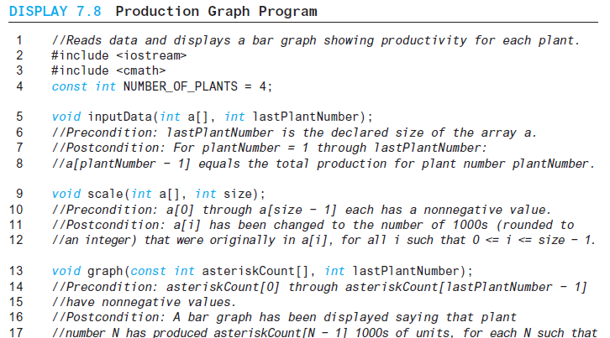
Display 7.8
(1/3)
Back
Next
Slide 7- <number>

Slide 85
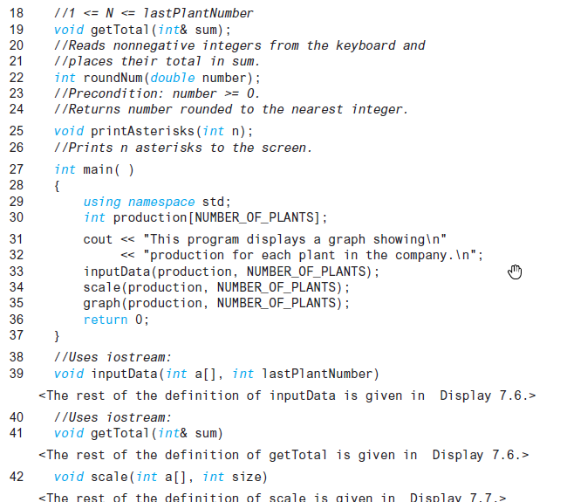
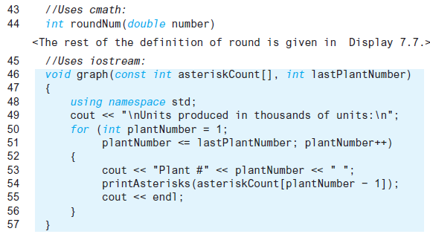
Display 7.8 (2/3)
Back
Next
Slide 7- <number>

Slide 86
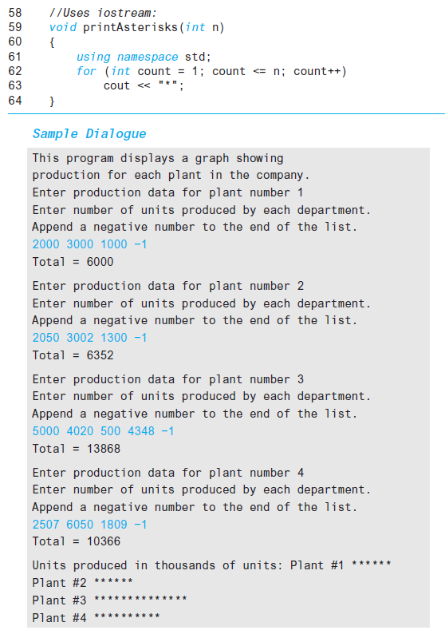
Display 7.8 (3/4)
Back
Next
Slide 7- <number>

Slide 87
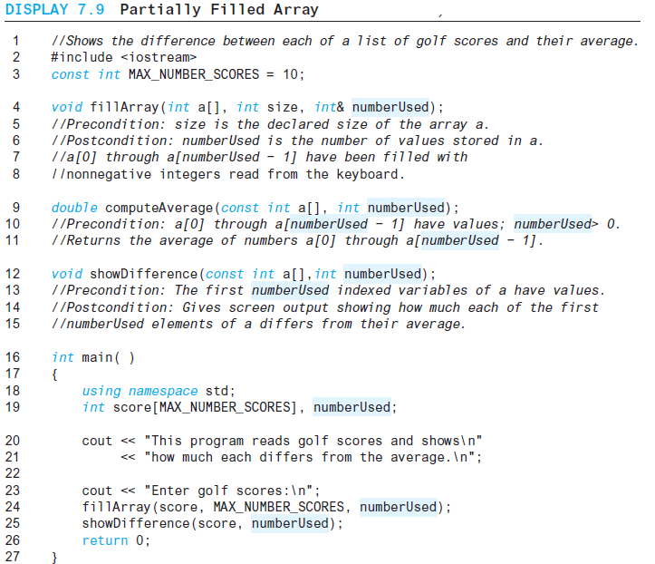
Display 7.9 (1/3)
Back
Next
Slide 7- <number>

Slide 88
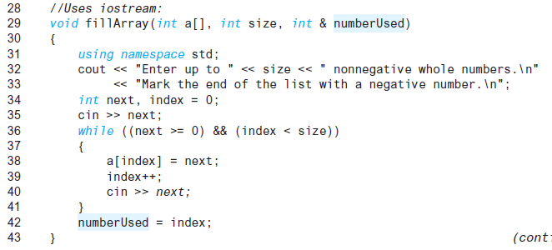
Display 7.9 (2/3)
Back
Next
Slide 7- <number>

Slide 89
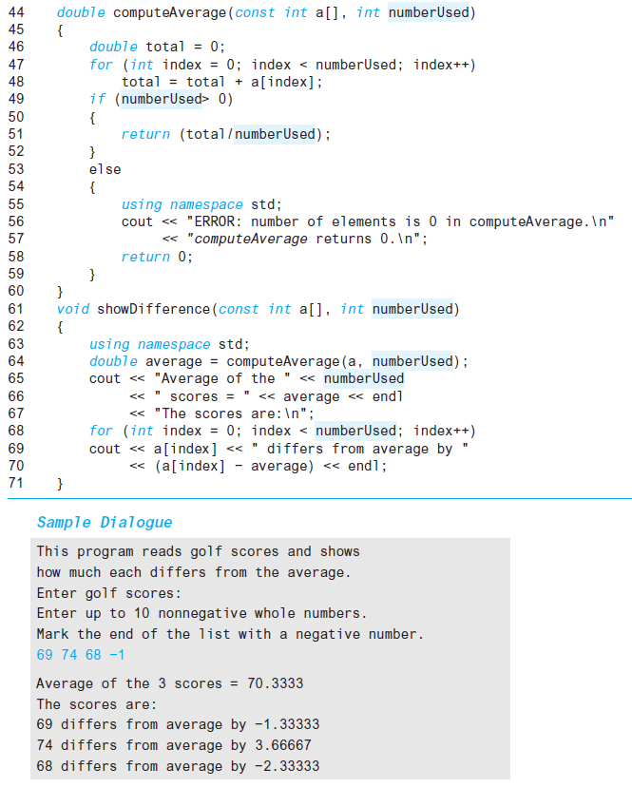
Display 7.9 (3/3)
Back
Next
Slide 7- <number>

Slide 90
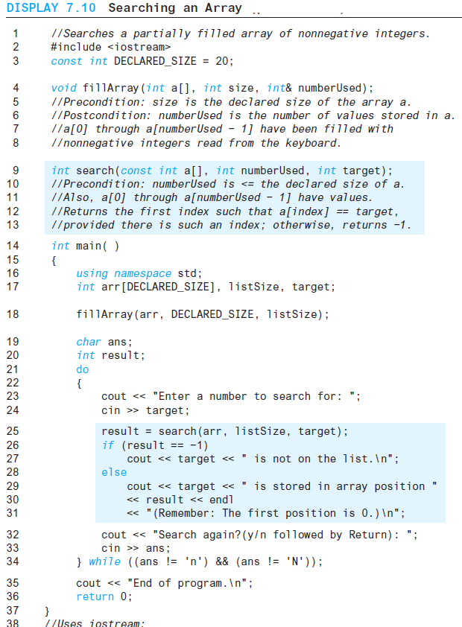
Display 7.10 (1/2)
Back
Next
Slide 7- <number>

Slide 91
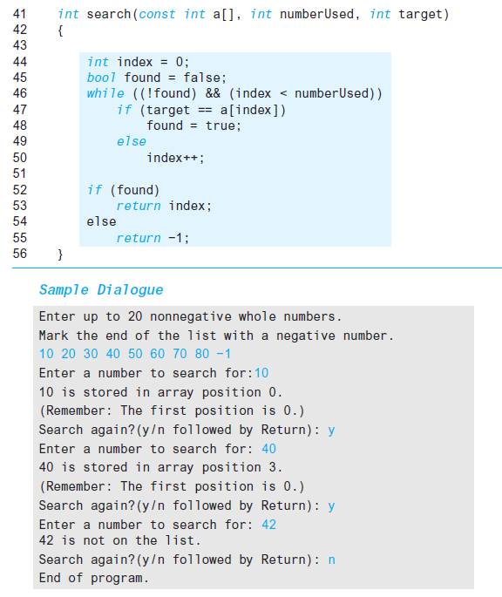
Display 7.10 (2/2)
Back
Next
Slide 7- <number>

Slide 92
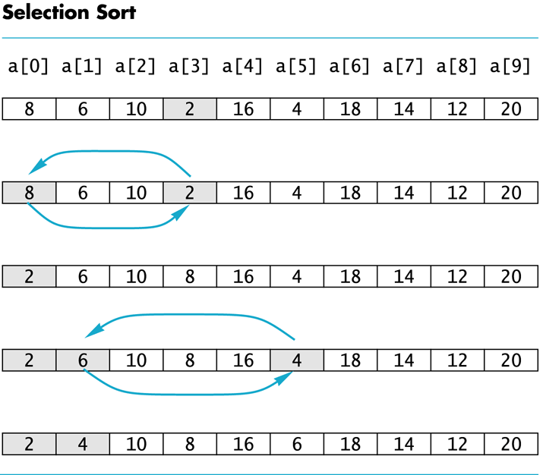
Display 7.11
Back
Next
Slide 7- <number>

Slide 93
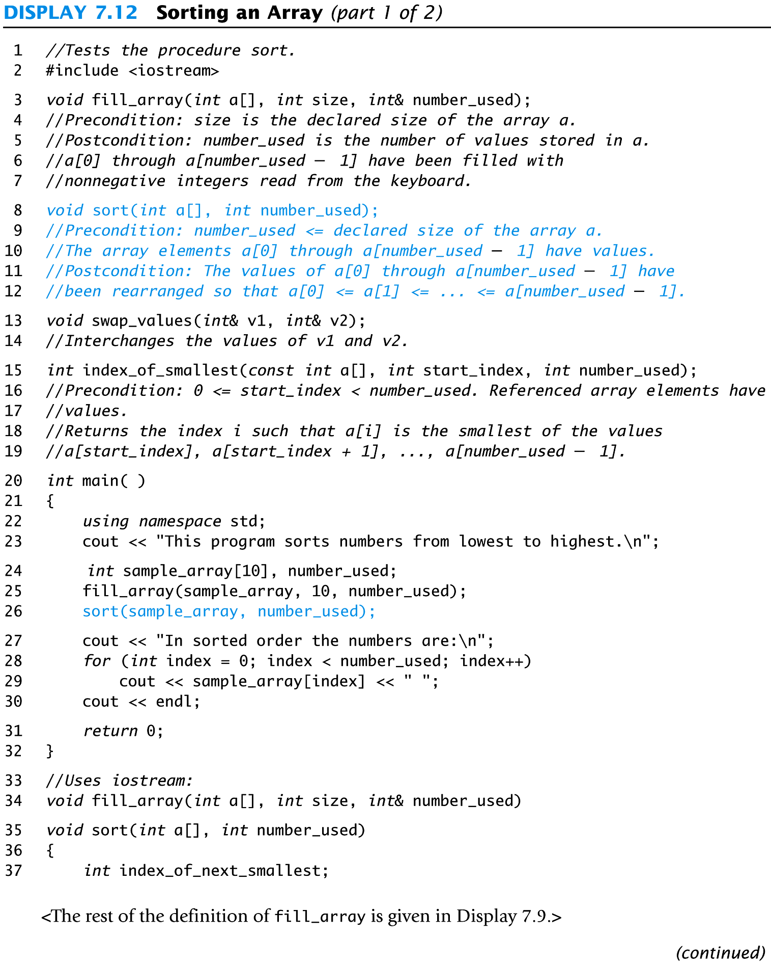
Display 7.12 (1/2)
Back
Next
Slide 7- <number>

Slide 94
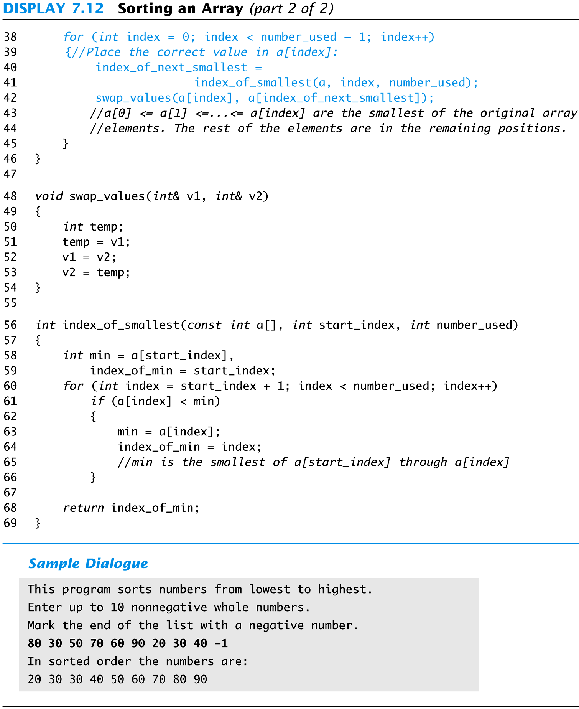
Display 7.12 (2/2)
Back
Next
Slide 7- <number>

Slide 95
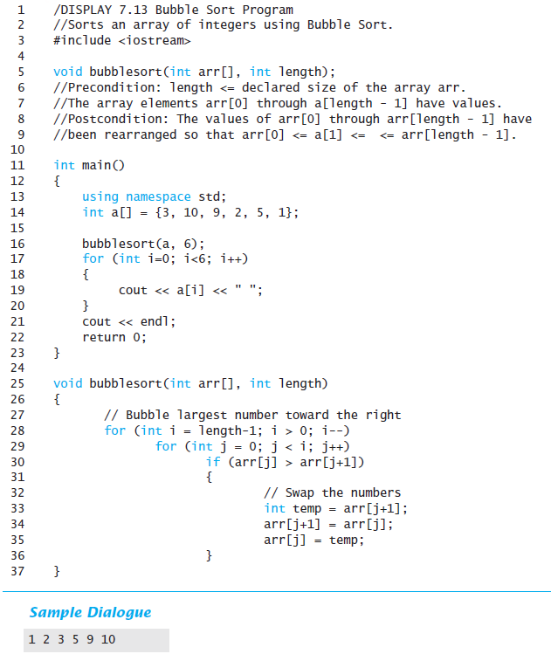
Display 7.13
Back
Next
Slide 7- <number>

Slide 96
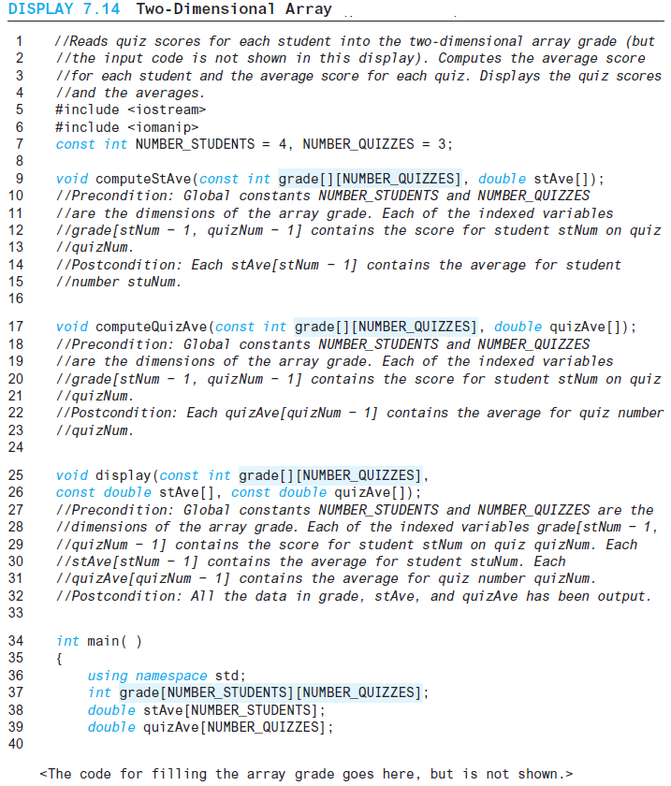
Display 7.14 (1/3)
Back
Next
Slide 7- <number>

Slide 97
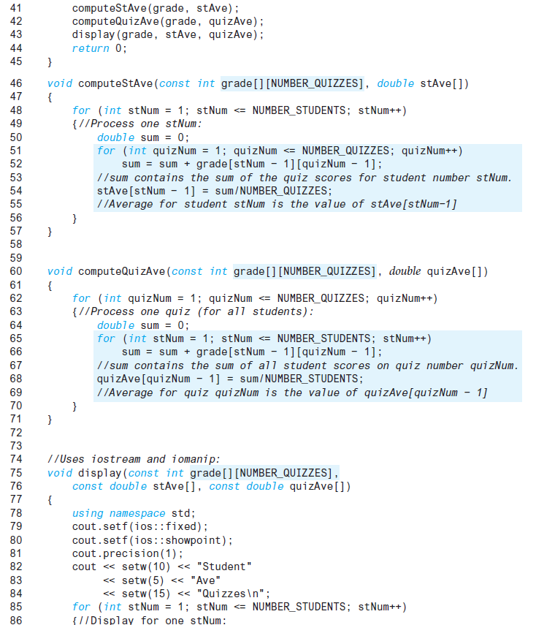
Display 7.14 (2/3)
Back
Next
Slide 7- <number>

Slide 98
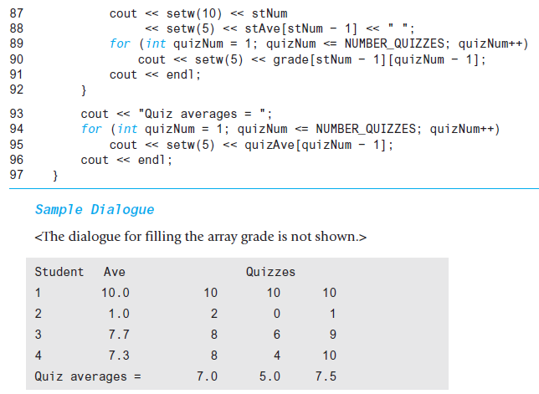
Display 7.14 (3/3)
Back
Next
Slide 7- <number>

Slide 99
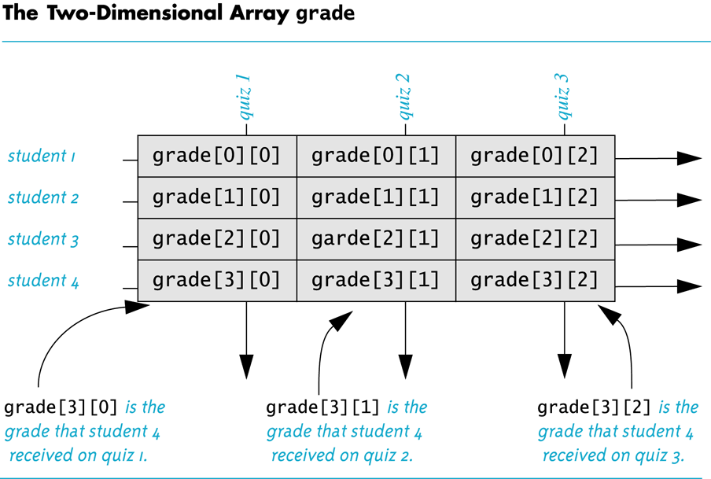
Display 7.15
Back
Next
Slide 7- <number>

Slide 100
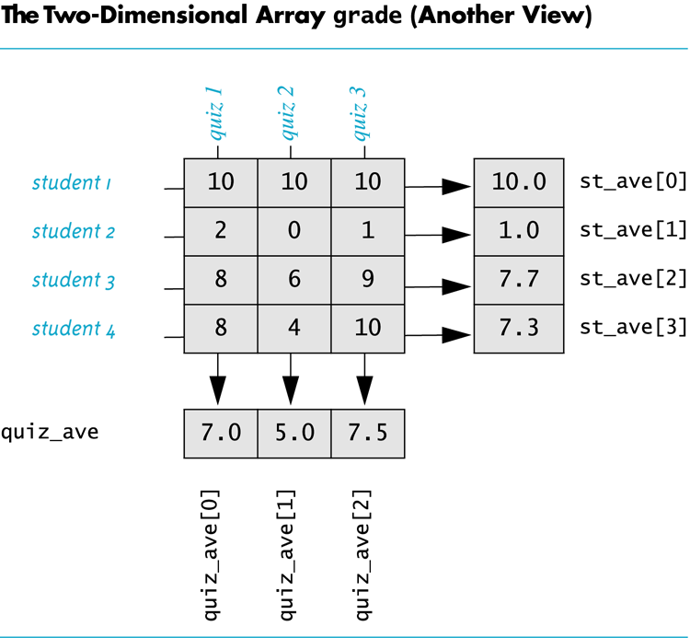
Display 7.16
Back
Next
Slide 7- <number>

