Slide 1
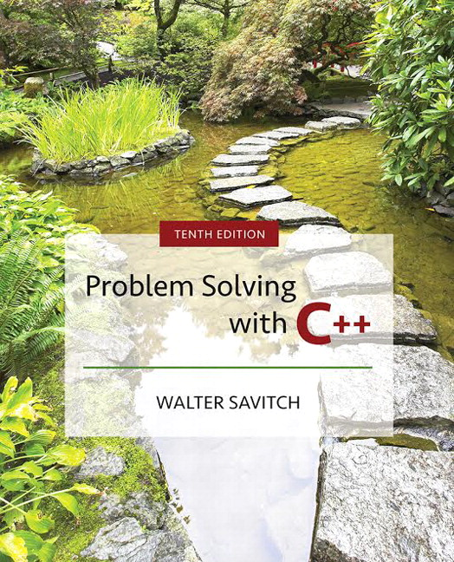

Slide 2
Chapter 8
Strings and Vectors

Slide 3
Overview
8.1 An Array Type for Strings
8.2 The Standard string Class
8.3 Vectors
Slide 8- <number>

Slide 4
8.1
An Array Type for Strings

Slide 5
An Array Type for Strings
C-strings can be used to represent strings of
characters
  C-strings are stored as arrays of characters
  C-strings use the null character '\0' to end a string
    The Null character is a single character
  To declare a C-string variable, declare an array of characters:
  char s[11];
Slide 8- <number>

Slide 6
C-string Details
Declaring a C-string as char s[10] creates space
for only nine characters
  The null character terminator requires one space
A C-string variable does not need a size variable
  The null character immediately follows the last
  character of the string
Example:
s[0] | s[1] | s[2] | s[3] | s[4] | s[5] | s[6] | s[7] | s[8] | s[9]
H | i |  | M | o | m | ! | \0 | ? | ?
Slide 8- <number>

Slide 7
C-string Declaration
To declare a C-string variable, use the syntax:
char Array_name[ Maximum_cString_Size + 1];
  + 1 reserves the additional character needed by '\0'
Slide 8- <number>

Slide 8
Initializing a C-string
To initialize a C-string during declaration:
char myMessage[20] = "Hi there.";
  The null character '\0' is added for you
Another alternative:
char shortString[ ] = "abc";
but not this:
char shortString[ ] = {'a', 'b', 'c'};
Slide 8- <number>

Slide 9
C-string error
This attempt to initialize a C-string does not
cause the \0 to be inserted in the array
  char shortString[ ] = {'a', 'b', 'c'};
Slide 8- <number>

Slide 10
Don't Change '\0'
Do not to replace the null character when
manipulating indexed variables in a C-string
  If the null character is lost, the array cannot act
  like a C-string
    Example: int index = 0;
    while (ourString[index] != '\0')
    {
    ourString[index] = 'X';
    index++;
    }
      This code depends on finding the null character!
Slide 8- <number>

Slide 11
Safer Processing of C-strings
The loop on the previous slide depended on
finding the '\0' character
  It would be wiser to use this version in case the
  '\0' character had been removed
  int index = 0;
  while (ourString[index] != '\0'
  && index < SIZE)
  {
  ourString[index] = 'X';
  index++;
  }
Slide 8- <number>

Slide 12
Assignment With C-strings
This statement is illegal:
aString = "Hello";
  This is an assignment statement, not an initialization
  The assignment operator does not work with
  C-strings
Slide 8- <number>

Slide 13
Assignment of C-strings
A common method to assign a value to a
C-string variable is to use strcpy, defined in
the cstring library
  Example: #include <cstring>
  …
  char aString[ 11];
  strcpy (aString, "Hello");
  Places "Hello" followed by the null character in
  aString
Slide 8- <number>

Slide 14
A Problem With strcpy
strcpy can create problems if not used carefully
  strcpy does not check the declared length of the first argument
  It is possible for strcpy to write characters beyond the declared size of the array
Slide 8- <number>

Slide 15
A Solution for strcpy
Many versions of C++ have a safer version of
strcpy named strncpy
  strncpy uses a third argument representing the
  maximum number of characters to copy
  Example: char anotherString[10];
  strncpy(anotherString,
  aStringVariable, 9);
  This code copies up to 9 characters into
  anotherString, leaving one space for '\0'
Slide 8- <number>

Slide 16
== Alternative for C-strings
The == operator does not work as expected with
C-strings
  The predefined function strcmp is used to compare C-string variables
  Example: #include <cstring>
  …
  if (strcmp(cString1, cString2))
  cout << "Strings are not the same.";
  else
  cout << "String are the same.";
Slide 8- <number>

Slide 17
strcmp's logic
strcmp compares the numeric codes of elements
in the C-strings a character at a time
  If the two C-strings are the same, strcmp returns 0
    0 is interpreted as false
  As soon as the characters do not match
    strcmp returns a negative value if the numeric code in the first parameter is less
    strcmp returns a positive value if the numeric code in the second parameter is less
    Non-zero values are interpreted as true
Slide 8- <number>

Slide 18
More C-string Functions
The cstring library includes other functions
  strlen returns the number of characters in a string
  int x = strlen( aString);
  strcat concatenates two C-strings
    The second argument is added to the end of the first
    The result is placed in the first argument
    Example:
    char stringVar[20] = "The rain";
    strcat(stringVar, "in Spain");
    Now stringVar contains "The rainin Spain"
Slide 8- <number>

Slide 19
The strncat Function
strncat is a safer version of strcat
  A third parameter specifies a limit for the number of characters to concatenate
  Example:
  char stringVar[20] = "The rain";
  strncat(stringVar, "in Spain", 11);
Display 8.1 (1)
Display 8.1 (2)
Slide 8- <number>

Slide 20
C-strings as
Arguments and Parameters
C-string variables are arrays
C-string arguments and parameters are used just
like arrays
  If a function changes the value of a C-string
  parameter, it is best to include a parameter for the declared size of the C-string
  If a function does not change the value of a C-string parameter, the null character can detect the end of the string and no size argument is needed
Slide 8- <number>

Slide 21
C-string Output
C-strings can be output with the insertion
operator
  Example: char news[ ] = "C-strings";
  cout << news << " Wow."
  << endl;
Slide 8- <number>

Slide 22
C-string Input
The extraction operator >> can fill a C-string
  Whitespace ends reading of data
  Example: char a[80], b[80];
  cout << "Enter input: " << endl;
  cin >> a >> b;
  cout << a << b << "End of Output";
  could produce:
  Enter input:
  Do be do to you!
  DobeEnd of Output
Slide 8- <number>

Slide 23
Reading an Entire Line
Predefined member function getline can read an
entire line, including spaces
  getline is a member of all input streams
  getline has two arguments
    The first is a C-string variable to receive input
    The second is an integer, usually the size of the first
    argument specifying the maximum number of elements in the first argument getline is allowed to fill
Slide 8- <number>

Slide 24
Using getline
The following code is used to read an entire line
including spaces into a single C-string variable
  char a[80];
  cout << "Enter input:\n";
  cin.getline(a, 80);
  cout << a << End Of Output\n";
  and could produce:
  Enter some input:
  Do be do to you!
  Do be do to you!End of Output
Slide 8- <number>

Slide 25
getline wrap up
getline stops reading when the number of
characters, less one, specified in the second
argument have been placed in the C-string
  one character is reserved for the null character
  getline stops even if the end of the line has not
  been reached
Slide 8- <number>

Slide 26
getline and Files
C-string input and output work the same way
with file streams
  Replace cin with the name of an input-file stream
  inStream >> cString;
  inStream.getline(cString, 80);
  Replace cout with the name of an output-file stream
  out_stream << cString;
Slide 8- <number>

Slide 27
getline syntax
Syntax for using getline is
cin.getline(String_Var, Max_Characters + 1);
  cin can be replaced by any input stream
  Max_Characters + 1 reserves one element for the null character
Slide 8- <number>

Slide 28
C-String to Numbers
"1234" is a string of characters
1234 is a number
When doing numeric input, it is useful to read
input as a string of characters, then convert
the string to a number
  Reading money may involve a dollar sign
  Reading percentages may involve a percent sign
Slide 8- <number>

Slide 29
C-strings to Integers
To read an integer as characters
  Read input as characters into a C-string, removing unwanted characters
  Use the predefined function atoi to convert the
  C-string to an int value
    Example: atoi("1234") returns the integer 1234
    atoi("#123") returns 0 because # is not
    a digit
Slide 8- <number>

Slide 30
C-string to long
Larger integers can be converted using the
predefined function atol
  atol returns a value of type long
Slide 8- <number>

Slide 31
C-string to double
C-strings can be converted to type double using
the predefined function atof
atof returns a value of type double
  Example: atof("9.99") returns 9.99
  atof("$9.99") returns 0.0 because the
  $ is not a digit
Slide 8- <number>

Slide 32
Library cstdlib
The conversion functions
atoi
atol
atof
are found in the library cstdlib
To use the functions use the include directive
#include <cstdlib>
Slide 8- <number>

Slide 33
Numeric Input
We now know how to convert C-strings to
numbers
How do we read the input?
  Function readAndClean, in Display 8.2…
    Reads a line of input
    Discards all characters other than the digits '0' through '9'
    Uses atoi to convert the "cleaned-up" C-string to int
Display 8.2 (1)
Display 8.2 (2)
Slide 8- <number>

Slide 34
Confirming Input
Function get_int, from Display 8.3…
  Uses readAndClean to read the user's input
  Allows the user to reenter the input until the user is satisfied with the number computed from the input string
Display 8.3 (1)
Display 8.3 (2)
Slide 8- <number>

Slide 35
Section 8.1 Conclusion
Can you
  Describe the benefits of reading numeric data as characters before converting the characters to a number?
  Write code to do input and output with C-strings?
  Use the atoi, atol, and atof functions?
  Identify the character that ends a C-string?
Slide 8- <number>

Slide 36
8.2
The Standard string Class

Slide 37
The Standard string Class
The string class allows the programmer to treat
strings as a basic data type
  No need to deal with the implementation as with C-strings
The string class is defined in the string library
and the names are in the standard namespace
  To use the string class you need these lines:
  #include <string>
  using namespace std;
Slide 8- <number>

Slide 38
Assignment of Strings
Variables of type string can be assigned with
the = operator
  Example: string s1, s2, s3;
  …
  s3 = s2;
Quoted strings are type cast to type string
  Example: string s1 = "Hello Mom!";
Slide 8- <number>

Slide 39
Using + With strings
Variables of type string can be concatenated
with the + operator
  Example: string s1, s2, s3;
  …
  s3 = s1 + s2;
  If s3 is not large enough to contain s1 + s2, more space is allocated
Slide 8- <number>

Slide 40
string Constructors
The default string constructor initializes the
string to the empty string
Another string constructor takes a C-string
argument
  Example:
  string phrase; // empty string
  string noun("ants"); // a string version
  // of "ants"
Slide 8- <number>

Slide 41
Mixing strings and C-strings
It is natural to work with strings in the following
manner
string phrase = "I love" + adjective + " "
+ noun + "!";
  It is not so easy for C++! It must either convert the null-terminated C-strings, such as "I love", to strings, or it must use an overloaded + operator that works with strings and C-strings
Display 8.4
Slide 8- <number>

Slide 42
I/O With Class string
The insertion operator << is used to output
objects of type string
  Example: string s = "Hello Mom!";
  cout << s;
The extraction operator >> can be used to input
data for objects of type string
  Example: string s1;
  cin >> s1;
    >> skips whitespace and stops on encountering more whitespace
Slide 8- <number>

Slide 43
getline and Type string
A getline function exists to read entire lines into
a string variable
  This version of getline is not a member of the
  istream class, it is a non-member function
  Syntax for using this getline is different than that used with cin: cin.getline(…)
Syntax for using getline with string objects:
getline(Istream_Object, String_Object);
Slide 8- <number>

Slide 44
getline Example
This code demonstrates the use of getline with
string objects
  string line;
  cout "Enter a line of input:\n";
  getline(cin, line);
  cout << line << "END OF OUTPUT\n";
  Output could be:
  Enter some input:
  Do be do to you!
  Do be do to you!END OF OUTPUT
Slide 8- <number>

Slide 45
Character Input With strings
The extraction operator cannot be used to read
a blank character
To read one character at a time remember to
use cin.get
  cin.get reads values of type char, not type string
The use of getline, and cin.get for string input are
demonstrated in
Display 8.5 (1)
Display 8.5 (2)
Slide 8- <number>

Slide 46
Another Version of getline
The versions of getline we have seen, stop
reading at the end of line marker '\n'
getline can stop reading at a character specified
in the argument list
  This code stops reading when a '?' is read
  string line;
  cout <<"Enter some input: \n";
  getline(cin, line, '?');
Slide 8- <number>

Slide 47
getline Returns a Reference
getline returns a reference to its first argument
This code will read in a line of text into s1 and
a string of non-whitespace characters into s2:
string s1, s2;
getline(cin, s1) >> s2;
cin >> s2;
returns
Slide 8- <number>

Slide 48
getline Declarations
These are the declarations of the versions of
getline for string objects we have seen
  istream& getline(istream& ins, string& strVar,
  char delimiter);
  istream& getline(istream& ins, string& strVar);
Slide 8- <number>

Slide 49
Mixing cin >> and getline
Recall cin >> n skips whitespace to find what it
is to read then stops reading when whitespace
is found
cin >> leaves the '\n' character in the input stream
  Example: int n;
  string line;
  cin >> n;
  getline(cin, line);
  leaves the '\n' which immediately ends getline's
  reading…line is set equal to the empty string
Slide 8- <number>

Slide 50
ignore
ignore is a member of the istream class
ignore can be used to read and discard all the
characters, including '\n' that remain in a line
  Ignore takes two arguments
    First, the maximum number of characters to discard
    Second, the character that stops reading and discarding
  Example: cin.ignore(1000, '\n');
  reads up to 1000 characters or to '\n'
Slide 8- <number>

Slide 51
String Processing
The string class allows the same operations we
used with C-strings…and more
  Characters in a string object can be accessed as if they are in an array
    last_name[i] provides access to a single character
    as in an array
    Index values are not checked for validity!
Display 8.6
Slide 8- <number>

Slide 52
Member Function length
The string class member function length returns
the number of characters in the string object:
  Example:
  int n = stringVar.length( );
Slide 8- <number>

Slide 53
Member Function at
at is an alternative to using [ ]'s to access
characters in a string.
  at checks for valid index values
  Example: string str("Mary");
  cout << str[6] << endl;
  cout << str.at(6) << endl;
  str[2] = 'X';
  str.at(2) = 'X';
Equivalent
Equivalent
Other string class functions are found in
Display 8.7
Slide 8- <number>

Slide 54
string class to numbers
C++11 has new functions to convert a string class object to a number
int i;
double d;
string s;
i = stoi("35"); // Converts the string "35" to an integer 35
d = stod("2.5"); // Converts the string "2.5" to the double 2.5
C++11 has new functions to convert a string class object to a number
string s = to_string(1.2*2); // “2.4” stored in s
Slide 1- <number>

Slide 55
Comparison of strings
Comparison operators work with string objects
  Objects are compared using lexicographic order (Alphabetical ordering using the order of symbols in the ASCII character set.)
  == returns true if two string objects contain the same characters in the same order
    Remember strcmp for C-strings?
  <, >, <=, >= can be used to compare string
  objects
Slide 8- <number>

Slide 56
Program Example:
Palindrome Testing
A palindrome is a string that reads the same
from front to back as it does from back to front
  This program ignores spaces and punctuation
  Upper and lowercase versions of letters are
  considered the same letter
  Examples: Able was I 'ere I saw Elba.
  Madam, I'm Adam.
  A man, a plan, a canal, Panama.
  Racecar
Slide 8- <number>

Slide 57
Palindrome Testing: removePunct
removePunct removes punctuation from a string
  removePunct compares each character in the string to the characters in a string containing all the punctuation characters and the space character.
  If a match is not found, the character is added to the string noPunct
  noPunct, the original string less any punctuation or spaces, is returned
Slide 8- <number>

Slide 58
Palindrome Testing: substr
The substr member function is used to locate
a substring within a string
  removePunct uses substr to extract a single
  character at a time from the source string. The
  character is stored in aChar.
  removePunct then uses function find to see if the character in aChar is in the string of punctuation characters
Slide 8- <number>

Slide 59
Palindrome Testing:
The Program
The entire palindrome testing program is
found in
Display 8.8 (1)
Display 8.8 (2)
Display 8.8 (3)
Display 8.8 (4)
Slide 8- <number>

Slide 60
string Objects to C-strings
Recall the automatic conversion from C-string
to string: char aCString[] = "C-string";
stringVariable = aCString;
strings are not converted to C-strings
Both of these statements are illegal:
  aCString = stringVariable;
  strcpy(aCString, stringVariable);
Slide 8- <number>

Slide 61
Converting strings to C-strings
The string class member function c_str returns
the C-string version of a string object
  Example:
  strcpy(aCString, stringVariable.c_str( ) );
This line is still illegal
aCString = stringVariable.c_str( ) ;
  Recall that operator = does not work with C-strings
Slide 8- <number>

Slide 62
Section 8.2 Conclusion
Can you
  Show how a string object can be used like a C-string?
  Write code to read an entire line into a string object?
  Use the string function at to access individual
  characters in a string object?
  Write code to convert a string to a C-string?
Slide 8- <number>

Slide 63
8.3
Vectors

Slide 64
Vectors
Vectors are like arrays that can change size as
your program runs
Vectors, like arrays, have a base type
To declare an empty vector with base type int:
vector<int> v;
  <int> identifies vector as a template class
  You can use any base type in a template class:
  vector<string> v;
Slide 8- <number>

Slide 65
Accessing vector Elements
Vectors elements are indexed starting with 0
  [ ]'s are used to read or change the value of an item:
  v[i] = 42;
  cout << v[i];
  [ ]'s cannot be used to initialize a vector element
Slide 8- <number>

Slide 66
Initializing vector Elements
Elements are added to a vector using the
member function push_back
  push_back adds an element in the next available position
  Example: vector<double> sample;
  sample.push_back(0.0);
  sample.push_back(1.1);
  sample.push_back(2.2);
Slide 8- <number>

Slide 67
The size Of A vector
The member function size returns the number
of elements in a vector
  Example: To print each element of a vector given the previous vector initialization:
  for (int i= 0; i < sample.size( ); i++)
  cout << sample[i] << endl;
Slide 8- <number>

Slide 68
The Type unsigned int
The vector class member function size returns
an unsigned int
  Unsigned int's are nonnegative integers
  Some compilers will give a warning if the previous for-loop is not changed to:
  for (unsigned int i= 0; i < sample.size( ); i++)
  cout << sample[i] << endl;
Slide 8- <number>

Slide 69
Alternate vector Initialization
A vector constructor exists that takes an
integer argument and initializes that number of
elements
  Example: vector<int> v(10);
  initializes the first 10 elements to 0
  v.size( ) would return 10
    [ ]'s can now be used to assign elements 0 through 9
    push_back is used to assign elements greater than 9
Slide 8- <number>

Slide 70
Vector Initialization
With Classes
The vector constructor with an integer argument
  Initializes elements of number types to zero
  Initializes elements of class types using the
  default constructor for the class
Slide 8- <number>

Slide 71
The vector Library
To use the vector class
  Include the vector library
  #include <vector>
  Vector names are placed in the standard namespace so the usual using directive is needed:
  using namespace std;
Display 8.9
Slide 8- <number>

Slide 72
vector Issues
Attempting to use [ ] to set a value beyond the
size of a vector may not generate an error
  The program will probably misbehave
The assignment operator with vectors does an
element by element copy of the right hand vector
  For class types, the assignment operator must make independent copies
Slide 8- <number>

Slide 73
vector Efficiency
A vector's capacity is the number of elements
allocated in memory
  Accessible using the capacity( ) member function
Size is the number of elements initialized
When a vector runs out of space, the capacity is
automatically increased
  A common scheme is to double the size of a vector
    More efficient than allocating smaller chunks of memory
Slide 8- <number>

Slide 74
Controlling vector Capacity
When efficiency is an issue
  Member function reserve can increase the capacity of a vector
    Example:
      v.reserve(32); // at least 32 elements
      v.reserve(v.size( ) + 10); // at least 10 more
  resize can be used to shrink a vector
    Example: v.resize(24);
    //elements beyond 24 are lost
Slide 8- <number>

Slide 75
Section 8.3 Conclusion
Can you
  Declare and initialize a vector of 10 doubles?
  Write code to increase the size of a vector in at
  least two different ways?
  Describe the difference between a vector's size and its capacity?
Slide 8- <number>

Slide 76
Chapter 8 -- End
Slide 8- <number>

Slide 77
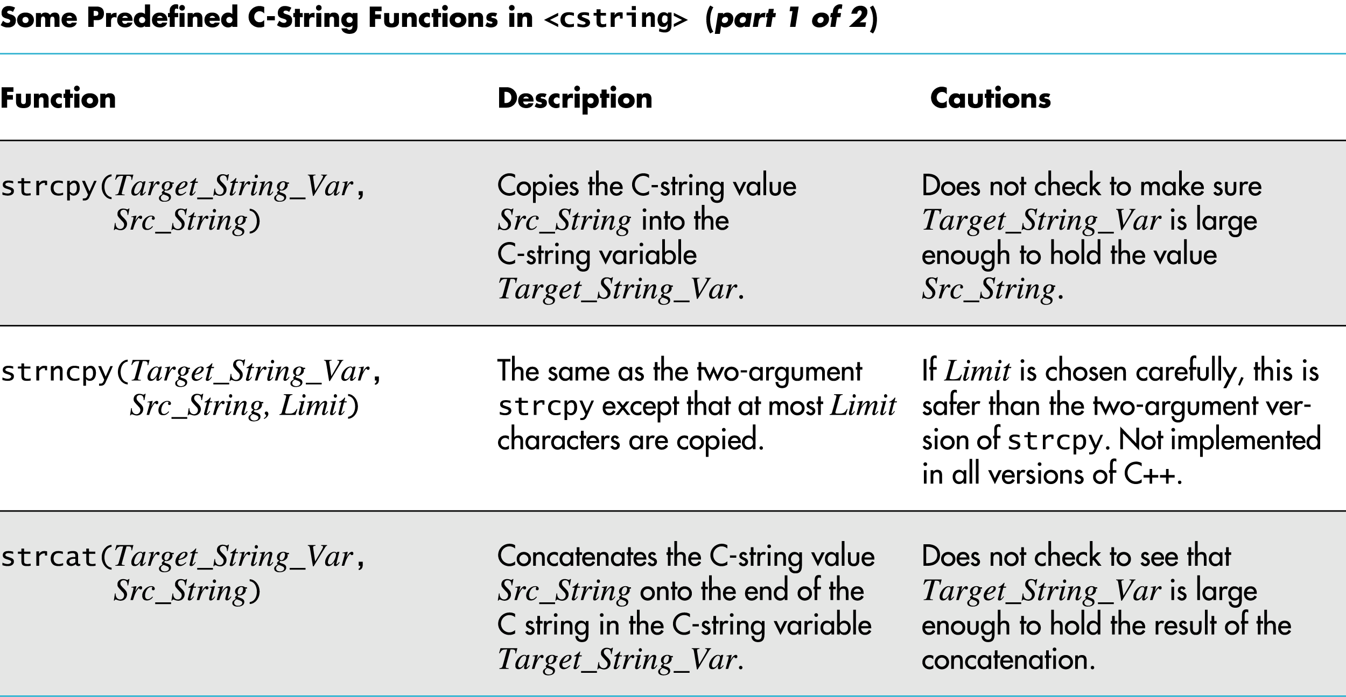
Display 8.1
(1/2)
Back
Next
Slide 8- <number>

Slide 78
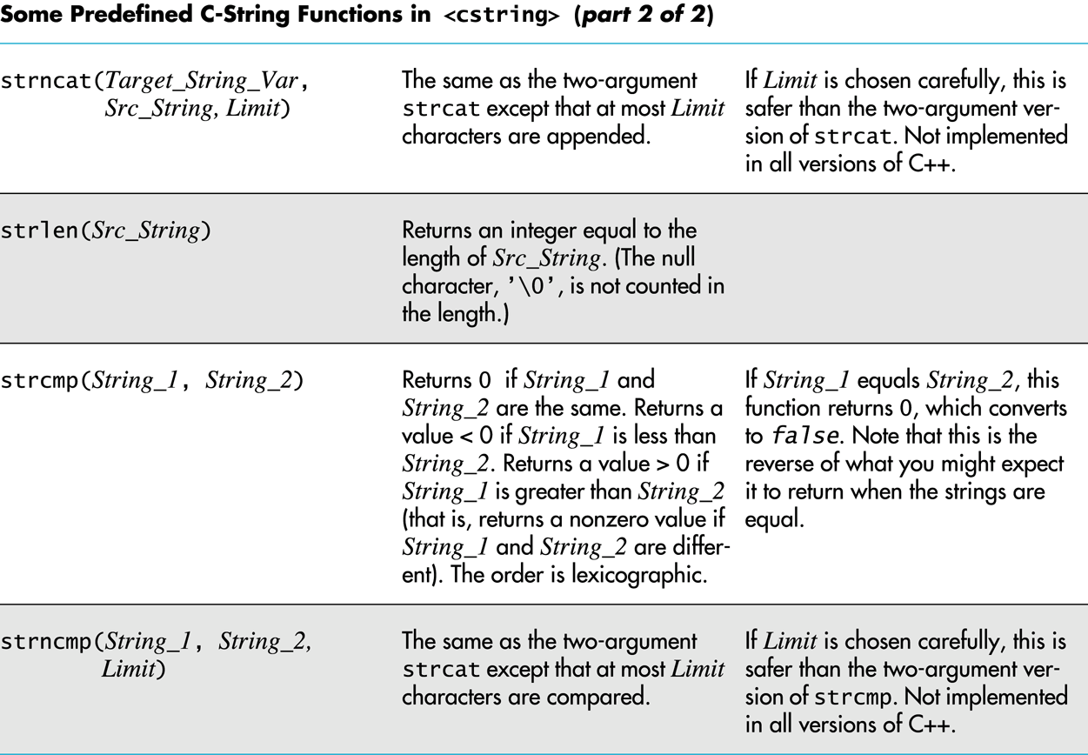
Display 8.1
(2/2)
Back
Next
Slide 8- <number>

Slide 79
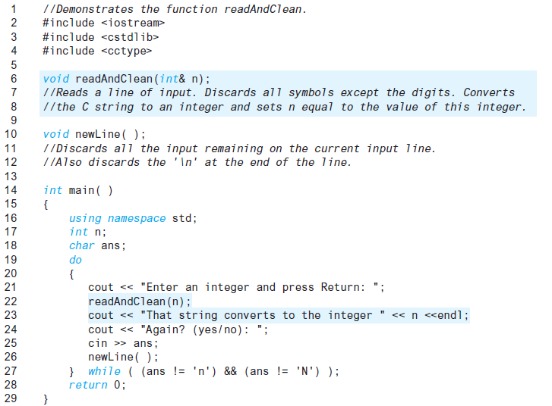
Display 8.2
(1/2)
Back
Next
Slide 8- <number>

Slide 80
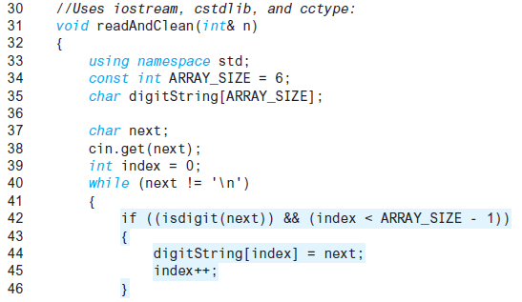
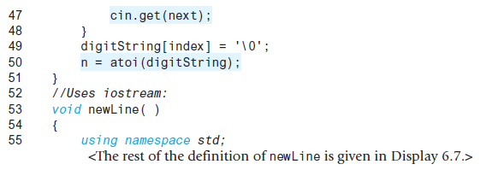
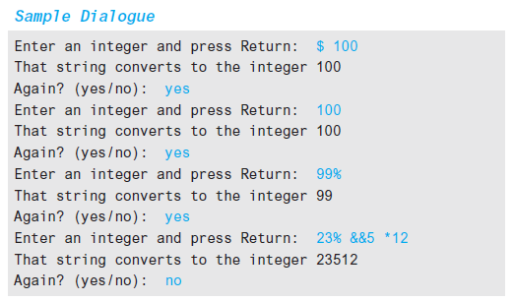
Display 8.2 (2/2)
Back
Next
Slide 8- <number>

Slide 81
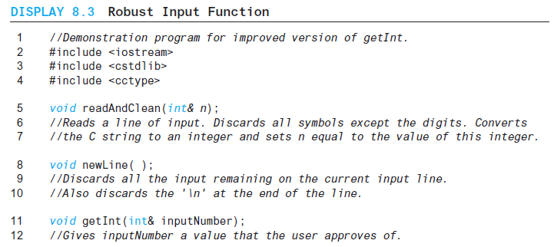
Display 8.3
(1/3)
Back
Next
Slide 8- <number>

Slide 82
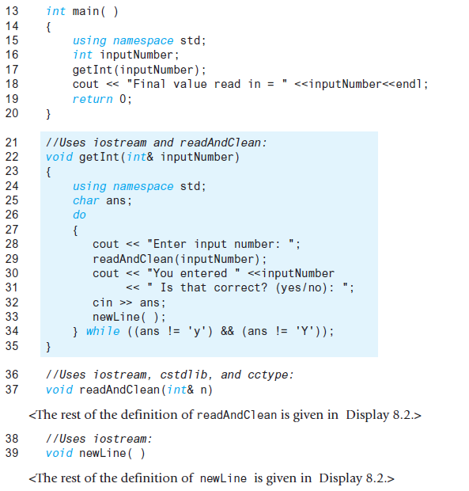
Display 8.3 (2/3)
Back
Next
Slide 8- <number>

Slide 83
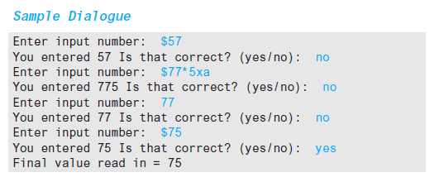
Display 8.3
(3/3)
Back
Next
Slide 8- <number>

Slide 84
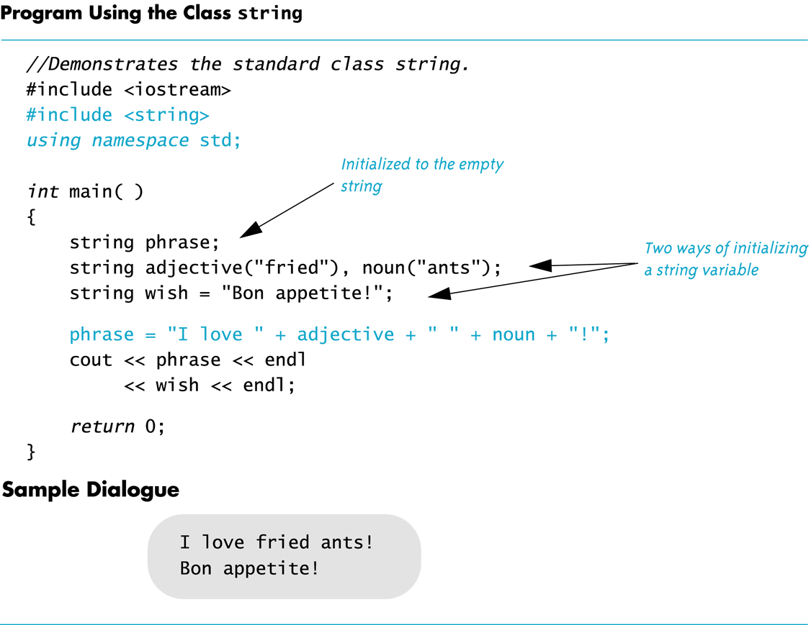
Display 8.4
Back
Next
Slide 8- <number>

Slide 85
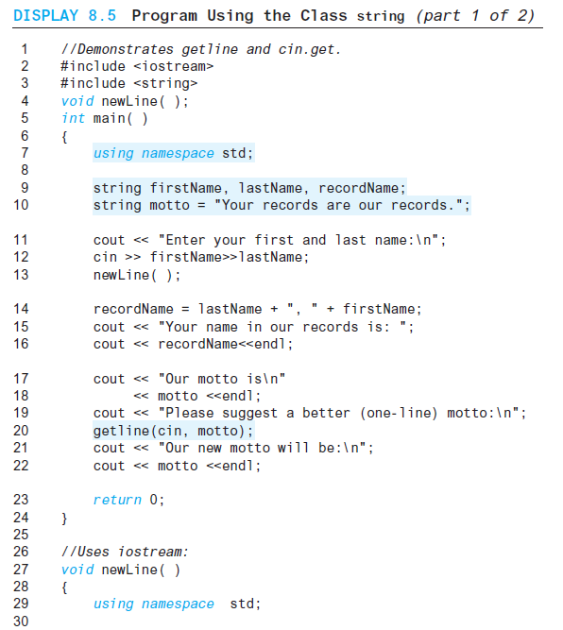
Display 8.5 (1/2)
Back
Next
Slide 8- <number>

Slide 86
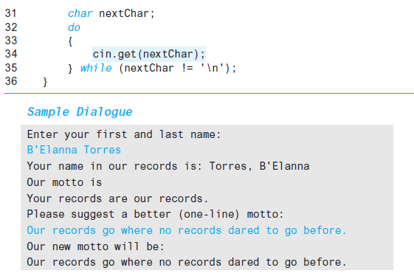
Display 8.5
(2/2)
Back
Next
Slide 8- <number>

Slide 87
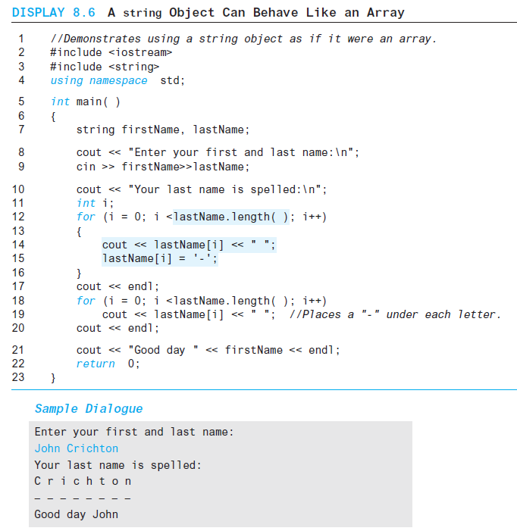
Display 8.6
Back
Next
Slide 8- <number>

Slide 88
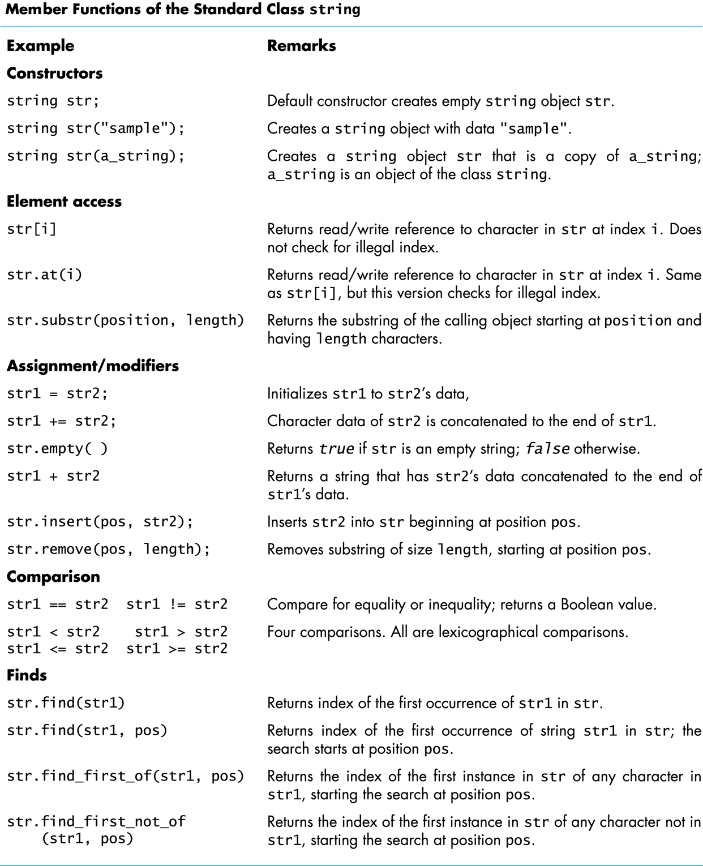
Display 8.7
Back
Next
Slide 8- <number>

Slide 89
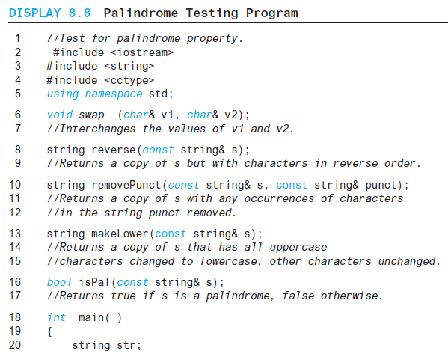
Display 8.8 (1/4)
Back
Next
Slide 8- <number>

Slide 90
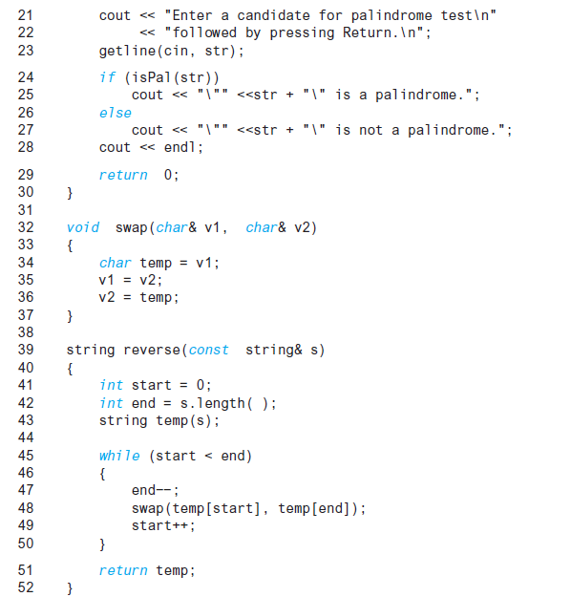
Display 8.8 (2/4)
Back
Next
Slide 8- <number>

Slide 91
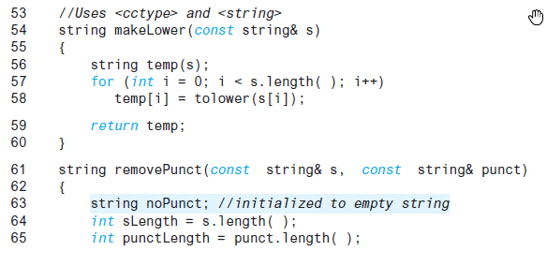
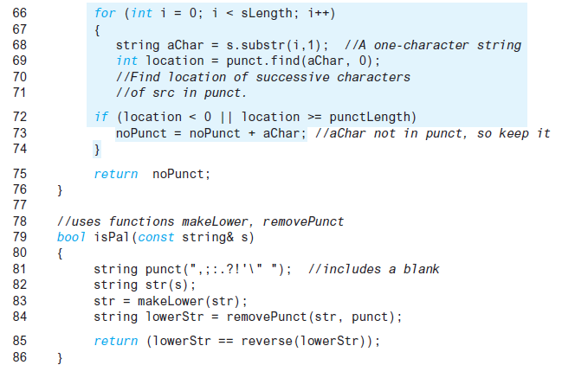
Display 8.8 (3/4)
Back
Next
Slide 8- <number>

Slide 92
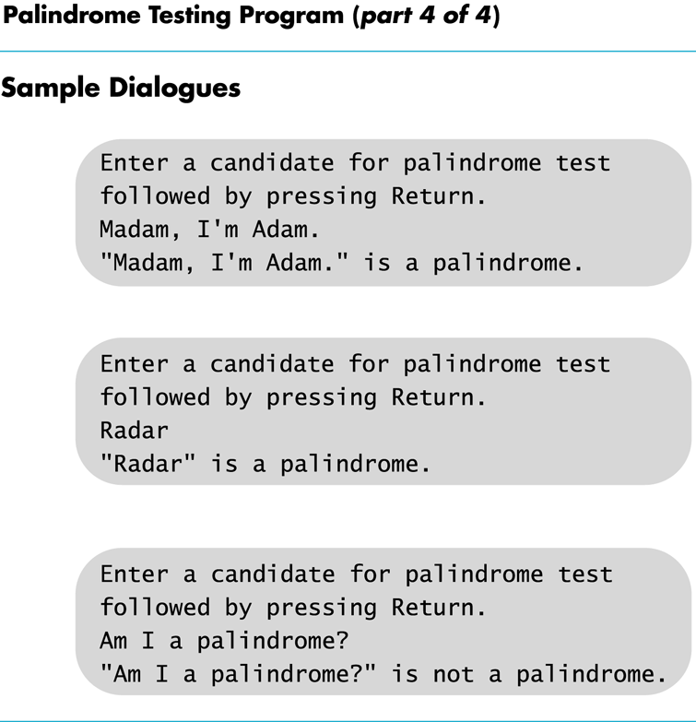
Display 8.8
(4/4)
Back
Next
Slide 8- <number>

Slide 93
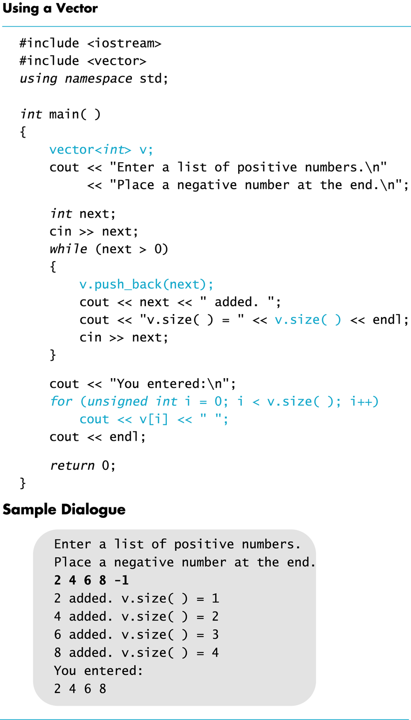
Display 8.9
Back
Next
Slide 8- <number>

