Slide 1
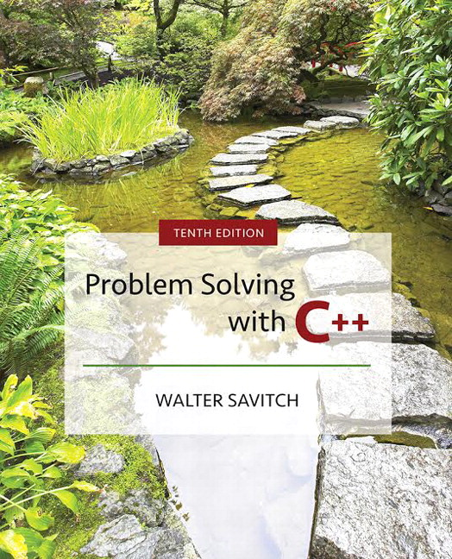

Slide 2
Chapter 9
Pointers and Dynamic Arrays

Slide 3
Overview
9.1 Pointers
9.2 Dynamic Arrays
Slide 9- <number>

Slide 4
9.1
Pointers

Slide 5
Pointers
A pointer is the memory address of a variable
Memory addresses can be used as names for
variables
  If a variable is stored in three memory locations, the address of the first can be used as a name for the variable.
  When a variable is used as a call-by-reference
  argument, its address is passed
Slide 9- <number>

Slide 6
Pointers Tell
Where To Find A Variable
An address used to tell where a variable is stored
in memory is a pointer
  Pointers "point" to a variable by telling where the variable is located
Slide 9- <number>

Slide 7
Declaring Pointers
Pointer variables must be declared to have a
pointer type
  Example: To declare a pointer variable p that can "point" to a variable of type double:
  double *p;
  The asterisk identifies p as a pointer variable
Slide 9- <number>

Slide 8
Multiple Pointer Declarations
To declare multiple pointers in a statement, use
the asterisk before each pointer variable
  Example:
  int *p1, *p2, v1, v2;
  p1 and p2 point to variables of type int
  v1 and v2 are variables of type int
Slide 9- <number>

Slide 9
The address of Operator
The & operator can be used to determine the
address of a variable which can be assigned to a
pointer variable
  Example: p1 = &v1;
  p1 is now a pointer to v1
  v1 can be called v1 or "the variable pointed to
  by p1"
Slide 9- <number>

Slide 10
The Dereferencing Operator
C++ uses the * operator in yet another way with
pointers
  The phrase "The variable pointed to by p" is
  translated into C++ as *p
  Here the * is the dereferencing operator
    p is said to be dereferenced
Slide 9- <number>

Slide 11
A Pointer Example
v1 = 0;
p1 = &v1;
*p1 = 42;
cout << v1 << endl;
cout << *p1 << endl;
output:
42
42
v1 and *p1 now refer to
the same variable
Slide 9- <number>

Slide 12
Pointer Assignment
The assignment operator = is used to assign
the value of one pointer to another
  Example: If p1 still points to v1 (previous slide)
  then
  p2 = p1;
  causes *p2, *p1, and v1 all to name
  the same variable
Slide 9- <number>

Slide 13
Caution! Pointer Assignments
Some care is required making assignments to
pointer variables
  p1= p3; // changes the location that p1 "points" to
  *p1 = *p3; // changes the value at the location that
  // p1 "points" to
Display 9.1
Slide 9- <number>

Slide 14
The new Operator
Using pointers, variables can be manipulated
even if there is no identifier for them
  To create a pointer to a new "nameless" variable of type int:
  p1 = new int;
  The new variable is referred to as *p1
  *p1 can be used anyplace an integer variable can
  cin >> *p1;
  *p1 = *p1 + 7;
Slide 9- <number>

Slide 15
Dynamic Variables
Variables created using the new operator are
called dynamic variables
  Dynamic variables are created and destroyed while the program is running
  Additional examples of pointers and dynamic
  variables are shown in
  An illustration of the code in Display 9.2 is
  seen in
Display 9.2
Display 9.3
Slide 9- <number>

Slide 16
new and Class Types
Using operator new with class types calls
a constructor as well as allocating memory
  If MyType is a class type, then
  MyType *myPtr; // creates a pointer to a
  // variable of type MyType
  myPtr = new MyType;
  // calls the default constructor
  myPtr = new MyType (32.0, 17);
  // calls Mytype(double, int);
Slide 9- <number>

Slide 17
Basic Memory Management
An area of memory called the freestore or the heap is reserved for dynamic variables
  New dynamic variables use memory in the freestore
  If all of the freestore is used, calls to new will fail
Unneeded memory can be recycled
  When variables are no longer needed, they can be deleted and the memory they used is returned to the freestore
Slide 9- <number>

Slide 18
The delete Operator
When dynamic variables are no longer needed,
delete them to return memory to the freestore
  Example:
  delete p;
  The value of p is now undefined and the memory used by the variable that p pointed to is back in the freestore
Slide 9- <number>

Slide 19
Dangling Pointers
Using delete on a pointer variable destroys the
dynamic variable pointed to
If another pointer variable was pointing to the
dynamic variable, that variable is also undefined
Undefined pointer variables are called
dangling pointers
  Dereferencing a dangling pointer (*p) is usually
  disasterous
Slide 9- <number>

Slide 20
Automatic Variables
Variables declared in a function are created by
C++ and destroyed when the function ends
  These are called automatic variables because their creation and destruction is controlled automatically
The programmer manually controls creation and
destruction of pointer variables with operators
new and delete
Slide 9- <number>

Slide 21
Global Variables
Variables declared outside any function definition
are global variables
  Global variables are available to all parts of a program
  Global variables are not generally used
Slide 9- <number>

Slide 22
Type Definitions
A name can be assigned to a type definition,
then used to declare variables
The keyword typedef is used to define new
type names
  Syntax:
  typedef Known_Type_Definition New_Type_Name;
    Known_Type_Definition can be any type
Slide 9- <number>

Slide 23
Defining Pointer Types
To avoid mistakes using pointers, define a
pointer type name
  Example: typedef int* IntPtr;
  Defines a new type, IntPtr, for pointer
  variables containing pointers to int variables
  IntPtr p;
  is equivalent to
  int *p;
Slide 9- <number>

Slide 24
Multiple Declarations Again
Using our new pointer type defined as
typedef int* IntPtr;
  Prevent this error in pointer declaration:
  int *P1, P2; // Only P1 is a pointer variable
with
IntPtr P1, P2; // P1 and P2 are pointer
// variables
Slide 9- <number>

Slide 25
Pointer Reference Parameters
A second advantage in using typedef to
define a pointer type is seen in parameter lists
  Example: void sampleFunction(IntPtr& pointerVar);
  is less confusing than
  void sampleFunction( int*& pointerVar);
Slide 9- <number>

Slide 26
Section 9.1 Conclusion
Can you
  Declare a pointer variable?
  Assign a value to a pointer variable?
  Use the new operator to create a new variable in the freestore?
  Write a definition for a type called NumberPtr to be a type for pointers to dynamic variables of type int?
  Use the NumberPtr type to declare a pointer variable called myPoint?
Slide 9- <number>

Slide 27
9.2
Dynamic Arrays

Slide 28
Dynamic Arrays
A dynamic array is an array whose size is
determined when the program is running, not
when you write the program
Slide 9- <number>

Slide 29
Pointer Variables and Array Variables
Array variables are actually pointer variables
that point to the first indexed variable
  Example: int a[10];
  typedef int* IntPtr;
  IntPtr p;
    Variables a and p are the same kind of variable
Since a is a pointer variable that points to a[0],
p = a;
causes p to point to the same location as a
Slide 9- <number>

Slide 30
Pointer Variables
As Array Variables
  Continuing the previous example:
  Pointer variable p can be used as if it were an
  array variable
  Example: p[0], p[1], …p[9]
  are all legal ways to use p
  Variable a can be used as a pointer variable
  except the pointer value in a cannot be changed
    This is not legal: IntPtr p2;
    … // p2 is assigned a value
    a = p2 // attempt to change a
Display 9.4
Display 9.5
Slide 9- <number>

Slide 31
Creating Dynamic Arrays
Normal arrays require that the programmer
determine the size of the array when the program
is written
  What if the programmer estimates too large?
    Memory is wasted
  What if the programmer estimates too small?
    The program may not work in some situations
Dynamic arrays can be created with just the
right size while the program is running
Slide 9- <number>

Slide 32
Creating Dynamic Arrays
Dynamic arrays are created using the new
operator
  Example: To create an array of 10 elements of
  type double:
  typedef double* DoublePtr;
  DoublePtr d;
  d = new double[10];
    d can now be used as if it were an ordinary array!
This could be an
integer variable!
Slide 9- <number>

Slide 33
Dynamic Arrays (cont.)
Pointer variable d is a pointer to d[0]
When finished with the array, it should be
deleted to return memory to the freestore
  Example: delete [ ] d;
    The brackets tell C++ a dynamic array is being deleted so it must check the size to know how many indexed variables to remove
    Forgetting the brackets, is not legal, but would tell the computer to remove only one variable
Display 9.6 (1)
Display 9.6 (2)
Slide 9- <number>

Slide 34
Pointer Arithmetic (Optional)
Arithmetic can be performed on the addresses
contained in pointers
  Using the dynamic array of doubles, d, declared previously, recall that d points to d[0]
  The expression d+1 evaluates to the address of d[1] and d+2 evaluates to the address of d[2]
    Notice that adding one adds enough bytes for one
    variable of the type stored in the array
Slide 9- <number>

Slide 35
Pointer Arthmetic Operations
You can add and subtract with pointers
  The ++ and - - operators can be used
  Two pointers of the same type can be subtracted to obtain the number of indexed variables between
    The pointers should be in the same array!
  This code shows one way to use pointer
  arithmetic:
  for (int i = 0; i < array_size; i++)
  cout << *(d + i) << " " ;
  // same as cout << d[i] << " " ;
Slide 9- <number>

Slide 36
Multidimensional Dynamic Arrays
To create a 3x4 multidimensional dynamic array
  View multidimensional arrays as arrays of arrays
  First create a one-dimensional dynamic array
    Start with a new definition:
    typedef int* IntArrayPtr;
    Now create a dynamic array of pointers named m:
    IntArrayPtr *m = new IntArrayPtr[3];
  For each pointer in m, create a dynamic array of int's
    for (int i = 0; i<3; i++)
    m[i] = new int[4];
Slide 9- <number>

Slide 37
A Multidimensial
Dynamic Array
The dynamic array created on the previous slide
could be visualized like this:
m
IntArrayPtr's
IntArrayPtr *
int's
Slide 9- <number>

Slide 38
Deleting
Multidimensional Arrays
To delete a multidimensional dynamic array
  Each call to new that created an array must have a corresponding call to delete[ ]
  Example: To delete the dynamic array created
  on a previous slide:
  for ( i = 0; i < 3; i++)
  delete [ ] m[i]; //delete the arrays of 4 int's
  delete [ ] m; // delete the array of IntArrayPtr's
Display 9.7 (1)
Display 9.7 (2)
Slide 9- <number>

Slide 39
Section 9.2 Conclusion
Can you
  Write a definition for pointer variables that will be used to point to dynamic arrays? The array elements are of type char. Call the type CharArray.
  Write code to fill array "entry" with 10 numbers
  typed at the keyboard?
  int * entry;
  entry = new int[10];
Slide 9- <number>

Slide 40
Chapter 9 -- End
Slide 9- <number>

Slide 41
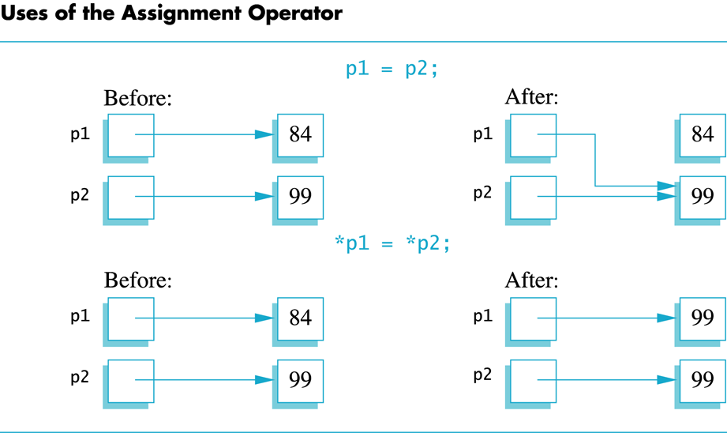
Display 9.1
Back
Next
Slide 9- <number>

Slide 42
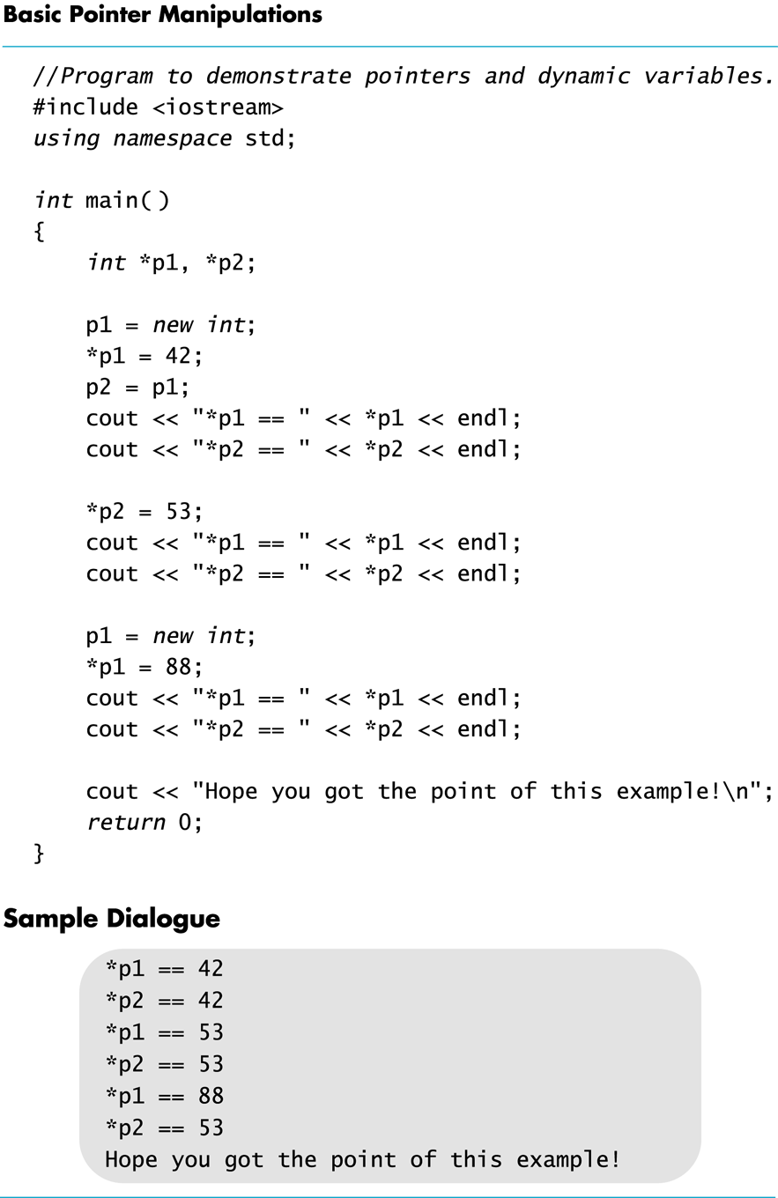
Display 9.2
Back
Next
Slide 9- <number>

Slide 43
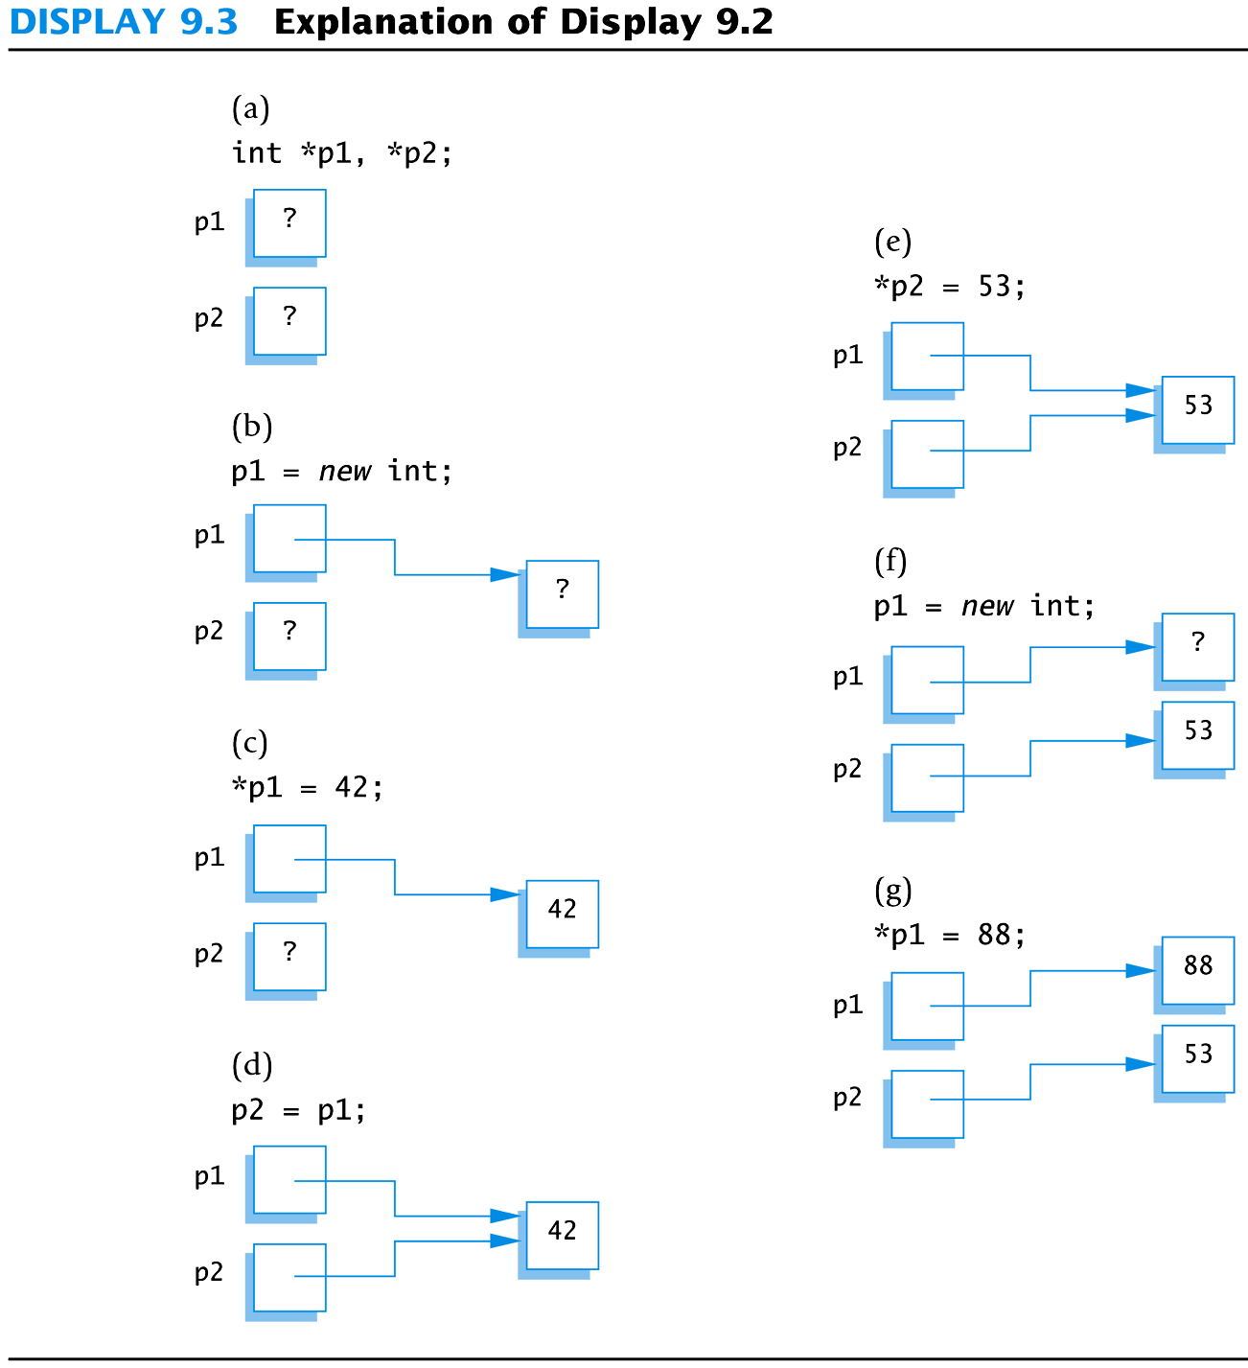
Display 9.3
Back
Next
Slide 9- <number>

Slide 44
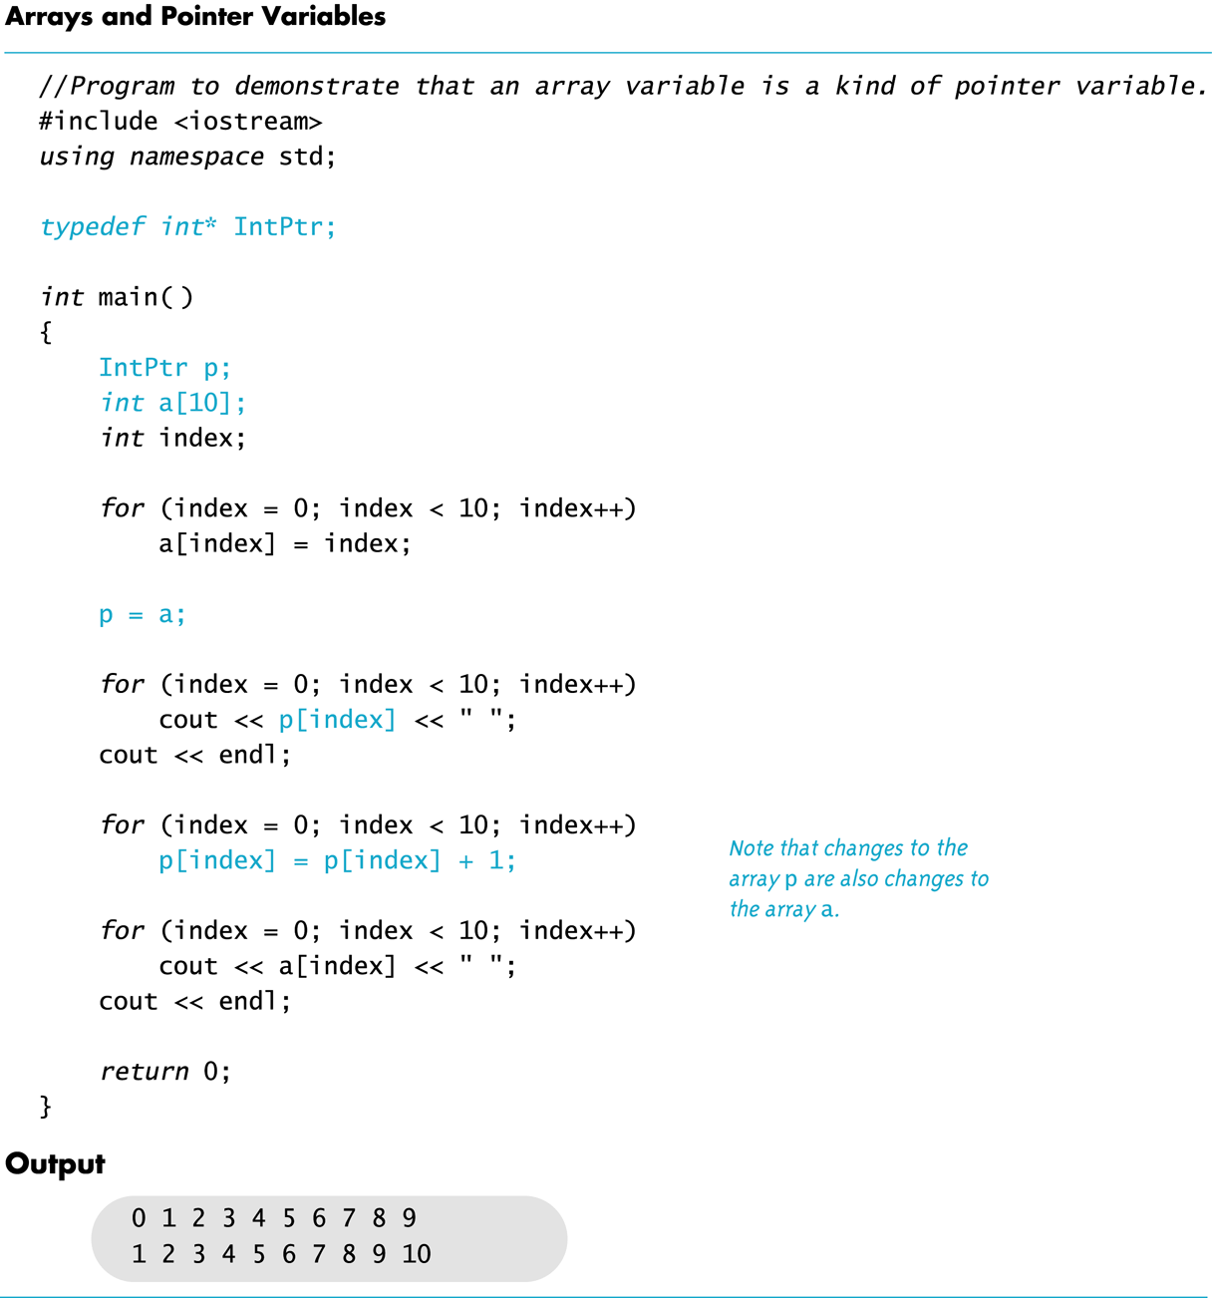
Display 9.4
Back
Next
Slide 9- <number>

Slide 45
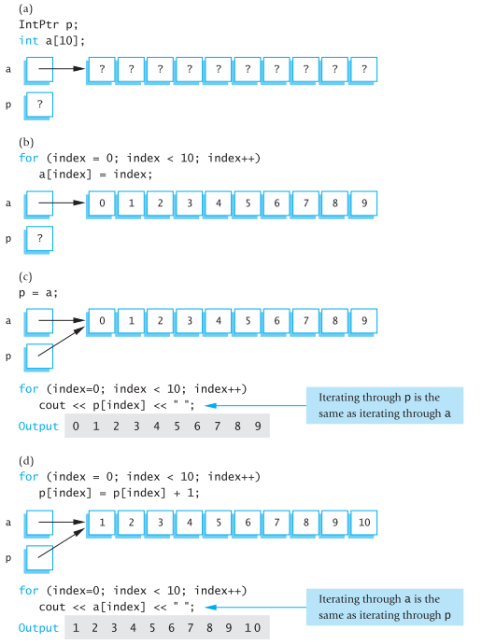
Display 9.5
Back
Next
Slide 9- <number>

Slide 46
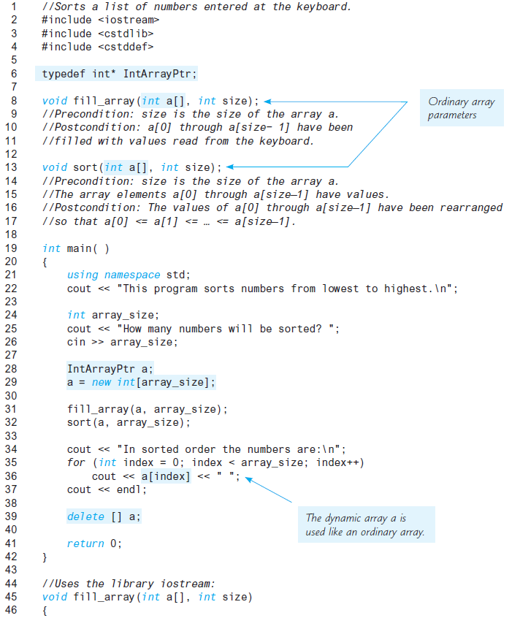
Display 9.6 (1/2)
Back
Next
Slide 9- <number>

Slide 47
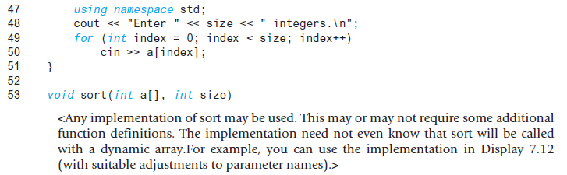
Display 9.6
(2/2)
Back
Next
Slide 9- <number>

Slide 48
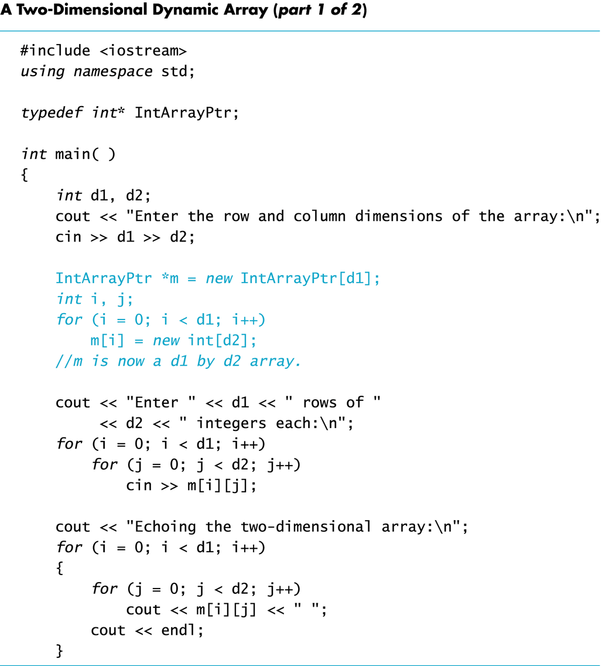
Display 9.7 (1/2)
Back
Next
Slide 9- <number>

Slide 49
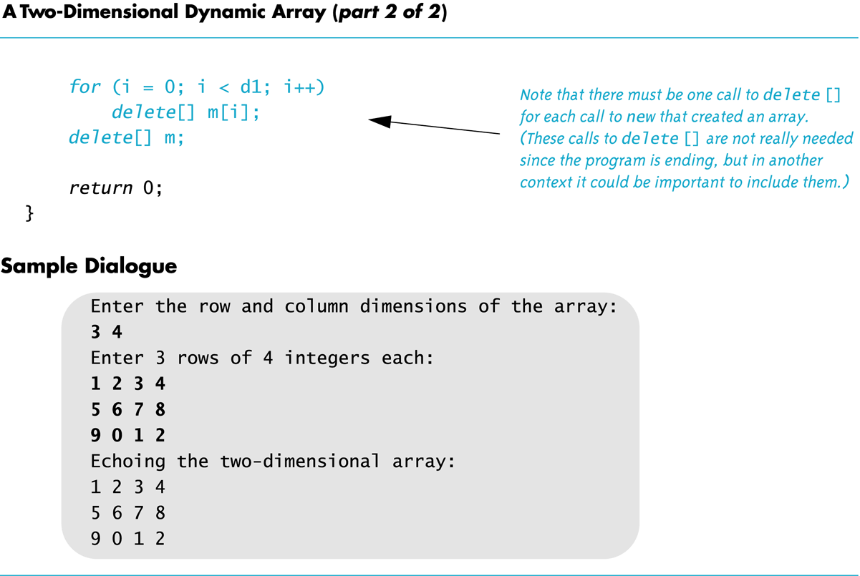
Display 9.7
(2/2)
Back
Next
Slide 9- <number>

