Slide 1
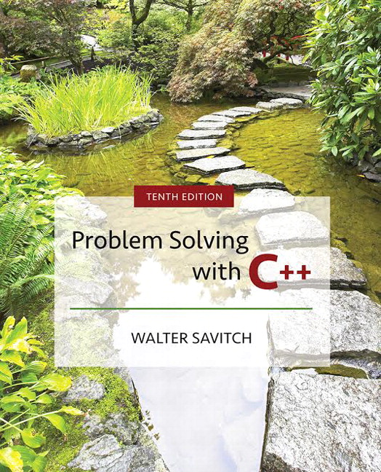

Slide 2
Chapter 10
Defining Classes

Slide 3
Overview
10.1 Structures
10.2 Classes
10.3 Abstract Data Types
10.4 Introduction to Inheritance
Slide 10- <number>

Slide 4
10.1
Structures

Slide 5
What Is a Class?
A class is a data type whose variables are objects
Some pre-defined data types you have used are
  int
  char
A pre-defined class you have used is
  ifstream
You can define your own classes as well
Slide 10- <number>

Slide 6
Class Definitions
A class definition includes
  A description of the kinds of values the variable
  can hold
  A description of the member functions
We will start by defining structures as a first
step toward defining classes
Slide 10- <number>

Slide 7
Structures
A structure can be viewed as an object
  Contains no member functions
  (The structures used here have no member functions)
  Contains multiple values of possibly different types
    The multiple values are logically related as a single item
    Example: A bank Certificate of Deposit (CD)
    has the following values:
    a balance
    an interest rate
    a term (months to maturity)
Slide 10- <number>

Slide 8
The CD Definition
The Certificate of Deposit structure can be
defined as
struct CDAccount
{
double balance;
double interestRate;
int term; //months to maturity
};
Keyword struct begins a structure definition
CDAccount is the structure tag or the structure’s type
Member names are identifiers declared in the braces
Remember this semicolon!
Slide 10- <number>

Slide 9
Using the Structure
Structure definition is generally placed outside
any function definition
  This makes the structure type available to all code
  that follows the structure definition
To declare two variables of type CDAccount:
CDAccount myAccount, yourAccount;
  myAccount and yourAccount contain distinct
  member variables balance, interestRate, and term
Slide 10- <number>

Slide 10
The Structure Value
The Structure Value
  Consists of the values of the member variables
The value of an object of type CDAccount
  Consists of the values of the member variables
  balance
  interestRate
  term
Slide 10- <number>

Slide 11
Specifying Member Variables
Member variables are specific to the
structure variable in which they are declared
  Syntax to specify a member variable:
  Structure_Variable_Name . Member_Variable_Name
  Given the declaration:
  CDAccount myAccount, yourAccount;
    Use the dot operator to specify a member variable
    myAccount.balance
    myAccount.interestRate
    myAccount.term
Slide 10- <number>

Slide 12
Using Member Variables
Member variables can be used just as any other
variable of the same type
  myAccount.balance = 1000;
  yourAccount.balance = 2500;
    Notice that myAccount.balance and yourAccount.balance
    are different variables!
  myAccount.balance = myAccount.balance + interest;
Display 10.1 (1)
Display 10.1 (2)
Display 10.2
Slide 10- <number>

Slide 13
Duplicate Names
Member variable names duplicated between
structure types are not a problem.
superGrow.quantity and apples.quantity are
different variables stored in different locations
struct FertilizerStock
{
double quantity;
double nitrogenContent;
};
FertilizerStock superGrow;
struct CropYield
{
int quantity;
double size;
};
CropYield apples;
Slide 10- <number>

Slide 14
Structures as Arguments
Structures can be arguments in function calls
  The formal parameter can be call-by-value
  The formal parameter can be call-by-reference
Example:
void getData(CDAccount& theAccount);
  Uses the structure type CDAccount we saw earlier as the type for a call-by-reference parameter
Slide 10- <number>

Slide 15
Structures as Return Types
Structures can be the type of a value returned by
a function
Example:
CDAccount shrinkWrap(double theBalance,
double theRate,
int theTerm)
{
CDAccount temp;
temp.balance = theBalance;
temp.interestRate = theRate;
temp.term = theTerm;
return temp;
}
Slide 10- <number>

Slide 16
Using Function shrinkWrap
shrinkWrap builds a complete structure value
in temp, which is returned by the function
We can use shrinkWrap to give a variable of
type CDAccount a value in this way:
CDAccount newAccount;
newAccount = shrinkWrap(1000.00, 5.1, 11);
Slide 10- <number>

Slide 17
Assignment and Structures
The assignment operator can be used to assign
values to structure types
Using the CDAccount structure again:
CDAccount myAccount, yourAccount;
myAccount.balance = 1000.00;
myAccount.interestRate = 5.1;
myAccount.term = 12;
yourAccount = myAccount;
  Assigns all member variables in yourAccount the
  corresponding values in myAccount
Slide 10- <number>

Slide 18
Hierarchical Structures
Structures can contain member variables that are also structures
struct PersonInfo contains a Date structure
struct PersonInfo
{
double height;
int weight;
Date birthday;
};
struct Date
{
int month;
int day;
int year;
};
Slide 10- <number>

Slide 19
Using PersonInfo
A variable of type PersonInfo is declared by
PersonInfo person1;
To display the birth year of person1, first access the
birthday member of person1
cout << person1.birthday…
But we want the year, so we now specify the
year member of the birthday member
cout << person1.birthday.year;
Slide 10- <number>

Slide 20
Initializing Classes
A structure can be initialized when declared
Example:
struct Date
{
int month;
int day;
int year;
};
  Can be initialized in this way
  Date dueDate = {12, 31, 2004};
Slide 10- <number>

Slide 21
Section 10.1 Conclusion
Can you
  Write a definition for a structure type for records consisting of a person’s wage rate, accrued vacation (in whole days), and status (hourly or salaried). Represent the status as one of the two character values ‘H’ and ‘S’. Call the type EmployeeRecord.
Slide 10- <number>

Slide 22
10.2
Classes

Slide 23
Classes
A class is a data type whose variables are
objects
  The definition of a class includes
    Description of the kinds of values of the member
    variables
    Description of the member functions
  A class description is somewhat like a structure definition plus the member variables
Slide 10- <number>

Slide 24
A Class Example
To create a new type named DayOfYear as
a class definition
  Decide on the values to represent
  This example’s values are dates such as July 4
  using an integer for the number of the month
    Member variable month is an int (Jan = 1, Feb = 2, etc.)
    Member variable day is an int
  Decide on the member functions needed
  We use just one member function named output
Slide 10- <number>

Slide 25
Class DayOfYear Definition
  class DayOfYear
  {
  public:
  void output( );
  int month;
  int day;
  };
Member Function Declaration
Slide 10- <number>

Slide 26
Defining a Member Function
Member functions are declared in the class
declaration
Member function definitions identify the class
in which the function is a member
  void DayOfYear::output()
  {
  cout << “month = “ << month
  << “, day = “ << day
  << endl;
  }
Slide 10- <number>

Slide 27
Member Function Definition
Member function definition syntax:
Returned_Type Class_Name::Function_Name(Parameter_List)
{
Function Body Statements
}
  Example: void DayOfYear::output( )
  {
  cout << “month = “ << month
  << “, day = “ << day << endl;
  }
Slide 10- <number>

Slide 28
The ‘::’ Operator
‘::’ is the scope resolution operator
  Tells the class a member function is a member of
  void DayOfYear::output( ) indicates that function output is a member of the DayOfYear class
  The class name that precedes ‘::’ is a type qualifier
Slide 10- <number>

Slide 29
‘::’ and ‘.’
‘::’ used with classes to identify a member
void DayOfYear::output( )
{
// function body
}
‘.’used with variables to identify a member
DayOfYear birthday;
birthday.output( );
Slide 10- <number>

Slide 30
Calling Member Functions
Calling the DayOfYear member function output
is done in this way:
DayOfYear today, birthday;
today.output( );
birthday.output( );
  Note that today and birthday have their own
  versions of the month and day variables for use by the output function
Display 10.3 (1)
Display 10.3 (2)
Slide 10- <number>

Slide 31
Encapsulation
Encapsulation is
  Combining a number of items, such as variables and functions, into a single package such as an object of a class
Slide 10- <number>

Slide 32
Problems With DayOfYear
Changing how the month is stored in the class
DayOfYear requires changes to the program
If we decide to store the month as three
characters (JAN, FEB, etc.) instead of an int
  cin >> today.month will no longer work because
  we now have three character variables to read
  if(today.month == birthday.month) will no longer
  work to compare months
  The member function “output” no longer works
Slide 10- <number>

Slide 33
Ideal Class Definitions
Changing the implementation of DayOfYear
requires changes to the program that uses
DayOfYear
An ideal class definition of DayOfYear could
be changed without requiring changes to
the program that uses DayOfYear
Slide 10- <number>

Slide 34
Fixing DayOfYear
To fix DayOfYear
  We need to add member functions to use when
  changing or accessing the member variables
    If the program never directly references the member
    variables, changing how the variables are stored will not
    require changing the program
  We need to be sure that the program does not ever
  directly reference the member variables
Slide 10- <number>

Slide 35
Public Or Private?
C++ helps us restrict the program from directly
referencing member variables
  private members of a class can only be referenced within the definitions of member functions
    If the program tries to access a private member, the
    compiler gives an error message
  Private members can be variables or functions
Slide 10- <number>

Slide 36
Private Variables
Private variables cannot be accessed directly
by the program
  Changing their values requires the use of public
  member functions of the class
  To set the private month and day variables in a new
  DayOfYear class use a member function such as
  void DayOfYear::set(int new_month, int new_day)
  {
  month = new_month;
  day = new_day;
  }
Slide 10- <number>

Slide 37
Public or Private Members
The keyword private identifies the members of
a class that can be accessed only by member
functions of the class
  Members that follow the keyword private are
  private members of the class
The keyword public identifies the members of
a class that can be accessed from outside the
class
  Members that follow the keyword public are public
  members of the class
Slide 10- <number>

Slide 38
A New DayOfYear
The new DayOfYear class demonstrated in
Display 10.4…
  Uses all private member variables
  Uses member functions to do all manipulation of the private member variables
    Member variables and member function definitions can be
    changed without changes to the
    program that uses DayOfYear
Display 10.4 (1)
Display 10.4 (2)
Slide 10- <number>

Slide 39
Using Private Variables
It is normal to make all member variables private
Private variables require member functions to
perform all changing and retrieving of values
  Accessor functions allow you to obtain the
  values of member variables
    Example: getDay in class DayOfYear
  Mutator functions allow you to change the values
  of member variables
    Example: set in class DayOfYear
Slide 10- <number>

Slide 40
General Class Definitions
The syntax for a class definition is
  class Class_Name
  {
  public:
  Member_Specification_1
  Member_Specification_2
  …
  Member_Specification_3
  private:
  Member_Specification_n+1
  Member_Specification_n+2
  …
  };
Slide 10- <number>

Slide 41
Declaring an Object
Once a class is defined, an object of the class is
declared just as variables of any other type
  Example: To create two objects of type Bicycle:
  class Bicycle
  {
  // class definition lines
  };
  Bicycle myBike, yourBike;
Slide 10- <number>

Slide 42
The Assignment Operator
Objects and structures can be assigned values
with the assignment operator (=)
  Example:
  DayOfYear dueDate, tomorrow;
  tomorrow.set(11, 19);
  dueDate = tomorrow;
Slide 10- <number>

Slide 43
Program Example:
BankAccount Class
This bank account class allows
  Withdrawal of money at any time
  All operations normally expected of a bank account (implemented with member functions)
  Storing an account balance
  Storing the account’s interest rate
Display 10.5 ( 1)
Display 10.5 ( 3)
Display 10.5 ( 2)
Display 10.5 ( 4)
Slide 10- <number>

Slide 44
Calling Public Members
Recall that if calling a member function from the
main function of a program, you must include
the the object name:
account1.update( );
Slide 10- <number>

Slide 45
Calling Private Members
When a member function calls a private
member function, an object name is not used
  fraction (double percent);
  is a private member of the BankAccount class
  fraction is called by member function update
  void BankAccount::update( )
  {
  balance = balance +
  fraction(interestRate)* balance;
  }
Slide 10- <number>

Slide 46
Constructors
A constructor can be used to initialize member
variables when an object is declared
  A constructor is a member function that is usually
  public
  A constructor is automatically called when an object
  of the class is declared
  A constructor’s name must be the name of the class
  A constructor cannot return a value
    No return type, not even void, is used in declaring or
    defining a constructor
Slide 10- <number>

Slide 47
Constructor Declaration
A constructor for the BankAccount class could
be declared as:
class BankAccount
{
public:
BankAccount(int dollars, int cents, double rate);
//initializes the balance to $dollars.cents
//initializes the interest rate to rate percent
…//The rest of the BankAccount definition
};
Slide 10- <number>

Slide 48
Constructor Definition
The constructor for the BankAccount class
could be defined as
BankAccount::BankAccount(int dollars, int cents, double rate)
{
if ((dollars < 0) || (cents < 0) || ( rate < 0 ))
{
cout << “Illegal values for money or rate\n”;
exit(1);
}
balance = dollars + 0.01 * cents;
interestRate = rate;
}
  Note that the class name and function name are the same
Slide 10- <number>

Slide 49
Calling A Constructor (1)
A constructor is not called like a normal member
function:
BankAccount account1;
account1.BankAccount(10, 50, 2.0);
Slide 10- <number>

Slide 50
Calling A Constructor (2)
A constructor is called in the object declaration
BankAccount account1(10, 50, 2.0);
  Creates a BankAccount object and calls the
  constructor to initialize the member variables
Slide 10- <number>

Slide 51
Overloading Constructors
Constructors can be overloaded by defining
constructors with different parameter lists
  Other possible constructors for the BankAccount
  class might be
  BankAccount (double balance, double interestRate);
  BankAccount (double balance);
  BankAccount (double interestRate);
  BankAccount ( );
Slide 10- <number>

Slide 52
The Default Constructor
A default constructor uses no parameters
A default constructor for the BankAccount class
could be declared in this way
class BankAccount
{
public:
BankAccount( );
// initializes balance to $0.00
// initializes rate to 0.0%
… // The rest of the class definition
};
Slide 10- <number>

Slide 53
Default Constructor Definition
The default constructor for the BankAccount
class could be defined as
BankAccount::BankAccount( )
{
balance = 0;
rate = 0.0;
}
It is a good idea to always include a default constructor
even if you do not want to initialize variables
Slide 10- <number>

Slide 54
Calling the Default Constructor
The default constructor is called during
declaration of an object
  An argument list is not used
  BankAccount account1;
  // uses the default BankAccount constructor
  BankAccount account1( );
  // Is not legal
Display 10.6 (1)
Display 10.6 (2)
Display 10.6 (3)
Slide 10- <number>

Slide 55
Initialization Sections
An initialization section in a function definition
provides an alternative way to initialize
member variables
  BankAccount::BankAccount( ): balance(0),
  interestRate(0.0);
  {
  // No code needed in this example
  }
  The values in parenthesis are the initial values for the
  member variables listed
Slide 10- <number>

Slide 56
Parameters and Initialization
Member functions with parameters can use
initialization sections
BankAccount::BankAccount(int dollars, int cents, double rate)
: balance (dollars + 0.01 * cents),
interestRate(rate)
{
if (( dollars < 0) || (cents < 0) || (rate < 0))
{
cout << “Illegal values for money or rate\n”;
exit(1);
}
}
  Notice that the parameters can be arguments in the initialization
Slide 10- <number>

Slide 57
Member Initializers
C++11 supports a feature called member initialization
  Simply set member variables in the class
  Ex: class Coordinate
      {
      private:
      int x=1;
      int y=2;
      ...
      };
  Creating a Coordinate object will initialize its x variable to 1 and y to 2 (assuming a constructor isn’t called that sets the values to something else)
Slide 10- <number>

Slide 58
Constructor Delegation
C++11 also supports constructor delegation. This lets you have a constructor invoke another constructor in the initialization section.
For example, make the default constructor call a second constructor that sets X to 99 and Y to 99:
Coordinate::Coordinate() : Coordinate(99,99)
{ }
Slide 10- <number>

Slide 59
Section 10.2 Conclusion
Can you
  Describe the difference between a class and
  a structure?
  Explain why member variables are usually private?
  Describe the purpose of a constructor?
  Use an initialization section in a function definition?
Slide 10- <number>

Slide 60
10.3
Abstract Data Types

Slide 61
Abstract Data Types
A data type consists of a collection of values
together with a set of basic operations
defined on the values
A data type is an Abstract Data Type (ADT)
if programmers using the type do not have
access to the details of how the values and
operations are implemented
Slide 10- <number>

Slide 62
Classes To Produce ADTs
To define a class so it is an ADT
  Separate the specification of how the type is used
  by a programmer from the details of how the type
  is implemented
  Make all member variables private members
  Basic operations a programmer needs should be
  public member functions
  Fully specify how to use each public function
  Helper functions should be private members
Slide 10- <number>

Slide 63
ADT Interface
The ADT interface tells how to use the ADT in
a program
  The interface consists of
    The public member functions
    The comments that explain how to use the functions
  The interface should be all that is needed to know how to use the ADT in a program
Slide 10- <number>

Slide 64
ADT Implementation
The ADT implementation tells how the
interface is realized in C++
  The implementation consists of
    The private members of the class
    The definitions of public and private member functions
  The implementation is needed to run a program
  The implementation is not needed to write the
  main part of a program or any non-member functions
Slide 10- <number>

Slide 65
ADT Benefits
Changing an ADT implementation does require
changing a program that uses the ADT
ADT’s make it easier to divide work among
different programmers
  One or more can write the ADT
  One or more can write code that uses the ADT
Writing and using ADTs breaks the larger
programming task into smaller tasks
Slide 10- <number>

Slide 66
Program Example
The BankAccount ADT
In this version of the BankAccount ADT
  Data is stored as three member variables
    The dollars part of the account balance
    The cents part of the account balance
    The interest rate
  This version stores the interest rate as a fraction
  The public portion of the class definition remains
  unchanged from the version of Display 10.6
Display 10.7 (1)
Display 10.7 (3)
Display 10.7 (2)
Slide 10- <number>

Slide 67
Interface Preservation
To preserve the interface of an ADT so that
programs using it do not need to be changed
  Public member declarations cannot be changed
  Public member definitions can be changed
  Private member functions can be added, deleted, or changed
Slide 10- <number>

Slide 68
Information Hiding
Information hiding was refered to earlier as
writing functions so they can be used like
black boxes
ADT’s implement information hiding because
  The interface is all that is needed to use the ADT
  Implementation details of the ADT are not needed
  to know how to use the ADT
  Implementation details of the data values are not
  needed to know how to use the ADT
Slide 10- <number>

Slide 69
Section 10.3 Conclusion
Can you
  Describe an ADT?
  Describe how to implement an ADT in C++?
  Define the interface of an ADT?
  Define the implementation of an ADT?
Slide 10- <number>

Slide 70
10.4
Introduction to Inheritance

Slide 71
Inheritance
Inheritance refers to derived classes
  Derived classes are obtained from another class
  by adding features
  A derived class inherits the member functions and variables from its parent class without having to re-write them
  Example
    In Chapter 6 we saw that the class of input-file streams is derived from the
    class of all input streams by adding member
    functions such as open and close
    cin belongs to the class of all input streams, but not
    the class of input-file streams
Slide 10- <number>

Slide 72
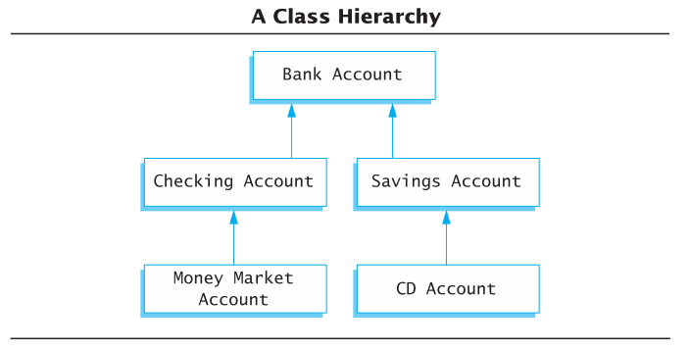
Inheritance Example
Natural hierarchy of bank accounts
Most general: A Bank Account stores a balance
A Checking Account “IS A” Bank Account that allows customers to write checks
A Savings Account “IS A” Bank Account without checks but higher interest
Accounts are more specific as we go down the hierarchy
Each box can be a class
Slide 10- <number>

Slide 73
Inheritance Relationships
The more specific class is a derived or child class
The more general class is the base, super, or parent class
If class B is derived from class A
  Class B is a derived class of class A
  Class B is a child of class A
  Class A is the parent of class B
  Class B inherits the member functions and variables of class A
Slide 10- <number>

Slide 74
Defining Derived Classes
Give the class name as normal, but add a colon and then the name of the base class
Objects of type SavingsAccount can access member functions defined in SavingsAccount or BankAccount
class SavingsAccount : public BankAccount
{
…
}
Display 10.9 (1-3)
Slide 10- <number>

Slide 75
Section 10.4 Conclusion
Can you
  Define object?
  Define class?
  Describe the relationship between parent and child
  classes?
  Describe the benefit of inheritance?
Slide 10- <number>

Slide 76
Chapter 10 -- End
Slide 10- <number>

Slide 77
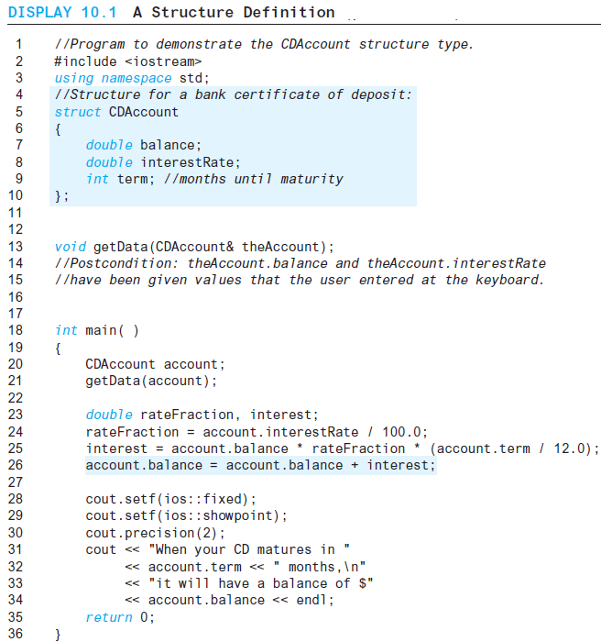
Display 10.1 (1/2)
Back
Next
Slide 10- <number>

Slide 78
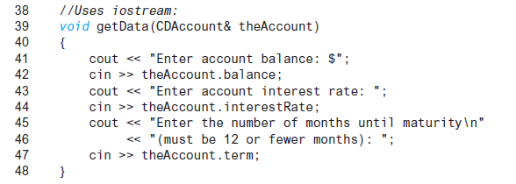
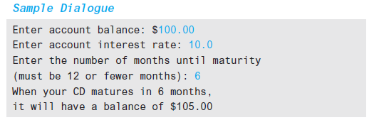
Display 10.1
(2/2)
Back
Next
Slide 10- <number>

Slide 79
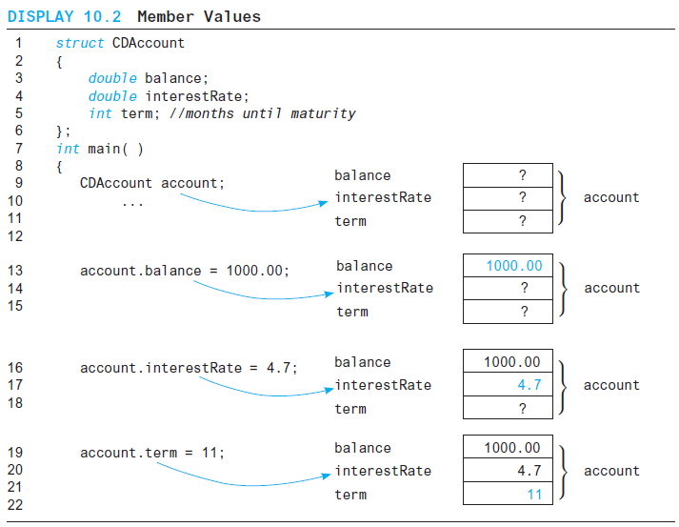
Display 10.2
Back
Next
Slide 10- <number>

Slide 80
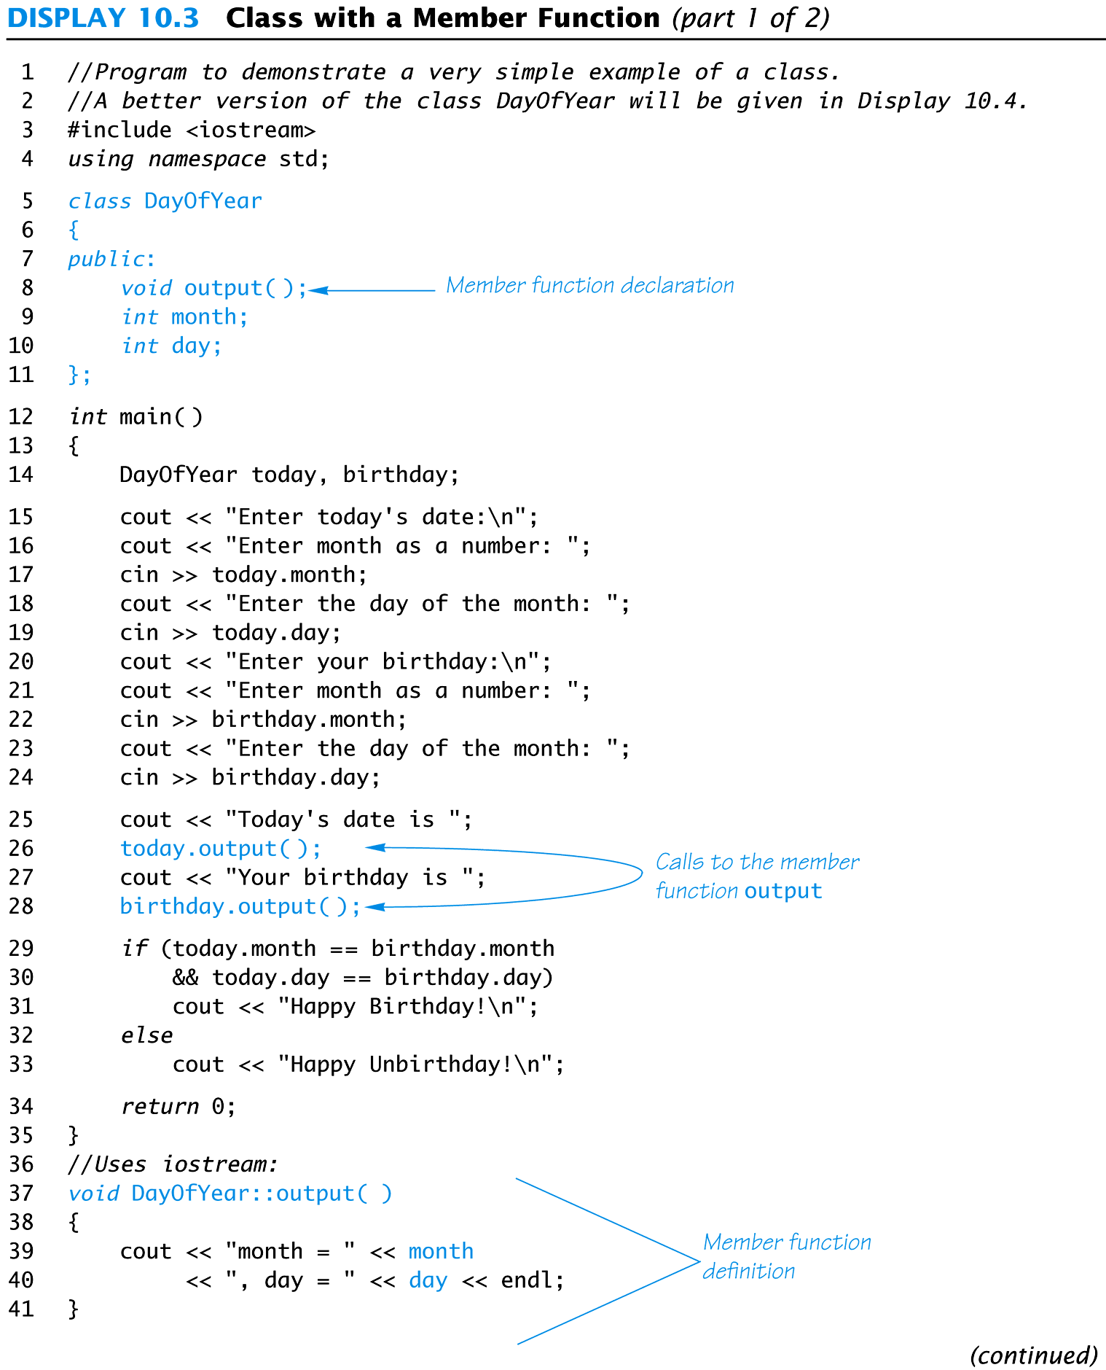
Display 10.3 (1/2)
Back
Next
Slide 10- <number>

Slide 81
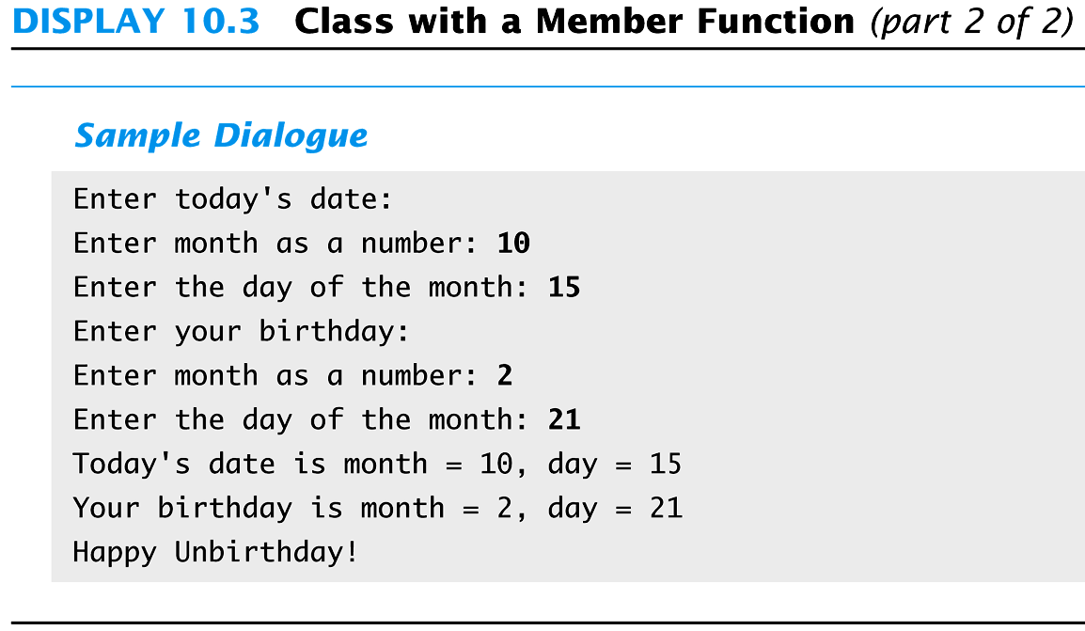
Display 10.3
(2/2)
Back
Next
Slide 10- <number>

Slide 82
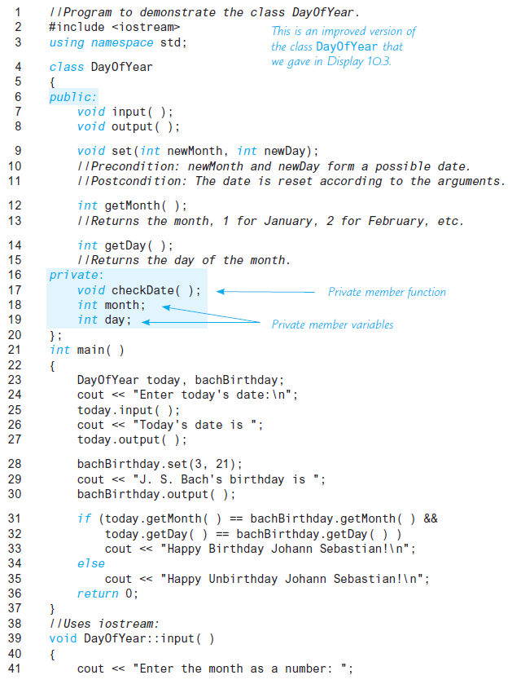
Display 10.4 (1/2)
Back
Next
Slide 10- <number>

Slide 83
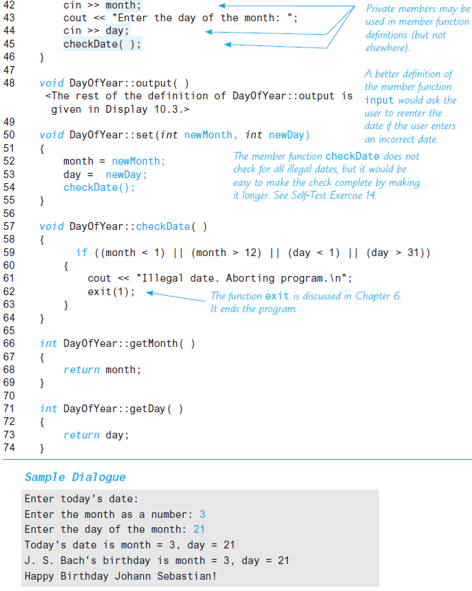
Display 10.4 (2/2)
Back
Next
Slide 10- <number>

Slide 84
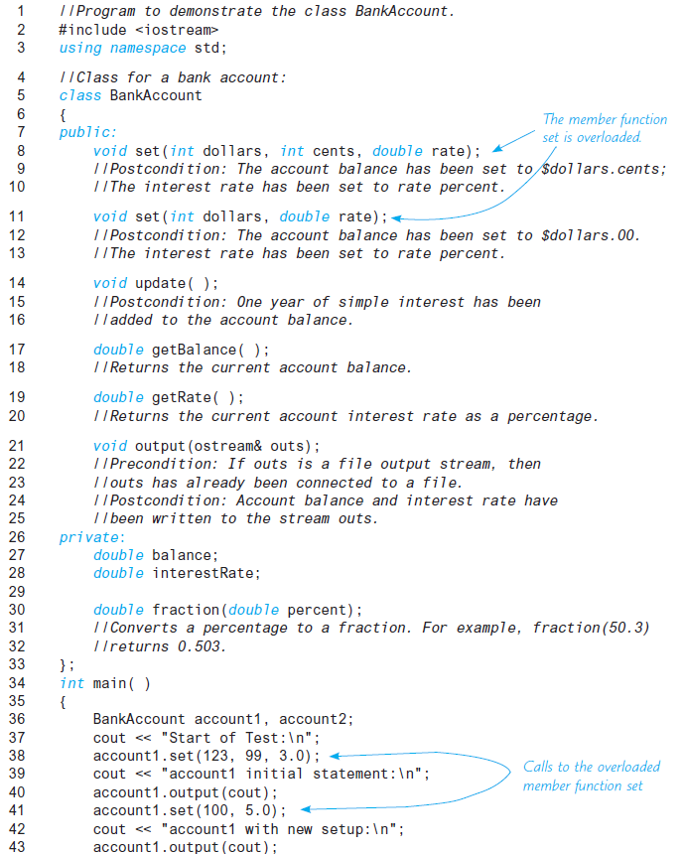
Display 10.5 (1/4)
Back
Next
Slide 10- <number>

Slide 85
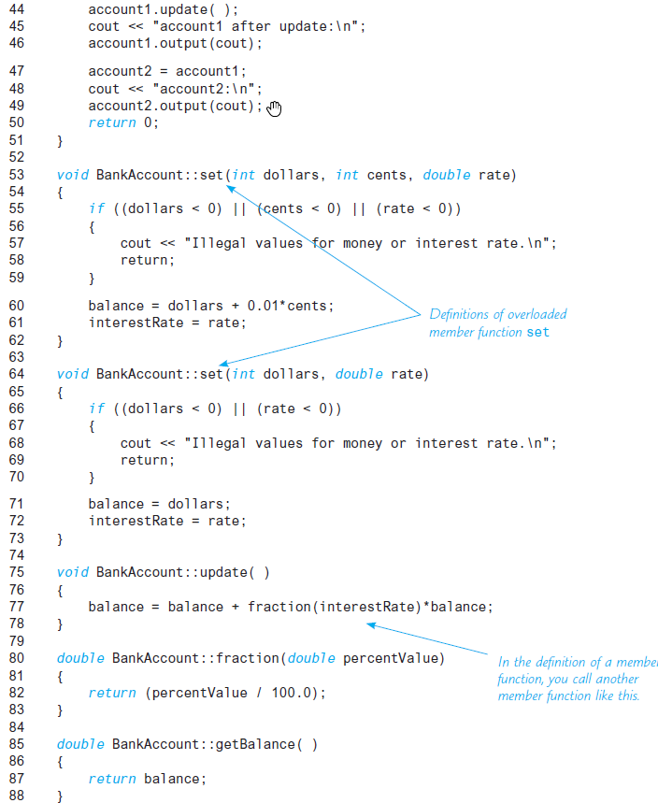
Display 10.5 (2/4)
Back
Next
Slide 10- <number>

Slide 86
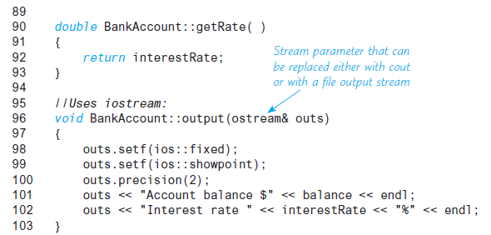
Display 10.5
(3/4)
Back
Next
Slide 10- <number>

Slide 87
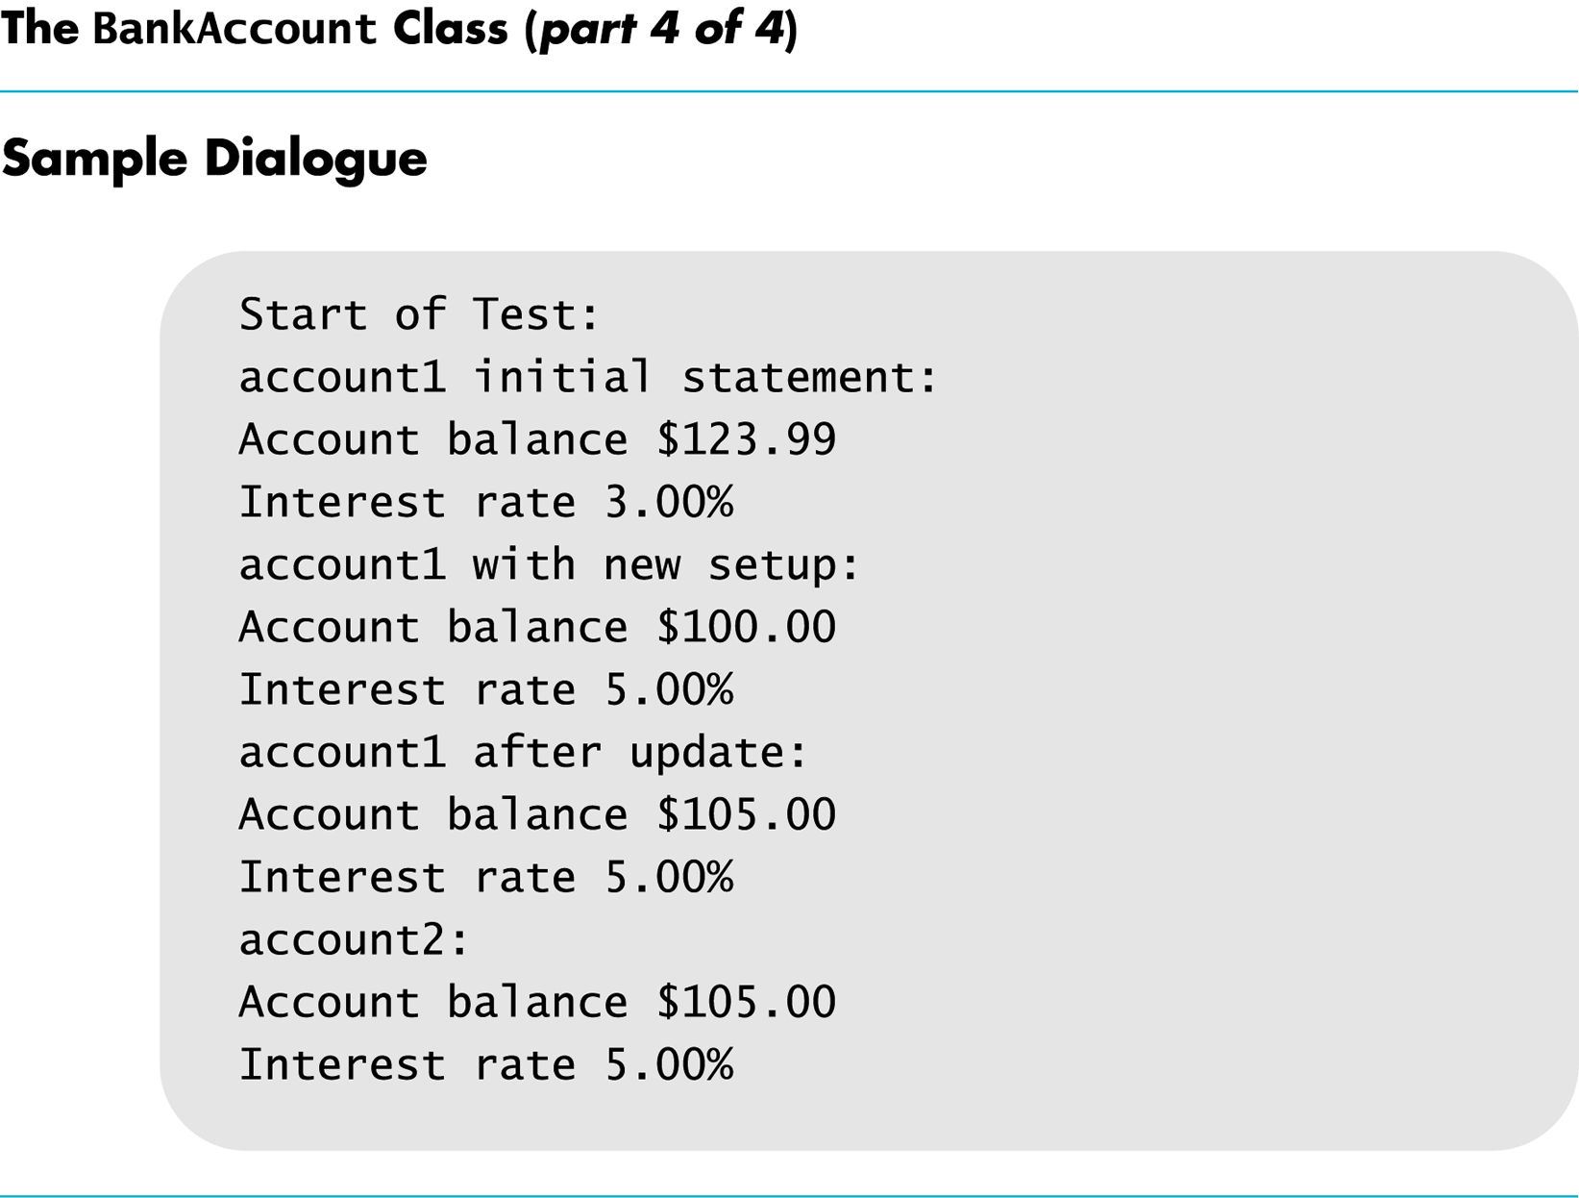
Display 10.5
(4/4)
Back
Next
Slide 10- <number>

Slide 88
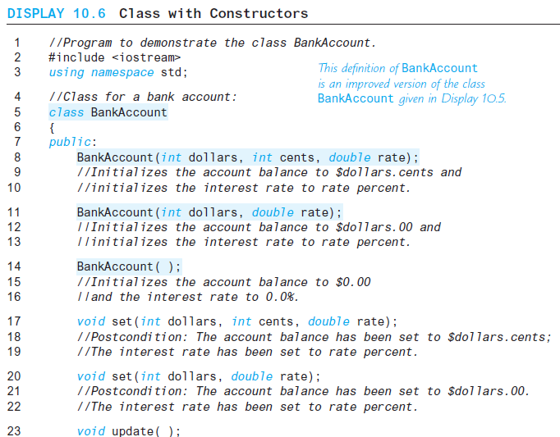
Display 10.6
(1/3)
Back
Next
Slide 10- <number>

Slide 89
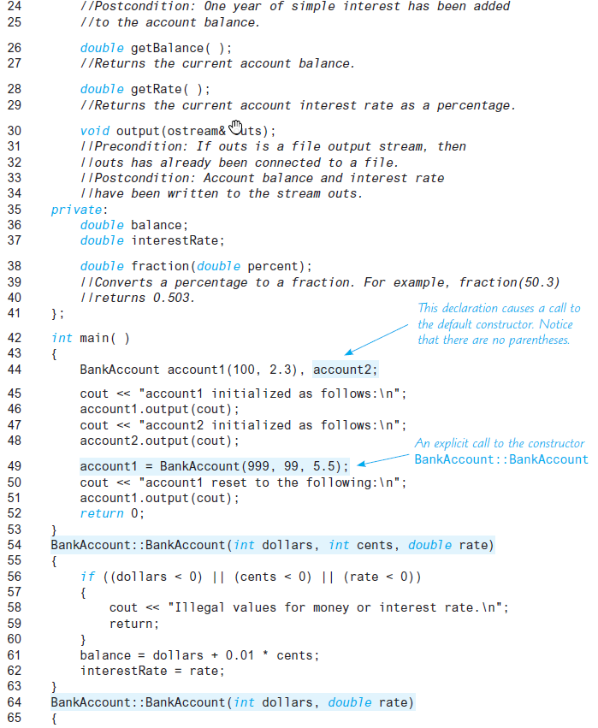
Display 10.6 (2/3)
Back
Next
Slide 10- <number>

Slide 90
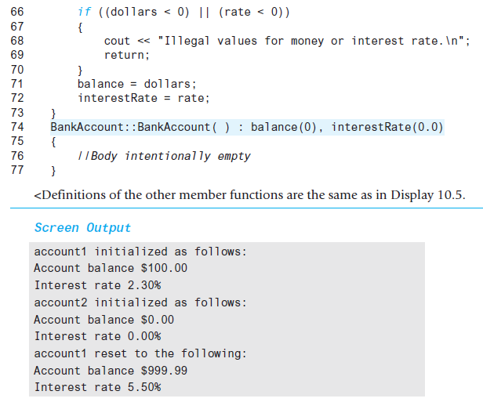
Display 10.6
(3/3)
Back
Next
Slide 10- <number>

Slide 91
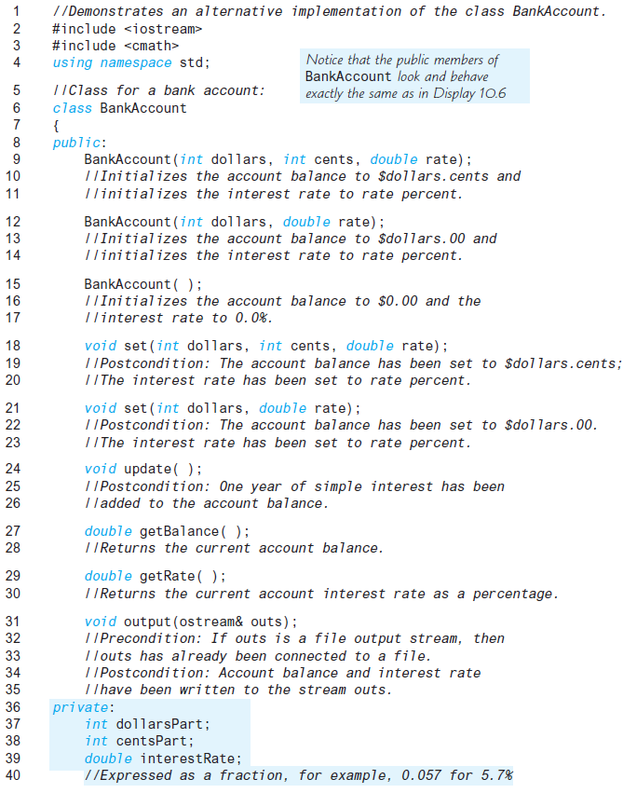
Display 10.7 (1/3)
Back
Next
Slide 10- <number>

Slide 92
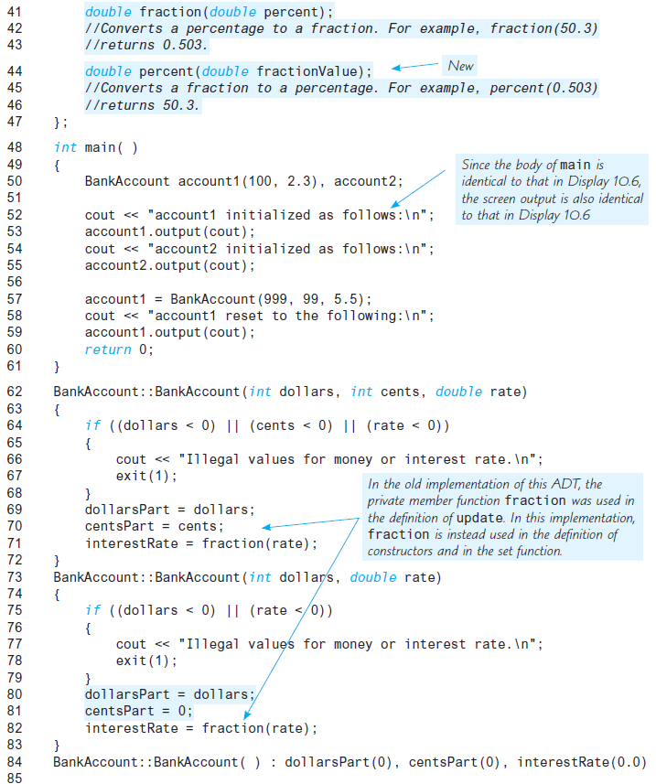
Display 10.7 (2/3)
Back
Next
Slide 10- <number>

Slide 93
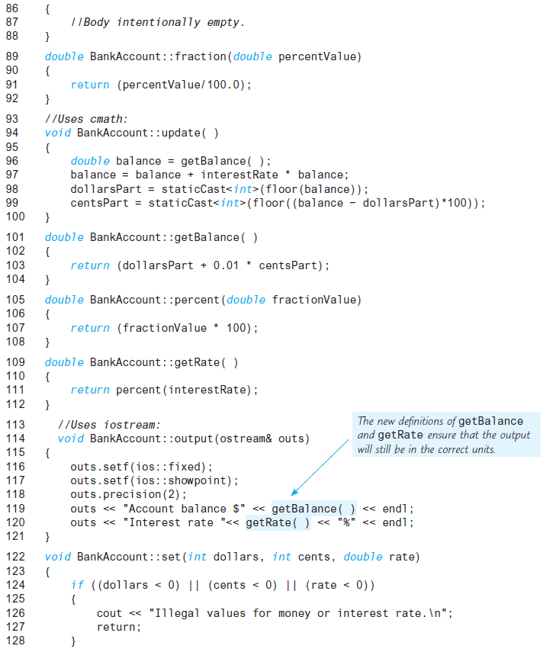
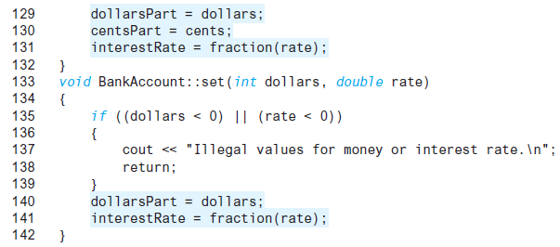
Display 10.7 (3/3)
Back
Next
Slide 10- <number>

Slide 94
Display 10.8
Back
Next
Slide 10- <number>

Slide 95
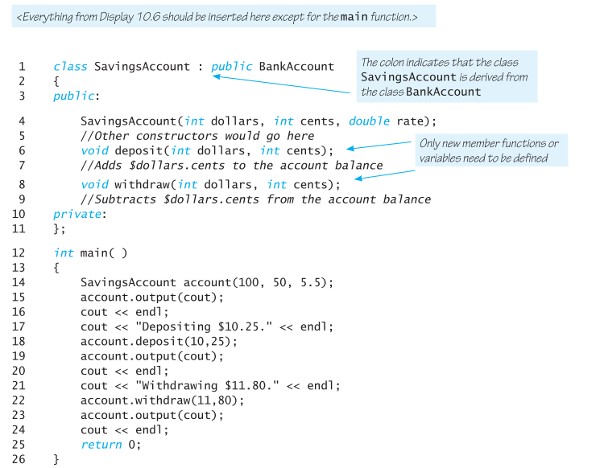
Display 10.9 (1/3)
Back
Next
Slide 10- <number>

Slide 96
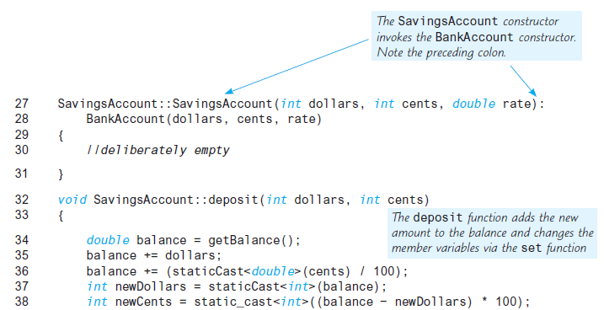
Display 10.9 (2/3)
Back
Next
Slide 10- <number>

Slide 97
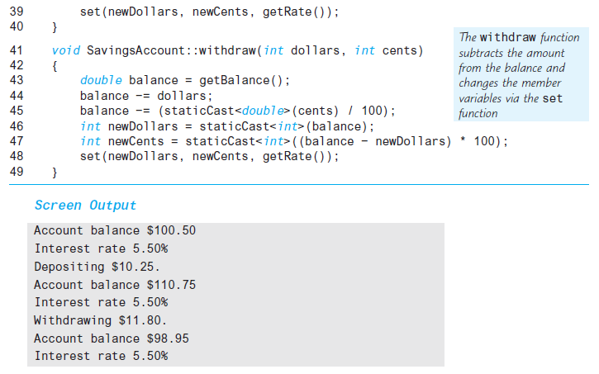
Display 10.9 (3/3)
Back
Next
Slide 10- <number>

