Slide 1
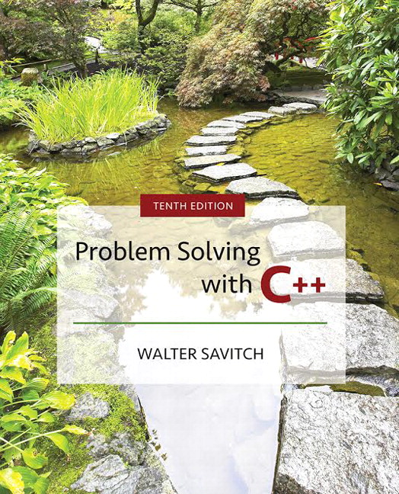

Slide 2
Chapter 14
Recursion

Slide 3
Overview
14.1 Recursive Functions for Tasks
14.2 Recursive Functions for Values
14.3 Thinking Recursively
Slide 14- <number>

Slide 4
14.1
Recursive Functions for Tasks

Slide 5
Recursive Functions for Tasks
A recursive function contains a call to itself
When breaking a task into subtasks, it may be
that the subtask is a smaller example of the same
task
  Searching an array could be divided into searching the first and second halves of the array
  Searching each half is a smaller version of searching the whole array
  Tasks like this can be solved with recursive functions
Slide 14- <number>

Slide 6
Case Study:
Vertical Numbers
Problem Definition:
  void writeVertical( int n );
  //Precondition: n >= 0
  //Postcondition: n is written to the screen vertically
  // with each digit on a separate line
Slide 14- <number>

Slide 7
Case Study:
Vertical Numbers
Algorithm design:
  Simplest case:
  If n is one digit long, write the number
  Typical case:
  1) Output all but the last digit vertically
  2) Write the last digit
    Step 1 is a smaller version of the original task
    Step 2 is the simplest case
Slide 14- <number>

Slide 8
Case Study:
Vertical Numbers (cont.)
The writeVertical algorithm:
  if (n < 10)
  {
  cout << n << endl;
  }
  else // n is two or more digits long
  {
  writeVertical(n with the last digit removed);
  cout << the last digit of n << endl;
  }
Slide 14- <number>

Slide 9
Case Study:
Vertical Numbers (cont.)
Translating the pseudocode into C++
  n / 10 returns n with the last digit removed
    124 / 10 = 12
  n % 10 returns the last digit of n
    124 % 10 = 4
Removing the first digit would be just as valid
for defining a recursive solution
  It would be more difficult to translate into C++
Display 14.1 ( 1 )
Display 14.1 ( 2 )
Slide 14- <number>

Slide 10
Tracing a Recursive Call
writeVertical(123)
if (123 < 10)
{ cout << 123 << endl;
}
else
// n is more than two digits
{
writeVertical(123/10);
cout << (123 % 10) << endl;
}
Calls writeVertical(12)
resume
Function call ends
Output 3
Slide 14- <number>

Slide 11
Tracing writeVertical(12)
writeVertical(12)
if (12 < 10)
{ cout << 12 << endl;
}
else
// n is more than two digits
{
writeVertical(12/10);
cout << (12 % 10) << endl;
}
Calls writeVertical(1)
resume
Output 2
Function call ends
Slide 14- <number>

Slide 12
Tracing writeVertical(1)
writeVertical(1)
if (1 < 10)
{ cout << 1 << endl;
}
else
// n is more than two digits
{
writeVertical(1/10);
cout << (1 % 10) << endl;
}
Simplest case is now true
Function call ends
Output 1
Slide 14- <number>

Slide 13
A Closer Look at Recursion
writeVertical uses recursion
  Used no new keywords or anything "new"
  It simply called itself with a different argument
Recursive calls are tracked by
  Temporarily stopping execution at the recursive call
    The result of the call is needed before proceeding
  Saving information to continue execution later
  Evaluating the recursive call
  Resuming the stopped execution
Slide 14- <number>

Slide 14
How Recursion Ends
Eventually one of the recursive calls must not
depend on another recursive call
Recursive functions are defined as
  One or more cases where the task is accomplished by using recursive calls to do a smaller version of the task
  One or more cases where the task is accomplished without the use of any recursive calls
    These are called base cases or stopping cases
Slide 14- <number>

Slide 15
"Infinite" Recursion
A function that never reaches a base case, in
theory, will run forever
  In practice, the computer will often run out of resources and the program will terminate abnormally
Slide 14- <number>

Slide 16
Example: Infinite Recursion
Function writeVertical, without the base case
void newWriteVertical(int n)
{
newWriteVertical (n /10);
cout << n % 10 << endl;
}
will eventually call newWriteVertical(0), which will
call newWriteVertical(0),which will call newWriteVertical(0), which
will call newWriteVertical(0), which will call newWriteVertical(0), which will call newWriteVertical(0), which will call newWriteVertical(0), …
Slide 14- <number>

Slide 17
Stacks for Recursion
Computers use a structure called a stack to keep
track of recursion
  A stack is a memory structure analogous to a stack of paper
    To place information on the stack, write it on a piece of paper and place it on top of the stack
    To place more information on the stack, use a clean sheet of paper, write the information, and place it on the top of the stack
    To retrieve information, only the top sheet of paper can be read, and thrown away when it is no longer needed
Slide 14- <number>

Slide 18
Last-in / First-out
A stack is a last-in/first-out memory structure
  The last item placed is the first that can be removed
Whenever a function is called, the computer
uses a "clean sheet of paper"
  The function definition is copied to the paper
  The arguments are plugged in for the parameters
  The computer starts to execute the function body
Slide 14- <number>

Slide 19
Stacks and The Recursive Call
When execution of a function definition reaches
a recursive call
  Execution stops
  Information is saved on a "clean sheet of paper" to enable resumption of execution later
  This sheet of paper is placed on top of the stack
  A new sheet is used for the recursive call
    A new function definition is written, and arguments are plugged into parameters
    Execution of the recursive call begins
Slide 14- <number>

Slide 20
The Stack and Ending Recursive Calls
When a recursive function call is able to
complete its computation with no recursive calls
  The computer retrieves the top "sheet of paper" from the stack and resumes computation based on the information on the sheet
  When that computation ends, that sheet of paper is discarded and the next sheet of paper on the stack is retrieved so that processing can resume
  The process continues until no sheets remain in the stack
Slide 14- <number>

Slide 21
Activation Frames
The computer does not use paper
Portions of memory are used
  The contents of these portions of memory is called an activation frame
    The activation frame does not actually contain a copy of the function definition, but references a single copy of the function
Slide 14- <number>

Slide 22
Stack Overflow
Because each recursive call causes an activation
frame to be placed on the stack
  infinite recursion can force the stack to grow beyond its limits to accommodate all the activation frames required
  The result is a stack overflow
  A stack overflow causes abnormal termination of the program
Slide 14- <number>

Slide 23
Recursion versus Iteration
Any task that can be accomplished using
recursion can also be done without recursion
  A nonrecursive version of a function typically
  contains a loop or loops
  A non-recursive version of a function is usually
  called an iterative-version
  A recursive version of a function
    Usually runs slower
    Uses more storage
    May use code that is easier to write and understand
Display 14.2
Slide 14- <number>

Slide 24
Section 14.1 Conclusion
Can you
  Identify a possible source of a stack overflow error?
  Write a recursive void-function with one parameter, a positive integer, that writes out that number of '*'s to the screen?
  Write writeVertical so the digits are output in
  reverse order?
Slide 14- <number>

Slide 25
14.2
Recursive Functions for Values

Slide 26
Recursive Functions for Values
Recursive functions can also return values
The technique to design a recursive function that
returns a value is basically the same as what
you have already seen
  One or more cases in which the value returned is computed in terms of calls to the same function with (usually) smaller arguments
  One or more cases in which the value returned is computed without any recursive calls (base case)
Slide 14- <number>

Slide 27
Program Example:
A Powers Function
To define a new power function that returns an
int, such that
int y = power(2,3);
places 23 in y
  Use this definition:
  x_{n} = x_{n-1} * x
  Translating the right side to C++ gives:
  power(x, n-1) * x
  The base case: n = = 0 and power should return 1
Display 14.3
Slide 14- <number>

Slide 28
Tracing power(2,1)
int power(2, 1)
{
…
if (n > 0)
return ( power(2, 1-1) * 2);
else
return (1);
}
Call to power(2,0)
resume
1
return 2
Function Ends
Slide 14- <number>

Slide 29
Tracing power(2,0)
int power(2, 0)
{
…
if (n > 0)
return ( power(2, 0-1) * 2);
else
return (1);
}
Function call ends
1 is returned
Slide 14- <number>

Slide 30
Tracing power(2, 3)
Power(2, 3) results in more recursive calls:
  power( 2, 3 ) is power( 2, 2 ) * 2
  Power( 2, 2 ) is power( 2, 1 ) * 2
  Power( 2, 1 ) is power( 2, 0 ) * 2
  Power ( 2, 0 ) is 1 (stopping case)
See details in
Display 14.4
Slide 14- <number>

Slide 31
Section 14.2 Conclusion
Can you
  Determine the output of this function if called with
  rose(4)?
  int rose(int n)
  {
  if ( n <= 0)
  return 1;
  else
  return ( rose (n-1) * n);
  }
Slide 14- <number>

Slide 32
14.3
Thinking Recursively

Slide 33
Thinking Recursively
When designing a recursive function, you do not
need to trace out the entire sequence of calls
  If the function returns a value
    Check that there is no infinite recursion: Eventually a stopping case is reached
    Check that each stopping case returns the correct value
    For cases involving recursion: if all recursive calls return the correct value, then the final value returned is the correct value
Slide 14- <number>

Slide 34
Reviewing the power function
There is no infinite recursion
  Notice that the second argument is decreased at each call. Eventually, the second argument must reach 0, the stopping case
  int power(int x, int n)
  {
  …
  if (n > 0)
  return ( power(x, n-1) * x);
  else
  return (1);
  }
Slide 14- <number>

Slide 35
Review of power (cont.)
Each stopping case returns the correct value
  power(x, 0) should return x0 = 1 which it does
  int power(int x, int n)
  {
  …
  if (n > 0)
  return ( power(x, n-1) * x);
  else
  return (1);
  }
Slide 14- <number>

Slide 36
Review of power (cont.)
All recursive calls return the correct value so the
final value returned is correct
  If n > 1, recursion is used. So power(x,n-1) must
  return x_{n-1} so power(x, n) can return x_{n-1} * n = x_{n}
  which it does
  int power(int x, int n)
  {
  …
  if (n > 0)
  return ( power(x, n-1) * x);
  else
  return (1);
  }
Slide 14- <number>

Slide 37
Recursive void-functions
The same basic criteria apply to checking the
correctness of a recursive void-function
  Check that there is no infinite recursion
  Check that each stopping case performs the correct action for that case
  Check that for each recursive case: if all recursive calls perform their actions correctly, then the entire case performs correctly
Slide 14- <number>

Slide 38
Case Study:
Binary Search
A binary search can be used to search a sorted
array to determine if it contains a specified value
  The array indexes will be 0 through final_index
  Because the array is sorted, we know
  a[0] <= a[1] <= a[2] <= … <= a[final_index]
  If the item is in the list, we want to know where it is in the list
Slide 14- <number>

Slide 39
Binary Search:
Problem Definition
The function will use two call-by-reference
parameters to return the outcome of the search
  One, called found, will be type bool. If the value is found, found will be set to true. If the value is found, the parameter, location, will be set to the index of the value
A call-by-value parameter is used to pass the
value to find
  This parameter is named key
Slide 14- <number>

Slide 40
Binary Search
Problem Definition (cont.)
Pre and Postconditions for the function:
//precondition: a[0] through a[final_index] are
// sorted in increasing order
//postcondition: if key is not in a[0] - a[final_index]
// found == false; otherwise
// found == true
Slide 14- <number>

Slide 41
Binary Search
Algorithm Design
Our algorithm is basically:
  Look at the item in the middle
    If it is the number we are looking for, we are done
    If it is greater than the number we are looking for, look in the first half of the list
    If it is less than the number we are looking for, look in the second half of the list
Slide 14- <number>

Slide 42
Binary Search
Algorithm Design (cont.)
Here is a first attempt at our algorithm:
  found = false;
  mid = approx. midpoint between 0 and final_index;
  if (key == a[mid])
  {
  found = true;
  location = mid;
  }
  else if (key < a[mid])
  search a[0] through a[mid -1]
  else if (key > a[mid])
  search a[mid +1] through a[final_index];
Slide 14- <number>

Slide 43
Binary Search
Algorithm Design (cont.)
Since searching each of the shorter lists is a
smaller version of the task we are working on,
a recursive approach is natural
  We must refine the recursive calls
    Because we will be searching subranges of the array, we need additional parameters to specify the subrange to search
    We will add parameters first and last to indicate the first and last indices of the subrange
Slide 14- <number>

Slide 44
Binary Search
Algorithm Design (cont.)
Here is our first refinement:
found = false;
mid = approx. midpoint between first and last;
if (key == a[mid])
{
found = true;
location = mid;
}
else if (key < a[mid])
search a[first] through a[mid -1]
else if (key > a[mid])
search a[mid +1] through a[last];
Slide 14- <number>

Slide 45
Binary Search
Algorithm Design (cont.)
We must ensure that our algorithm ends
  If key is found in the array, there is no recursive call and the process terminates
  What if key is not found in the array?
    At each recursive call, either the value of first is increased or the value of last is decreased
    If first ever becomes larger than last, we know that there are no more indices to check and key is not in the array
The final pseudocode is shown in
Display 14.5
Display 14.7
Slide 14- <number>

Slide 46
Binary Search
Writing the Code
Function search implements the algorithm:
  Function search interface:
  void search(const int a[ ], int first, int last,
  int key, bool& found, int& location);
  //precondition: a[0] through a[final_index] are
  // sorted in increasing order
  //postcondition: if key is not in a[0] - a[final_index]
  // found = = false; otherwise
  // found = = true
Display 14.6 (1)
Display 14.6 (2)
Slide 14- <number>

Slide 47
Binary Search
Checking the Recursion
There is no infinite recursion
  On each recursive call, the value of first is increased or the value of last is decreased. Eventually, if nothing else stops the recursion, the stopping case of first > last will be called
Slide 14- <number>

Slide 48
Binary Search
Checking the Recursion (cont.)
Each stopping case performs the correct action
  If first > last, there are no elements between a[first] and a[last] so key is not in this segment and it is correct to set found to false
  If k == a[mid], the algorithm correctly sets found to true and location equal to mid
  Therefore both stopping cases are correct
Slide 14- <number>

Slide 49
Binary Search
Checking the Recursion (cont.)
For each case that involves recursion, if all
recursive calls perform their actions correctly,
then the entire case performs correctly
Since the array is sorted…
  If key < a[mid], key is in one of elements a[first]
  through a[mid-1] if it is in the array. No other
  elements must be searched…the recursive call is correct
  If key > a[mid], key is in one of elements a[mid+1] through a[last] if it is in the array. No other elements must be searched… the recursive call is correct
Slide 14- <number>

Slide 50
Binary Search
Efficiency
The binary search is extremely fast compared to
an algorithm that checks each item in order
  The binary search eliminates about half the elements between a[first] and a[last] from consideration at each recursive call
  For an array of 100 items, the binary search never compares more than seven elements to the key
  For an array of 100 items, a simple serial search will average 50 comparisons and may do as many as 100!
Slide 14- <number>

Slide 51
Binary Search
An Iterative Version
The iterative version of the binary search
may be run faster on some systems
The algorithm for the iterative version, shown in
Display 14.8, was created by mirroring the
recursive function
  Even if you plan an iterative function, it may be
  helpful to start with the recursive approach
Display 14.8
Slide 14- <number>

Slide 52
Program Example:
A Recursive Member Function
A member function of a class can be recursive
The update function from class BankAccount of
Display 10.6 is will be overloaded to create a
recursive version
  Update adds interest for a specified number of years to an account balance
Slide 14- <number>

Slide 53
Class BankAccount
Function update
update uses one parameter, years, and the
following algorithm:
  If the number of years is 1, then (// stopping case) call the other function named update
  If the number of years is greater than 1, then
    Make a recursive call to post years – 1 worth of interest then call the other update function for one year's interest
Display 14.9 (1)
Display 14.9 (2)
Slide 14- <number>

Slide 54
Function update
Checking the Recursion
There is no infinite recursion
  Each recursive call reduces the number of years by one until years is 1, a stopping case
Each stopping case performs the correct action
  One stopping case is years == 1. It calls the other update function which was previously checked for correctness
Slide 14- <number>

Slide 55
Function update
Checking the Recursion (cont.)
For the cases that involve recursion, if all
recursive calls perform correctly, the entire case
performs correctly:
  When years > 1, the recursive call correctly posts years – 1 worth of interest, then calls the other update function to post one additional year's interest. The other update function correctly posts interest for one year. Then the entire action for years > 1 will be correct.
Slide 14- <number>

Slide 56
Overloaded Functions
There is no confusion (for the computer) between
the two versions of update
  When the recursive version of update calls the
  version of update with no parameters, that is not a recursive call
  Only calls to the version of update with the exact same function declaration are recursive calls
Slide 14- <number>

Slide 57
Section 14.3 Conclusion
Can you
  Write a recursive function definition for the
  following function?
  int squares(int n);
  //Precondition: n >= 1
  //Returns the sum of the squares of numbers 1 through n
Slide 14- <number>

Slide 58
Chapter 14 -- End
Slide 14- <number>

Slide 59
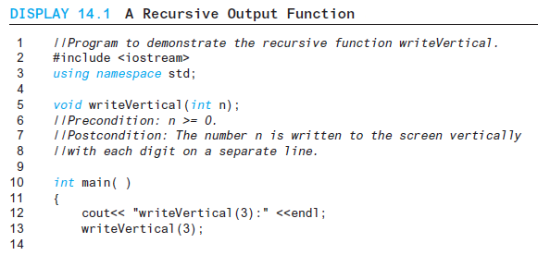
Display 14.1 (1/2)
Back
Next
Slide 14- <number>

Slide 60
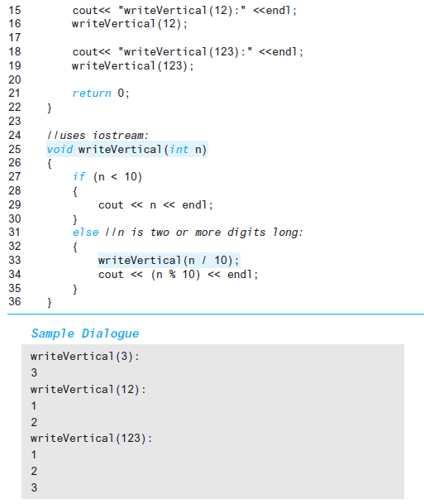
Display 14.1
(2/2)
Back
Next
Slide 14- <number>

Slide 61
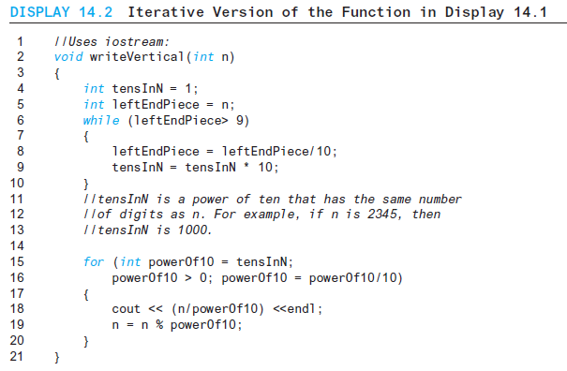
Display 14.2
Back
Next
Slide 14- <number>

Slide 62
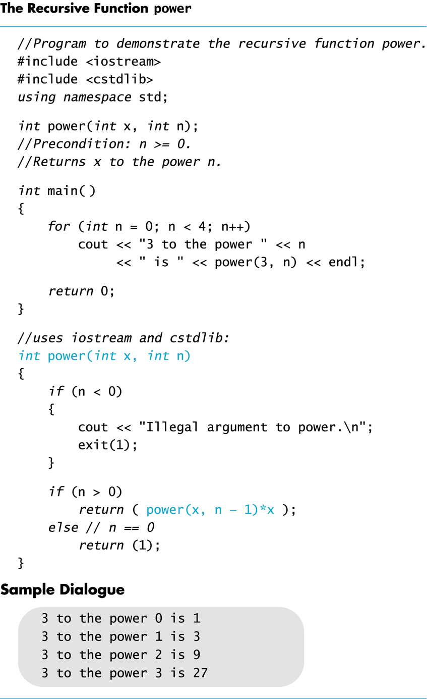
Display 14.3
Back
Next
Slide 14- <number>

Slide 63
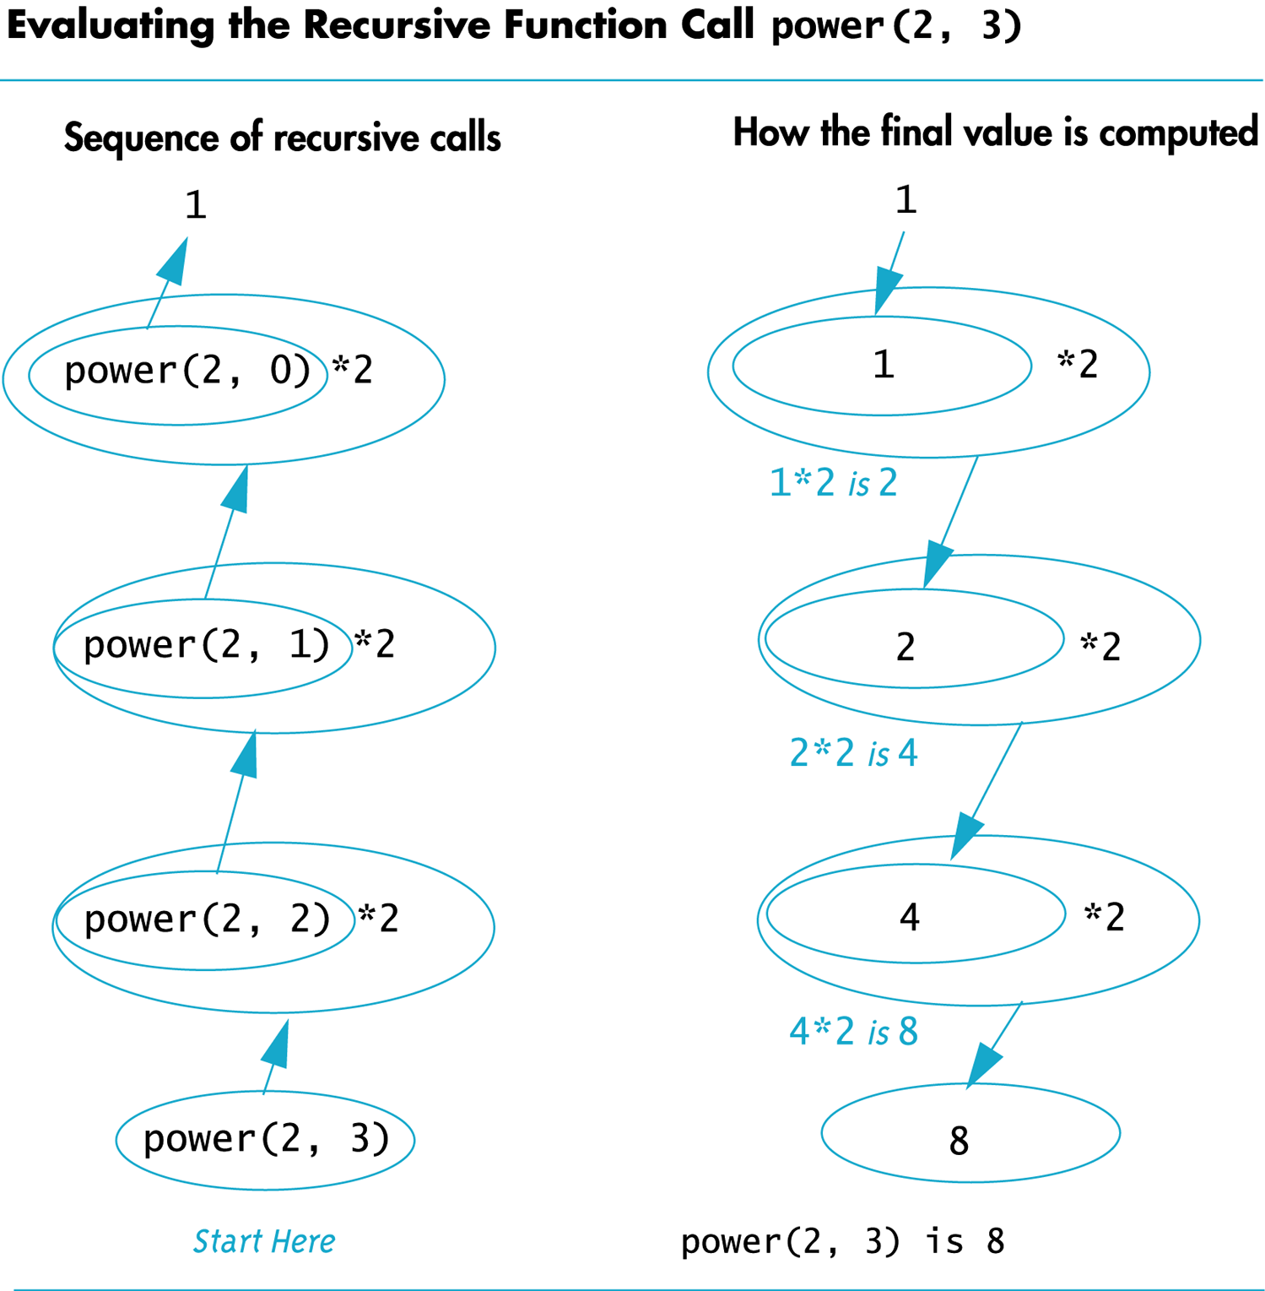
Display 14.4
Back
Next
Slide 14- <number>

Slide 64
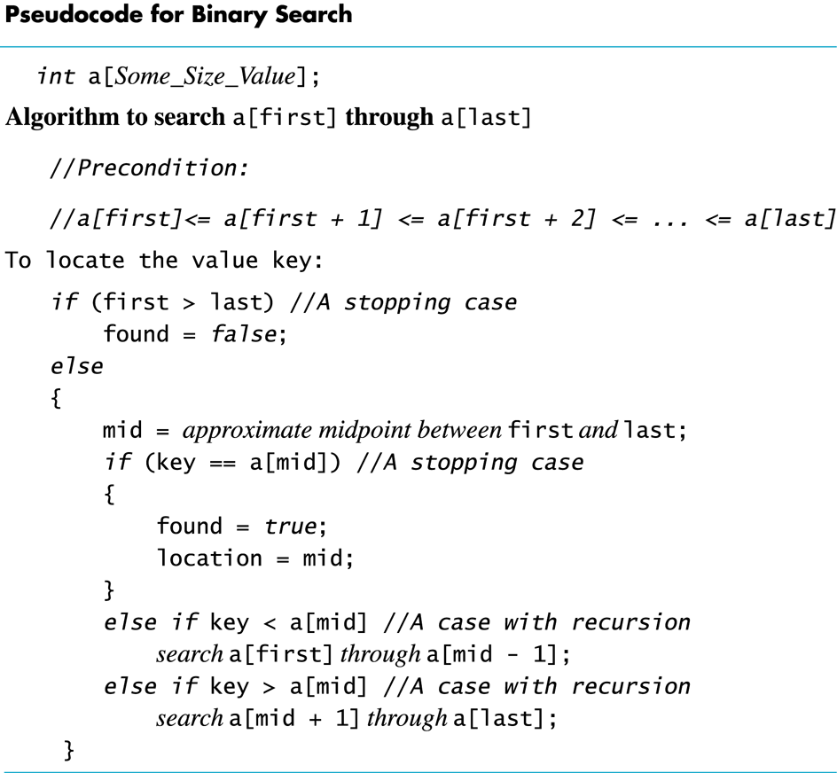
Display 14.5
Back
Next
Slide 14- <number>

Slide 65
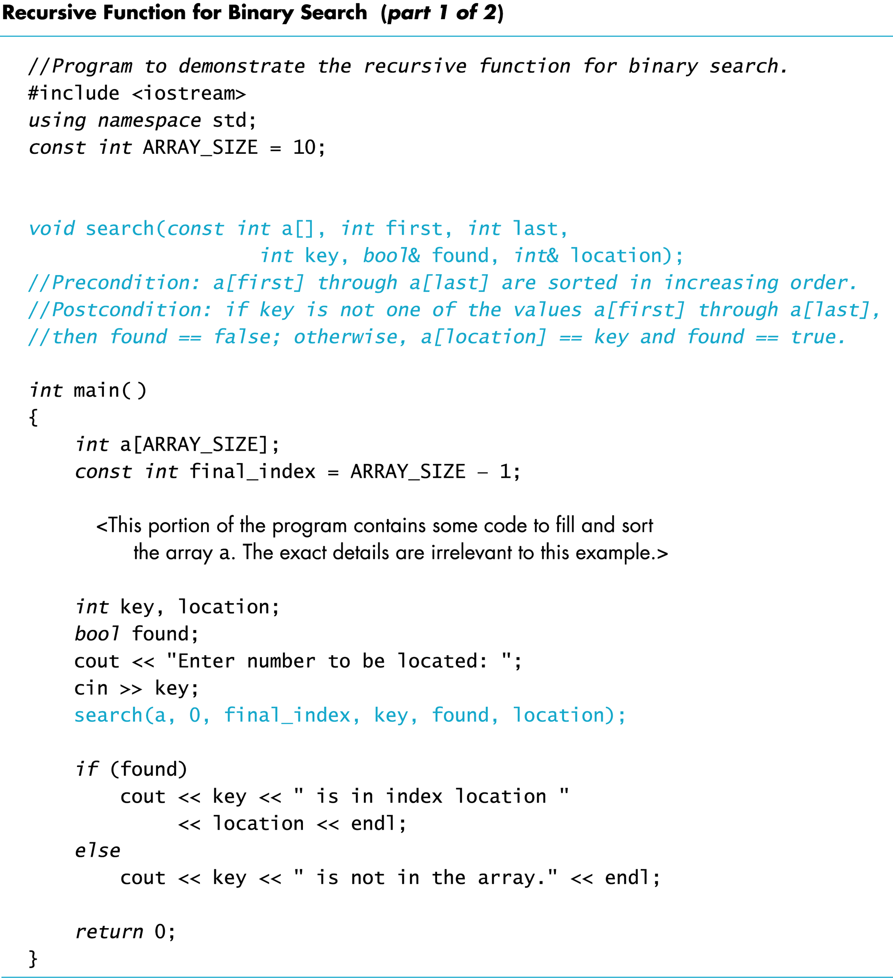
Display 14.6 (1/2)
Back
Next
Slide 14- <number>

Slide 66
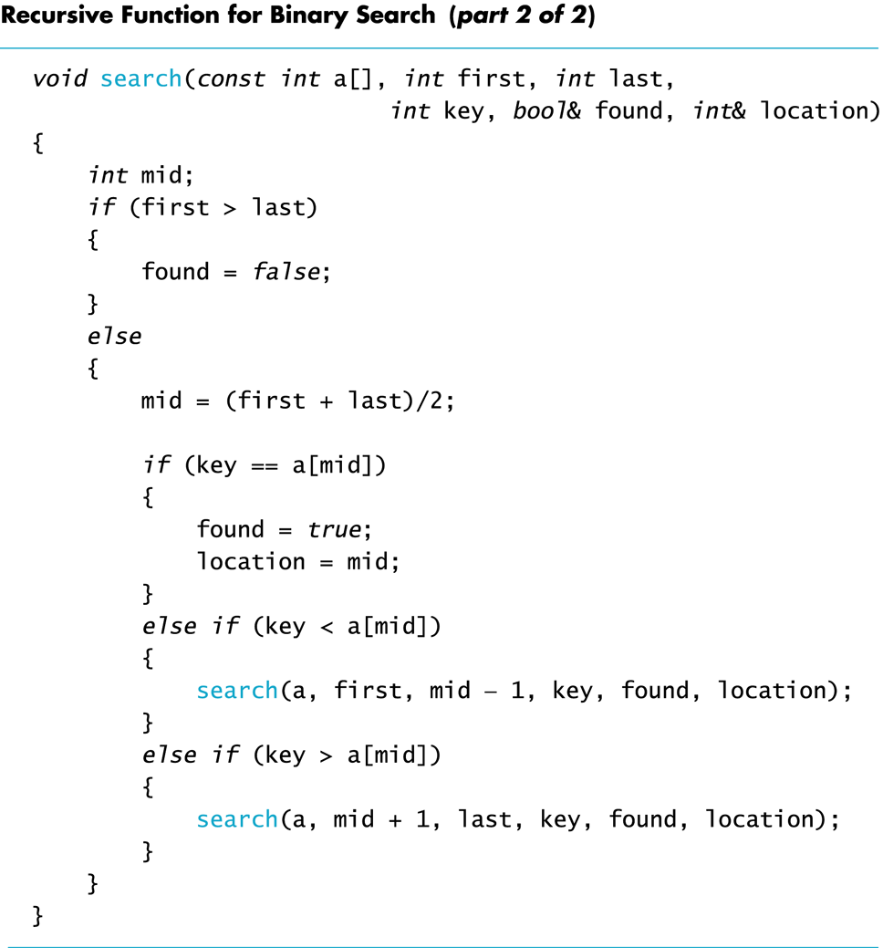
Display 14.6
(2/2)
Back
Next
Slide 14- <number>

Slide 67
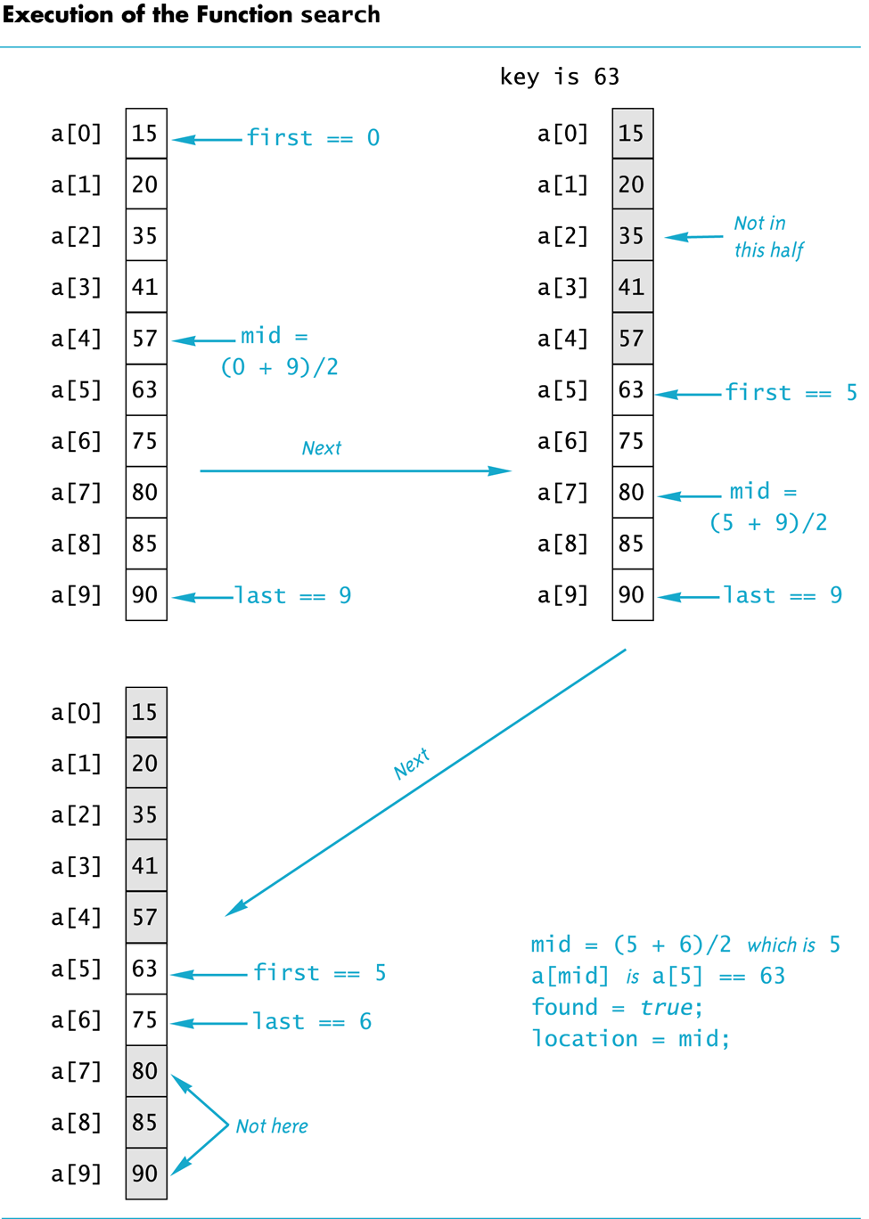
Display 14.7
Back
Next
Slide 14- <number>

Slide 68
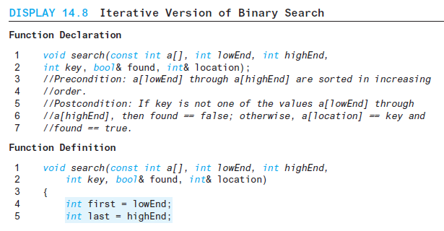
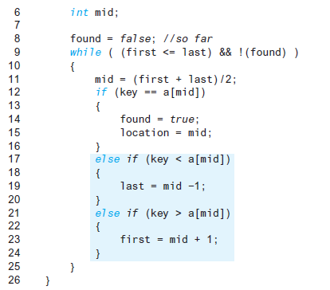
Display 14.8
Back
Next
Slide 14- <number>

Slide 69
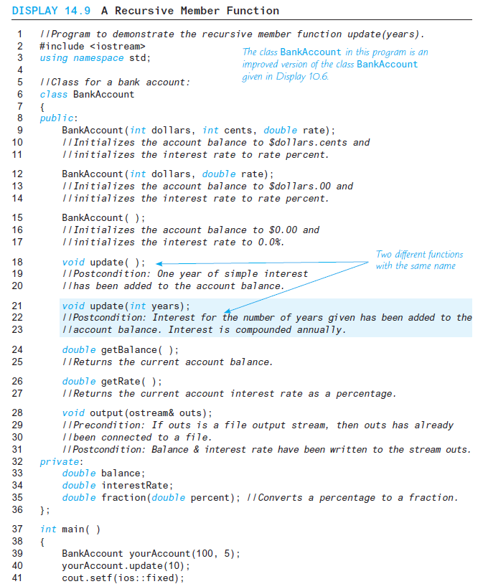
Display 14.9 (1/2)
Back
Next
Slide 14- <number>

Slide 70
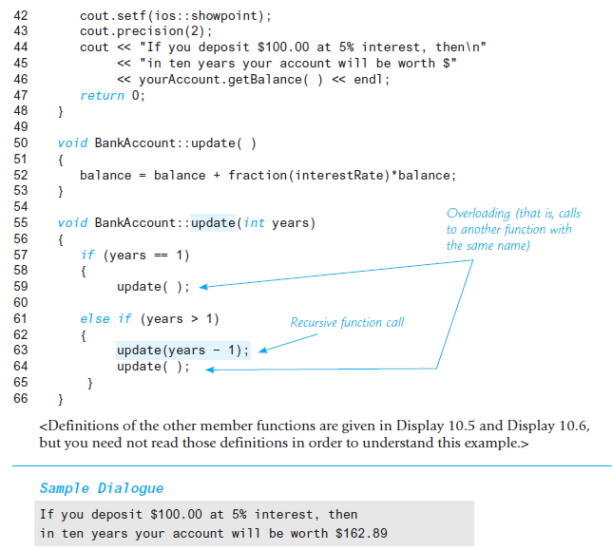
Display 14.9 (2/2)
Back
Next
Slide 14- <number>

