Slide 1
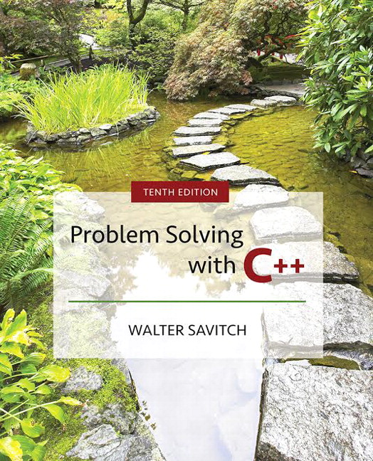

Slide 2
Chapter 15
Inheritance

Slide 3
Overview
15.1 Inheritance Basics
15.2 Inheritance Details
15.3 Polymorphism
Slide 15- <number>

Slide 4
15.1
Inheritance

Slide 5
Inheritance Basics
Inheritance is the process by which a new class,
called a derived class, is created from another
class, called the base class
  A derived class automatically has all the member variables and functions of the base class
  A derived class can have additional member variables and/or member functions
  The derived class is a child of the base or parent class
Slide 15- <number>

Slide 6
Example Inheritance Hierarchy for Home Automation Devices
DISPLAY 15.1
Device
base
or
parent class
string model
string serialNumber
string status()
IS-A
IS-A
derived or child class
derived or child class
DoorDevice
ThermostatDevice
string status()
void openClose()
string status()
void setTemp(int t)
An object of type DoorDevice or ThermostatDevice includes functions and variables defined in Device, such as model and serialNumber.
The status() function can be overridden. If a DoorDevice object is treated like a Device object, then calling status()will invoke DoorDevice’s status() function, not Device’s status()function. This is necessary when the Device class doesn’t know what to return as a status and only the derived classes can return the information.
Slide 15- <number>

Slide 7
Employee Classes
To design a record-keeping program with
records for salaried and hourly employees…
  Salaried and hourly employees belong to a class of people who share the property "employee"
  A subset of employees are those with a fixed wage
  Another subset of employees earn hourly wages
All employees have a name and SSN
  Functions to manipulate name and SSN are the same
  for hourly and salaried employees
Slide 15- <number>

Slide 8
A Base Class
We will define a class called Employee for all
employees
The Employee class will be used to define
classes for hourly and salaried employees
A definition of the employee class is found
in
Display 15.2
Display 15.3
Slide 15- <number>

Slide 9
Function printCheck
Function printCheck will have different
definitions to print different checks for each type
of employee
  An Employee object lacks sufficient information to print a check
  Each derived class will have sufficient information to print a check
Slide 15- <number>

Slide 10
Class HourlyEmployee
HourlyEmployee is derived from Class Employee
  HourlyEmployee inherits all member functions and member variables of Employee
  The class definition begins
  class HourlyEmployee : public Employee
    :public Employee shows that HourlyEmployee is
    derived from class Employee
  HourlyEmployee declares additional member
  variables wageRate and hours
Display 15.4
Slide 15- <number>

Slide 11
Inherited Members
A derived class inherits all the members of the
parent class
  The derived class does not re-declare or re-define members inherited from the parent, except…
  The derived class re-declares and re-defines
  member functions of the parent class that will have a different definition in the derived class
  The derived class can add member variables and functions
Slide 15- <number>

Slide 12
Implementing a Derived Class
Any member functions added in the derived
class are defined in the implementation file for
the derived class
  Definitions are not given for inherited functions that are not to be changed
The HourlyEmployee class is
defined in
Display 15.6
Slide 15- <number>

Slide 13
Class SalariedEmployee
The class SalariedEmployee is also derived from
Employee
  Function printCheck is redefined to have a meaning specific to salaried employees
  SalariedEmployee adds a member variable salary
The interface for SalariedEmployee is
found in
contains the implementation
Display 15.5
Display 15.7 (1-2)
Slide 15- <number>

Slide 14
Parent and Child Classes
Recall that a child class automatically has all the
members of the parent class
The parent class is an ancestor of the child class
The child class is a descendent of the parent
class
The parent class (Employee) contains all the
code common to the child classes
  You do not have to re-write the code for each child
Slide 15- <number>

Slide 15
Derived Class Types
An hourly employee is an employee
  In C++, an object of type HourlyEmployee can be used where an object of type Employee can be used
  An object of a class type can be used wherever any of its ancestors can be used
  An ancestor cannot be used wherever one of its descendents can be used
Slide 15- <number>

Slide 16
Derived Class Constructors
A base class constructor is not inherited in a
derived class
  The base class constructor can be invoked by the
  constructor of the derived class
  The constructor of a derived class begins by invoking
  the constructor of the base class in the initialization
  section:
  HourlyEmployee::HourlyEmployee : Employee( ),
  wageRate( 0),
  hours( )
  { //no code needed }
Any Employee constructor
could be invoked
Slide 15- <number>

Slide 17
Default Initialization
If a derived class constructor does not invoke a
base class constructor explicity, the base class
default constructor will be used
If class B is derived from class A and class C
is derived from class B
  When a object of class C is created
    The base class A's constructor is the first invoked
    Class B's constructor is invoked next
    C's constructor completes execution
Slide 15- <number>

Slide 18
Private is Private
A member variable (or function) that is private
in the parent class is not accessible to the
child class
  The parent class member functions must be used to access the private members of the parent
  This code would be illegal:
  void HourlyEmployee::printCheck( )
  {
  netPay = hours * wageRate;
    netPay is a private member of Employee!
Slide 15- <number>

Slide 19
The protected Qualifier
protected members of a class appear to be
private outside the class, but are accessible by
derived classes
  If member variables name, netPay, and ssn are listed as protected (not private) in the Employee class, this code, illegal on the previous slide, becomes legal:
  HourlyEmployee::printCheck( )
  {
  netPay = hours * wageRate;
Slide 15- <number>

Slide 20
Programming Style
Using protected members of a class is a
convenience to facilitate writing the code of
derived classes.
Protected members are not necessary
  Derived classes can use the public methods of their ancestor classes to access private members
Many programming authorities consider it
bad style to use protected member variables
Slide 15- <number>

Slide 21
Redefinition of
Member Functions
When defining a derived class, only list the
the inherited functions that you wish to change
for the derived class
  The function is declared in the class definition
  HourlyEmployee and SalariedEmployee each have their own definitions of printCheck
demonstrates the use of
the derived classes defined in earlier displays.
Display 15.8 (1-2)
Slide 15- <number>

Slide 22
Redefining or Overloading
A function redefined in a derived class has the
same number and type of parameters
  The derived class has only one function with the same name as the base class
An overloaded function has a different number
and/or type of parameters than the base class
  The derived class has two functions with the same name as the base class
    One is defined in the base class, one in the derived class
Slide 15- <number>

Slide 23
Function Signatures
A function signature is the function's name
with the sequence of types in the parameter
list, not including any const or '&'
  An overloaded function has multiple signatures
Some compilers allow overloading based on
including const or not including const
Slide 15- <number>

Slide 24
Access to a
Redefined Base Function
When a base class function is redefined in a
derived class, the base class function can still
be used
  To specify that you want to use the base class version of the redefined function:
  HourlyEmployee sallyH;
  sallyH.Employee::printCheck( );
Slide 15- <number>

Slide 25
Section 15.1 Conclusion
Can you
  Explain why the declaration for getName is not part of the definition of SalariedEmployee?
  Give a definition for a class TitledEmployee derived from class SalariedEmployee with one additional string called title? Add two member functions getTitle and setTitle. It should redefine setName.
Slide 15- <number>

Slide 26
15.2
Inheritance Details

Slide 27
Inheritance Details
Some special functions are, for all practical
purposes, not inherited by a derived class
  Some of the special functions that are not
  effectively inherited by a derived class include
    Destructors
    Copy constructors
    The assignment operator
Slide 15- <number>

Slide 28
Copy Constructors and
Derived Classes
If a copy constructor is not defined in a derived
class, C++ will generate a default copy
constructor
  This copy constructor copies only the contents of member variables and will not work with pointers and dynamic variables
  The base class copy constructor will not be used
Slide 15- <number>

Slide 29
Operator = and
Derived Classes
If a base class has a defined assignment
operator = and the derived class does not:
  C++ will use a default operator that will have nothing to do with the base class assignment operator
Slide 15- <number>

Slide 30
Destructors and
Derived Classes
A destructor is not inherited by a derived class
The derived class should define its own
destructor
Slide 15- <number>

Slide 31
The Assignment Operator
In implementing an overloaded assignment
operator in a derived class:
  It is normal to use the assignment operator from the base class in the definition of the derived class's assignment operator
  Recall that the assignment operator is written as a member function of a class
Slide 15- <number>

Slide 32
The Operator = Implementation
This code segment shows how to begin the
implementation of the = operator for a derived
class:
Derived& Derived::operator= (const Derived& rhs)
{
Base::operator=(rhs)
  This line handles the assignment of the inherited member variables by calling the base class assignment operator
  The remaining code would assign the member variables introduced in the derived class
Slide 15- <number>

Slide 33
The Copy Constructor
Implementation of the derived class copy
constructor is much like that of the assignment
operator:
Derived::Derived(const Derived& object)
:Base(object), <other initializing>
{…}
  Invoking the base class copy constructor sets up the inherited member variables
    Since object is of type Derived it is also of type Base
Slide 15- <number>

Slide 34
Destructors in Derived Classes
If the base class has a working destructor,
defining the destructor for the defined class is
relatively easy
  When the destructor for a derived class is called, the destructor for the base class is automatically called
  The derived class destructor need only use delete on dynamic variables added in the derived class, and data they may point to
Slide 15- <number>

Slide 35
Destruction Sequence
If class B is derived from class A and class C
is derived from class B…
  When the destructor of an object of class C goes out of scope
    The destructor of class C is called
    Then the destructor of class B
    Then the destructor of class A
  Notice that destructors are called in the reverse order of constructor calls
Slide 15- <number>

Slide 36
Section 15.2 Conclusion
Can you
  List some special functions that are not inherited by a derived class?
  Write code to invoke the base class copy constructor in defining the derived class's copy constructor?
Slide 15- <number>

Slide 37
15.3
Polymorphism

Slide 38
Polymorphism
Polymorphism refers to the ability to associate
multiple meanings with one function name
using a mechanism called late binding
Polymorphism is a key component of the
philosophy of object oriented programming
Slide 15- <number>

Slide 39
A Late Binding Example
Imagine a graphics program with several types
of figures
  Each figure may be an object of a different class, such as a circle, oval, rectangle, etc.
  Each is a descendant of a class Figure
  Each has a function draw( ) implemented with code specific to each shape
  Class Figure has functions common to all figures
Slide 15- <number>

Slide 40
A Problem
Suppose that class Figure has a function center
  Function center moves a figure to the center of the screen by erasing the figure and redrawing it in the center of the screen
  Function center is inherited by each of the derived classes
    Function center uses each derived object's draw function to draw the figure
    The Figure class does not know about its derived classes, so it cannot know how to draw each figure
Slide 15- <number>

Slide 41
Virtual Functions
Because the Figure class includes a method to
draw figures, but the Figure class cannot know
how to draw the figures, virtual functions are
used
Making a function virtual tells the compiler that
you don't know how the function is implemented
and to wait until the function is used in a
program, then get the implementation from the
object.
  This is called late binding
Slide 15- <number>

Slide 42
Virtual Functions in C++
As another example, let's design a record-
keeping program for an auto parts store
  We want a versatile program, but we do not know all the possible types of sales we might have to account for
    Later we may add mail-order and discount sales
    Functions to compute bills will have to be added later when we know what type of sales to add
    To accommodate the future possibilities, we will make the bill function a virtual function
Slide 15- <number>

Slide 43
The Sale Class
All sales will be derived from the base class
Sale
The bill function of the Sale class is virtual
The member function savings and operator <
each use bill
The Sale class interface and implementation
are shown in
Display 15.9
Display 15.10
Slide 15- <number>

Slide 44
Virtual Function bill
Because function bill is virtual in class Sale,
function savings and operator <, defined only in
the base class, can in turn use a version of bill
found in a derived class
  When a DiscountSale object calls its savings function, defined only in the base class, function savings calls function bill
  Because bill is a virtual function in class Sale, C++ uses the version of bill defined in the object that called savings
Slide 15- <number>

Slide 45
DiscountSale::bill
Class DiscountSale has its own version of
virtual function bill
  Even though class Sale is already compiled,
  Sale::savings( ) and Sale::operator< can still use function bill from the DiscountSale class
  The keyword virtual tells C++ to wait until bill is
  used in a program to get the implementation of bill from the calling object
  DiscountSale is defined and used in
Display 15.11
Display 15.12
Slide 15- <number>

Slide 46
Virtual Details
To define a function differently in a derived class
and to make it virtual
  Add keyword virtual to the function declaration in the base class
  virtual is not needed for the function declaration in the derived class, but is often included
  virtual is not added to the function definition
  Virtual functions require considerable overhead so excessive use reduces program efficiency
Slide 15- <number>

Slide 47
Overriding
Virtual functions whose definitions are changed
in a derived class are said to be overridden
Non-virtual functions whose definitions are
changed in a derived class are redefined
Slide 15- <number>

Slide 48
Type Checking
C++ carefully checks for type mismatches in
the use of values and variables
This is referred to as strong type checking
  Generally the type of a value assigned to a variable must match the type of the variable
    Recall that some automatic type casting occurs
Strong type checking interferes with the
concepts of inheritance
Slide 15- <number>

Slide 49
Type Checking and Inheritance
Consider
class Pet
{
public:
virtual void print();
string name;
}
and
class Dog :public Pet
{
public:
virtual void print();
string breed;
}
Slide 15- <number>

Slide 50
A Sliced Dog is a Pet
C++ allows the following assignments:
vdog.name = "Tiny";
vdog.breed = "Great Dane";
vpet = vdog;
However, vpet will loose the breed member of
vdog since an object of class Pet has no breed
member
  This code would be illegal:
    cout << vpet.breed;
This is the slicing problem
Slide 15- <number>

Slide 51
The Slicing Problem
It is legal to assign a derived class object into a
base class variable
  This slices off data in the derived class that is not also part of the base class
  Member functions and member variables are lost
Slide 15- <number>

Slide 52
Extended Type Compatibility
It is possible in C++ to avoid the slicing
problem
  Using pointers to dynamic variables we can assign objects of a derived class to variables of a base class without loosing members of the derived class object
Slide 15- <number>

Slide 53
Dynamic Variables and Derived Classes
Example:
ppet->print( ); is legal and produces: name: Tiny
breed: Great Dane
Pet *ppet;
Dog *pdog;
pdog = new Dog;
pdog->name = "Tiny";
pdog->breed = "Great
Dane";
ppet = pdog;
void Dog::print( )
{
cout << "name: "
<< name << endl;
cout << "breed: "
<< breed << endl;
}
Display 15.13 (1-2)
Slide 15- <number>

Slide 54
Use Virtual Functions
The previous example:
ppet->print( );
worked because print was declared as a virtual
function
This code would still produce an error:
cout << "name: " << ppet->name
<< "breed: " << ppet->breed;
Slide 15- <number>

Slide 55
Why?
ppet->breed is still illegal because ppet is a
pointer to a Pet object that has no breed member
Function print( ) was declared virtual by class
Pet
  When the computer sees ppet->print( ), it checks the virtual table for classes Pet and Dog and finds that ppet points to an object of type Dog
    Because ppet points to a Dog object, code for Dog::print( )
    is used
Slide 15- <number>

Slide 56
Remember Two Rules
To help make sense of object oriented
programming with dynamic variables,
remember these rules
  If the domain type of the pointer p_ancestor is a base class for the for the domain type of pointer p_descendant,
  the following assignment of pointers is allowed
  p_ancestor = p_descendant;
  and no data members will be lost
  Although all the fields of the p_descendant are there, virtual functions are required to access them
Slide 15- <number>

Slide 57
Virtual Compilation
When using virtual functions, you will have to
define each virtual function before compiling
  Declaration is no longer sufficient
  Even if you do not call the virtual function you may see error message:
  "undefined reference to Class_Name virtual table"
Slide 15- <number>

Slide 58
Virtual Destructors
Destructors should be made virtual
  Consider Base *pBase = new Derived;
  …
  delete pBase;
  If the destructor in Base is virtual, the destructor for Derived is invoked as pBase points to a Derived object, returning Derived members to the freestore
    The Derived destructor in turn calls the Base destructor
Slide 15- <number>

Slide 59
Non-Virtual Destructors
If the Base destructor is not virtual, only the Base
destructor is invoked
This leaves Derived members, not part of Base,
in memory
Slide 15- <number>

Slide 60
Section 15.3 Conclusion
Can you
  Explain why you cannot assign a base class object to a derived class object?
  Describe the problem with assigning a derived class object to a base class object?
Slide 15- <number>

Slide 61
Chapter 15 -- End
Slide 15- <number>

Slide 62
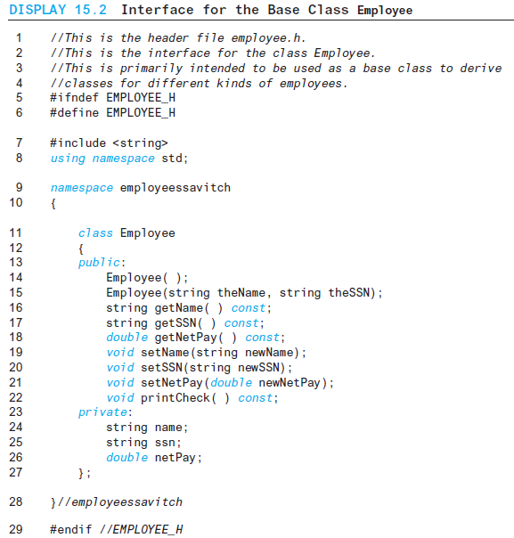
Display 15.2
Back
Next
Slide 15- <number>

Slide 63
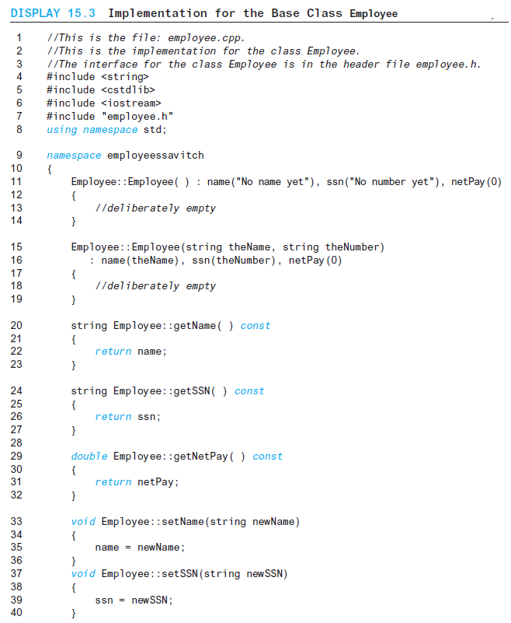
Display 15.3 (1/2)
Back
Next
Slide 15- <number>

Slide 64
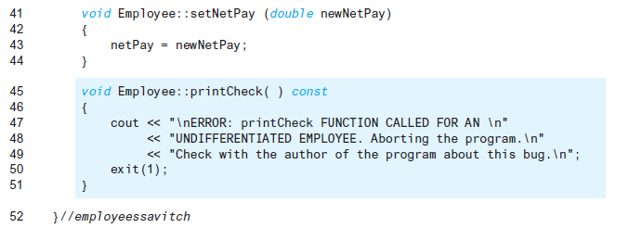
Display 15.3
(2/2)
Back
Next
Slide 15- <number>

Slide 65
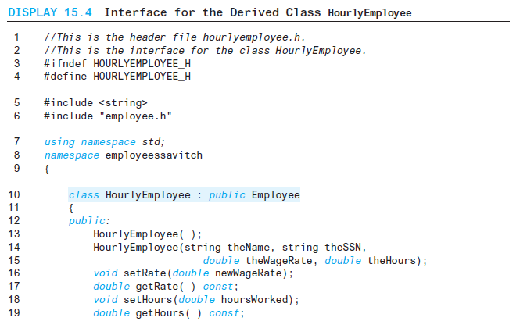
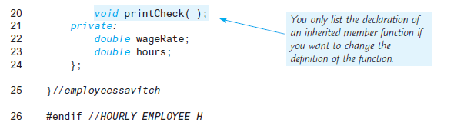
Display 15.4
Back
Next
Slide 15- <number>

Slide 66
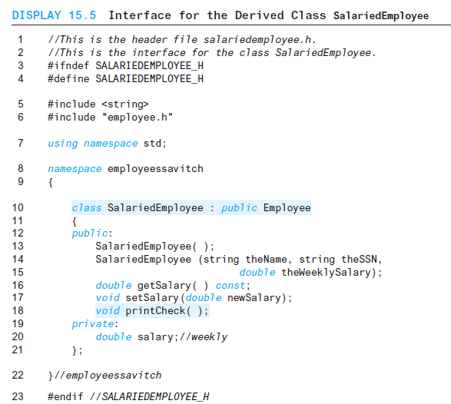
Display 15.5
Back
Next
Slide 15- <number>

Slide 67
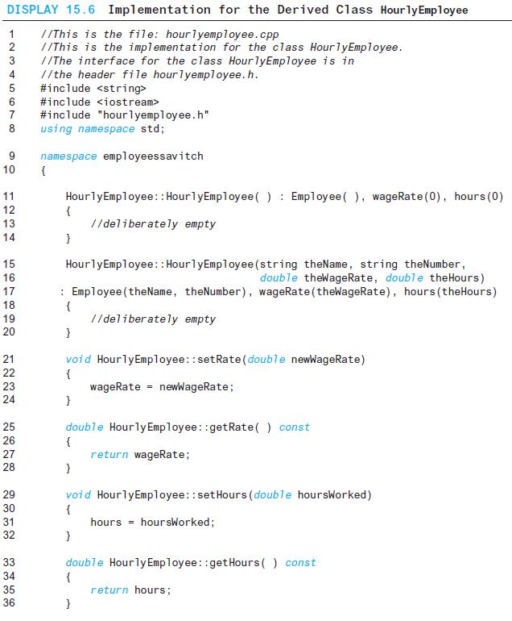
Display 15.6 (1/2)
Back
Next
Slide 15- <number>

Slide 68
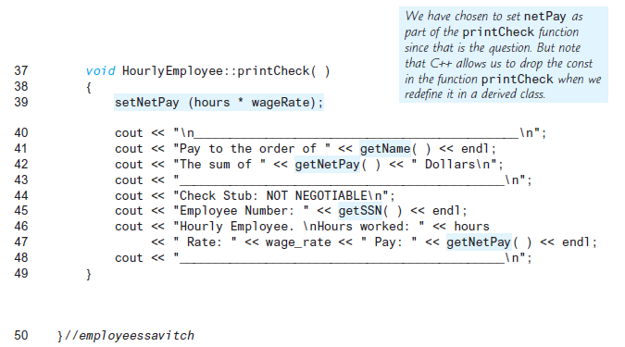
Display 15.6 (2/2)
Back
Next
Slide 15- <number>

Slide 69
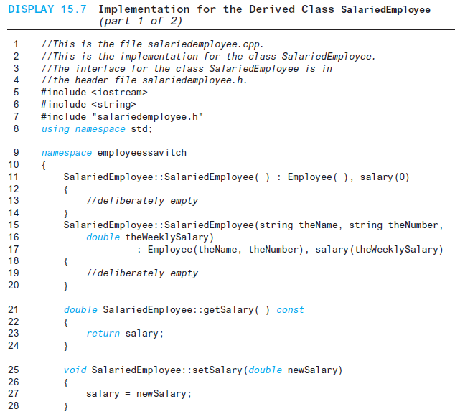
Display 15.7 (1/2)
Back
Next
Slide 15- <number>

Slide 70
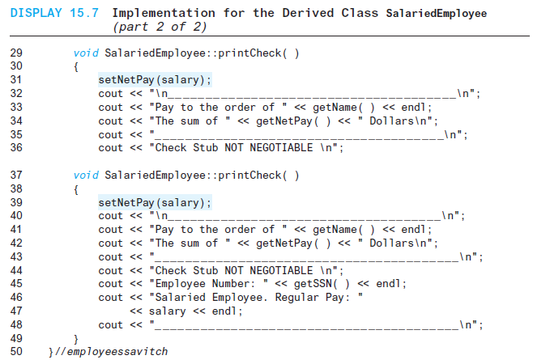
Display 15.7
(2/2)
Back
Next
Slide 15- <number>

Slide 71
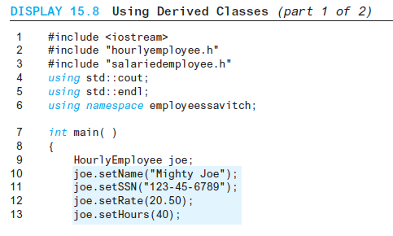
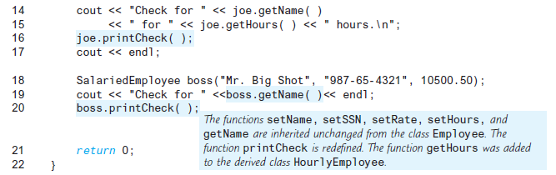
Display 15.8 (1/2)
Back
Next
Slide 15- <number>

Slide 72
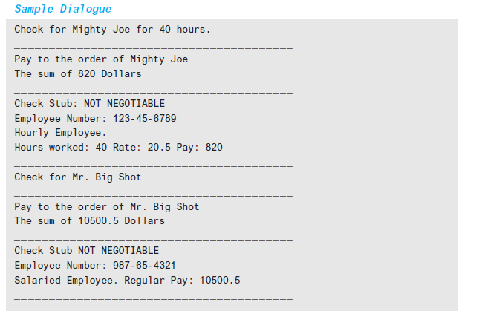
Display 15.8
(2/2)
Back
Next
Slide 15- <number>

Slide 73
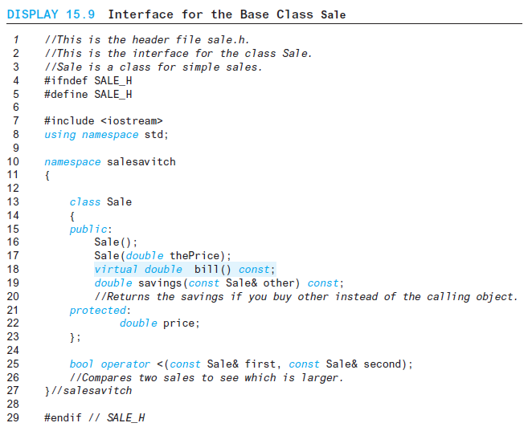
Display 15.9
Back
Next
Slide 15- <number>

Slide 74
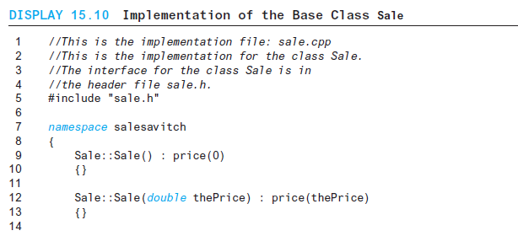
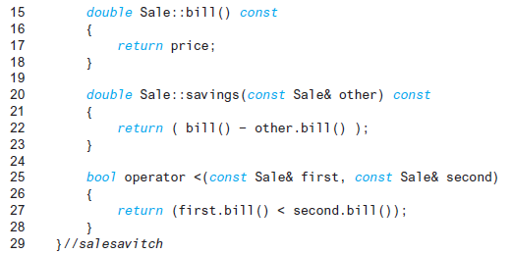
Display 15.10
Back
Next
Slide 15- <number>

Slide 75
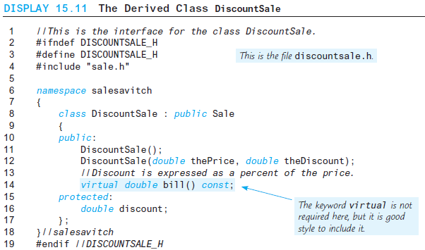
Display 15.11
Back
Next
Slide 15- <number>

Slide 76
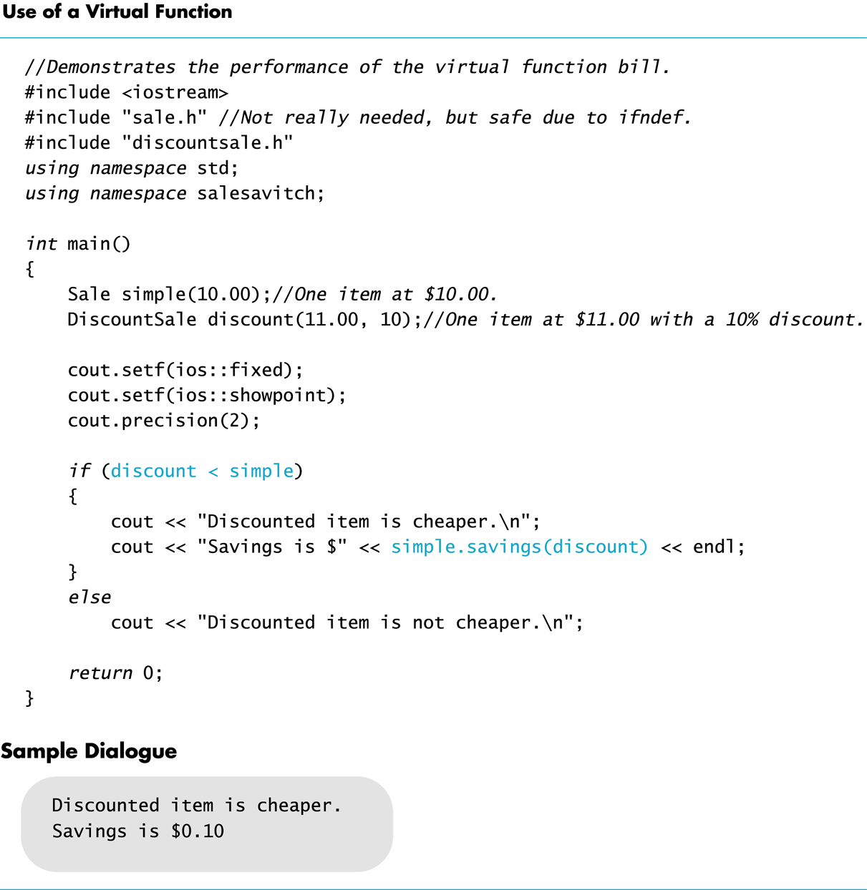
Display 15.12
Back
Next
Slide 15- <number>

Slide 77
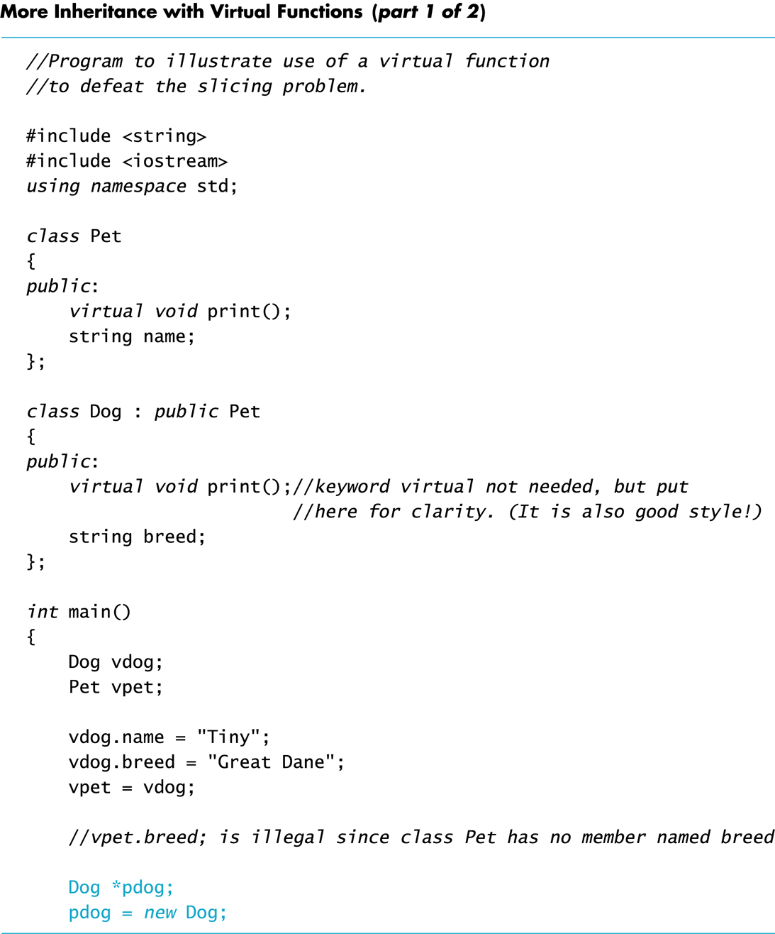
Display 15.13 (1/2)
Back
Next
Slide 15- <number>

Slide 78
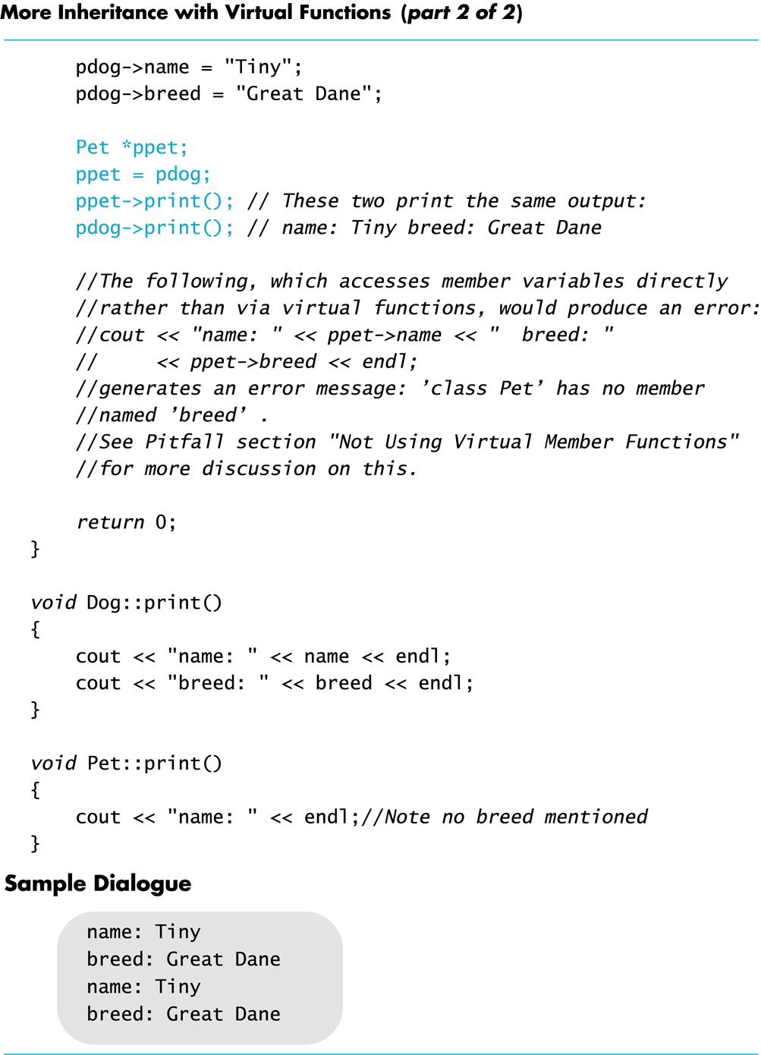
Display 15.13 (2/2)
Back
Next
Slide 15- <number>

