Slide 1
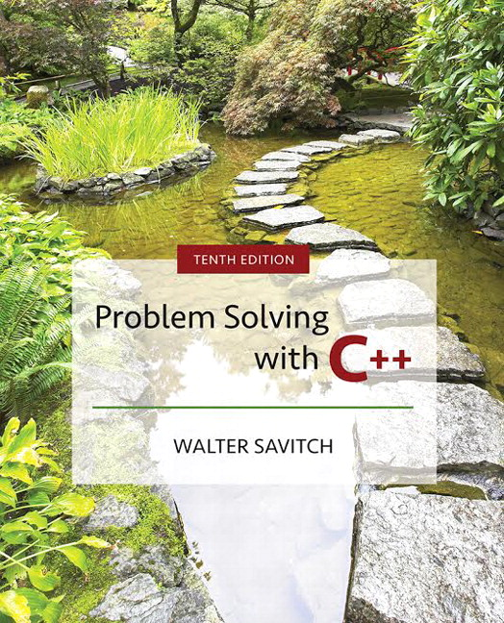

Slide 2
Chapter 17
Templates

Slide 3
Overview
17.1 Templates for Algorithm Abstraction
17.2 Templates for Data Abstraction
Slide 17- <number>

Slide 4
17.1
Templates for Algorithm Abstraction

Slide 5
Templates for Algorithm Abstraction
Function definitions often use application
specific adaptations of more general algorithms
  For example: The general algorithm used in
  swapValues could swap variables of any type:
  void swapValues(typeOfVar& v1,
  typeOfVar& v2)
  {
  typeOfVar temp;
  temp = v1;
  v1 = v2;
  v2 = temp;
  }
Slide 17- <number>

Slide 6
swapValues for char
Here is a version of swapValues to swap
character variables:
  void swapValues(char& v1, char& v2)
  {
  char temp;
  temp = v1;
  v1 = v2;
  v2 = temp;
  }
Slide 17- <number>

Slide 7
A General swapValues
A generalized version of swapValues is shown
here.
  void swapValues(typeOfVar& v1, typeOfVar& v2)
  {
  typeOfVar temp;
  temp = v1;
  v1 = v2;
  v2 = temp;
  }
  This function, if typeOfVar could accept any type,
  could be used to swap values of any type
Slide 17- <number>

Slide 8
Templates for Functions
A C++ function template will allow swapValues
to swap values of two variables of the same type
  Example:
  template<class T>
  void swapValues(T& v1, T& v2)
  {
  T temp;
  temp = v1;
  v1 = v2;
  v = temp;
  }
Type parameter
Template prefix
Slide 17- <number>

Slide 9
Template Details
template<class T> is the template prefix
  Tells compiler that the declaration or definition that follows is a template
  Tells compiler that T is a type parameter
    class means type in this context
    (typename could replace class but class is usually used)
    T can be replaced by any type argument
    (whether the type is a class or not)
A template overloads the function name by
replacing T with the type used in a function call
Slide 17- <number>

Slide 10
Calling a Template Function
Calling a function defined with a template is
identical to calling a normal function
  Example:
  To call the template version of swapValues
  char s1, s2;
  int i1, i2;
  …
  swapValues(s1, s2);
  swapValues(i1, i2);
    The compiler checks the argument types and generates an appropriate version of swapValues
Slide 17- <number>

Slide 11
Templates and Declarations
A function template may also have a separate
declaration
  The template prefix and type parameter are used
  Depending on your compiler
    You may, or may not, be able to separate declaration and definitions of template functions just as you do with regular functions
  To be safe, place template function definitions in the same file where they are used…with no declaration
    A file included with #include is, in most cases, equivalent to being "in the same file“
    This means including the .cpp file or .h file with implementation code
Slide 17- <number>

Slide 12
The Type Parameter T
T is the traditional name for the type parameter
  Any valid, non-keyword, identifier can be used
  "VariableType" could be used
  template <class VariableType>
  void swapValues(VariableType& v1,
  VariableType& v2)
  {
  VariableType temp;
  …
  }
Display 17.1
Slide 17- <number>

Slide 13
Templates with
Multiple Parameters
Function templates may use more than one
parameter
  Example:
  template<class T1, class T2>
    All parameters must be used in the template function
Slide 17- <number>

Slide 14
Algorithm Abstraction
Using a template function we can express more
general algorithms in C++
Algorithm abstraction means expressing
algorithms in a very general way so we can
ignore incidental detail
  This allows us to concentrate on the substantive part of the algorithm
Slide 17- <number>

Slide 15
Program Example:
A Generic Sorting Function
The sort function below uses an algorithm that
does not depend on the base type of the array
void sort(int a[], int numberUsed)
{
int indexOfNextSmallest;
for (int index = 0; index < numberUsed -1; index++)
{
indexOfNextSmallest =
indexOfSmallest(a, index, numberUsed);
swapValues(a[index], a[indexOfNextSmallest]);
}
}
  The same algorithm could be used to sort an array of any type
Slide 17- <number>

Slide 16
Generic Sorting:
Helping Functions
sort uses two helper functions
  indexOfSmallest also uses a general algorithm and
  could be defined with a template
  swapValues has already been adapted as a template
All three functions, defined with templates, are
demonstrated in
Display 17.2
Display 17.3 (1-2)
Slide 17- <number>

Slide 17
Templates and Operators
The function indexOfSmallest compares items
in an array using the < operator
  If a template function uses an operator, such as <, that operator must be defined for the types being compared
  If a class type has the < operator overloaded for the class, then an array of objects of the class could be sorted with function template sort
Slide 17- <number>

Slide 18
Defining Templates
When defining a template it is a good idea…
  To start with an ordinary function that accomplishes the task with one type
    It is often easier to deal with a concrete case rather than the general case
  Then debug the ordinary function
  Next convert the function to a template by replacing type names with a type parameter
Slide 17- <number>

Slide 19
Inappropriate Types for Templates
Templates can be used for any type for which
the code in the function makes sense
  swapValues swaps individual objects of a type
  This code would not work, because the assignment
  operator used in swapValues does not work with arrays:
  int a[10], b[10];
  <code to fill the arrays>
  swapValues(a, b);
Slide 17- <number>

Slide 20
Section 17.1 Conclusion
Can you
  Identify a template prefix?
  Identify a parameter type in a template prefix?
  Compare and contrast function overloading with the use of templates?
    What additional complexities are involved when class types are involved as parameter types?
Slide 17- <number>

Slide 21
17.2
Templates for Data Abstraction

Slide 22
Templates for Data Abstraction
Class definitions can also be made more general
with templates
  The syntax for class templates is basically the same as for function templates
    template<class T> comes before the template definition
    Type parameter T is used in the class definition just like any other type
    Type parameter T can represent any type
Slide 17- <number>

Slide 23
A Class Template
The following is a class template
  An object of this class contains a pair of values of
  type T
  template <class T>
  class Pair
  {
  public:
  Pair( );
  Pair( T firstValue, T secondValue);
  …
  continued on next slide
Slide 17- <number>

Slide 24
Template Class Pair (cont.)
  void setElement(int position, T value);
  //Precondition: position is 1 or 2
  //Postcondition: position indicated is set to value
  T getElement(int position) const;
  // Precondition: position is 1 or 2
  // Returns value in position indicated
  private:
  T first;
  T second;
  };
Slide 17- <number>

Slide 25
Declaring
Template Class Objects
Once the class template is defined, objects may
be declared
  Declarations must indicate what type is to be used for T
  Example: To declare an object so it can hold a pair of integers:
  Pair<int> score;
  or for a pair of characters:
  Pair<char> seats;
Slide 17- <number>

Slide 26
Using the Objects
After declaration, objects based on a template
class are used just like any other objects
  Continuing the previous example:
  score.setElement(1,3);
  score.setElement(2,0);
  seats.setElement(1, 'A');
Slide 17- <number>

Slide 27
Defining the Member Functions
Member functions of a template class are defined
the same way as member functions of ordinary
classes
  The only difference is that the member function
  definitions are themselves templates
Slide 17- <number>

Slide 28
Defining a Pair Constructor
This is a definition of the constructor for class
Pair that takes two arguments
template<class T>
Pair<T>::Pair(T firstValue, T secondValue)
: first(firstValue), second(secondValue)
{
//No body needed due to initialization above
}
  The class name includes <T>
Slide 17- <number>

Slide 29
Defining setElement
Here is a definition for setElement in the
template class Pair
void Pair<T>::setElement(int position, T value)
{
if (position = = 1)
first = value;
else if (position = = 2)
second = value;
else
…
}
Slide 17- <number>

Slide 30
Template Class Names as Parameters
The name of a template class may be used as the type of a function parameter
  Example: To create a parameter of type Pair<int>:
  int addUp(const Pair<int>& thePair);
  //Returns the sum of two integers in thePair
Slide 17- <number>

Slide 31
Template Functions with Template Class Parameters
Function addUp from a previous example can
be made more general as a template function:
template<class T>
T addUp(const Pair<T>& thePair)
//Precondition: operator + is defined for T
//Returns sum of the two values in thePair
Slide 17- <number>

Slide 32
Program Example:
An Array Class
The example in the following displays is a
class template whose objects are lists
  The lists can be lists of any type
The interface is found in
The program is in
The implementation is in
Display 17.4 (1-2)
Display 17.5
Display 17.6 (1-3)
Slide 17- <number>

Slide 33
Implementation Notes
Note that in Display 17.4, the class definition for GenericList, we put the implementation of the overloaded << operator in the header file itself
  This is common for template classes with friend operators
  This is because << is a friend, not a member of the class; as a result, implementation is simpler this way
Slide 1- <number>

Slide 34
Separate implementation of overloaded friend operator
We can put the implementation of << into the implementation file but there is extra work
  Make forward declaration with the diamond in the .h file
  Implement << in the .cpp file
Display 17.7
Display 17.8
Slide 1- <number>

Slide 35
typedef and Templates
You specialize a class template by giving a type
argument to the class name such as Pair<int>
  The specialized name, Pair<int>, is used just
  like any class name
You can define a new class type name with the
same meaning as the specialized name:
typedef Class_Name<Type_Arg> New_Type_Name;
For example: typedef Pair<int> PairOfInt;
PairOfInt pair1, pair2;
Slide 17- <number>

Slide 36
Section 17.2 Conclusion
Can you
  Give the definition for the member function
  getElement for the class template Pair?
  Give the definition for the constructor with zero
  arguments for the template class Pair?
Slide 17- <number>

Slide 37
Chapter 17 -- End
Slide 17- <number>

Slide 38
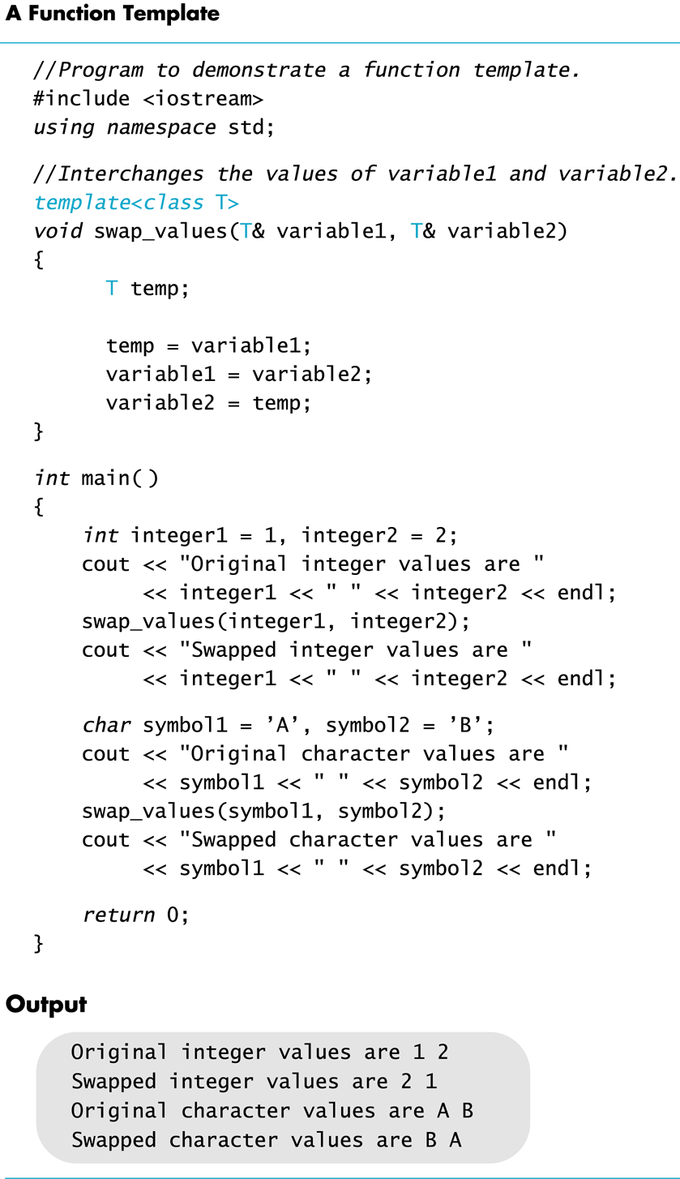
Display 17.1
Back
Next
Slide 17- <number>

Slide 39
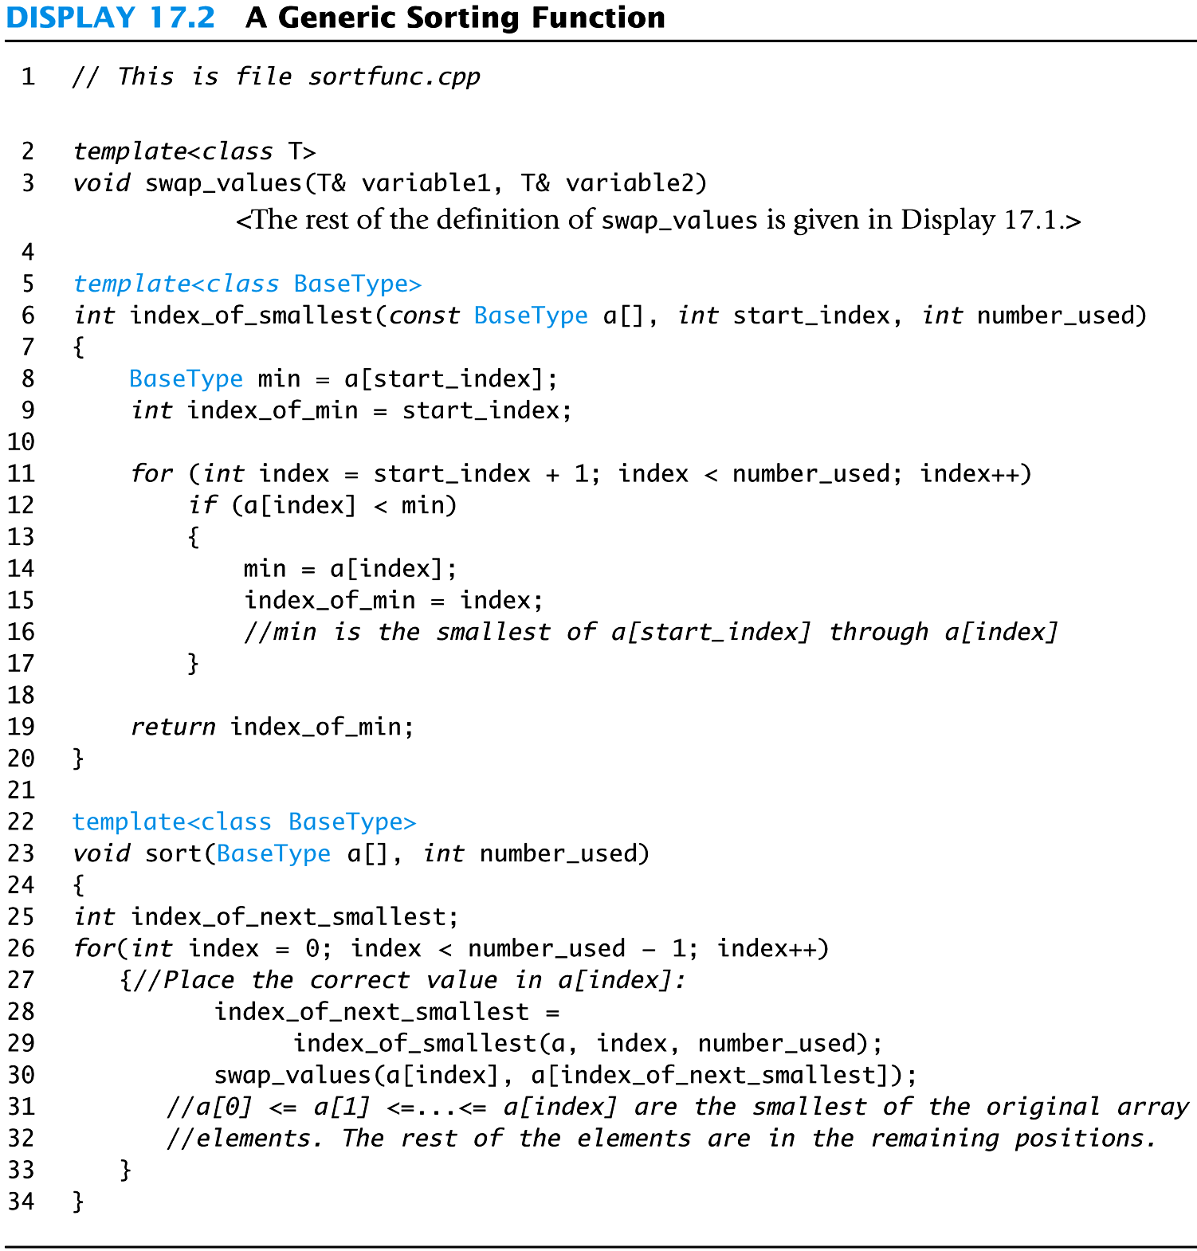
Display 17.2
Back
Next
Slide 17- <number>

Slide 40
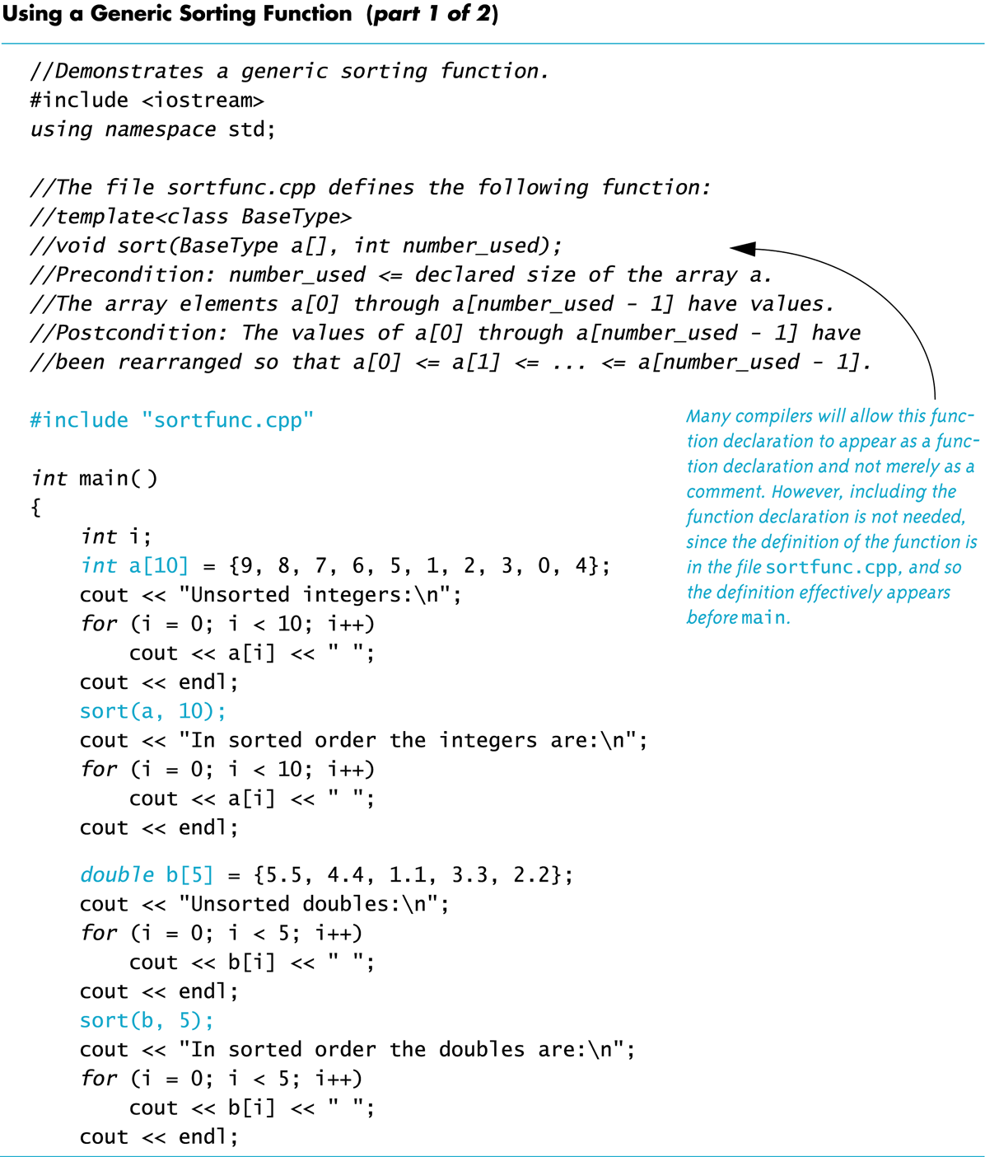
Display 17.3 (1/2)
Back
Next
Slide 17- <number>

Slide 41
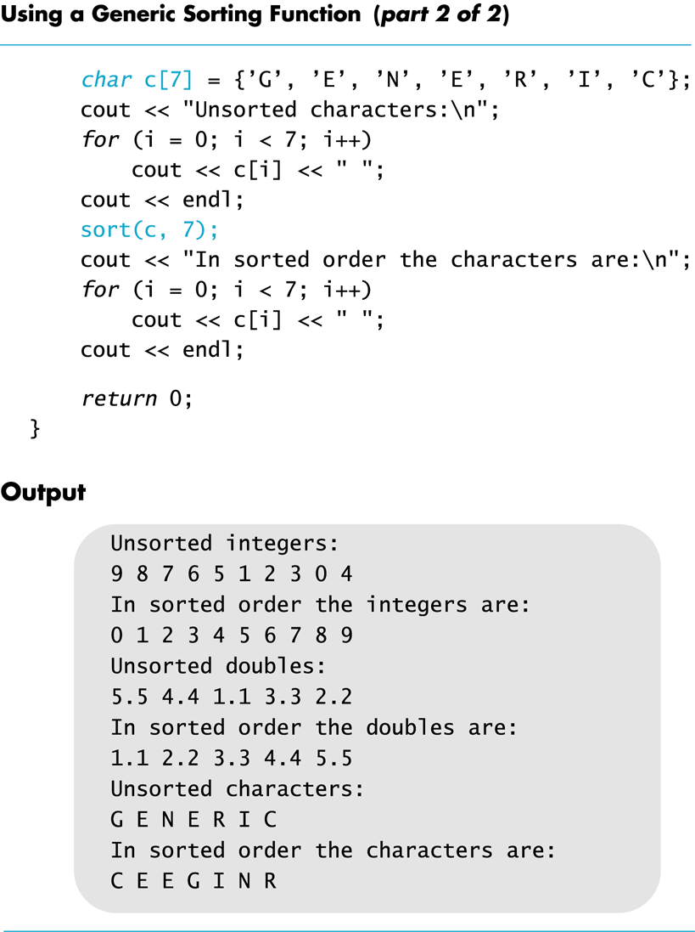
Display 17.3 (2/2)
Back
Next
Slide 17- <number>

Slide 42
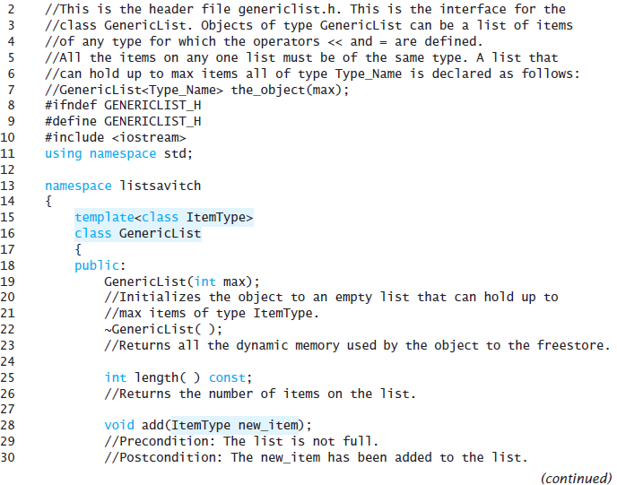
Display 17.4 (1/2)
Back
Next
Slide 17- <number>

Slide 43
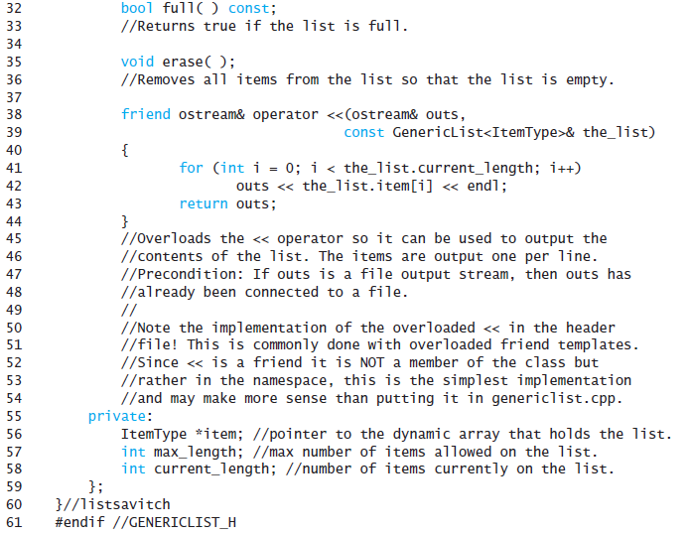
Display 17.4
(2/2)
Back
Next
Slide 17- <number>

Slide 44
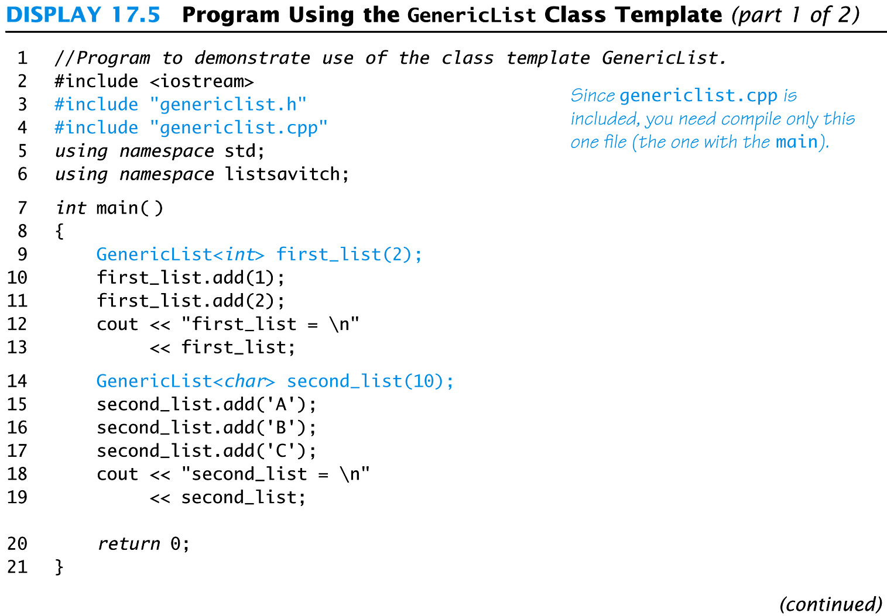
Display 17.5
1/2
Back
Next
Slide 17- <number>

Slide 45
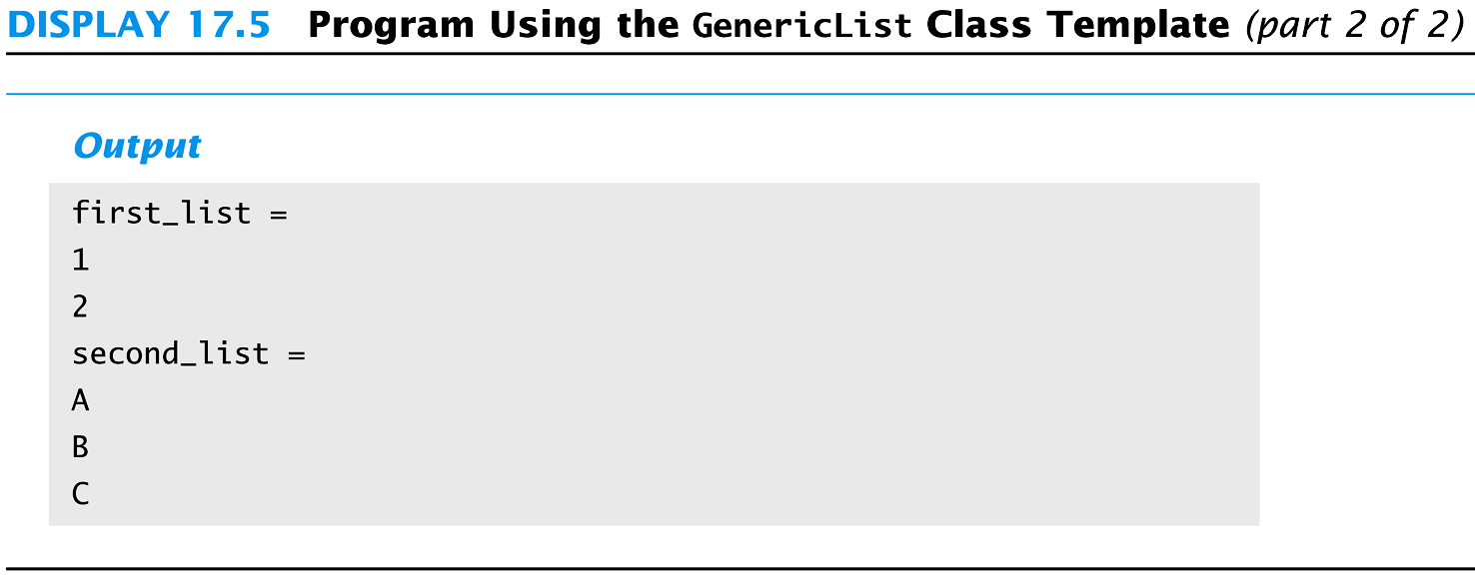
Display 17.5
2/2
Back
Next
Slide 17- <number>

Slide 46
Display 17.6
1/3
Back
Next
1 //This is the implementation file: genericlist.cpp
2 //This is the implementation of the class template named GenericList.
3 //The interface for the class template GenericList is in the
4 //header file genericlist.h.
5 #ifndef GENERICLIST_CPP
6 #define GENERICLIST_CPP
7 #include <iostream>
8 #include <cstdlib>
9 #include "genericlist.h" //This is not needed when used as we are using this file,
10 //but the #ifndef in genericlist.h makes it safe.
11 using namespace std;
12
13 namespace listsavitch
14 {
15 //Uses cstdlib:
16 template<class ItemType>
17 GenericList<ItemType>::GenericList(int max) : maxLength(max),
18 currentLength(0)
19 {
20 item = new ItemType[max];
21 }
Slide 17- <number>

Slide 47
Display 17.6 (2/3)
22
23 template<class ItemType>
24 GenericList<ItemType>::~GenericList( )
25 {
26 delete [] item;
27 }
28
29 template<class ItemType>
30 int GenericList<ItemType>::length( ) const
31 {
32 return (currentLength);
33 }
34
35 //Uses iostream and cstdlib:
36 template<class ItemType>
37 void GenericList<ItemType>::add(ItemType newItem)
38 {
39 if ( full( ) )
40 {
41 cout << "Error: adding to a full list.\n";
42 exit(1);
43 }
44 else
45 {
46 item[currentLength] = newItem;
47 currentLength = currentLength + 1;
48 }
49 }
Back
Next
Slide 17- <number>

Slide 48
Display 17.6
(3/3)
Back
Next
51 template<class ItemType>
52 bool GenericList<ItemType>::full( ) const
53 {
54 return (currentLength == maxLength);
55 }
56
57 template<class ItemType>
58 void GenericList<ItemType>::erase( )
59 {
60 currentLength = 0;
61 }
62 }//listsavitch
63 #endif // GENERICLIST_CPP Notice that we have enclosed all the template
64 // definitions in #ifndef... #endif.
Slide 17- <number>

Slide 49
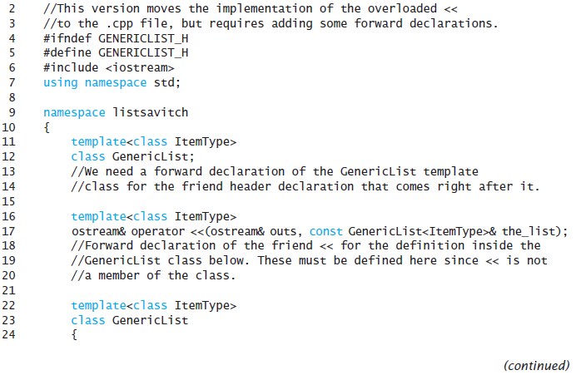
Display 17.7
1/2
Back
Next
Slide 17- <number>

Slide 50
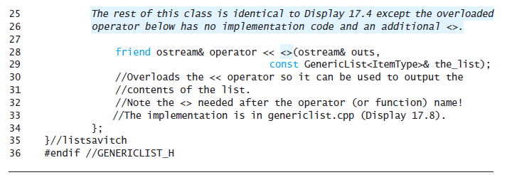
Display 17.7 (2/2)
Back
Next
Slide 17- <number>

Slide 51
Display 17.8
Back
Next
2 //This is the implementation file: genericlist.cpp
3 //This is the implementation of the class template named GenericList.
4 //The interface for the class template GenericList is in the
5 //header file genericlist.h.
6 #ifndef GENERICLIST_CPP
7 #define GENERICLIST_CPP
8 #include <iostream>
9 #include <cstdlib>
10 #include "genericlist.h" //Not needed when used as we are using this file,
11 //but the #ifndef in genericlist.h makes it safe.
12 using namespace std;
13
14 namespace listsavitch
15 {
16 The rest of this file is identical to Display 17.6 except for the
17 Implementation of <<.
18 template<class ItemType>
19 ostream& operator <<(ostream& outs, const GenericList<ItemType>& theList)
20 {
21 for (int i = 0; i < theList.currentLength; i++)
22 outs << theList.item[i] << endl;
23 return outs;
24 }
25 }//listsavitch
26 #endif // GENERICLIST_CPP Notice that we have enclosed all the template
27 // definitions in #ifndef... #endif.
Slide 17- <number>

