Slide 1
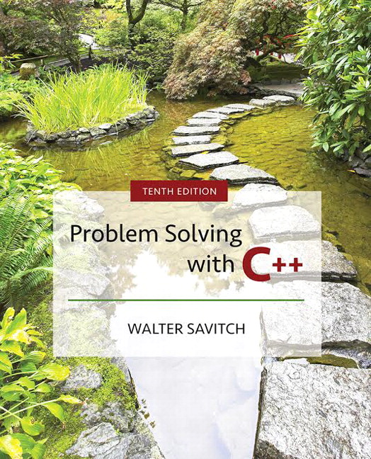

Slide 2
Overview
18.1 Iterators
18.2 Containers
18.3 Generic Algorithms
18.4 C++ Is Evolving
Slide 18- <number>

Slide 3
18.1
Iterators

Slide 4
Iterators
STL has containers, algorithms and Iterators
  Containers hold objects, all of a specified type
  Generic algorithms act on objects in containers
  Iterators provide access to objects in the containers yet hide the internal structure of the container
Slide 18- <number>

Slide 5
Using Declarations
Using declarations allow use of a function or name defined in a namespace:
  using ns::fun( );
  using ns::iterator;
  using std::vector;
  using std::vector<int> ::iterator;
Slide 18- <number>

Slide 6
Iterator Basics
An iterator is a generalization of pointer
  Not a pointer but usually implemented using pointers
  The pointer operations may be overloaded for behavior appropriate for the container internals
  Treating iterators as pointers typically is OK.
  Each container defines an appropriate iterator type.
  Operations are consistent across all iterator types.
Slide 18- <number>

Slide 7
Basic Iterator Operations
Basic operations shared by all iterator types
  ++ (pre- and postfix) to advance to the next data item
  == and != operators to test whether two iterators point to the same data item
  * dereferencing operator provides data item access
  c.begin( ) returns an iterator pointing to the first element of container c
  c.end( ) returns an iterator pointing past the last element of container c. Analogous to the null pointer. Unlike the null pointer, you can apply -- to the iterator returned by c.end( ) to get an iterator pointing to last element in the container.
Slide 18- <number>

Slide 8
More Iterator Operations
-- (pre- and postfix) moves to previous data item Available to some kinds of iterators.
*p access may be read-only or read-write depending on the container and the definition of the iterator p.
STL containers define iterator types appropriate to the container internals.
Some containers provide read-only iterators
Display 18.1
Slide 18- <number>

Slide 9
Kinds of Iterators
  Forward iterators provide the basic operations
  Bidirectional iterators provide the basic operations and the -- operators (pre- and postfix) to move to the previous data item.
  Random access iterators provide
    The basic operations and –
    Indexing p[2] returns the third element in the container
    Iterator arithmetic p + 2 returns an iterator to the third element in the container
Display 18.2 (1-2)
Slide 18- <number>

Slide 10
Constant and Mutable Iterators
Categories of iterator divide into constant and mutable iterator.
  Constant Iterator cp does not allow assigning element at p
  using std::vector<int>::const_iterator;
  const_iterator cp = v.begin( );
  *cp = something; // illegal
  Mutable iterator p does allow changing the element at p.
  using std::vector<int>::iterator;
  iterator p = v.begin( );
  *p = something; // OK
Slide 18- <number>

Slide 11
Using auto
The C++11 auto keyword can simplify variable declarations for iterators, e.g. instead of:
  vector<int>::iterator p = v.begin();
We simply use:
  auto p = v.begin();
Slide 18- <number>

Slide 12
Reverse Iterators
A reverse iterator enables cycling through a container from the end to the beginning. Reverse iterators reverse the more usual behavior of ++ and –
rp-- moves the reverse iterator rp towards the beginning of the container.
rp++ moves the reverse iterator rp towards the end of the container.
reverse_iterator rp;
for(rp = c.rbegin( ); rp != c.rend( ); rp++)
process_item_at (rp);
Object c is a container with bidirectional iterators
Display 18.3 (1-2)
Slide 18- <number>

Slide 13
Other Kinds of Iterators
Two other kinds of (weaker) iterator –
  An input iterator is a forward iterator that can be used with input streams.
  An output iterator is a forward iterator that can be used with output streams.
Slide 18- <number>

Slide 14
18.2
Containers

Slide 15
Containers
The STL provides three kinds containers:
  Sequential Containers are containers where the ultimate position of the element depends on where it was inserted, not on its value.
  Container Adapters use the sequential containers for storage, but modify the user interface to stack, queue or other structure.
  Associative Containers maintain the data in sorted order to implement the container’s purpose. The position depends on the value of the element.
Slide 18- <number>

Slide 16
Sequential Containers
The STL sequential containers are the list, vector and deque. (The slist is not in the STL.)
Sequential means the container has a first, element, a second element and so on.
An STL list is a doubly linked list.
An STL vector is essentially an array whose allocated space can grow while the program runs.
An STL deque (“d-que” or “deck”) is a “double ended queue”. Data can be added or removed at either end and the size can change while the program runs.
Display 18.4
Display 18.5
Slide 18- <number>

Slide 17
Common Container Members
The STL sequential containers each have different characteristics, but they all support these members:
  container( ); // creates empty container
  ~container( ); // destroys container, erases all members
  c.empty( ) // true if there are no entries in c
  c.size( ) const; // number of entries in container c
  c = v; //replace contents of c with contents of v
Slide 18- <number>

Slide 18
More Common Container Members
c.swap(other_container); // swaps contents of
// c and other_container.
c.push_back(item); // appends item to container c
c.begin( ); // returns an iterator to the first
// element in container c
c.end( ); // returns an iterator to a position
// beyond the end of the container c.
c.rbegin( ); // returns an iterator to the last element
// in the container. Serves to as start of
// reverse traversal.
Slide 18- <number>

Slide 19
More Common Container Members
c.rend( ); // returns an iterator to a position
// beyond the of the container.
c.front( ); // returns the first element in the
// container (same as *c.begin( );)
c.back( ); //returns the last element in the container
// same as *(--c.end( ));
c.insert(iter, elem); //insert copy of element elem
//before iteIr
c.erase(iter); //removes element iter points to,
// returns an iterator to element
// following erasure. returns c.end( ) if
// last element is removed.
Slide 18- <number>

Slide 20
More Common Container Members
c.clear( ); // makes container c empty
c1 == c2 // returns true if the sizes equal and
// corresponding elements in c1 and c2 are
//equal
c1 != c2 // returns !(c1==c2)
c.push_front(elem) // insert element elem at the
// front of container c.
// NOT implemented for vector due to large
// run-time that results
Slide 18- <number>

Slide 21
PITFALL:
Iterators and Removing Elements
Removing elements will invalidates some iterators.
erase member returns an iterator pointing to the next element past the erased element.
With list we are guaranteed that only iterators pointing to the erased element are invalidated.
With vector and deque, treat all operations that erase or insert as invalidating previous iterators.
Slide 18- <number>

Slide 22
Operation Support
Operation | Function | vector | List | deque
Insert at front | push_front(e) | - | X | X
Insert at back | push_back(e) | X | X | X
Delete at front | pop_front( ) | - | X | X
Delete at back | pop_back( ) | X | X | X
Insert in middle | insert(e) | (X) | X | (X)
Delete in middle | erase(iter ) | (X) | X | (X)
Sort | sort( ) | X | - | X
(X) Indicates this operation is significantly slower.
Display 18.6
Slide 18- <number>

Slide 23
The Container Adapters stack and queue
Container Adapters use sequence containers for storage but supply a different user interface.
A stack uses a Last-In-First-Out discipline.
A queue uses a First-In-First-Out discipline.
A priority queue keeps its items sorted on a property of the items called the priority, so that the highest priority item is removed first.
The deque is the default container for both stack and queue.
A vector cannot be used for a queue as the queue requires operations at the front of the container.
Slide 18- <number>

Slide 24
Container Adapter stack
Declarations:
  stack<T> s; // uses deque as underlying store
  stack<T, underlying_container> t ; //uses the specified
  //container as underlying container for stack
  Stack<T> s (sequence_container); // initializes stack to
  // to elements in sequence_container.
Header:
#include <stack>
Defined types:
value_type, size_type
No iterators are defined.
Slide 18- <number>

Slide 25
stack Member Functions
Sample Member Functions
Member function | Returns
s.size( ) | number of elements in stack
s.empty( ) | true if no elements in stack else false
s.top( ) | reference to top stack member
s.push(elem) | void Inserts copy of elem on stack top
s.pop( ) | void function. Removes top of stack.
s1 = = s2 | true if sizes same and corresponding pairs of elements are equal, else false
Display 18.10 (1-2)
Slide 18- <number>

Slide 26
Container Adapter queue
Declarations:
  queue<T> q; // uses deque as underlying store
  queue<T, underlying_container> q ; //uses the specified
  //container as underlying container for queue
  Stack<T> s (sequence_container); // initializes queue to
  // to elements in sequence_container.
Header:
#include <queue>
Defined types:
value_type, size_type
No iterators are defined.
Slide 18- <number>

Slide 27
queue Member Functions
Sample Member Functions
Member function | Returns
q.size( ) | number of elements in queue
q.empty( ) | true if no elements in queue else false
q.front( ) | reference to front queue member
q.push(elem) | void adds a copy of elem at queue rear
q.pop( ) | void function. Removes front of queue.
q1 == q2 | true if sizes same and corresonding pairs of elements are equal, else false
Slide 18- <number>

Slide 28
Associative Containers set and map
Associative containers keep elements sorted on a some property of the element called the key.
Only the first insertion of a value into a set has effect.
The order relation to be used may be specified:
set<T, OrderRelation> s;
The default order is the < relational operator for both set and map.
Slide 18- <number>

Slide 29
The set Associative Container
Declarations:
  set<T> s; // uses deque as underlying store
  set<T, Ordering> s ; //uses the specified
  // order relation to sort elements in the set
  // uses < if no order is specified.
Header:
#include <set>
Defined types:
value_type, size_type
Iterators: iterator, const_iterator, reverse_iterator, const_reverse_iterator
Slide 18- <number>

Slide 30
set Member Functions
function | Returns
s.size( ) | number of elements in set
s.empty( ) | true if no elements in set else false
s.insert(el) | Insert elem in set. No effect if el is a member
s.erase(itr) | Erase element to which itr refers
s.erase(el) | Erase element el from set. No effect if el is not a member
s.find(el) | Mutable iterator to location of el in set if present, else returns s.end( )
s1 == s2 | true if sizes same and corresponding pairs of elements are equal, else false
Display 18.12
Slide 18- <number>

Slide 31
The map associative container
A map is a function given as a set of ordered pairs <first, second>
For each first in an ordered pair <first, second> there is at most one value, second, that appears in an ordered pair in the map.
  First and second can be different data types, so for example you could map an integer to a string
The STL provides a template class pair<T1,T2> defined in the utility header file.
You may wish to read about the multiset and multimap. See Josuttis, The C++ Standard Library Addison Wesley.
Slide 18- <number>

Slide 32
Maps as associative arrays
An alternative interpretation is that a map is an associative array. For example, numbermap["c++"] = 5 associates the integer 5 with the string "c++"
The easiest way to add and retrieve data from a map is to use the [] operator
  However, if you attempt to access map[key] and key is not already in the map, then a new entry with the default value will be added!
Display 18.14 (1-2)
Slide 18- <number>

Slide 33
map Member Functions
Function | Returns
m.size( ) | number of pairs in the map
m.empty( ) | true if no pairs are in the map else false
m.insert(el) el is a pair <key, T> | Inserts el into map. Returns <iterator, bool>. If successful, bool is true, iterator points to inserted pair. Otherwise bool is false
m.erase(key) | Erase element with key value key from map.
m.find(el) | Mutable iterator to location of el in map if present, else returns m.end( )
m1 = = m2 | true if maps contain the same pairs, else false
m[target] | Returns a reference to the map object associated to a key of target.
Slide 18- <number>

Slide 34
Efficiency
The STL was designed with efficiency as an important consideration.
STL requires compliant implementations to guarantee a maximum running time.
STL implementations strive to be optimally efficient.
Sorting is usually specified to be O(N*log(N)) where N is the number of items being sorted
Search is usually specified to be O(log(N)) where N is the number of items being searched.
Slide 18- <number>

Slide 35
Tip: Use ranged-for, auto with containers
C++11 ranged-for loop and auto keyword make it easier to iterate through containers. Consider the following map and set:
We can iterate through each container conveniently with a ranged for loop and auto:
map<int, string> personIDs = {
{1,"Walt"},
{2,"Kenrick"}
};
set<string> colors = {"red","green","blue"};
for (auto p : personIDs)
cout << p.first << " " << p.second << endl;
for (auto p : colors)
cout << p << " ";
Slide 18- <number>

Slide 36
18.3
Generic Algorithms

Slide 37
Generic Algorithms
“Generic Algorithm” are a template functions that use iterators as template parameters.
This chapter will use Generic Algorithm, Generic function, and STL function template to mean the same thing.
Function interface specifies task, minimum strength of iterator arguments, and provides run-time specification.
Slide 18- <number>

Slide 38
Running Times and Big-O Notation
To be useful, running times for an algorithm must specify time as a function of the problem size.
We can time a program with a stop watch or instrument the code with calls to the system clock to empirically determine running time.
What problems do you see there?
There is a better way.
Slide 18- <number>

Slide 39
Worst case running time
In the rest of the chapter we will always mean “worst case running time” when we specify a running time.
How do we proceed? Do we count “steps” or “operations”?
What is a step? What is an operation?
Disagreement abounds, but mostly we agree to count =, <, &&, !, [ ], ==, and ++
This simplifying assumption works well in practice.
Slide 18- <number>

Slide 40
An example
int i = 0;
bool found = false;
while (( i < N ) && !(found))
if (a[i] == target)
found = true;
else
i++;
Assume target is not in array.
Loop runs N times, 6 operations per iteration.
<, &&, ! , [i] , ==, ++
After N iterations, boolean expression adds 3
operations, <, &&, and !
Total of 6N + 3 operations.
Slide 18- <number>

Slide 41
Objections
Not all operations take the same time
A given operation takes different time on different machines
We ignores some operations that might be significant.
What we are really interested in is the growth rate of the running time as a function of the problem size, not precise computations for a particular architecture.
Slide 18- <number>

Slide 42
Big-O Notation
Estimates of running time are usually expressed with the Big-O notation.
We pronounce this “Big-Oh.” The O is the letter Oh, not the digit zero, 0.
We say that our loop in a previous slide runs in
O(6N + 3).
This means that the actual running time will be less than or equal to
c(6N+3)
We say the code runs in O(6N+3)
Slide 18- <number>

Slide 43
Large Coefficients Do Not Matter
Big-O estimates do not distinguish 5N + 5 and 100N
These all have Big-O estimates of O(N³)
  N³ + 4000N² – N + 1
  8N³ + 5N – 1000
  1000N³ + 4N² – 100000N + 1
Regardless of the coefficient, the largest exponent “rules”
Slide 18- <number>

Slide 44
Some generic terminology
T(N) means runnning time.
Linear running time
  T(N) = aN + b
Quadratic running time
  T(N) has highest term N²
O(log N) A function with this running time is very fast
O(N log N) A function with this running time is slower than linear, but much faster than quadratic.
Display 18.16
Slide 18- <number>

Slide 45
Container Access Time 1
vector: push_back(el), pop_back( ) have O(1) (constant upper bound) running time
deque: push_back(el), push_front(el),
pop_back( ), push_back(el) are all O(1)
list: insert anywhere is O(1)
Finding the location of an element in a list has O(N) running time.
Slide 18- <number>

Slide 46
Container Access Time 2
vector, deque insert in the middle is O(N)
vector insert at the front is O(N)
Most set and map operations are O(log N) Other set and map operations are O(1).
Slide 18- <number>

Slide 47
Generic Algorithm Classification
Algorithms are classified into
  Nonmodifying Sequence Algorithms
  Modifying Sequence Algorithms
  Sorting and Related Algorithms
  Numeric Algorithms
We will deal with nonmodifying, modifying and sorting algorithms.
See Josuttis for more information on algorithms.
Slide 18- <number>

Slide 48
Nonmodifying Sequence Algorithms
Nonmodifying algorithms that do not modify the container they operate upon.
The declaration of the generic function find algorithm:
template<class InputIterator, class T>
InputIterator find (InputIterator first, InputIterator last,
const T& value);
The declaration tells us find works with any container that provides an iterator at least as strong as an input iterator.
Type T objects must be equality comparable.
Slide 18- <number>

Slide 49
Iter find(Iter first, Iter last, const T& value);
The generic algorithm find( ) locates an element within a sequence. It takes three arguments.
The first two specify a range: [start, end), the third specifies a target value for the search.
If requested value is found, find( ) returns an iterator that points to the first element that is identical to the sought-after value.
If the requested value is not found, find( ) returns an iterator pointing one element past the final element in the sequence (that is, it returns the same value as end( ) does).
Slide 18- <number>

Slide 50
More nonmodifying Algorithms
count Counts occurrences of a value in a sequence
equal Asks are elements in two ranges equal?
search Looks for the first occurrence of a match sequence within another sequence
binary_search Searches for a value in a container sorted using less. If the container was sorted using another predicate, this predicate must be supplied to binary_search. This is an efficient search for sorted sequences with random access iterators.
Slide 18- <number>

Slide 51
Container Modifying Algorithms
Container modifying algorithms change the content of the elements or their order.
copy Copies from a source range to a destination range. This can be used to shift elements in a container to the left provided that the first element in the source range is not contained in the destination range.
remove Removes all elements from a range equal to the given value
random_shuffle shuffles the elements of a sequence. Argument 1 is an iterator pointing to the first of the sequence. Argument 2 points one position past the last element of the sequence.
Slide 18- <number>

Slide 52
Sorting Algorithms
Algorithm analysis tells us that the runtime of the most efficient sort algorithms that depend on swapping elements is O(N log(N)). N is the number of elements being sorted.
All the STL sorting algorithms are required to be O(N log(N)), so these algorithms (up to a multiplicative constant) as fast as possible.
sort Sorts elements in a range in nondescending order, or in an order determined by a user-specified binary predicate.
merge Merges two sorted source ranges into a single destination range.
Slide 18- <number>

Slide 53
18.4
C++ Is Evolving

Slide 54
C++ Is Evolving
The International Standards Organization ratifies proposed changes to the language
  C++11, C++14, C++17 are some of the specifications, with the number indicating the year of reaching the draft standard stage
Examples of some additions
  std::array
  Threads
  Regular Expressions
  Smart Pointers
Slide 18- <number>

Slide 55
The standard array container
std::array allows you to use a vector-like notation for random access into a fixed-size sequence of elements
Provides safe array access with the performance and minimal storage of a regular array
It is a template-based class
#include <array>
using std::array;
Slide 18- <number>

Slide 56
std::array Example
The following creates an array of 4 ints:
array<int, 4> a = {1, 2, 3, 4};
Use a.size() to get the number of elements and use [] to access elements:
// Output each element in the array
for (int i = 0; i < a.size(); i++)
cout << a[i] << endl;
Slide 18- <number>

Slide 57
std::array Example
Given:
array<int, 4> a = {1, 2, 3};
Index 3 initialized to zero:
cout << a[2] << endl; // 3
cout << a[3] << endl; // 0
No harmful effects accessing outside the boundaries of the array:
a[100] = 10; // Ignored, no memory write
Slide 18- <number>

Slide 58
Regular Expressions
For our purposes, a regular expression provides a way to match patterns of text
  Formally, a regular expression describes a language from the class of regular languages
  Some compilers still missing regex support
This is a large topic, only a brief introduction is given here!
#include <regex>
using std::regex;
Slide 18- <number>

Slide 59
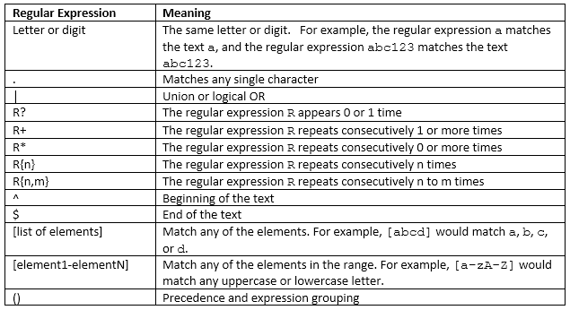
Regular Expressions
Slide 18- <number>

Slide 60
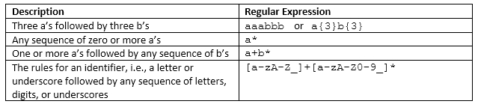
Regular Expression Examples
Slide 18- <number>

Slide 61
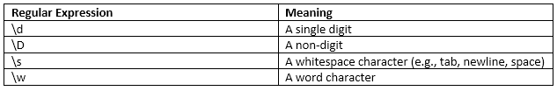
Some Regular Expression Character Classes
Note that these regular expression character classes must contain the \ character, so we either need to escape it with \\ or use R“(literal text)“ instead
Slide 18- <number>

Slide 62
Example – Matching a Phone Number
// A phone number in the format xxx-xxx-xxxx
string phonePattern = R"(\d{3}-\d{3}-\d{4})";
// A pattern with two words separated by whitespace
string twoWordPattern = R"(\w+\s\w+)";
regex regPhone(phonePattern);
regex regTwoWord(twoWordPattern);
string s;
cout << "Enter a string to test the phone pattern." << endl;
getline(cin, s);
if (regex_match(s, regPhone))
cout << s << " matches " << phonePattern << endl;
else
cout << s << " doesn't match " << phonePattern << endl;
cout << endl;
cout << "Enter a string to test the two word pattern." << endl;
getline(cin, s);
if (regex_match(s, regTwoWord))
cout << s << " matches " << twoWordPattern << endl;
else
cout << s << " doesn't match " << twoWordPattern << endl;
Slide 18- <number>

Slide 63
Threads
A thread is a separate computational process that runs concurrently
  You can think of a thread as a program that can run at the same time (in parallel) as other threads
  Useful for performance reasons and to prevent your program from blocking while waiting for input
#include <thread>
using std::thread;
Slide 18- <number>

Slide 64
Sample Program
This program runs func() in two threads and main runs in a third thread
void func(int a)
{
cout << "Hello World: " << a << endl;
}
int main()
{
thread t1(func, 10); // Runs func(10) in a thread
thread t2(func, 20); // Runs func(20) in a thread
t1.join(); // Waits for thread 1 to finish
t2.join(); // Waits for thread 2 to finish
}
Slide 18- <number>

Slide 65
Mutex
You can use a mutex to give a thread exclusive access to run a block of code. Other threads will wait for the mutex to be unlocked before entering
#include <mutex>
...
using std::mutex;
...
mutex globalLock;
void func(int a)
{
globalLock.lock();
cout << "Hello World: " << a << endl;
globalLock.unlock();
}
int main()
{
thread t1(func, 10);
thread t2(func, 20);
t1.join();
t2.join();
}
Slide 18- <number>

Slide 66
Threads
It is also possible to run a class in a thread
See textbook for example
Slide 18- <number>

Slide 67

Smart Pointers
A template class that automatically frees up memory allocated to dynamic variables when they go out of scope
Uses a technique called reference counting that counts how many pointers reference an allocated node
  p = new Node();
  q = p;
Ref count = 1
p
1
p
2
Ref count = 2
q
Slide 18- <number>

Slide 68
Reference Counting
Ref count = 2
  p = nullptr;
  q = nullptr;
p
2
q
1
Ref count = 1
q
0
Ref count = 0
Memory deallocated
Slide 18- <number>

Slide 69
Reference Counting
Fails if there is a circular reference
If p is reassigned the memory should be deleted but the reference count is stuck at 1 and won’t be deleted because the count needs to reach zero
p
2
Ref count = 2
Slide 18- <number>

Slide 70
Smart Pointers
Old code without smart pointers
Node *p = new Node();
P->callFunction();
delete p; // delete when done with the pointer
Converted to smart pointers
#include <memory>
using std::shared_ptr;
...
shared_ptr<Node> p(new Node()); // Template class
p->callFunction(); // Use like a regular pointer
// delete p; No longer needed, will be deleted automatically
// when reference count reaches 0
Slide 18- <number>

Slide 71
Chapter Summary 1
An iterator is a generalization of pointer. Iterators allow cycling through containers without compromising the container structure.
Most iterators have operations ++ and dereferencing * defined.
Main kinds of iterators are:
  Forward, where ++ works but -- does not
  Bidirectional where ++ and -- work
  Random access where ++ -- indexing and iterator arithmetic all work.
Slide 18- <number>

Slide 72
Chapter Summary 2
Kinds of container classes are
  Sequence containers: vector, deque, list
  Adapters: stack, queue, priority queue
    Deque is the default underlying container
    User can select an underlying container
    Stack discipline is last-in-first-out
    Queue discipline is first-in-first-out
    Priority queue keeps largest key on top.
Slide 18- <number>

Slide 73
Chapter Summary 3
  Associative containers: set, map, multiset, multimap
    Associative containers store elements in sorted order
    Map is a set of <key, value> pairs, allowing retrieval on key.
    Multiset and multiset allow single key for multiple entries
Slide 18- <number>

Slide 74
Chapter Summary 4
Containers with iterators also provide member functions begin( ) and end( ) that return iterator types useful to traverse the container:
for (p = c.begin( ); p != c.end( ); p++)
process(*p ); // *p is the current item
Dereferencing a constant iterator *const_p provides read only access.
Dereferencing a mutable iterator produces a read-write access: *mutable_p
Slide 18- <number>

Slide 75
Chapter Summary 5
The sequence container list provides mutable bidirectional iterators.
The sequence containers vector and deque provides mutable random access iterators.
The STL provides template functions (sometimes called generic algorithms or template functions) that provide very guarantees on maximum running time.
Slide 18- <number>

Slide 76
Chapter Summary 6
C++ is changing. Some recent features include:
  std::array, provides safe array access
  Regular expressions, pattern matching capabilities
  Thread library, allows code to run concurrently
  Smart pointers, uses reference counting to relieve the burden from the programmer to perform memory management, as long as there are no circular references
Slide 18- <number>

Slide 77
Chapter 18 -- End
Slide 18- <number>

Slide 78
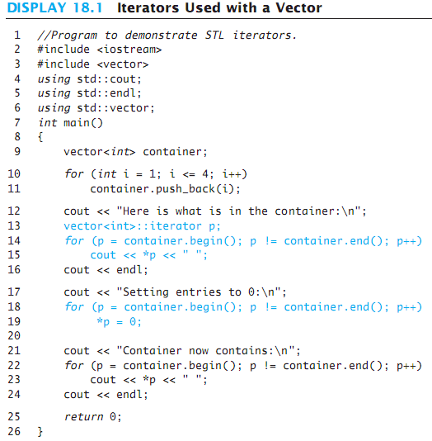
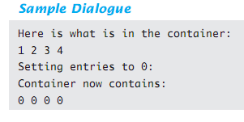
Display 18.1
Back
Next
Slide 18- <number>

Slide 79
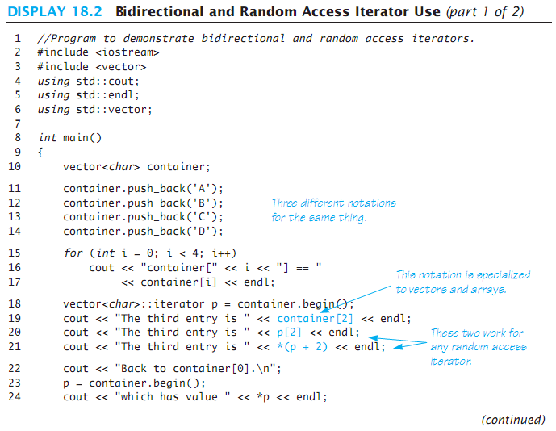
Display 18.2 (1/2)
Back
Next
Slide 18- <number>

Slide 80
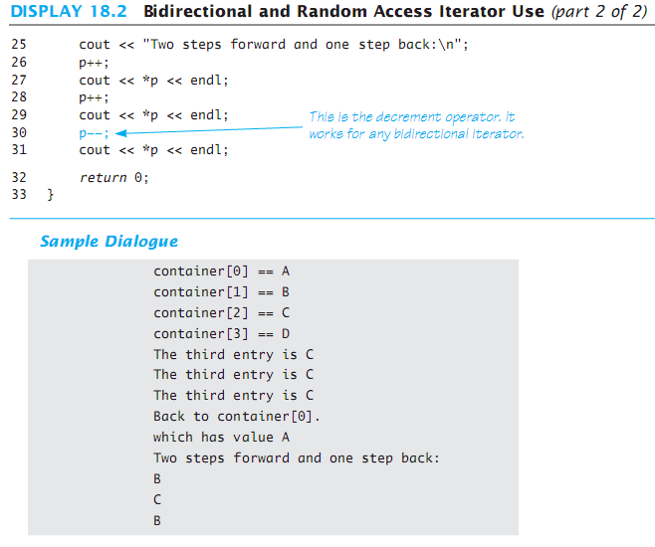
Display 18.2 (2/2)
Back
Next
Slide 18- <number>

Slide 81
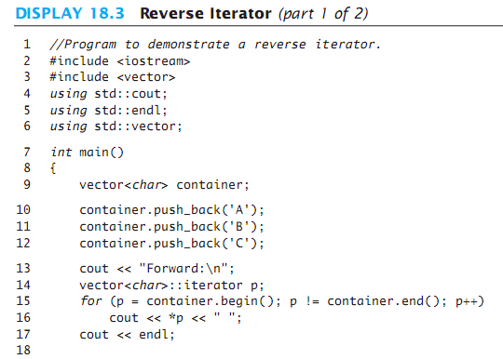
Display 18.3 (1/2)
Back
Next
Slide 18- <number>

Slide 82
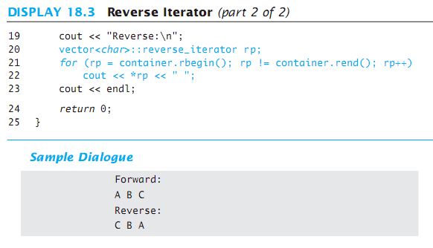
Display 18.3 (2/2)
Back
Next
Slide 18- <number>

Slide 83
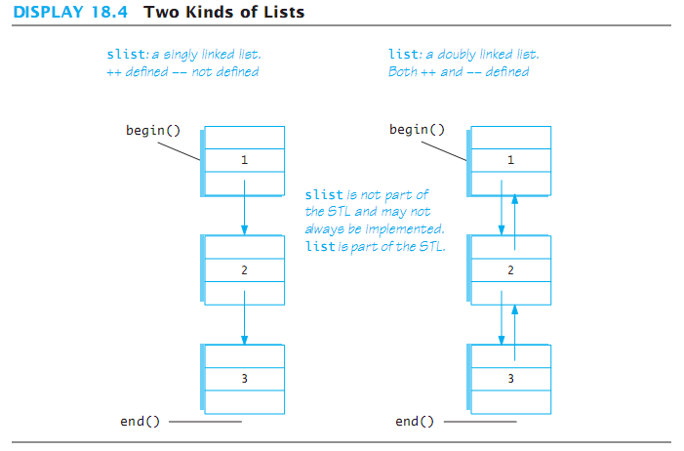
Display 18.4
Back
Next
Slide 18- <number>

Slide 84
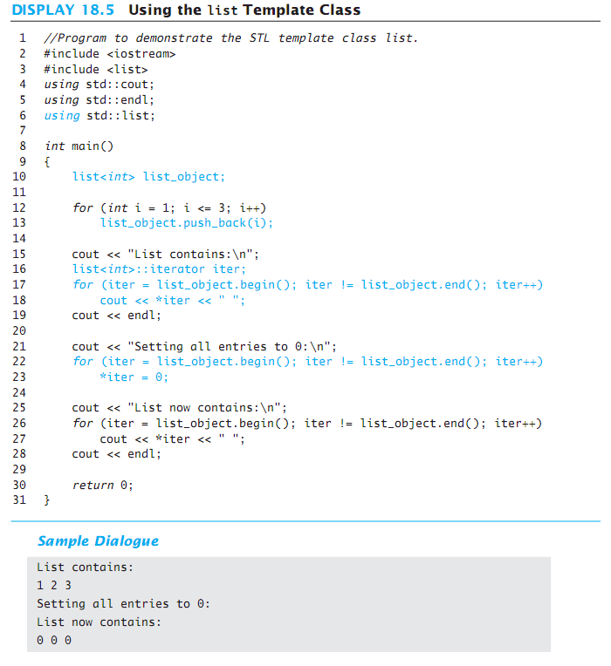
Display 18.5
Back
Next
Slide 18- <number>

Slide 85
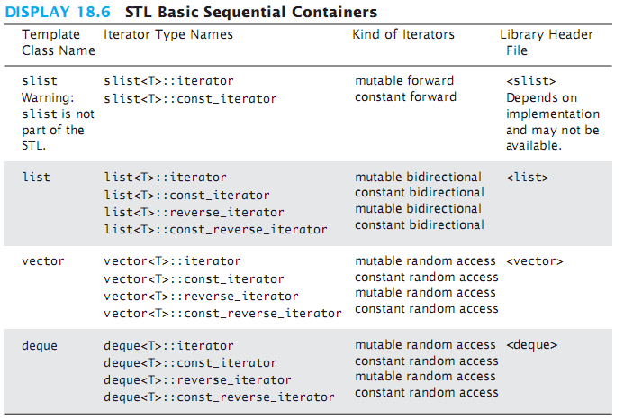
Display 18.6
Back
Next
Slide 18- <number>

Slide 86
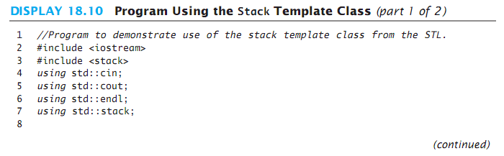
Display 18.10 (1/2)
Back
Next
Slide 18- <number>

Slide 87
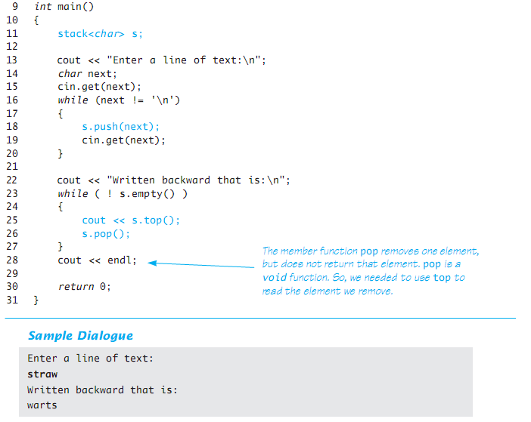
Display 18.10 (2/2)
Back
Next
Slide 18- <number>

Slide 88
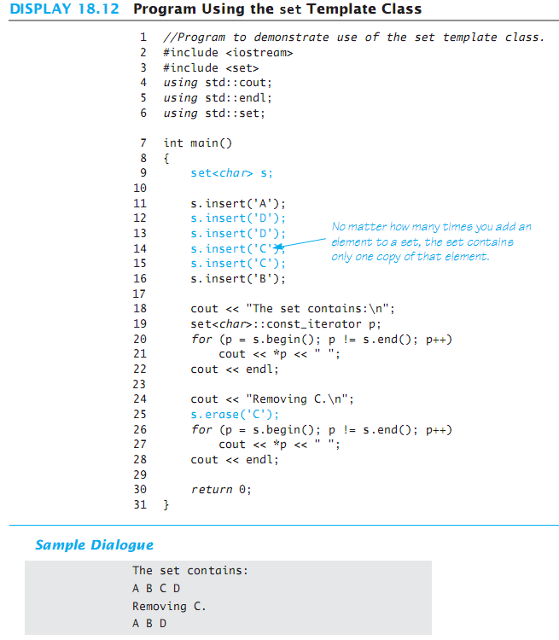
Display 18.12
Back
Next
Slide 18- <number>

Slide 89
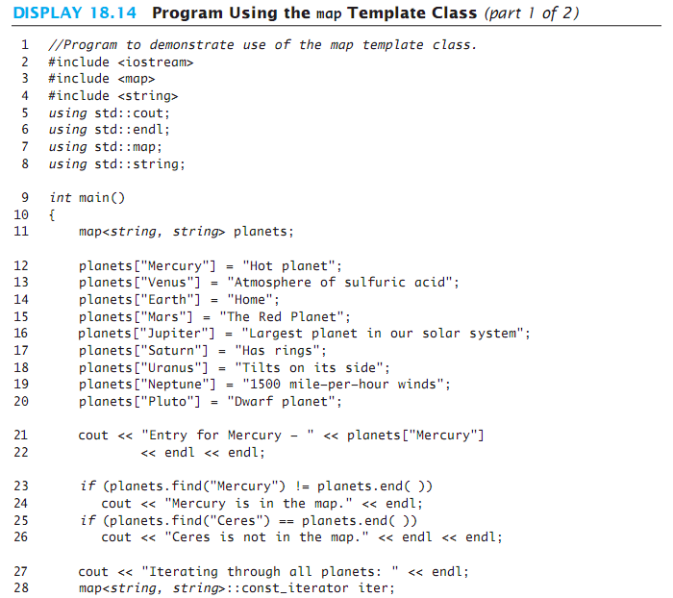
Display 18.14 (1/2)
Back
Next
Slide 18- <number>

Slide 90
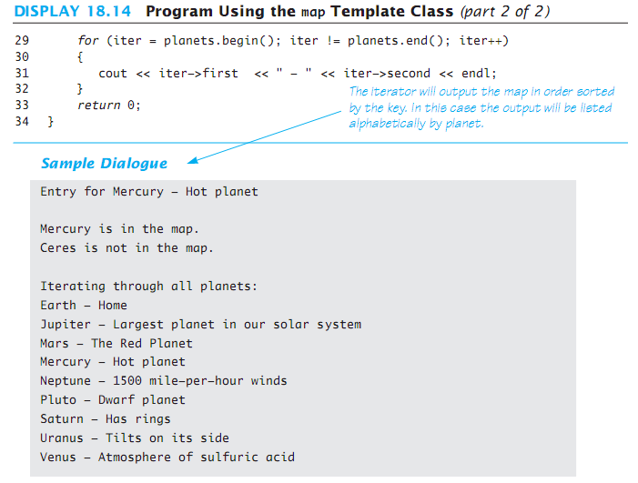
Display 18.14 (2/2)
Back
Next
Slide 18- <number>

Slide 91
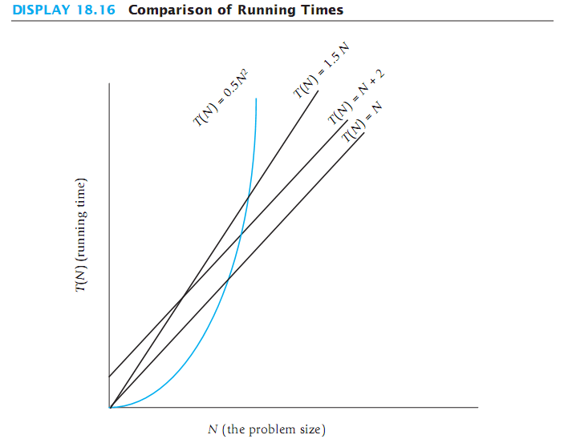
Display 18.16
Back
Next
Slide 18- <number>

