Slide 1
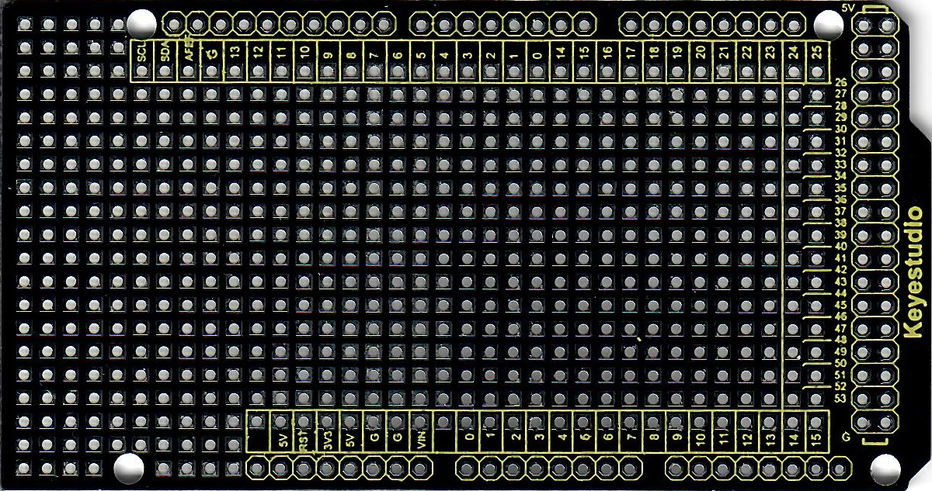

Slide 2
MegaEsp Components
Name | Voltage | Current mA | Pinout | Info
Active buzzer | 3.5-5.5 | 30 | 12
IR Receiver | 2.5-5.5 | 0.35 | 2
DS3231 RTC | 2.3-5.5 | 0.5 | I2C (SDA=20, SCL=21) 1 Hz ticker pin = 7
RGB led |  | 20 | R(11), G(10), B(9) | Resistor 220 ohm * 3
Push button |  |  | 6 | PULLUP
TM1637 0.56” Clock digital display | 5 | 80 | CLK=4, DIO=5
LCD1602 + HD44780 LCD display | 4.7-5.3 | 21 | I2C (SDA=20, SCL=21)

Slide 3
Venta Components
Name | V | mA | Pinout | Info
NPN power transistor |  |  |  | Power switch for motion sensors
HC-SR501 Motion sensor Room | 5-20 | 1 |  | GND passes throw NPN transistor
HC-SR501 Motion sensor Storage | 5-20 |  |  | GND passes throw NPN transistor
LM393 Light Detection Photosensitive Sensor Module | 5
AHT21 Temperature and Humidity Sensor | 2-5.5 | 1 | I2C (SDA=20, SCL=21)
Main Relay | 5 | 90
Venta Relay | 5 | 90
Light Relay | 5 | 90

Slide 4
- + S
+ S
Buzzer
RTC
- +
GND
VCC
SDA
SCL
SQW
32K
Step Down 5V
- +
Reset
Button
R GB

