Slide 1
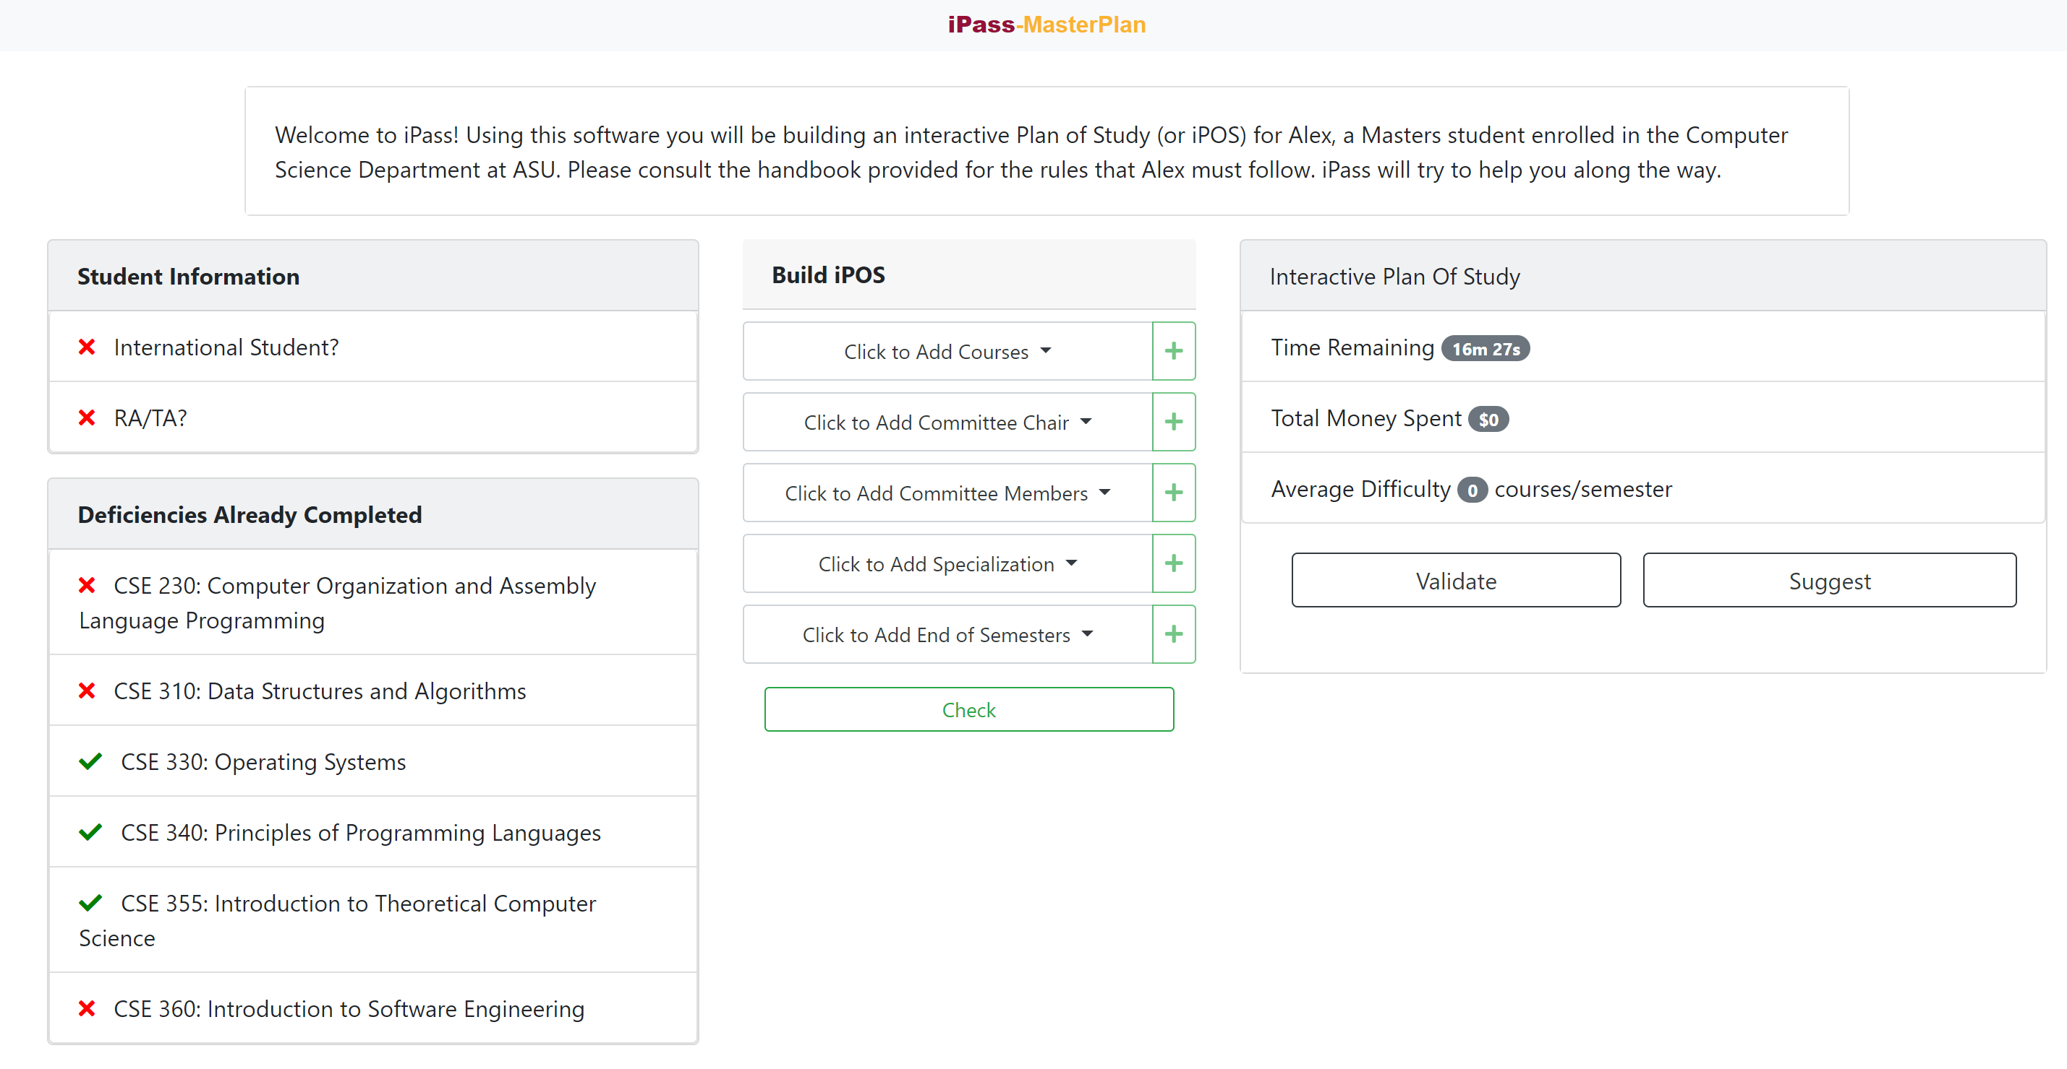
Student information
Add actions to plan of study
Planning area

Slide 2
Student information
Add actions to plan of study
Planning area

Slide 3
Student information
Add actions to plan of study
Planning area

Slide 4
Student information
Add actions to plan of study
Planning area

