Slide 1
Are you already p0wned?
Uncovering Indicators Of Compromise…
Author: Joff Thyer © 2014

Slide 2
P0wned / Hacked / Compromised?
The answer is probably “yes” in most cases
Persistently?
Frequently compromised?
Defense team always in Incident Response mode?
How does penetration testing help?
Illuminates what we already knew or suspected
Is there another way?

Slide 3
Compromise characteristics
Lets assume that the compromise has already occurred.
Lets go hunting for evidence of compromise
What are we looking for?
Artifacts of compromise activity
Deviations from baseline
Telltale patterns of network activity

Slide 4
How?
Examine the overall state and behavior of the environment
Indicators of command and control channels
Indicators of escalation
Indicators of pivoting activity
What is “normal” state and behavior versus “odd” / “abnormal”?

Slide 5
Command and Control (C2)
After the first beachhead is established, an attacker is interested in:
Establishing persistent, and reliable C2
Escalating privileges
Expanding access deeper into the environment
Pivoting
Can we detect C2 activity?

Slide 6
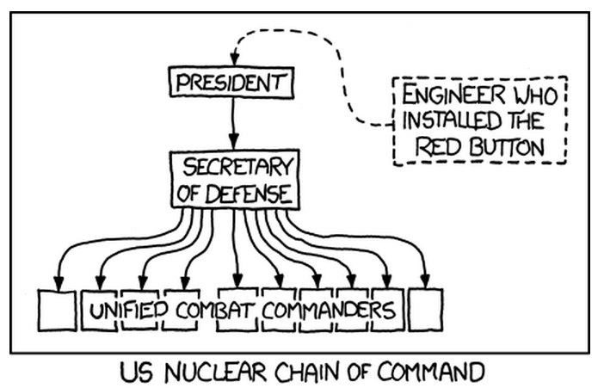

Slide 7
DNS C2: Intranet Cache
Split DNS is a common architecture today
Examine the DNS cache on the internal network
Dump cache records:
Bind9: “rndc dump cache”
Windows: “dnscmd /zoneprint ..cache”
Perform independent lookups on records in cache. Are they all valid?
Are any of the records considered “bad domains”
https://isc.sans.edu/suspicious_domains.html

Slide 8
DNS C2: Query type/frequency
Vast majority of query types and responses are going to be “A”, and “CNAME” records.
What if a specific device or devices are:
Receiving many NXDomain responses
Producing many TXT queries
Querying with a specific name pattern such as “dnscat.a.b.c.d.domain.tld”
What if a specific device has a DNS query frequency that is above the network average.

Slide 9
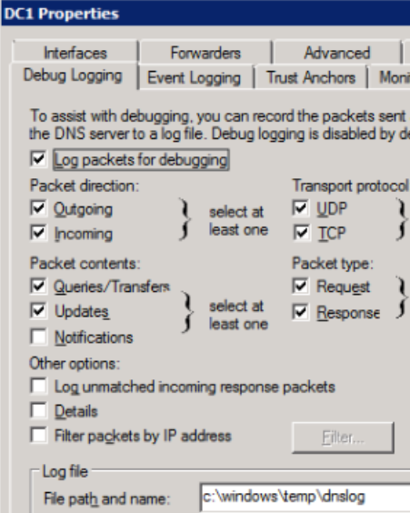
Enable DNS query logging

Slide 10
DNS C2: Analyze Logs
Tally all queries by
Response code
Eg: NOERROR, NXDOMAIN
Query type
Eg: A, CNAME, SRV …
Response type
Eg: A, CNAME, SRV …
Create means, and standard deviations
Look for outliers!

Slide 11
HTTP C2: User-Agent
Malware can reliably depend on TCP port 80 / TCP port 443.
Malware can have unusual HTTP User-Agent strings.
Either using PCAP, or proxy logs
Look at frequency counts of all user agent strings over time
Look closely at the low frequency count items
Examine devices transmitting these agent strings

Slide 12
C2: Firewall logs
Obtain firewall logs that include session setup and tear-down
48 hours or more of logging is preferred
Create a script that parses the log and shows TCP session length for all sessions in the log
Sort the output in descending order of session length
Specifically note any sessions that remain open

Slide 13
C2: Firewall log frequency analysis
Use a sampling method across TCP/UDP connection tuples to analyze frequency
A Discrete Fast Fourier Transform can be used to convert from the original “time” domain to a “frequency” domain.
DFFT application can be used to highlight regular beaconing.

Slide 14
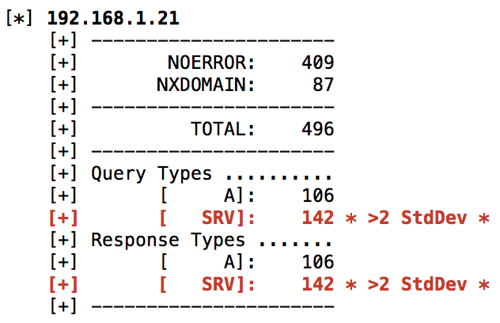
C2: DNS statistics

Slide 15
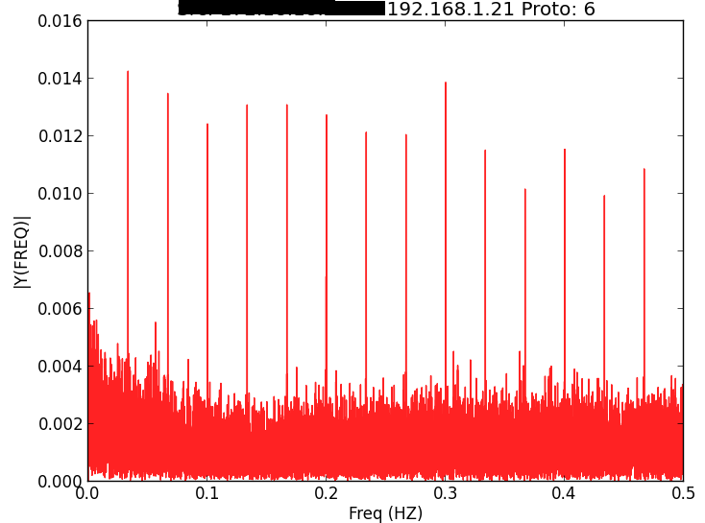
C2: Firewall log FFT beaconing

Slide 16
Pivoting activity
Common scenario is a widespread locally administrative or domain credential.
If RID-500, we can use it to login remotely
Even more fun before KB-2871997
Admin creds are often discovered through methods like:
Examining unattended installation XML files
Examining group policy pref files.

Slide 17
Pivoting activity
Once local escalation achieve, credentials often dumped from lsass memory using mimikatz method
Neighboring systems scanned using an SMBLogin scanner
Then, remote login attempted using protocols such as:
Psexec
WMIC
WinRM

Slide 18
Pivoting activity and event logs
Windows events are logged with peer to peer station login
What if we use metasploit’s “psexec_psh”?
Remote login
Starts a service
Executes a powershell script
Some event identifiers of interest
4624 – Logon success
4625 – Logon failure
4776 – Credential validation
7035 – Service control manager start

Slide 19
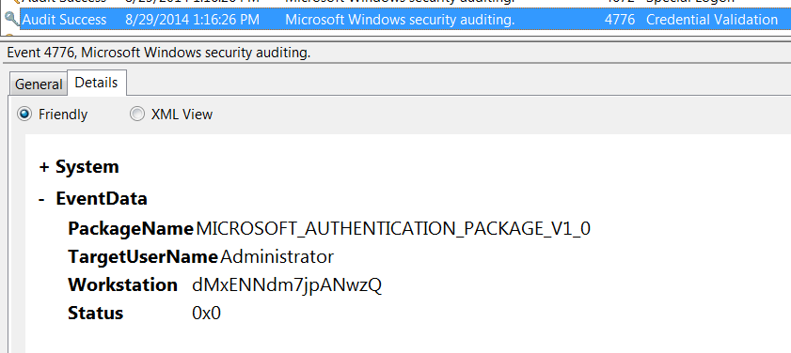
What is logged remotely when using ‘psexec_psh’?

Slide 20
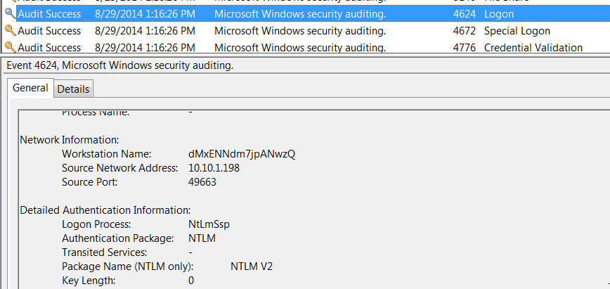

Slide 21
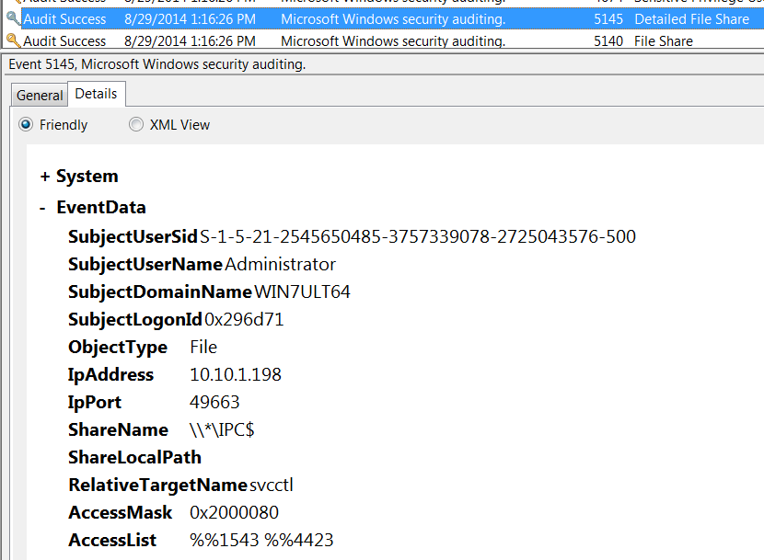

Slide 22
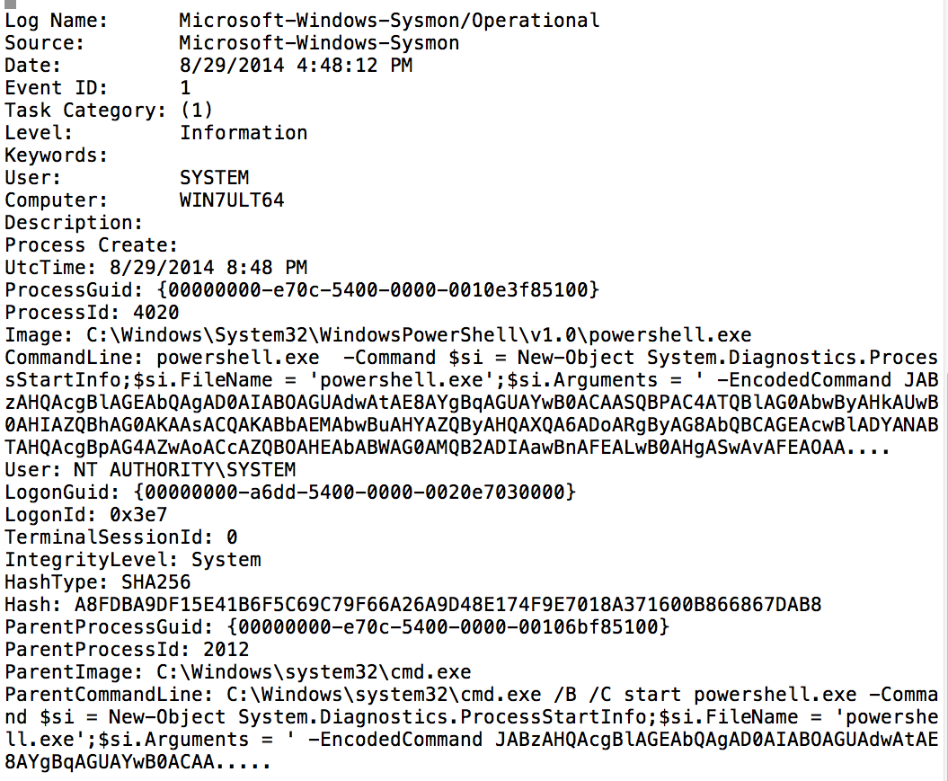
SysInternals “SYSMON”

Slide 23
Look at your logs!
Extract event ID’s of interest
4624, 4625, 4776, 7035
Powershell provides methods
$cred = Get-Credential
$events = Get-WinEvent –Credential $cred `
–LogName “Security”
$events | Group-Object –Property Id –NoElement `
| Sort-Object –property Count –descending

Slide 24
Looking for workstation variance
What software is installed across the domain?
Do all workstations adhere to a single baseline?
If not, why?
What are the “Run”, and “RunOnce” registry keys across the domain?
Count strings by frequency and sort
Look for low frequency counts

Slide 25
First get a list of all workstations
Powershell - Lets query LDAP for “computer” objects:
$DirSearcher = New-Object ` System.DirectoryServices.DirectorySearcher([adsi]’’)
$DirSearcher.Filter = ‘(objectClass=Computer)’ $DirSearcher.FindAll().GetEnumerator() `
| ForEach-Object { $_.Properties.name }
If you have RSAT then,
Get-ADComputer -Filter ‘ObjectClass -eq “Computer”’ | select -expand DNSHostName

Slide 26
“Run” and “RunOnce” keys
Below example using WinRM
$cred = Get-Credential Invoke-Command -Credential $cred -ComputerName myhostname -ScriptBlock {Get-Item HKLM:\Software\Microsoft\Windows\CurrentVersion\Run}
Invoke-Command -Credential $cred -ComputerName myhostname -ScriptBlock {Get-Item HKLM:\Software\Microsoft\Windows\CurrentVersion\RunOnce}

Slide 27
“Run” key using WMI
$HKLM = 2147483650
$reg_run = "Software\Microsoft\Windows\CurrentVersion\Run"
$registry = Get-WmiObject StdRegProv `
-Namespace Root/Default `
-Credential $cred `
-ComputerName $Target –List
$enum = $registry.EnumValues($HKLM, $reg_run)
ForEach ($key in $enum.sNames) {
$value = ($registry.GetStringValue($HKLM, $reg_run, $key)).sValue
Write-Output " [+] $reg_run : $key = $value”
}

Slide 28
List installed software
Invoke-Command -Credential $cred ` -ComputerName myhostname ` -ScriptBlock `
{Get-ItemProperty HKLM:\Software\Microsoft\Windows\Uninstall\* `
| Select displayname, `
publisher, installdate}

Slide 29
Installed software
Total up all of the installed packages by workstation
Are then any unusual installed software packages?
Unusual software publishers?
Unusual version strings?
Unusual vendor / install location?
Can you account for variance?

Slide 30
Retrieve certificate store
$command = (”
try { mkdir '//localhost/admin$/Temp/certstorage’ } catch {}
Get-ChildItem -Path cert: -Recurse -CodeSigningCert |
Where-Object { `$_.GetType().Name -eq 'X509Certificate2' } | %{
[System.IO.file]::WriteAllBytes(
'//localhost/admin$/temp/certstorage/' + `$_.Thumbprint + '.cer',
(`$_.Export('CERT', 'secret')))}
")
$bytes = [System.Text.Encoding]::Unicode.GetBytes($command)
$encoded = [Convert]::ToBase64String($bytes)
$wmic = Invoke-WmiMethod -Credential $cred `
-ComputerName $Target `
-Class Win32_Process `
-Name Create `
-ArgumentList "powershell -Exec bypass -EncodedCommand $encoded"

Slide 31
Look for certificate store variance
Total the number of code signing certificates
Sub-totals on:
Publisher, Publisher URL, Timestamps
Are there workstations with statistical variance in the number and type of code signing certs?
Is the lifetime signing flag set? Is the timestamping valid?
Can the certificate be verified?
Whats is the revocation status?
Check using CRL, and OCSP

Slide 32
#end_of_slides
Parting thought:
We are looking for “odd”, no necessarily “evil”.
Credit and thanks to:
Seth Misenar
Dr. Eric Cole
Eric Conrad
John Strand
Black Hills Information Security Employees

