Slide 1
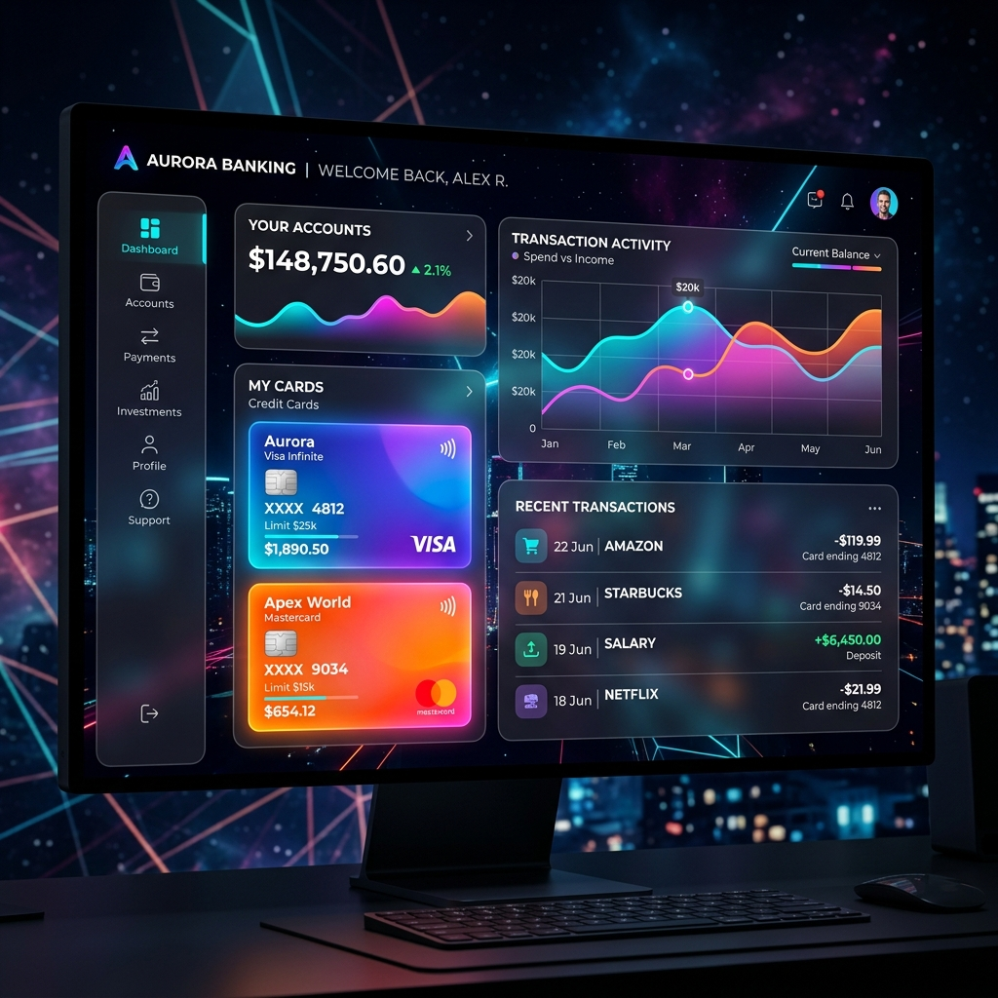
NIDHI BANK
Premium Digital Banking Ecosystem

Slide 2
Executive Project Summary
Vision: A high-fidelity, secure, and modern fintech solution.
Design: Implementation of the 'Glassmorphism' aesthetic (translucency & blur).
Functional: Real-time fund transfers, virtual card system, and administrative hub.
Architecture: Fully decoupled Frontend-Backend-Database orchestration.
Goal: To provide a zero-friction banking experience for modern users.

Slide 3
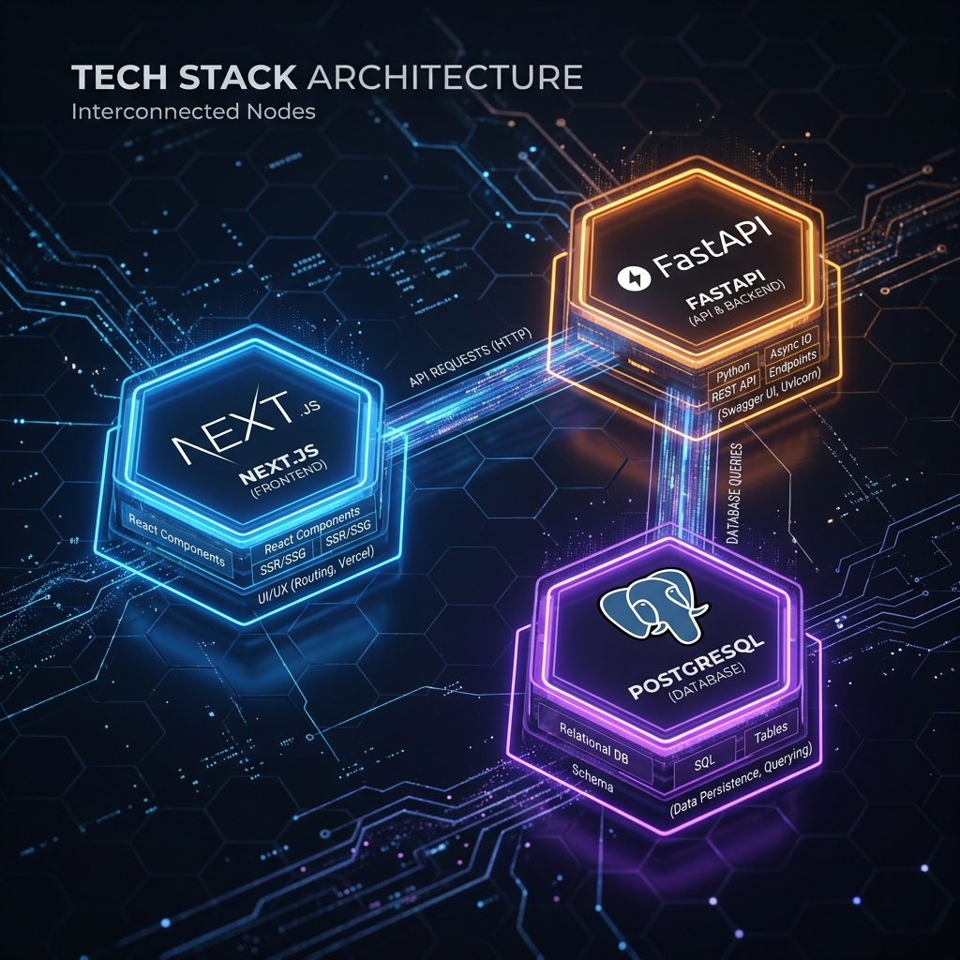
Modern Tech Stack Architecture
Frontend: Next.js 14+ (React) utilizing App Router and CSS Modules.
Backend: FastAPI (Python) - High performance, asynchronous data handling.
Database: Neon PostgreSQL - Serverless relational storage for ACID integrity.
DevOps: Automated deployment via Vercel (Frontend) and Render (Backend).
Communication: Secure RESTful API interactions with global CORS hardening.

Slide 4
Premium UI/UX: Glassmorphism
Aesthetic: Blurred translucent panels with vibrant glowing accents.
Color Palette: Midnight blue foundations with Indigo and Violet highlights.
Interactivity: Smooth frame-based animations and pulsing notification badges.
Responsiveness: 100% mobile-adaptive navigation with toggleable sidebars.
Localization: Standardized Indian Rupee (₹) symbol and en-IN formatting.

Slide 5
Backend Engineering: FastAPI
Security: Bcrypt salting and hashing for credential protection.
Validation: Pydantic-driven data serialization and error handling.
Database Connectivity: psycopg2 with RealDictCursor for efficient mapping.
Performance: Asynchronous endpoint handling for high-concurrency requests.
Integrity: Server-side validation of all financial transfer operations.

Slide 6
Database: Neon PostgreSQL
Data Tables: Normalized schema for 'Users' and 'Transactions'.
Financial Precision: Using DECIMAL(12,2) for exact monetary calculations.
Relationships: Foreign key constraints linking ledgers to user identities.
Auditability: Global timestamps ensuring a robust transaction audit trail.
Architecture: Scalable serverless branching for development environments.

Slide 7
Financial Logic: Fund Transfers
Atomicity: Single-transaction SQL blocks for simultaneous balance updates.
Integrity: Automatic 'Rollback' on any failure during transfer processing.
Validation: Server-side balance checks to prevent overdrafts.
History: Immediate logging of transfers into the immutable ledger.
Interface: Quick-transfer form with real-time success feedback.

Slide 8

Security Hub & Defense
Credentials: Zero-knowledge password storage using production Bcrypt.
Network: Rigid CORS policy management on the FastAPI Render node.
Visibility: Security center with login activity and device monitoring.
Prevention: Mitigation of legacy hashing vulnerabilities (max-length limits).
Access: Multi-layer validation for profile identity access.

Slide 9
Administrative User Management
Management: Centralized directory for all registered banking customers.
Search: Real-time filtering by name, email, or account number.
Monitoring: Visibility into active balances, Member IDs, and IFSC codes.
Onboarding: Ability to manage 10+ mock accounts for system demonstration.
Dashboard: Integrated overview of recent system-wide activity.

Slide 10
Card Management Ecosystem
Virtual Cards: Interactive digital debit/credit card generation.
Controls: Real-time tools to 'Freeze Card' or 'Reset PIN'.
Security: Mock security credentials allowing for safe testing.
Visuals: Glassmorphism card UI with glowing border indicators.
Integration: Full linkage between card transactions and user balance.

Slide 11
Recent Innovation Milestones
Real-time Sync: Fixed stale balance issues in the Account Identity modal.
Event Signaling: Linked UI refreshes to the 'new-transaction' event.
Redeploy Automation: Implemented 'redeploy.py' for 1-click CI/CD updates.
Localization: Completed global transition to Indian Rupee (₹) standard.
Stability: Enhanced error handling for cross-origin database requests.

Slide 12
Deployment & Final Vision
Frontend Hosting: Vercel (Production URL: nidhibank.vercel.app).
Backend Web Service: Render (Service ID: banking-backend-api).
CI/CD: Automated Git synchronization across environments.
Scalability: Foundation ready for real-world user scaling.
Summary: A complete, functional Fintech application delivered with excellence.

Slide 13
Questions & Discussion
Thank you for your attention!
Project Repository: NidhiBank (Private GitHub)
Architecture: Next.js + FastAPI + PostgreSQL
Developed with Antigravity AI Support
Any Questions?

