Slide 1
系統專題研究-物聯網中介軟體設計 Final Project 大樓智慧照明服務
D04944002 楊大煒
D05922021 李祐棠

Slide 2
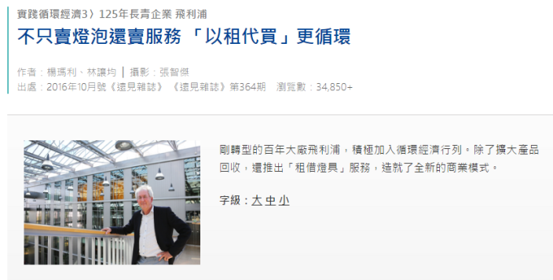
<以租代買>擁有
將照明變成一種服務
收費會比直接購買燈泡便宜
顧客購買後，服務會一直用下去
顧客不須管理與維護燈泡

Slide 3
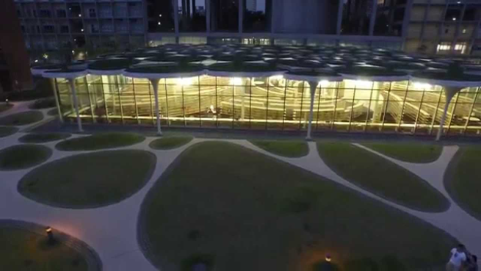
System Target: Light Monitor
大樓電燈智能監控
監控建築物內照明設備是否需要更換
通知維護廠商更換燈泡
隨時添加需要監控的照明
隨時擴展到不同的建築物
https://www.youtube.com/watch?v=agpBh4ujGWA

Slide 4

System Target: Light Control
結合智能照明的功能，節省照明
利用PIR sensor
室內無人一段時間自動關燈
少人時段公共區域自動減光，節約燈具消耗

Slide 5
Control Logic
按開關開燈，系統環境亮度設定適當的光度
Light Sensor 偵測燈光是否有正常運作，回報 server
PIR Sensor 偵測現場是否有人，適時關燈
Server 可對系統做各種設定Controller 依不同時間，調節光度/關燈

Slide 6

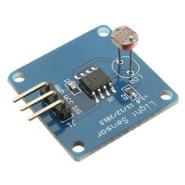
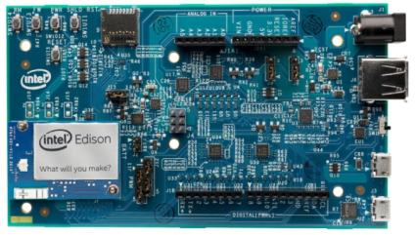
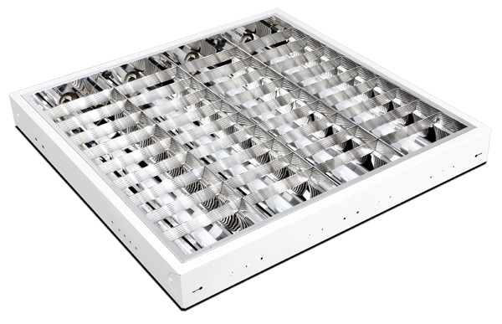
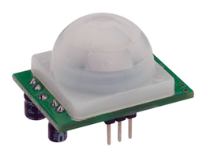
系統架構
Sensor
Light
Database
Controller

Slide 7
Light Sensors & Light
Light Sensor and LED as light
Running on Wudevice
Sensor connect to controller using Z-WAVE, sending sensed light level and receiving control

Slide 8
Light Sensors
Zwave_fail.mp4

Slide 9
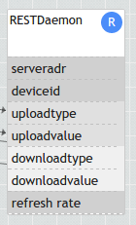
A general daemon
User can set server address
To upload:
Uploadtype, uploadvalue
Upon uploadvalue update, daemon send request to assigned server
Data field related to download:
Server get download type, value, update to all listener

Slide 10
Controller / Server
Controller:
Collect Data from sensors,
Implement all control logic
Server:
Listen to upload data from controller
According to dataID, extract datavalue and save to database (we implement in SQL)
Send update command to controller

Slide 11
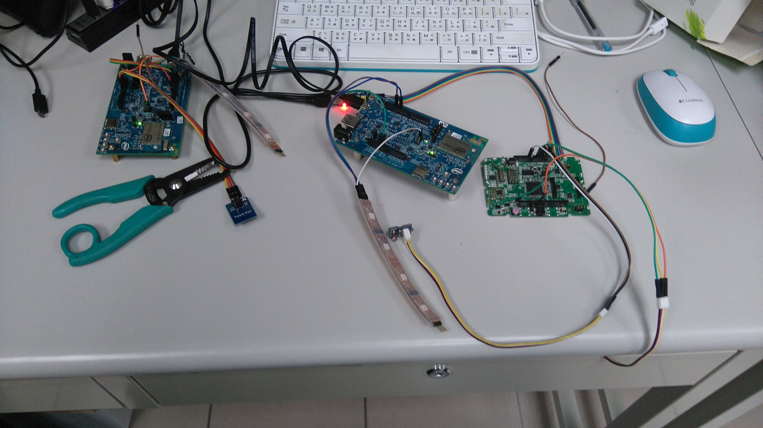
System Structure
Controller
Sensor:
Pir sensor x1
Light sensor x1
LED x1
Wudevice x1
Edison x1
Controller:
LED x1
Touch pad x1
Edison x1
REST client x1
REST Server:
REST server x1
Sensor Set
Touch Switch

Slide 12
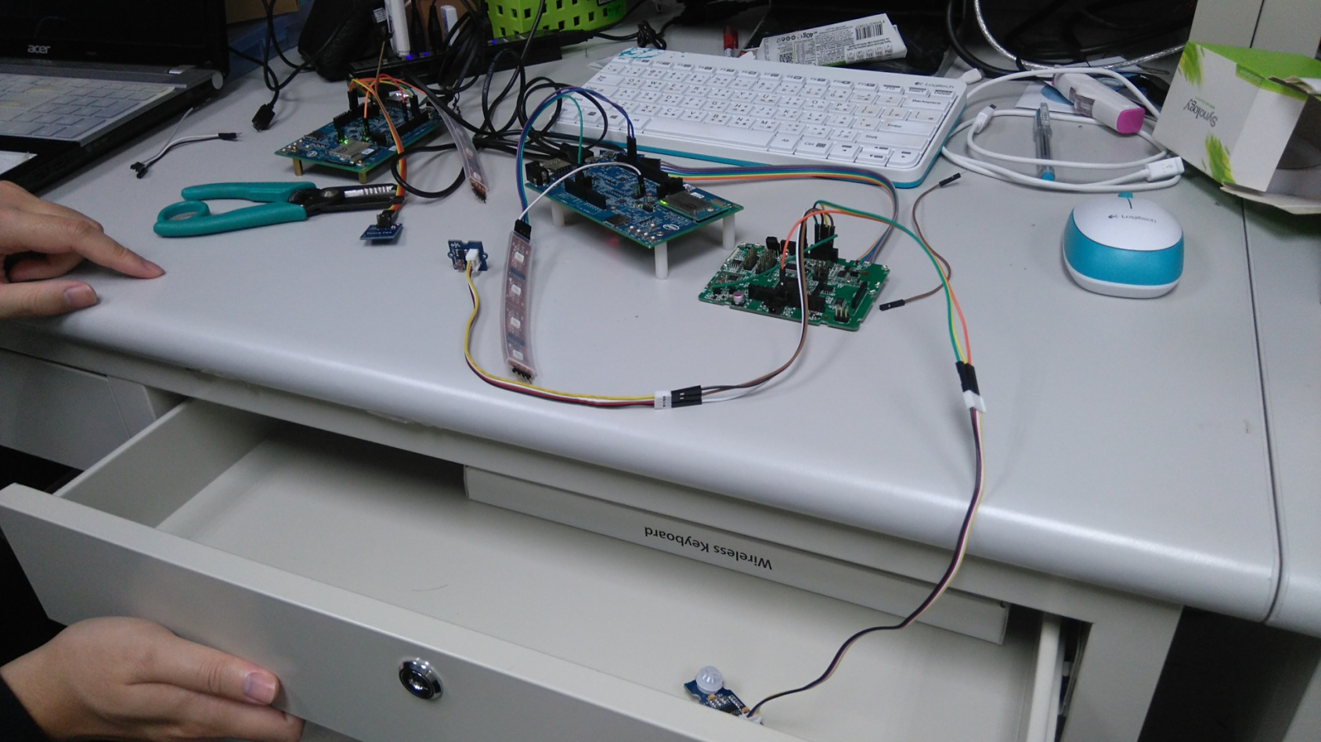
System Structure
PIR sensor is here

Slide 13
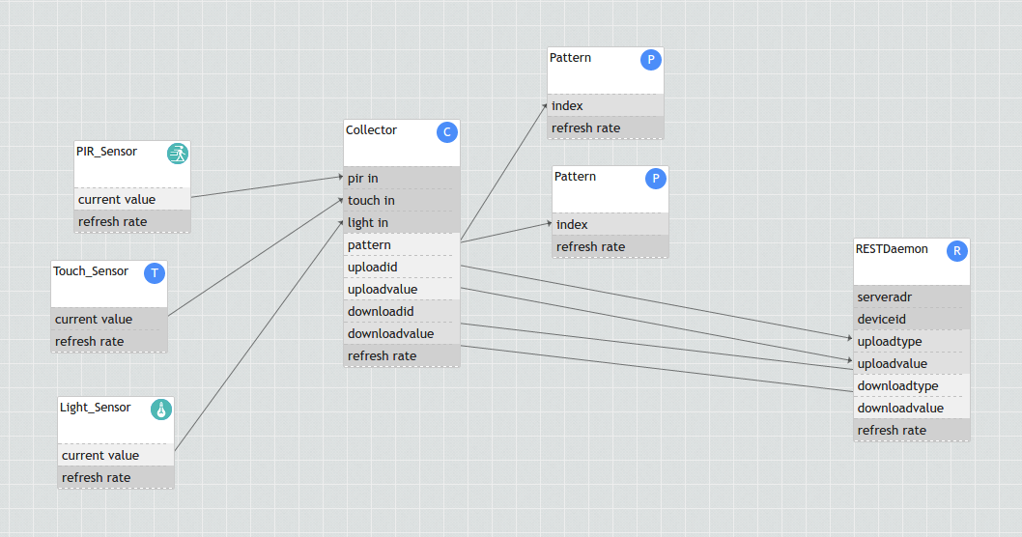
FBP for One Area

Slide 14
Demo: Light Control
Adjust light with light sensor value
Lghtpattern_level.mp4

Slide 15
Demo: Light Control
Close light based on PIR sensor
Close_wo_pir.mp4
Close_wi_pir.mp4
Notes:
Left: PIR triggered signal
Right: PIR close light

Slide 16
Demo: Upload Server
Upload data to server
severwork.mp4

Slide 17
Demo: Server Command
Server can close light remotely, or set the time to close light without people in environment
Server_close_light.mp4
Server_set_time.mp4
Notes:
Left: close light
Right: set timer

Slide 18
Improvement to WuKong
能夠大量管理devices 的API或是介面
自行連結新的devices，並即時deploy
現有的介面並不適於大量 devices的管理
諸如location 或各類資訊需要自動化的設定方式

Slide 19
Other Problems
<WuClass name="REST_Daemon" id="2040" virtual="false" type="hard">
<property name="pir_recv" access="readwrite" datatype="short" default="0"/>
<property name="lightsensor_recv" access="readwrite" datatype="short" default="false"/>
<property name="refresh_rate" access="readwrite" datatype="refresh_rate" default="100" />
</WuClass>
Deploy Failed with very limited info:
File not found: …/wkdeploy.wkpf_linktable

Slide 20
Other Problems
Wukong signal is not reliable.
If we set a property to 1, and back to 0 quickly, the receiver will only get one update and get 0.

