Slide 1

YODI RAMADHANI ALFARIZ
yodialfa.github.io
BPJS KESEHATAN
Cost Prediction

Slide 2


MENU

Slide 3
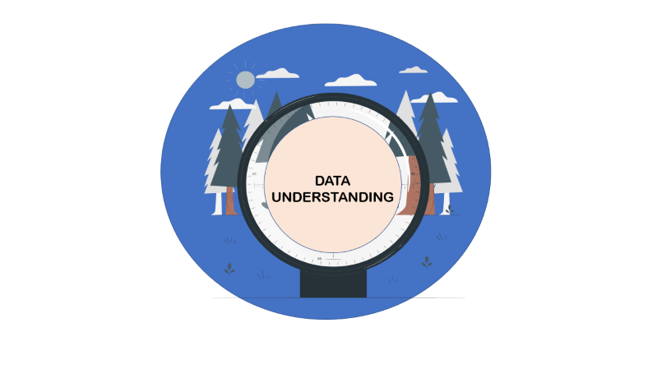


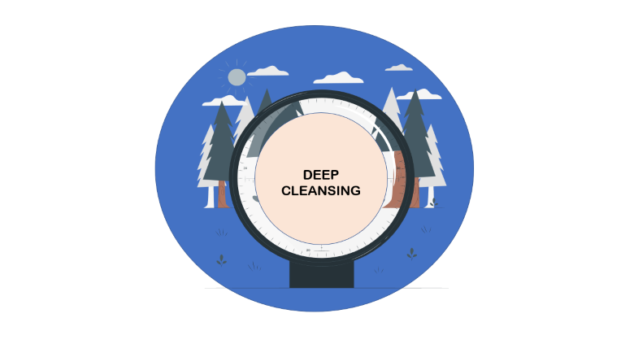






MENU

Slide 4
DATA
UNDERSTANDING

Slide 5
DATA
UNDERSTANDING
36 Features
57.971 Rows
Some Features has been encoded by Author, So I try to Explore categorical data. And the target is unit_cost

Slide 6
DATA
CLEANSING

Slide 7
DATA
CLEANSING
Drop Missing Value
Drop Duplicated
0 Missing Value
0 Duplicated Data
I try to find missing values, and duplicated data. But
I didn’t found there. So I’m going through to next step

Slide 8
BASELINE
MODELLING

Slide 9
BASELINE
MODELLING

Slide 10
DEEP
CLEANSING

Slide 11
DEEP CLEANSING

Slide 12
MODELLING AND
DEVELOPMENT

Slide 13
MODELLING
AND DEVELOPMENT

