Slide 1

YODI RAMADHANI ALFARIZ
yodialfa.github.io
BPJS KESEHATAN
Cost Prediction

Slide 2


MENU

Slide 3
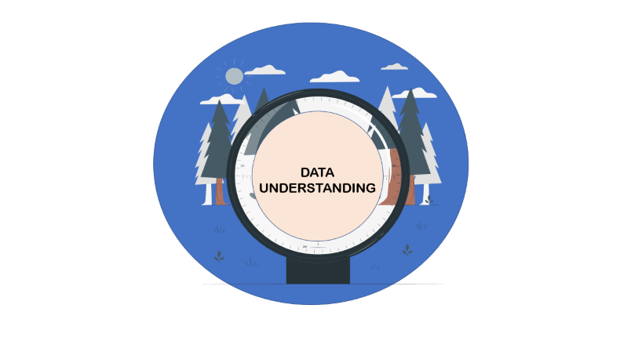


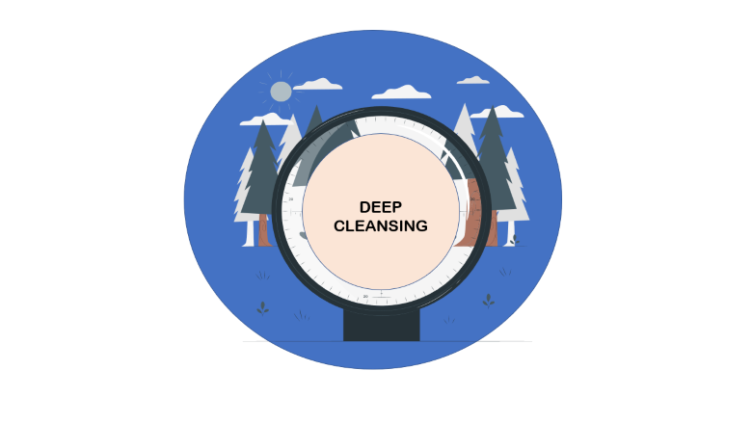






MENU

Slide 4
DATA
UNDERSTANDING

Slide 5
DATA
UNDERSTANDING
36 Features
57.971 Rows
Some Features has been encoded by Author, So I try to Explore categorical data. And the target is unit_cost

Slide 6
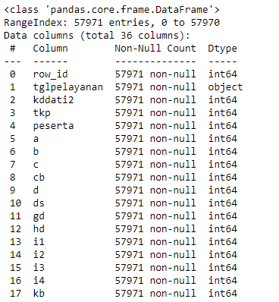
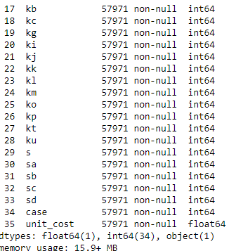
DATA
UNDERSTANDING

Slide 7
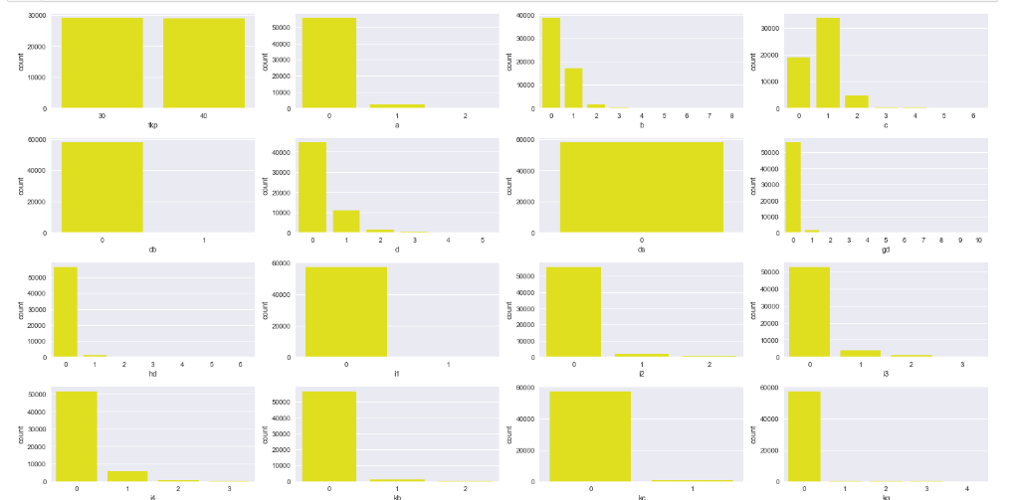
DATA
UNDERSTANDING
Count From Categorical Data (1)

Slide 8
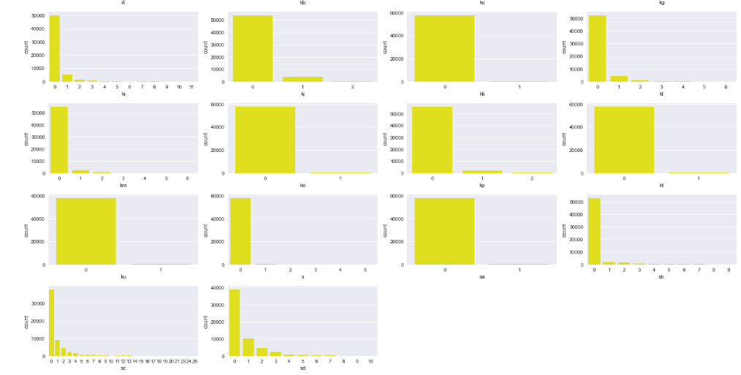
DATA
UNDERSTANDING
Count From Categorical Data (2)

Slide 9
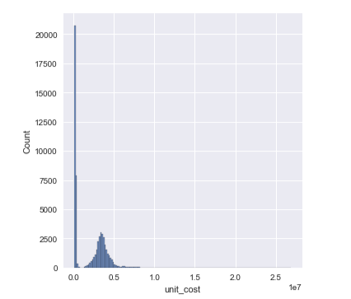
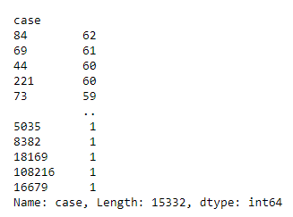
DATA
UNDERSTANDING
We can see ‘unit_cost’ isn’t normal distribution
case
And from categorical data we can see ‘ds’ is has 1 value. The majority of features is categorical data. And numerical data is ‘case’ and ‘unit_cost’.
‘peserta’ is unique value from id member,
Data distribution from unit_cost

Slide 10
DATA
CLEANSING

Slide 11
DATA
CLEANSING
Drop Missing Value
Drop Duplicated
0 Missing Value
0 Duplicated Data
I try to find missing values, and duplicated data. But
I didn’t found there. So I’m going through to next step

Slide 12
BASELINE
MODELLING

Slide 13
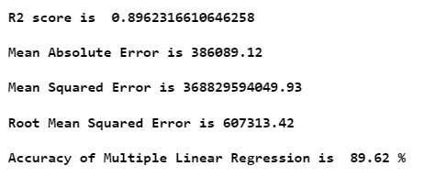
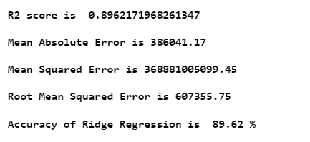
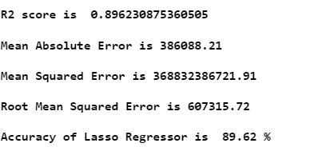
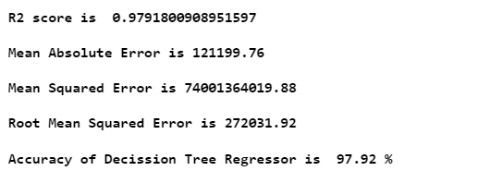
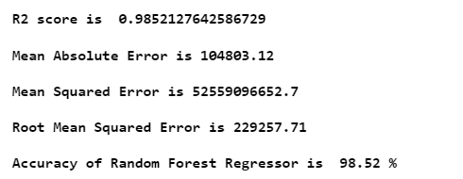
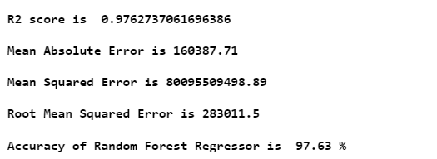
BASELINE
MODELLING
Multiple Linear Regression
Ridge Regression
Lasso Regression
Decision Tree
Random Forest
Light GBM
DT, RF and LGBM is high R2 Score and Slowest RMSE than Linear Regression, Ridge and Lasso

Slide 14
DEEP
CLEANSING

Slide 15
DEEP CLEANSING

Slide 16
MODELLING AND
DEVELOPMENT

Slide 17
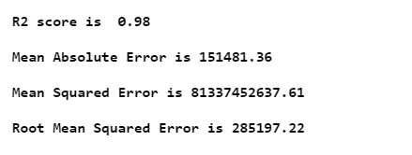
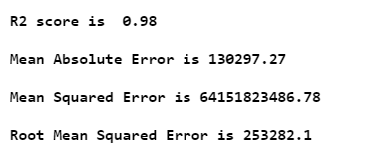
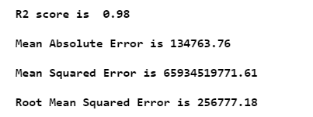
MODELLING
AND DEVELOPMENT
From Baseline Model
Decision Tree
Random Forest
Light GBM
After Tunning Hyperparameter
DT and RF on RMSE seem that Overfitting. But LGBM After Tunning Hyperparameter has an increasment for RMSE. And We Choose LGBM

