Slide 1

BPJS KESEHATAN
Cost Prediction
YODI RAMADHANI ALFARIZ
yodialfa.github.io

Slide 2
BUSINESS PROBLEM
We have historical data from BPJS Kesehatan which include ‘unit_cost’ for payment. And that data useful for prediction.
OBJECTIVE
To predict Cost Prediction for BPJS Kesehatan

Slide 3


MENU

Slide 4
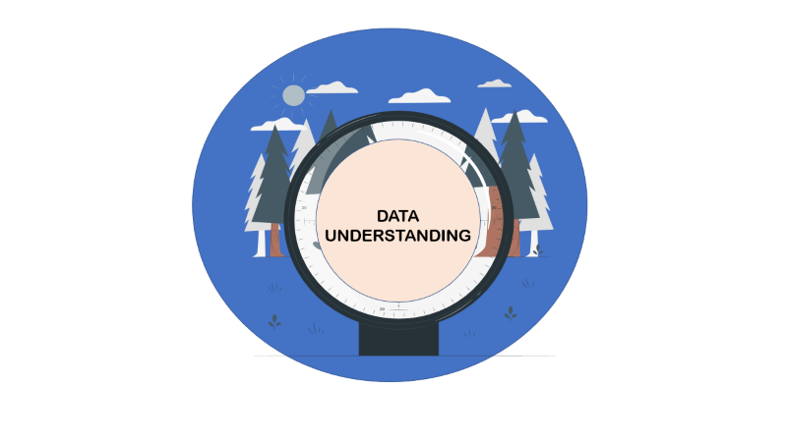


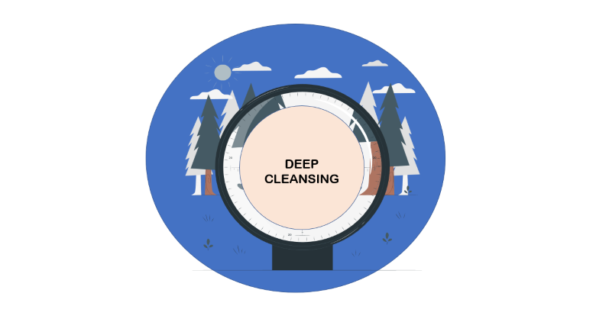






MENU

Slide 5
DATA
UNDERSTANDING

Slide 6
DATA
UNDERSTANDING
36 Features
57.971 Rows
Some Features has been encoded by Author, So I try to Explore categorical data. And the target is unit_cost

Slide 7
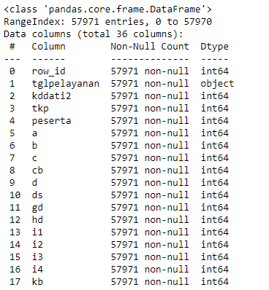
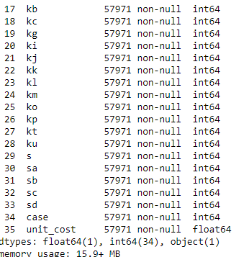
DATA
UNDERSTANDING

Slide 8
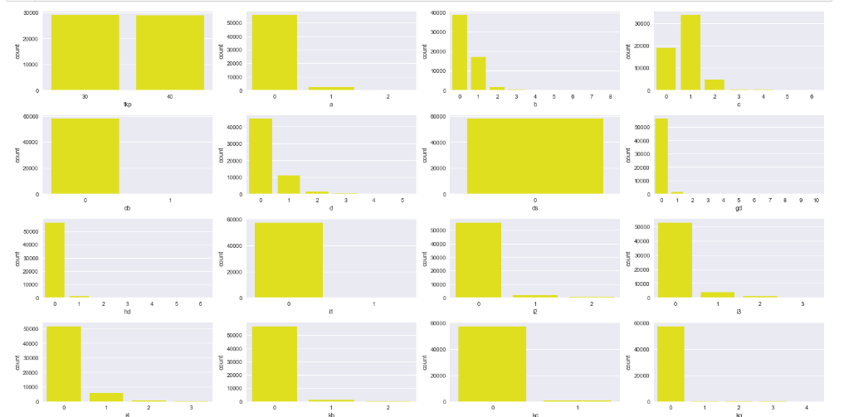
DATA
UNDERSTANDING
Count From Categorical Data (1)

Slide 9
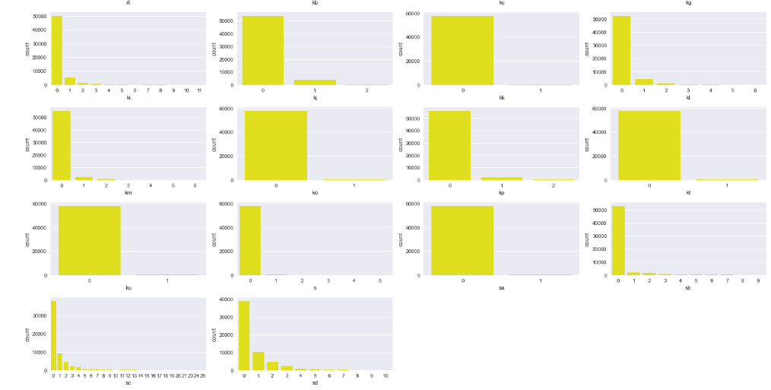
DATA
UNDERSTANDING
Count From Categorical Data (2)

Slide 10
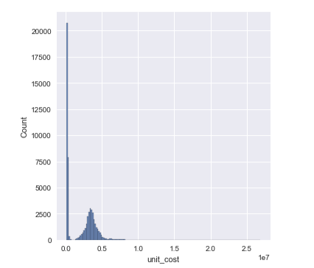
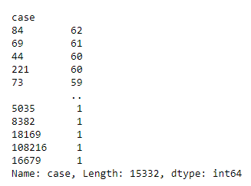
DATA
UNDERSTANDING
We can see ‘unit_cost’ isn’t normal distribution
case
And from categorical data we can see ‘ds’ is has 1 value. The majority of features is categorical data. And numerical data is ‘case’ and ‘unit_cost’.
‘peserta’ is unique value from id member,
Data distribution from unit_cost

Slide 11
DATA
CLEANSING

Slide 12
DATA
CLEANSING
Drop Missing Value
Drop Duplicated
0 Missing Value
0 Duplicated Data
I try to find missing values, and duplicated data. But
I didn’t found there. So I’m going through to next step

Slide 13
BASELINE
MODELLING

Slide 14
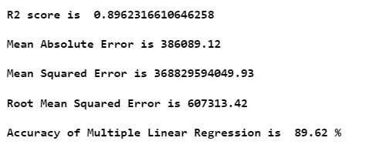
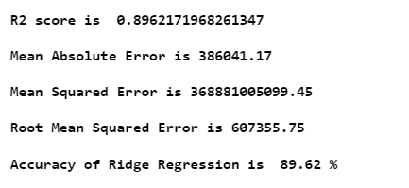
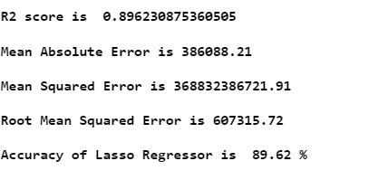
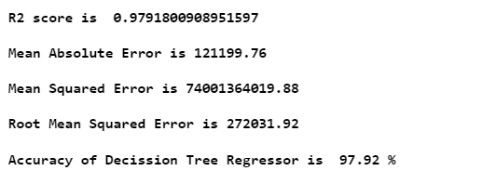
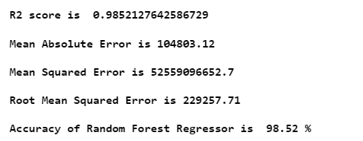
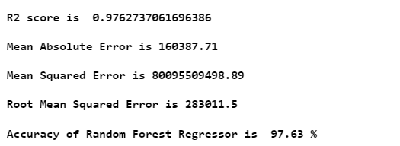
BASELINE
MODELLING
Multiple Linear Regression
Ridge Regression
Lasso Regression
Decision Tree
Random Forest
Light GBM
DT, RF and LGBM is high R2 Score and Slowest RMSE than Linear Regression, Ridge and Lasso

Slide 15
DEEP
CLEANSING

Slide 16
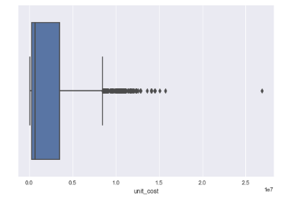
DEEP CLEANSING
We will drop ‘ds’ because has 1 value. And ‘peserta’ because we don’t need id member here.
And the target is has an outlier. We will remove the outlier
‘data in unit_cost’ didn’t normal

Slide 17
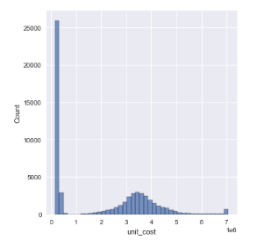
DEEP CLEANSING
After we remove outlier in unit_cost, we still look the data isn’t normal. And we have to log transform to normalize the data

Slide 18
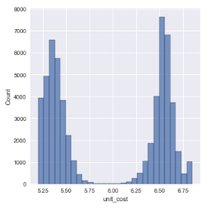
DEEP CLEANSING
And finaly we have normalized data, but we can see the data is bimodal (two peak). But we will fitting into Machine learning which immune that bimodal data. We will try every Machine Learning to see the performance of ML to our data.

Slide 19
MODELLING AND
DEVELOPMENT

Slide 20
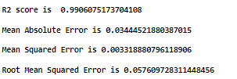
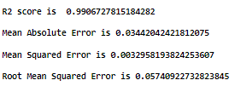
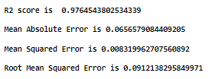
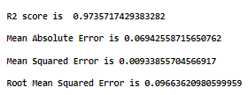
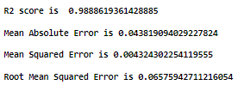
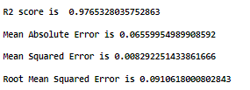
MODELLING
AND DEVELOPMENT
Before Tunning
Decision Tree
Random Forest
RANSAC
After Tunning Hyperparameter
DT and RF RMSE seem that Overfitting after HyperParameter Tunning. And RANSAC seem has improvement after tunning, but the performance isn’t significant.

Slide 21
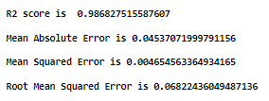
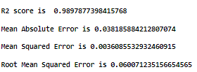
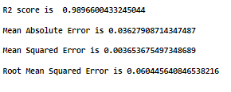

MODELLING
AND DEVELOPMENT
Before Tunning
Light GBM
XGB Regressor
After Tunning Hyperparameter
LGBM and XGB show improvement after tunning. But XGB is slowest RMSE here. We will choose XGB to Final Model

Slide 22
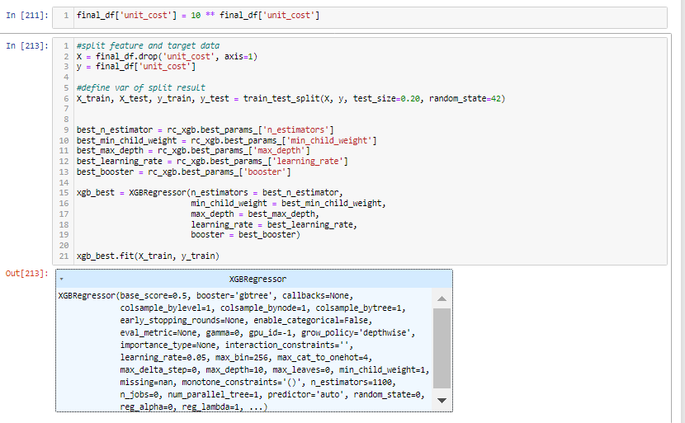
MODELLING
AND DEVELOPMENT
Invers Target into Normal And Fitting Using Best Parameter

Slide 23
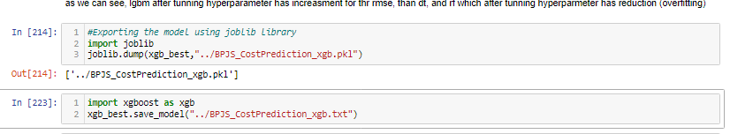
MODELLING
AND DEVELOPMENT
Export Joblib File for Development
We have joblib file for, and we will load that file in Streamlit for development.

Slide 24
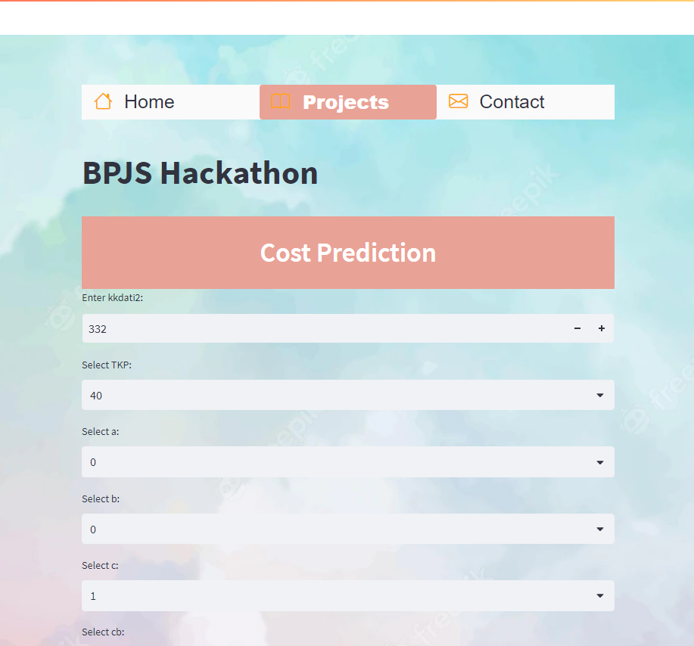
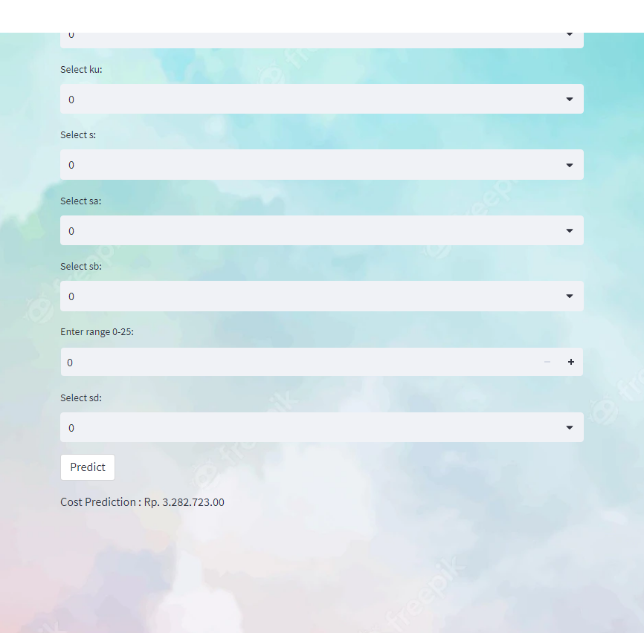
MODELLING
AND DEVELOPMENT
Link for The App : Streamlit
And now we can predict the ‘unit_cost’

Slide 25
THANK YOU

Slide 26
Github : https://github.com/yodialfa/
LinkedIn : https://www.linkedin.com/in/yodialfariz/
Email : yodialfariz@gmail.com
Phone : 082218293933
Twitter : @yodiumh

