Slide 1
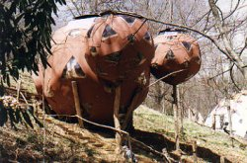
Chrysalis
Step-by-Step

Slide 2
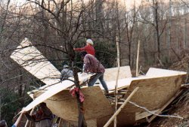
We assembled the first sheets on a double triangle skid, and tied it to a nearby uphill tree. We are standing on a temporary floor.

Slide 3
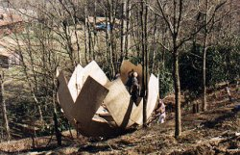
We had beautiful spring weather.

Slide 4
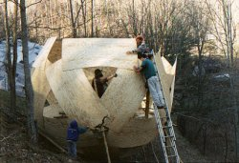
Colin in blue hood, Greg in triangle, Michael in red hat, Steve on ladder. Skid is visible at left of Colin.

Slide 5
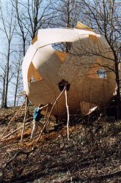
Time to level the sphere and install a foundation. Measurements are easier when the structure is present.

Slide 6
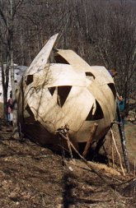
One foundation post is visible, another can be seen in shadow. Three of the five installed so far. The posts are thick locust pieces, long and heavy, stuck in 5 ft. deep angular postholes and packed with stones. The last two posts were installed months later since the 3 front ones held the ball firmly.

Slide 7
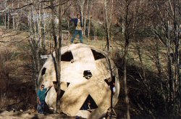
All the plywood is fastened in place. Russ is visible in triangle.

Slide 8
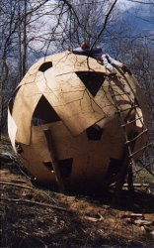
Brim is helping install skylights on suspended ladder.

Slide 9
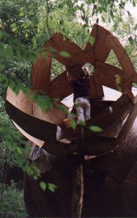
Installing bedroom pod. The first pod was lifted as a unit by a group of volunteers at the farm.
I found it easier to take the second one apart piece by piece after letting it warp, and assemble it aloft.

Slide 10
Finished cottage, Spring 1997

Slide 11
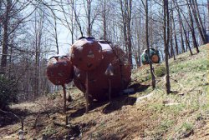
Frameless plywood spheres of 4x8 sheets of 1/4" AC exterior plywood.

Slide 12
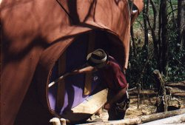
The door turned on a wooden rod and worked quite smoothly.

Slide 13
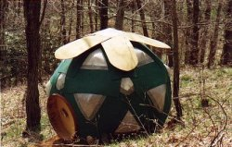
The fat helicopter outhouse perches uphill from Chrysalis. Inge and Acorn later moved it downhill to the deck they built behind their house.

Slide 14
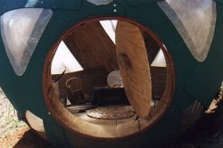
Inside the outhouse.

