Slide 1
Class Diagram
Mr. Parin Kobboon
Mr. Krai Chamnivikaipong
Ms. Thanapar Leelasathapornkun

Slide 2
Content
Classes Diagram
Association
Combination Example

Slide 3
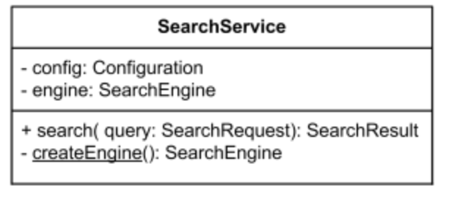
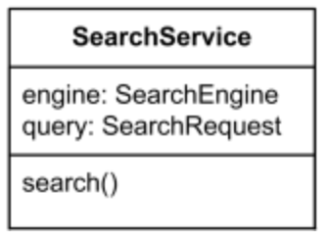
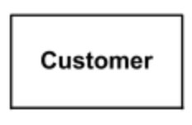
Class Diagram
SearchService
Notes:
https://www.uml-diagrams.org/class-reference.html
A class is a classifier which describes a set of objects that share the same
features
constraints
semantics (meaning).
There are 4 different levels of visibility: Public: for all other classes visible (in UML: + ) Private: not visible outside same class, even in sub classes (in UML: − ) Protected: visible in sub classes (in UML: # ) Package: visible only for classes in same package (folder) (in UML: ∼ )
guillemets « » or angle quotes

Slide 4
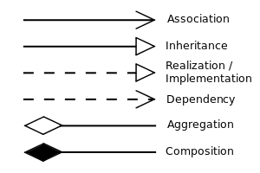
Relationship

Slide 5
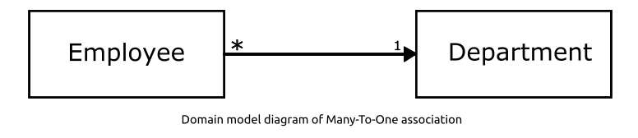
Association

Slide 6
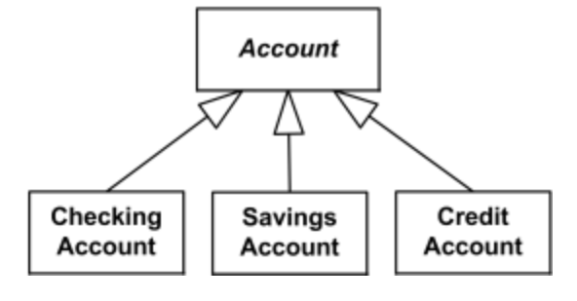
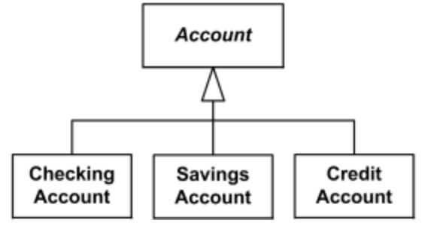
Inheritance
"separate target style"
"shared target style"

Slide 7
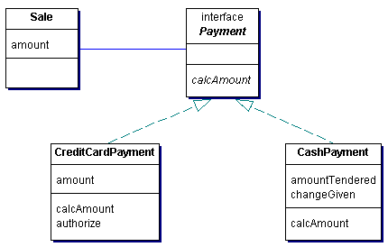
Implementation

Slide 8
Implementation

Slide 9
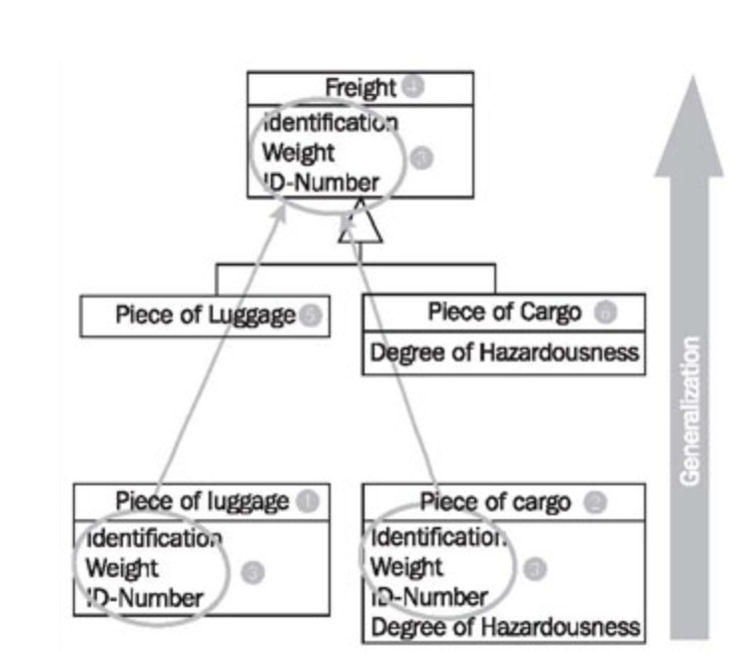
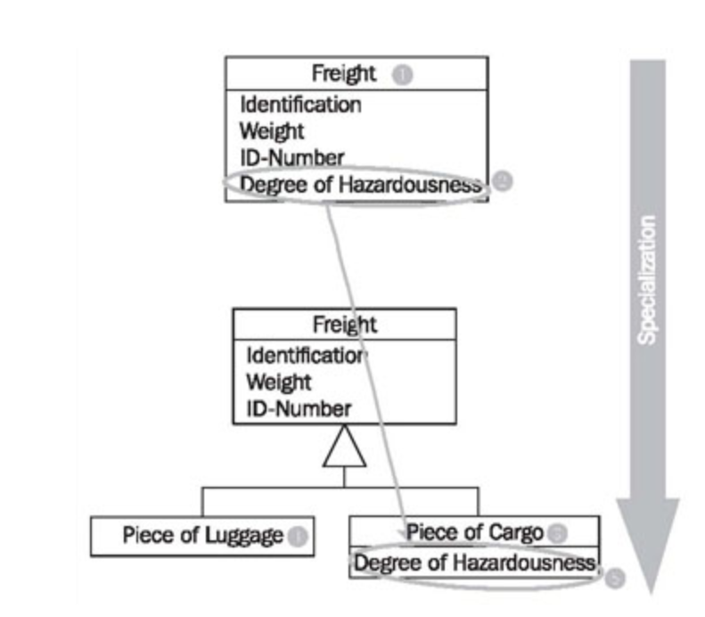
Generalization
Specialization
Notes:
Generalization is the process of extracting shared characteristics from two or more classes, and combining them into a generalized superclass. Shared characteristics can be attributes, associations, or methods
In contrast to generalization, specialization means creating new subclasses from an existing class. If it turns out that certain attributes, associations, or methods only apply to some of the objects of the class, a subclass can be created. The most inclusive class in a generalization/specialization is called the superclass and is generally located at the top of the diagram. The more specific classes are called subclasses and are generally placed below the superclass.

Slide 10
Dependency
Food
Human

Slide 11
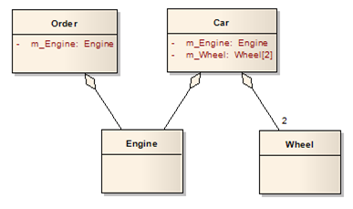
Aggregation

Slide 12
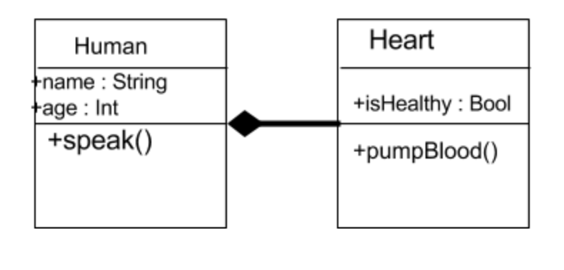
Composition

