Slide 1
ChillStream
Phase-Change Thermal Battery Water Dispenser
Cold water for the 50th person in line — not just the first.
Executive Overview • Product Investment Proposal • 2026

Slide 2
The Problem
Water coolers fail at the moment of peak demand
School lunch bell rings — 60 students, 5 minutes
Office break time — 30 people cluster at the cooler
Traditional cooler: 2-5L of pre-chilled water
After 10-15 pours, reservoir is depleted
Incoming mains water at 25°C mixes with remaining cold
Recovery time: 20-40 minutes
The first users get cold water.
Everyone else gets lukewarm.
20-40 min
Recovery time after peak demand depletes the reservoir
85%+
Of pours during rush hour served above target temperature
$0
Revenue from solving this — no product addresses peak demand in countertop form factor

Slide 3
The Solution: Phase-Change Thermal Battery
Store
Deliver
Recover
IDLE TIME
PEAK DEMAND
BETWEEN RUSHES
Compressor freezes PCM coating
on submerged HX plates to -5°C.
Cold energy stored as latent heat.
No water movement needed.
User opens tap. Mains pressure
pushes water through PCM-coated
plates. Water chills from 25°C to
4°C on contact. No pump.
Compressor recharges the PCM.
33 min for full 5L recharge.
Partial recharge much faster.
50-min school period = full reset.
Latent heat stores 5-10x more energy per kg than sensible heat — enabling countertop form factor with 50-pour capacity.

Slide 4
Product Architecture
1
Insulated Tank
2
Submerged Plate HX
3
Cover / Manifold
Simple SS vessel
Holds water at rest
Open top, sealed by cover
Serviceable — lift cover to clean
Brazed SS plates with
PCM coating (-5 to -10°C)
Refrigerant channels freeze PCM
Water channels chill on pour
Routes all fluid connections:
• Mains water in (top)
• Chilled water out (to tap)
• Refrigerant lines (to HX)
No pressure rating needed
No embedded channels
Food-grade stainless steel
Standard component (Kaori, SWEP)
Scales by plate count:
4 plates = 5L | 8 plates = 10L
Only complex manufactured part
Lifts off for full tank access
Injection-molded + brazed fittings
Key design principle:
Water moves only when the tap is open (mains pressure driven). No circulation pump. The cover is the single point of service — lift it off, and the tank is accessible for cleaning. The HX comes out with the cover.

Slide 5
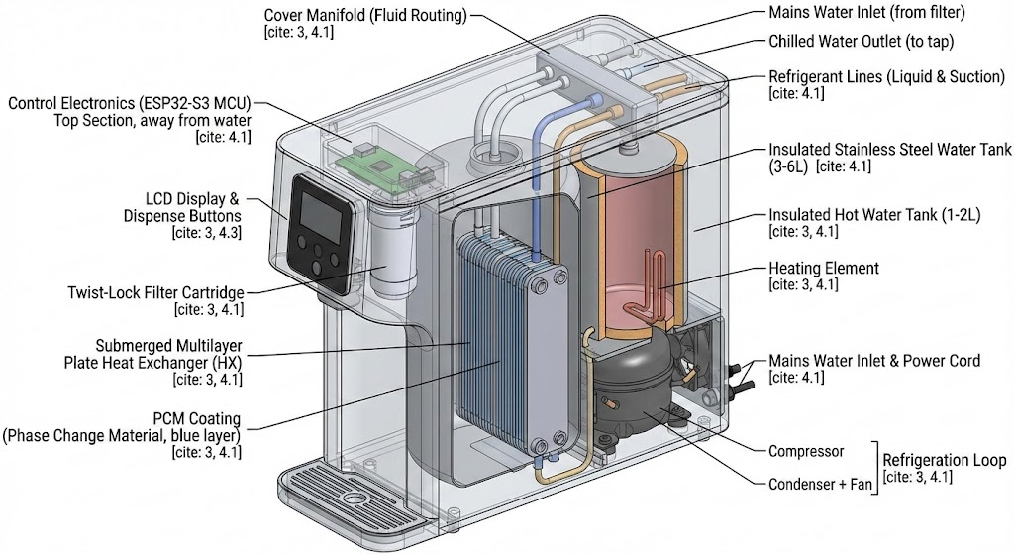
Inside ChillStream
Annotated cross-section — all major subsystems visible. Section references map to the system description document.

Slide 6
Fleet-First IoT Platform
Fleet Dashboard
Real-time monitoring
Temperatures, capacity %, compressor state across all units
Usage analytics
Pours/day, peak times, demand vs. capacity — sizing recommendations
Predictive maintenance
Compressor anomaly detection, condenser fouling alerts
Filter management
Fleet-wide filter life tracking, replacement scheduling
OTA firmware updates
Staged rollout, automatic rollback, zero downtime
Remote commands
Reboot, config push, maintenance mode, diagnostics
On-Unit Display
• Cold capacity gauge (% remaining)
• Live output temperature during pour
• Filter life indicator
• Recharge ETA when capacity is low
• PIN-protected operator settings
Connectivity
• WiFi (ESP32-S3, built-in — $0 extra HW)
• MQTT telemetry + HTTPS for OTA/config
• TLS 1.3, X.509 device certificates
• Works fully offline — buffers 7 days locally
• AP mode captive portal for setup

Slide 7
Market Opportunity
Schools (K-12)
Peak demand at every bell — the hardest use case.
Budget-sensitive. Fleet purchases by district.
$800-1,100
130,000+ in the US alone
per unit
Offices
Steady use with lunch/break clusters.
Facility managers want zero-maintenance.
$600-900
~1M commercial offices in US
per unit
Healthcare / Clinics
Waiting rooms, staff areas.
Hygiene and compliance matter.
$800-1,100
~230,000 medical offices
per unit
Hospitality
High-visibility locations.
Premium positioning possible.
$900-1,200
Hotels, coworking, airports
per unit
Entry point: Schools (hardest use case = best proof point) and offices (highest volume).

Slide 8
Unit Economics
5L MODEL — BOM BREAKDOWN
5L Model
10L Model
Cold assembly (tank + HX + cover + PCM)
$75
30%
$749
$999
Refrigeration system
$50
20%
COGS: $386
Gross margin: 48%
Offices, small clinics
COGS: $442
Gross margin: 56%
Schools, large offices
Hot water system
$25
10%
Water path (valves, flow sensor, filter housing)
$20
8%
Electronics (ESP32, PCB, sensors, relays, PSU)
$25
10%
Display + UI
$15
6%
Enclosure + packaging + misc
$43
17%
Filter Cartridge
COGS: $6 | Margin: 70%
2-3 replacements/year per unit
NFC tag for auto lifecycle tracking
Proprietary twist-lock (recurring revenue)
Materials subtotal
$253
$20
Assembly + test + brazing + scrap (5%)
$133
TOTAL COGS — 5L UNIT
$386

Slide 9
Recurring Revenue Model
Two recurring streams per unit:
Filter cartridges
$20/cartridge × 2-3/year = $40-60/unit/year
70% gross margin. Proprietary twist-lock with NFC.
Cloud SaaS (optional)
$10/month/unit = $120/unit/year
85% gross margin. Fleet dashboard, analytics, OTA.
Combined: $160-180/unit/year
ANNUAL RECURRING AT FLEET SCALE
10 units
$1,600-1,800
Single site (small office building)
50 units
$8,000-9,000
School district or multi-floor office
100 units
$16,000-18,000
Regional facility operator
500 units
$80,000-90,000
National FM company
1,000 units
$160,000-180,000
Enterprise account
Hardware is the door opener. Recurring revenue is the business model.
At 1,000 deployed units, annual recurring exceeds initial hardware revenue within 12-18 months of fleet buildout.

Slide 10
Why ChillStream Wins
Physics advantage
Latent heat stores 5-10x more energy than sensible heat per kg. A 3 kg PCM mass replaces a 15-20L cold water tank. This is why we fit in a countertop form factor.
No moving parts in the water path
No pump, no circulator. Water moves on mains pressure only. Fewer failure modes. Lower cost. Silent during dispense.
Standard components, novel assembly
The plate HX is off-the-shelf (Kaori, SWEP). The compressor is catalog (Secop, Embraco). The tank is a simple vessel. The innovation is in the assembly and the PCM coating — not in reinventing the parts.
Fleet-first IoT from day one
Built for operators managing 10-1,000 units. Not a consumer gadget with an app bolted on. Predictive maintenance, sizing recommendations, OTA updates, compliance reporting.
Recurring revenue built into the product
Proprietary filter with NFC lifecycle tracking. Cloud SaaS for fleet management. Combined: $160-180/unit/year at 70-85% margin.

Slide 11
Roadmap & Key Risks
18-MONTH DEVELOPMENT ROADMAP
TOP RISKS & MITIGATIONS
M1-M3
PCM + HX prototype
Material selection, thermal simulation, bench prototype of submerged plate HX
PCM encapsulation durability
Can coated plates survive 10,000+ freeze-thaw cycles? → Material science partnership + accelerated life test by M3
M4-M6
Full functional prototype
Complete unit: cold + hot + electronics + display + WiFi
EVT
Engineering validation. Performance testing. Begin certification.
HX thermal performance
M7-M9
Can 4 plates achieve 25°C→4°C at 1 L/min? → Thermal simulation + bench prototype by M3
M10-M12
DVT
Design validation. Reliability testing. 10,000-cycle PCM test.
Cover manifold complexity
M13-M14
Pilot fleet
5-10 units deployed in real schools and offices. Field data.
Single part routes water + refrigerant + sensors. → Industrial design + mechanical prototype by M4
M15-M18
PVT → Production
Manufacturing validation. Certification complete. Ship.
Mineral fouling
HX plates always submerged in water. → Upstream filter + descaling protocol + accelerated fouling test

Slide 12
The Ask
Phase 1: Prove the Physics
Phase 2: Validate the Product
Phase 3: Scale to Market
M1-M6
$250K
M7-M14
$400K
M15-M18+
$350K
PCM material selection and encapsulation testing
Submerged plate HX thermal prototype
Cover manifold mechanical prototype
Full functional prototype (1 unit)
Thermal performance validation
EVT + DVT (10-20 units)
Certification (UL, NSF, FCC/CE)
IoT platform development (dashboard, OTA)
Pilot fleet: 5-10 units in real deployments
Field data collection and iteration
PVT and production tooling
Manufacturing line setup
First 500-unit production run
Sales team and channel partnerships
Launch marketing
Total investment to production:
$1M over 18 months

