Slide 1
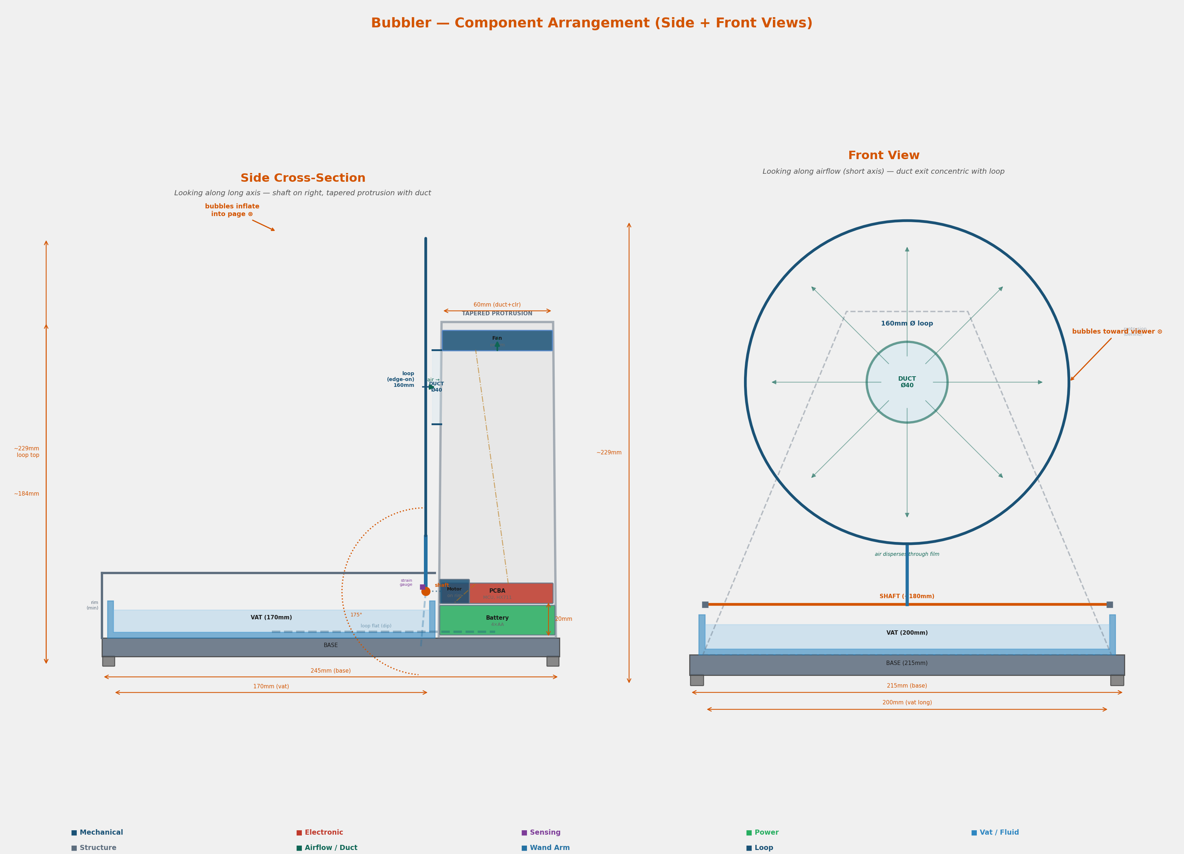
Bubbler
Big bubbles. Zero effort.
An automated soap bubble machine that produces giant bubbles up to 500 mm using force-curve feedback. No app, no cloud -- just press power and watch.
Product Overview | Concept Stage | 2026
1/8

Slide 2
The Problem
Large bubbles are hard to produce
Giant soap bubbles (200-500 mm) require precise airflow control, correct dip timing, and film that survives rotation. Manual technique is inconsistent and takes practice to learn.
Existing machines make only small bubbles
Consumer bubble machines produce 20-50 mm bubbles with high pop rates and no adaptation. They blow hard, pop fast, and waste soap. No feedback loop means no improvement over time.
Gap between cheap toys and pro gear
Toy machines cost $10-30 but produce tiny bubbles. Professional stage equipment costs $200+ and needs power outlets. Nothing in between serves families, performers, and outdoor events well.
TARGET USERS
Families | Performers | Event organizers
Outdoor parties | Buskers | Kids' entertainment
2/8

Slide 3
How It Works
1. Fill
Fill vat with soap solution
Pour bubble solution into the built-in vat. Standard dish soap mix works. The wand loop sits submerged, ready to dip.
2. Press
Press power -- wand dips into vat
Single button press starts the cycle. The motor arm dips the wand loop into the soap solution, coating it with a thin film.
3. Inflate
Arm rotates up, fan gently inflates film
The arm rotates 175 degrees upward. A DC fan blows a controlled ramp of air through the soap film, inflating it into a large bubble.
4. Optimize
Force sensing optimizes each cycle
A strain gauge on the wand arm measures 50-200 mN during inflation. Firmware classifies each outcome and auto-adjusts fan speed, dip duration, and blow ramp. Converges in 5-10 cycles.
3/8

Slide 4
Architecture
Sensing Signal Chain
Strain gauge --> HX711 ADC --> STM32 MCU
50-200 mN force 24-bit 10-80 Hz hill-climbing optimizer
Actuation Chain
STM32 --> Motor H-bridge (dip/rotate) + Fan PWM (inflate)
KEY COMPONENTS
MCU (STM32)
Bare-metal firmware, hill-climbing on 5 parameters, no app/cloud
Strain Gauge + HX711
Force-curve feedback at 10-80 Hz, cycle outcome classification
DC Motor + H-bridge
Wand dip and 175-degree arm rotation, bidirectional control
DC Fan + MOSFET
PWM-controlled airflow ramp for gentle bubble inflation
Power (4xAA batteries)
~7 hr runtime, simple replacement, no charging needed
Enclosure (IPX4)
215x206 mm footprint, ~250 mm height, splash-resistant
Component Arrangement
4/8

Slide 5
Key Innovation
Force-curve feedback: the strain gauge on the wand arm turns every inflation cycle into a learning opportunity.
What It Measures
Force: 50-200 mN during inflation
Sample rate: 10-80 Hz via HX711 ADC
Resolution: sub-mN with 24-bit ADC
Cycle Outcome Classification
Success: Bubble detaches cleanly -- force drops to baseline
Pop: Sudden force spike then zero -- film burst mid-inflation
No film: Near-zero force throughout -- dip failed to coat
Partial: Force plateau then slow decay -- bubble formed but small
Hill-Climbing Optimizer (5 parameters)
Fan speed ramp: PWM duty cycle profile during inflation
Dip duration: How long the wand stays in the soap vat
Blow ramp rate: How quickly airflow increases
Rotation speed: Arm angular velocity during lift
Pause duration: Wait time between dip and blow
Converges in 5-10 cycles to local optimum for current conditions.
5/8

Slide 6
Constraints & BOM
Bubble size
Up to 500 mm
Wand loop geometry + controlled airflow
Battery life
~7 hrs (4xAA)
Low-power MCU, motor duty-cycled
Footprint
215 x 206 mm
Compact enough for a tabletop
Operating temp
5-40 C
Soap film physics limit the range
Wind tolerance
4 kph crosswind
Fan ramp compensation algorithm
Electronics
IPX4
Splash-resistant enclosure for outdoor use
BOM ESTIMATE (~$12.80 total)
STM32 MCU
$1.50
Strain gauge + HX711 ADC
$0.80
DC motor + H-bridge
$1.80
DC fan + MOSFET driver
$1.10
Enclosure (molded plastic)
$3.50
Wand + loop + shaft
$1.50
Misc (PCB, connectors, passives)
$2.60
Total BOM
~$12.80 | Target retail: sub-$50
4xAA batteries not included in BOM. No app, no cloud -- keeps ongoing costs at zero.
6/8

Slide 7
Hardest Problems
1. Film survival during rotation
The soap film must survive a 175-degree arm rotation from the vat to the blow position without breaking. Film thickness, rotation speed, and acceleration profile all matter. Too fast and the film tears from inertia; too slow and it drains and thins. Requires empirical tuning of the motor ramp curve.
2. Force-curve interpretation
Classifying cycle outcomes (success, pop, no-film, partial) from noisy strain gauge signals at 10-80 Hz. The HX711 output includes mechanical vibration, motor coupling, and wind noise. Signal conditioning and threshold-based classification must be reliable enough for the hill-climbing optimizer to converge.
3. Wind compensation at 4 kph
Outdoor use means crosswind. A 4 kph breeze changes the effective airflow through the soap film, shifting optimal fan speed and blow duration. The optimizer must detect wind-induced pop patterns and compensate within a few cycles. No wind sensor -- inferred from force-curve anomalies only.
All three require physical prototyping. Soap film behavior cannot be fully simulated -- build, measure, iterate.
7/8

Slide 8
Gate Result & Next
GATE: PASS
System description complete.
62 pass / 23 N/A / 3 minor
Ready to proceed to PRD.
KEY SPECS
Bubbles up to 500 mm | 4xAA (~7 hr) | 215x206 mm footprint
~250 mm height | IPX4 | 5-40 C | BOM ~$12.80 | Sub-$50 retail
ARCHITECTURE
Strain gauge + HX711 + STM32 | Bare-metal FW | No app, no cloud
3 MINOR GAPS
Gap 1
FW versioning scheme not yet defined
Gap 2
Decision consequences formatting incomplete
Gap 3
Schedule milestones need dates
WHAT'S NEXT
- Build functional prototype with off-the-shelf motor, fan, and HX711 breakout
- Validate soap film survival during arm rotation (175 deg)
- Test force-curve classification accuracy across soap formulations
- Measure wind compensation convergence at 4 kph crosswind
- Confirm 4xAA battery life target with real duty cycles
Next step: build the mechanical prototype. Validate film survival, force sensing, and the optimization loop before committing to PCB.
8/8

