Slide 1
Chair Balancing Act
A tilt-sensing audio feedback device for fixed-leg chairs
All legs down = silence. Any leg lifts = rising tone. More tilt = louder.
Part safety reminder, part office prank, part gift-shop impulse buy.
Product Overview • Concept Stage • 2026

Slide 2
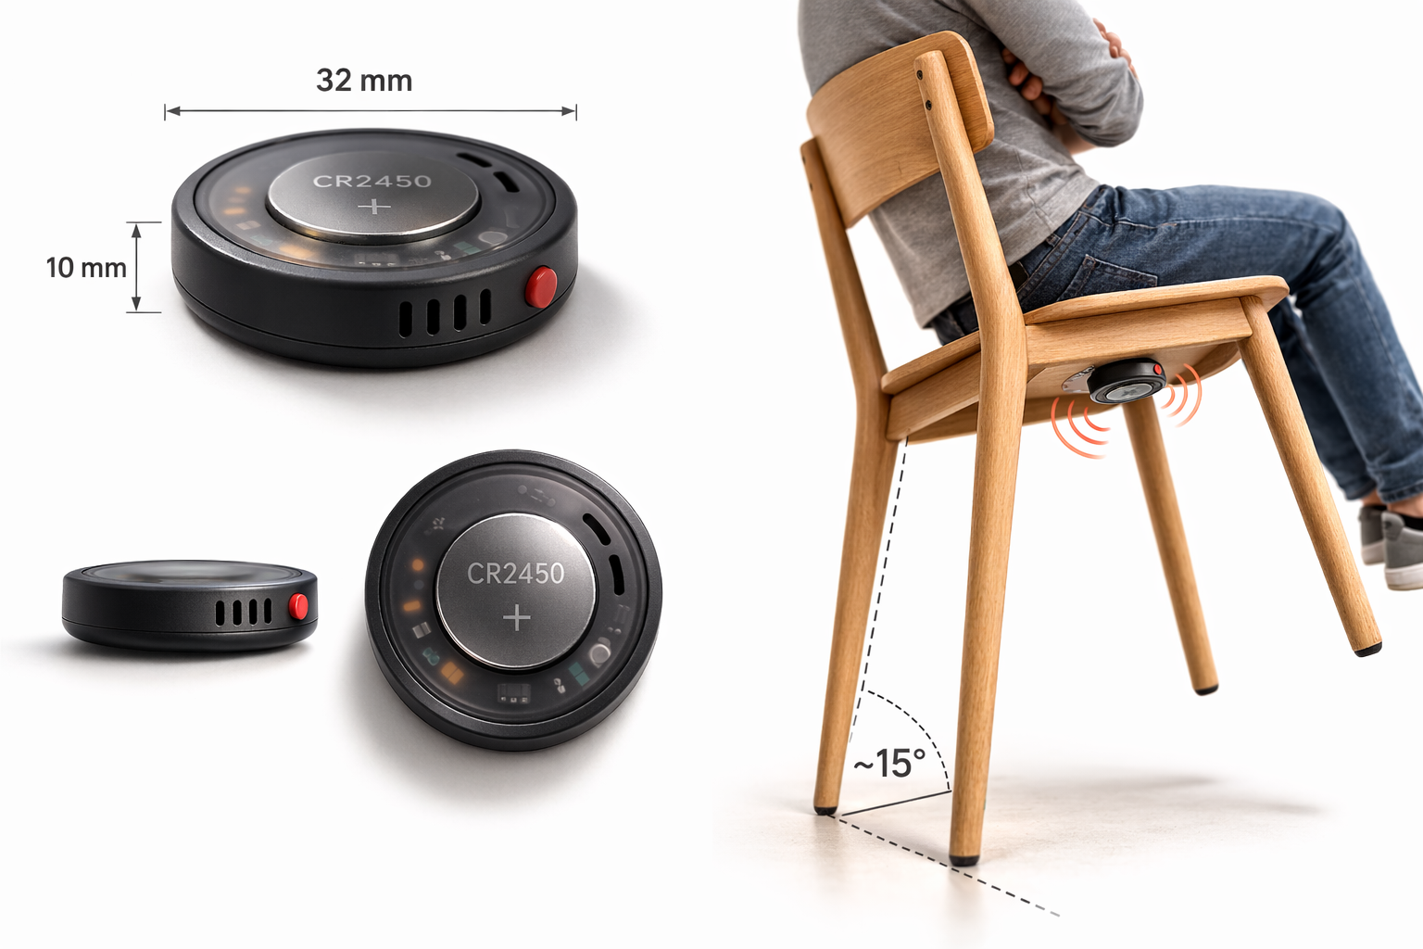
Product Overview

Slide 3
How It Works
Static Balance
Dynamic Balance
Near Fall
SILENCE
CONTINUOUS RISING TONE
MAXIMUM ALARM
All legs on the floor. Device sleeps. No sound at all.
Any leg lifts off the floor. Agreeable low tone begins. Rises smoothly with tilt. Pitch + volume + urgency scale proportionally.
Steep angle, close to tipping point. Tone at peak urgency. Everyone in the room knows what's happening.
The device:
~32 mm round × 10 mm • ~15g • CR2450 coin cell (months of life) • AirTag-sized • Adhesive mount under chair seat • Fixed-leg chairs only

Slide 4
Architecture & Constraints
SUBSYSTEMS
HARD CONSTRAINTS
Accelerometer
I2C + wake interrupt
BOM cost
<$8 at 1k units
Tilt angle on pitch + roll
Gift/novelty price — retail $15-25
MCU + Firmware
Reads accel, generates PWM tone
Filter, tone generation, calibration
Battery life
>2 months on CR2450
Forget-and-use, no charging
Class-D Amp + Piezo Speaker
PWM input, piezo output
Amplifies MCU tone output
Latency
<100 ms tilt-to-sound
CR2450 Coin Cell
MCU sleeps in static balance
Comedy timing is the product
Months of life, user-replaceable
Button
Size
32 mm × 10 mm, 15g
GPIO
AirTag-sized, hidden under seat
On/off, mode cycle
Data flow: Accelerometer --I2C--> MCU (filter + tone gen) --PWM--> Class-D Amp --> Piezo speaker

Slide 5
Hardest Problems & Component Tradeoffs
THREE HARDEST PROBLEMS
COMPONENT TRADEOFFS
1
Escalation curve across chair types
MCU
Cost + PWM
School chairs and dining chairs have different fall points and tilt ranges. The continuous tone must start gently at first leg lift and peak just before the fall point — not too early (annoying) or too late (useless). Needs auto-calibration + playtesting.
ATtiny ($0.50) has HW PWM for tone gen. STM32L0 ($1.20) has DAC for smoother audio. nRF52 ($3) overkill.
Accelerometer
FW complexity
Cheapest has no filtering — $0.50 more gets on-chip motion detection, saves weeks of FW tuning.
2
Filtering fidgeting from tilting
Sitting down, crossing legs, leaning to grab something — all produce accelerometer signals. Continuous model means any sustained tilt produces sound — the dead-band and time filter are critical.
Audio path
Simplicity
MCU PWM + class-D amp ($0.30) replaces audio playback IC. Enables real-time continuous tone, not fixed clips.
Designing the continuous tone
Speaker
Physical constraint
3
Dynamic (4 mm tall, louder) vs. piezo (2.5 mm, fits 10 mm enclosure). Piezo resonance aids escalation.
The tilt-to-tone mapping IS the product. Must be agreeable at low tilt and urgent near fall. Three modes (serious, comedic, stealth) need distinct character. Needs sound designer + playtesting with kids.
Power
Simplicity
CR2450 coin cell: no charging circuit, no USB port, months of life, user-replaceable. LiPo only if V2 needs more current.
Hardware is simple. The product lives or dies on the escalation curve — how tilt maps to tone. Playtesting > engineering.

Slide 6
PRD Summary: 45 Requirements
BY TRACK
BY PRIORITY
GATE RESULT
Hardware
18 reqs
40 Must-have
PASS
(8 electrical, 8 mechanical, 4 PCB)
5 Should-have
66 pass / 23 N/A / 1 minor gap (FW versioning scheme)
Firmware
18 reqs
0 Nice-to-have (V2 only)
(7 core, 4 modes, 4 calibration, 2 power, 1 versioning)
Integration
9 reqs
(end-to-end tests spanning HW + FW)
KEY REQUIREMENTS
FW-C-05
Continuous tone: pitch + volume scale proportionally with tilt
FW-C-06
Real-time tracking: angle change to tone change < 100ms
INT-02
Zero false triggers on transient motion (sitting down, bumping)
FW-PM-04
Battery life >= 6 months at 20 tilt events/day
HW-M-01
Enclosure max 35mm dia x 10mm height
HW-E-06
Total sleep current <= 2 uA (static balance)

Slide 7
Open Items & V2 Horizon
7 OPEN ITEMS (resolve before production)
V2 (if market validates)
M2
Escalation curve tuning across 5+ chair types
Custom tone profiles via USB
Board respin: USB-C connector, upload escalation curve parameters
M2
Piezo volume validation in real environments
BLE + companion app
M2
False trigger testing with real users (fidgety kids)
MCU change: ATtiny -> nRF52. Full board respin + app dev
M2
PWM audio quality -- pleasant tone at low tilt?
Adjustable sensitivity
M2
CPSIA / EN 71 acoustic safety for children's products
Requires BLE. Depends on V2 BLE decision
M3
Tone design for 3 modes (sound designer + FW)
Rechargeable battery
M3
Adhesive durability testing
Adds charging IC, USB-C, Li-Po. Enclosure redesign
V2 decisions should wait for 6+ months of V1 sales data and customer feedback.

