Slide 1
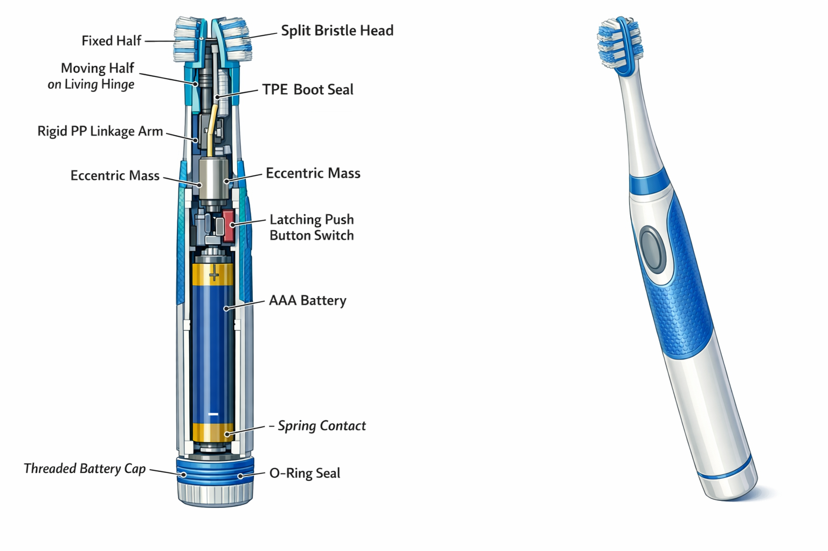
Consumable Electric
Toothbrush
Use it. Toss it. Open a new one.
A battery-powered vibrating toothbrush designed as a true consumable. AAA alkaline, no MCU, dual-injection sealed. $3-5 retail vs. Oral-B Pulsar at $8-12.
Product Overview | Concept Stage | 2026
1/8

Slide 2
The Problem
Oral-B Pulsar is overpriced for a disposable
At $8-12, the Pulsar pretends to be reusable but has a sealed, non-replaceable battery. When it dies, you throw it away.
Manual brushes don't clean as well
Powered vibration removes more plaque than manual brushing. But rechargeable brushes cost $30-200. Budget consumers are stuck.
No honest sub-$5 powered option exists
Premium rechargeable ($30+) or Oral-B Pulsar ($8-12). Nothing below $5 where powered brushing becomes truly disposable.
TARGET USERS
Budget-conscious consumers | Travelers
Hotels & hospitality | Multi-pack buyers
2/8

Slide 3
How It Works
1. Open
Tear open blister pack
AAA alkaline battery is pre-installed with years of shelf life. No charging, no pairing, no setup.
2. Press
Push the button once
Latching push-button turns motor on. ERM vibration motor spins up instantly. Bristles oscillate via split-head mechanism.
3. Brush
2 minutes, twice daily
Split bristle head concentrates oscillation at bristle tips. Rinse under tap after use. IPX5 sealed.
4. Toss
~90 days later, motor stops
Alkaline cell drops below stall voltage. Clear end-of-life: it works or it doesn't. Discard and open a new one.
3/8

Slide 4
Architecture
Power Path
AAA Cell --> Latching Switch --> ERM Motor
1.5V alkaline push on/off 60-100mA, direct drive
Mechanical Path
Motor --> Eccentric --> Linkage --> Split Head --> Bristles
SUBSYSTEMS
AAA Alkaline Cell (1.5V)
1000-1200 mAh, ~750 min runtime, years of shelf life
Latching Push-Button
Mechanical push-on/push-off, sealed by TPE overmold
Cylindrical ERM Motor
6x12mm, 60-100mA at 1.5V, axial mount in handle neck
Split Bristle Head
Fixed + moving halves, living hinge pivot, 1-2mm oscillation
Rigid PP Body (1st shot)
Handle, motor pocket, battery tube, insert-molded bristles
TPE Overmold (2nd shot)
Seals all penetrations, grip, button membrane, head boot
Battery Cap + O-ring
Threaded PP cap, static radial seal, factory-installed
Zero software. Zero electronics.
No MCU, no PCB, no firmware, no app, no cloud. The entire electrical system is 3 components and 2 wires.
4/8

Slide 5
Dual-Injection Sealing
How do you waterproof a $1.50 product for 90 days of wet use?
1st Shot: Rigid PP Body
Injection-mold the structural handle with bristles pre-loaded in the mold cavity. Plastic flows around each bristle base, creating a watertight seal at every tuft. No secondary sealing.
2nd Shot: TPE Overmold
After motor, wiring, switch, and battery are assembled into the rigid body, the 2nd injection encapsulates everything. TPE bonds chemically to PP, sealing all penetrations in one step: grip texture, button membrane, and dynamic head boot.
4 Seal Zones
1. Bristle insert-mold: PP flows around nylon tuft bases during 1st injection
2. TPE body overmold: 2nd shot seals handle, switch, wire penetrations
3. TPE head boot: Flexible boot around split-head pivot, survives millions of flex cycles
4. O-ring battery cap: Threaded PP cap compresses O-ring at handle base
5/8

Slide 6
Constraints & BOM
BOM cost
< $1.50
At 10k units; < $1.20 at 50k
Motor runtime
>= 350 min
~750 min calculated (AAA @ 80mA)
Water resistance
IPX5
Dual-injection + O-ring, 90 days wet use
Handle diameter
<= 16mm
AAA cell (10.5mm) + PP wall + TPE
Retail price
$3 - $5
Undercutting Oral-B Pulsar ($8-12)
Shelf life
> 2 years
Alkaline chemistry, sealed blister pack
BOM ESTIMATE (10k units)
ERM motor (cylindrical, 6x12mm)
$0.12
AAA alkaline cell
$0.07
Latching push-button switch
$0.03
Wiring (2x, 26AWG, tinned)
$0.01
Spring contact + plate contact
$0.02
PA-612 nylon bristle tufts (x35)
$0.02
O-ring (battery cap seal)
$0.01
PP resin (1st shot, ~8g)
$0.02
TPE resin (2nd shot, ~3g)
$0.02
Battery cap (threaded PP)
$0.02
Blister packaging + card
$0.08
Assembly + test (90-100s/unit)
$0.72
Total COGS
~$1.14 (50k: ~$0.92)
6/8

Slide 7
Hardest Problems
1. Dynamic seal at the split head joint
The moving bristle half oscillates ~1-2mm at 150+ Hz while the TPE boot must keep water out of the motor cavity. Fatigue + sealing problem -- the boot must survive millions of flex cycles in a wet, toothpaste-laden environment.
2. Insert-molding bristle seal quality at speed
~35 bristle tufts penetrate the PP surface. At production speed, every tuft base must be sealed by injection. A single unsealed tuft is a water ingress path. Narrow process window.
3. BOM discipline with dual-injection process
Overmolding adds ~$0.10-0.20/unit vs. single-shot, tooling is 2-3x higher ($15k-25k). With $3-5 retail and distribution margins, every component must be ruthlessly cost-optimized.
All three are manufacturing challenges, not design unknowns. Oral-B Pulsar proves the architecture -- the risk is execution at lower cost.
7/8

Slide 8
Gate Result & Next
GATE: PASS
System description complete.
40 pass / 47 N/A / 2 fail
Ready for mold design.
POWER
80 mA active | < 1 uA off | AAA 1000 mAh
~750 min runtime | ~187 days @ 4 min/day | non-rechargeable
KEY SPECS
~160mm long | ~15mm dia | IPX5 | Single SKU
No MCU | No PCB | No app | $3-5 retail
7 OPEN ITEMS
M1
Motor performance validation at end-of-life voltage (~1.0V)
M2
Living hinge geometry: thickness, width, PP grade for 4M cycles
M2
TPE head boot fatigue life in wet toothpaste environment
M3
Insert-mold bristle seal QC: tuft pull-force per ISO 20126
M3
Retail channel acceptance test (shelf appeal, blister design)
M4
O-ring compression verification for production QC
M4
Motor current draw screening for dead/high-draw units
Next step: source motor samples and AAA cells, build a hand-assembled prototype in a 3D-printed shell, and validate split-head oscillation and motor stall voltage. Then commit to dual-injection tooling.
8/8

