Slide 1
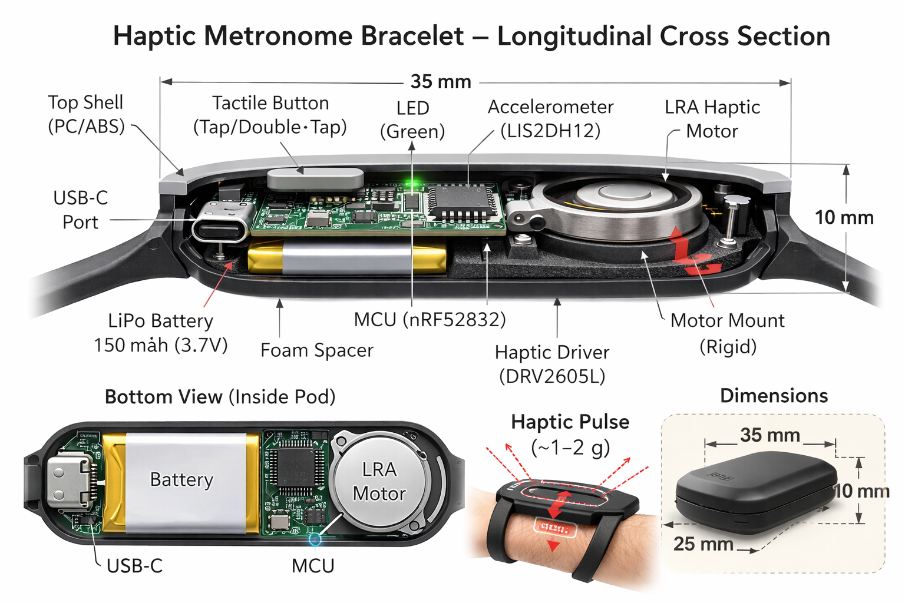
Haptic Metronome
Bracelet
Feel the beat. Hear nothing.
A wrist-worn vibrotactile metronome for musicians who need silent, precise time -- practice, rehearsal, and stage.
Product Overview | Concept Stage | 2026
1/8

Slide 2
The Problem
Audible clicks are unusable on stage
Click tracks bleed into microphones, in-ear monitors isolate from the room, and audible metronomes distract the audience.
Phone apps are imprecise
Android audio latency: 5-40 ms. iOS: 5-15 ms. OS interrupts and background tasks cause timing jitter. Phone vibration motors are too slow and vague for musical time.
Existing solutions compromise
Earpiece click tracks occupy an ear. Visual metronomes require looking away from the music. There is no silent, precise, hands-free time reference that leaves both ears and eyes open.
TARGET USERS
Guitarists | Pianists | String players
Wind & brass | Vocalists | Conductors
2/8

Slide 3
How It Works
1. Set
Open app, set BPM and time signature
App pushes config over BLE to the bracelet. Save presets and setlists for quick recall.
2. Tap
Tap the bracelet to start
Accelerometer detects a fingertip tap on the pod. Haptic pulses begin immediately. LED flashes on beat for the first 4 bars as a sanity check, then goes dark.
3. Feel
Feel the beat on your wrist
Single pulse = normal beat (~15 ms crisp tap). Dual-pulse = downbeat ("da-dum", two taps 40 ms apart). You always know where beat 1 is.
4. Stop
Double-tap to stop
Accelerometer detects the double-tap gesture. Pulses stop. Device goes to low-power idle, ready for the next tap.
3/8

Slide 4
Architecture
Beat Signal Chain
Timer ISR --> I2C cmd --> DRV2605L --> LRA motor
< 100 us jitter waveform select shaped drive crisp tap on wrist
Gesture Chain
Tap on pod --> LIS2DH12 interrupt --> FW validation --> Start/Stop
SUBSYSTEMS
MCU (nRF52832)
Timing engine, BLE 5.0, gesture detection, haptic control
Haptic (DRV2605L + LRA)
Crisp vibrotactile pulses, auto-resonance tracking
Accelerometer (LIS2DH12)
Hardware tap/double-tap detection, Z-axis validation
BLE 5.0 (GATT)
App config, presets, battery status, OTA updates
Power (150mAh LiPo)
USB-C charging, 30+ hrs continuous play
LED (1x green)
Sanity check: first 4 bars only, then dark
Thin actuator, thick app
The bracelet handles timing and haptics. The app handles everything else: BPM, meter, accent patterns, presets, setlists, practice logs. No physical controls for config -- tap/double-tap for start/stop only.
4/8

Slide 5
Feeling the Downbeat
How do you know where beat 1 is when you can only feel vibration?
Normal Beat (2, 3, 4...)
Single pulse: one crisp tap
|--15ms--|
Downbeat (Beat 1)
Dual-pulse: "da-dum"
Two taps, 40 ms apart
|--15ms--|----40ms----|--15ms--|
Why pattern, not intensity?
Amplitude is ambiguous: "Slightly stronger" vs. "normal" is hard to distinguish when your arm is moving.
Pattern is distinct: The brain detects a double-tap as a different event, not just a louder version of the same event.
Works at tempo: At 200 BPM (300 ms between beats), the 70 ms dual-pulse uses 23% of the interval -- tight but clear.
5/8

Slide 6
Constraints & BOM
Timing jitter
< 100 us
Hardware timer ISR, not software loop
Haptic rise time
< 10 ms
LRA mandatory; ERM too slow above 160 BPM
Battery life
> 8 hrs continuous
150 mAh LiPo, ~4.9 mA avg during play
Pod size
35 x 25 x 10 mm
Fits comfortably on wrist during playing
Pod weight
< 20g
Lighter than most watches
Sweat resistance
IPX4
Silicone overmold, sealed USB-C flap
BOM ESTIMATE (1k units)
nRF52832 MCU
$2.80
DRV2605L haptic driver
$1.50
LRA motor (8mm)
$1.50
LIS2DH12 accelerometer
$0.80
LiPo 150mAh + protection
$1.60
Crystals + LED + passives
$0.70
USB-C + charge IC + LDO
$0.95
PCB (28x18mm, 4-layer)
$0.80
Pod enclosure (silicone overmold)
$2.50
Silicone wristband + lugs
$1.20
Packaging + USB-C cable
$1.20
Assembly + test
$2.50
Total COGS
~$18.05 (5k: ~$14.50)
6/8

Slide 7
Hardest Problems
1. Haptic perceptibility during playing
Can the LRA pulse (~1.5g) be felt on the wrist while strumming guitar, bowing violin, or playing piano expressively? Arm motion creates competing vibrations. Tight skin contact and sharp LRA rise time are the primary mitigations. Must prototype and test with real musicians.
2. Tap gesture vs. playing motion
The accelerometer must reliably detect a deliberate fingertip tap on the pod while rejecting strumming, bowing, and arm movement. Two-stage detection: hardware threshold trigger, then firmware Z-axis dominance validation. Target: < 1% false trigger, < 5% missed tap.
3. Downbeat perception at tempo
Can musicians distinguish the dual-pulse downbeat from a single pulse at 120, 160, and 200 BPM? At 200 BPM the 70 ms dual-pulse occupies 23% of the beat interval. The 40 ms gap must be above tactile temporal resolution (~5-10 ms). Needs testing with 5+ musicians across instruments.
All three require prototype validation with real musicians. No amount of simulation replaces putting this on a wrist.
7/8

Slide 8
Gate Result & Next
GATE: PASS
Full system description complete.
89 / 2 N/A / 0 fail
Ready to proceed to PRD.
POWER
4.9 mA playing | 19 uA idle | 150 mAh battery
30 hrs continuous | 10 days typical use | 45 min charge
KEY SPECS
35x25x10mm pod | ~25g total | IPX4 | 22mm standard band
BLE 5.0 | OTA (signed) | USB-C charge | $45-60 retail
8 OPEN ITEMS
M2
Haptic perceptibility test with guitarists, pianists, strings
M2
DRV2605L waveform sequence timing precision
M2
Dual-pulse downbeat perception at 120/160/200 BPM
M3
Tap gesture false-trigger rate across instruments
M3
Wristband comfort during 2+ hour sessions
M4
IPX4 seal durability (USB-C flap, 500+ cycles)
M1
BOM volume validation (5k min for $15 target)
M3
Band attachment strength during playing
Next step: prototype the haptic pod on an nRF52 devkit with a DRV2605L breakout board. Put it on wrists. Play music. Validate the three hardest problems before committing to PCB.
8/8

