Slide 1
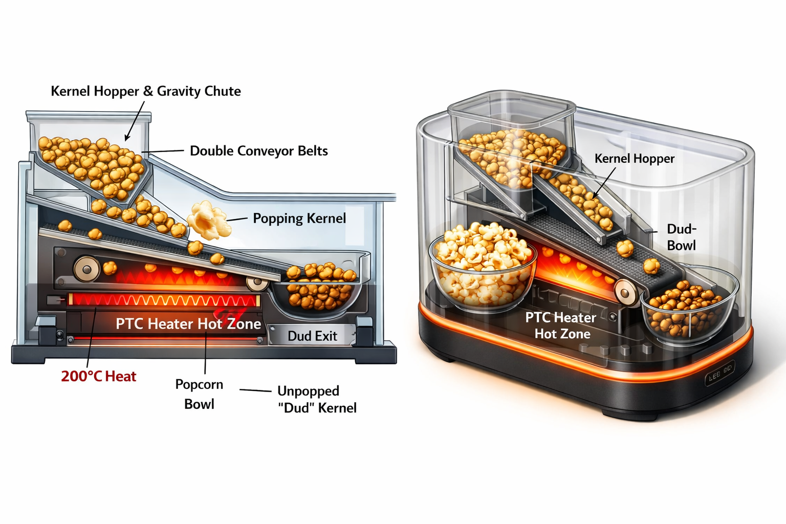
Pop!
One kernel at a time. Physics does the sorting.
A miniature desktop popcorn machine that pops kernels individually on a slow conveyor belt through a hot zone. Popped kernels escape into a bowl. Duds ride to the end. USB-C powered. Mesmerizing.
Product Overview | Concept Stage | 2026
1/8

Slide 2
The Problem
Microwave popcorn is invisible
Push a button, wait 3 minutes, listen for the slowdown. Nothing to see. No ritual. No spectacle. The bag arrives pre-made with artificial butter flavor and regret.
Stovetop is overkill
Oil, pot, lid, constant shaking, burned kernels stuck to the bottom, cleanup. All for a snack. Nobody does this at their desk.
No desk-scale popcorn experience exists
There is nothing that turns popcorn into a meditative, kernel-by-kernel show you watch while you work. Pop! fills the space between snack and spectacle.
TARGET USERS
Desk workers | Dorm dwellers | Gadget lovers
Gift recipients | Snack enthusiasts | Ages 14+
2/8

Slide 3
How It Works
1. Fill
Pour kernels into the hopper
Lift the clear lid, pour in two tablespoons of kernels. The hopper holds ~100. Plug in the USB-C cable.
2. Start
Press the button, wait 45 seconds
LED ring glows amber as the PTC heater preheats to 200C. When the ring turns green, the conveyor belt starts.
3. Watch
Kernels pop one at a time
Kernels slide down the gravity chute single-file onto the belt. The belt carries each through the hot zone. Pop! The kernel explodes, escapes the belt, tumbles into the bowl.
4. Eat
Popcorn bowl fills, duds go to waste
Popped kernels escape sideways into the clear bowl. Duds ride the belt to the end and drop into the dud bowl. No sensors, no sorting logic. Physics does it.
3/8

Slide 4
Architecture
Kernel Pipeline
Hopper --> Chute --> Belt --> Hot Zone --> Bowl / Dud
gravity single-file slow grip 200C PTC physics sorting
Key Insight: No Sensors for Sorting
Popped = 25mm, escapes belt. Unpopped = 6mm, stays gripped. Physics wins.
SUBSYSTEMS
Double Conveyor Belt
PTFE-fiberglass mesh, grips kernels through hot zone, 5-8 mm/s
PTC Ceramic Heater (20W)
Self-regulating, 200C, mounted under belt path
Gravity Chute
Angled slide, narrows to 9mm, single-files kernels passively
MCU (ESP32-C3)
PID temp control, motor PWM, LED effects, optional BLE
USB-C PD (30W)
20V @ 1.5A via STUSB4500, no wall brick
LED Ring (WS2812B x8)
Amber = preheat, green = running, blue = done, red = fault
Dumb firmware, smart mechanism
The firmware runs PID temperature control and constant-speed motor drive. No pop detection, no sorting logic, no jam recovery. The conveyor belt and physics handle everything the firmware doesn't need to know about.
4/8

Slide 5
Physics-Based Sorting
How does the machine know which kernels popped?
Unpopped Kernel (Dud)
Size: ~6mm | Hard, round
Fits snugly between the two belts. Belt tension grips it. Rides the full belt path. Drops into the dud bowl at the end.
Popped Kernel
Size: ~25mm | Expanded 10-15x | Irregular
Way too big for the belt gap. The expansion force pushes the spring-loaded belts apart. The kernel breaks free and escapes sideways into the popcorn bowl. No sensor needed.
The conveyor belt IS the sensor
Belt gap: ~4mm at rest — spring-loaded rollers apply light tension. 6mm kernels get gripped. 25mm popcorn can't be held.
Belt speed: 5-8 mm/s — each kernel spends 10-16 seconds in the hot zone. Fast enough to be interesting, slow enough to pop.
Belt material: PTFE-coated fiberglass — survives 260C continuous. Food-safe (FDA approved). Low-stick so popcorn doesn't adhere.
5/8

Slide 6
Constraints & BOM
Hot zone temp
~200C
PTC self-regulating, PID-controlled
Belt speed
5-8 mm/s
10-16s per kernel in hot zone
Power
USB-C PD 30W
19W steady state, 11W headroom
Footprint
150 x 180 x 140mm
Fits on a desk next to monitor
Weight
~400g
Light enough to move with one hand
Food safety
FDA / EU 1935/2004
PTFE belt, Tritan bowls
BOM ESTIMATE (1k units)
ESP32-C3-MINI-1
$1.50
STUSB4500 PD controller
$1.20
USB-C + buck regulator
$0.90
MOSFET + DRV8837 motor driver
$1.00
PTC ceramic heater (20W)
$1.50
DC gearmotor (30 RPM)
$2.00
Conveyor belt assembly
$3.50
Stainless steel chute
$0.80
NTC thermistor + passives
$0.65
WS2812B LEDs x8 + piezo
$1.00
PCB (50x40mm, 4-layer)
$1.20
Enclosure (all parts)
$5.10
Thermal insulation
$0.30
Packaging + cable + samples
$1.50
Assembly + test
$2.50
Total COGS
6/8
~$24.75 (5k: ~$18.50)

Slide 7
Hardest Problems
1. Belt grip vs. pop escape
The belt must grip unpopped kernels (~6mm) firmly enough to transport them, yet release popped kernels (~25mm) reliably. Spring-loaded belt tension is the tuning variable. Too tight: popped kernels get crushed. Too loose: unpopped kernels slip. Must prototype with real kernels and real belts at M1.
2. Heat transfer through the belt
Kernels are heated through PTFE-fiberglass mesh from a PTC heater below. If heat transfer is too slow, each kernel takes >12 seconds to pop and the cadence is boring. May need heater on both sides or direct radiant exposure through mesh openings. Target: pop within 8-12 seconds of entering the hot zone.
3. Gravity chute jamming
The passive chute must single-file kernels from a bulk hopper using only geometry and gravity. Kernels are 4-8mm, irregular, and tend to bridge in narrowing channels. V-groove cross-section and polished surface help. A small vibration motor is the fallback. Must test with multiple kernel brands at M1.
All three are mechanism problems solved by prototyping, not simulation. M1: 3D-printed frame, off-shelf belts, PTC heater, real kernels.
7/8

Slide 8
Gate Result & Next
GATE: PASS
System description complete.
70 pass / 13 N/A / 3 minor
Ready for mechanism prototype.
POWER
USB-C PD: 20V @ 1.5A (30W) | Steady state: ~19W
Heater 17W | Motor 0.3W | MCU 0.15W | LEDs 0.8W | 11W headroom
KEY SPECS
150x180x140mm | ~400g | Clear enclosure | Tritan bowls
ESP32-C3 | BLE 5.0 | OTA | Retail $50-80 | BOM <$25
8 OPEN ITEMS
M1
Belt grip vs. pop escape tuning with real kernels
M1
Heat transfer rate through PTFE-fiberglass belt
M1
Gravity chute jamming across kernel brands
M2
Popped kernel escape direction / bowl placement
M2
Thermal isolation (outer surface <45C)
M3
Belt longevity at 200C (target 500+ hours)
M2
UL/ETL path for <25W heating appliance
M2
USB-C PD compatibility across charger brands
Next step: 3D-print the frame, source PTFE belts and a PTC heater, build the conveyor mechanism. Pop real kernels. Validate belt grip, chute flow, and escape geometry before committing to tooling.
8/8

