Slide 1
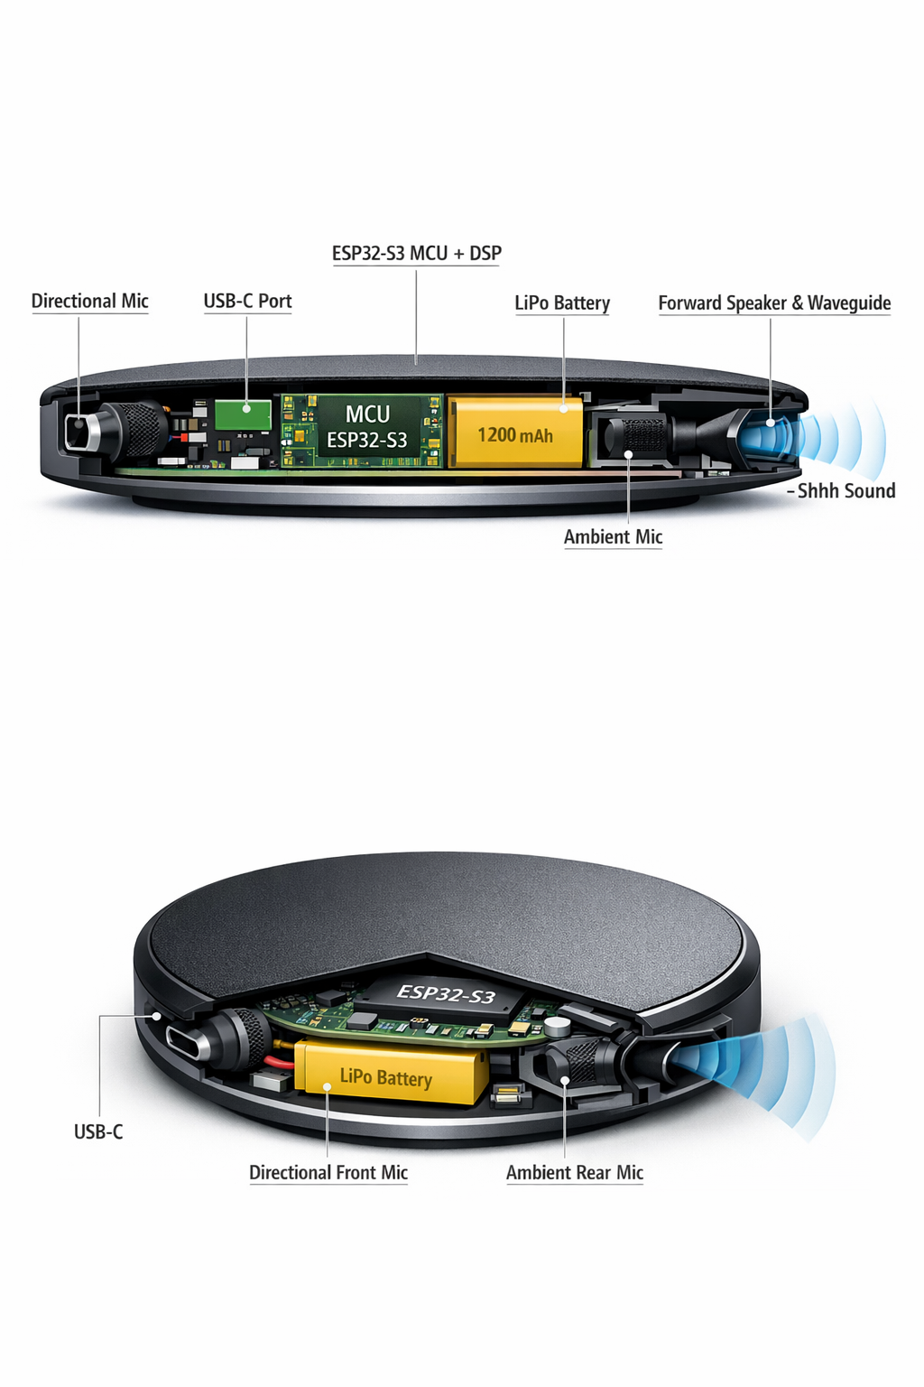
Shusher
The polite nudge you never had to give.
A palm-sized puck that listens for sustained loud speech, then fires a discreet, human-sounding "shhh" toward the offender. You aim it. It does the rest.
Product Overview | Concept Stage | 2026
1/8

Slide 2
The Problem
Loud talkers and speakerphone abusers
Cafes, coworking spaces, trains -- someone always decides the whole room needs to hear their call. You tolerate it, or you confront a stranger. Neither feels good.
Confrontation is awkward
Asking someone to lower their voice means making yourself the center of attention. Most people avoid it. The loud talker wins by default.
No passive, low-effort solution exists
Noise-cancelling headphones help you, but they don't signal anything to the offender. There's no device that delivers a social nudge without making you the messenger.
TARGET USERS
Remote workers | Students | Commuters
Library goers | Introverts | Anyone who values quiet
2/8

Slide 3
How It Works
1. Aim
Point the puck at the noise source
Place Shusher on your table and aim the front face toward the loud talker. Press the side button once. A brief vibration confirms it's active.
2. Detect
Device listens and compares
Two mics -- front (cardioid) and rear (omni) -- measure audio levels continuously. When the front mic detects sustained loud speech 10+ dB above ambient for 6+ seconds, the trigger fires.
3. Shush
A natural "shhh" fires forward
A pre-recorded human shush plays through a front-facing speaker with waveguide. Audible at 2-5m, blends with cafe noise for everyone else. Plausibly deniable.
4. Cool
Wait, then repeat if needed
After a shush, a 30-60 second cooldown prevents re-triggering. One polite nudge per incident. If they get loud again, another shush fires.
3/8

Slide 4
Architecture
Detection Chain
Front mic --> Bandpass --> RMS --> Differential --> Trigger
cardioid PDM 300-4kHz IIR 50ms window front vs rear sustained >6s
Shush Chain
Flash sample --> I2S --> MAX98357A --> Speaker + Waveguide
SUBSYSTEMS
MCU (ESP32-S3)
Dual-core 240 MHz, audio DSP, BLE 5.0, 8MB flash
Front mic (ICS-43434)
Cardioid via acoustic porting, PDM 16 kHz, 65 dB SNR
Rear mic (ICS-43434)
Omnidirectional, ambient baseline reference
Speaker (28mm + waveguide)
Forward-biased shush output, 80-85 dB @ 10cm
Amp (MAX98357A)
I2S class-D, auto-shutdown when idle
Power (1200 mAh LiPo)
USB-C charging, ~3 days per charge
Designed to disappear
No visible LEDs during operation. No electronic sound artifacts. The shush sounds human -- breathy, variable, naturally timed. The offender wonders if someone nearby shushed them. Not a gadget.
4/8

Slide 5
Plausible Deniability
The product works only if nobody knows it's there.
Looks like a coaster
70mm diameter, 15mm tall, matte dark puck. No branding on top. Speaker slot disguised as a seam line. Mic port looks like a mold mark. Sits naturally on any cafe table.
Sounds human
20+ pre-recorded shush variants across 5 styles: classic "shhh," throat clear, gentle "ahem," whispered "excuse me," and passive-aggressive sigh. Each firing picks a different sample. Breathy, slightly variable, naturally timed. No robotic quality, no beeps, no electronic artifacts.
The discretion stack
No LEDs during operation: A single LED under the device confirms power-on, then goes dark. Invisible on a table.
Forward-biased audio: Waveguide provides ~4-6 dB front-to-side ratio. The target hears it; side-facing listeners don't.
Cooldown prevents harassment: Max one shush per 30-60 seconds. A polite nudge, not a weapon.
5/8

Slide 6
Constraints & BOM
Battery life
~3 days
1200 mAh LiPo, 4-hr daily active sessions
Size
70mm x 15mm
Coaster-sized puck, fits naturally on a table
Shush range
2-5 meters
Audible to the target, blends beyond 5m
Trigger latency
~6 seconds
Sustained loud speech, not brief bursts
False positive rate
< 1 / hour
Shushing the barista is a product killer
Weight
~65g
PCB 20g + battery 25g + enclosure 15g + speaker 5g
BOM ESTIMATE (1k units)
ESP32-S3-WROOM-1 (N8)
$2.80
Front MEMS mic (ICS-43434)
$0.80
Rear MEMS mic (ICS-43434)
$0.80
MAX98357A class-D amp
$1.20
28mm dynamic speaker
$0.60
LRA haptic motor (8mm)
$0.50
LiPo battery (1200 mAh)
$2.50
MCP73831 charge IC + USB-C
$0.80
LDO + passives + RGB LED
$0.50
PCB (55mm round, 4-layer)
$1.20
Enclosure (2-piece + waveguide)
$2.50
Packaging + assembly + test
$2.80
Total COGS
~$17.25 (5k: ~$13.50)
6/8

Slide 7
Hardest Problems
1. Distinguishing shush-worthy noise from cafe ambiance
The front mic picks up everything in the aimed direction -- the loud talker, but also music, dish clatter, espresso machines. The classifier must isolate sustained loud speech above the ambient baseline and hold for seconds before triggering. Too sensitive: shushes the barista. Too conservative: never fires.
2. Making the shush sound convincingly human
If the shush sounds electronic or robotic, the product fails socially. It needs to sound like a real person -- breathy, slightly variable, naturally timed. Speaker coloration, waveguide resonances, and enclosure vibration could add artifacts. Multiple recordings with randomized selection on each firing.
3. Achieving useful directivity from a small speaker
A 70mm puck with a 28mm speaker and short waveguide won't produce a tight beam. Target: ~4-6 dB front-to-side ratio at 2-4 kHz (the "shhh" frequency range). Enough to make the shush louder for the target than for people at 90 degrees, but not a laser. Waveguide geometry and speaker placement are critical.
All three require physical prototyping. Acoustic porting, waveguide geometry, and sound recording quality can only be validated by building and testing in real environments.
7/8

Slide 8
Gate Result & Next
GATE: 74 PASS
System description complete.
74 pass / 6 N/A / 8 fail
8 items need prototype validation.
POWER
84 mA active | 2.3 mA standby | 1200 mAh battery
~3 days typical | USB-C charge | ~2.5 hr 0-100%
KEY SPECS
70mm x 15mm puck | ~65g | ESP32-S3 | BLE 5.0
2 MEMS mics | Waveguide speaker | $50-70 retail
KEY OPEN ITEMS
M2
Cardioid mic porting: 10-15 dB front-to-rear rejection?
M2
Waveguide: >4 dB front-to-side ratio at 2-4 kHz?
M2
Shush naturalness through 28mm speaker in plastic enclosure
M3
False positive rate in 5+ real cafe environments
M2
ESP32-S3 BLE + dual-mic audio coexistence under load
M2
Sound recording session: 20+ shush variants, 5 styles
M1
Market positioning: $50 tool vs. $30 fun gadget
M3
DSP duty-cycle optimization for extended battery life
Next step: breadboard prototype on an ESP32-S3 devkit with two MEMS mics and a small speaker. Test the front/rear differential in a real cafe. Record the shush samples.
8/8

