Slide 1
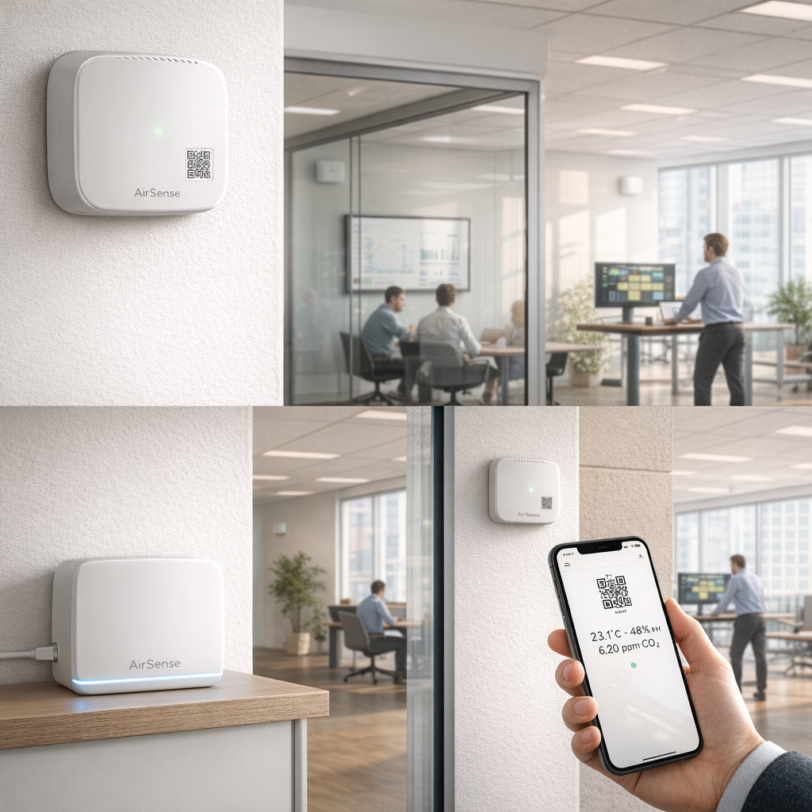
AirSense
Indoor Environment Monitor
Room-level CO2, temperature, humidity, and particulate matter.
Battery-powered BLE sensor nodes. Per-floor gateways. Cloud dashboard.
Replace complaint-driven HVAC management with data.
Product Overview | Concept Stage | 2026

Slide 2
Three-Tier Architecture
SENSOR NODE
GATEWAY
CLOUD BACKEND
1 per room
1 per floor
Centralized
nRF52840 SoC (BLE 5.3)
ESP32-S3 + Ethernet
MQTT ingestion (AWS IoT Core)
CO2 (SCD41) + T/H (SHT40) + PM (PMSA003I)
BLE 5.3
Passively scans BLE advertisements
MQTT/TLS
TimescaleDB time-series storage
2x AA batteries, >12 month target
Aggregates data from up to 50 nodes
REST API + web dashboard
Deep sleep 99% of the time
Forwards to cloud via MQTT/TLS
Alert engine (CO2, temp, device health)
BLE advertisement every 5 min
Mains-powered, always on
OTA firmware deployment to fleet
Sensor node (BLE adv, one-way) --> Gateway (passive scan, Ethernet) --> Cloud (MQTT) --> Dashboard (REST API)

Slide 3
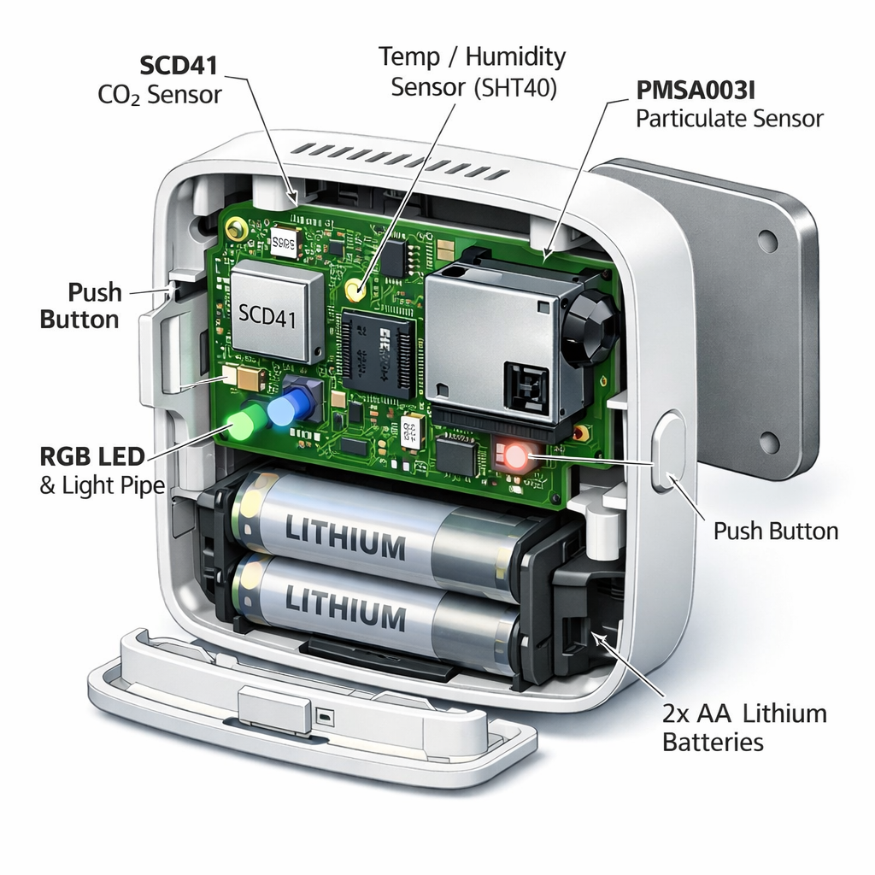
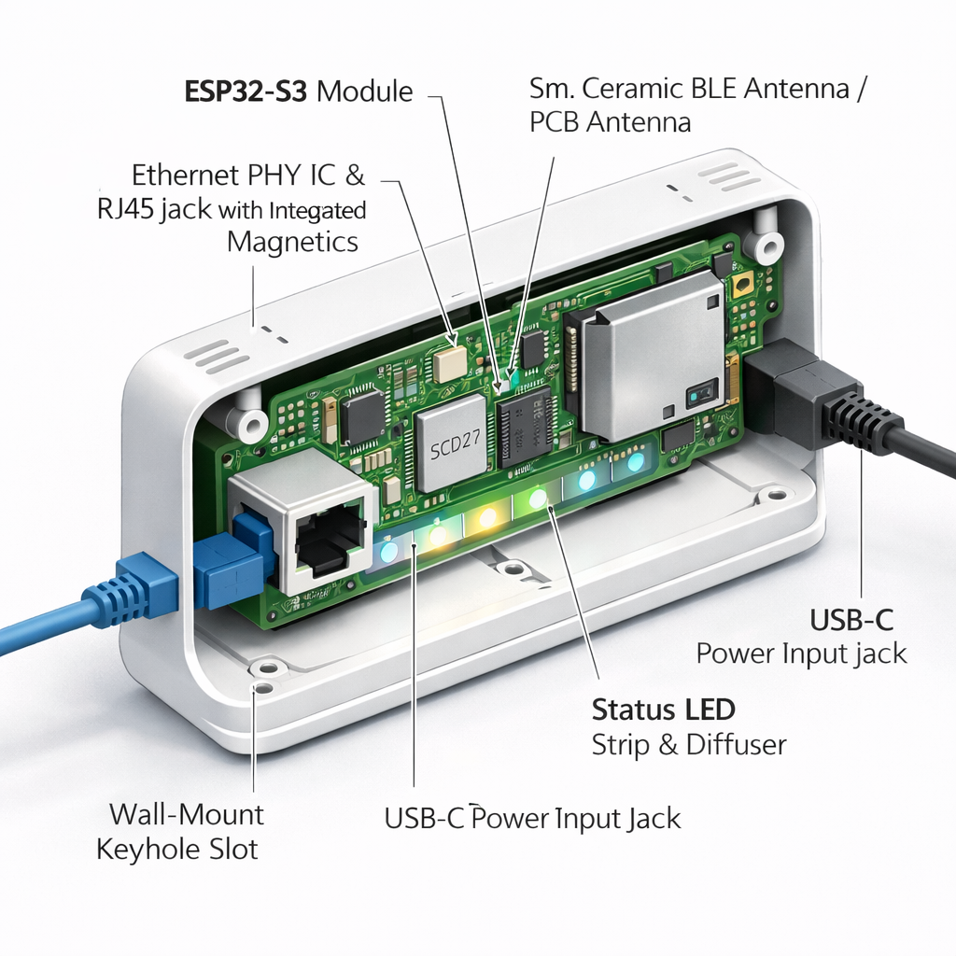
Inside the Hardware
SENSOR NODE (1 per room)
GATEWAY (1 per floor)
MCU
ESP32-S3 (BLE + WiFi + Ethernet MAC)
Uplink
100 Mbps Ethernet, MQTT over TLS
Power
Mains-powered via USB-C, always on
Capacity
Scans up to 50 BLE sensor nodes

Slide 4
Sensor Node — Components & Power
SENSORS
POWER ARCHITECTURE
SCD41 (Sensirion)
$8-12
Source
2x AA lithium (Energizer L91)
CO2 ppm + temp + humidity | +/-40 ppm accuracy
Capacity
3000 mAh, 6V input -> TPS62740 -> 3.3V
SHT40 (Sensirion)
$1-2
Temperature + humidity | +/-0.2C, +/-1.8% RH
Sleep current
~2 uA (MCU + regulator quiescent)
PMSA003I (Plantower)
$7-9
Sense cycle
5s active every 5 min = 99.7% sleeping
PM1.0, PM2.5, PM10 | +/-10 ug/m3
Target life
>12 months (PM sensor is the bottleneck)
FIRMWARE (Zephyr RTOS on nRF52840)
Battery issue
PM sensor @ 25 mA eats 417 uA avg alone
Sensor Mgr
BLE Advertiser
Power Mgr
OTA Mgr
Config Mgr
Read SCD41, SHT40, PMSA003I on schedule. Power-gate PM sensor.
Encode readings into 20-byte extended advertisement payload.
Deep sleep entry/exit, battery ADC monitoring.
BLE DFU via MCUboot. A/B partitioning, rollback on failure.
Sample interval, PM enable/disable. BLE write from gateway.

Slide 5
Constraints & Cost
HARD CONSTRAINTS
SENSOR NODE BOM (1k units)
Battery life
nRF52840 SoC
$4.50
>12 months on 2x AA
Mount and forget. No wiring, no charging.
SCD41 CO2 sensor
$10.00
Node BOM
SHT40 temp/humidity
$1.50
<$35 at 1k units
50-200 nodes per building -- cost must scale.
PMSA003I PM sensor
$8.00
TPS62740 regulator
$1.50
Gateway BOM
<$40 at 1k units
1 per floor. Justifies itself vs. WiFi.
RGB LED + passives
$0.50
PCB (45x45mm, 4-layer)
$1.50
CO2 accuracy
+/-50 ppm + 5%
2x AA battery holder
$0.40
Facility managers make HVAC decisions from this.
2x AA lithium cells
$2.50
Certification
FCC, CE, IC
Enclosure (ABS molded)
$2.50
BLE = intentional radiator. All target markets.
Assembly + test
$2.50
Density
50 nodes per gateway
Total COGS (sensor node)
~$35.90
BLE scanning must handle without packet loss.
Gateway: ESP32-S3 + Ethernet PHY + PSU + enclosure
~$35
Cloud hosting: <$0.50/node/month

Slide 6
Hardest Problems & Component Tradeoffs
THREE HARDEST PROBLEMS
COMPONENT TRADEOFFS
1
PM sensor vs. battery life
nRF52840
Performance
The PMSA003I draws 25 mA during sampling -- 50x more than everything else combined. At 5 min intervals, it alone exceeds the entire power budget. Options: reduce PM sampling to 30-60 min, make PM a removable module, or accept shorter battery.
Best BLE sleep ($4.50) vs. ESP32-C3 ($1.50, worse sleep). 12-month battery forces the premium.
SCD41 CO2
Performance
Only photoacoustic CO2 at this size + accuracy. $10 dominates BOM. No alternative meets spec.
2
BLE range in concrete offices
BLE advertising reach drops to 5-10m through concrete walls. 1 gateway per floor assumes 15m line-of-sight. Dense offices may need 2-3 gateways per floor, increasing cost.
PMSA003I PM
Cost vs. power
Adds $8 + destroys battery budget. Removable module (two SKUs) lets the customer decide.
OTA over BLE to sleeping nodes
TPS62740
Power efficiency
3
360 nA quiescent ($1.50) vs. LDO ($0.30, wastes months of battery in quiescent alone).
Firmware updates via cloud -> gateway -> BLE DFU to a node that sleeps 99% of the time. Must coordinate wake windows, handle interrupted transfers, and never brick deployed devices.
ESP32-S3 (GW)
Cost
Cheapest BLE+Ethernet path ($3-4). Mains-powered -- no power tension at all.
The PM sensor is the central tension: it differentiates the product but threatens the battery target. Two-SKU model is the likely resolution.

Slide 7
Key Technical Decisions
1
BLE + Gateway vs. WiFi Direct
CHOSEN: BLE + GATEWAY
WiFi draws 100-300 mA during Tx vs. 8 mA for BLE advertising. WiFi would drain AAs in weeks. The gateway adds $35-40 per floor but enables >12 month battery life per sensor node.
Consequences:
Adds a second hardware product (gateway). BLE range limits placement to ~15m LOS. 1 gateway per ~500 m2.
2
AA Batteries vs. Rechargeable LiPo
CHOSEN: 2x AA LITHIUM
Facility staff can swap AAs in seconds with no tools. Rechargeable adds USB-C, charge IC, and 'another thing to charge' -- doesn't fit mount-and-forget deployment.
Consequences:
Non-rechargeable: ~$6/year per node in batteries. 200-node building = $1,200/year. Rechargeable V2 SKU possible if this becomes a concern.
3
Cloud-Only vs. Edge Analytics
CHOSEN: CLOUD-ONLY (V1)
Sensor nodes sleep 99%. Gateway could do edge analytics, but adds FW complexity for marginal latency gain -- dashboard refreshes every 30s anyway. Cloud processing keeps FW simple and allows algorithm updates without OTA.
Consequences:
Requires reliable Ethernet. Alert latency is cloud-round-trip (~1-5s). Acceptable for HVAC decisions (minutes-scale).

Slide 8
Open Questions & Risks
#
Question / Risk
Impact
Target
1
PM sensor power budget exceeds target -- reduce sample rate, make removable module, or accept shorter battery?
H
M2
2
BLE range in concrete offices -- need field testing in 3+ real buildings
M
M3
3
SCD41 warm-up: does 5s window maintain +/-50 ppm? If 15s needed, CO2 power 3x.
H
M2
4
OTA reliability over BLE DFU to sleeping nodes -- retry strategy needed
M
M3
5
SCD41 sole source risk -- Sensirion only, 12-26 week lead times historically
H
M1
6
Gateway density: 1/floor vs. 1/zone. Need field testing.
M
M4
7
Battery replacement economics: $1,200/yr for 200-node building. Acceptable?
L
M6
Items #1 and #3 are the highest-priority: both threaten the 12-month battery target, which is the product's core promise.

