Slide 1










Microsoft Entra Verified ID
Verifier endpoint
Get access token
Helpdesk app
App registration
Start
Update cache
Presentation request
Check status and update UI
Request Service API
Status endpoint
Read cache
Callback endpoint
Update cache
Notifications

Slide 2




Azure Blob
Cache (user state)
Helpdesk app
Azure APIM
Logic App
/verify
/Status
/Callback
/Verify
/Status
/Callback
User interface
JavaScript
Microsoft Entra
Verified ID

Slide 3
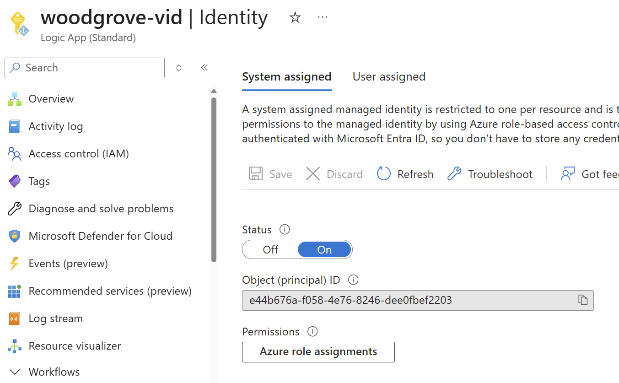
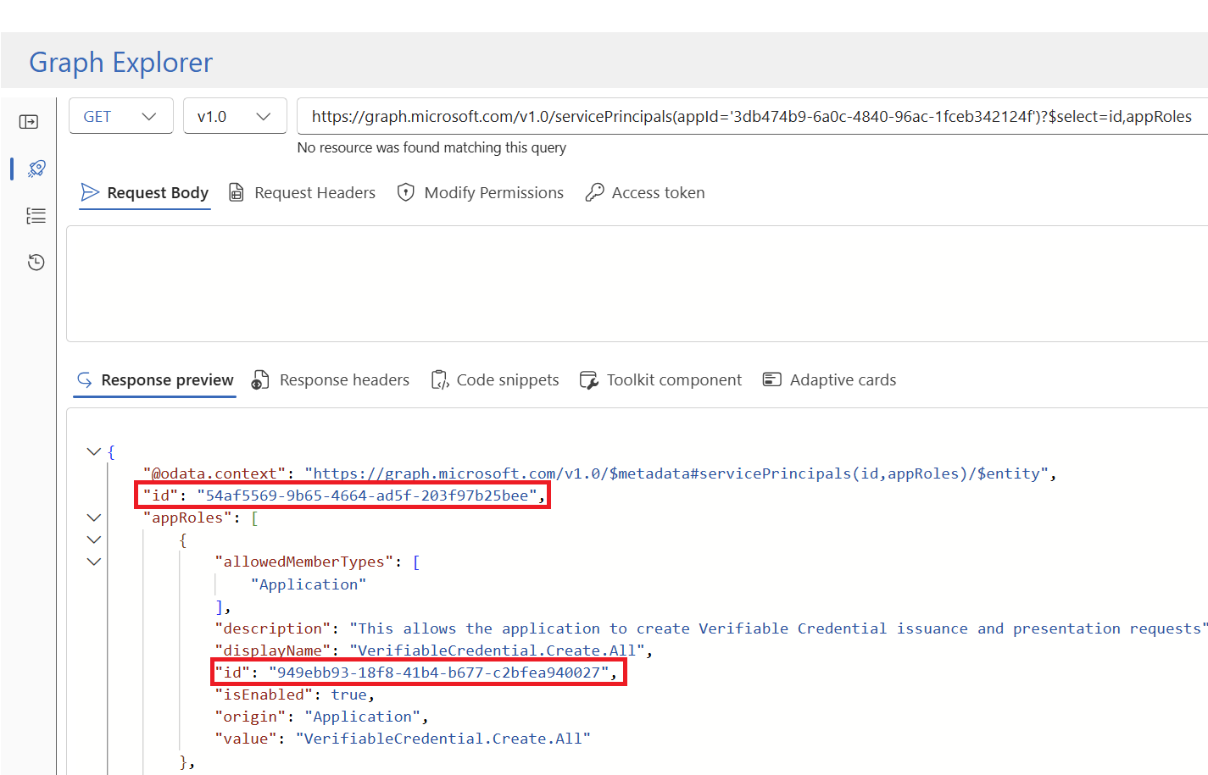
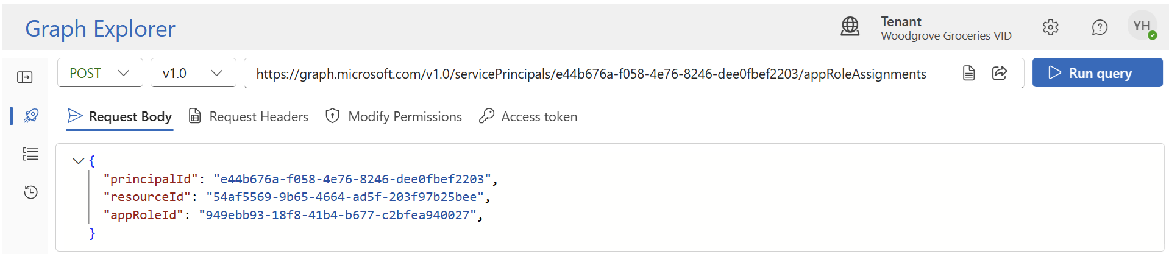

Slide 4
Azure Blob table
Cache (user state)
Azure Logic App
Azure API management
Helpdesk app
/verify
/Status
/Callback
/verify
/Status
/Callback
User interface
JavaScript
Microsoft Entra ID
Verified ID

Slide 5








Helpdesk app
Verifier endpoint
Status endpoint
Callback endpoint
Start
Update cache
Return cheche object
Update cache
Check status and update UI
Acquire access token (client credentials)
Start presentation request
Notifications
Application registration
Verified ID Request Service API

