Slide 1
Distributional Reinforcement Learning Prior + One-shot Learning

Slide 2
EXP design:
Tested participants’ (N=30):
Prior of a frequency distribution
Whether they can extract a frequency distribution [1,1,4,6] from 1-2 brief visual exposures in a generation task.
Participants estimated the frequency distribution of 4 visual items across 12 positions [1,1,4,6] using a generation task.
Primary DV: Sum of Absolute Deviations (SAD) from the true distribution.
PRIOR · no feedback
LEARNING · array exposure + feedback
Blind Prior
Icon Prior
Trial 1
Trial 2
1
2
3
4
Provide prior distribution counts for 4 items.
No additional information shown.
Provide prior counts for 4 items.
Item shapes visible — no sample of the distribution shown.
Array exposure → generation.
Feedback: Sum-Average SAD.
Array exposure → generation.
Feedback: SAD.
Following EXP’ participants completed a questionnaire about their strategies and understating of the task

Slide 3
Research Questions
Prior
What distribution do participants assign before seeing any visual information?
Does seeing the item shapes change the prior distribution?
Is the blind prior more uniform than expected by chance?
Is the proportion of Uniform-classified participants higher than expected under the null?
What distributional shapes do participants' priors take?
Are the observed classification proportions different from chance? a. Per-category: is each category's proportion surprising? b. Combined: is the two-type dominance (Uniform + Unimodal-mild) surprising?
Does the first exposure improve estimates relative to the uninformed blind prior? (Blind vs T1)
Learning
Does the first exposure shift estimates relative to the icon prior?
Is any observed change in the direction of the true distribution?
Does a second exposure with feedback improve estimates beyond T1?
What is the overall learning from blind to final estimate? (Blind vs T2)
Does the two-exposure sequence improve estimates relative to the icon prior? (Icon vs T2)
Is there a monotonic trend across all four phases? (Page's L)

Slide 4
Prior
# | Question | Test | Fig | Metric | Sig | Effect | Answer | Slide
P1 | What distribution do participants assign before seeing any visual information? | Descriptive | 1 table, 2.1-2.2 | SAD M=9.0 (SD=2.8), Mode=8 |  |  | On average it's uniform | #7 left
P2 | Is the blind prior more uniform than expected by chance? | Multinomial sim (100k, two-tailed) | 2.9 | Obs SAD=2.73 vs null=4.65 | p<.001 |  | Significantly more uniform than chance | #7
P3 | Is Uniform proportion by chance? | Monte Carlo sim (100k, two-tailed) | 9.4 | 63% obs vs 29.5% null | p<.001 | h=0.69 (M-L) | Uniform rate far exceeds chance | #9
P4 | What distributional shapes do participants' priors take? | Shape classification (5 refs) | 2.3, 9.4 | 63% Uni (n=19), 33% UniMild (n=10), 3% Bimodal (n=1) |  |  | Two dominant types; 97% Uni+UniMild | #9
P5 | Is the two-type dominance (Uniform + Unimodal-mild) surprising? | Monte Carlo top-2 | 9.4 | 97% vs 91.1% null | p=.363 n.s. |  | NOT significant against null | #9
P6 | Is each category's observed proportion surprising? (Unimodal-mild) | Monte Carlo per-category | 9.4 | 33% obs vs 61.7% null | p=.002 | h=-0.58 (M-L) | Fewer UniMild; Uniform excess at its expense | #9

Slide 5
Prior (icon type)
# | Question | Test | Fig | Metric | Sig | Effect | Answer | Slide
P7 | Does seeing the item shapes change the prior distribution? | Descriptive | 1, 2.4 | SAD M=7.9 (SD=2.4) |  |  | Slightly lower SAD than blind, near uniform | #10
P2a | Is the icon prior also more uniform than expected by chance? | Multinomial sim (100k, two-tailed) | 2.9 | Icon SAD=3.20 vs null=4.65 | p=.0002 |  | Icon prior also significantly more uniform than chance | #10
P2b | Is the blind-to-icon reduction significant? | Paired perm + Wilcoxon | 2.4, 2.5 | diff=1.13, W=17.5 | p=.040 | d=0.201 (small) | Seeing shapes significantly reduces SAD; 10 improved, 4 worsened, 16 no change | #10
P2c | Does first exposure improve over uninformed blind prior? (Blind vs T1) | Paired perm (two-sided) | 3.1 | Fill from v25 | Fill | Fill Cliff's d | Fill | #11

Slide 6
Learning
# | Question | Test | Fig | Metric | Sig | Effect | Answer | Slide
L1 | Does the first exposure shift estimates relative to the icon prior? | Paired perm (one-tailed) | 3.1 | diff=-0.20 (T1 slightly worse) | p=.696 n.s. | d=-0.097 (negl.) | No significant change from exposure | #11
L2 | Is any observed change in the direction of [1,1,4,6]? | Direction counts | 3.4 | 9 improved, 12 worsened |  |  | Roughly equal; no improvement signal | #11
L3 | Does a second exposure with feedback improve estimates beyond T1? | Paired perm (one-tailed) | 3.1 | diff=-0.40 (T2 worse) | p=.791 n.s. | d=-0.073 (negl.) | No significant change; 10 improved, 13 worsened, 7 no change | #12
S1 | What is the overall learning from blind to final estimate? | Paired perm + Cliff's d | 3.2 | diff=0.53 | p=.275 n.s. | d=0.043 (negl.) | No significant overall learning; 9 improved, 11 worsened, 10 no change | #12
S2 | Monotonic trend? | Page's L (two-tailed) | 3.1 | Z=-3.79 (SAD increasing) | p<.001 |  | Significant trend in WRONG direction (worsening); likely regression from low blind prior | #12
S3 | Does two-exposure sequence improve over icon prior? (Icon vs T2) | Paired perm + Cliff's d | 3.2b | Fill from v25 | Fill |  | Fill | #12

Slide 7
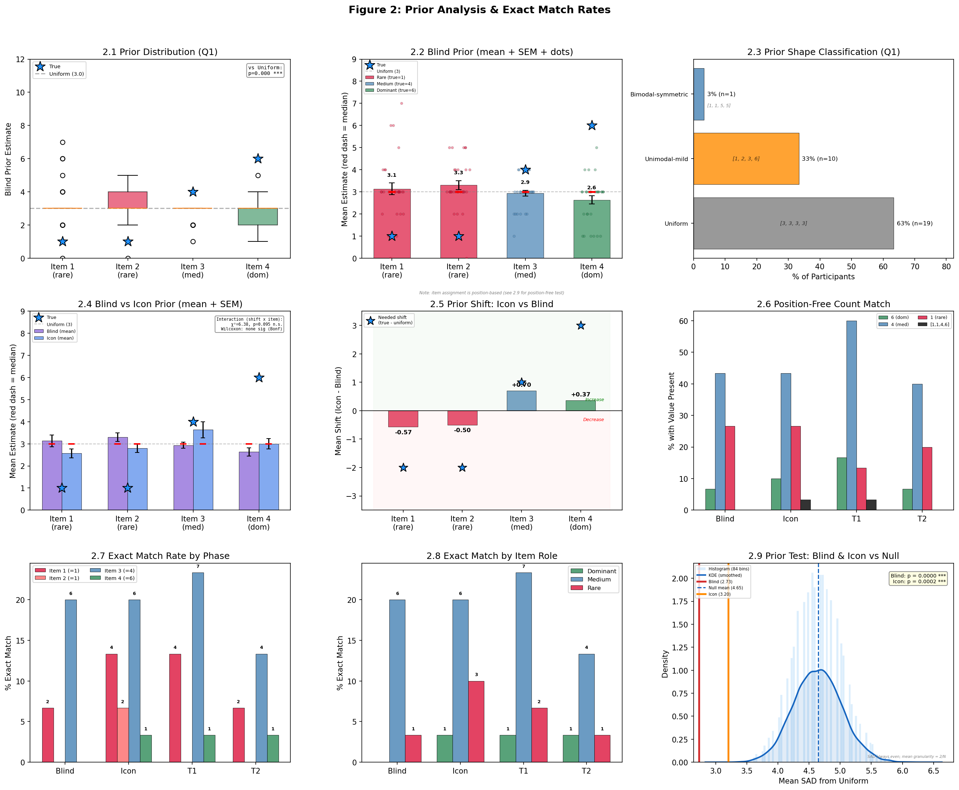
Prior (P1-P2)
Blind prior estimates cluster near uniform [3,3,3,3].
Mean SAD from uniform = 2.73 (SD=2.8). Mode = 8 (= uniform SAD).
Multinomial simulation (100k, two-tailed):
Prior - Observed mean SAD (2.73) significantly lower than null (4.65), p < .001.
Fig 2.2
Fig 2.9
Also for Prior (icon) Observed mean SAD (3.2) significantly lower than null, p < .001
Q: Item assignment in blind phase (panels 2.2, 2.4, 2.7, 2.8): Items are position-mapped. gen_est_item4 records the count typed into the position where the dominant shape will later appear. In the blind phase (gray squares), this is a chance baseline.

Slide 8
Prior (P1-P2)
Before ☹
Multinomial simulation (100k, two-tailed):
Prior - Observed mean SAD (2.73) significantly lower than null (4.65), p < .001.
Fig 2.2
Fig 2.9
Also for Prior (icon) Observed mean SAD (3.2) significantly lower than null, p < .001
Q: Item assignment in blind phase (panels 2.2, 2.4, 2.7, 2.8): Items are position-mapped. gen_est_item4 records the count typed into the position where the dominant shape will later appear. In the blind phase (gray squares), this is a chance baseline.

Slide 9
Prior: Classification Method
Reference | Sorted Vector | Character
Uniform | [3,3,3,3] | Flat, no differentiation
Unimodal-mild | [1,2,3,6] | One moderate peak
Unimodal-extreme | [0,1,2,9] | One strong peak
Bimodal-symmetric | [1,1,5,5] | Two equal peaks
J-shaped (True) | [1,1,4,6] | Matches true distribution
Each participant's blind response is sorted ascending.
The sorted vector is compared via SAD to 5 reference distributions.
Classified as the reference with minimum SAD.
Ties broken by chi-square distance.
'Uniform' means no meaningful differentiation (includes [2,3,3,4], [2,2,4,4], [3,3,3,3]), not literally equal counts.

Slide 10
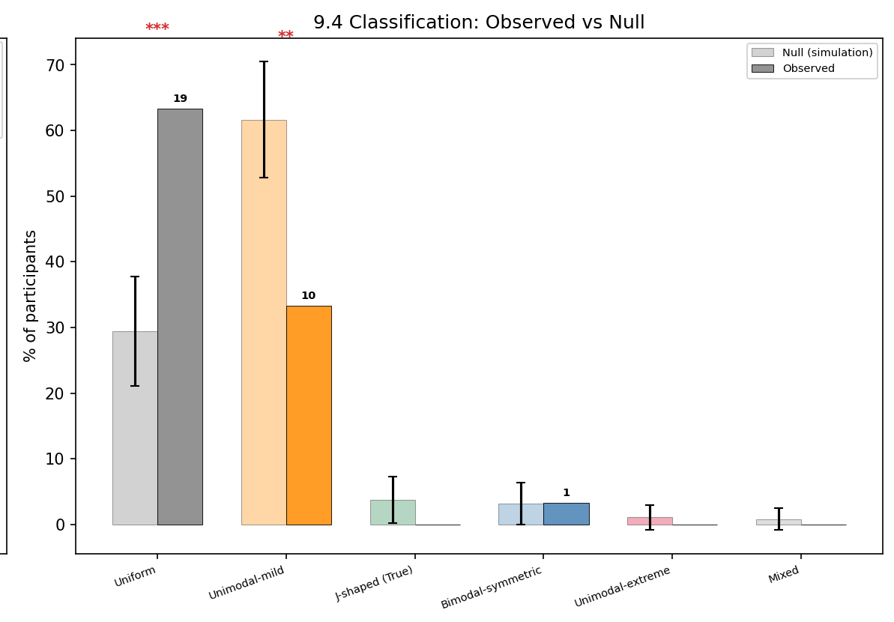
Prior: Classification Results (P3-P6)
63% (n=19) Uniform, 33% (n=10) Unimodal-mild, 3% (n=1) Bimodal.
Only 2 of 5 possible prior types observed.
Monte Carlo significance (100k, same classifier):
Uniform: 63% vs 29.5% null, p<.001, h=0.69. ), indicating that participants' tendency toward equi-distribution is not an artifact of multinomial sampling noise.
Unimodal-mild: 33% vs 61.7% null, p=.002, h=-0.58.
Combined: 97% vs 91.1%, p=.363 n.s.
Fig 2.3
Fig 9.4

Slide 11
Icon Prior (P7, P2a, P2b)
Icon prior SAD (M=7.9) lower than blind (M=9.0).
Icon also more uniform than chance (SAD=3.20 vs null=4.65, p=.0002).
Blind-to-Icon reduction significant: diff=1.13, p=.040, d=0.201 (small).
Blind to T1 (combined effect): Fill diff, Fill p, Fill Cliff's d from v25.
Fig 2.4 / 2.5

Slide 12
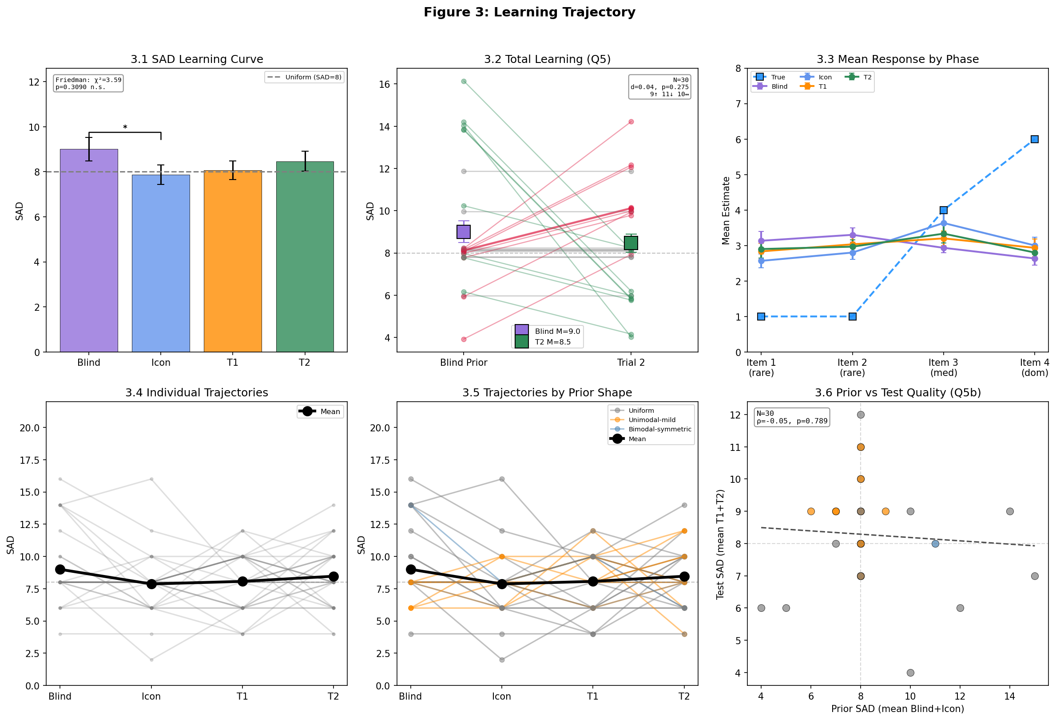
Learning: First Exposure (L1-L2)
First exposure (Icon to T1) produced no significant change.
SAD diff=-0.20, p=.696, d=-0.097 (negligible).
Direction: 9 improved, 12 worsened.
Fig 3.1

Slide 13
Learning: T1-T2 and Overall (L3, S1, S2)
T1 to T2: diff=-0.40, p=.791, d=-0.073 (n.s.).
Overall Blind to T2: diff=0.53, p=.275, d=0.04 (negligible).
Direction: 9 improved, 11 worsened, 10 no change.
Icon to T2 (exposure learning): Fill diff, Fill p, Fill Cliff's d from v25.
Page's trend (two-tailed): Z=-3.79, p<.001.
Significant but in WRONG direction (SAD increasing).
Likely regression from low blind prior.
Fig 3.2 / 3.2b
Fig 3.4

Slide 14
Summary
Finding | Statistic | Conclusion
Blind prior is uniform | SAD obs=2.73 vs null=4.65, p<.001 | Strong uniform prior, not chance artifact
63% classified Uniform | 63% vs 29.5% null, p<.001, h=0.69 | Active equi-distribution tendency
Unimodal-mild deficit | 33% vs 61.7% null, p=.002, h=-0.58 | Uniform excess at expense of unimodal-mild
Icon prior also uniform | Icon SAD=3.20 vs null=4.65, p=.0002 | Still uniform after seeing shapes
Blind vs Icon significant | diff=1.13, p=.040, d=0.201 (small) | Seeing shapes slightly reduces SAD
No significant learning | Blind-to-T2: p=.275, d=0.04 (negl.) | Two exposures + SAD feedback insufficient at N=30
Significant worsening trend | Page Z=-3.79, p<.001 (SAD increasing) | Likely regression from low blind prior
Icon to T2 (exposure learning) | Fill from v25 | Fill

