Slide 1

Geopandas

Slide 2
Geospatial Data Visualization
About GeoPandas
Example

Slide 3
Geospatial Data Visualization
Visualizing information on a map
Communicate complex patterns, relationships and tends
Types of geospatial data:
Vector data
Raster data
Techniques
Mapping
GIS Software
Web mapping (GeoPandas)
Applications:
Environmental monitoring
Urban planning
Disaster response
Public health
Challenges
Data quality
Big data
Interpretation

Slide 4
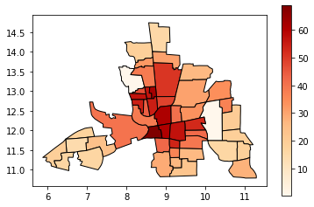
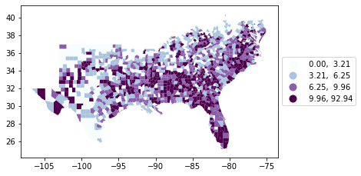
Examples

Slide 5
Data types
Point (Lat/Long)
Line String
Polygon
Multipoint
Multiline string
Geometry collection

Slide 6
GEOPANDAS
Open source project
Core components
GeoSeries
GeoDataFrame
Geometry Types
Key features
Spatial Operations
Plotting
File IO

