Slide 1
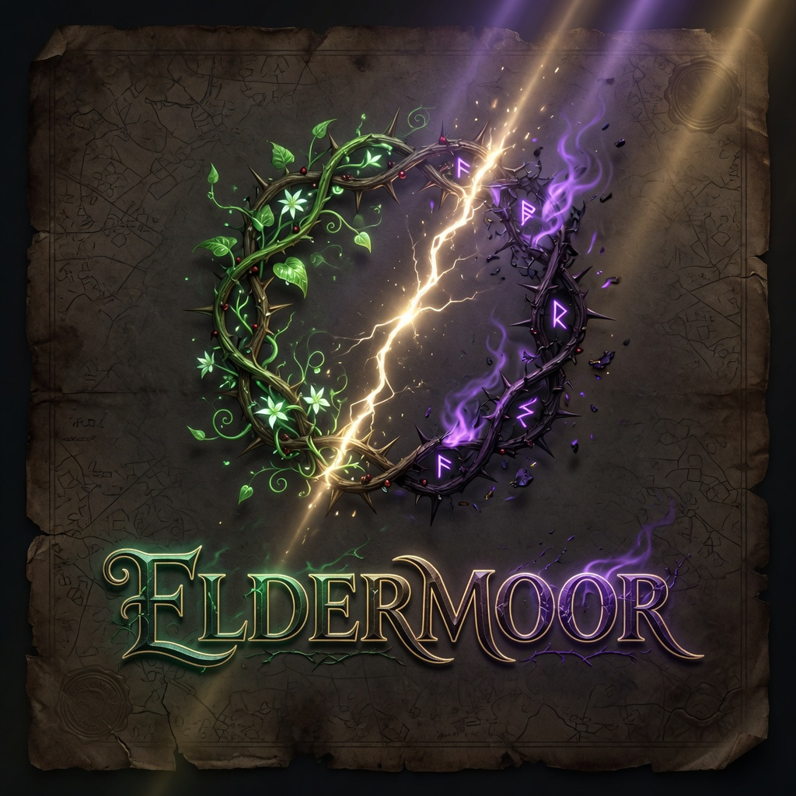
ELDERMOOR
The wilderness does not grade you.
Open-world survival · Beast economy · Vita / Mortis · Co-op · War on the High Council
Concept pitch v0.2 · Original IP

Slide 2
The gap
Palworld proved what happens when a giant IP ignores adult fans.
Wizard fantasy has the same hole — still unfilled.
What fans want
What they got
What we ship
Creatures as systems
Own base / academy
Real multiplayer
Free experimental magic
Agency, not school rails
Strong SP story tour
Beasts as side content
Little co-op fantasy
Fenced dark paths
Institutional caution
Beast labor economy
Camp → private academy
Co-op from day one
Vita vs Mortis identity
Council as endgame war
ELDERMOOR · CONFIDENTIAL CONCEPT
2 / 10

Slide 3
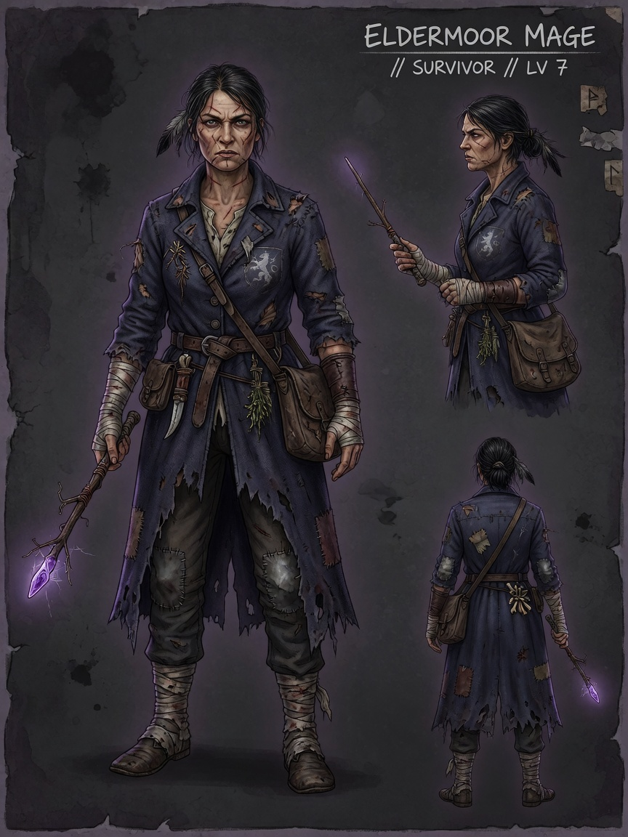
The game
You wake discarded in the unsealed Wild Arcana with a weak wand and broken memories. Bind original beasts as workers and weapons. Build an enclave. Choose Life or Death magic. When your power cannot be ignored, the High Council marches.
01
Beasts first
02
Your enclave
03
Vita / Mortis
04
Native multiplayer
05
Nobody → threat
ELDERMOOR · CONFIDENTIAL CONCEPT
3 / 10

Slide 4
Core loop
Proven Palworld / Ark skeleton — wizard systems on top.
1
2
3
4
5
Base
Prepare
Expedition
Capture
Process
Reassign beasts
Check production
Repair defenses
Potions & gear
Capture tools
Path rites
Biome routes
Farm & scout
Read the wilds
Soften
Opportunity window
Method commit
Craft & upgrade
Integrate beasts
Raise Heat
ELDERMOOR · CONFIDENTIAL CONCEPT
4 / 10

Slide 5
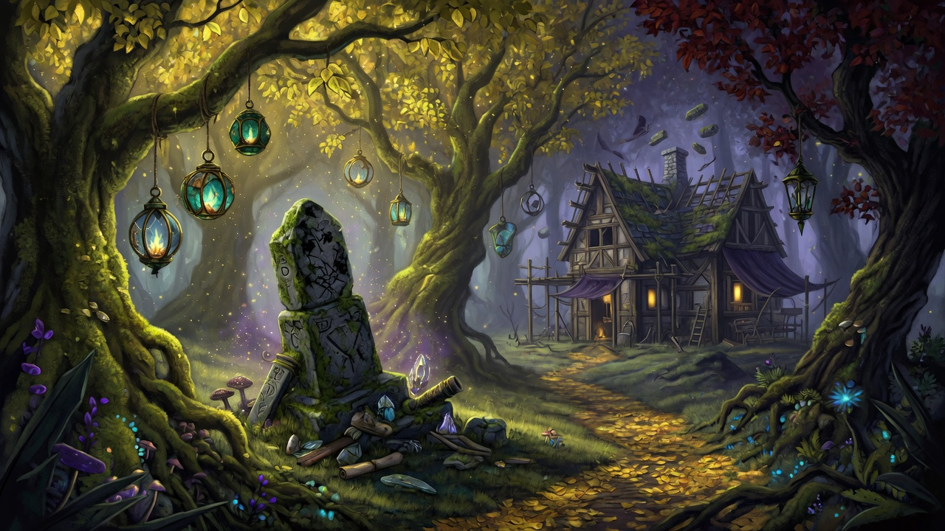
Capture is skill
Not “HP low → ball.” Soften → opportunity window → commit method.
Snare circle
Bait offering
Placement & kite
Species knowledge
Bonding focus
Pact ritual
Channel under fire
Setup / co-op
Dominance brand
Sever-bind
Mortis control
High-risk last second
ELDERMOOR · CONFIDENTIAL CONCEPT
5 / 10

Slide 6
Vita / Mortis
A real identity fork — rewrites beasts, base, economy, heat, and endings.
VITA — Life
MORTIS — Death
Pacts, healing, reclamation
Loyal partners, breeding quality
Stable compound growth
Lower heat, sanctuary fantasy
Brands, sacrifice, corruption
Thralls, mutations, spikes
Aggressive shortcuts
Higher heat, siege fantasy
ELDERMOOR · CONFIDENTIAL CONCEPT
6 / 10

Slide 7
Story spine
1
2
3
Discarded
Enclave
Fork
Wake with fragments. Nobody.
Beasts + base. Optional memories.
Vita or Mortis commitment.
4
5
6
Heat
War
Aftermath
Watchers → Inquisitors.
Armies. Academies. Council.
Destroy / rule / reform / unseal.
ELDERMOOR · CONFIDENTIAL CONCEPT
7 / 10

Slide 8
Vertical slice — First Sealbreak
IN SCOPE
OUT
Thornwake Glade + Blackvein Mire
12 catchable beasts (roster locked)
Multi-method capture + opportunity window
Base: shelter, 3 stations, pen, defenses
Path fork ritual (Vita / Mortis)
Co-op 1–4 on shared base
Ashcrown elite encounter
Full Council war
Breeding / 100+ dex
Megaserver politics
Romance systems
Live-ops battle pass
ELDERMOOR · CONFIDENTIAL CONCEPT
8 / 10

Slide 9
Positioning
Axis | Legacy-likes | Palworld-likes | Eldermoor
Creature core | Light | Yes | Yes + magic methods
Base automation | No | Yes | Yes (path-themed)
Multiplayer | No / weak | Yes | Yes day-1
Identity path | Limited | Tech/guns | Vita / Mortis
Endgame war | Story boss | Light | Institutions
IP risk | Licensed | Original | Original
ELDERMOOR · CONFIDENTIAL CONCEPT
9 / 10

Slide 10
Next / ask
Greenlight a vertical slice that proves one sentence:
“I assigned a beast to work, caught something harder, and want one more expedition.”
01
02
03
04
05
Engine + greybox loop
Capture window prototype
12-beast blockout
4p co-op soak test
Steam page from slice only
Package: C:\Users\fabia\mages · Original IP · PC Early Access intent
ELDERMOOR · CONFIDENTIAL CONCEPT
10 / 10

