Slide 1
Assignment 3: Predicting Future Outcomes for Turtle Games
Youko Fujino

Slide 2
Scenario
BUSINESS CONTEXT
Turtle Games, a global game manufacturer and retailer, has hired your data team to analyse customer trends.
DATA SOURCE
Turtle Games collected data from sales and customer reviews.
We used Python and R to explore the Turtle Games dataset and generate visualisations and insights.
WHY ARE WE INVESTIGATING IT?
Better map TG customer profile, improve the efficiency of their loyalty programme, and, ultimately, uplift TG sales.

Slide 3
Questions
Identify our customer profile to target market campaigns better
Cluster consumers in groups considering their remuneration and spending score patterns
How Loyalty Points are impacted by Remuneration, Spending Score and Age
Through Text Analytics, give insights about consumers' perceptions of Turtle Games products
5) Predict the accumulation of loyalty using an MLR model
Provide overall insights and recommendations

Slide 4

Who is Turtle Games customer?
Avg age of 39 years old
- 1/4 of customers below 29-year-olds, while the majority fall between 29 and 49 years old
Avg remuneration of £48k/year
Considerable variance in remuneration (sd: £23.1k)
Avg loyalty points of 1580
Considerable variance in loyalty_points (sd: 1283pts)
Spending score of 50 (out of 100)
Distribution with a normal pattern, with a mean of 50.0 and a standard deviation of 26.1. indicating moderate variability in spending behaviour
56% Female and 44% Male
Highly educated consumers
1) Graduate, 2)PHD, 3) Postgraduate

Slide 5
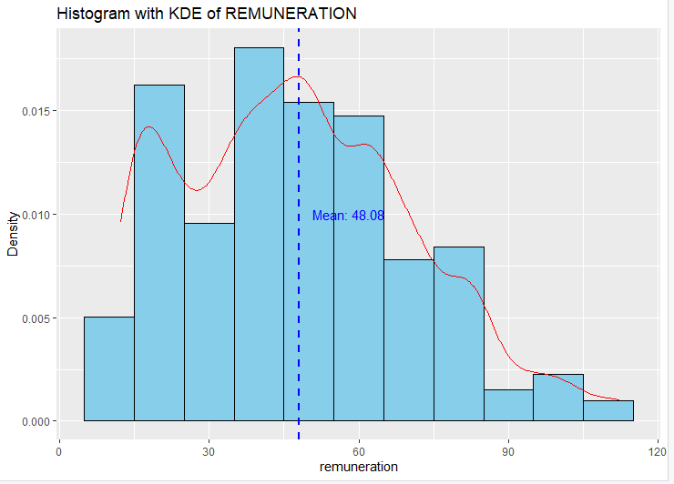

How remuneration is distributed among Turtle Game Consumers?
- Avg Remuneration of £48.1k/year
Concentration between £15k -$60k
Distribution falls after £60k
Shapiro Test: Remuneration not follow a Normal Distribution
Slight left skewness (-0.04) : a minor asymmetry towards the lower values.
Kurtosis (2.1): moderate degree of peakedness and heavier tails

Slide 6
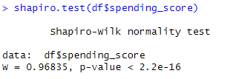
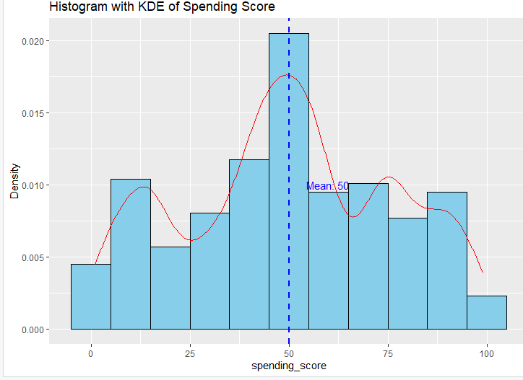
How spending_scores are distributed among Turtle Game Consumers?
Avg: 50 (out of 100)
The spending score exhibits a reasonably symmetrical distribution, centred around an average of 50.0. A prominent peak around the 50 range resembles a bell-shaped curve indicative of a normal distribution.
Shapiro Test: Loyalty points not follow a Normal Distribution
The spending_score data has a slightly left-skewed distribution with a moderate degree of peakedness and heavier tails, but less pronounced than in a leptokurtic distribution. Despite a slight deviation from normality, the distribution is relatively close with minor deviations.

Slide 7
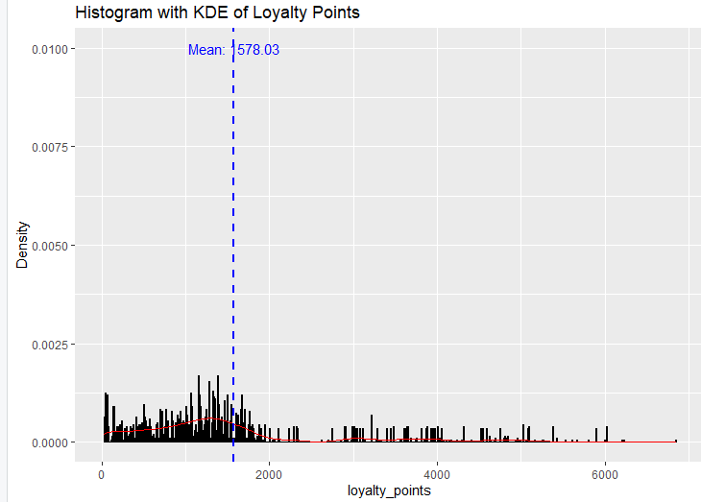

How loyalty points are distributed among Turtle Game Consumers?
Avg Loyalty Points: 1578
Most consumers ranging between 1k and 2k, with outliers starting to appear with loyalty points superior to 3k.
Shapiro Test: Loyalty points not follow a Normal Distribution
Strong right skewness (1.46): distribution is stretched towards the higher values.
Hight Kurtosis (4.71): high degree of peakedness and heavy tails, meaning there are more extreme values (outliers) than a normal distribution.

Slide 8
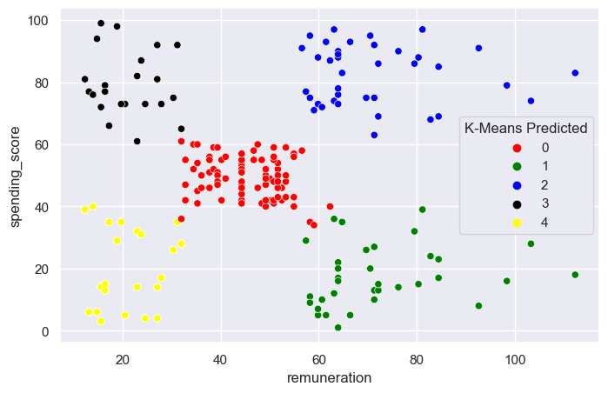
Prioritise high-spending consumers but push incentives for the ‘potential’ cluster
Potential: (Green) – High income but low spending score
Average (Red) – Avg remuneration and avg spending score
VIP (Blue)– High-income and high spending
Irresponsible (Black) – Low income but high spending score
Irrelevant (Yellow) – low income and low spending score

Slide 9
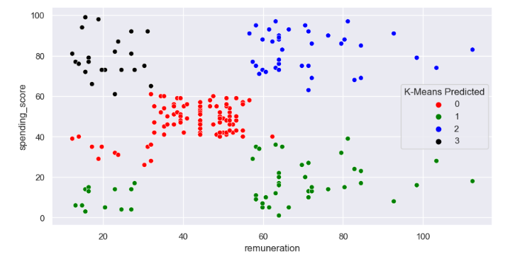
K=4
K=5

Slide 10
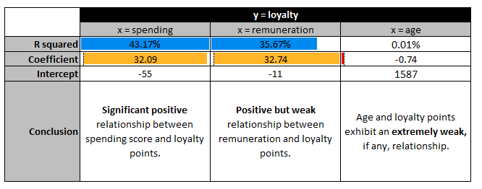
How Loyalty Points are impacted by: Remuneration, Spending Score and Age
Linear Regression Results
= avg loyalty points

Slide 11

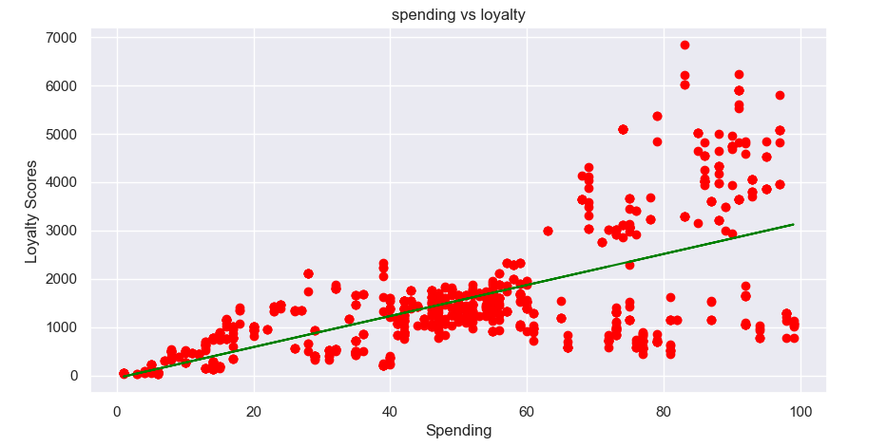
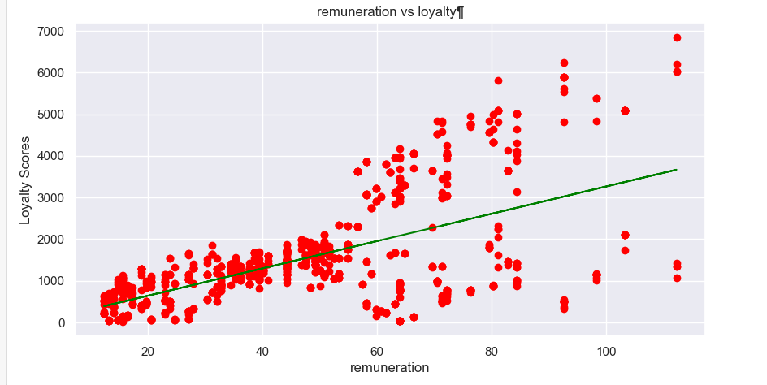
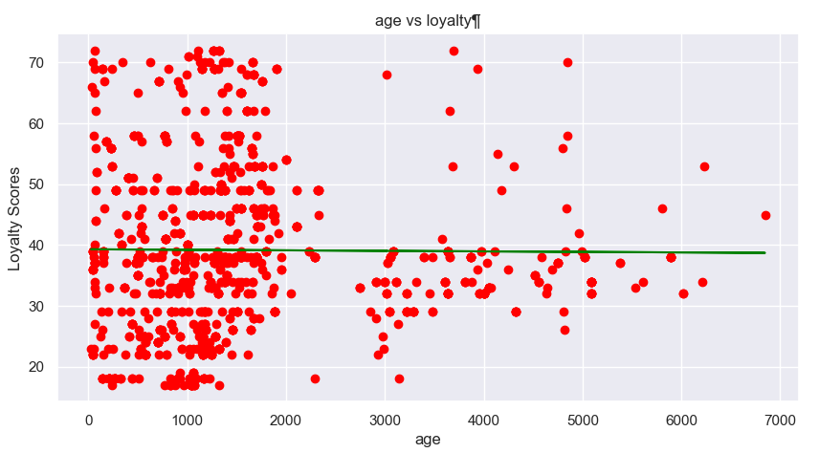
How Loyalty Points are impacted by: Remuneration, Spending Score and Age
Spending vs Lotalty
Remuneration vs Loyalty
Age vs Loyalty

Slide 12
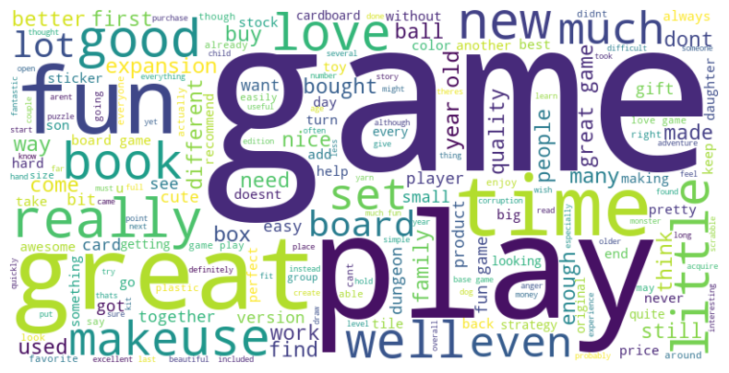
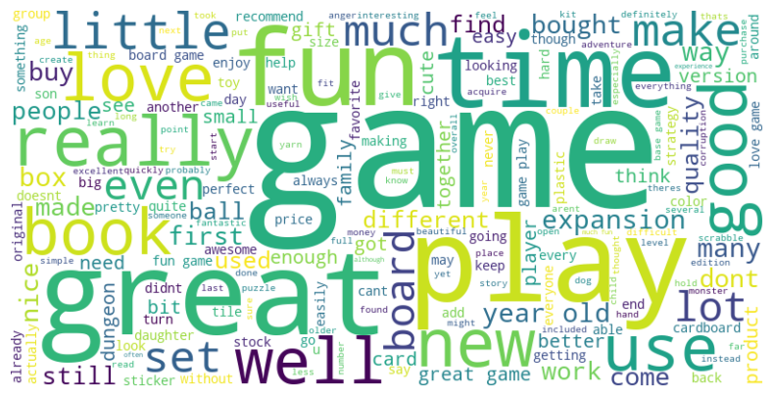
What do consumers say about Turtle Games?
Consumer Reviews
Consumer Summaries

Slide 13
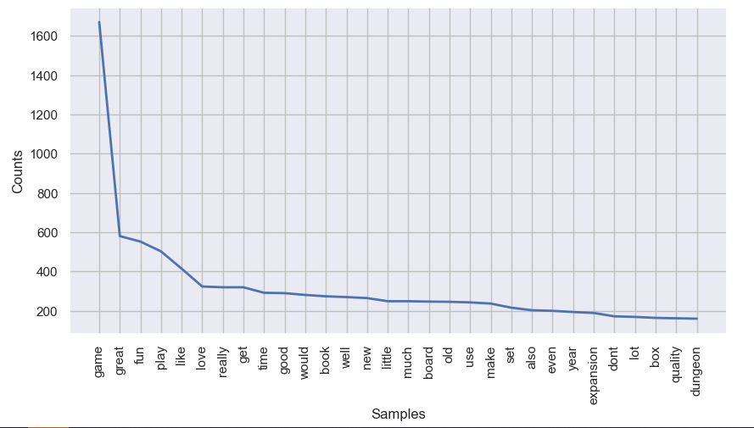
Game, Great and Fun are the most common words in the reviews!
Words Count | Turtle Game Reviews

Slide 14
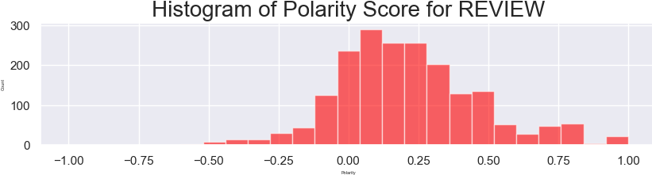
Consumers have an overall positive feeling about Turtle Games
The polarity histograms of reviews and summaries show a right-tailed distribution, indicating an overall positive sentiment among reviews.

Slide 15
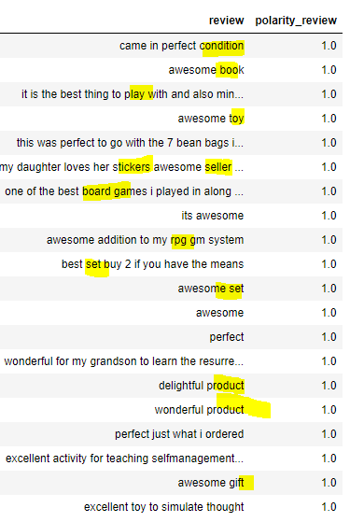
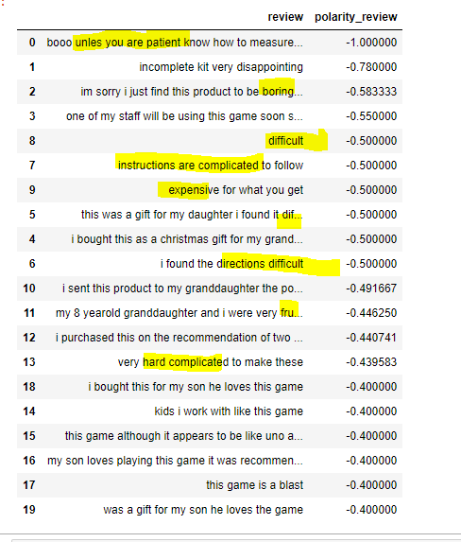
5. Top positive and top negative comments
Top Positive Reviews
Top Negative Reviews
Difficult
Complicated
Frustrating
Hard
Expensive
Condition
Set
Product
Toy

Slide 16
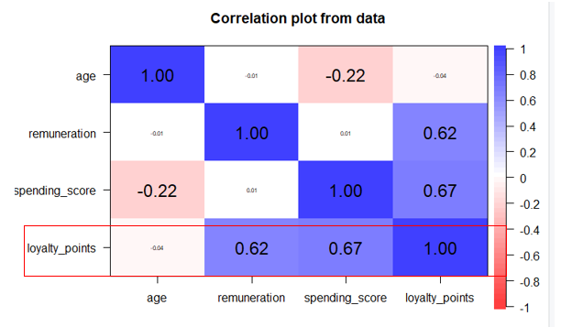
Choosing the right variable to predict loyalty
Remuneration: moderate positive correlation with loyalty points, but weak with spending_score.
Consumers with higher remuneration tend to have higher loyalty points but not necessarily higher spending score.
Spending_score: moderate positive correlation with loyalty_points (0.672)
Age: very weakly negatively correlated with loyalty and moderately weakly with spending score.

Slide 17
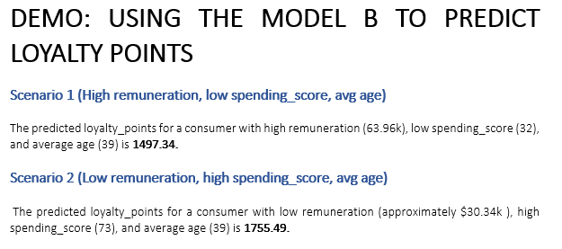
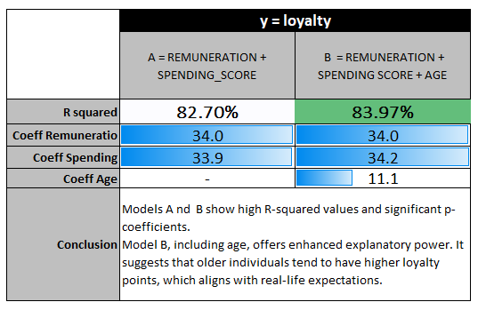
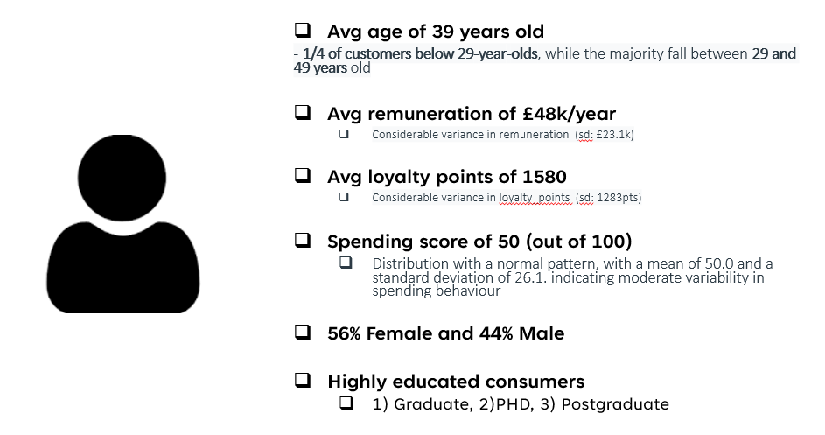
Building the best MLR model to predict loyalty
MODEL A = REMUNERATION + SPENDING_SCORE
MODEL B = REMUNERATION + SPENDING SCORE + AGE
Potential
Irresponsible

Slide 18
Insights & Recommendations
Redesign the
Loyalty Programme
Personalise Rewards: Customize rewards based on individual characteristics like remuneration and spending score, aligning incentives with the average remuneration of $48.1k per year and the demographic of the consumers
Prioritise high-spending consumers but push targeted incentives for the ‘potential’ cluster (high remuneration, but low spending). These can go from targeted adds to special discounts for bigger purchases.
Gamification: Incorporate gamification elements into the loyalty program to increase engagement and retention. Develop challenges, badges, and rewards systems that motivate customers to interact with the program actively
Segment to Communicate: Segment the loyalty programme based on consumer demographics, such as education level and spending habits, to create targeted loyalty programs and communications.
When building a national campaign, consider the overall profile of TG consumers: female (56%), relatively young (mode of 38), educated, average remuneration of £48k/year, average spending score of 50(out of 100). Then, apply the MLR model to predict the expected loyalty points in each customer cluster within the expected sales and, therefore, expected spending_scores.
Partnerships and Alliances: Collaborating with other businesses is crucial to enhance the value proposition of the loyalty program. By partnering with brands that align with the preferences and lifestyles of TG consumers, we can significantly boost our program's appeal and reach.
Listen to the consumers: Overall, consumers show a positive sentiment towards TG, with conditions, set and the product mentioned in top positive reviews. However, there are complaints about the games' difficulty, complexity and instructions.
Segment to Communicate
Make UX Simple!
(Reviews)
Notes:
Avg age of 39 years old
- 1/4 of customers below 29-year-olds, while the majority fall between 29 and 49 years old
Avg remuneration of £48k/year
Considerable variance in remuneration (sd: £23.1k)
Avg loyalty points of 1580
Considerable variance in loyalty_points (sd: 1283pts)
Spending score of 50 (out of 100)
Distribution with a normal pattern, with a mean of 50.0 and a standard deviation of 26.1. indicating moderate variability in spending behaviour
56% Female and 44% Male
Highly educated consumers
1) Graduate, 2)PHD, 3) Postgraduate

