Slide 1
PROJECT TITLE & TEAM
TECHINICAL PREPAREDNESS FOR FLOODS
Team Members:
R.B. YOGANANDA REDDY -ECE,3rd year
S.BHAVANI - ECE,3rd year
K.HEMANTH KUMAR - ECE,3rd year
K.VISHNU VARDHAN REDDY - ECE,3rd year
M.SAI PRAKASH - ECE,3rd year

Slide 2
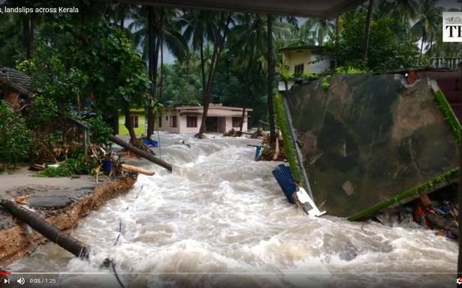
PROBLEM STATEMENT
Example :- Floods are among the most frequent and costly natural disasters. Flooding often occurs for several days of sustained rain. Flash floods occur suddenly, due to rapidly rising water along a stream or low-lying area. From the recent Kerala floods and many past floods occurred in A.P, MUMBAI, CHENNAI, UTHARAKAND….etc. These floods prediction may not be perfect as it was a natural disaster, so preparedness is the only way to save the lives of the people.

Slide 3
SOLUTION
Example:- Robot which can sail on water and can supply the food packets as we said we use AI so that it can identify them and meet the person and later it can send the total data to the server like IBM CLOUD SERVER and send the data to the rescue team. It will not only send the data where the people present , as it has artificial intelligence it can send some information to the rescue team that how to contact to the people and save them. So that we can save maximum lives. It can also interact with the people so that the people can get some relief and it has many more features. As we never use this kind of device ever before, it has multidisciplinary functions like helps in forecasting, Preparedness, & Relief. Etc..

Slide 4
PROTOTYPE BLOCK DIAGRAM
IBM
RASPBERRY PI
SENSORS
MOVEMENTS
CONTROL ROOM

Slide 5
TECHNOLOGY STACK
Example :-
we came up with an idea that using an AI and IOT
Designing a robot which has many features and having more technical knowledge
It also uses machine learning algorithm
It has capable of speaking and listening
And features are present in it

Slide 6
CHALLENGES
Based on the brief analysis of the past 10 year’s flood data, we came up with an idea that using an AI and IOT devices that helps in monitoring the people who are affected to floods so that it helps in not only rescuing the people but also animals. This reduce human loss created by the natural disasters…
This idea came from our Techmate’s team by the very deep analysis on Natural Disasters and the loss during the Disaster. Hope our idea brings a drastic change in preparedness of Natural calamities like Floods….

Slide 7
CONTACT US
Name: R.B. YOGANANDA REDDY
Mobile No:9063763527
Email ID:yoganandh999@gmail.com
Name: S. BHAVANI
Mobile No:9550355319
Email ID:snicki686@gmail.com
Name: K.HEMANTH KUMAR REDDY
Mobile No: 9573543171
Email ID:kollahemanthkumar16@gmail.com
Name: K.VISHNU VARDHAN REDDY
Mobile No: 9866077697
Email ID:vishnuvardhanreddy667@gmail.com
Name: M.SAI PRAKASH REDDY
Mobile No:7036832522
Email ID:saiprakash.muthukuru@gmail.com

