Slide 1
Tele-Directo
Team Botts
Team Members:
Roshan
Yoga
Yositha
Shivani
Thahrin
Thamizh Iniyan

Slide 2
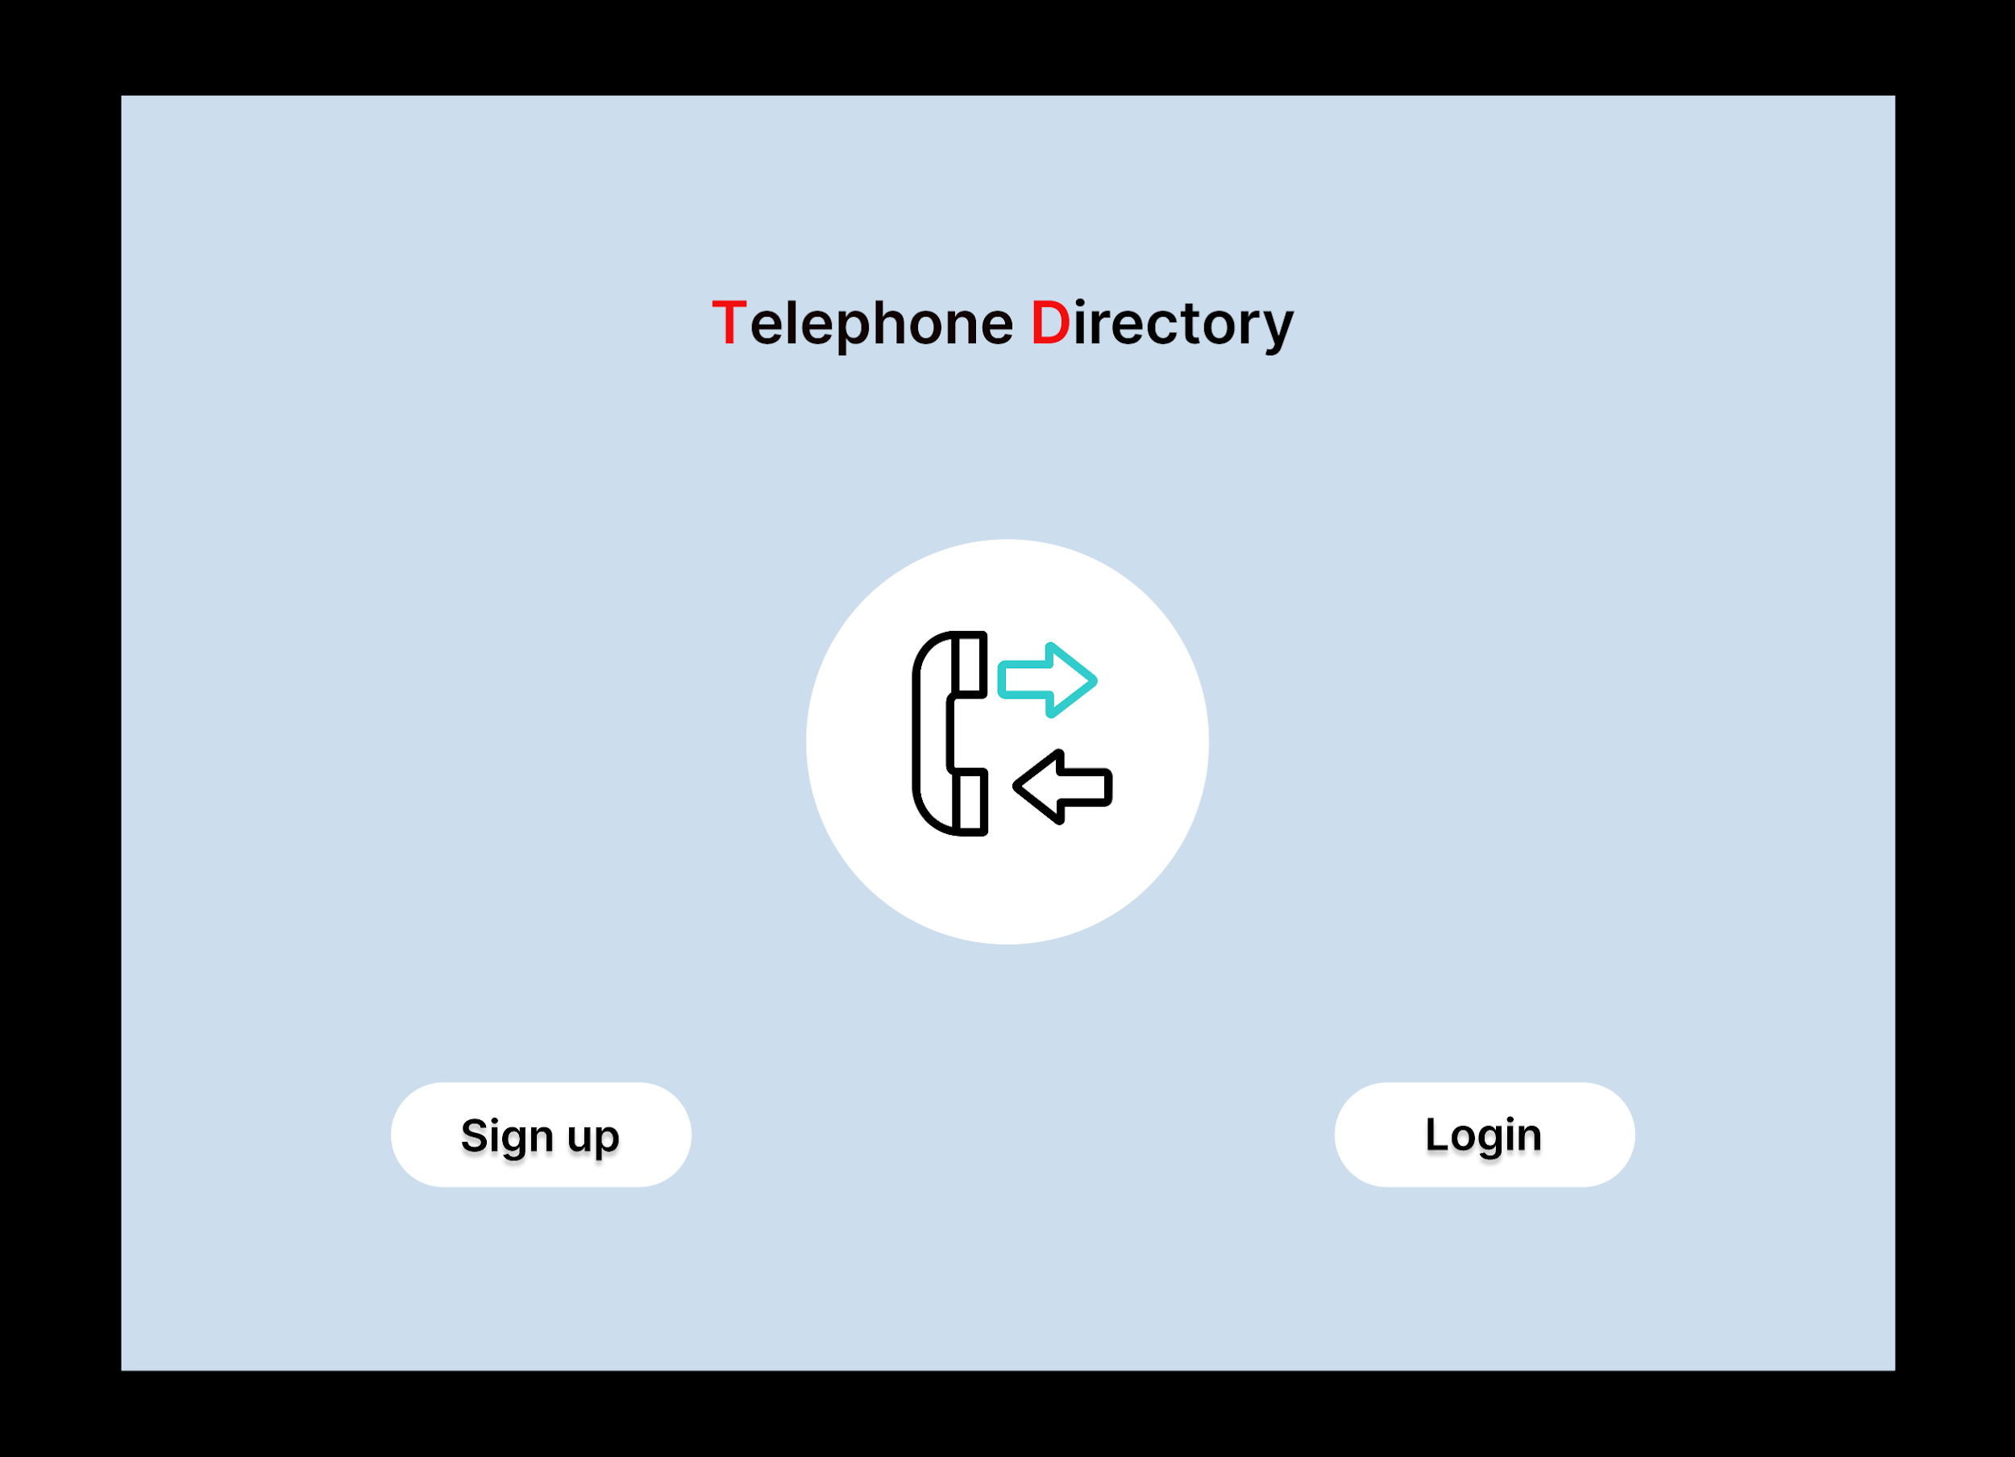

Slide 3
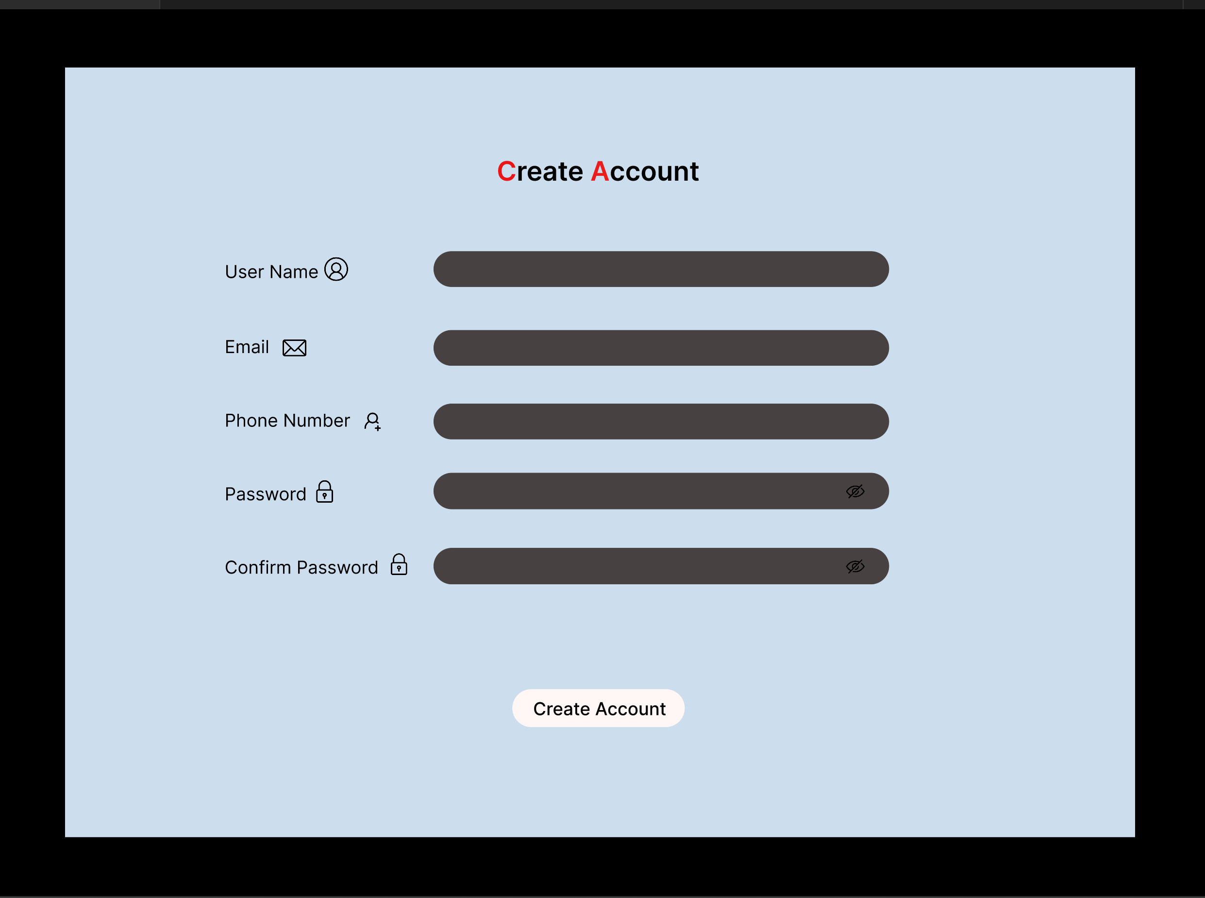

Slide 4
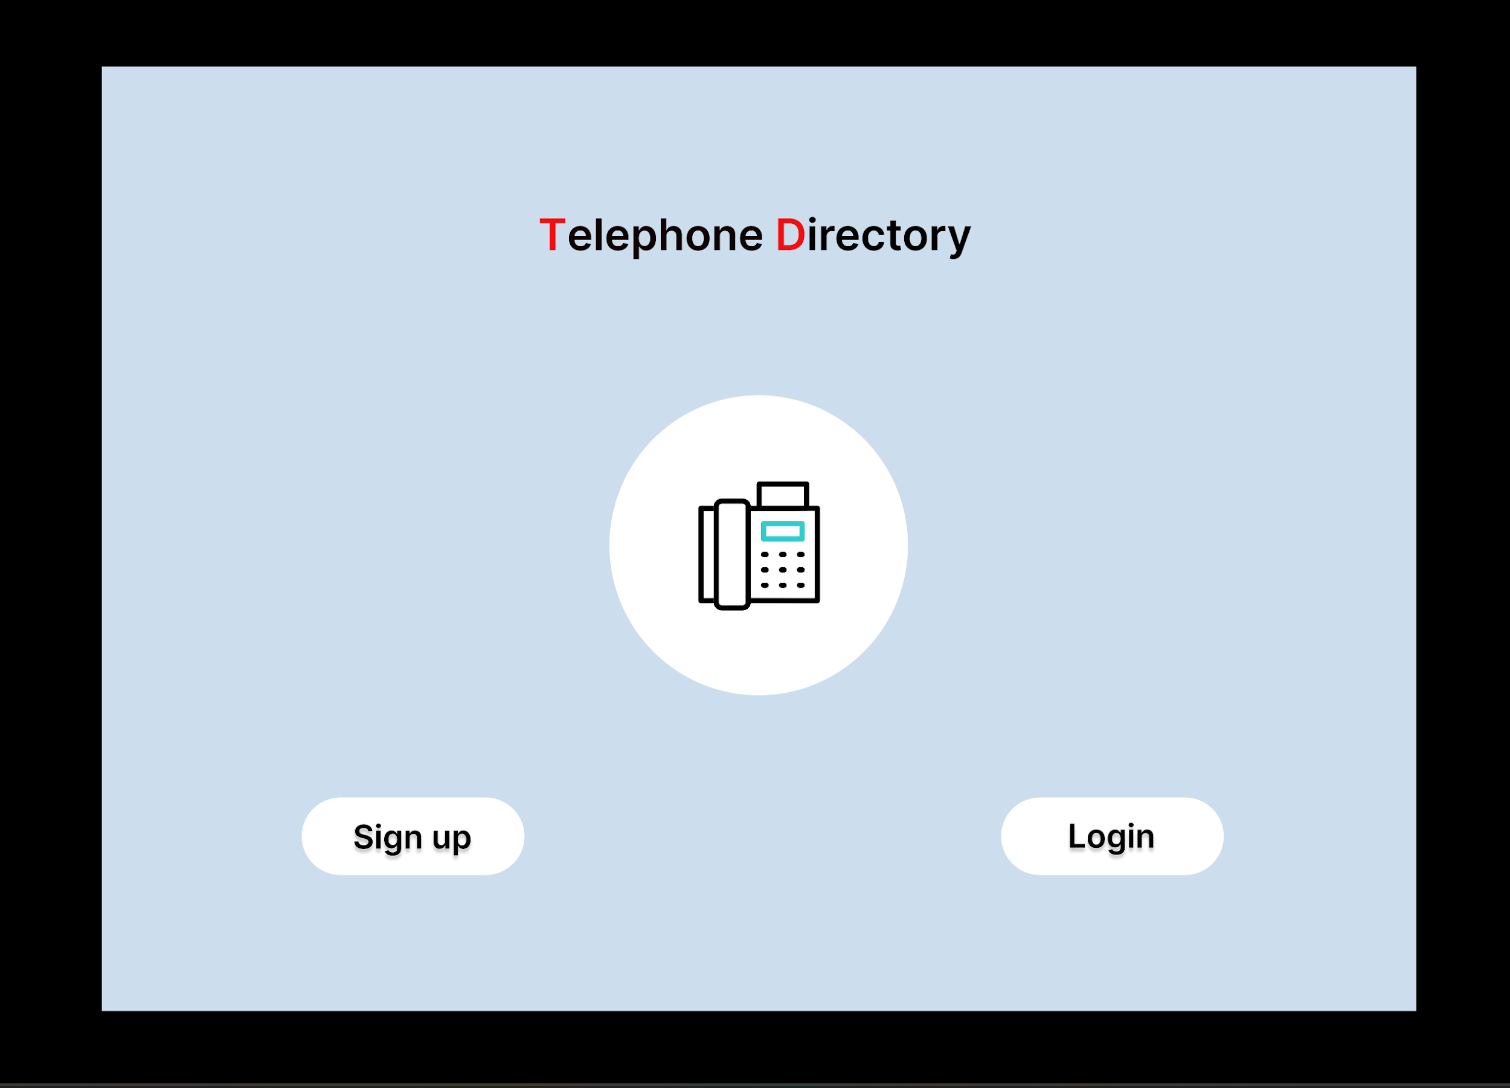

Slide 5
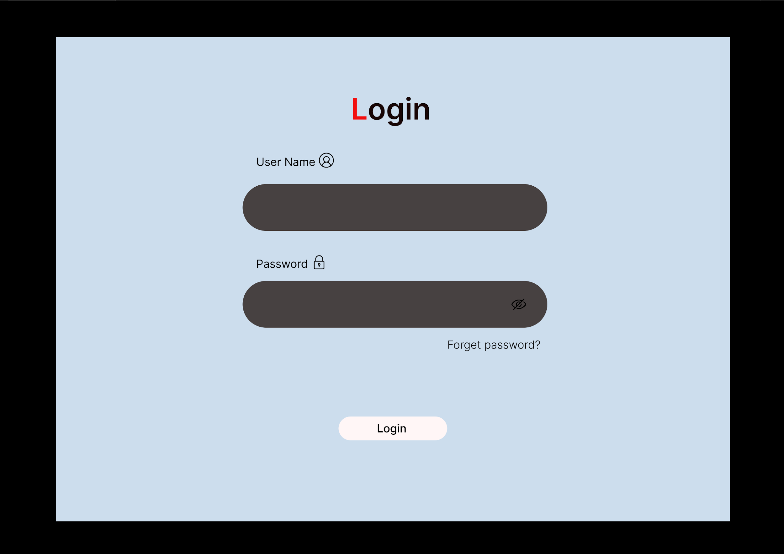

Slide 6
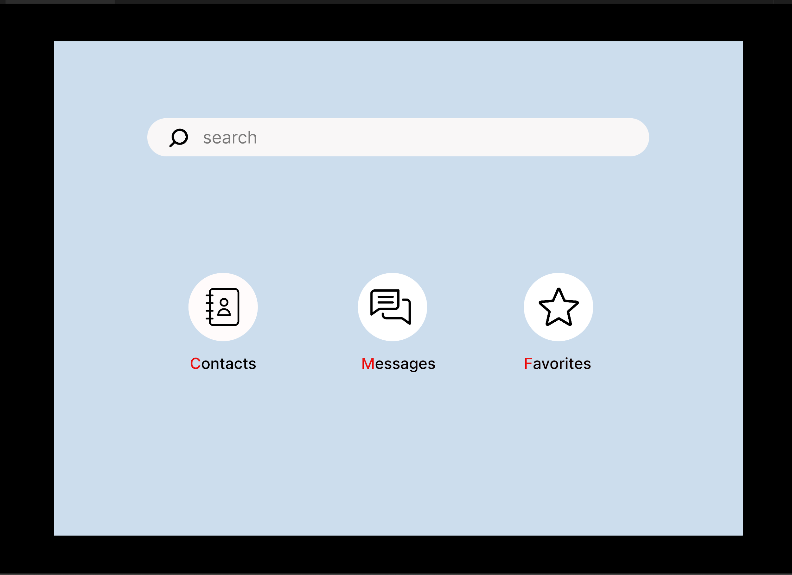

Slide 7
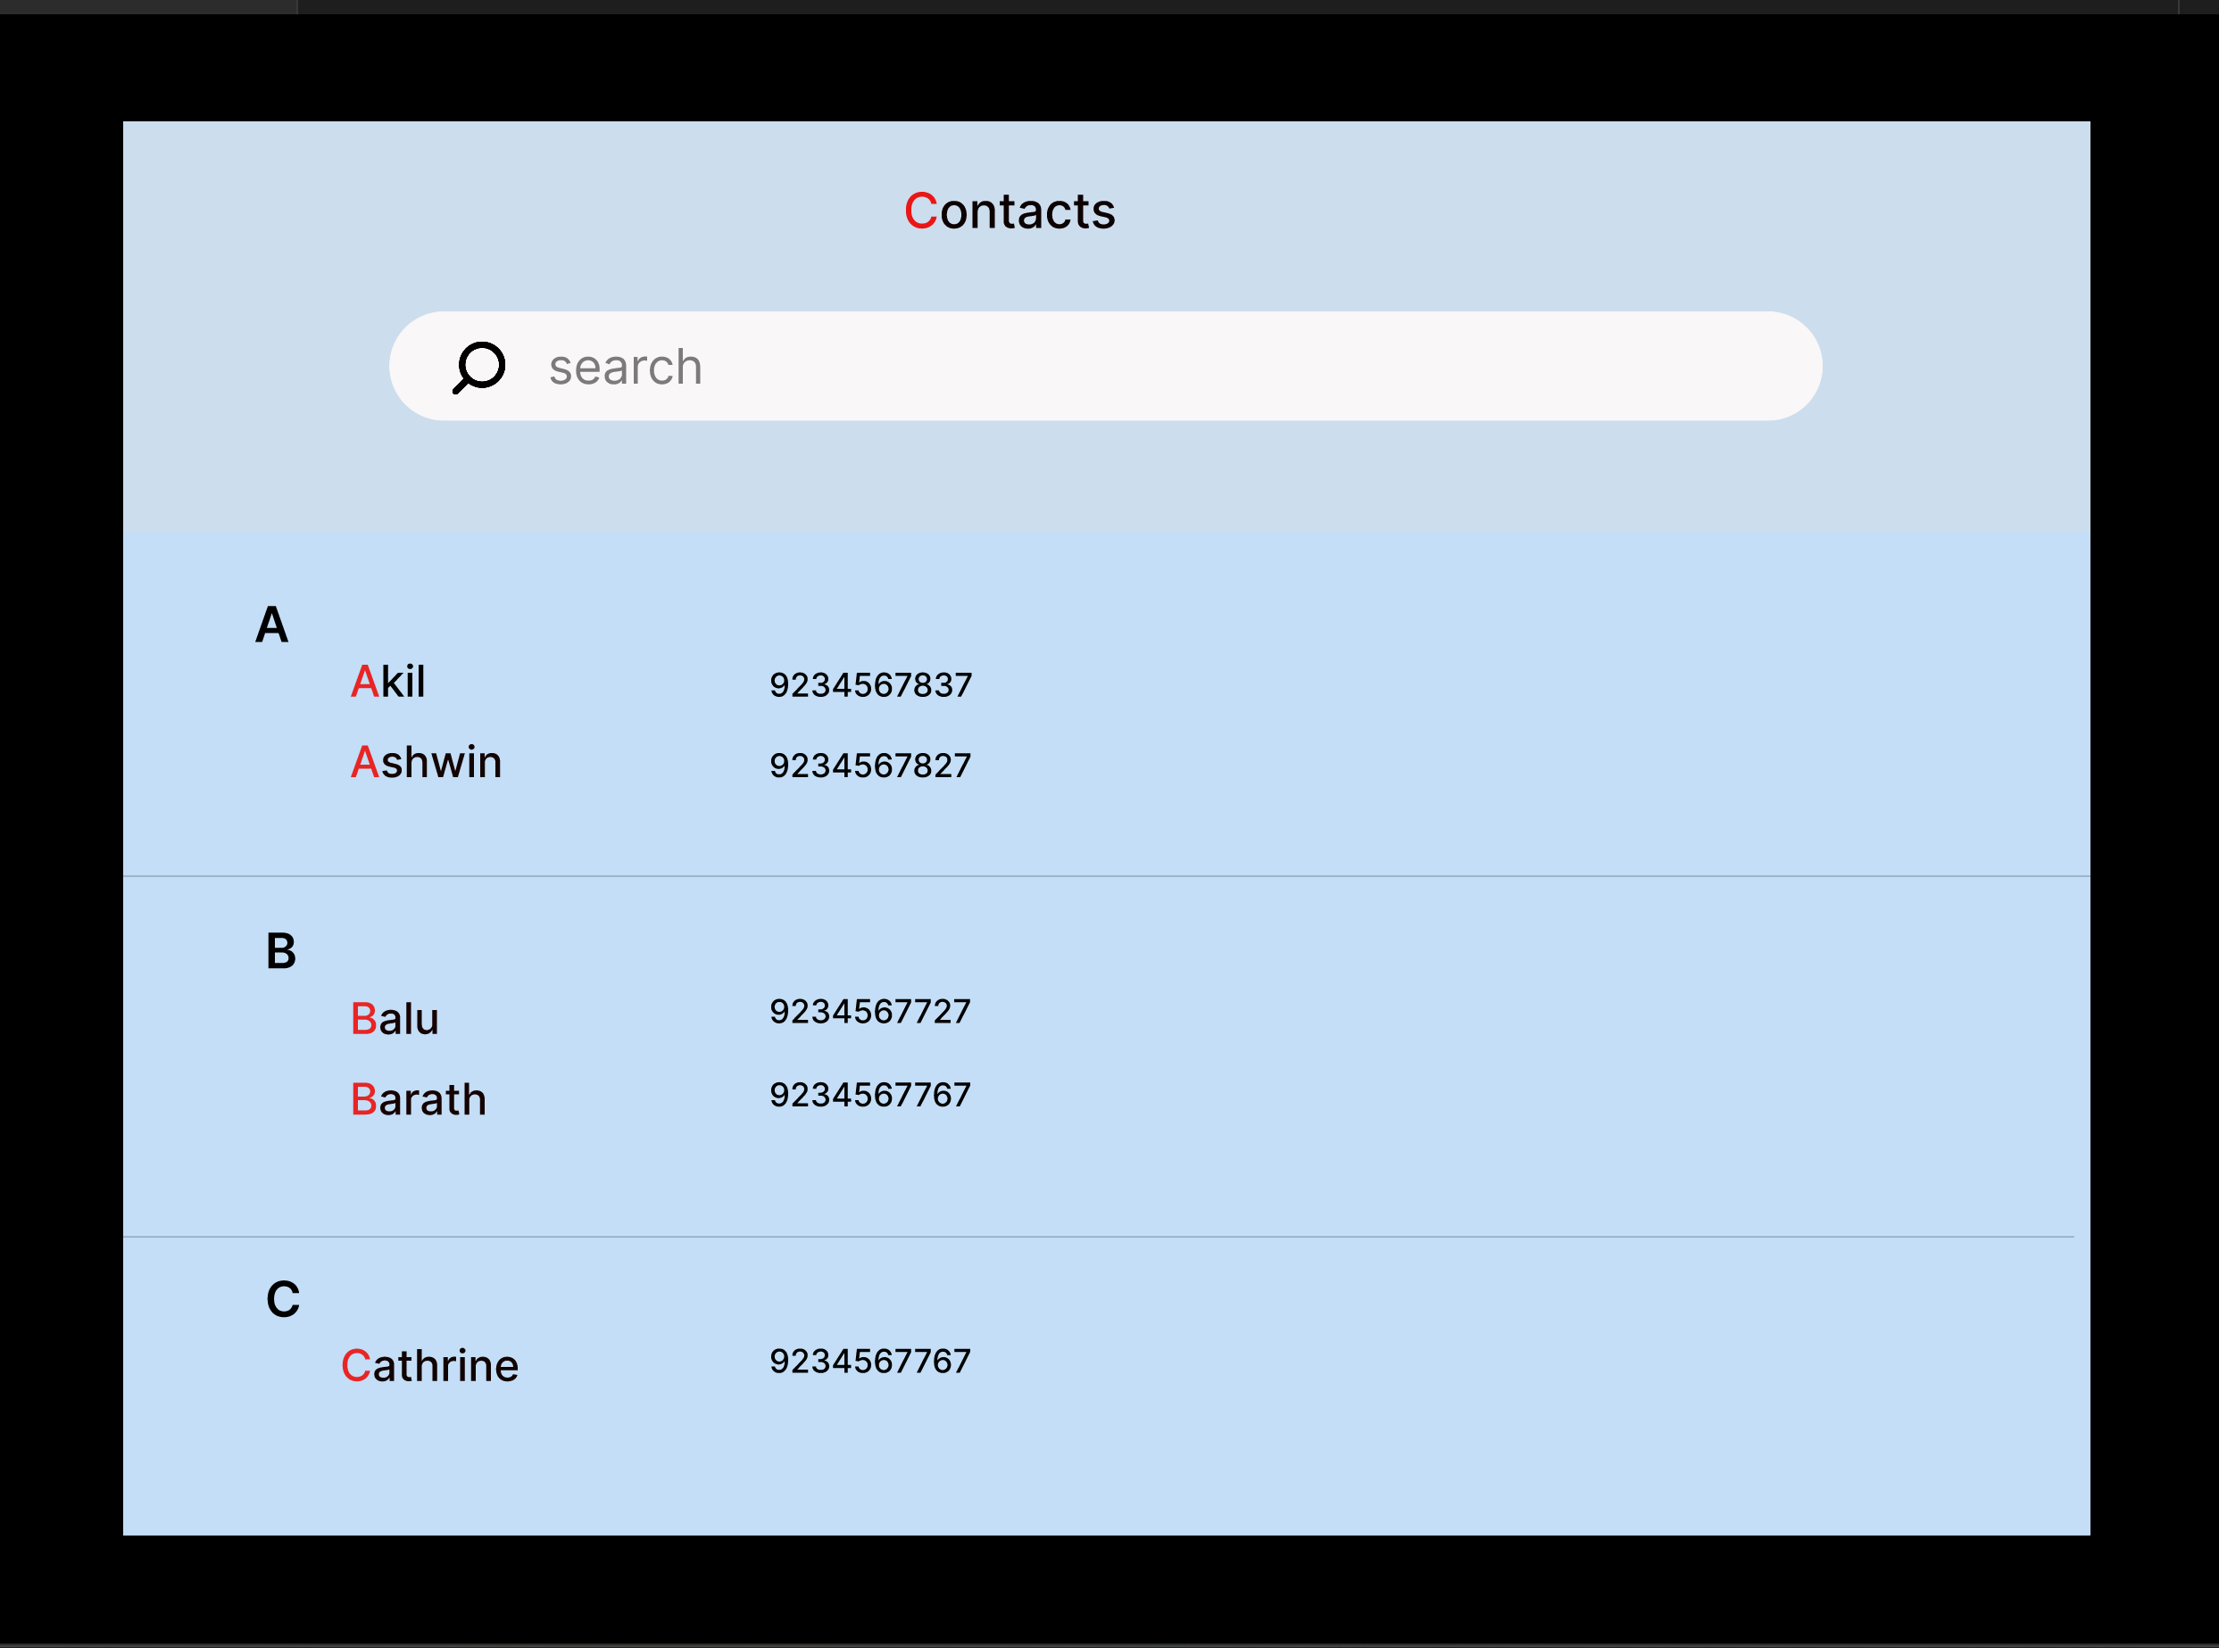

Slide 8
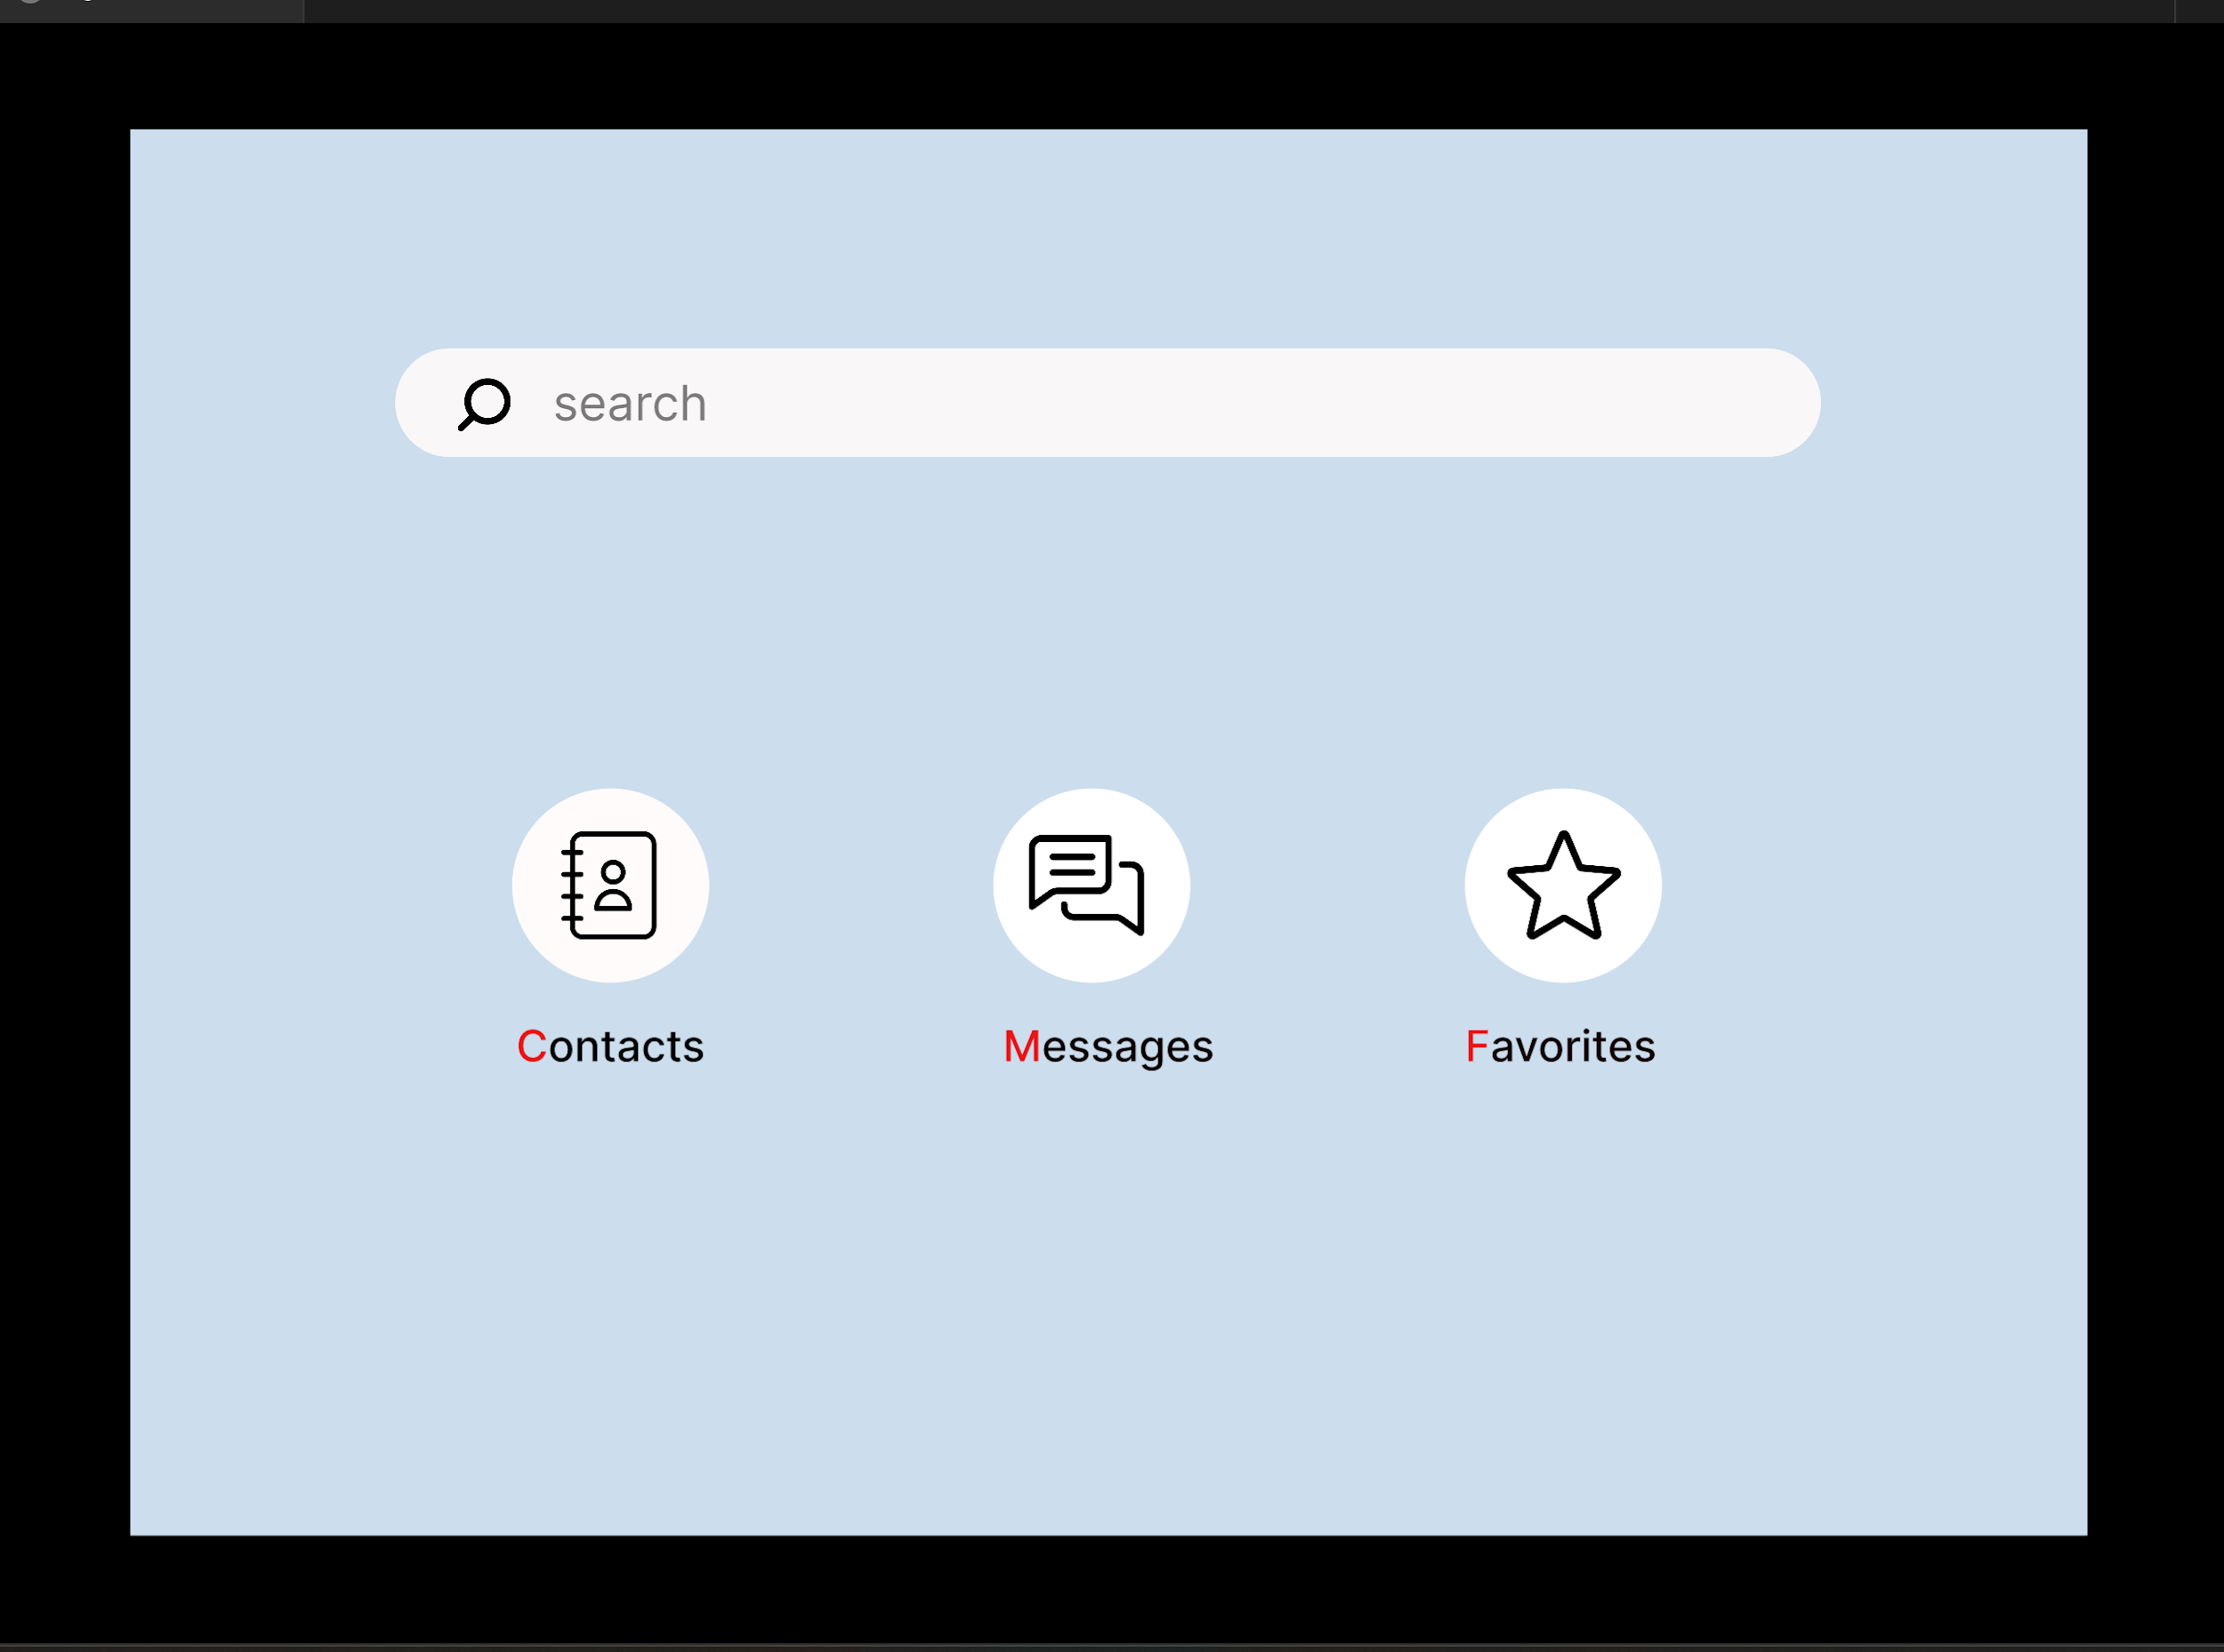

Slide 9
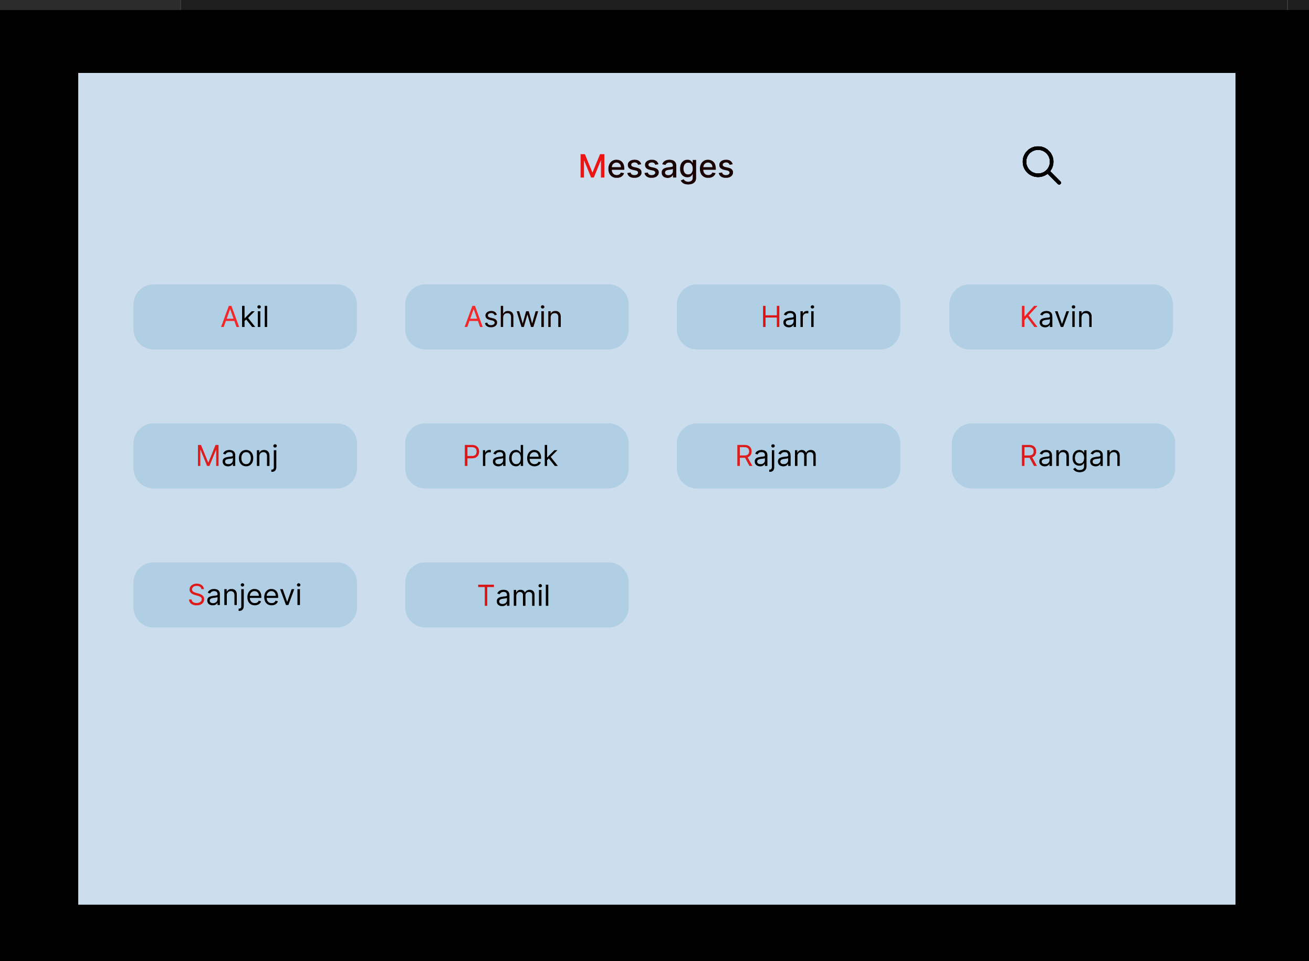

Slide 10
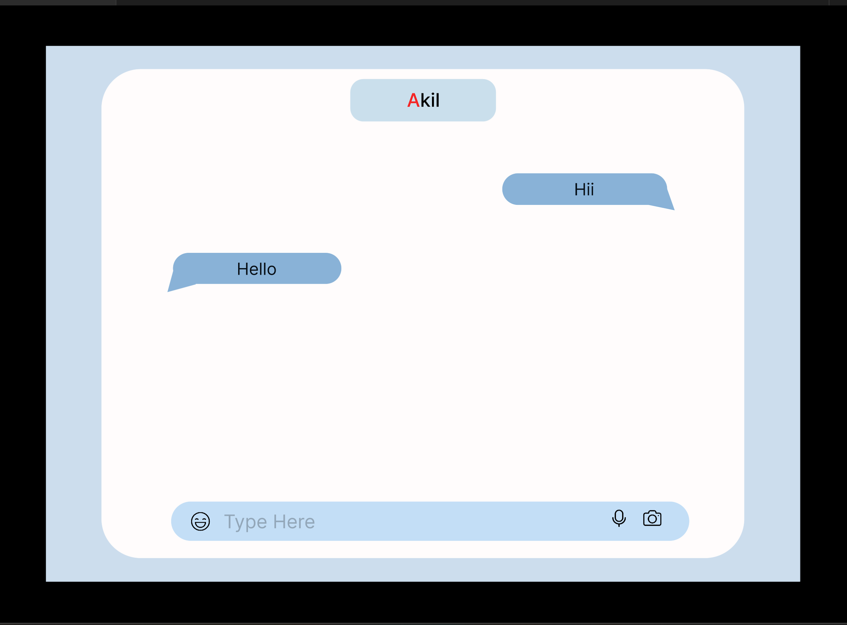

Slide 11
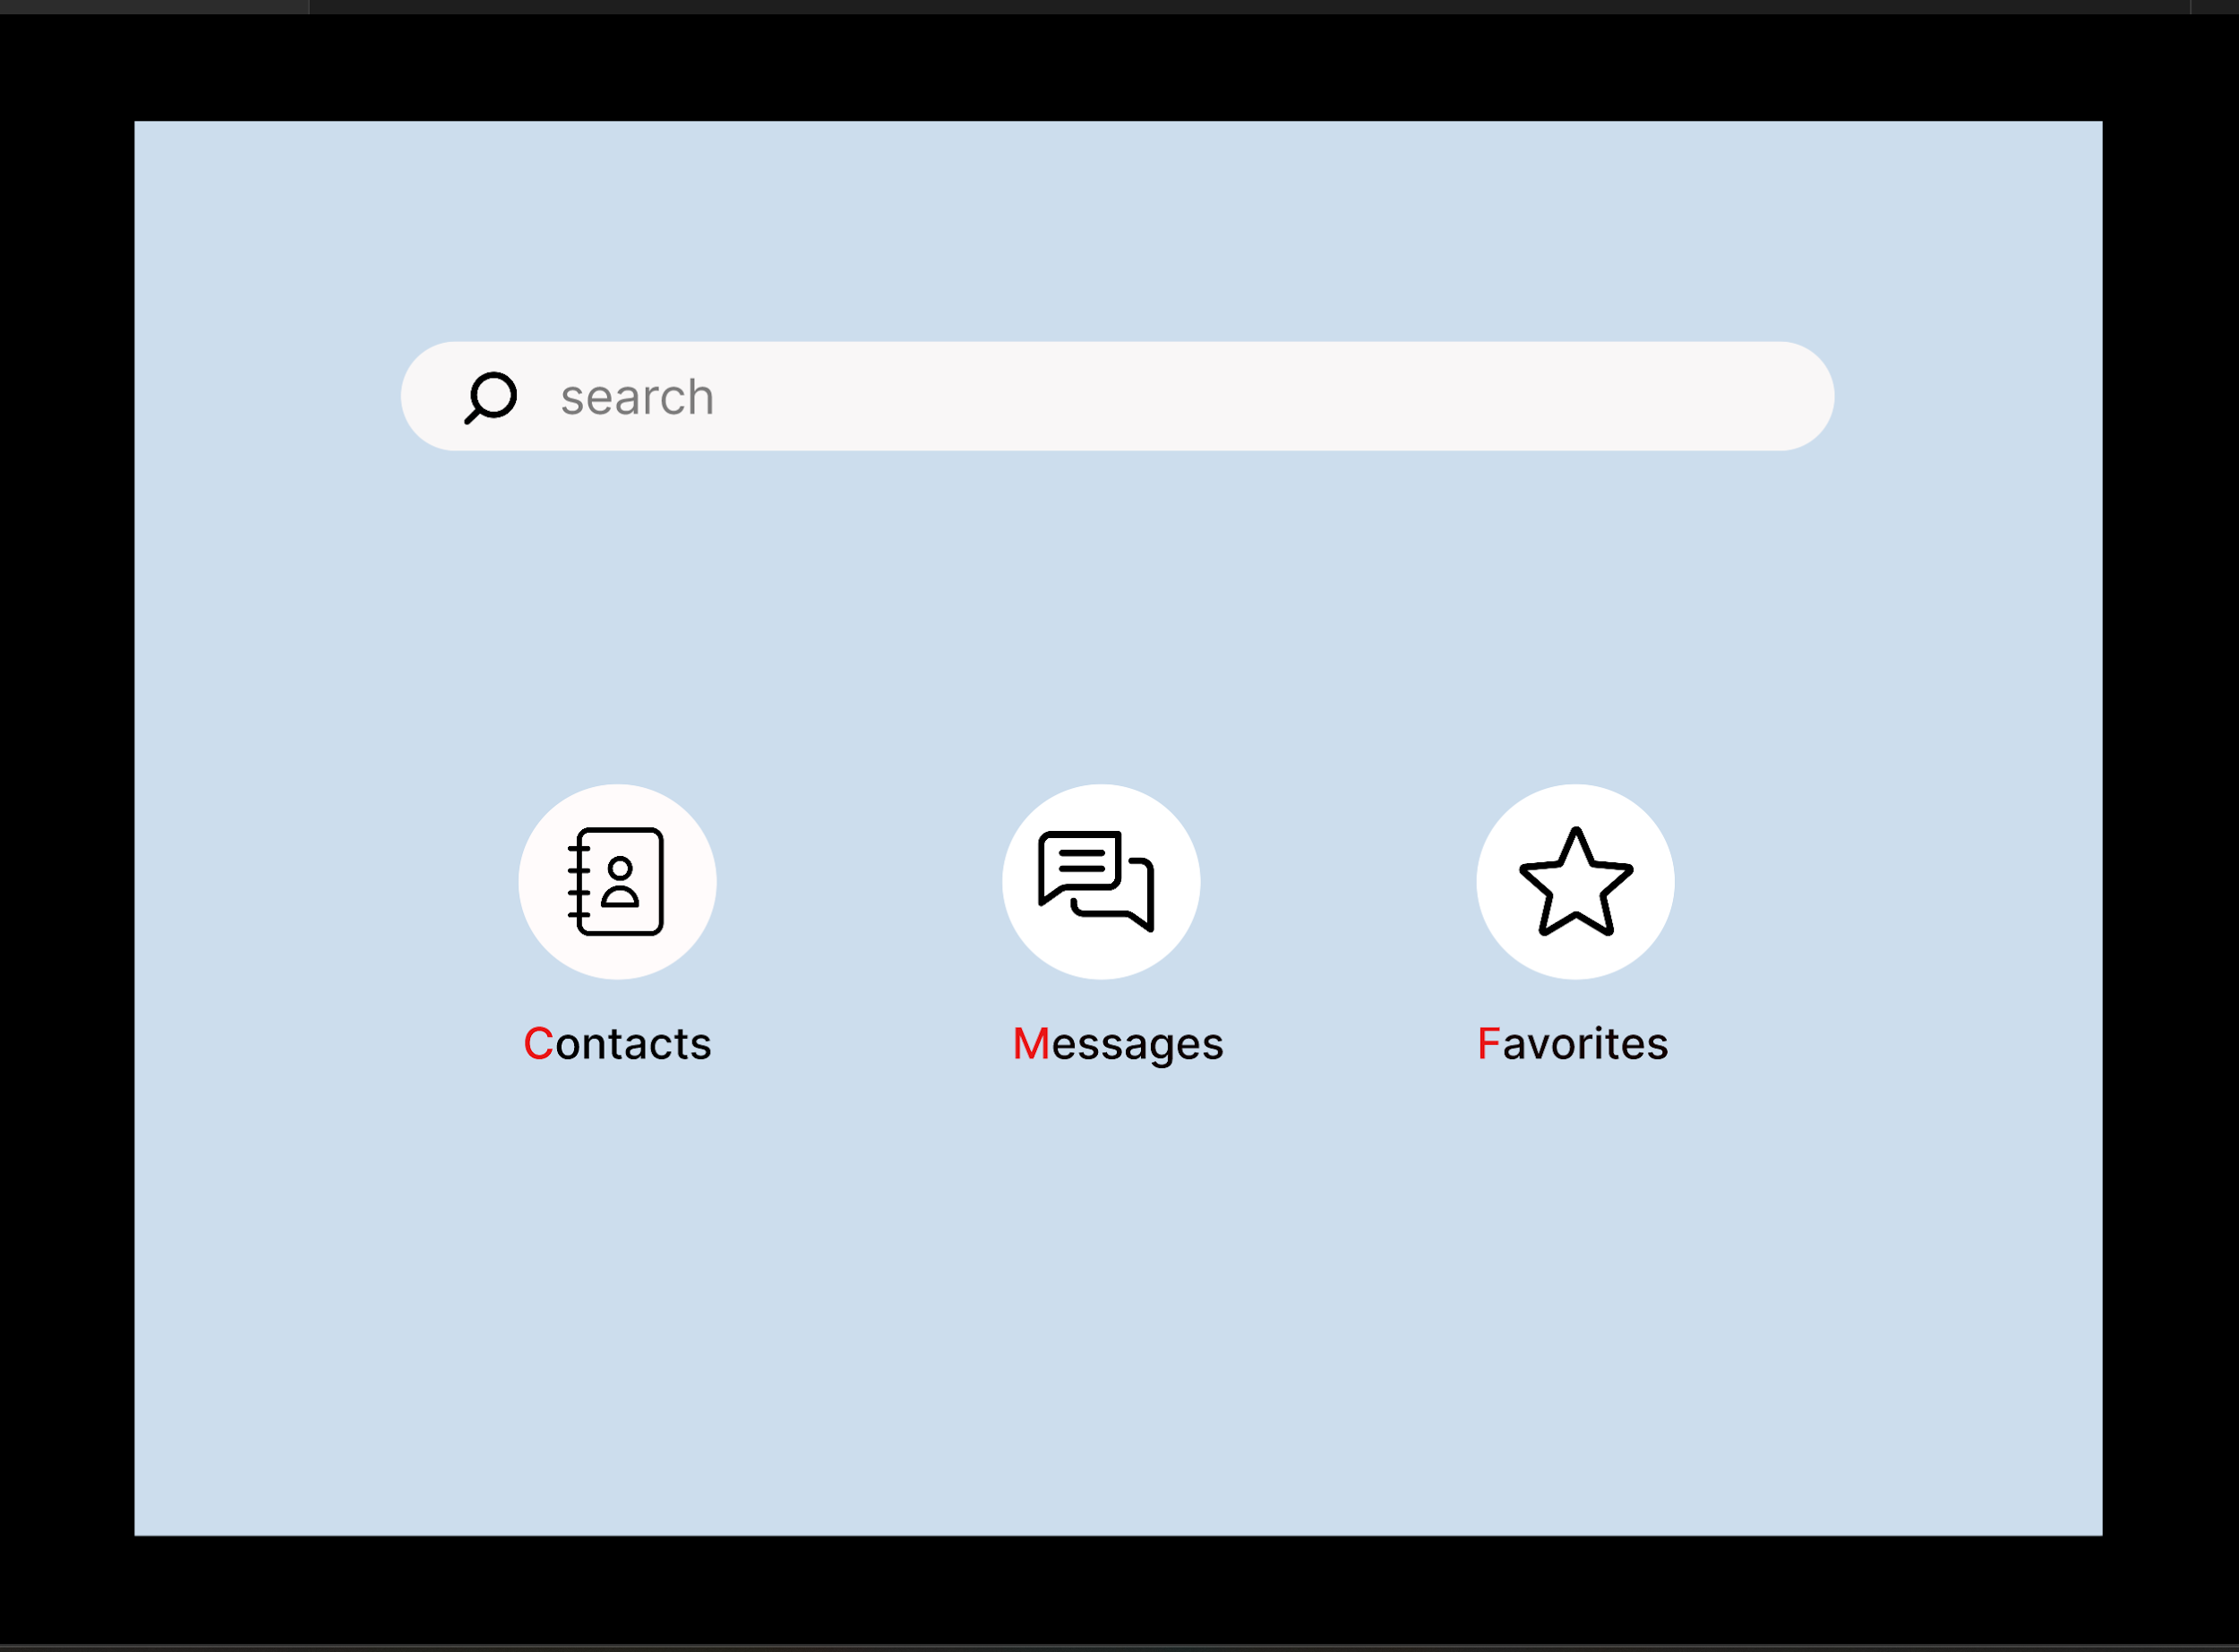

Slide 12
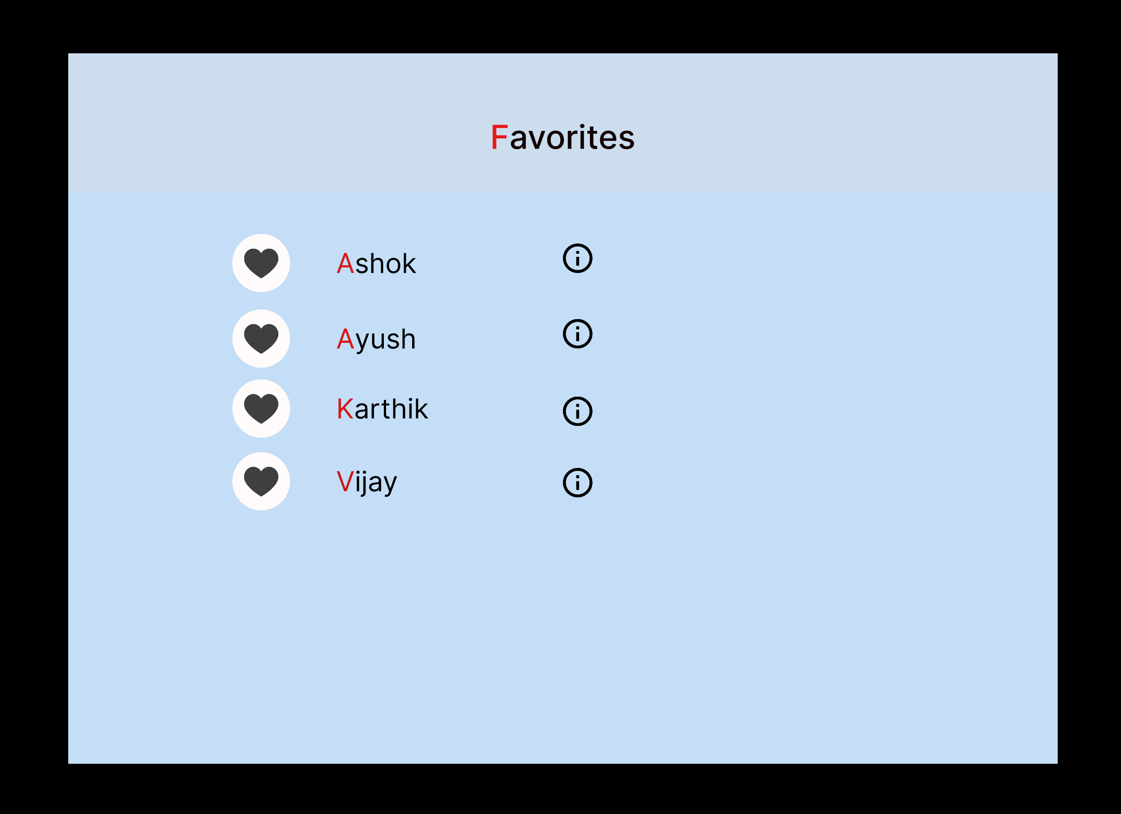

Slide 13
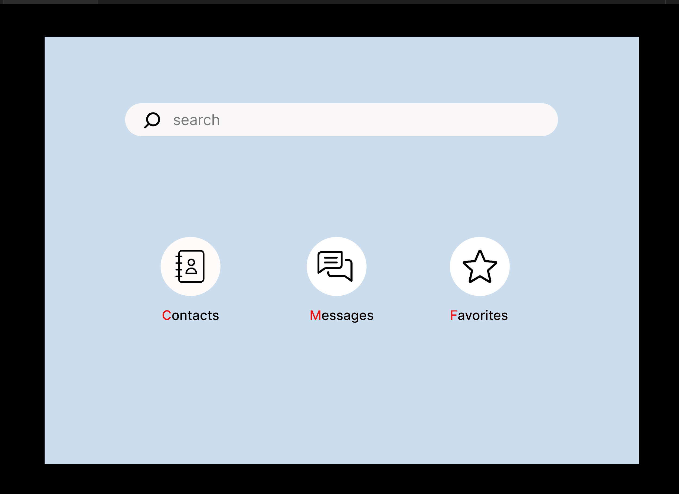

Slide 14
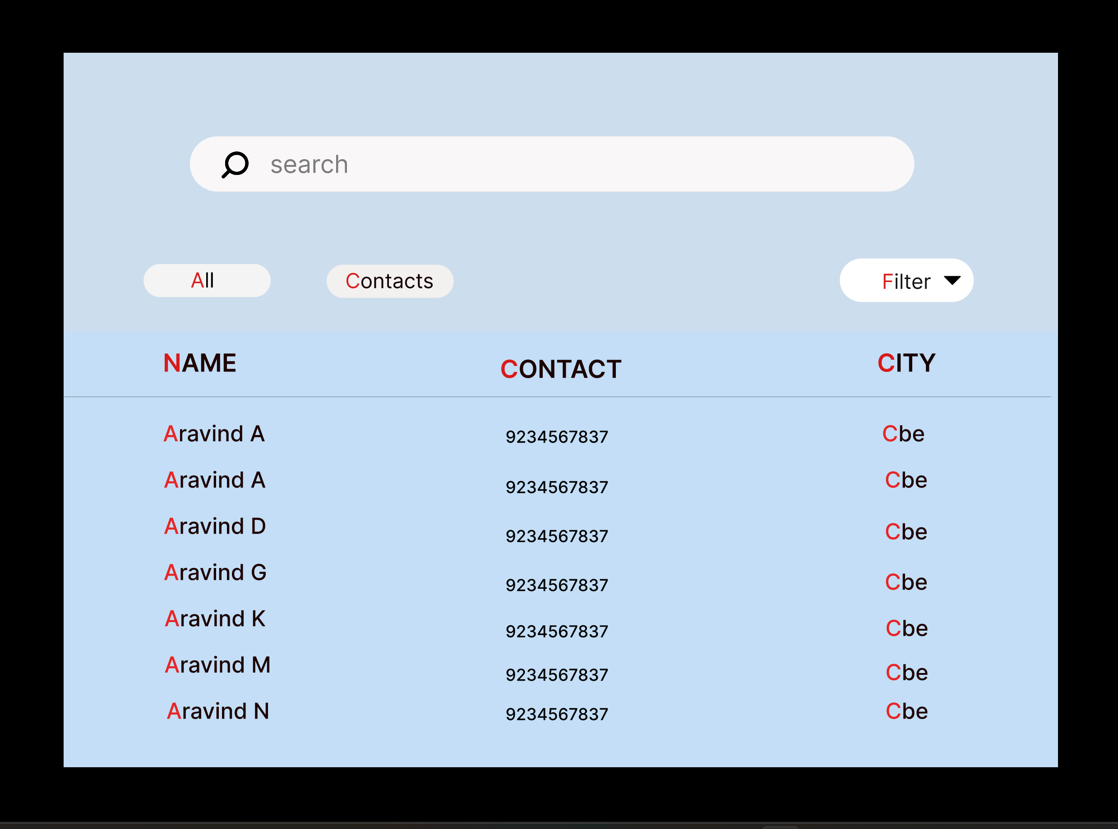

Slide 15
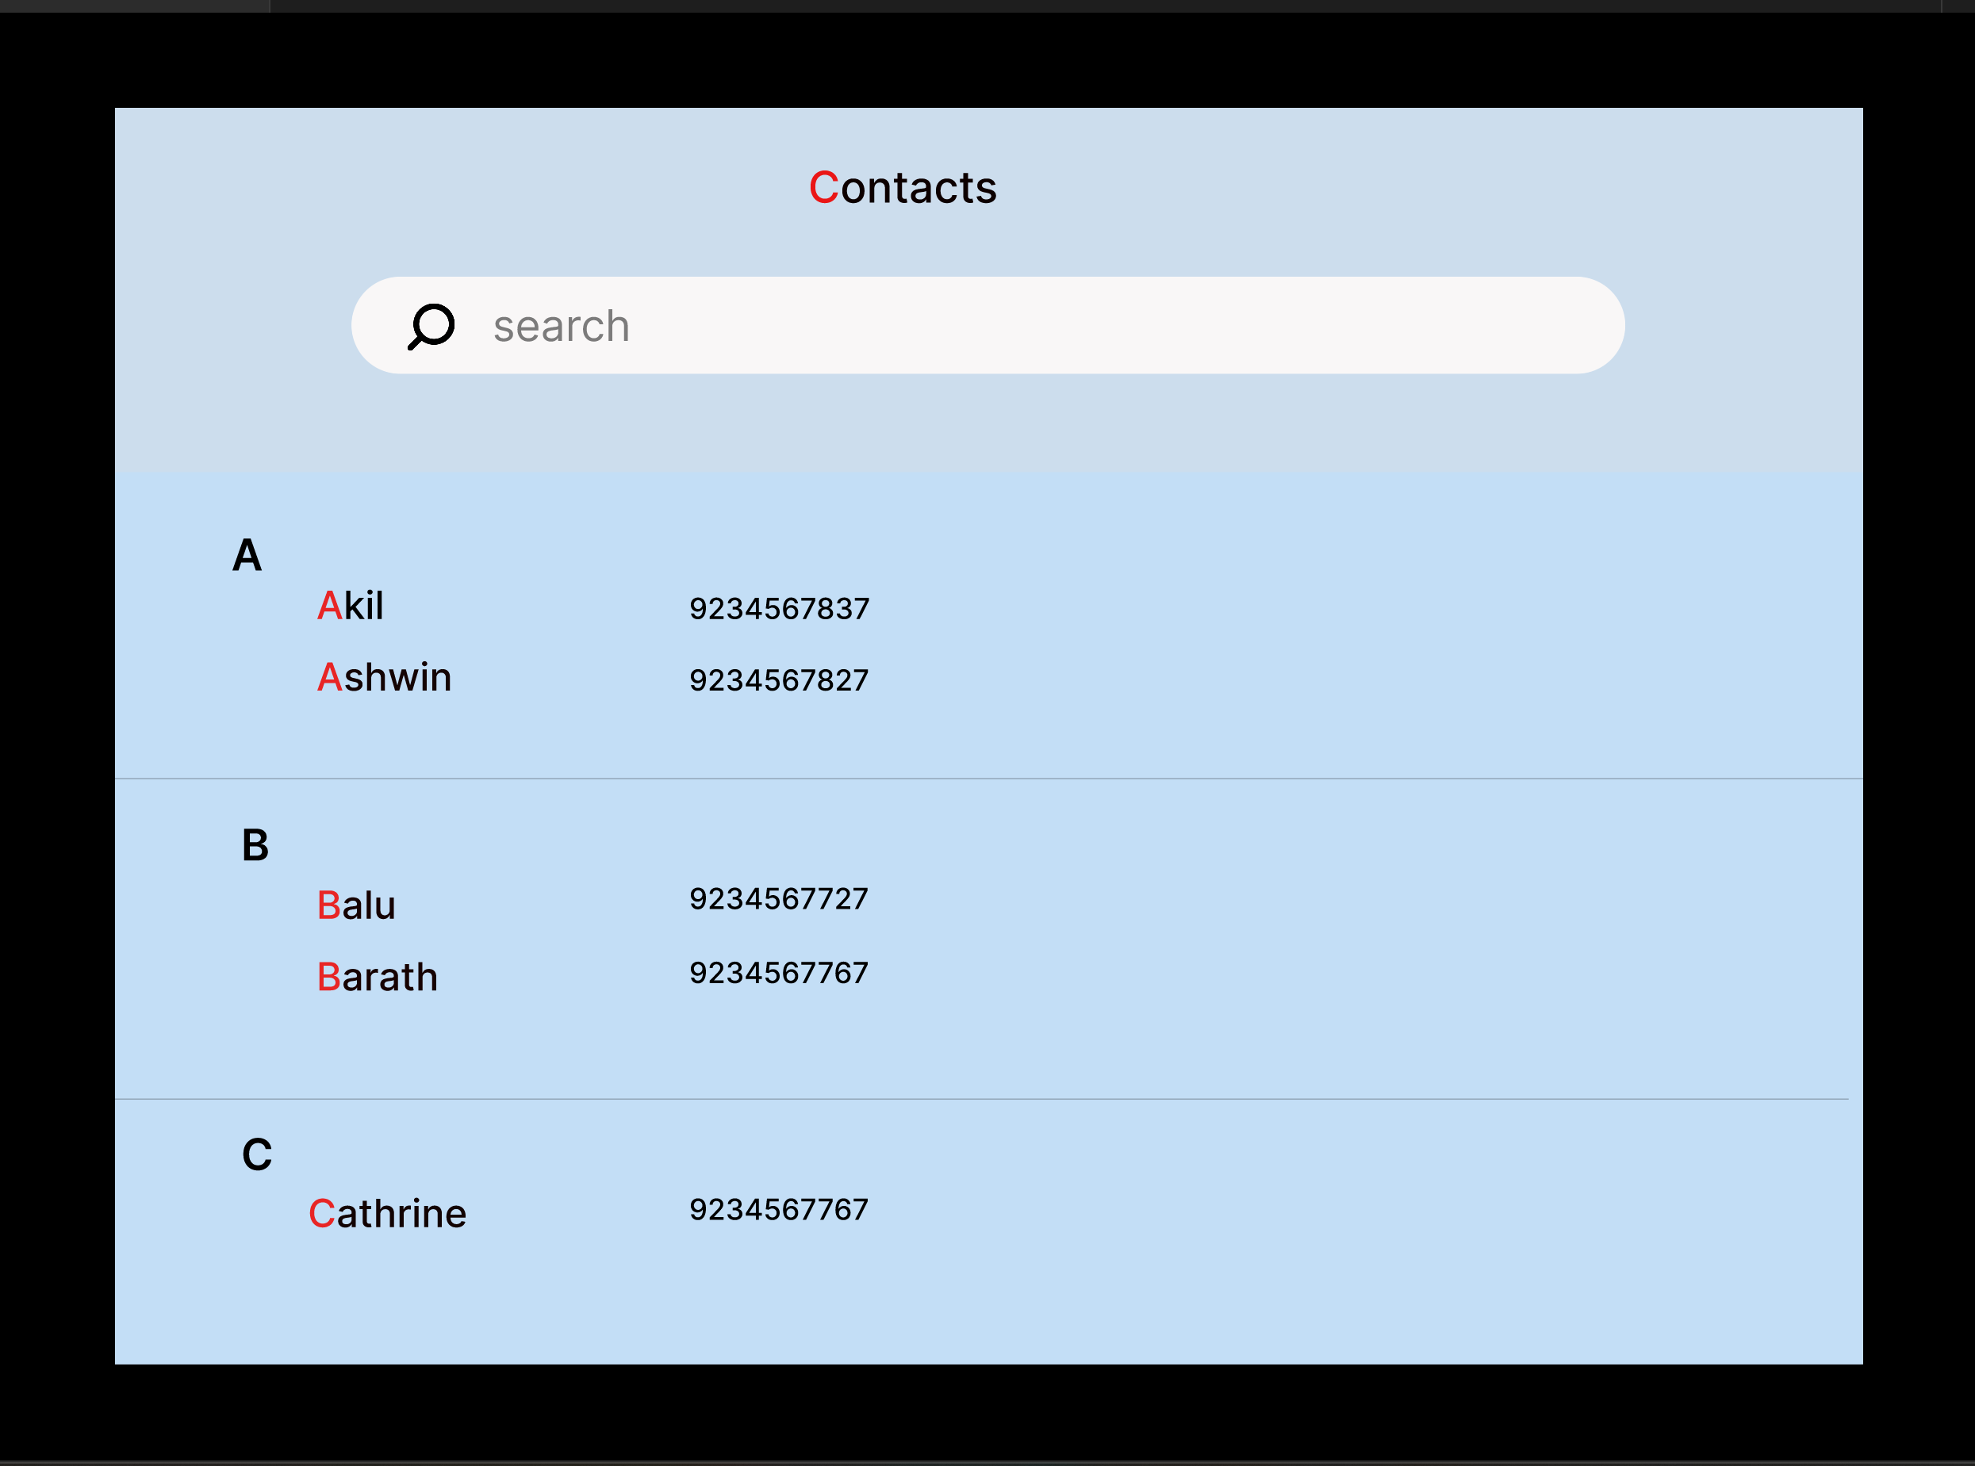

Slide 16
https://www.figma.com/file/cUAYyBERSzeBukhWQRdzxL/Tele-Direct?node-id=0%3A1
Link (Prototype) :
Link (Gidhub) :
https://github.com/yoga2511

Slide 17
THANK YOU

