Slide 1
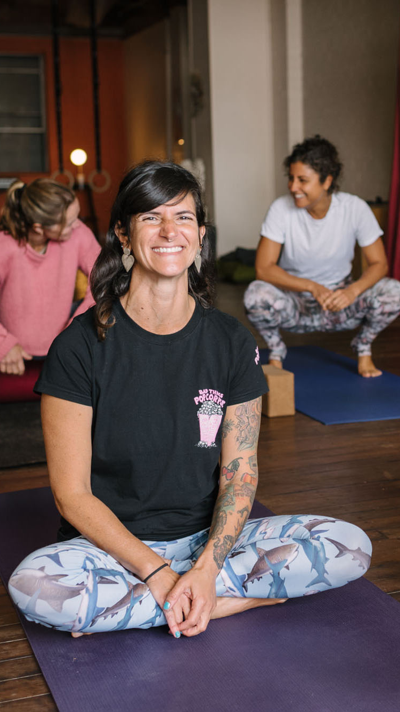
YOGA TODAY
TEST
History of Yoga
and Tantra

Slide 2

This article introduces our CPD Short Course from Tova Olsson and tracks alongside her book:
Yoga and Tantra: History, Philosophy and Mythology
We consider this one of our most important resources, so it is free for all members.
There's more to yoga than the default narrative suggests, and anyone who teaches or intends to teach yoga simply must avail themselves.

