Slide 1
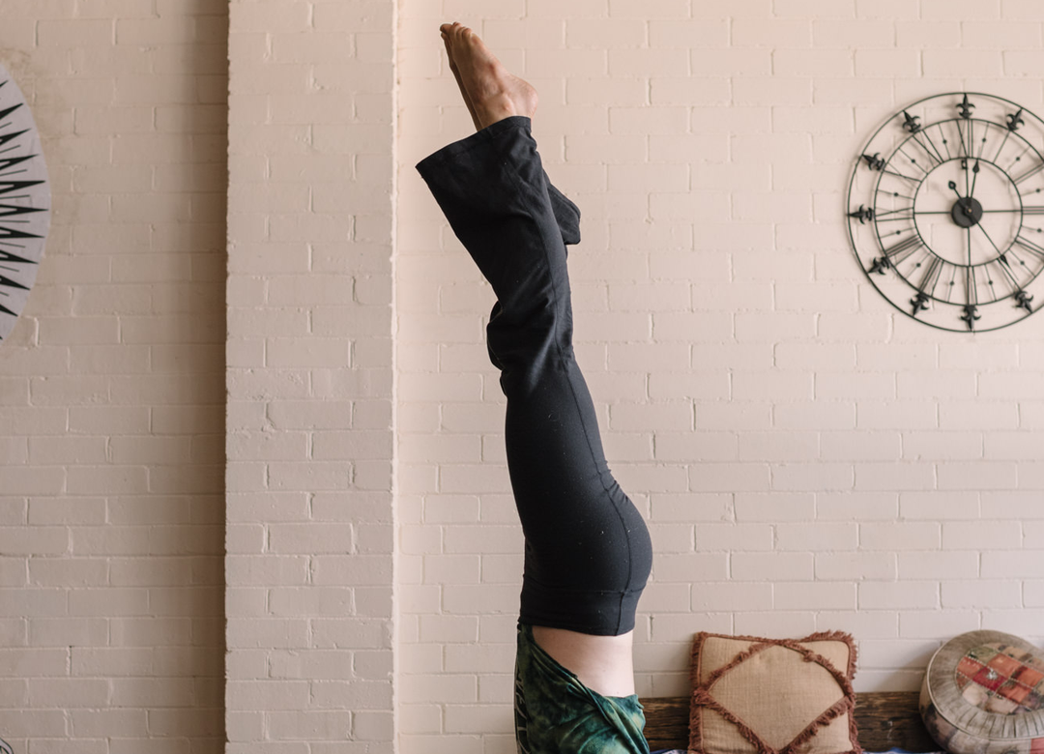


YOGA TODAY
TEST
in Nepal
A sacred journey of self-exploration, aligning one's Self with something greater and attaining a deeper sense of oneself.
Read the article →

