Slide 1
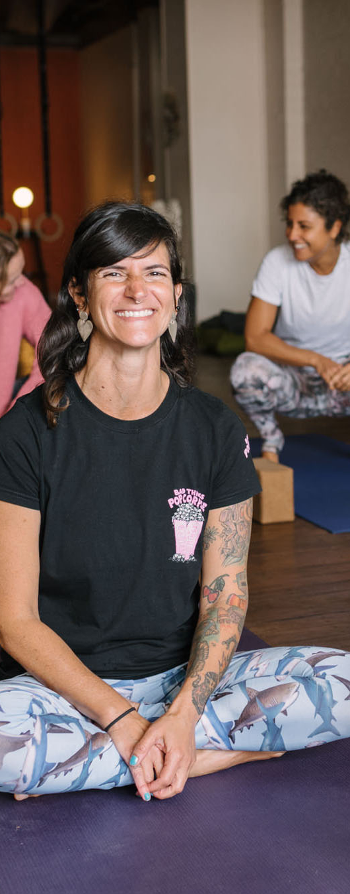


CPD SHORT COURSE
TEST
From Breath
to Samādhi
Josh Pryor is the CEO for Yoga Australia, a Mysore Style Yoga practitioner, author, studio-owner, and life-long student. Celia Roberts is a Senior yoga teacher and therapist, an award winning Mind-Body practitioner and among other qualifications, has a Bio-Medical Science degree.
Earn 1 CPD points on completion.

Slide 2


An exciting course on the metaphysics of pranayama, exposing the quintessential pivot of yoga, the doctrine of expansion beyond the skull. Yogic breathwork stretches us further than physical, to the uncanny and tranquil state of samādhi.

Slide 3

Be sure to log in to your Yoga Australia member dashboard to explore the range of CPD short courses available and receive access to exclusive discounts and free courses.
Access the course at yogaaustralia.org.au
Link in bio
›

