Slide 1
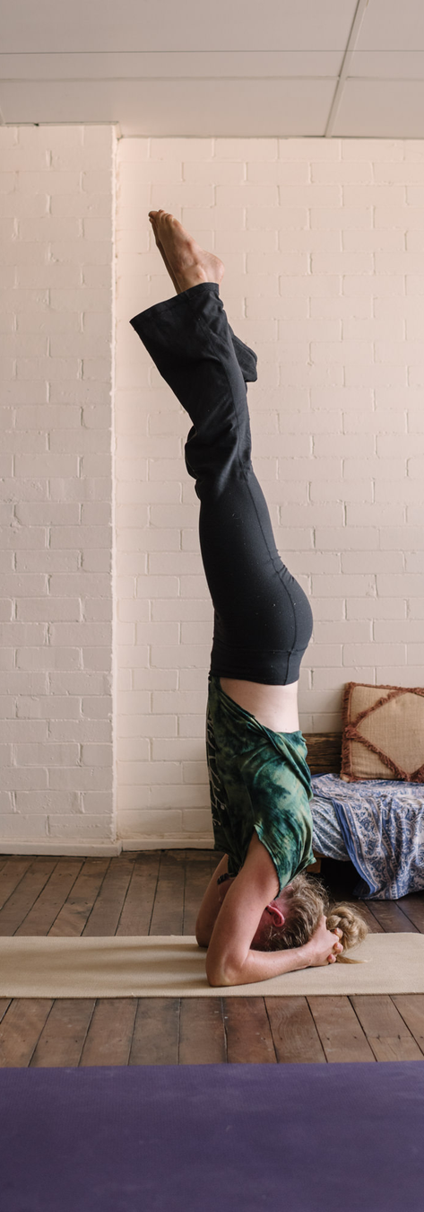


SYDNEY
TEST
HEART
RESET
Join us for a rejuvenating experience with expert-led discussions and Japanese Yoga practice.
Reconnect your mind and body
Sunday 9 November
10am - 1pm
Crows Nest, NSW

Slide 2
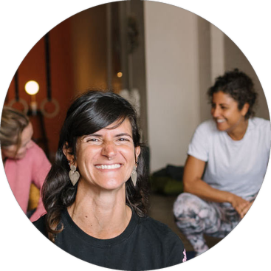
SYDNEY
60-minute Japanese Yoga
with Susan Hughes
As the seasons shift, so do we!
This Japanese Yoga (Ryoho) class supports the heart and small intestine, the organs of the summer season. Through grounding movements, we'll take some stress away from our chest to allow our heart space to soften.

Slide 3

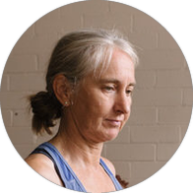
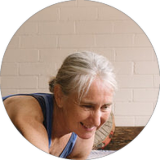
SYDNEY
60-MINUTE EXPERT-LED DISCUSSION:
Trends Shaping the Next
Generation of Yoga Teaching
Susan Hughes
Pixie Lillas
Rachael Coopes
Discover what's next for yoga teachers and communities in a dynamic conversation that blends modern innovation with timeless wisdom.

Slide 4
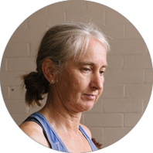

SYDNEY
Hosted by our NSW
Community Representatives
Katie Brown
Alexi Pallpratt
All yoga teachers, students, and trainers from Sydney and beyond are warmly invited to join us.
Sunday 9 November | 10am - 1pm
Crows Nest Centre, Crows Nest, NSW
Register at yogaaustralia.org.au/events

