Slide 1
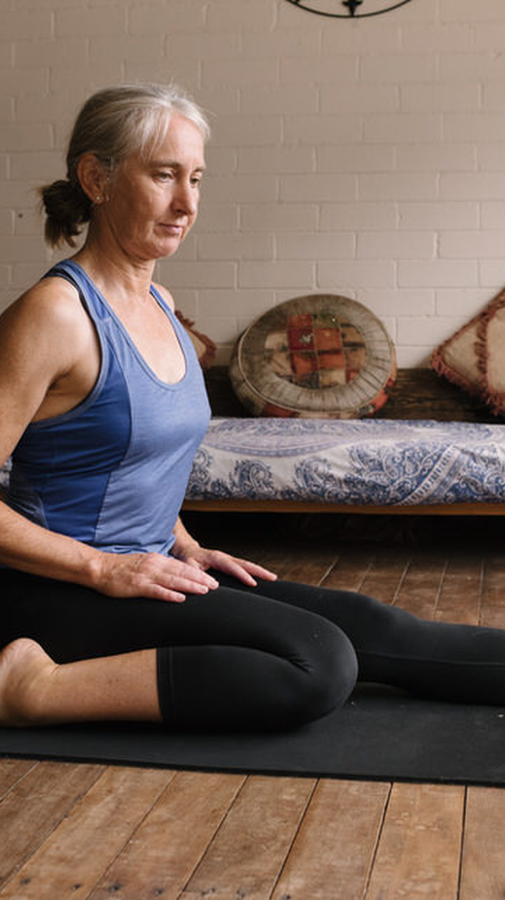


TEST Ask us anything about
private health rebates for yoga...
Do I have to be a member of Yoga Australia to apply for registration?
Yes. Applications are made directly
through Yoga Australia. Yoga
Australia uses its registration
framework to assess eligible
teachers and provides the resulting
list directly to the funds. There is no
separate application to the funds.
LEARN MORE

