Slide 1
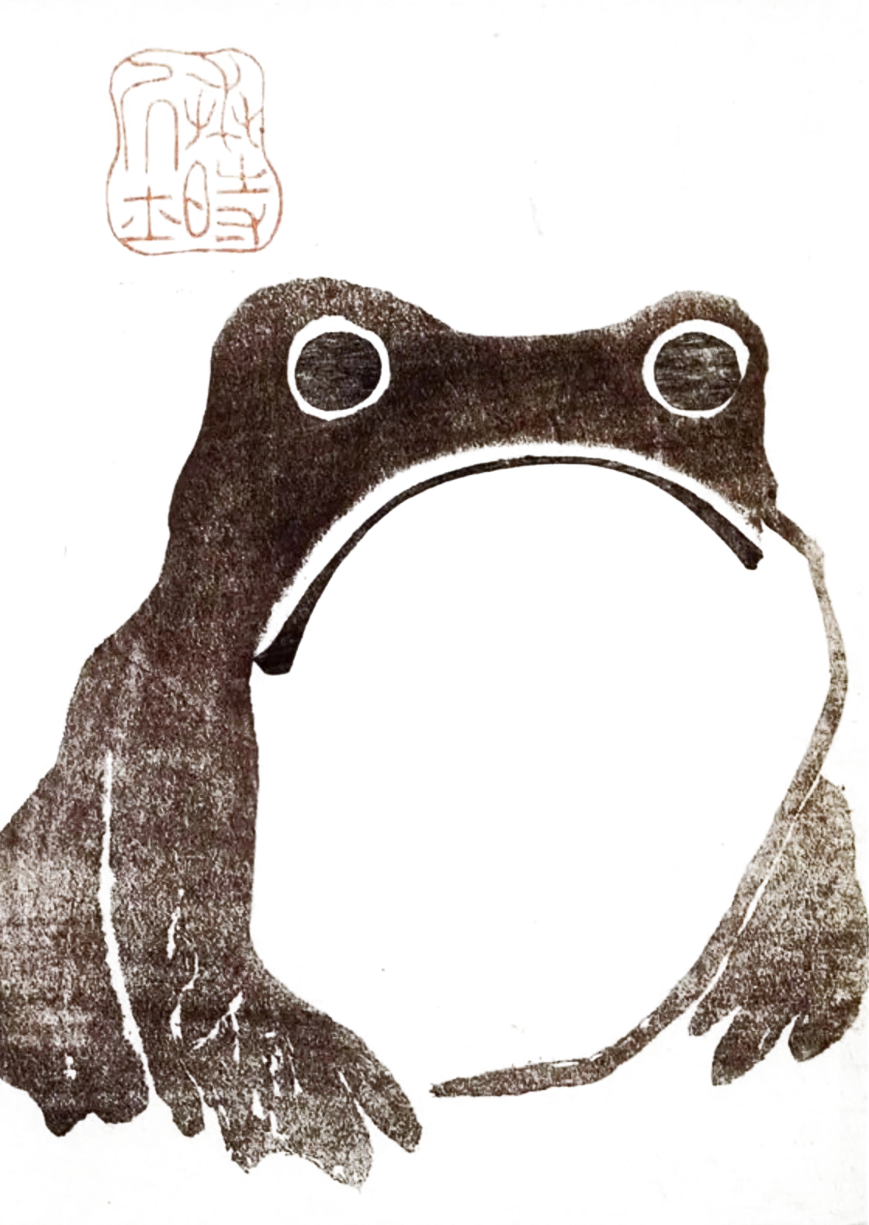
AFTERNOON ZAZEN · ZEN MEDITATION
EASE
AND JOY
“To get in touch with reality, there is an art of meditation, of what is called yoga or jhāna in India, chan in China, and Zen in Japan. It is the art of temporarily silencing the mind, of stopping the chatter in the skull.”
ALAN WATTS
A FOUR-WEEK COURSE · FOUR CONSECUTIVE TUESDAYS IN SEPTEMBER
THE 8TH, 15TH, 22ND AND 29TH · 5.15PM
LEVEL 2, 372 KING STREET

Slide 2
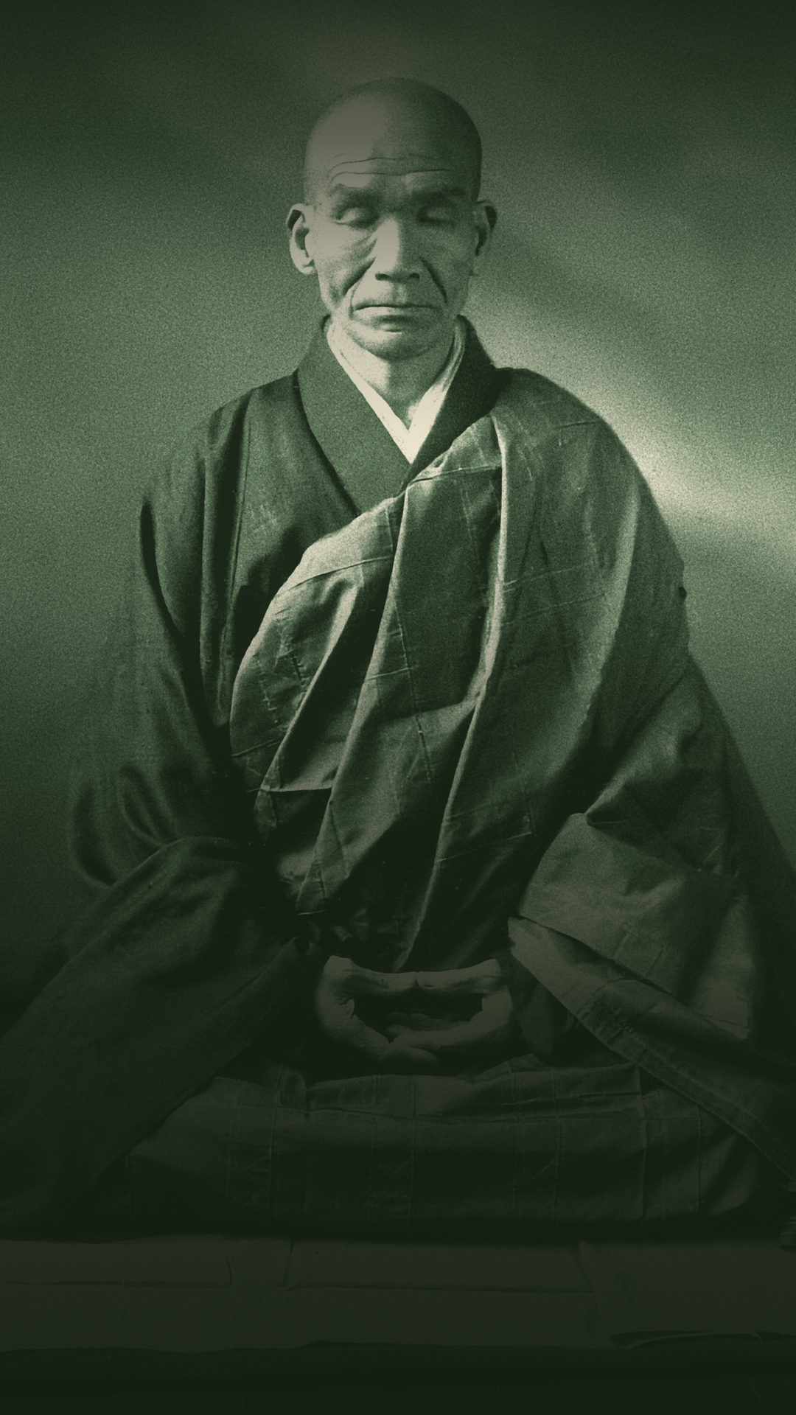
AFTERNOON ZAZEN · ZEN MEDITATION
EASE
AND JOY
“To get in touch with reality, there is an art of meditation, of what is called yoga or jhāna in India, chan in China, and Zen in Japan. It is the art of temporarily silencing the mind, of stopping the chatter in the skull.”
ALAN WATTS
A FOUR-WEEK COURSE · FOUR CONSECUTIVE TUESDAYS IN SEPTEMBER
THE 8TH, 15TH, 22ND AND 29TH · 5.15PM
LEVEL 2, 372 KING STREET

