Slide 1
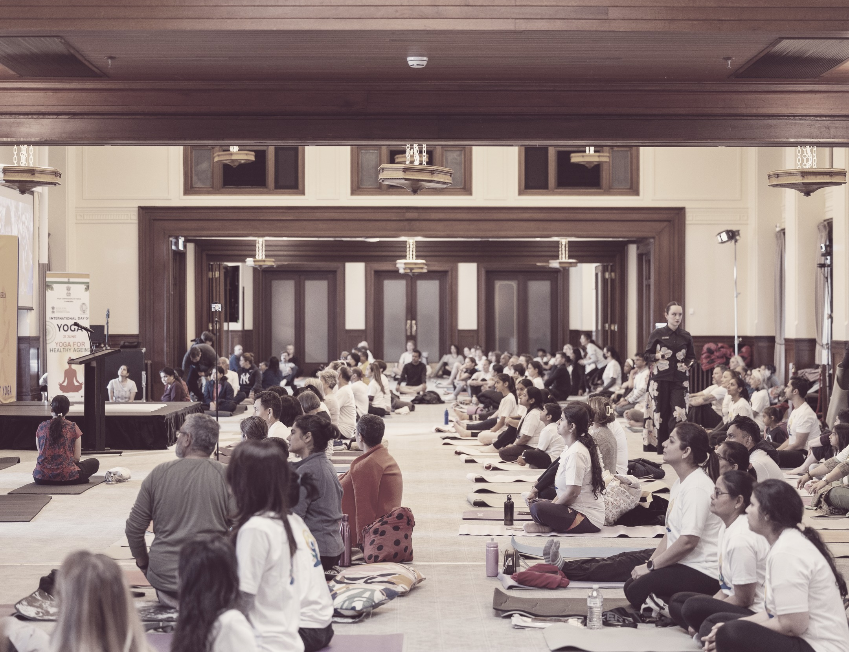
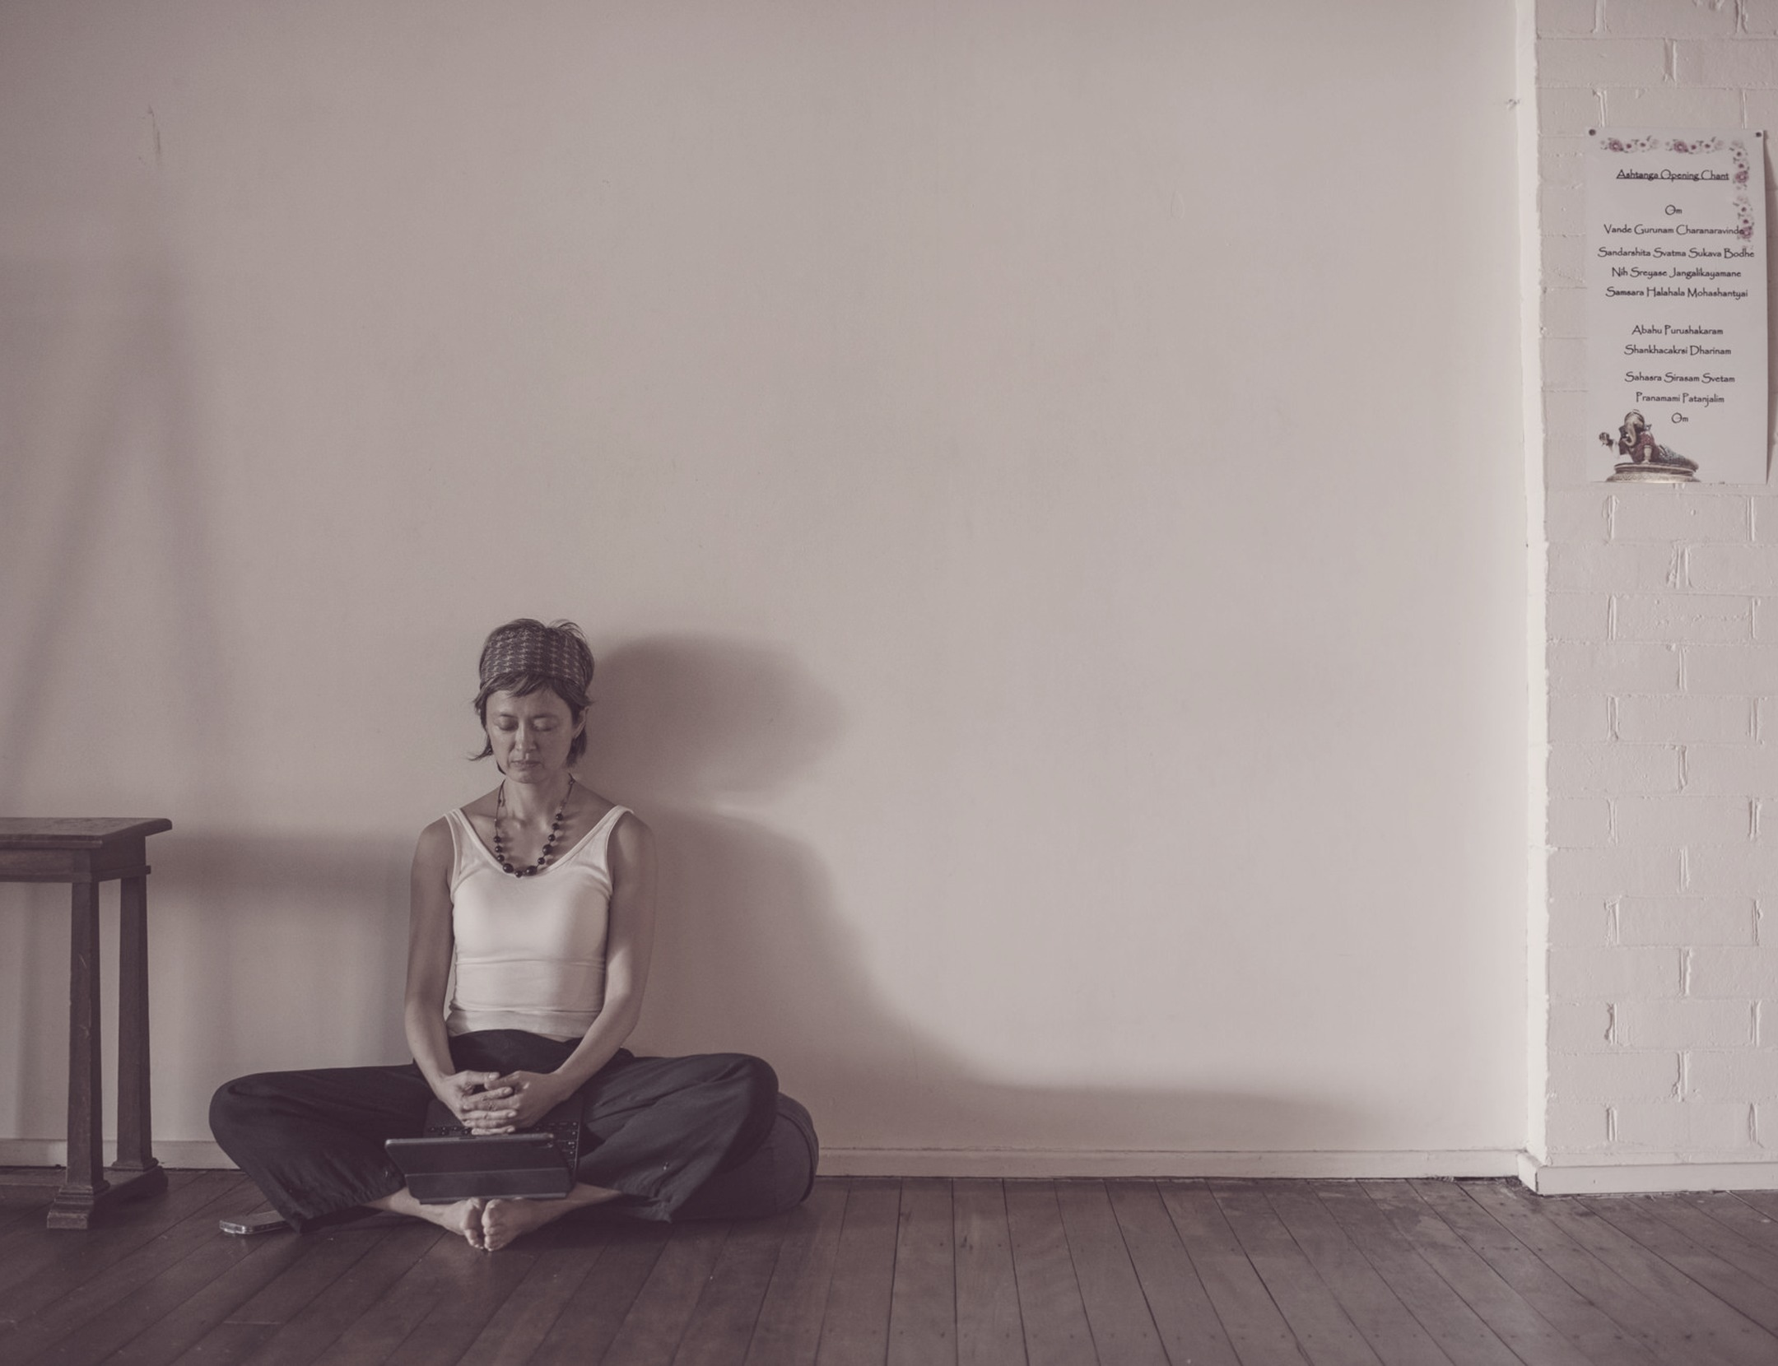
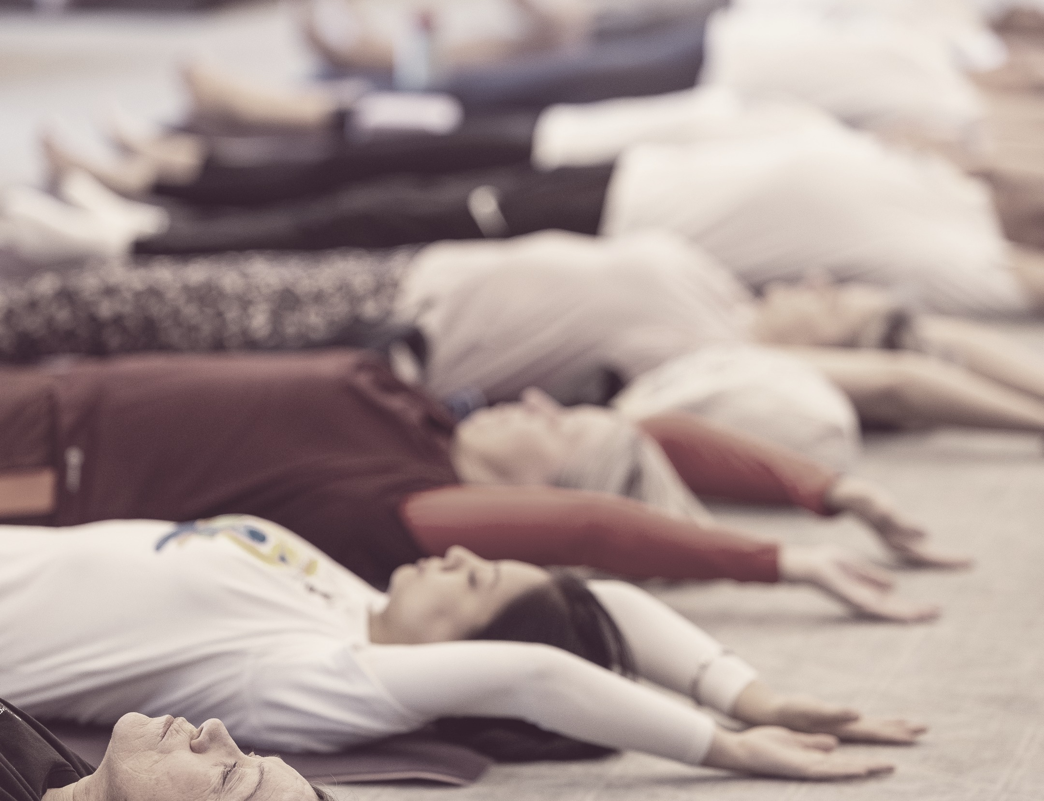

THE STATE OF YOGA IN AUSTRALIA
State of Yoga
2026
01
Clearing the Air
04
New to Teaching
02
Sustainability
05
Modelling Leadership
03
Emerging Paths

