Slide 1

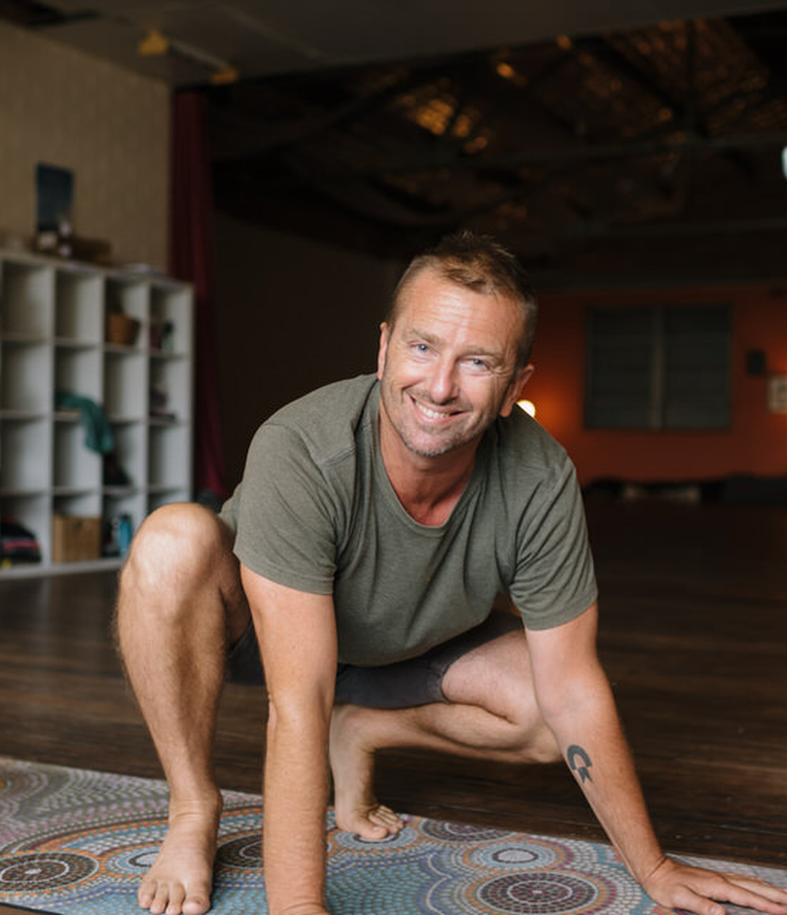

TEST
how did you feel about
your first class?

