Slide 1

MOVIE THEATRE REVENUE & OPERATIONS ANALYTICS
A Power BI Business Intelligence Solution
Client: CineMax Multiplex Pvt. Ltd.
Presented by: Yogalakshmi
Business Intelligence Analyst
Notes:
Good afternoon everyone. Welcome to this presentation on Movie Theatre Revenue and Operations Analytics, a Power BI project built for CineMax Multiplex. My name is Yogalakshmi, and I worked on this project as the Business Intelligence Analyst. Over the next few minutes, I will walk you through the business background, the problems we solved, the dashboards we built, and the key insights that came out of this work.

Slide 2




Business Background
Understanding CineMax's data landscape
Multi-Theatre Operations
High-Volume Transactions
Scattered Data Sources
No Central Reporting
CineMax operates multiple theatres across Tamil Nadu, serving thousands of moviegoers.
Large volumes of ticket sales, food sales, bookings, and promotions are generated daily.
Data was stored across multiple Excel files, making consolidation slow and error-prone.
Management lacked a centralized reporting system to view customer and business data.
CineMax Multiplex Pvt. Ltd. | Movie Theatre Revenue & Operations Analytics
2
Notes:
Let's start with some background. CineMax operates multiple theatres across Tamil Nadu, and every single day, the business generates a large volume of data — ticket sales, food sales, bookings, promotions, and customer information. The challenge was that all of this data was scattered across multiple Excel files. There was no centralized system for management to view what was happening across theatres, which made it very hard to get a clear, real-time picture of the business.

Slide 3


Business Problem & Project Objective
BUSINESS PROBLEMS
PROJECT OBJECTIVES
No centralized dashboard for reporting
Monitor revenue across theatres and movies
Difficult to identify top-performing movies
Analyze customer behaviour and preferences
Limited visibility into theatre occupancy
Track theatre performance and occupancy
Promotion effectiveness was unclear
Improve operational efficiency
Manual reporting consumed valuable time
Support data-driven decision making
CineMax Multiplex Pvt. Ltd. | Movie Theatre Revenue & Operations Analytics
3
Notes:
Based on this background, we identified several business problems. There was no centralized dashboard, it was difficult to identify top-performing movies, there was limited visibility into theatre occupancy, promotion effectiveness was unclear, and manual reporting consumed a lot of time. To solve these problems, we set clear project objectives: to monitor revenue, analyze customer behaviour, track theatre performance, improve operational efficiency, and ultimately support data-driven decisions for management.

Slide 4


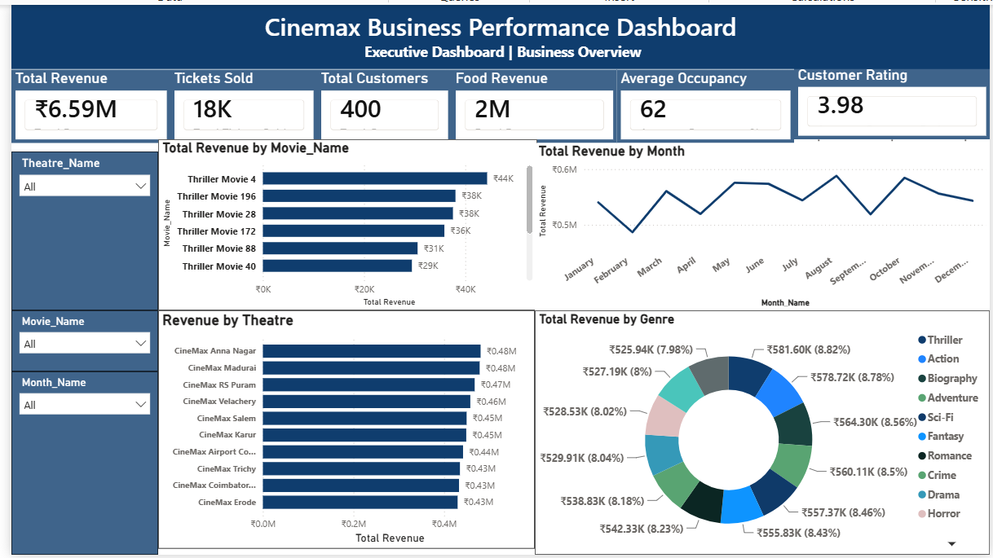
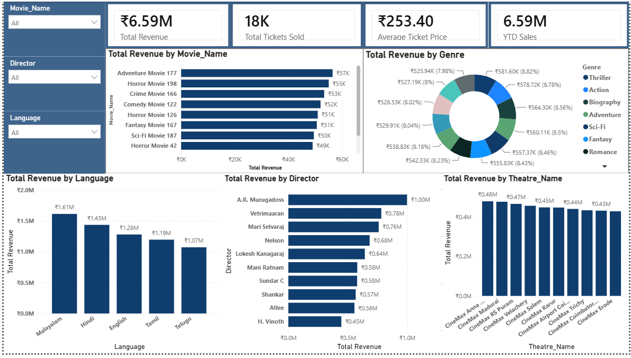


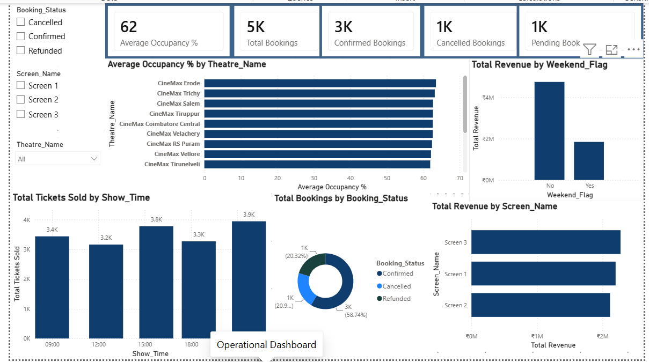
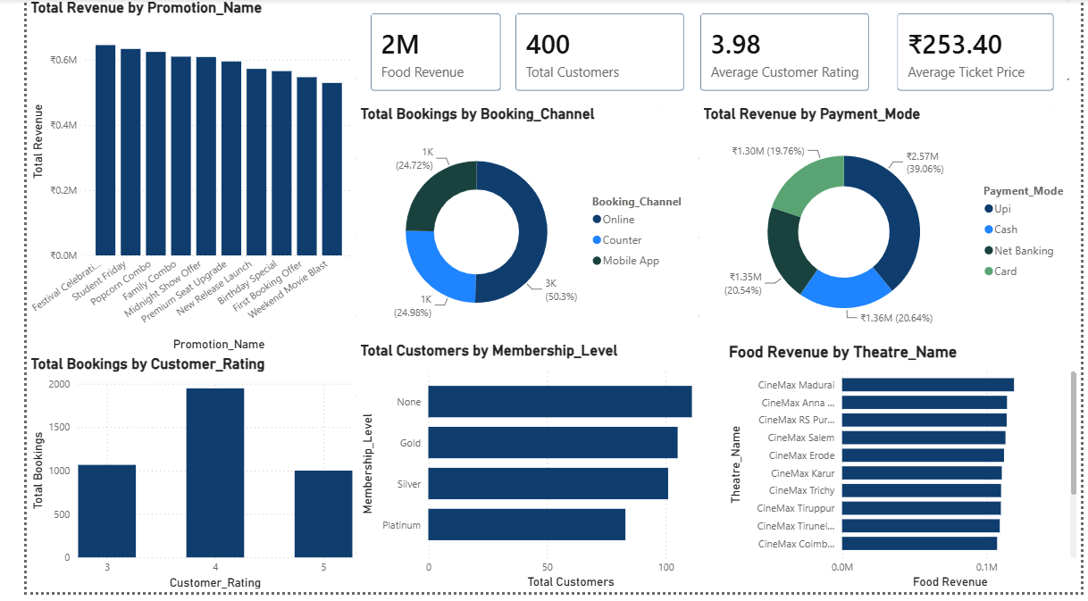
Dashboard Overview
Four connected Power BI dashboards for a 360° business view
Executive Dashboard
Revenue Analysis
KPIs, monthly revenue, revenue by movie and genre.
Revenue by language, director and theatre.
Operational Dashboard
Customer & Promotion
Occupancy, booking status, peak show timings, weekend vs weekday.
Promotions, booking channels, payments, membership, food revenue.
CineMax Multiplex Pvt. Ltd. | Movie Theatre Revenue & Operations Analytics
4
Notes:
Here is an overview of the four dashboards we built in Power BI. The Executive Dashboard gives leadership a quick view of KPIs, monthly revenue, and revenue by movie and genre. The Revenue Analysis dashboard breaks revenue down by language, director, and theatre. The Operational Dashboard tracks occupancy, booking status, peak show timings, and weekend versus weekday revenue. And the Customer and Promotion Dashboard shows promotion performance, booking channels, payment methods, membership levels, and food revenue. Together, these four dashboards give management a complete, 360-degree view of the business.

Slide 5


Key Business Insights
Top Revenue Movies
Best-Performing Theatres
Peak Booking Timings
Clear visibility into the highest revenue-generating movies across all theatres.
CineMax Anna Nagar and Madurai lead in total revenue contribution.
Evening 6 PM show time drives the highest ticket volumes.
Successful Promotions
Booking Preferences
Food Revenue Contribution
Festival and Student Friday offers generate the strongest booking response.
Online booking channel accounts for over half of all customer bookings.
Food sales add a significant share to total theatre revenue.
“Interactive dashboards enable faster and better business decisions.”
CineMax Multiplex Pvt. Ltd. | Movie Theatre Revenue & Operations Analytics
5
Notes:
Now let's look at the key business insights that came out of this analysis. We can now clearly see the highest revenue-generating movies, identify the best-performing theatres, understand peak booking timings, measure which promotions are most successful, see customer booking preferences, and track how much food revenue contributes to the total. The overall takeaway is simple: interactive dashboards enable faster and better business decisions for CineMax management.

Slide 6
Conclusion
Project Outcome
Centralized reporting across all theatres
Interactive, easy-to-use dashboards
Better business visibility for management
Improved operational decisions
Data-driven management culture
Thank You
Questions & Answers
Notes:
To conclude, this project gave CineMax a centralized reporting system, interactive dashboards, better business visibility, improved operational decisions, and a foundation for data-driven management going forward. Thank you very much for your time. I am happy to take any questions.

