Slide 1
QPGen
The Question Paper Generator

Slide 2
Problem Statement!
To create an Automated Question Paper Generator for Institutional Assessment .

Slide 3
Pattern
01
02
03
Unit 1
2 * 5 = 10 2 * 5 =10
12 * 2 = 24 16 * 2 = 32
16 * 1 = 16 8 * 1 = 8
Total = 50 Marks
IA
Unit 2 & 3
2 * 5 = 10 2 * 5 =10
12 * 2 = 24 16 * 2 = 32
16 * 1 = 16 8 * 1 = 8
Total = 50 Marks
All Units
2 * 10 = 20 2 * 10 = 20
13 * 5 = 65 16 * 5 = 80
15 * 1 = 15
Total = 100 Marks

Slide 4
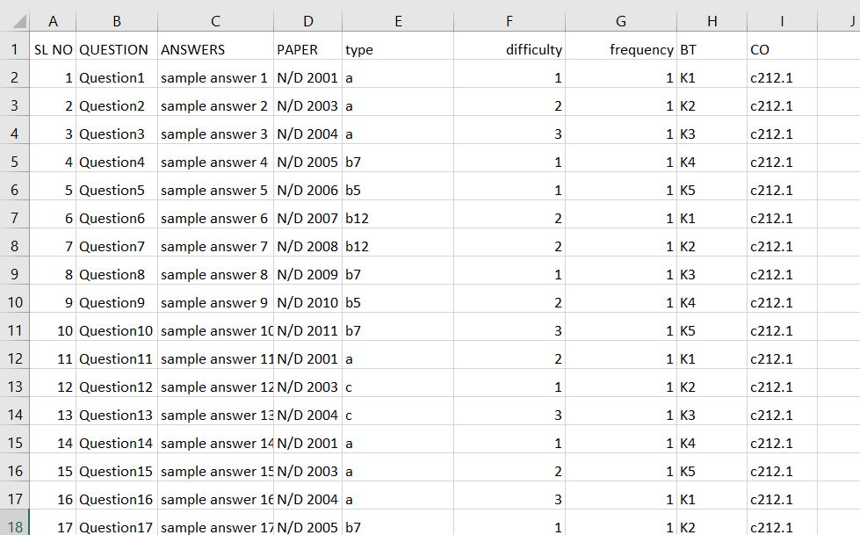
Question Bank Format

Slide 5
Selection Mechanism
IA1 | EASY | MODERATE | HARD
Part – A (5) | 2 | 2 | 1
Part – B (2 either or) | 1 | 2 | 1
Part – C (1 either or) | 2 Questions will be selected with difficulty levels for each randomly
IA2 | Unit 2 | Unit 3
Part – A (5) | 2 from one unit and 3 from one unit will be selected randomly | 2
Part – B (2 either or) | 2 | 2
Part – C (1 either or) | 1 | 1
IA3 | Unit 1 | Unit 2 | Unit 3 | Unit 4 | Unit 5
Part – A (10) | 2 | 2 | 2 | 2 | 2
Part – B (5 either or) | 2 | 2 | 2 | 2 | 2
Part – C (1 either or) | 2 Questions will be selected randomly from all the 5 Units

Slide 6
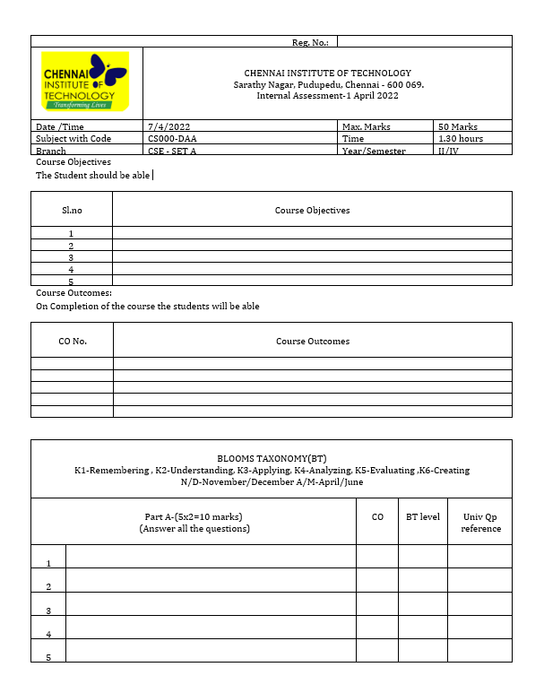
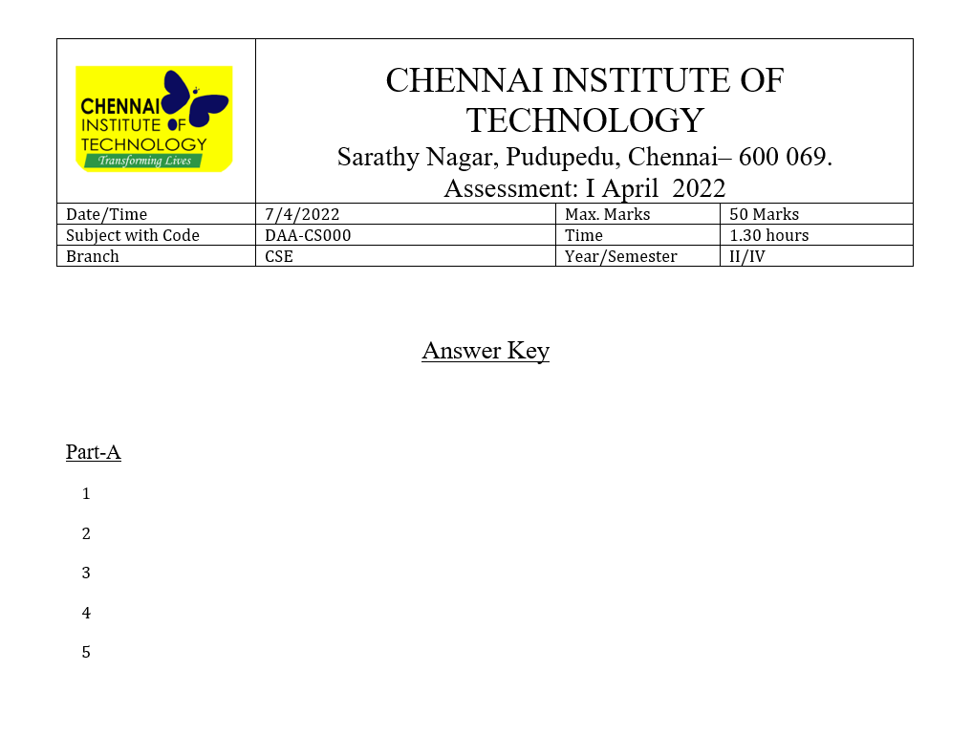
Document Generation

Slide 7
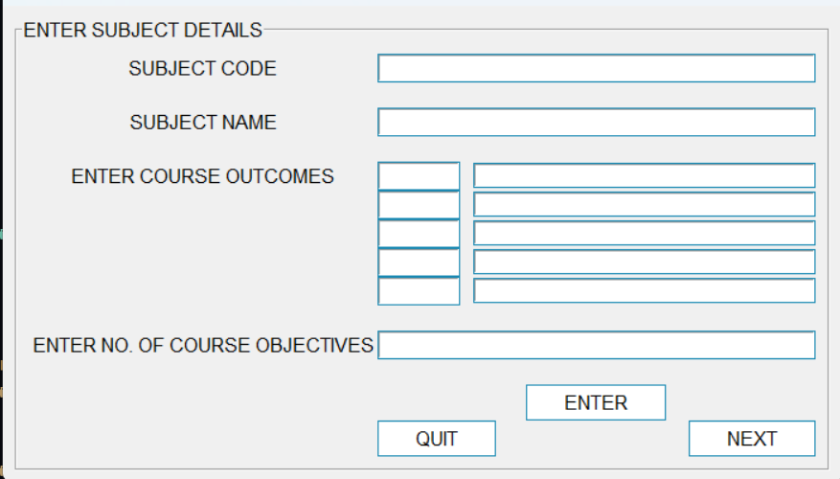
Supportive Tools
Data congregating tool

Slide 8
TEAM
Logic Design
Sanjay Kumar V
Yogan G
Sindhuja C
CSE – ‘C’
CSE – ‘C’
CSE – ‘C’
Document Design
Yashwanth Kumar
Syed Izhaan
Vemuri Adithya
CSE – ‘C’
CSE – ‘C’
CSE – ‘C’

