Slide 1
Kubernetes – K8S
Kubernetes, often abbreviated as K8s, is an open-source system designed to automate the deployment, scaling, and management of containerized applications. It acts as a powerful orchestration platform that simplifies the complexities of running containers at scale.
High-Level Overview:
Containers: Kubernetes operates on the foundation of containers, which are lightweight, portable units of software that package an application along with its dependencies.
Pods: Pods are the smallest deployable units in Kubernetes. They typically encapsulate a single container, but can also house multiple closely related containers that need to share resources.
Nodes: Nodes are the worker machines (physical or virtual) that host the pods.
Container Registries: Built images are stored in container registries (e.g., Docker Hub, Google Container Registry, private registries). These registries act as repositories for images, allowing them to be shared and accessed easily.
Notes:
Kubernetes, often abbreviated as K8s, is an open-source system designed to automate the deployment, scaling, and management of containerized applications. It acts as a powerful orchestration platform that simplifies the complexities of running containers at scale.
High-Level Overview:
Containers: Kubernetes operates on the foundation of containers, which are lightweight, portable units of software that package an application along with its dependencies.
Pods: Pods are the smallest deployable units in Kubernetes. They typically encapsulate a single container, but can also house multiple closely related containers that need to share resources.
Nodes: Nodes are the worker machines (physical or virtual) that host the pods.
Container Registries: Built images are stored in container registries (e.g., Docker Hub, Google Container Registry, private registries). These registries act as repositories for images, allowing them to be shared and accessed easily.

Slide 2
Kubernetes – K8S
Control Plane: The control plane is the brain of the Kubernetes cluster, responsible for managing and coordinating the entire system. It includes components like:
API Server: The central point of communication for all interactions with the cluster.
Scheduler: Decides which node to place each pod on based on resource availability and other constraints.
Controller Manager: Ensures the desired state of the cluster matches the actual state by continuously monitoring and reconciling any discrepancies.
etcd: A distributed key-value store that holds the cluster's configuration data.
Kubelet: serving as the primary "node agent" that runs on each node within a cluster. It acts as the bridge between the Kubernetes control plane and the individual nodes, responsible for managing the lifecycle of containers on those nodes.
Declarative Configuration: Users define the desired state of their applications in a YAML or JSON files, and Kubernetes strives to make the actual state match the desired state for scaling, Self-Healin and Load-Balancing.

Slide 3
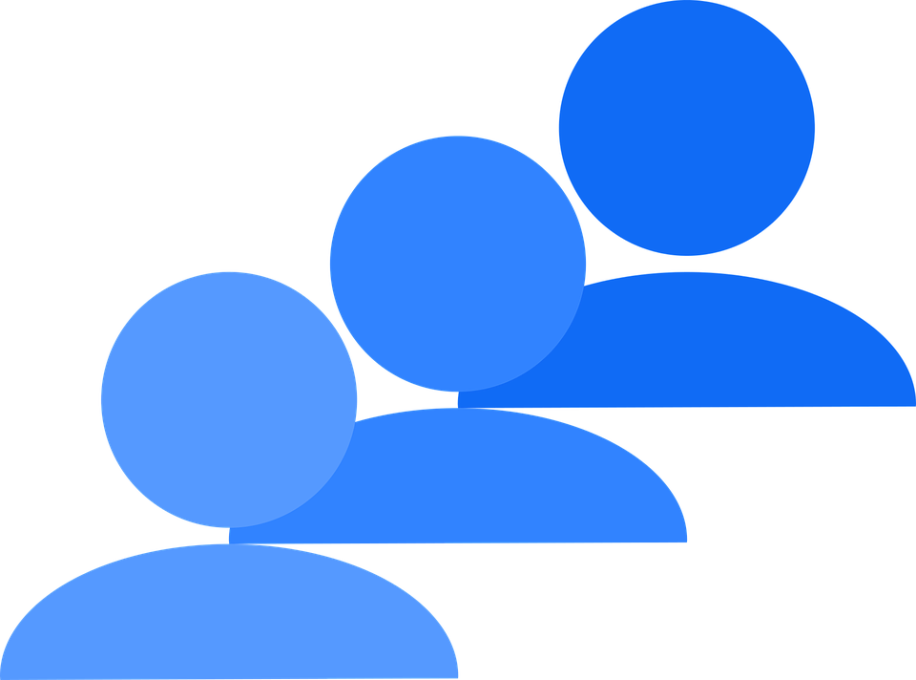
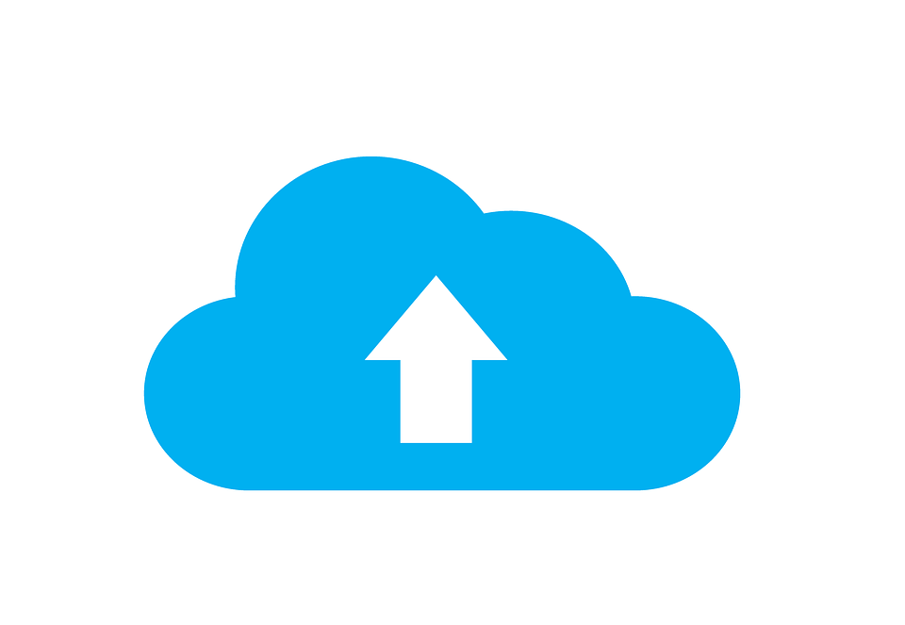
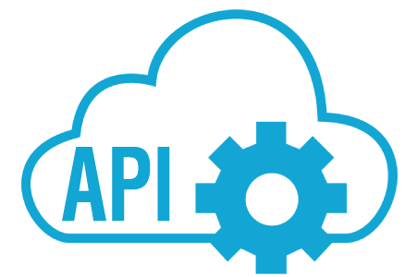

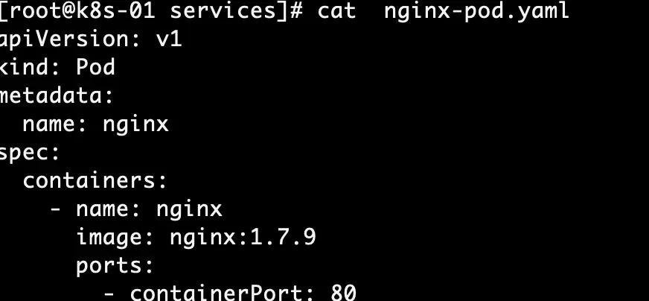

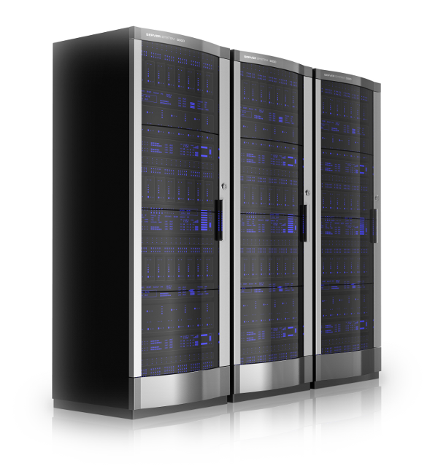

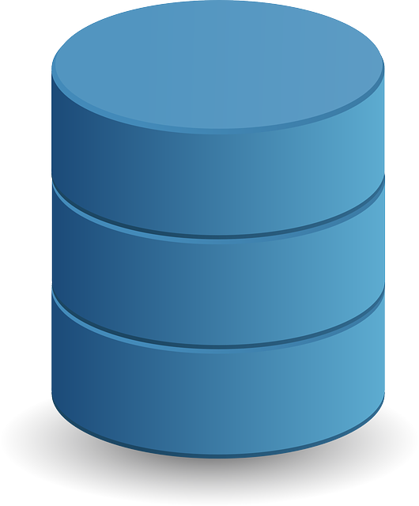
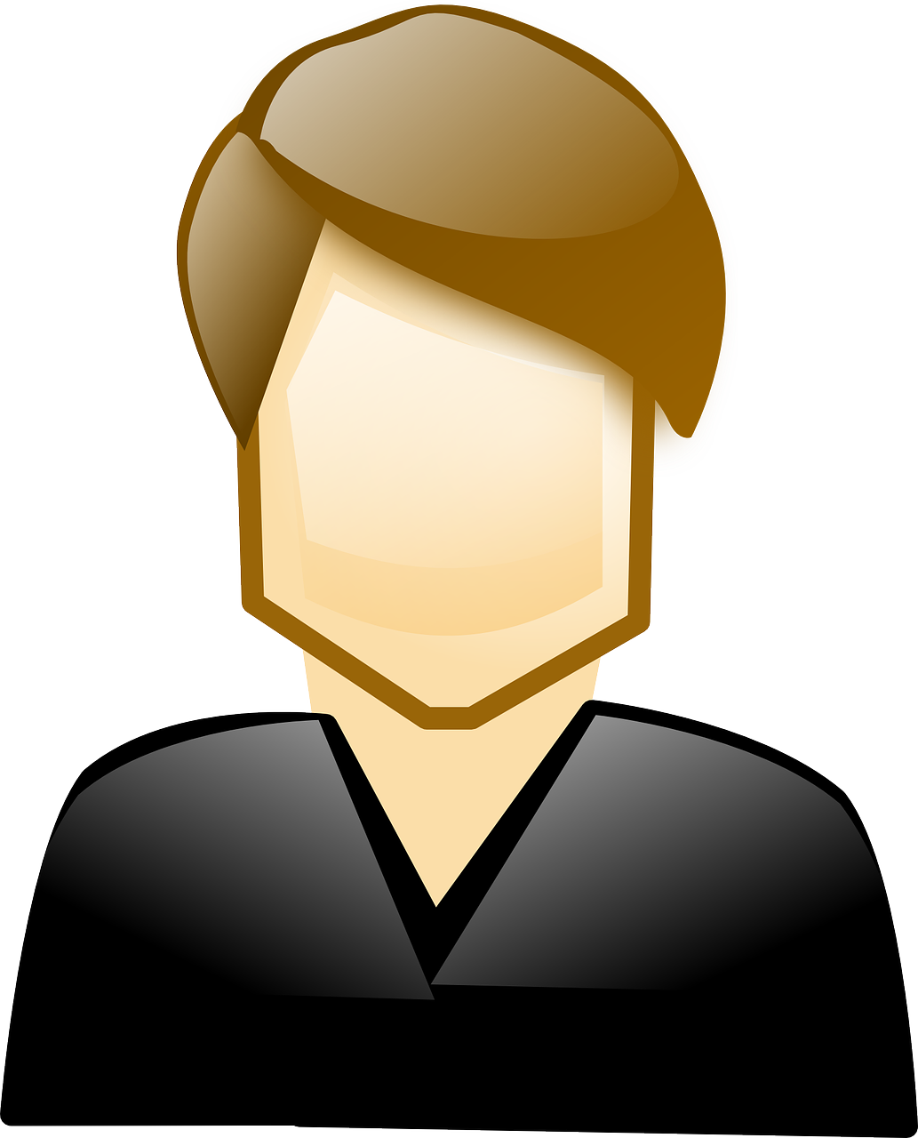
Kubernetes – K8S
K8S Cluster
162.x.x.1
Container Registries
Node1
Kubelet
Pod
Resource
Node
Management
Users
A:f
Image1
A:f
Image1
A:b
K8S Master
Node2
A:f
A:b
Monitoring
Kubectl
Node 3
Control Plane
A:f
A:b
YMAL
etdc
API Server
Scheduler
Controller
Manager
This Photo by Unknown Author is licensed under CC BY-NC
Notes:
Kubernetes, often abbreviated as K8s, is an open-source system designed to automate the deployment, scaling, and management of containerized applications. It acts as a powerful orchestration platform that simplifies the complexities of running containers at scale.
High-Level Overview:
Containers: Kubernetes operates on the foundation of containers, which are lightweight, portable units of software that package an application along with its dependencies.
Pods: Pods are the smallest deployable units in Kubernetes. They typically encapsulate a single container, but can also house multiple closely related containers that need to share resources.
Nodes: Nodes are the worker machines (physical or virtual) that host the pods.
Container Registries: Built images are stored in container registries (e.g., Docker Hub, Google Container Registry, private registries). These registries act as repositories for images, allowing them to be shared and accessed easily.
Control Plane: The control plane is the brain of the Kubernetes cluster, responsible for managing and coordinating the entire system. It includes components like:
API Server: The central point of communication for all interactions with the cluster.
Scheduler: Decides which node to place each pod on based on resource availability and other constraints.
Controller Manager: Ensures the desired state of the cluster matches the actual state by continuously monitoring and reconciling any discrepancies.
etcd: A distributed key-value store that holds the cluster's configuration data.
Kubelet: serving as the primary "node agent" that runs on each node within a cluster. It acts as the bridge between the Kubernetes control plane and the individual nodes, responsible for managing the lifecycle of containers on those nodes.
Declarative Configuration: Users define the desired state of their applications in a YAML or JSON files, and Kubernetes strives to make the actual state match the desired state for scaling, Self-Healin and Load-Balancing.

