Slide 1

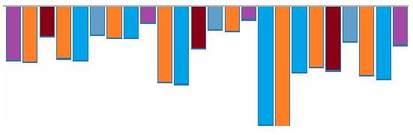
EDA on Used Car Sales
Yogananda Rao Locherla
Notes:
Hi Everyone,
Welcome to the session on EDA with Used Car sales Dataset.
Here I am Yoga, will walk you through
the various aspects of Data Analysis to understand the data,
Defining the problem statement
Deriving the insights by Visualizing the data.
Lets get started

Slide 2


Introduction to Used Car Sales Dataset
Problem Statement
Exploring the Dataset
Observations & Conclusions
Actionable Insights
Notes:
Agenda:
This discussion is logically arranged to deliver the content much effectively.

Slide 3

Introduction
Dataset contains one of the used cars company sales.
~ 10k records
Few decades sales history
Visual Data Analysis

Slide 4
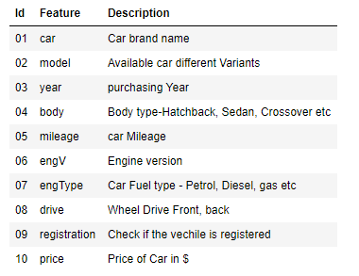
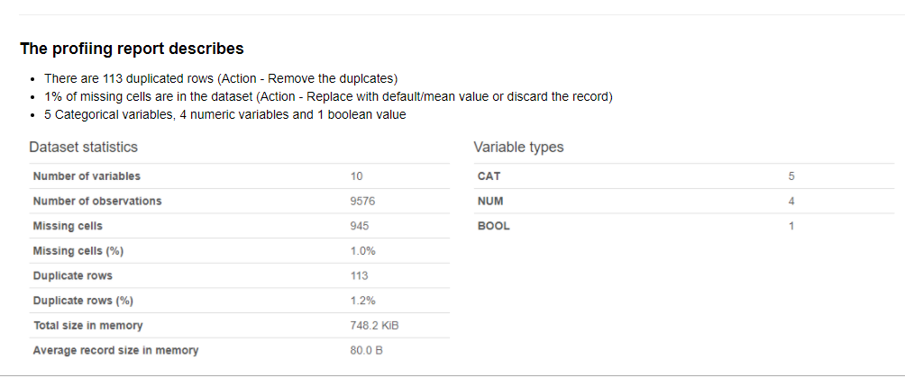
Introduction
Notes:
Data Profiling
Finding missing / erroneous Data
Data Cleansing
Removing duplicates
Fixing missing/erroneous data
Mean
median
Mode
Handling missing data,
Handling redundant data,
Handling inconsistent data,
Handling outliers,
Handling typos

Slide 5

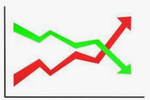
Problem Statement
The company has earned its name because of sincerity in work and quality of services.
But for past few months their sales is down.

Slide 6
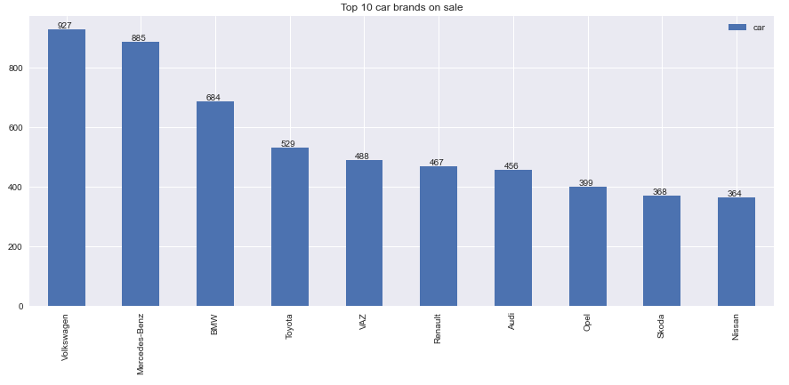
Data Exploration

Slide 7
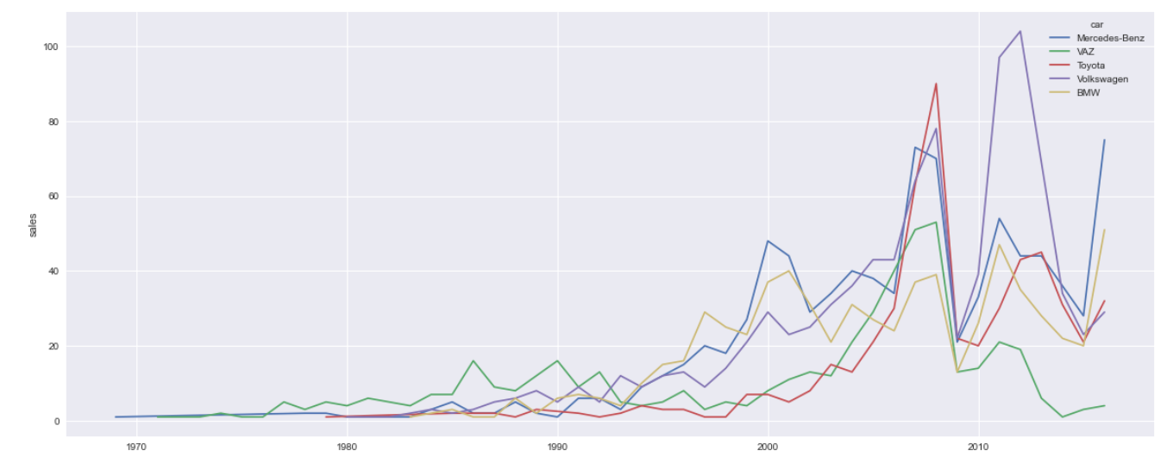
Data Exploration
Year wise car sales

Slide 8
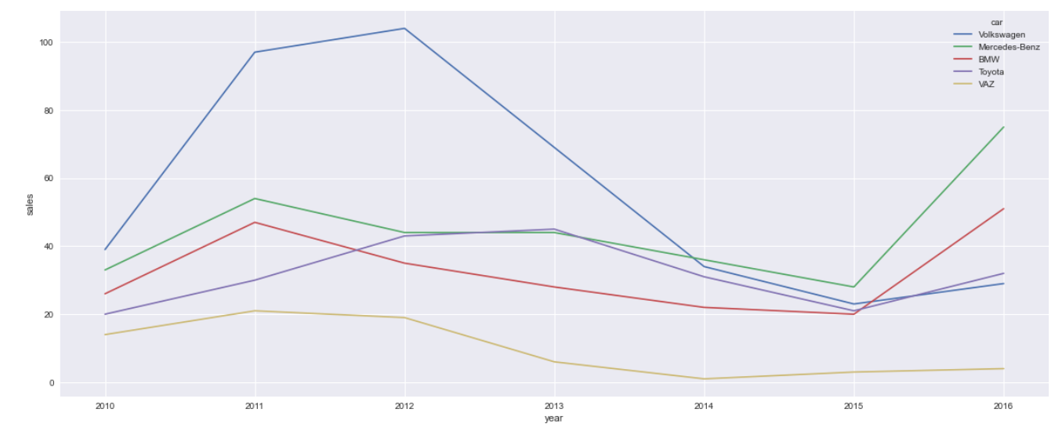
Data Exploration
Year wise recent car sales
Notes:
Observations:
Overall Volkswagen used cars are reported high sales and occupies 1st place, but the sales are dipping in the recent past.
Mercedes-Benz significantly performing best sales and followed by BMW. These brands sales are sky rocketed and proven the customer trust.
Toyota cars are consistent in sales and keeping their position.
On flip side, Volkswagen and Vaz car sales are under performing in recently.

Slide 9
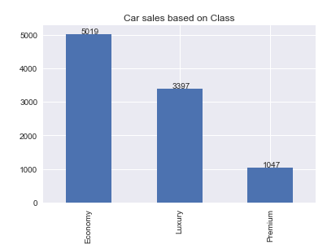
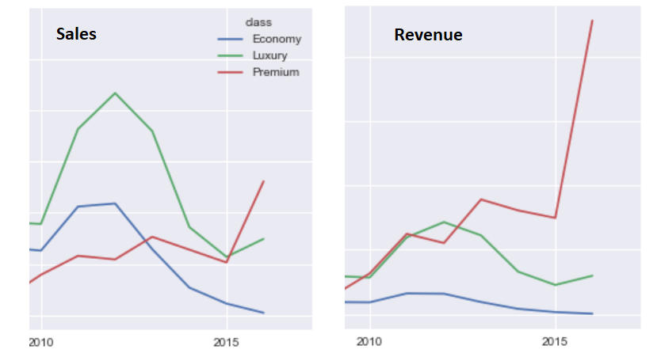
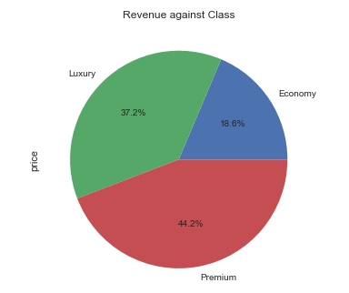
Data Exploration
Sales & Revenue based on Class.
Notes:
Observations:
Economy Cars are best selling segment followed by Luxury and Premium
Though the economy car sales are predominant in sales, but revenues are not impressive.
Economy - 18.6%
Luxury - 37.2%
Premium - 44.2%
From the above charts, it is evident that, Economy car sales are comes to '0', Luxury and Premium takes the momentum of high sales.
In addition the revenue generated by Premium cars is 500% higher than other cars in recent year.
So possible reason of reduced sales due to ground touching Economy class car sales.

Slide 10
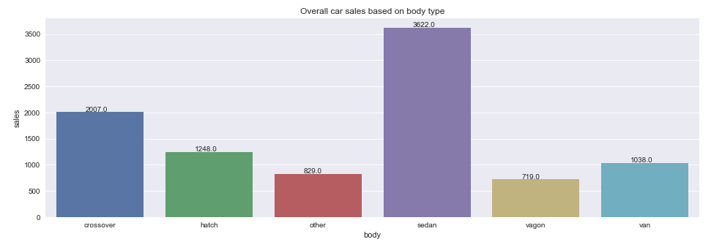
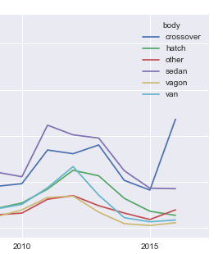
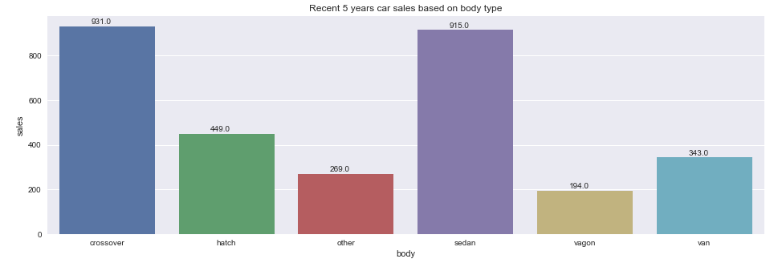
Data Exploration
Sales based on body type.
Notes:
Observations:
Overall Crossover, Sedan and hatches are more demanded car body types
It is observed that recent crossover sales are skyrocketing.
Van and Vagon body types are loosing sales and other cars are gaining market.
So possible reason of declining sales are Van & Vagon type cars are loosing market.

Slide 11
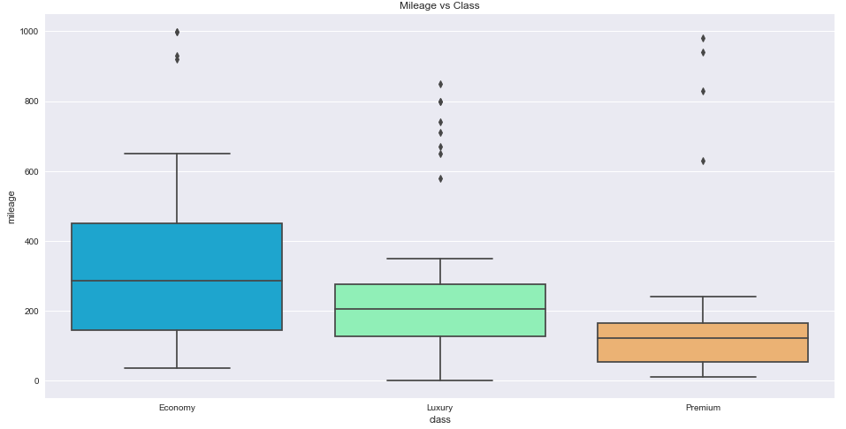
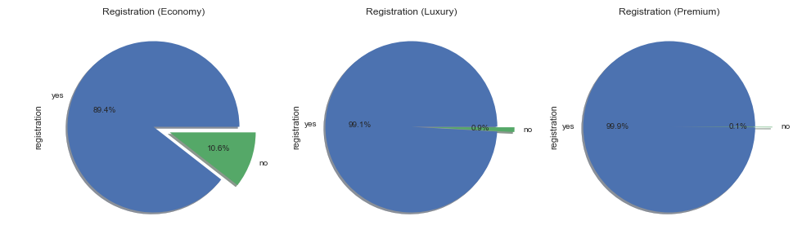
Data Exploration
Mileage and Registrations by ‘Class’
Notes:
Observations:
Majority of unregistered cars were from Economy class

Slide 12
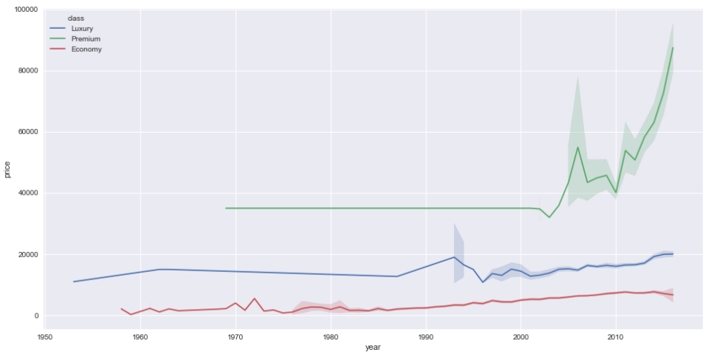
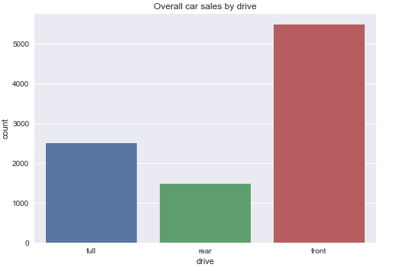
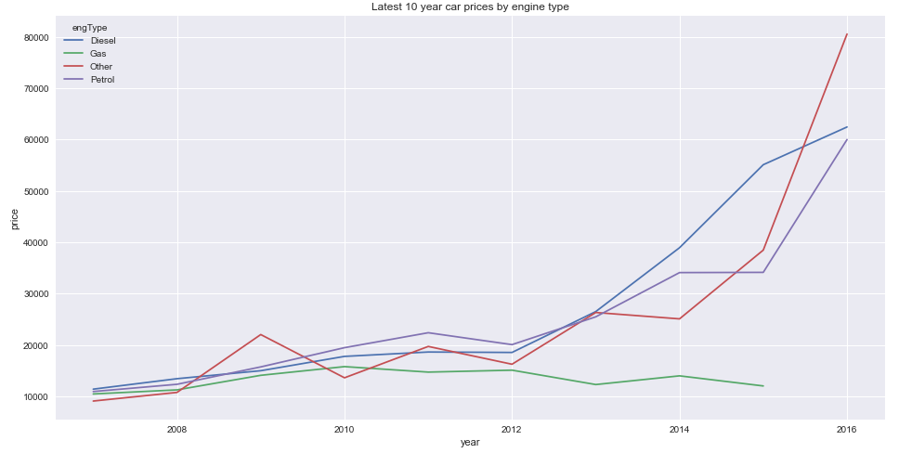
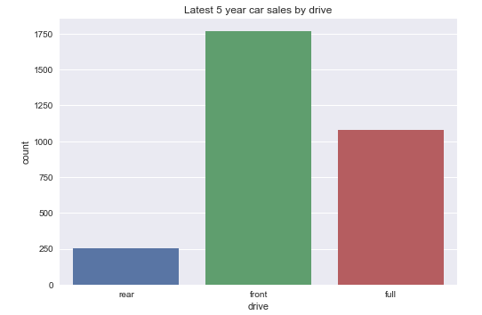
Data Exploration
Car sales based on Drive
Car prices based on Class & Eng Type
Class
Engine Type

Slide 13
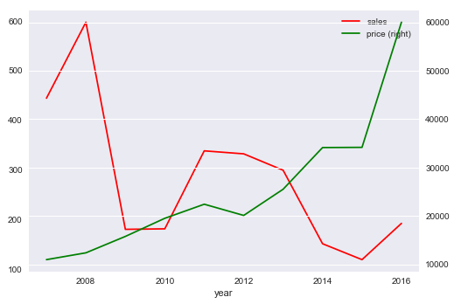
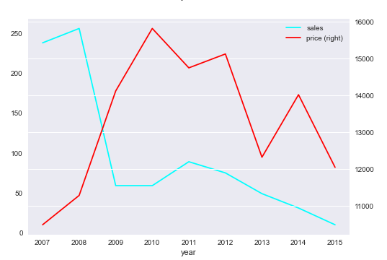
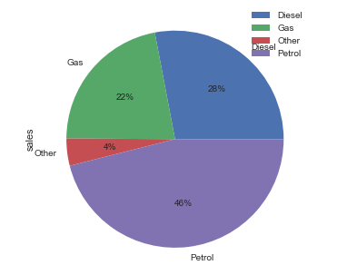
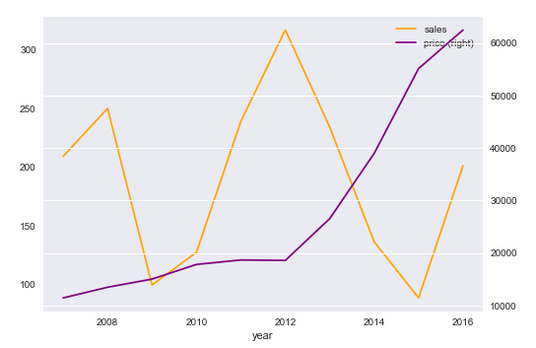
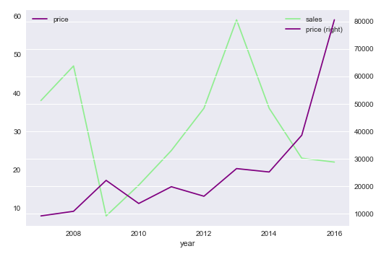
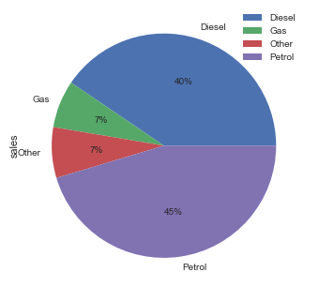
Data Exploration
Prices and Sales based on Engine Type
Before 2012
Petrol
Gas
After 2012
Diesel
Other

Slide 14
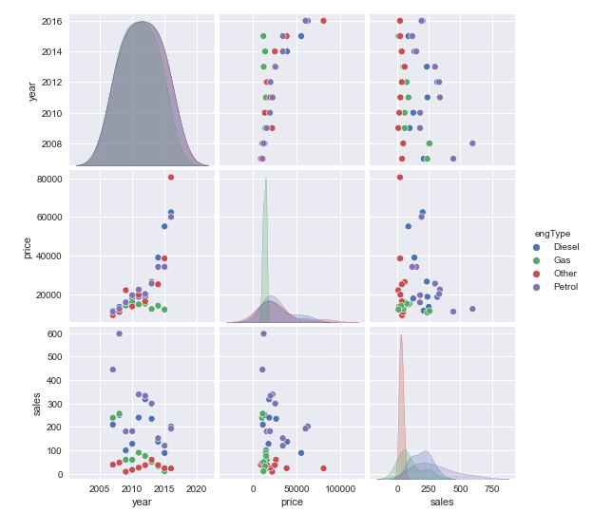
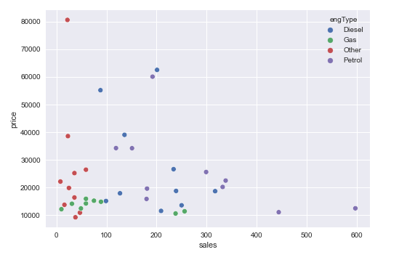
Data Exploration
Correlation between Sales and Prices over the years

Slide 15

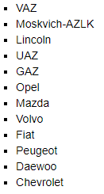
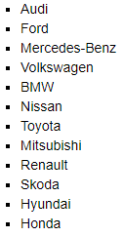
Observations & Conclusions
Most sales happening price range is between 10000 to 40000 /-
There are very few cars sold in 20000 to 36000 price bracket, which is best competitive price range
Economy cars are mostly comes with Gas engines, but in the recent days customers are not preferring Gas cars. Where as
Petrol car sales are consistent
Diesel car sales are gaining momentum
Other car sales are gradually increasing
None of the cars sold from Economy segment in year 2016.
Car registrations are most considered in Luxury and Premium cars
Even with affordable price range, gas and other engine type cars are least preferred.
Most preferred
engine types are Petrol and Diesel
body types are cross-overs and sedan
Other type cars are consistent and gradually increasing in sales
Overall, Sedans are always on demand follows with Cross-over and hatch.
Tremendous sales reported in 2016 for these super premium cars by Bentley, Land Rover, Toyota, Tesla, Lexus, Cardillac & BMW
recently Crossovers are leading in sales followed by sedans
Most of the recent premium cars engine type is Petrol
Cars Loose / Gain Market

Slide 16



Actionable Insights
Cars should be available from all price ranges.
→ As 10000 to 40000 /- is the most sales happening price range and there are no cars available in 20000 to 36000 /- price bracket, procuring these price ranged cars should potentially improves the sales.
Procure cars based on customer trends.
→ Petrol and Diesel cars are most popular.
Full wheel drive is most preferred in Crossovers and Front wheel drive in Sedan cars
Luxury and Premium used cars booming sales due to hike in new car prices.
Tactical & Strategic Decision
→Less preferred old cars should be announced with great deals and clear the stock. In that way we can save money, renting space for storage
→Procure more demanded cars like Mercedes-Benz, BMW, Volkswagen, Toyota, Nissan, Ford, Audi.. etc
→ Procure more Economy price range cars which is of Petrol or Diesel engine types

